Slide 1
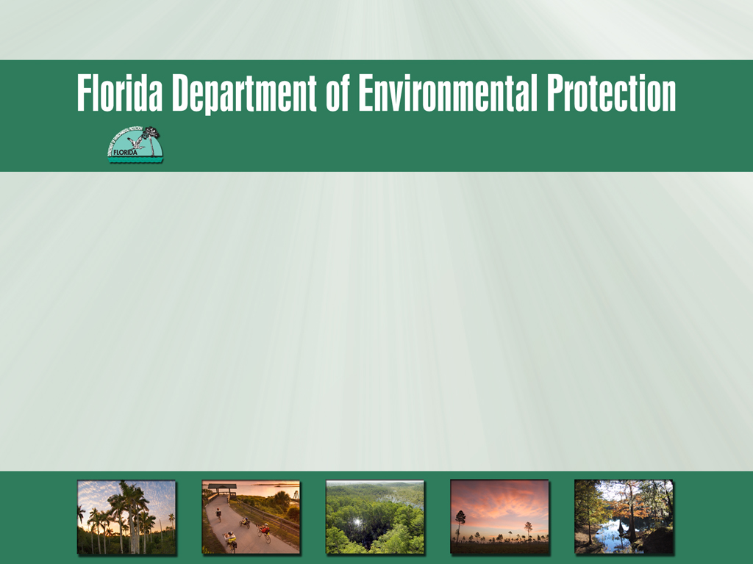
Everglades West Coast and Caloosahatchee Estuary
Basin Management Action Plans
2014 Annual Report
January 28, 2015

Slide 2
Agenda
Overview of the Caloosahatchee and Everglades West Coast BMAP Annual Reports.
Stakeholder Activities During the Reporting Period from Both BMAPs.
Department Activities During the Reporting Period.

Slide 3
Year in Review

Slide 4
Updates
Lake Okeechobee BMAP Adoption
  Estimated TN Reductions: 123.1 MT/yr
  Estimated TP Reductions: 145.8 to 148.1 MT/yr
Continue work on TMDL model
Community Forums

Slide 5
Overview of BMAP
Annual Reports

Slide 6
BMAP Process
BMAP process is a phased approach to:
Implement the TMDLs.
Itemize set of total nitrogen (TN) load reduction activities and projects.
Identify needs for additional studies and monitoring.
Allow for participation of stakeholders, partners and interested parties.

Slide 7
Annual Reports Overview
Everglades West Coast and Caloosahatchee BMAPs were adopted in November 2012.
This is the second annual progress report on BMAP activities.
Information was provided by the stakeholders on activities from December 1, 2013 through November 30, 2014.
The reports include:
  Background on the total maximum daily loads (TMDLs) and BMAP.
  Activities during the reporting period.
  Water quality and biological monitoring.

Slide 8
Everglades West Coast

Slide 9
Adjustment of TMDL in the BMAP
For purposes of initial allocation, loading assigned to stakeholders based on land uses.
Allocation based on relative amount of developed (non-natural) loading:
Hendry Creek
  Lee County.
  Catalina.
  Florida Department of Transportation (FDOT).
  Agriculture.
Imperial River
  Lee County.
  Bonita Springs.
  FDOT.
  Agriculture.

Slide 10
Activities
Hendry Creek
FDOT increased its street sweeping activities.
Lee County increased its street sweeping activities, as well as its public education and outreach efforts.
To date, the Florida Department of Agriculture and Consumer Services (FDACS) has enrolled 26.7 acres out of a total of 97.9 total acres based on the 2004 land use coverage.

Slide 11
Activities, continued
Imperial River
City of Bonita Springs continued its education and outreach activities, and is exploring a pilot project for a woodchip-based denitrifying bioreactor.
Lee County increased its street sweeping activities, as well as its public education and outreach efforts.
To date, FDACS has enrolled 4,125.8 acres out of a total of 11,604.6 total acres based on the 2004 land use coverage.

Slide 12
Activities, continued
Hendry Creek
Entity | Project Number | Project Name | TN Reduction (lbs/yr)
FDOT | HC-FDOT-3 | Street Sweeping – additional reductions | 72
Lee County | LC-2 | Street Sweeping – additional reductions | 50
Agriculture | N/A | Agricultural BMPs | 78
Total | N/A | Total Reductions in Reporting Period* | 200
Imperial River
Entity | Project Number | Project Name | TN Reduction (lbs/yr)
Lee County | LC-3 | Street Sweeping – additional reductions | 108
Agriculture | N/A | Agricultural BMPs | 9,955
Total | N/A | Total Reductions in Reporting Period* | 10,063
*The FDACS enrolled acres is the total to date, not only those enrolled in BMPs during the reporting period.

Slide 13
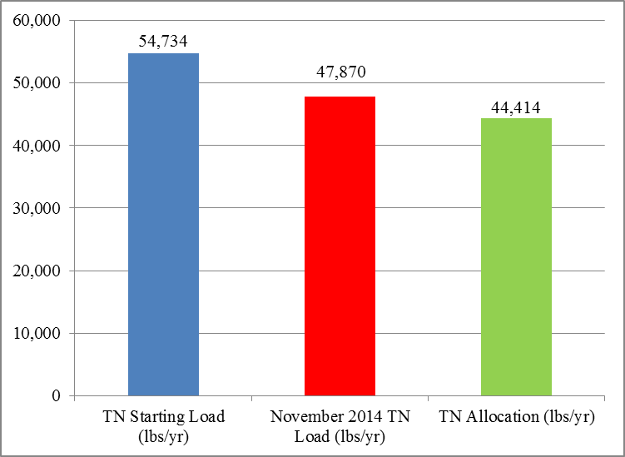
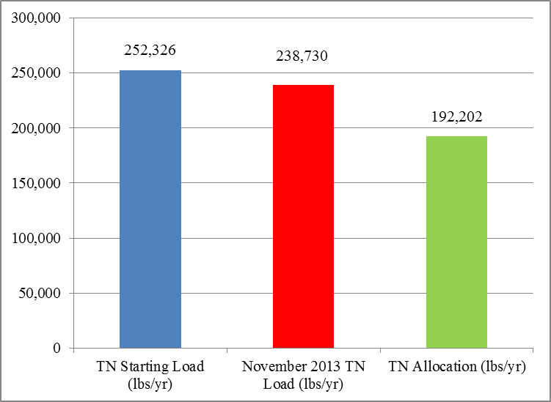
Progress to the TMDL
The total project reductions, including those shown as completed in the BMAP are 6,864 lbs/yr TN in the Hendry Creek Basin and 13,596 lbs/yr TN in the Imperial River Basin.
Hendry Creek Basin Project Reductions
Imperial River Basin Project Reductions

Slide 14
Monitoring
The BMAP monitoring plan was designed to enhance the understanding of basin loads, identify areas with high nutrient concentrations, and track long-term water quality trends.
Water quality monitoring continues, and is being conducted by:
  Lee County (Hendry Creek and Imperial River).
  Department, South District (Hendry Creek).
  Bonita Springs (Imperial River).

Slide 15
Caloosahatchee Estuary

Slide 16
Activities
Charlotte County continued its education and outreach efforts.
The City of Cape Coral continued its outreach program, which includes Florida Yards and Neighborhoods Program and illicit discharge awareness.
East County Water Control District continued its education and outreach effort, including the annual Wings over Water Festival.

Slide 17
Activities, continued
FDOT increased its street sweeping and continued its education outreach efforts.
Lee County designed the Nalle Grade Stormwater Park, and continued its street sweeping and education efforts.
To date, FDACS has enrolled 17,722.3 acres out of a total of 36,180.5 acres based on land use.

Slide 18
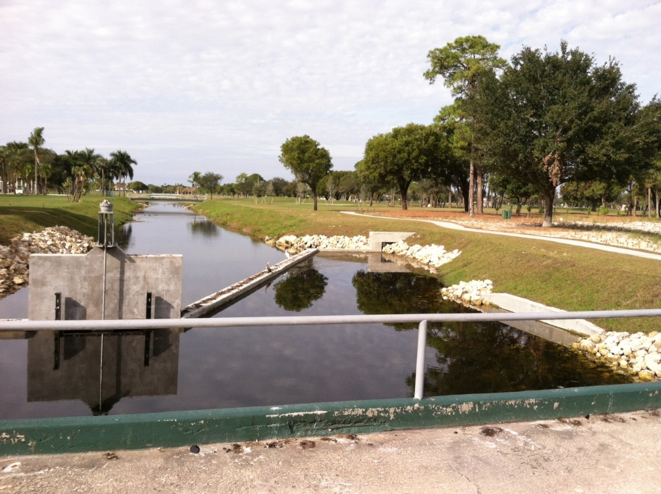
Activities, continued
  City of Ft. Myers completed the Carrell Canal Water quality retrofit project.

Slide 19
Activities, continued
Entity | Project Number | Project Name | TN Reduction (lbs/yr)
Cape Coral | CC-2 | Street Sweeping | 676
FDOT | FDOT-4 | Street Sweeping – New Reductions | 473
Fort Myers | FM-11 | Carrell Canal Water Quality Retrofit | 1,275
Lee County | LC-16 | Street Sweeping – New Reductions | 220
Agriculture | Not applicable | Agricultural BMPs | 29,089
Total | N/A | Total Reductions in Reporting Period* | 31,733
*The FDACS enrolled acres is the total to date, not only those enrolled in BMPs during the reporting period.

Slide 20
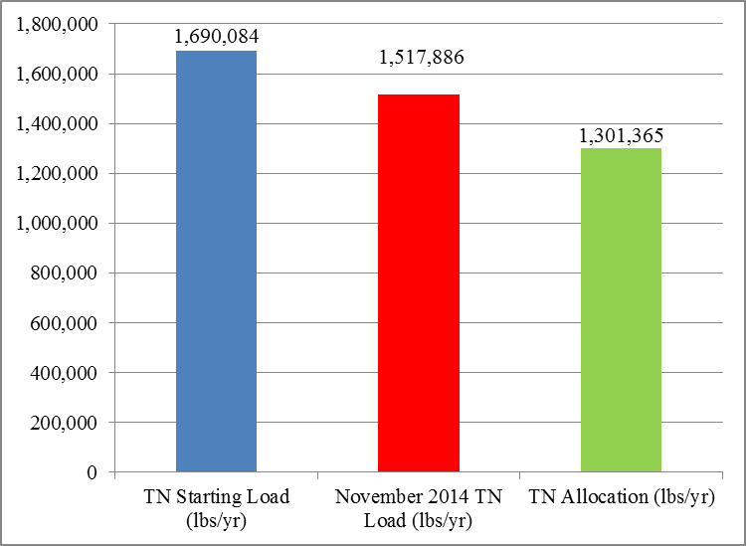
Progress to the TMDL
The total project reductions, including those shown as completed in the BMAP, are 172,198 lbs/yr TN.

Slide 21
Monitoring
Water quality monitoring continues, and is being conducted by:
  City of Cape Coral.
  City of Ft. Myers.
  Lee County.
  SFWMD.
  Department, South District.
Seagrass sampling is being conducted by:
  SFWMD monthly.
  Department, South District bi-monthly
Oyster monitoring is being conducted monthly by SFWMD, with density evaluated semi-annually.

Slide 22
City of Ft. Myers

Slide 23
City of Bonita Springs

Slide 24
Department Activities During the Reporting Period

Slide 25
Update on BMAP Considerations

Slide 26
BMAP Considerations
Both the Caloosahatchee and Everglades West Coast BMAPs included the following consideration:
  Septic tank loading.
The Everglades West Coast BMAP included a consideration for:
  DO research.
The Caloosahatchee BMAP included considerations for:
  Revising the allocations.

Slide 27
Septic Tank Loading

Slide 28
Septic Tank Loading
The Department contracted with Dr. Ming Ye at Florida State University to develop the ArcGIS-Based Nitrate Load Estimation Toolkit (ArcNLET).
This model estimates nitrogen loads from septic systems to surface waterbodies.

Slide 29
What is ArcNLET?
A simplified model that considers key hydrogeologic processes of groundwater flow and nitrate fate and transport.
The model is implemented in ArcGIS to:
  Simulate nitrate fate and transport, including the denitrification process.
  Consider multiple septic tanks.
  Provide a management and planning tool for environmental management and regulation.
ArcNLET is publicly available at: http://people.sc.fsu.edu/~mye/ArcNLET.

Slide 30
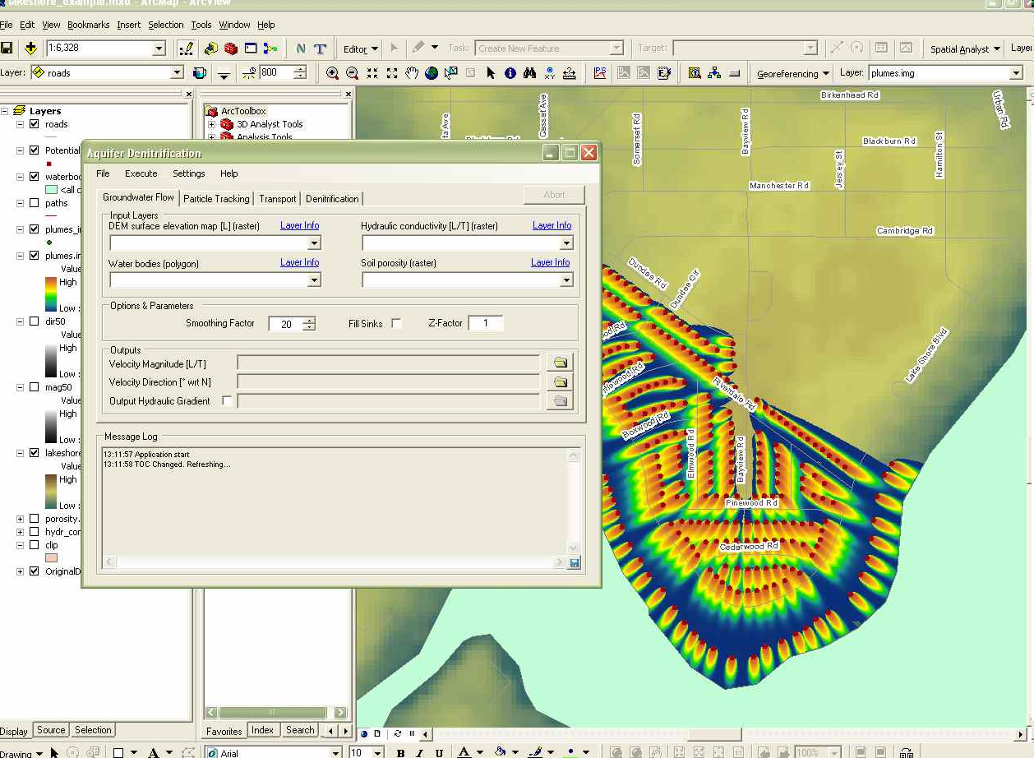
ArcNLET

Slide 31
ArcNLET Input Data
All input data files are in ArcGIS format.
Locations of septic tanks.
Locations of waterbodies.
Topography (DEM: Digital Elevation Model).
Hydrogeological and transport parameters.

Slide 32
ArcNLET Requirements
Users of ArcNLET need to have
  Basic knowledge of hydrogeology such as concepts of groundwater flow and solute transport.
  Intermediate level of ArcGIS skills for preparing input files and visualizing software output files.
Interpretation and improvement of ArcNLET results require:
  Fundamental understanding of groundwater flow and solute transport.
  Familiarity with site-specific information such as geology and hydrogeology.

Slide 33
Use of ArcNLET
ArcNLET has been used to simulate septic tank loading in the following areas:
  Lower St. Johns River Basin (City of Jacksonville).
  St. Lucie River and Estuary Basin (City of Port St. Lucie, City of Stuart, and Martin County).
  Indian River Lagoon Basin (model being calibrated to the Indian River County conditions).
The technical report with the modeling results can be obtained from the Department.

Slide 34
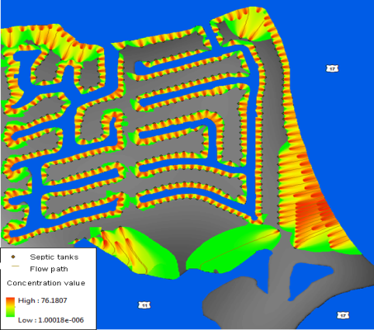
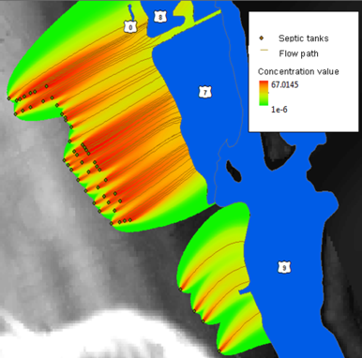
ArcNLET Spatial Variability of Nitrogen Plumes
Spatial variability is obvious at different modeling sites, e.g., Seagate Harbor (left) (reduction ratio of 10.8%) and Hobe sound (right) (reduction ration of 70.5%) in the Martin County.

Slide 35
ArcNLET St. Lucie Results
Category | Basin 4-5-6 | C-23 | C-24 | C-44/ S-153 | North Fork | South Fork
Percentage of nitrogen load from septic systems to BMAP estimated load | 22.87% | 0.03% | 1.66% | 0.00% | 31.20% | 10.33%
Percentage of load reduction of removed septic systems to BMAP required reduction | 33.67% | 0.05% | 1.71% | 0.00% | 17.02% | 1.35%
Percentage of load reduction to BMAP required reduction | 81.02% | 0.06% | 3.25% | 0.00% | 85.75% | 25.76%

Slide 36
Source Identification Sampling

Slide 37
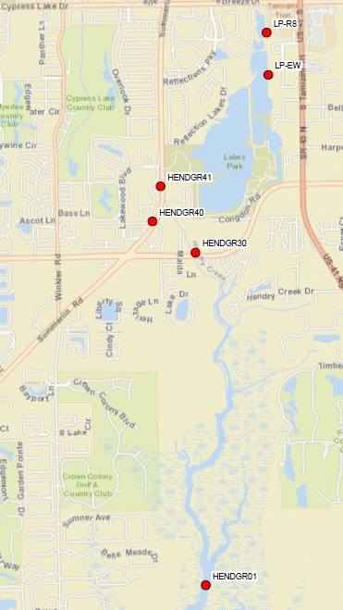
Hendry Creek Source ID
Walk the WBID October 2013.
Additional sampling October 2014:
  6 Sites
  Fecal Coliform, Sucralose, Acetaminophen, Enterococci, qPCR – HF183
Dry season sample.

Slide 38
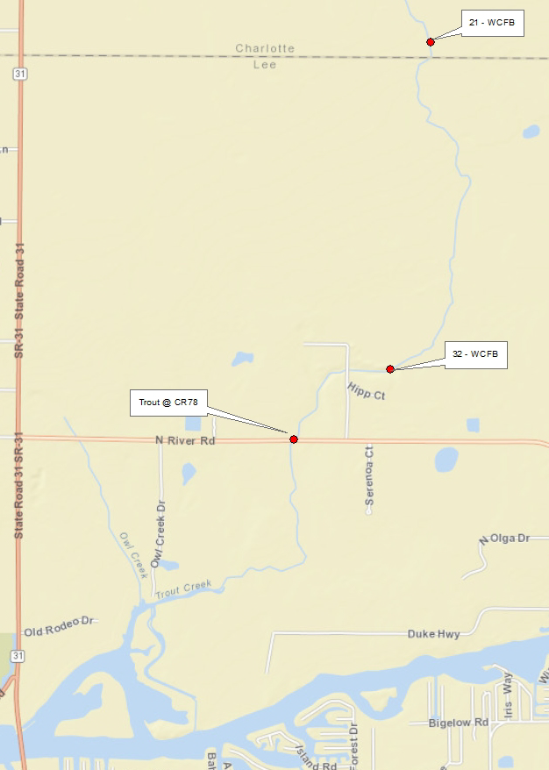
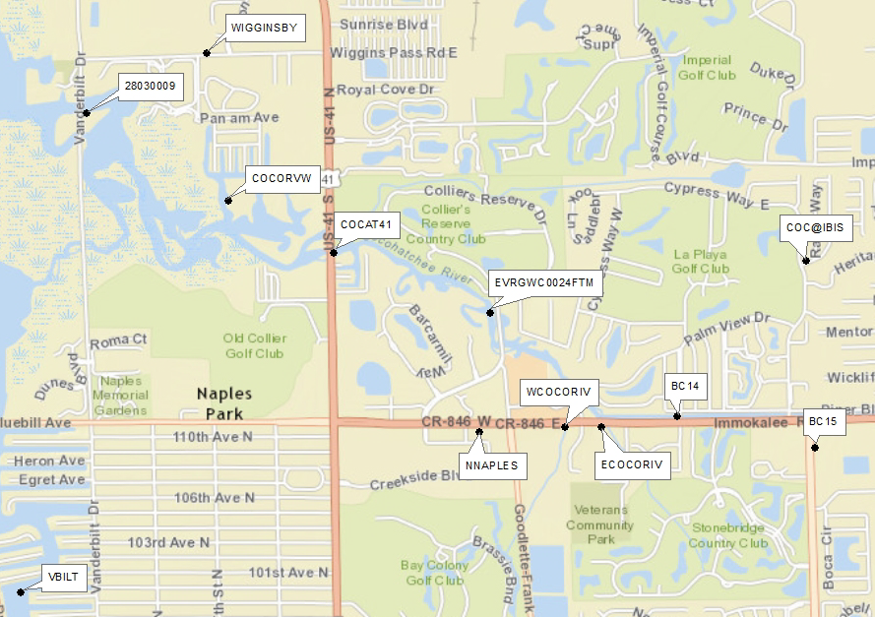
Source ID
Trout Creek
Cocohatchee River

Slide 39
Ground Water Nutrient Study

Slide 40
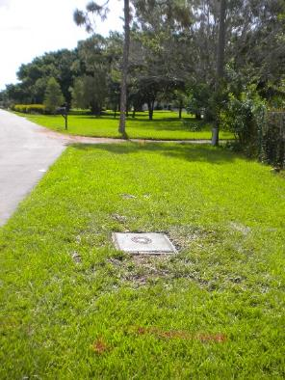
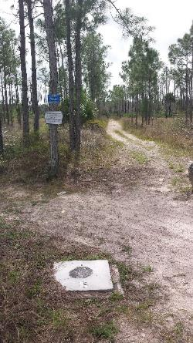
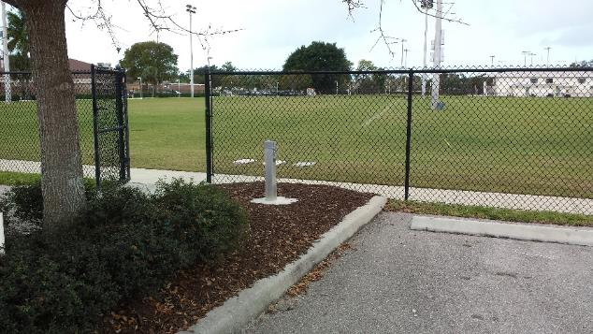
Ground Water Nutrient Study
Understand sources of nitrogen in the basin:
  Ground water contribution.
  Source identification.
Network of 30 shallow water wells
throughout 4 basins, including Hendry Creek and Imperial River.
Goal: Quarterly sampling
for 2 years.
To date, 3 quarters have
been sampled.

Slide 41
Core Parameters
Boron
Chloride
Ammonia.
Nitrite+Nitrate
Potassium
Total Kjehldahl Nitrogen
Sucralose
Total Phosphorus
Depth to water
pH
Temperature
Specific Conductance
Dissolved Oxygen
Turbidity
Oxidation Reduction Potential

Slide 42
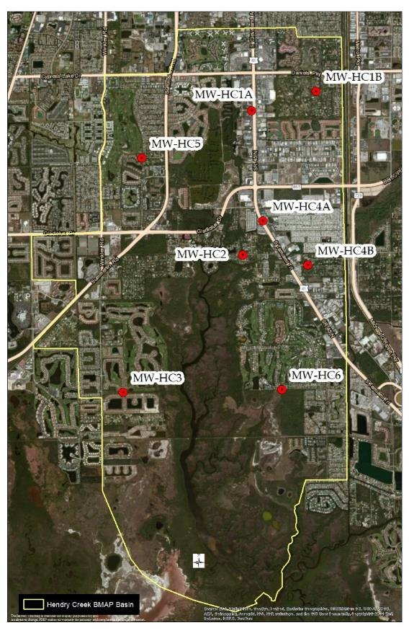
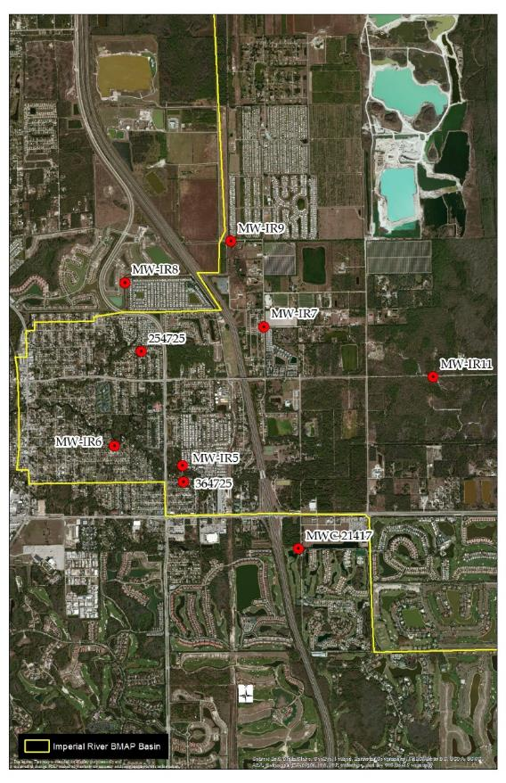
Well Locations in BMAP Basins
Hendry Creek
Imperial River

Slide 43
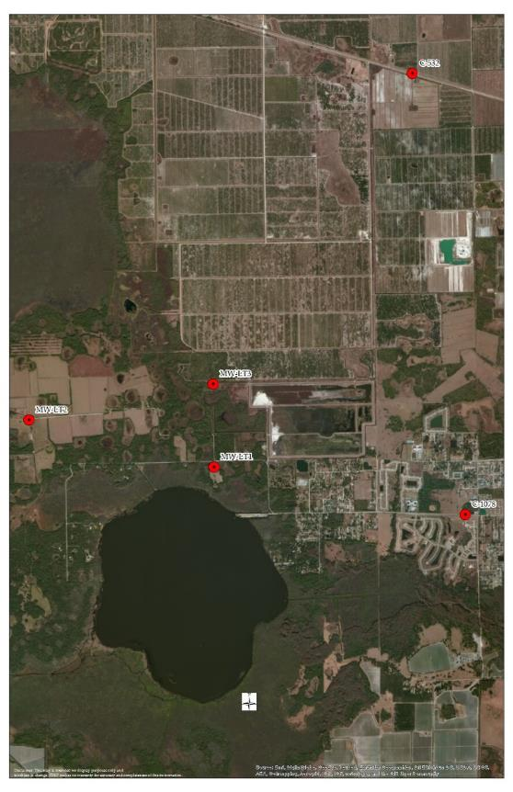
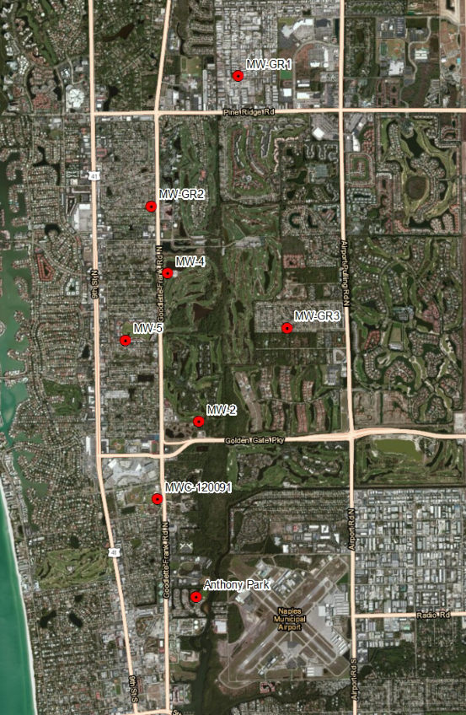
Additional Well Locations
Lake Trafford
Gordon River

Slide 44

Further Investigation
WateReuse Research Foundation.
Develop additional indicators to determine nutrient loading attributable to reclaimed water versus septic tank effluent.
Laboratory and field data.
Final report.

Slide 45
Caloosahatchee
Modeling Status

Slide 46
Modeling Status
Dr. Xueqing Gao and Douglas Gilbert met with the modeling technical subgroup on October 22, 2014 and FDACS staff on October 24th.
The Department has been working with SFWMD modeling staff, FDACS and other stakeholders to address remaining water budget issues with the watershed model.

Slide 47
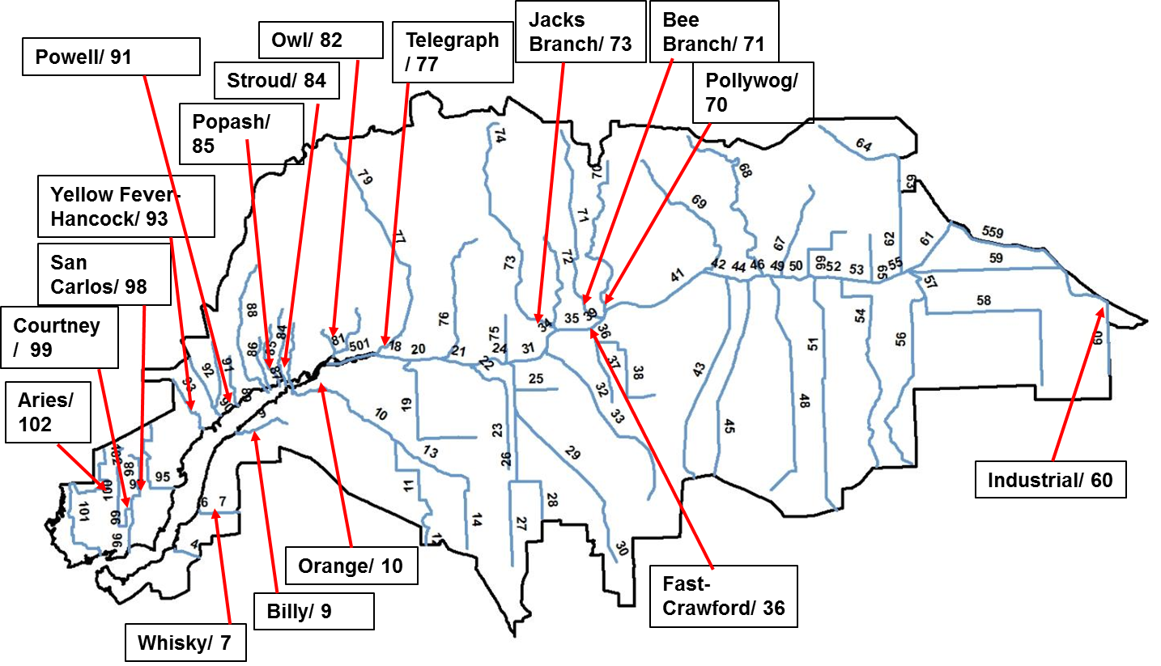
HSPF Reach Network
HSPF daily flow calibration was done for the freshwater streams/canals tributary to the Caloosahatchee River and Estuary.
Reach Name/Number
Location of Tributary Flow Calibration Sites
(arrow shows approximate location of flow measurements)

Slide 48
HSPF Daily Flow Calibration
Calibration at some locations was good, while other locations were not as good because of reversing flows.
The Department has committed to work with stakeholders to address remaining HSPF flow calibration issues at the S79 structure, before drafting TMDLs for the estuary.
Contact Doug Gilbert for more information. Douglas.Gilbert@dep.state.fl.us

Slide 49
Caloosahatchee Tributaries
TN data since 2009 has been compiled for stations tributary to the Caloosahatchee Estuary
An analysis is underway, and a detailed discussion is planned for the meeting to be held in March 2015.
Stakeholder involvement is essential to ensure all data is being considered.

Slide 50
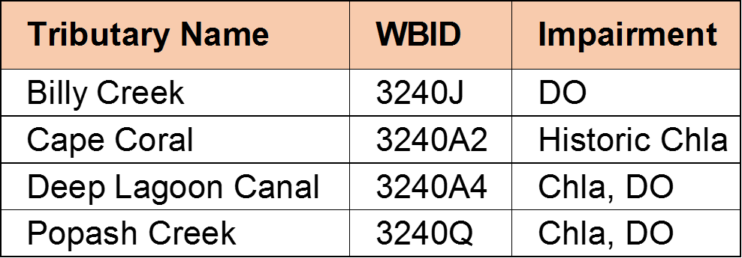
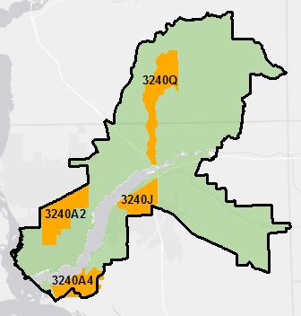
Tributaries TMDLs
TMDLs are planned for the following tributaries

Slide 51
Next Steps

Slide 52
Upcoming Events
The Department plans to hold the next meeting in early March 2015.
Upcoming funding opportunities:
  TMDL state grant.
  Section 319(h) federal grant.
  For more information contact Connie Becker
    Connie.L.Becker@dep.state.fl.us
    850-245-8505

Slide 53
Contact Information
For additional information please contact:
Sara Davis, Basin Coordinator
850-245-8825
Sara.C.Davis@dep.state.fl.us

