Slide 1
Fort Myers Country Club
Water Quality for Now and the Future

Slide 2
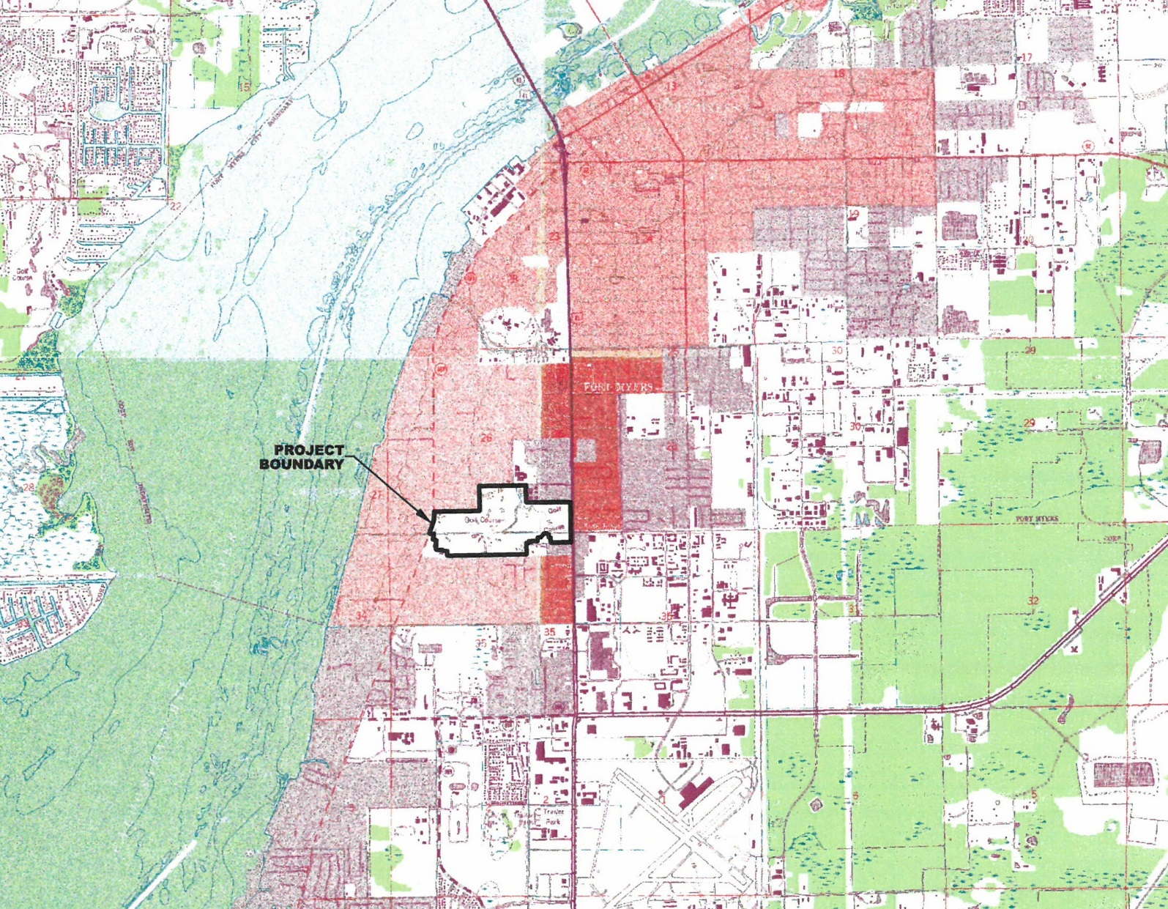
Fort Myers Country Club

Slide 3
Fort Myers Country Club
2008 Storm Water Master Plan projects
Use vacant areas between the golf holes for water quality treatment
Serve untreated residential to the north and commercial to the east
Use 2013 ERP for water quality improvements in a redevelopment area
Maximize water quality treatment while improving water management functions affecting golf play

Slide 4
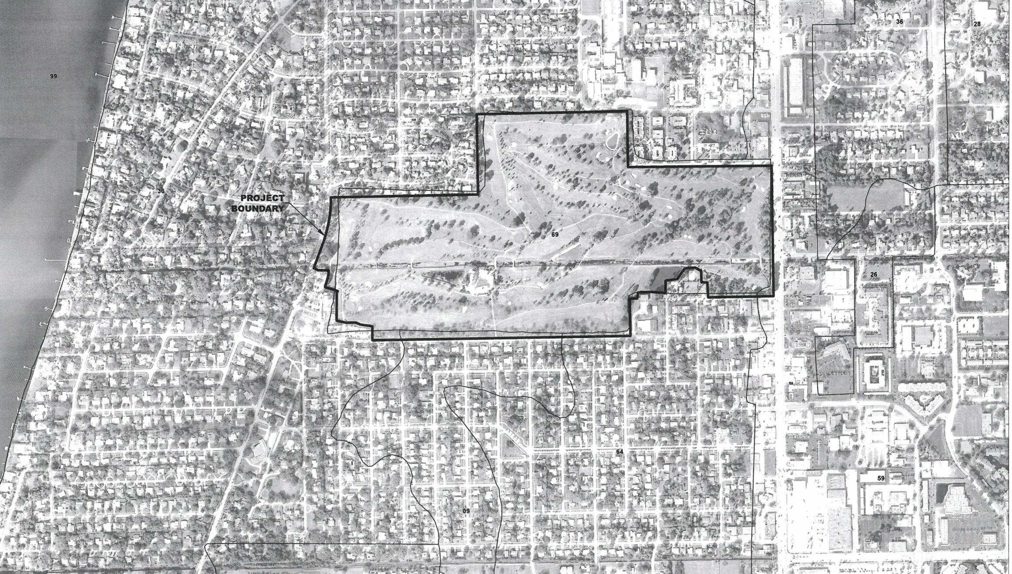
Fort Myers Country Club

Slide 5
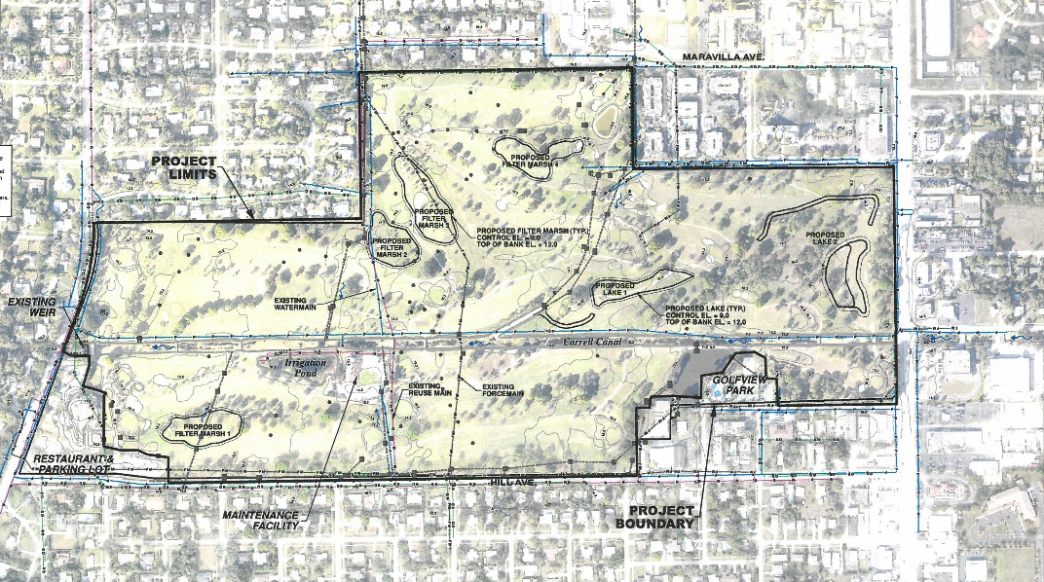
Fort Myers Country Club

Slide 6
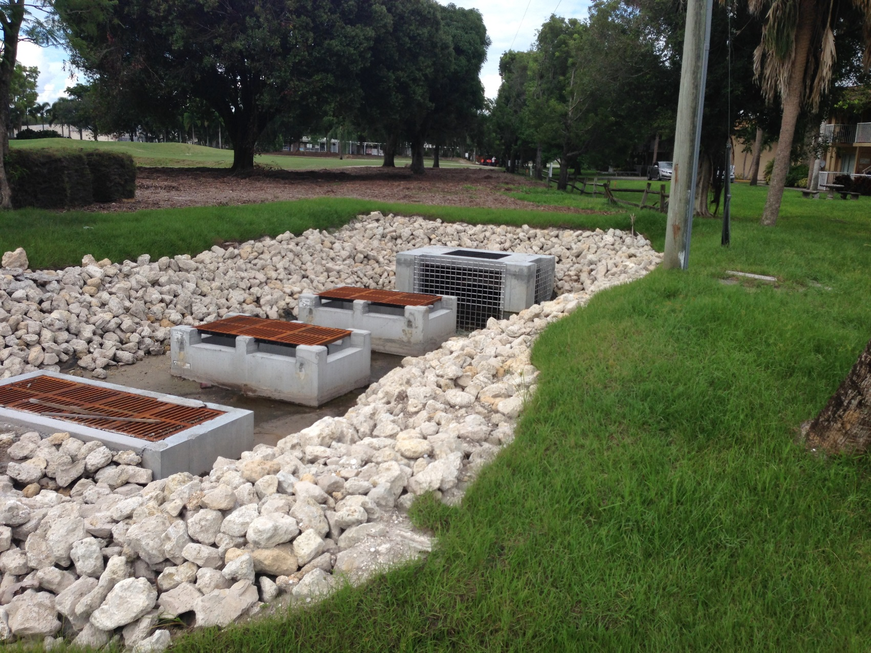
Fort Myers Country Club

Slide 7
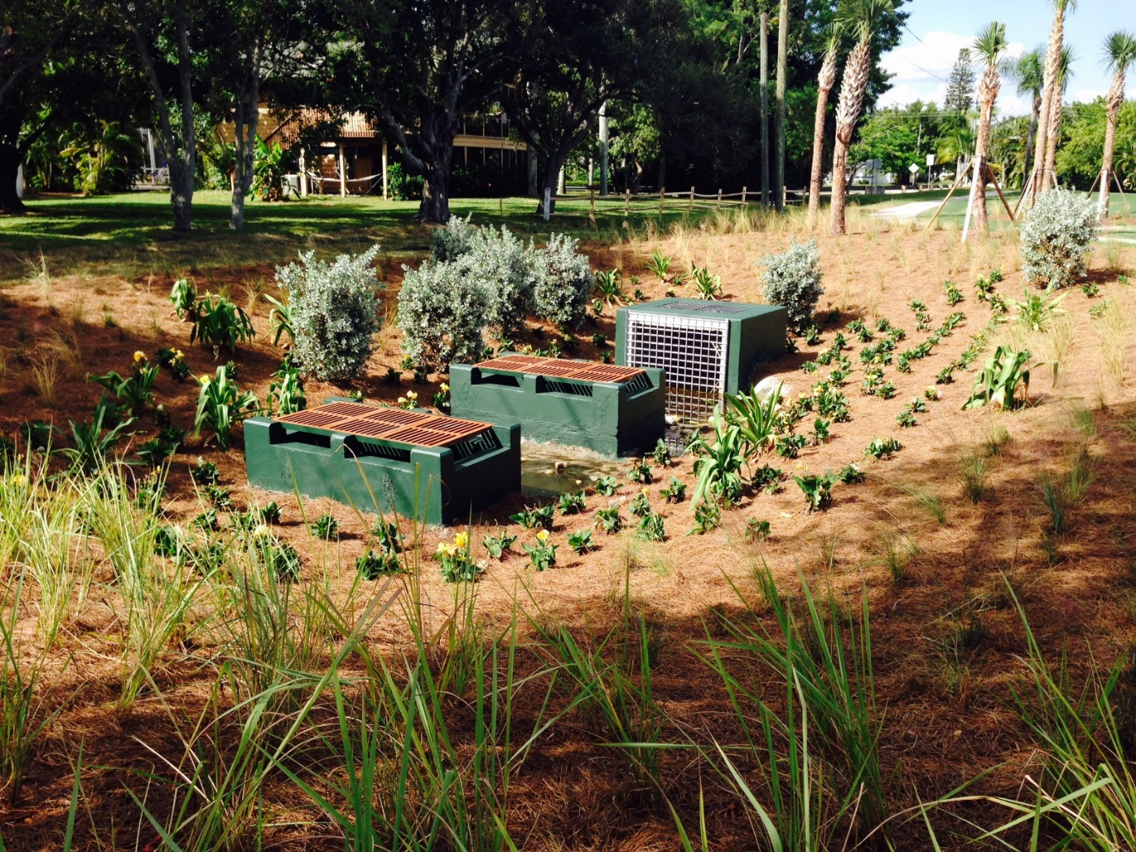
Fort Myers Country Club

Slide 8
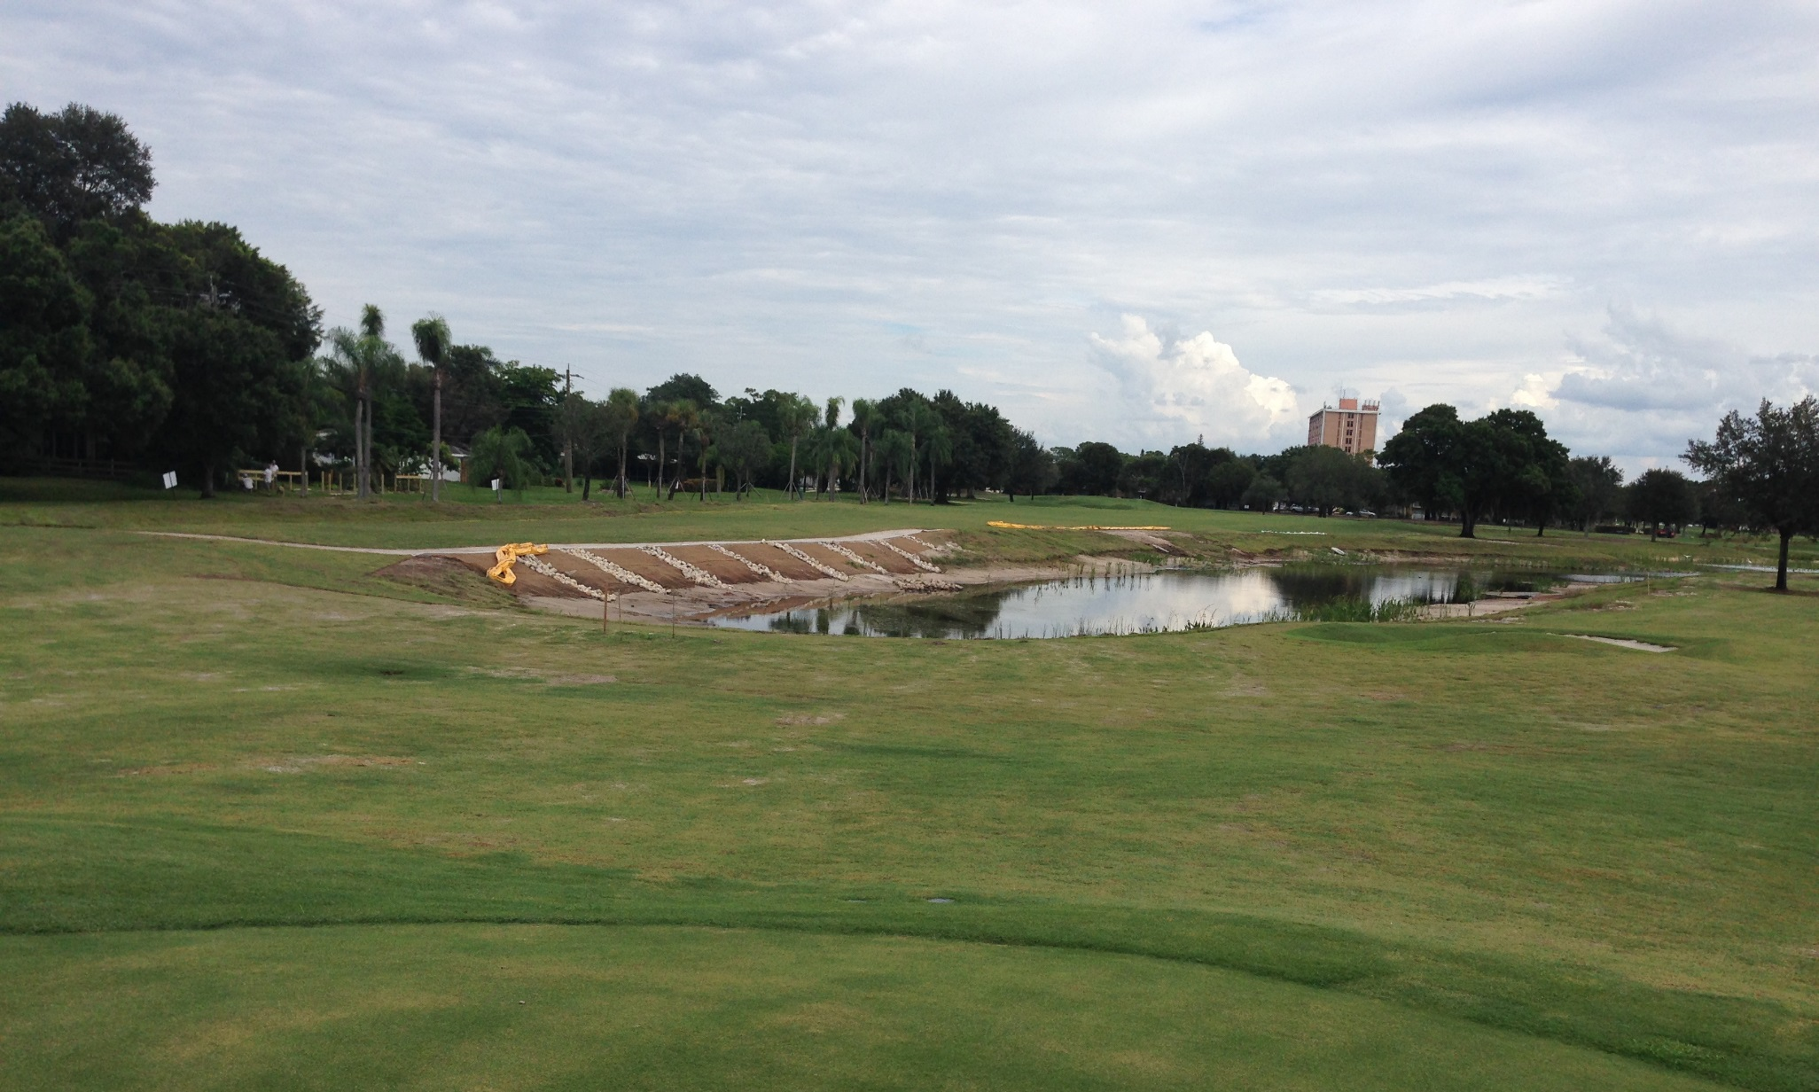
Fort Myers Country Club

Slide 9
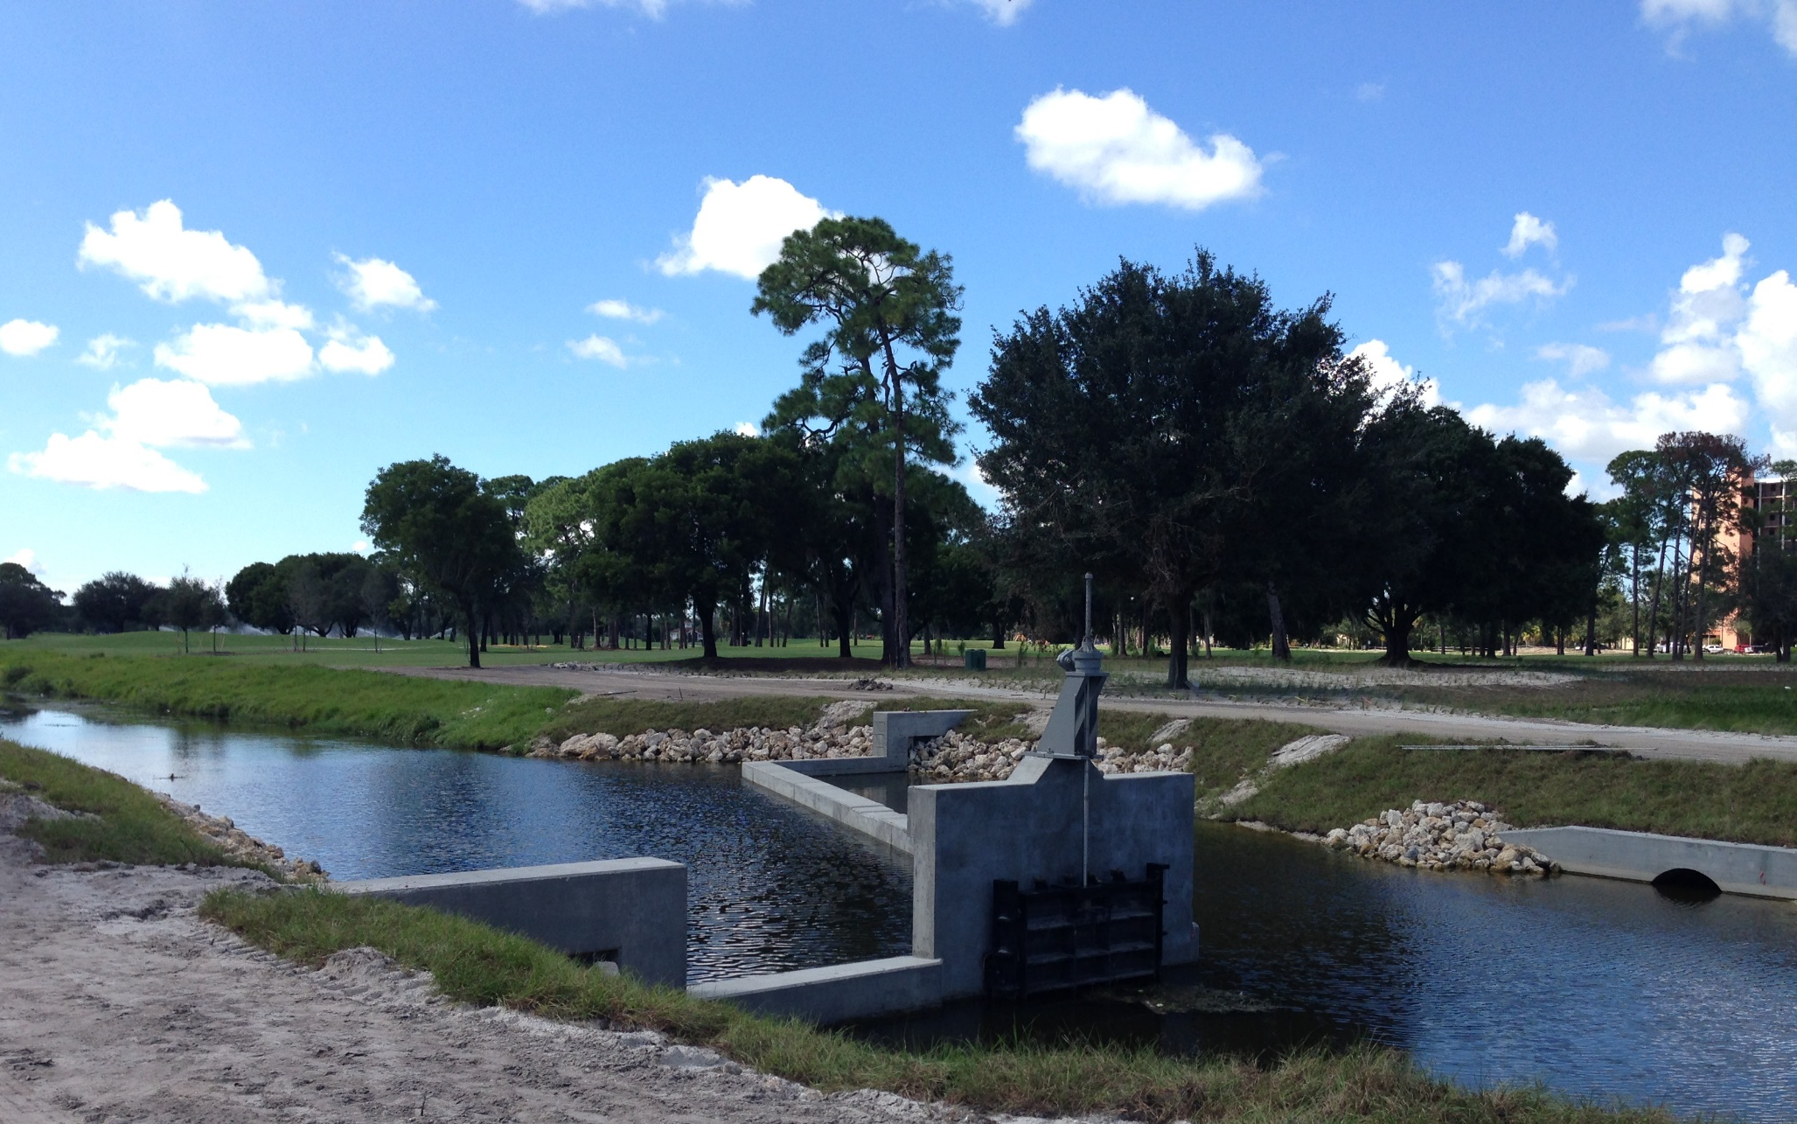
Fort Myers Country Club

Slide 10
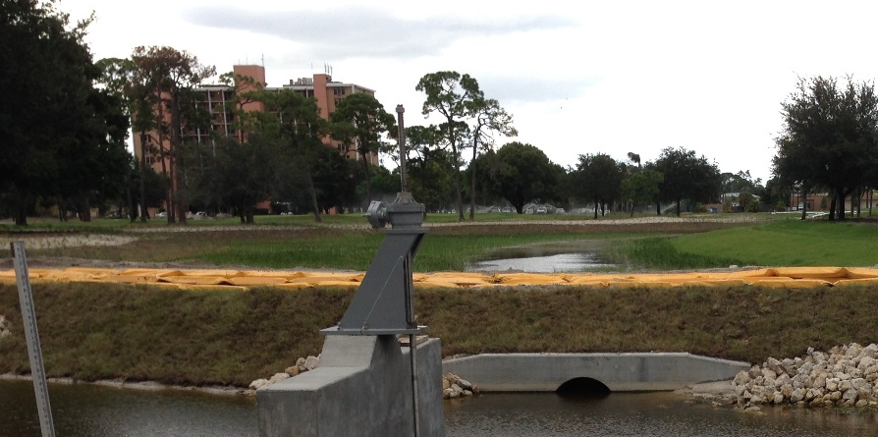
Fort Myers Country Club

