Slide 1
Fecal Coliform TMDL Implementation Plan Guidance
John Abendroth, Env. Administrator Watershed Planning & Coordination Section Bureau of Watershed Restoration

Slide 2
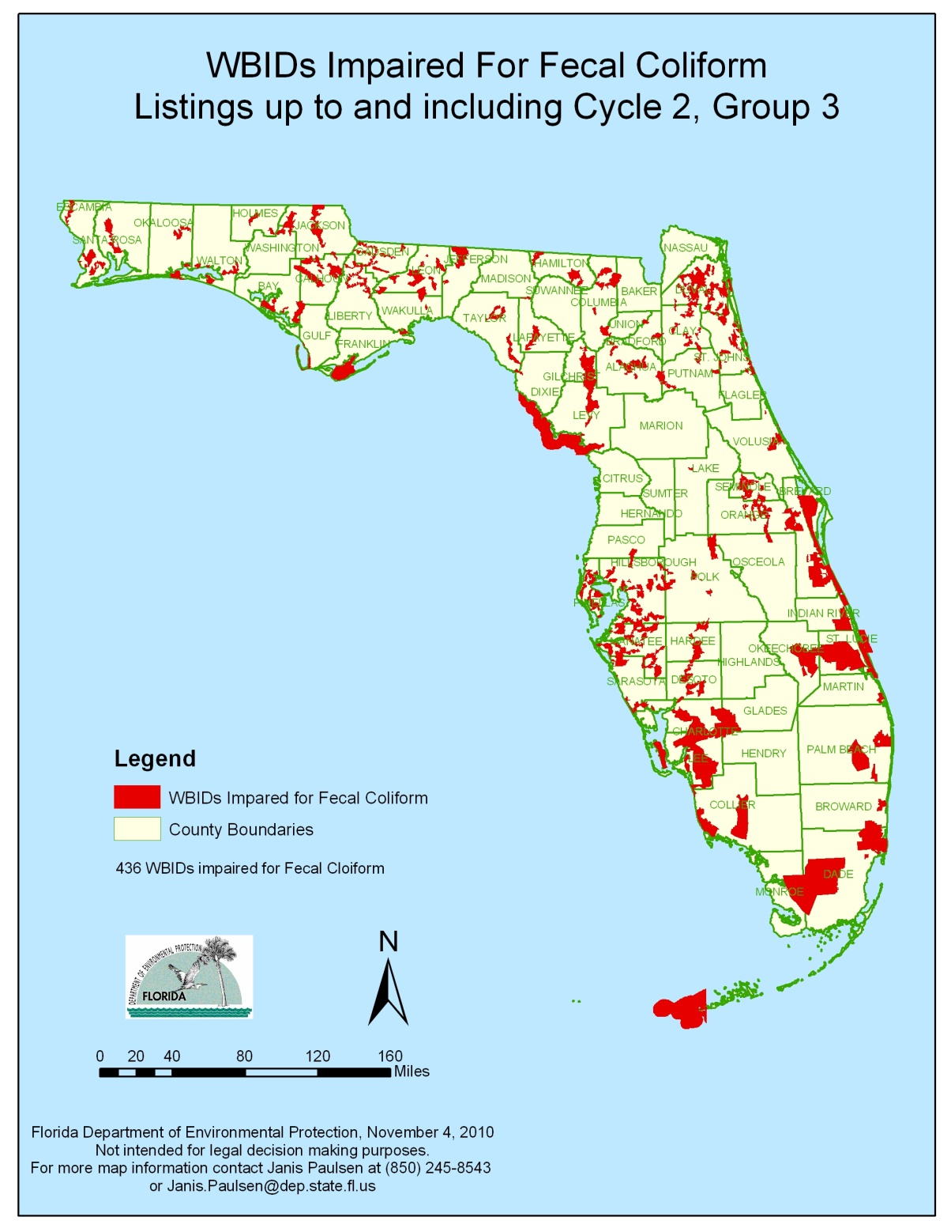
Verified Impairments for Fecal Coliforms

Slide 3
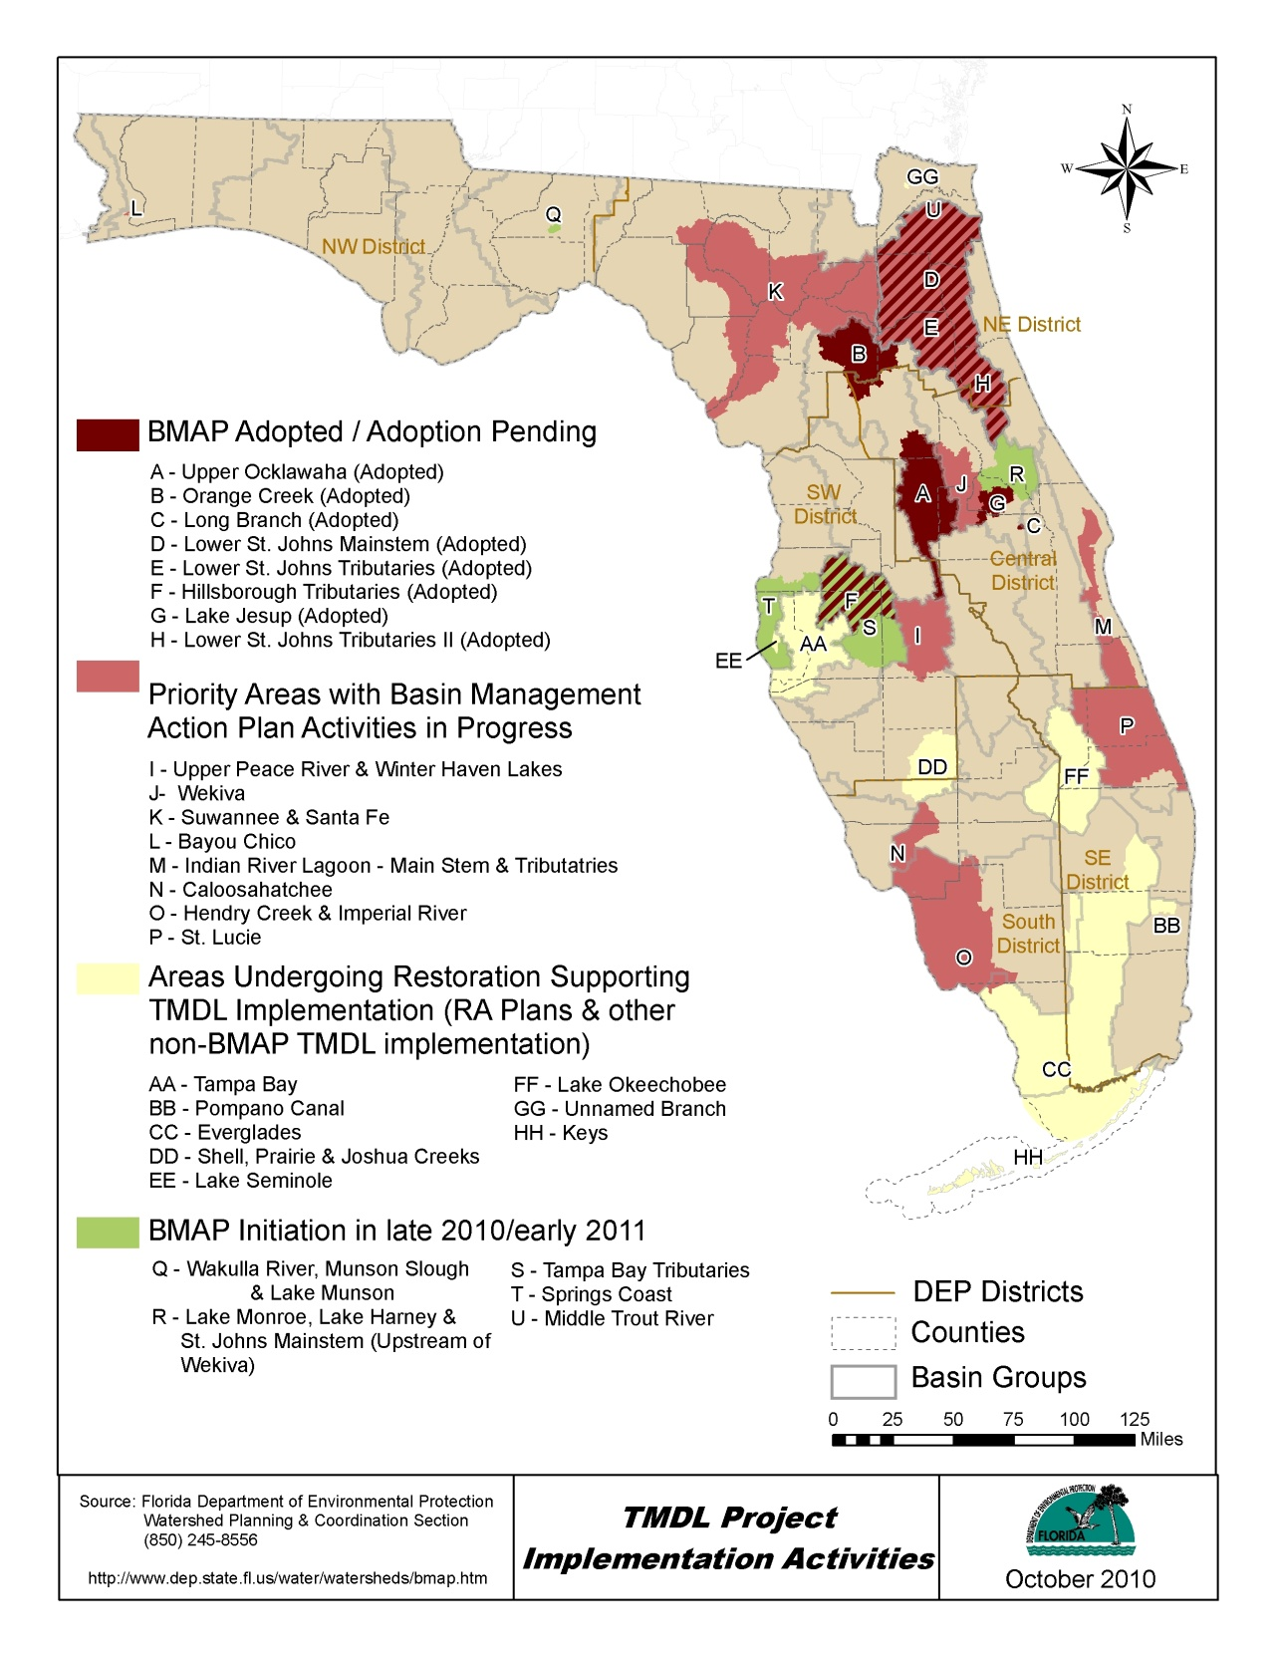
Current and
Planned
TMDL
Implementation
Activities

Slide 4
Fecal Coliform Issues
Used as an indicator organism for human pathogens – public health issue
NOT a good indicator of risk
EPA is working on a new water quality standard using other indicator organisms
Even if non-human sources, some in the public may not want to recreate in these waters

Slide 5

Who’s Responsible?

Slide 6
Source Identification
This is the primary difficulty –
Impairment may be based from a small amount of data and/or from a very small number of sampling stations in the WBID
Problems are often sporadic, not chronic
Other difficulties tying F.C. to pathogens:
  Salinity in tidally influenced areas
  Impacts of coliforms in resuspended sediments
  Grow on vegetation in warm climates
  Don’t differentiate between human, livestock and wildlife

Slide 7
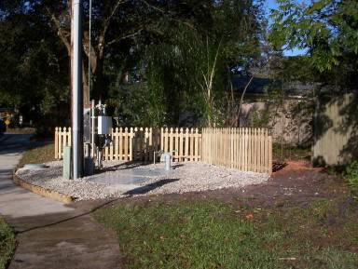
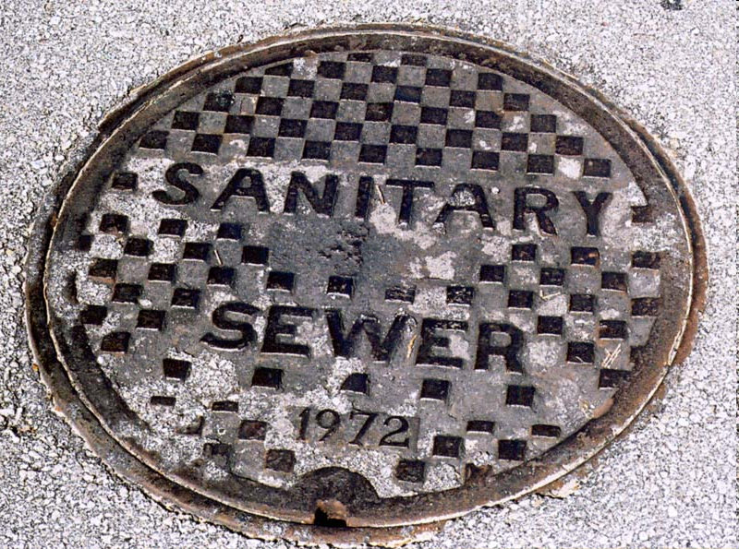
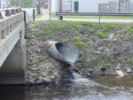
Structural Sources

Slide 8
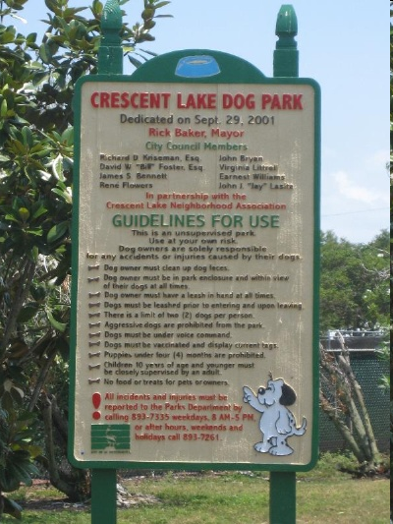

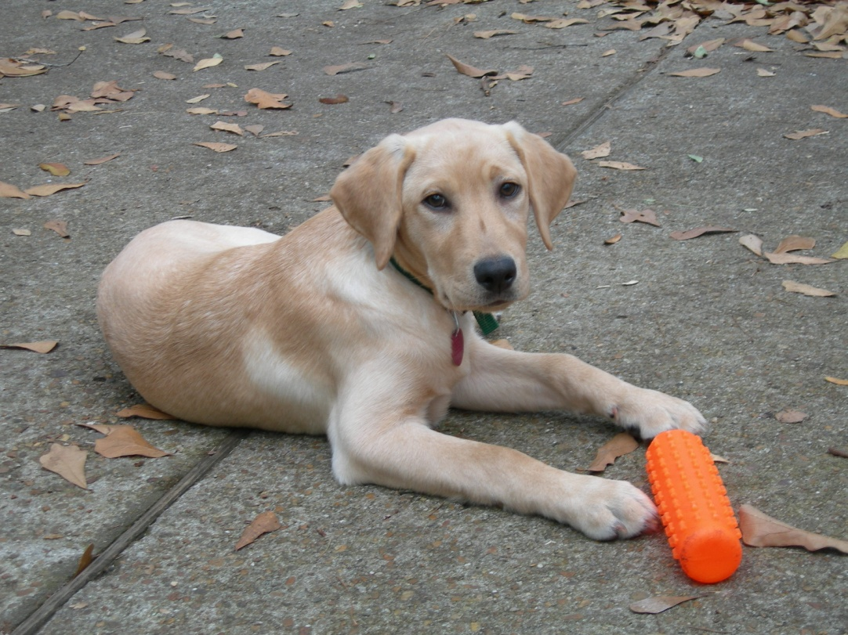
Pet Wastes

Slide 9
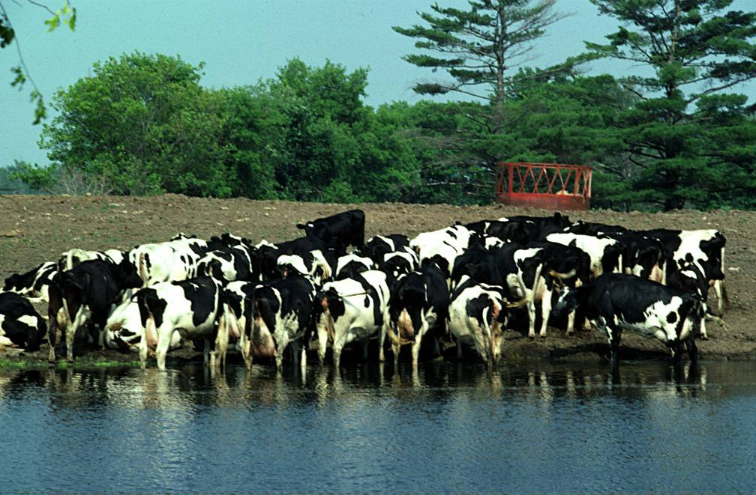
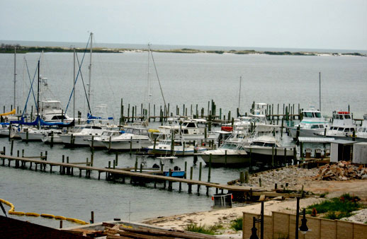
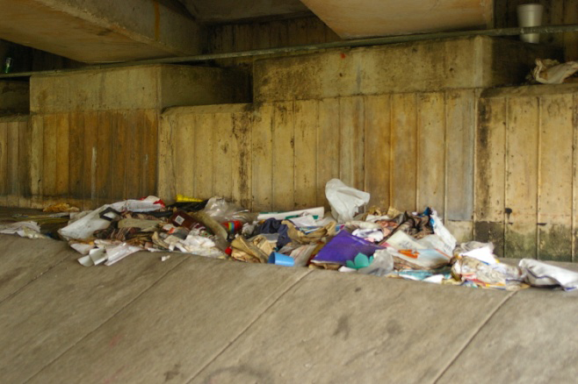
Land Uses
Agricultural Sources
Marinas
Homeless

Slide 10

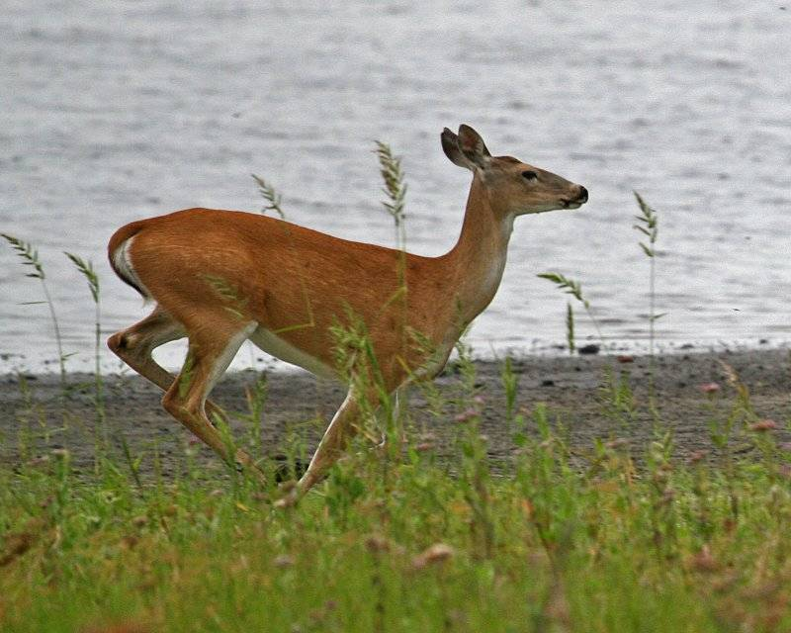
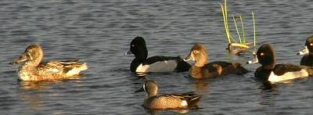
Uncontrollable Sources: Wildlife / Vegetation

Slide 11

Each basin has its own unique issues
Feces-throwing monkey on the loose in Tampa Bay
AP
January 14, 2009
CLEARWATER, Fla. – Wildlife officials said a rhesus monkey known to throw feces when mad is on the loose in Tampa Bay. Authorities have been trying to capture the primate since Tuesday afternoon, but it managed to evade a bucket truck and tranquilizer dart.
Gary Morse with the Florida Fish and Wildlife Conservation Commission says the adult male is thought to have escaped from an unlicensed source. It was last seen in Clearwater.
The monkey is not considered dangerous.

Slide 12
How Best to Implement the fecal coliform TMDL?
Develop a formal BMAP?
Local effort *****
Either way, the process primarily involves detective work
There are a number of tools that be used
The cost of source identification will vary depending on the number and type of tools you implement

Slide 13
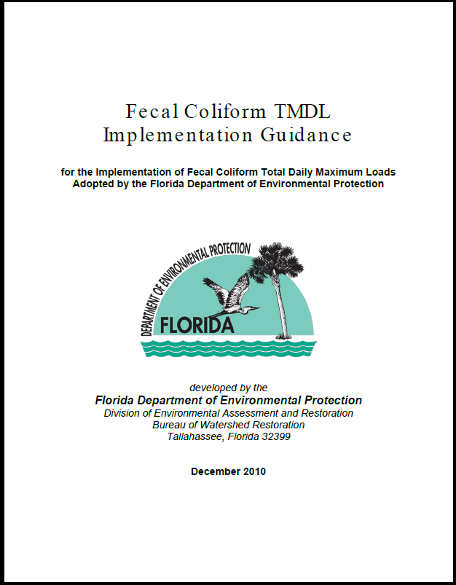
How can we help?

Slide 14
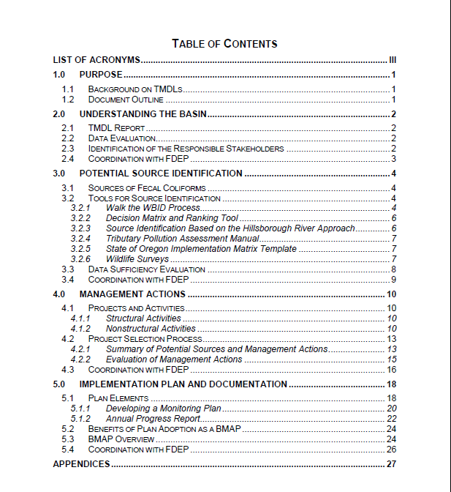
Contents of the Guidance Document

Slide 15
Linkage to Phase 1 MS4 permit requirements
Part VIII.B.4. Discharging into Waters with an Adopted DEP or EPA-Established Fecal Coliform TMDL that does not have a BMAP
  Within 30 months of permit issuance, the permittee shall develop and submit to the Department for approval a Bacterial Pollution Control Plan (BPCP) to identify the sources of bacteria and activities that will be undertaken to reduce fecal coliform loadings from stormwater outfalls to water bodies with adopted fecal coliform TMDLs to the MEP. To develop the plan, the permittee shall use the assessment tools and methodology within the Department’s Fecal Coliform TMDL Guidance On-Line Tool Kit. The BPCP shall, at a minimum, include the following elements, as appropriate:

Slide 16
Phase 1 MS4 Requirements (cont.)
a. Identification of potential sources of bacteria discharged from the MS4 system.
b. Bacteria source tracking or other assessment techniques, including monitoring, to better refine the identification of bacterial sources to the MS4 system and prioritize them for implementation of activities to reduce fecal coliform loadings.
c. Adoption and implementation of a pet waste management ordinance or program.
d. Implementation of an educational program directed at reducing bacterial pollution.
e. Identification of additional structural or nonstructural BMPs or program activities needed to reduce bacterial loadings discharged from the MS4 into water bodies with an adopted fecal coliform TMDL to the MEP. This shall include a summary of BMPs and other activities to be implemented, the schedule for their implementation, and the anticipated load reductions from the implemented activities.
f. The permittee shall include in each ANNUAL REPORT a status report on the implementation of the requirements in this section of the permit and on the estimated load reductions that have occurred.

Slide 17
Contact
John Abendroth
Environmental Administrator
John.abendroth@dep.state.fl.us
850.245-8555
Guidance document will soon be available at:
http://www.dep.state.fl.us/water/watersheds/bmap.htm

