Slide 1
2017 Source ID Pilot Study Maps
Florida Department of Environmental Protection
Division of Environmental Assessment and Restoration
Draft Version December 18, 2017
Contact Anita Nash for more information 850.245.8545

Slide 2
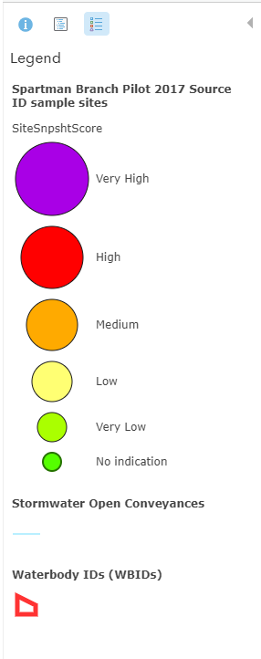
















Symbology
Next
Remaining trails to follow.
“SiteSnpshtScore” is the score assigned to a single site, for a single sampling event, considering all the results from the full suite:
  e.coli
  Acetaminophen
  Sucralose (used in Miller because records do not show reuse water or OSTDS)
  MST human marker HF-183
  Propidium Monoazide (PMA) was added to human marker HF183 during round 4 for differentiating live fraction of the Bacteroides out of the total Bacteroides detected in the sample
Spartman
Branch, Miller, Jackson, Wagner, Hopkins, Butcher Pen, Summary.
ArcGIS Online Map Log In

Slide 3
Butcher Pen Creek

Slide 4
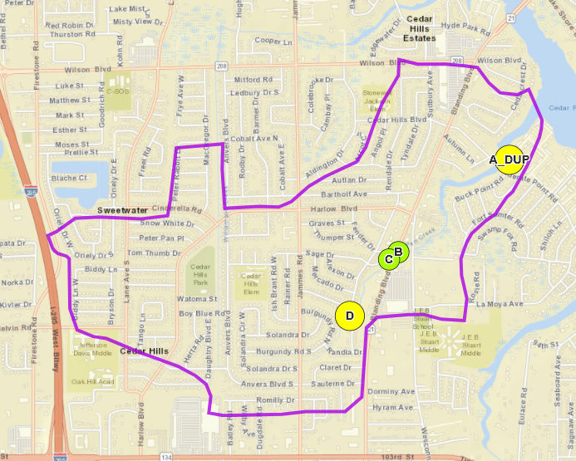
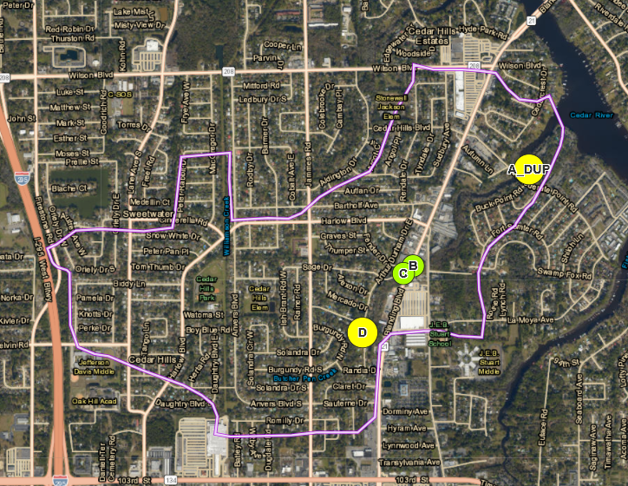





Butcher Pen Round 1
3/9/2017
First and last sampling event during the 2017 Pilot Study.

Slide 5

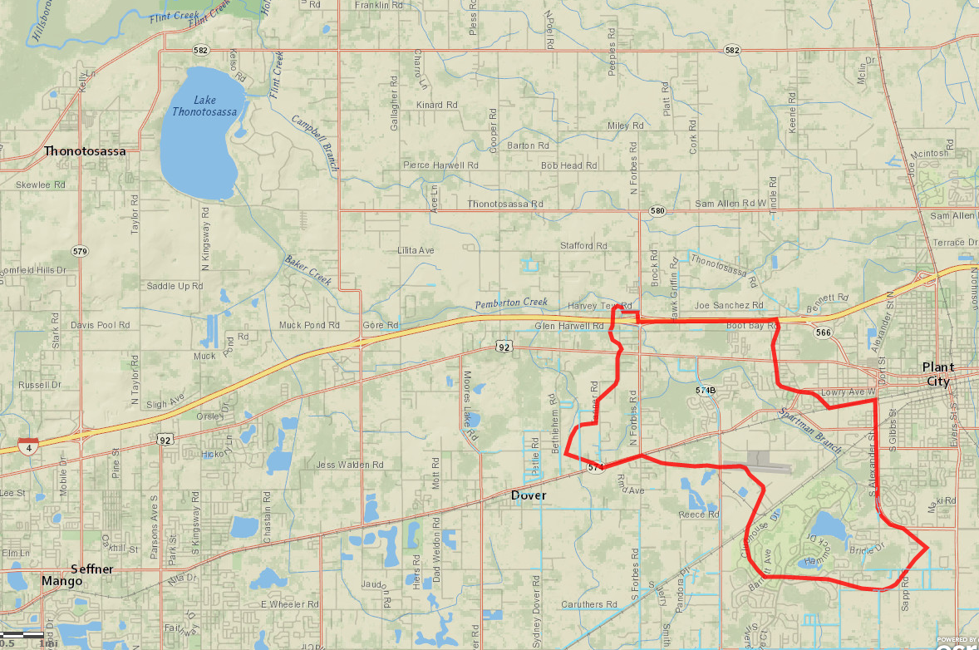
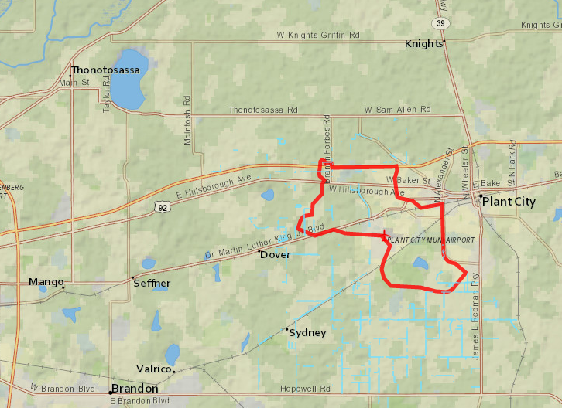


Spartman Branch WBID
Next
Flows north west to Pemberton Creek, Baker Creek, then into Lake Thonotosassa
Rural Hillsborough County
Plant City

Slide 6
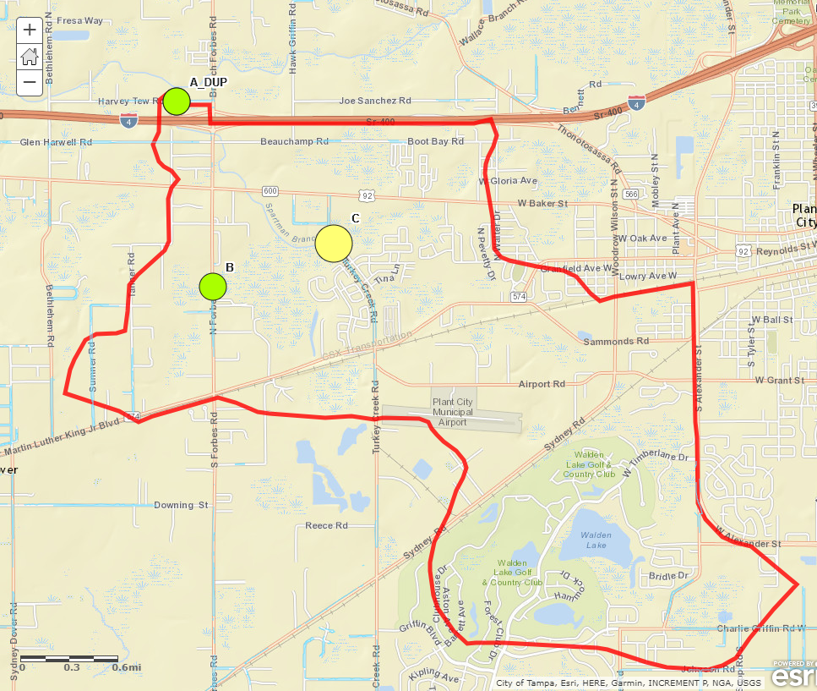
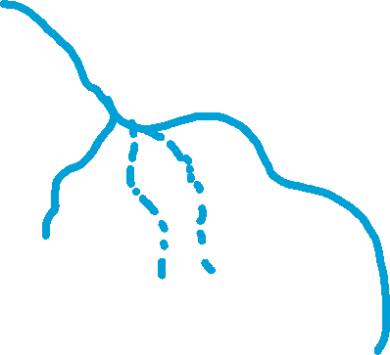
Spartman Branch
Next
Sample Event 1 March 21

Slide 7
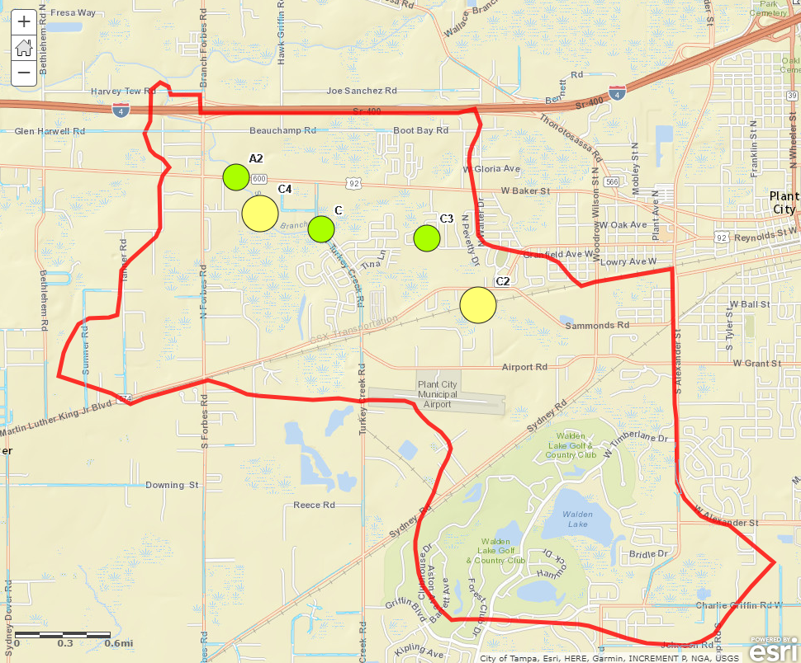
Spartman Branch
Next
Sample Event 2
April 10
The south west tributary was dry.
Shortly after, the creek went dry.

Slide 8
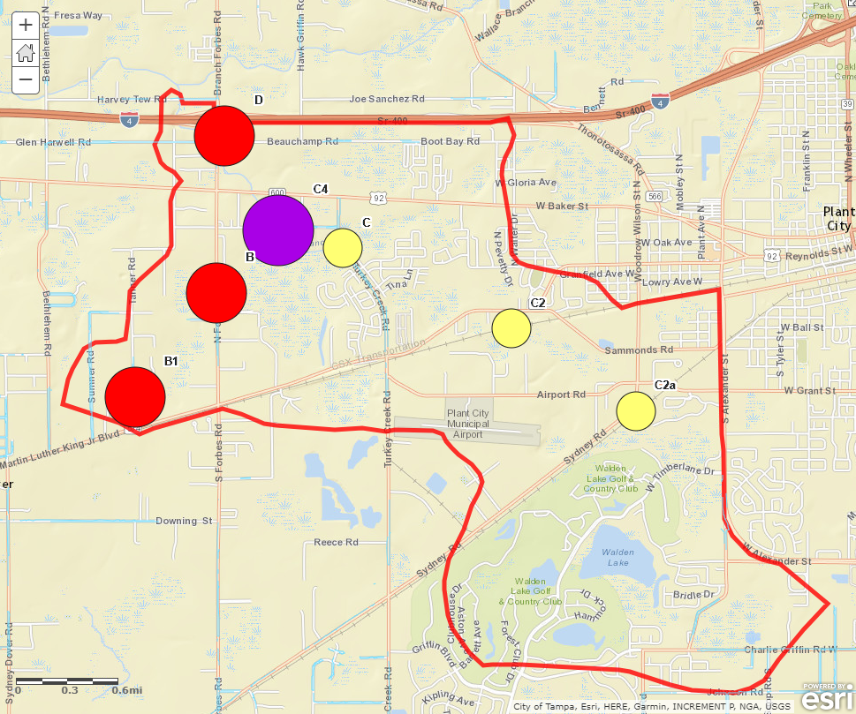
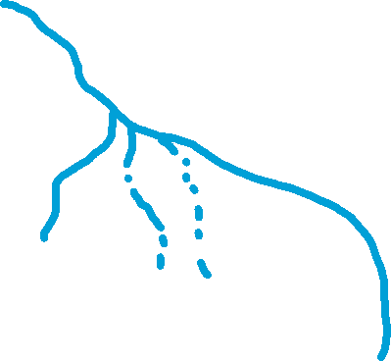
Spartman Branch
Next
Sample Event 3
July 18
This event was after the creek began flowing again.

Slide 9
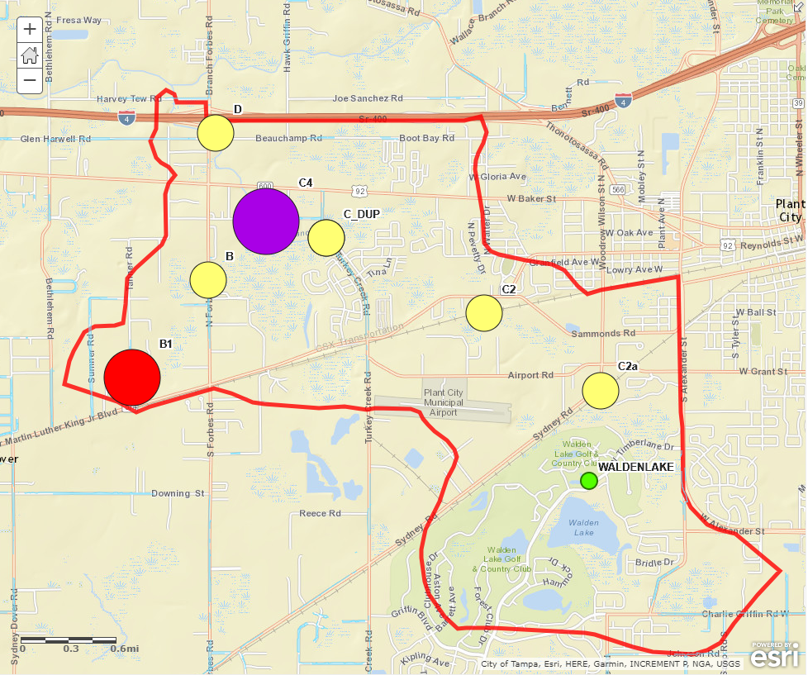
Spartman Branch
Next
Sample
Event 4
August 16
The last sampling event was to confirm hot spots before the conclusion of the pilot study.

Slide 10
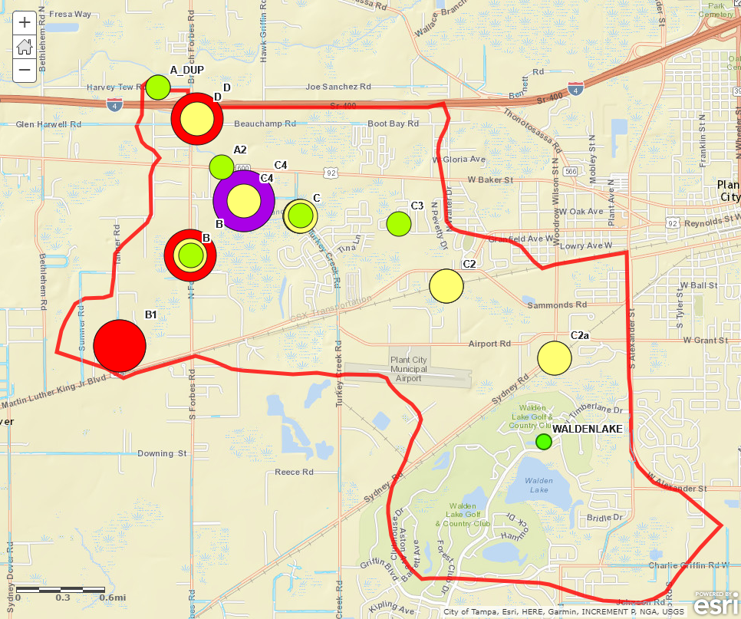
Spartman Branch
Next
All 4 pilot sampling events on one map.

Slide 11
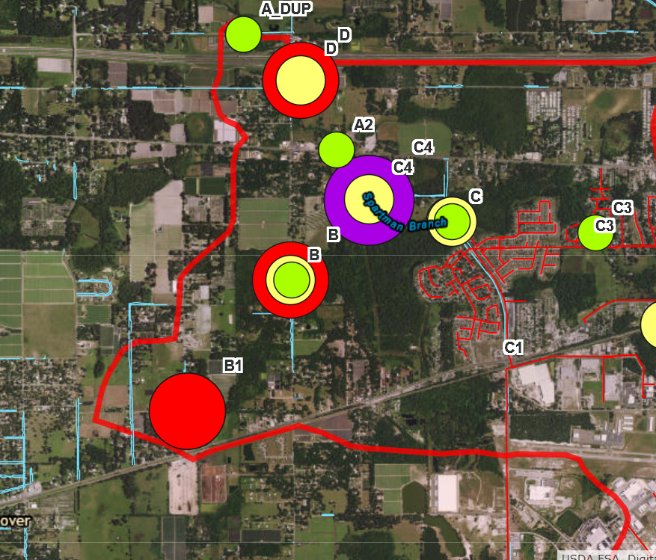
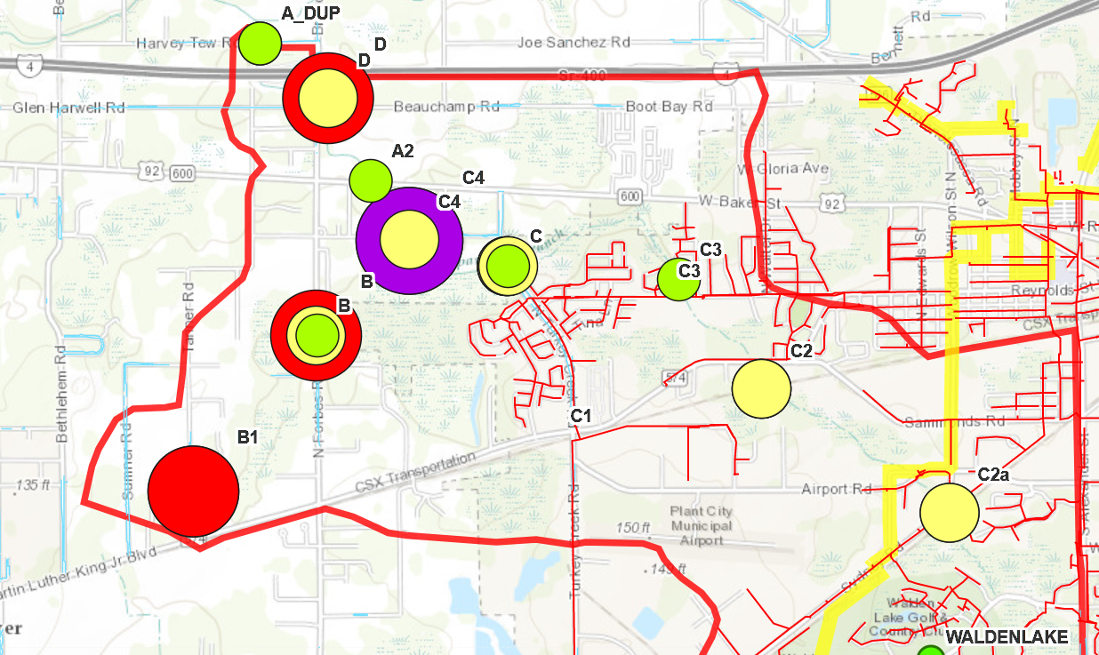
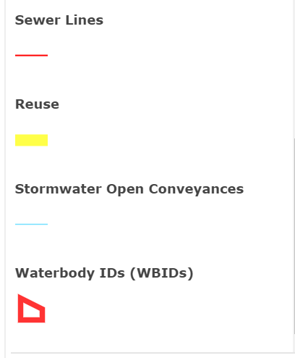
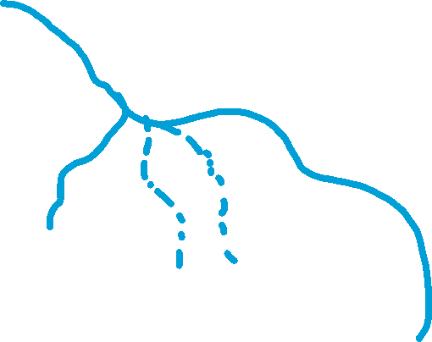



Spartman Branch
Click
Next
All 4 pilot sampling events on one map.

Slide 12
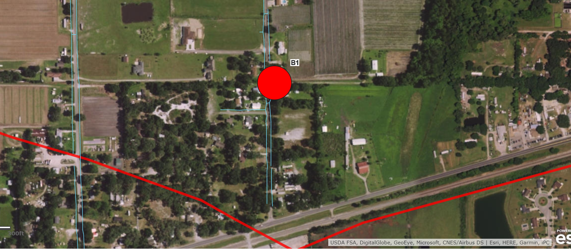


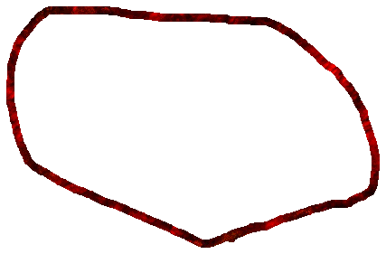
Example of hit in area serviced by OSTDS.
WBID Line
Estimated Watershed Boundary

Slide 13
Miller Creek

Slide 14
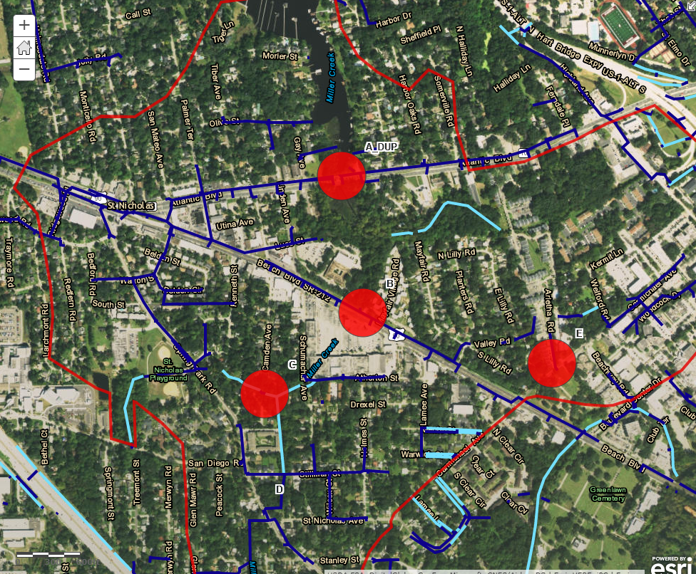






Miller Round 1
Next

Slide 15
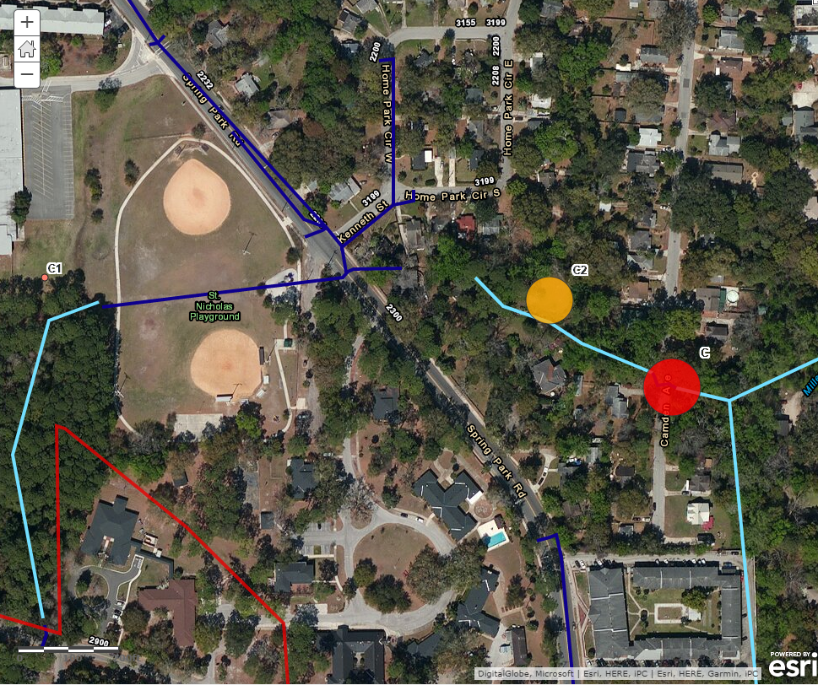
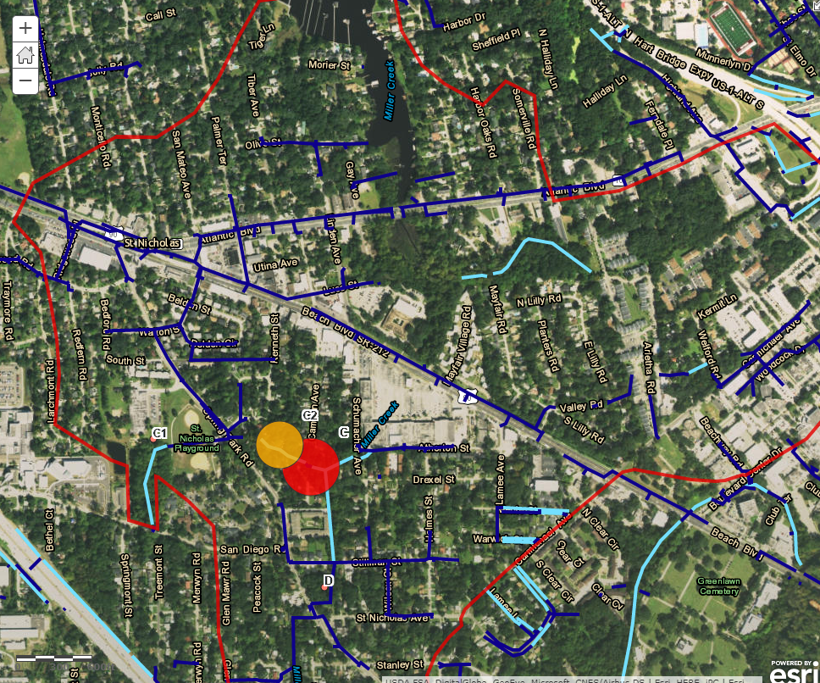




Miller Round 2-C
Next

Slide 16
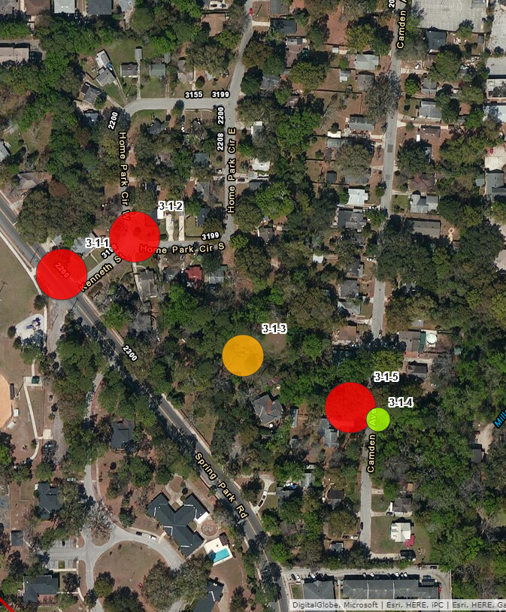




Miller Round 3-C2
Next

Slide 17
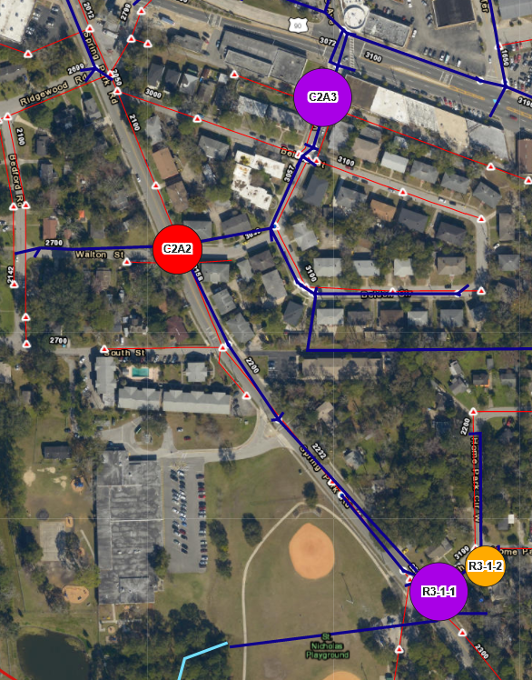


Miller Round 4-C2
Next
This was the last sampling event under the 2017 Pilot study.

Slide 18
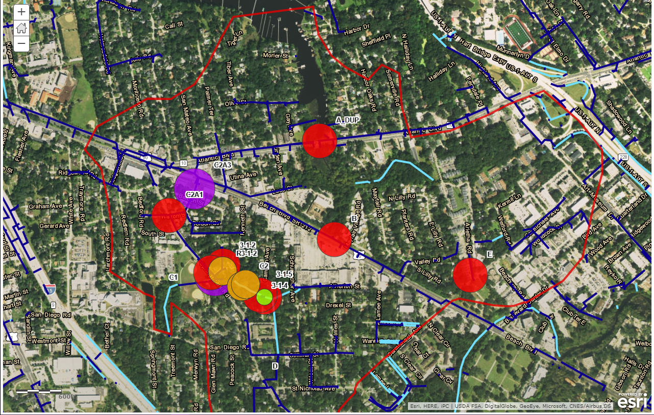



Miller
All 4 rounds of monitoring.

Slide 19
Jackson Creek

Slide 20
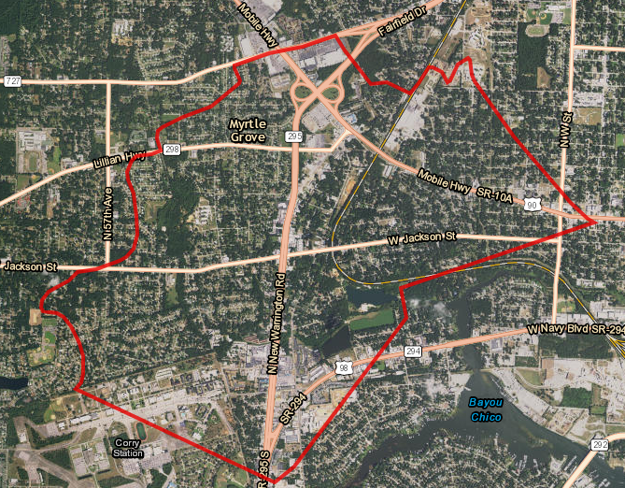


Jackson Creek WBID
Flow Direction
Next

Slide 21
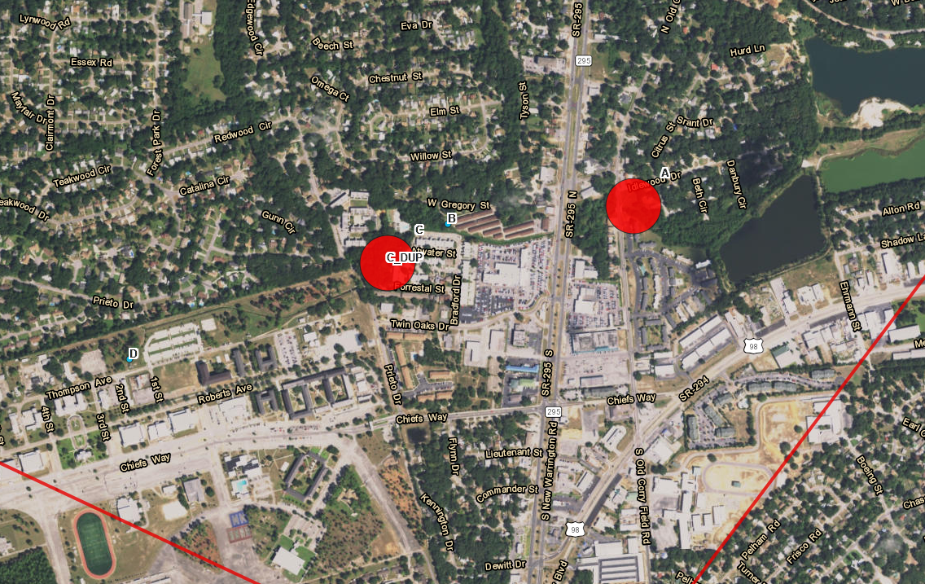

Jackson Round 1
Next
No Sample of this trib. Too shallow for grab.
No Sample. No Water on mainstem.
Hit at A.
Hit at C and Duplicate. D/S of convergence of north south tributary

Slide 22


Jackson Round 1
Next
No Sample. No Water on mainstem.
Hit at C and C-Duplicate D/S of convergence of north-south tributary

Slide 23
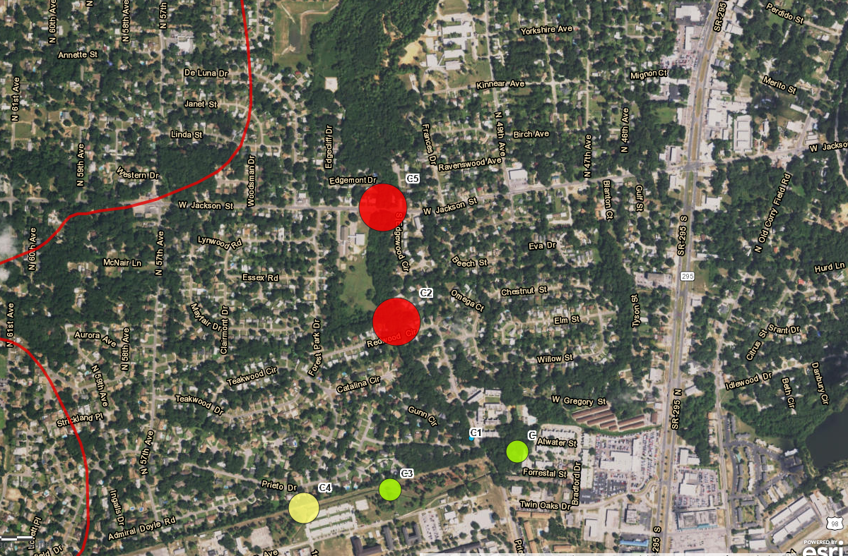
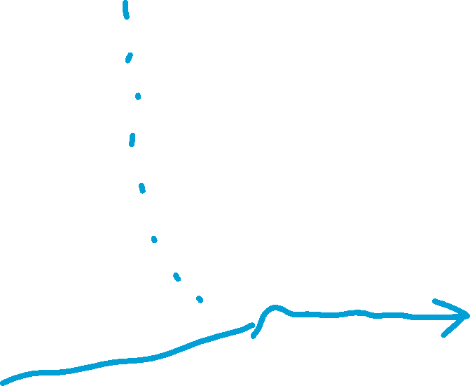

Jackson
Round 2 - C
This tributary was not flowing. Samples taken from stagnate pools at road intersections.
Next
The main creek was flowing.

Slide 24
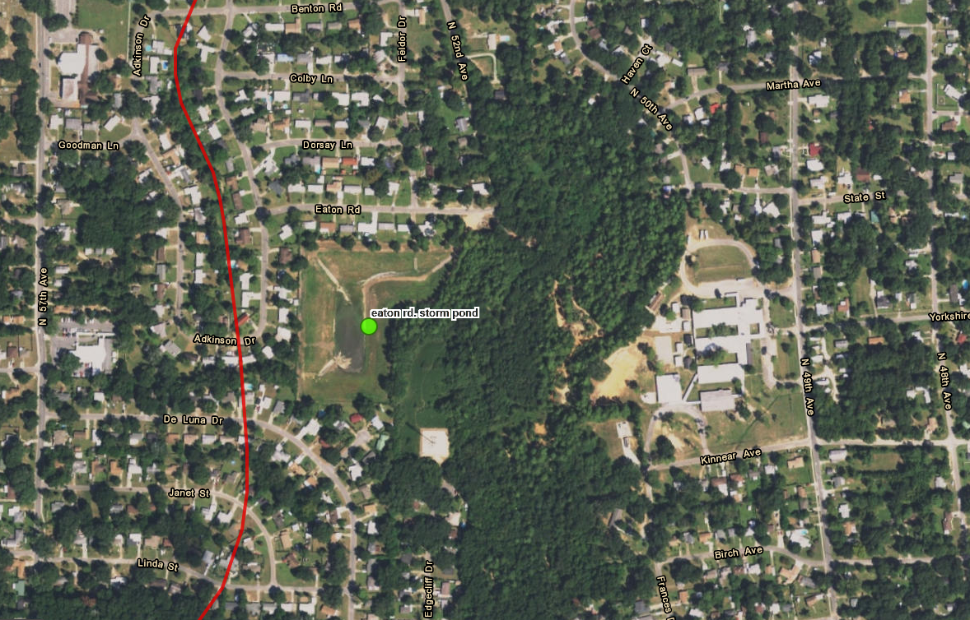

Jackson
C5 contributing area recon
GPS wet locations and outfalls
Next
Sample

Slide 25
Jackson Creek
Where in the WBID are we?
Next
Eaton Rd. Stormwater Pond
C5
Bayou Chico

Slide 26
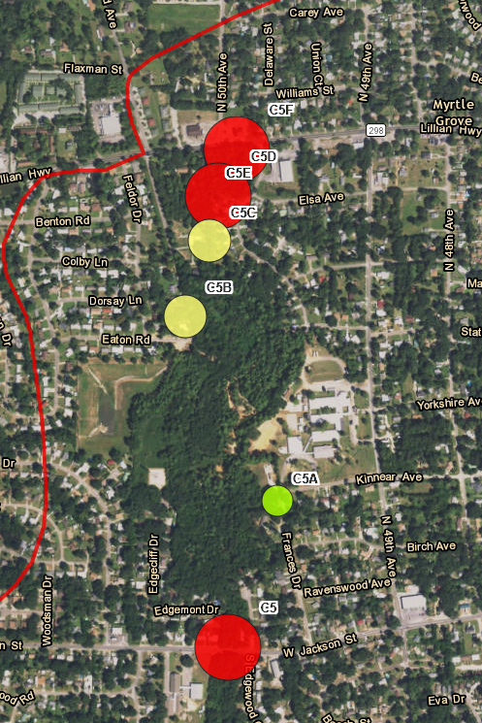
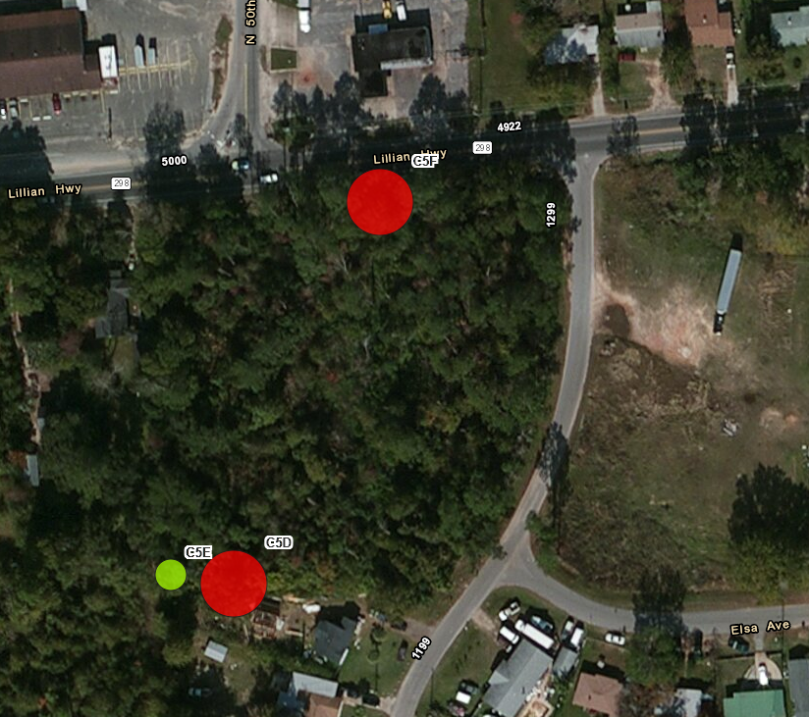
Jackson
Round 3 – C5
Next

Slide 27
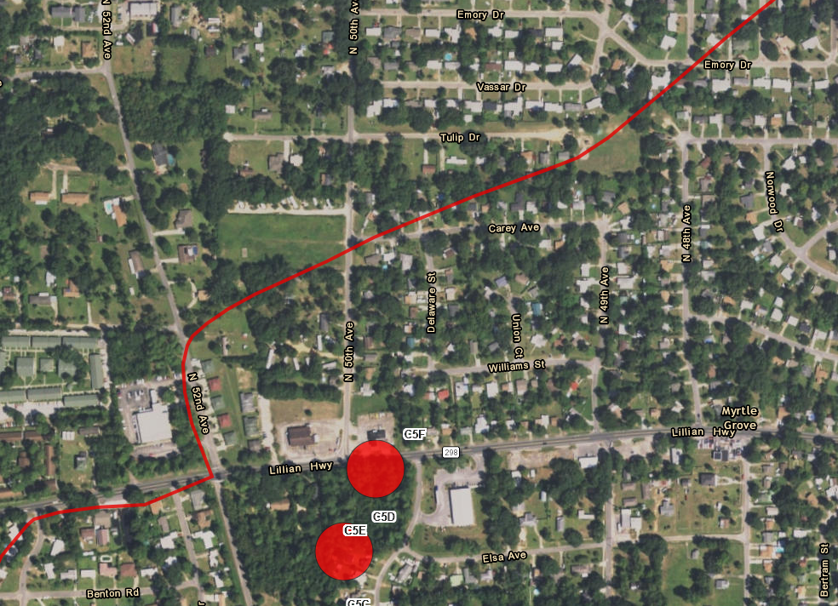

Jackson
Round 3 – C5
Next
(2 areas of interest)

Slide 28
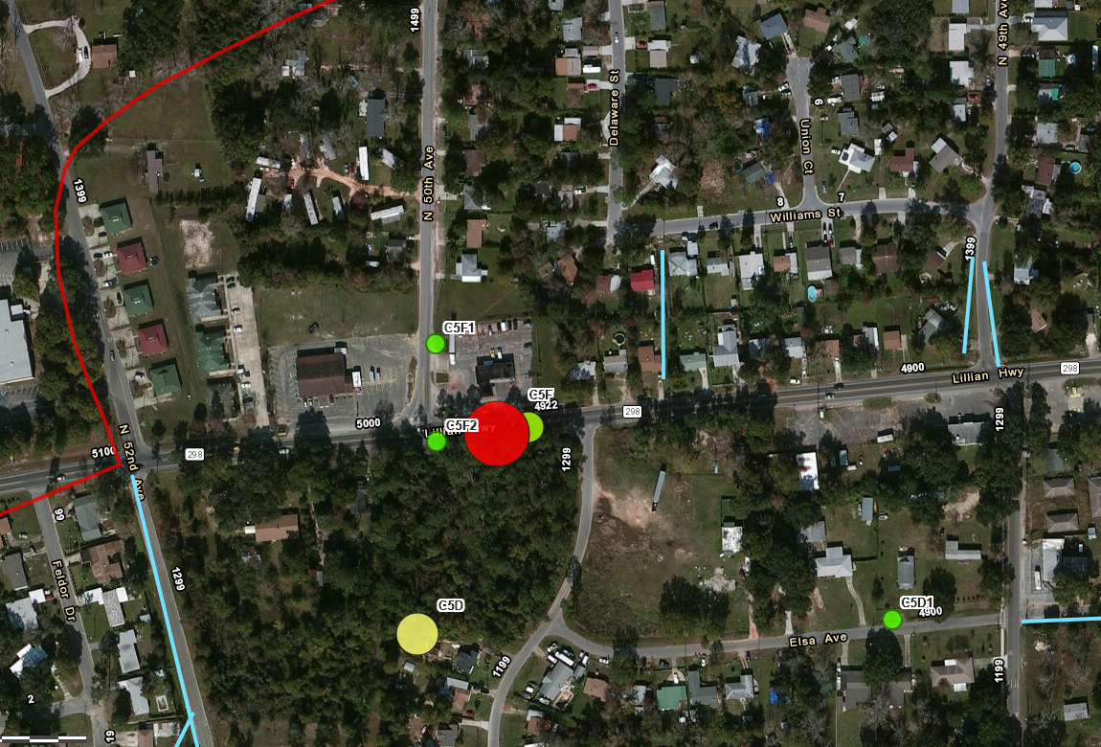

Jackson
Round 4 – C5D and C5F
Next
This was the last sampling event under the 2017 Pilot study.
Everything contributing to here is stormwater. Let’s zoom in here.

Slide 29
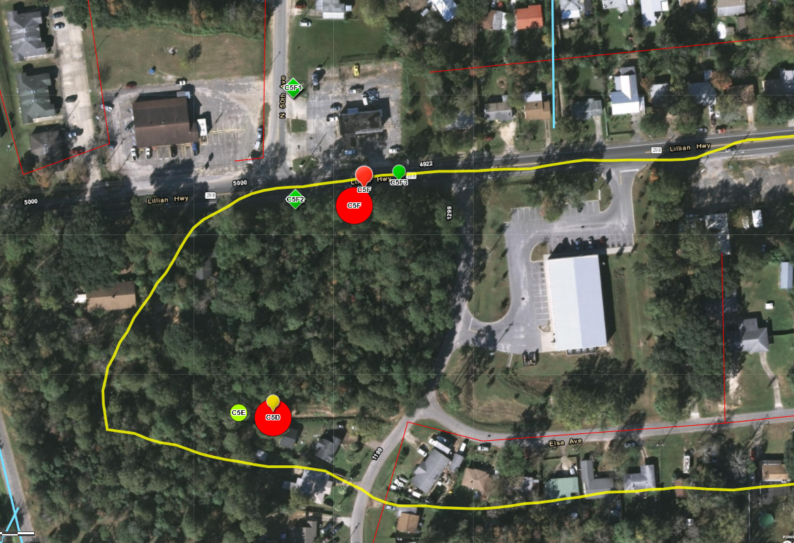
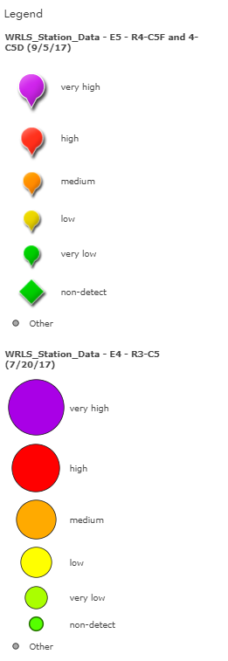


Jackson
Rounds 3 and 4 – C5F close-up
Next
Further investigations recommended:
  N 50th Ave. & Lillian Hwy. outfalls
  Elsa Ave. outfall

Slide 30
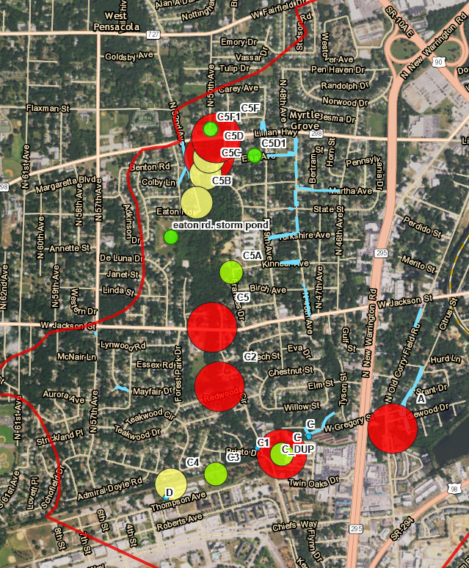



Review of all stations
Pilot Study 2017
Jackson Creek

Slide 31
Hopkins Creek

Slide 32
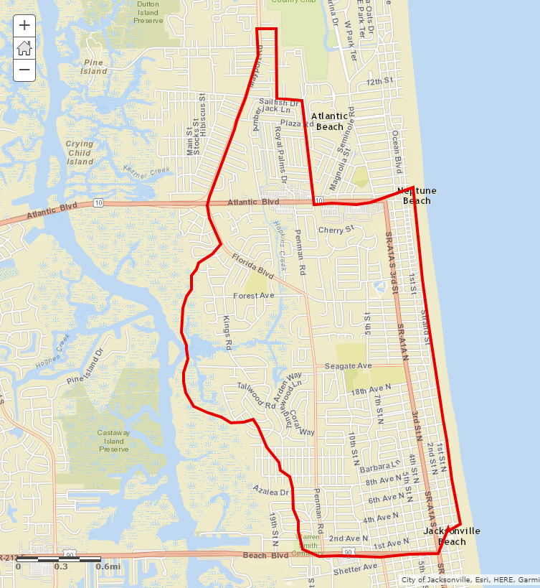

Hopkins Creek Watershed
Event | Round | Date
1 | 1 | 3/9/2017
2 | 2-B and 2-A | 3/23/2017
3 | Post Elimination | 4/10/2017
4 | 3-B9 | 4/18/2017
5 | 3-B5 | 4/19/2017
6 | 4-B9C | 6/20/2017
7 | 5 - Persistence Check Sampling Event | 8/28/2017

Slide 33
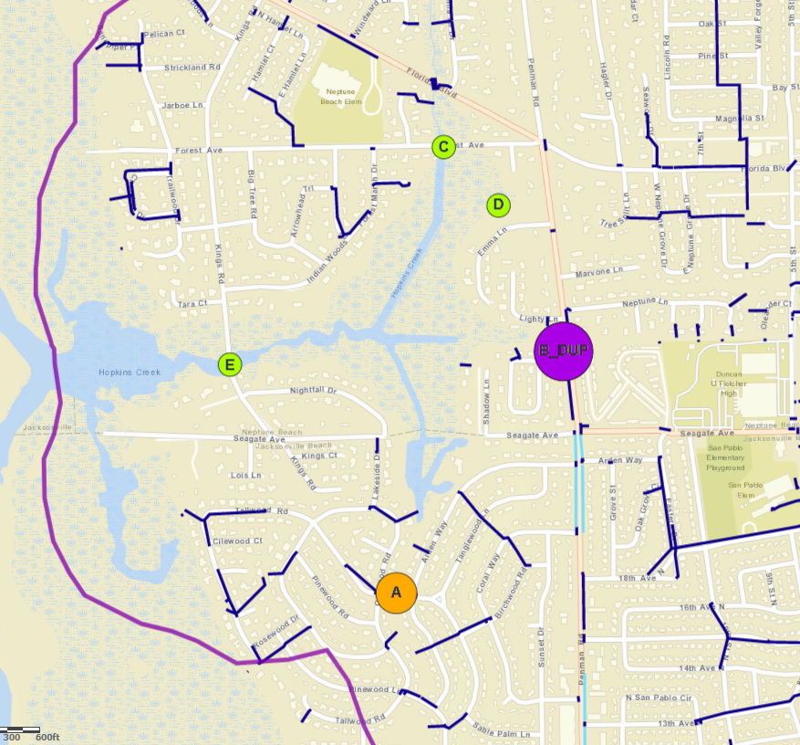


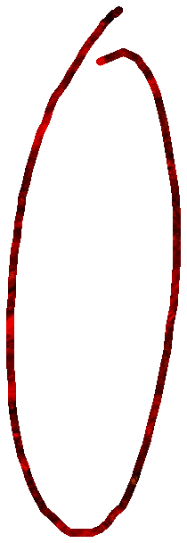
Hopkins
Round 1
Sampling Event 1
Event | Round | Date
1 | 1 | 3/9/2017
2 | 2-B and 2-A | 3/23/2017
3 | Post Elimination | 4/10/2017
4 | 3-B9 | 4/18/2017
5 | 3-B5 | 4/19/2017
6 | 4-B9C | 6/20/2017
7 | 5 - Persistence Check Sampling Event | 8/28/2017

Slide 34
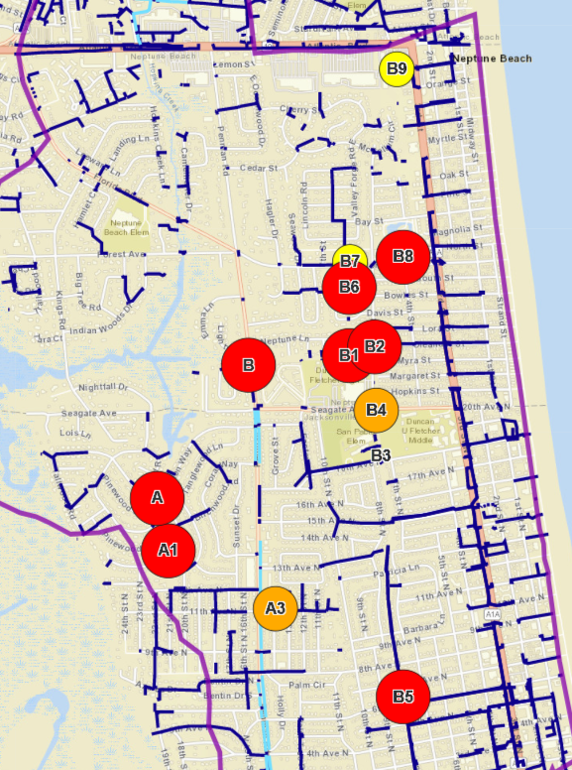

Hopkins
Round 2–A and 2-B
Sampling Event 2
Event | Round | Date
1 | 1 | 3/9/2017
2 | 2-B and 2-A | 3/23/2017
3 | Post Elimination | 4/10/2017
4 | 3-B9 | 4/18/2017
5 | 3-B5 | 4/19/2017
6 | 4-B9C | 6/20/2017
7 | 5 - Persistence Check Sampling Event | 8/28/2017

Slide 35
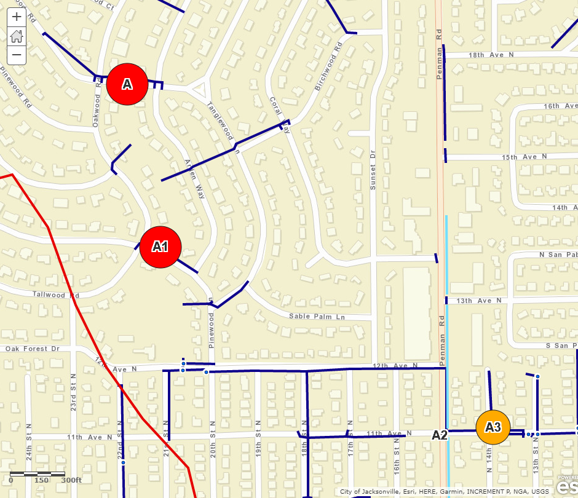

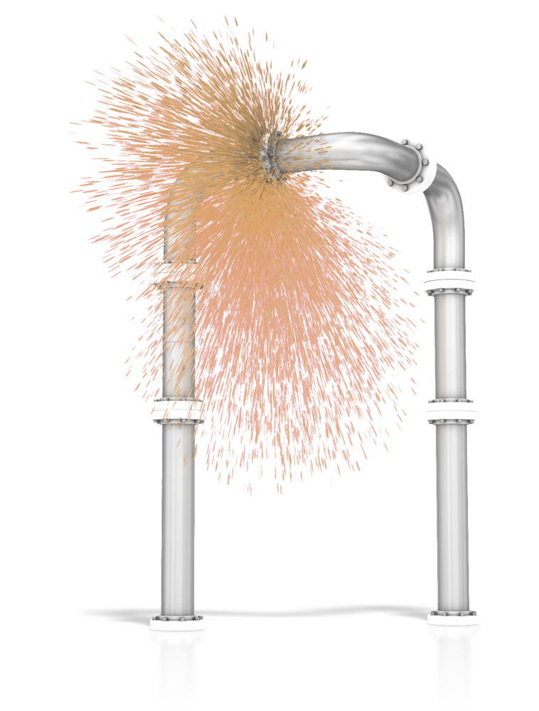



Hopkins
Round 2-A
Sampling Event 2
Source identified and eliminated.

Slide 36
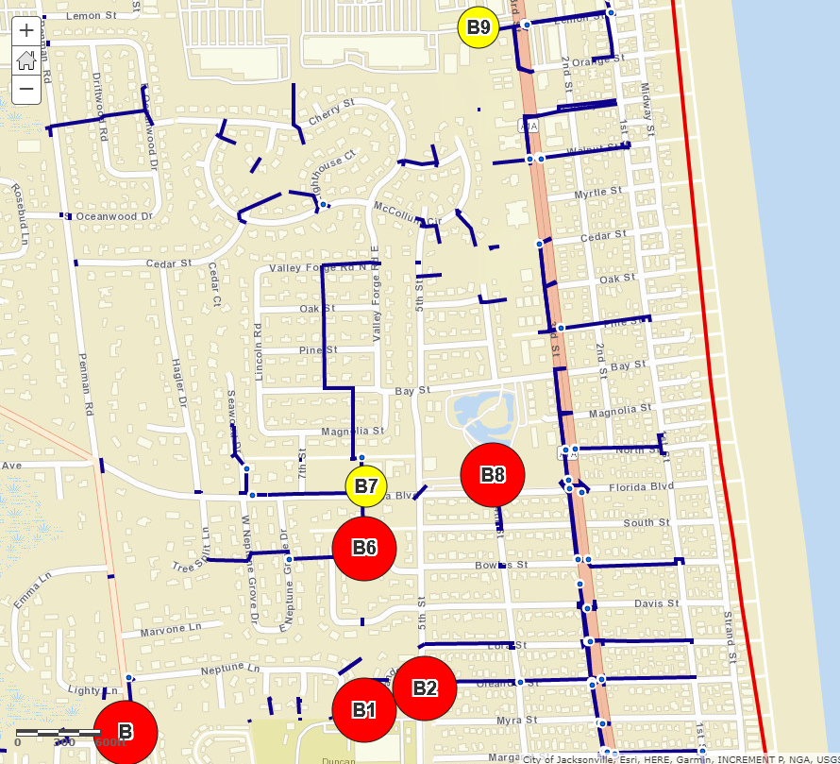


Hopkins
Sampling Event 2
(Closer look at Round 2-B)
Event | Round | Date
1 | 1 | 3/9/2017
2 | 2-B and 2-A | 3/23/2017
3 | Post Elimination | 4/10/2017
4 | 3-B9 | 4/18/2017
5 | 3-B5 | 4/19/2017
6 | 4-B9C | 6/20/2017
7 | 5 - Persistence Check Sampling Event | 8/28/2017

Slide 37
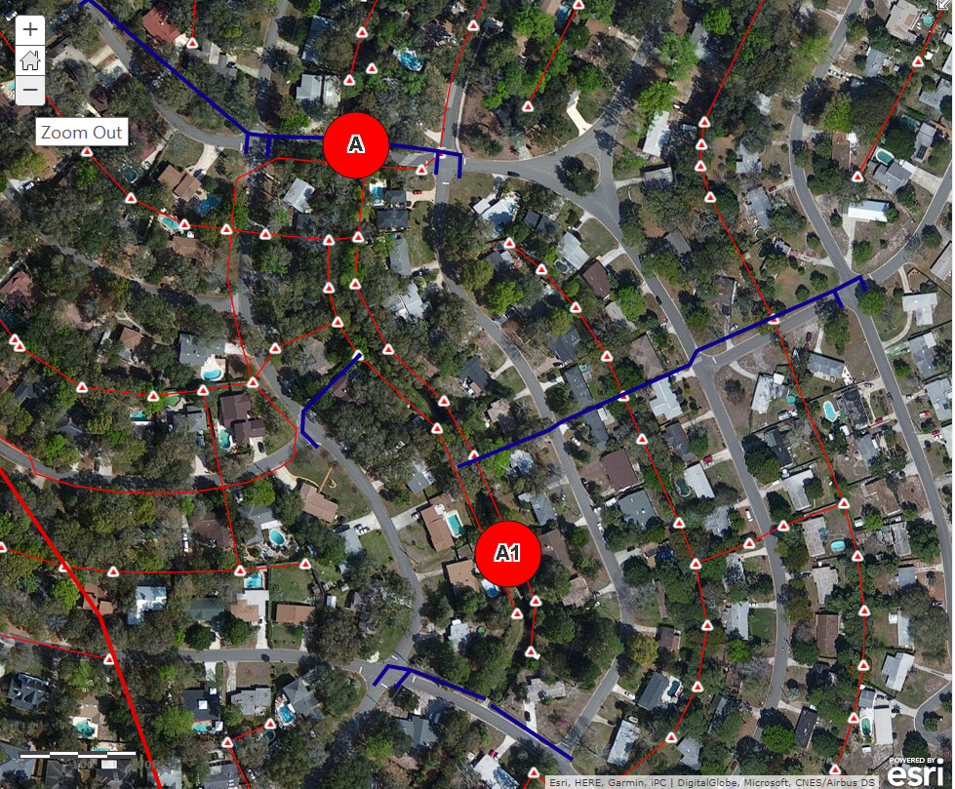


Hopkins
Sampling Event 3
Sampled too soon after removal of source. Need to let the system flush with rain to remove remnants.
Later in 2017, the city’s sanitary sewer utility replaced or lined all the sewer pipes in this region.
Event | Round | Date
1 | 1 | 3/9/2017
2 | 2-B and 2-A | 3/23/2017
3 | Post Elimination | 4/10/2017
4 | 3-B9 | 4/18/2017
5 | 3-B5 | 4/19/2017
6 | 4-B9C | 6/20/2017
7 | 5 - Persistence Check Sampling Event | 8/28/2017

Slide 38
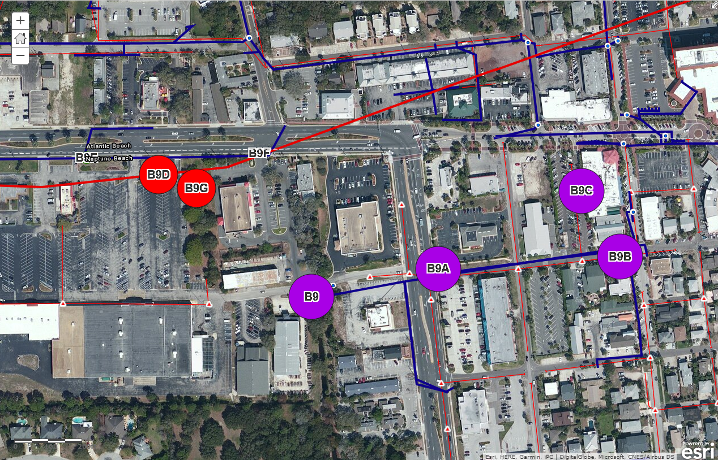


Hopkins Sample Event 4
Event | Round | Date
1 | 1 | 3/9/2017
2 | 2-B and 2-A | 3/23/2017
3 | Post Elimination | 4/10/2017
4 | 3-B9 | 4/18/2017
5 | 3-B5 | 4/19/2017
6 | 4-B9C | 6/20/2017
7 | 5 - Persistence Check Sampling Event | 8/28/2017

Slide 39
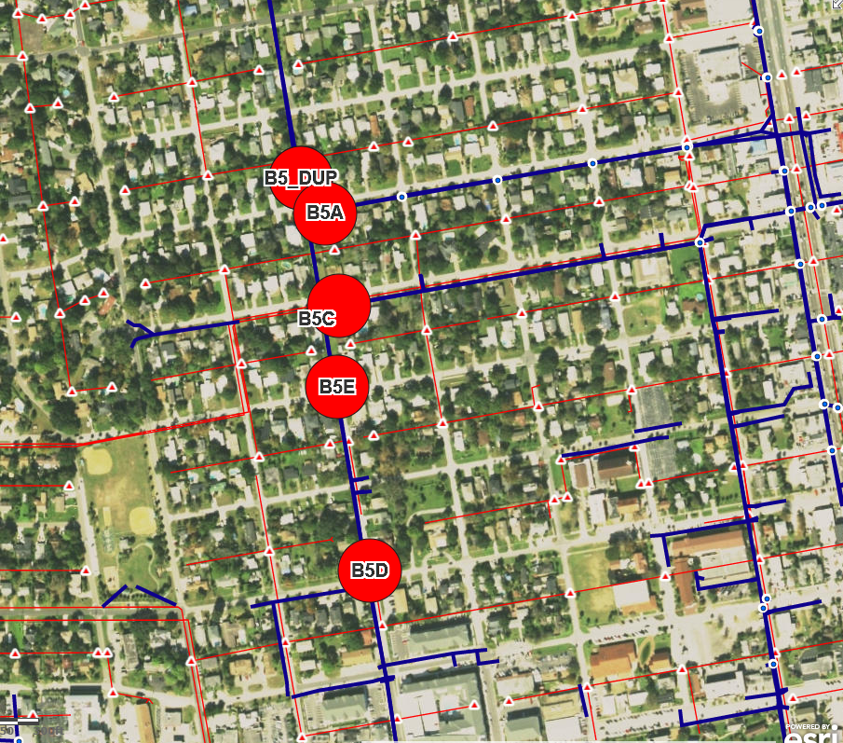




Hopkins
Sample Event 5
Tidal multi directional flow along the main ditch.
Sucralose is the only indicator of sewage during this event, could be remnants of the source to the north deposited by the tides.
Event | Round | Date
1 | 1 | 3/9/2017
2 | 2-B and 2-A | 3/23/201
3 | Post Elimination | 4/10/2017
4 | 3-B9 | 4/18/2017
5 | 3-B5 | 4/19/2017
6 | 4-B9C | 6/20/2017
7 | 5 - Persistence Check Sampling Event | 8/28/2017

Slide 40
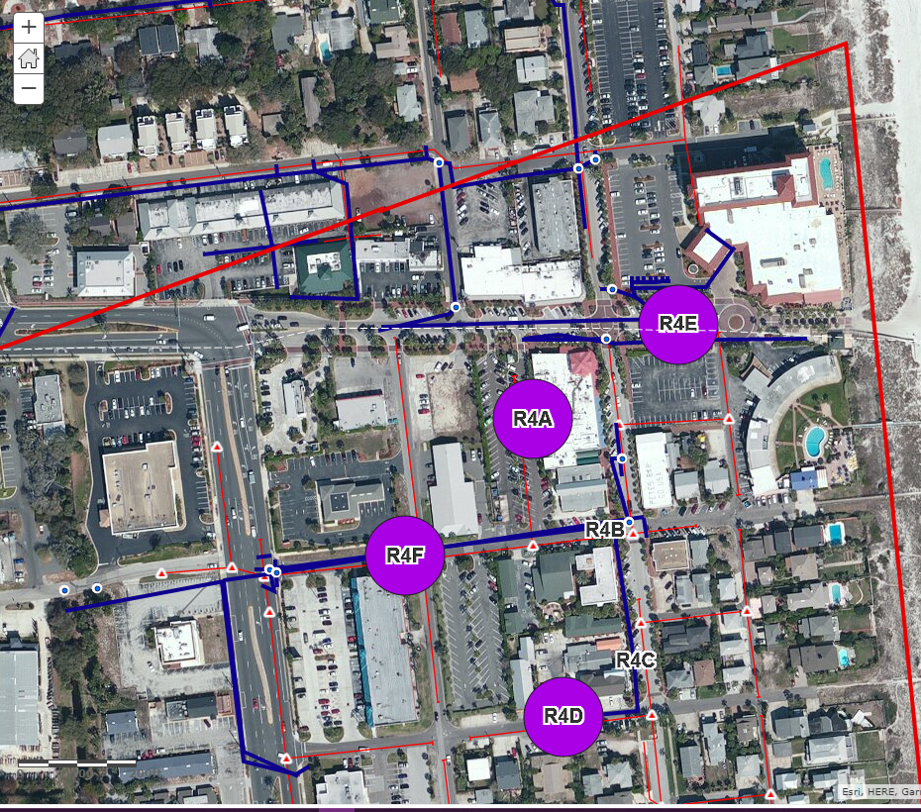


Hopkins
Sampling Event 6
Event | Round | Date
1 | 1 | 3/9/2017
2 | 2-B and 2-A | 3/23/2017
3 | Post Elimination | 4/10/2017
4 | 3-B9 | 4/18/2017
5 | 3-B5 | 4/19/2017
6 | 4-B9C | 6/20/2017
7 | 5 - Persistence Check Sampling Event | 8/28/2017

Slide 41
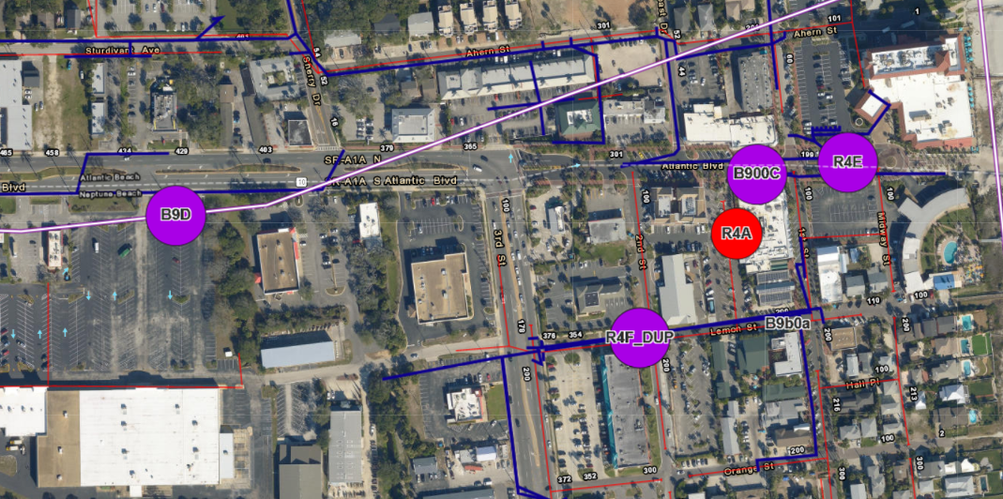




Hopkins Sample Event 7
Last sampling event for the
Pilot Study 2017
Event | Round | Date
1 | 1 | 3/9/2017
2 | 2-B and 2-A | 3/23/2017
3 | Post Elimination | 4/10/2017
4 | 3-B9 | 4/18/2017
5 | 3-B5 | 4/19/2017
6 | 4-B9C | 6/20/2017
7 | 5 - Persistence Check Sampling Event | 8/28/2017

Slide 42
Wagner Creek

Slide 43
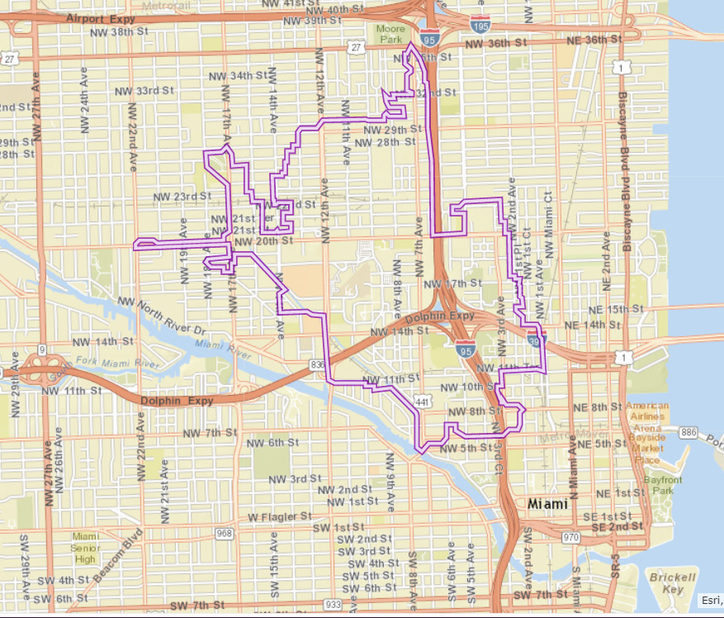
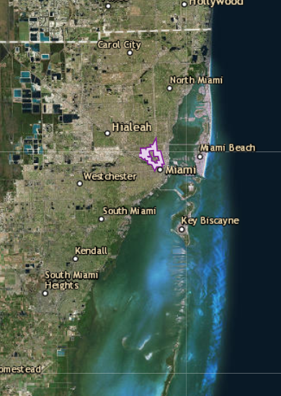
Wagner Creek
Event | Round | Date Sampled
1 | 1 | 3/23/2017
2 | 2-D | 4/10/2017
3 | 2-B | 6/20/2017
4 | 2-B check and 3-B | 8/30/2017

Slide 44

Wagner Creek
Sampling event 1 - 3/23/2017
Indication of untreated sewage in Wagner Creek

Slide 45

Wagner Creek
Sampling event 2 –4/10/2017
Attempt to trace the most upstream hits, round 2–D.
No sample here, access denied because of road construction safety issues
No sample here, access denied because of road construction safety issues

Slide 46


Wagner Creek
Sampling event 3 –4/10/2017
These navy blue lines represent underground stormwater conveyances.
2 underground storm conveyances which contribute downstream of site B.

Slide 47

Wagner Creek
Sampling event 3 –4/10/2017
B- in creek,
B1- storm manhole,
B4- storm manhole,
B3- no stormwater in manhole.

Slide 48

Wagner Creek
Sampling event 3 –4/10/2017
B- id creek,
B1- storm manhole,
B4- storm manhole,
B3- no stormwater in manhole.

Slide 49

Wagner Creek
Sampling event 3 –4/10/2017
B5- storm manhole

Slide 50

Wagner Creek
Sampling event 3 –4/10/2017
B6 & B7 near outfall in creek.
C and Duplicate in creek at bridge

Slide 51


Wagner Creek
Sampling event 4 – 8/30/2017
B in creek.
B4 in storm manhole.
B0A in creek near outfall.

Slide 52

Wagner Creek
Sampling event 4 – 8/30/2017
B0B & B0C in creek near bridges.
B5 in storm manhole.
B0E at outfall.

Slide 53



Wagner Creek
Sampling event 4 – 8/30/2017
Dry
B6, Duplicate, & B7 outfalls.
C in creek at bridge.
B7A &B6A in storm manholes.
Dry
Dry
Dry

Slide 54



Source ID Pilot Study 2017
Progress Summary
1 source eliminated after 2nd sampling event.
7 more hot spots identified.
Followed 2 trails upstream to the
farthest extent of
city owned conveyances.
7 sampling events.
Signal traced into 6 potentially separate hot spots.
6
All 4 sites hot on first sampling event. Site B was hottest.
Flow stopped; hits in remaining pools at road crossings. 2 hot spots identified.
Hopkins
Followed 1 source trail for 4 rounds of monitoring.
Wagner
2
Jackson
Miller
2 hot tributaries identified during first round of monitoring.
Delays related to retirement of city staff and incomplete GIS inventory of stormwater conveyances incomplete.
4 hot spots identified.
Spartman Branch
Butcher Pen
All low hits on rounds 1 and 2. Creek dried up; delayed progress.
4
Sampled after rain returned,
identified 2 hot spots serviced by OSTDS.
1 source identified & eliminated
No Hits during Round 1.
2
21 hots pots remain

Slide 55
Pilot 2017 Summary Stats

Slide 56
Appendix A: Lab Data

Slide 57
Confidence of Presence of Raw Sewage in a Sample (per analyte)
Version 2017

Slide 58
Scoring results

Slide 59
Butcher Pen Lab Results
Pilot 2017

Slide 60
Wagner Creek Lab Results
Pilot 2017
* Wagner was sampled during rising tide on 6-20-17. This confounds interpretation of the results.

Slide 61
Miller Creek Lab Results
Pilot 2017

Slide 62
Hopkins Creek Lab Results
Pilot 2017

Slide 63
Spartman Branch Lab Results
Pilot 2017

Slide 64
Jackson Creek Lab Results
Pilot 2017

Slide 65
End.

Slide 66
Symbol Sizes
Next
VERY HIGH
Break Point: 80 (80 pt) (4th purple) (black)
HIGH
39 (68 pt) (3rd red) (black)
MEDIUM
20 (56pt) (3rd light orange) (black)
LOW
5 (44 pt) (2nd Yellow)(black)
VERY LOW
1 (32pt) (3rd yellow-green)(black)
NO indication of raw sewage
(20 pt) (3rd green) (dark green 2px)

