Slide 1
Observational Identification of Sources of Bacteria to Stormwater
July 2016
Anita Nash
Division of Environmental Assessment and Restoration

Slide 2
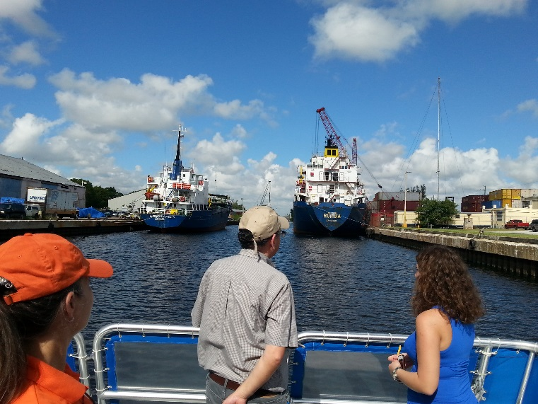
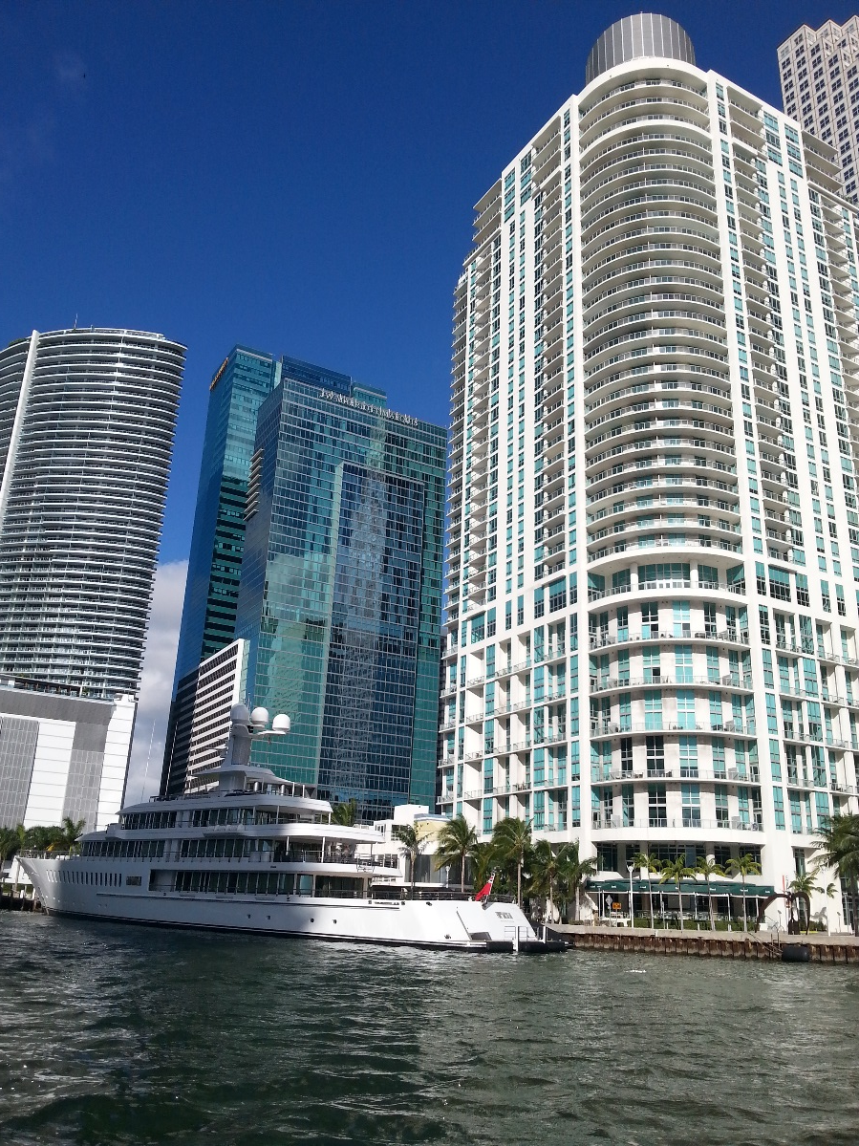
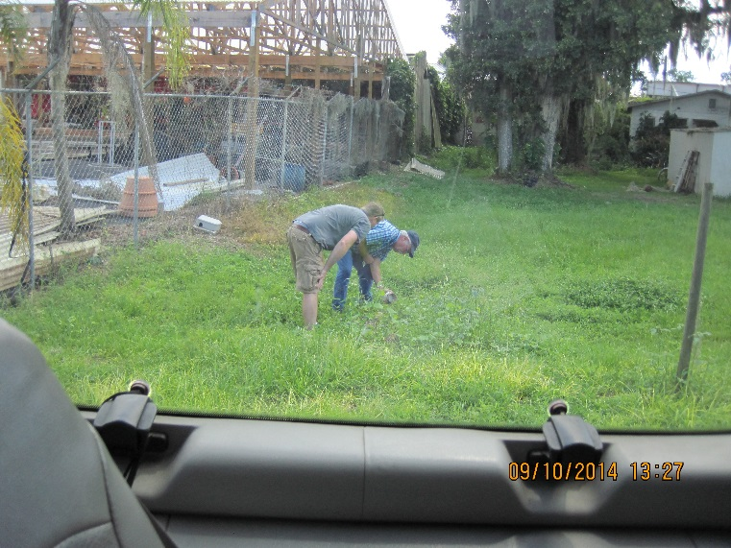
City, Industrial, Rural
Notes:
Fecal indicator bacteria impairments occur in every landuse in Florida.
So, finding the sources usually requires multiple tools and techniques.
Most importantly, the more people engaged daily with source id and elimination, the more restoration we see. We need your help! So, I’ll take you through a slide show and discuss what is a concern and why, and how you can help! Keep in mind, fecal indicator bacteria, ecoli, enterococci, and fecal coliform are just that. They indicate increased probability of pathogens in our waterways. Most waters in FL are classified for human uses such as swimming, fishing, and drinking. If pathogens are in the water, we may see people getting sick so its important we all pitch in and be part of the solution!
As I go through these, I want you to take note and consider what you can do when you see these issues problems and concerns.
So, lets start simple.

Slide 3
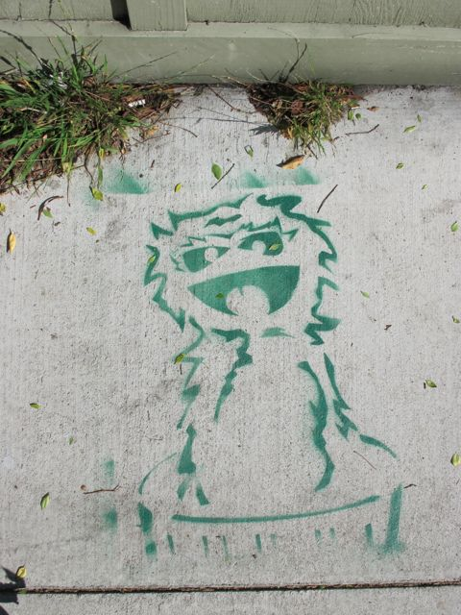
Segment 1: Trash
Notes:
Photo from https://www.stencilarchive.org/

Slide 4
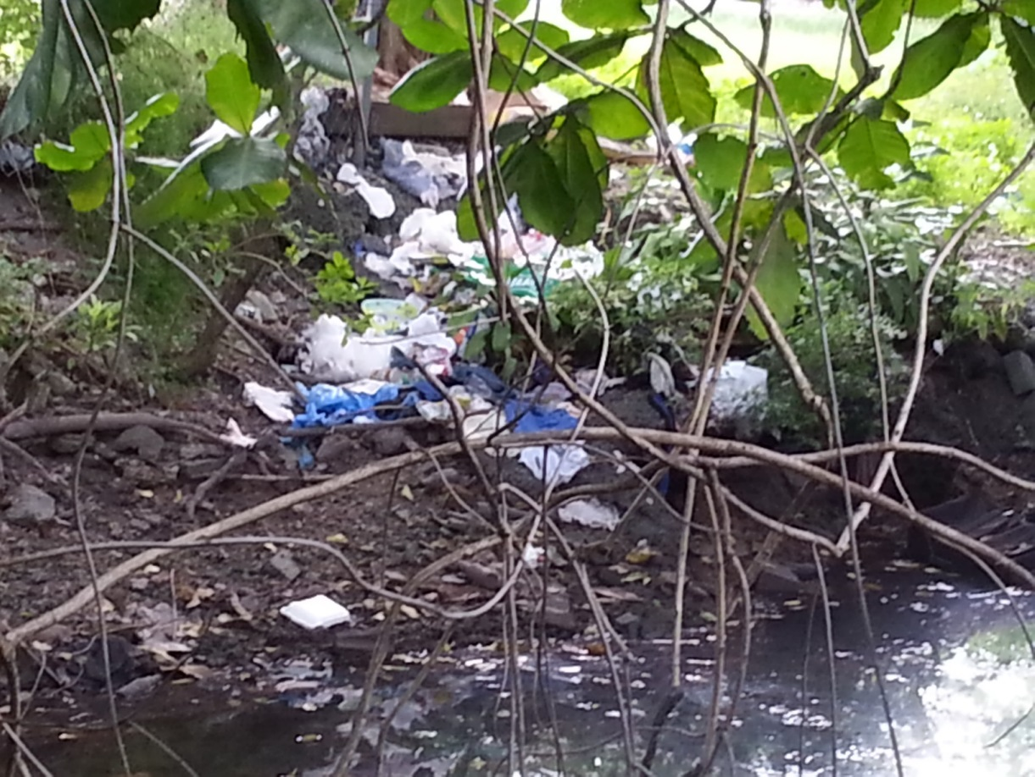
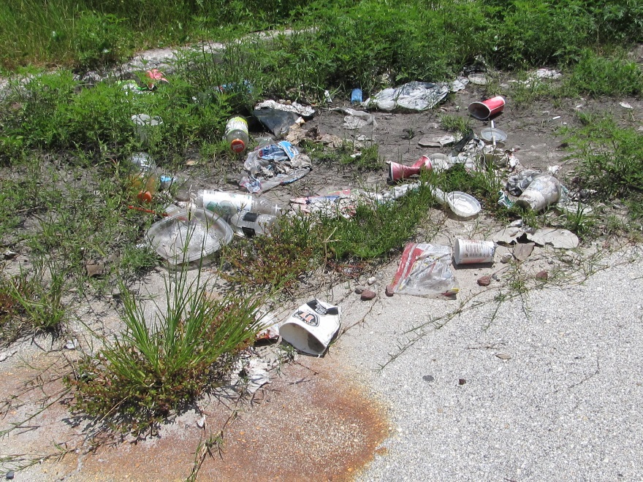
Trash!
Notes:
Pathogens in trash? Maybe, maybe not.
I get concerned about most trash.
Rubber gloves- used when dealing with things that are dangerous on our skin.
Drink bottles- how likely are these to contain pathogens? Wide range of potential.
Diapers!!! Enough said!

Slide 5
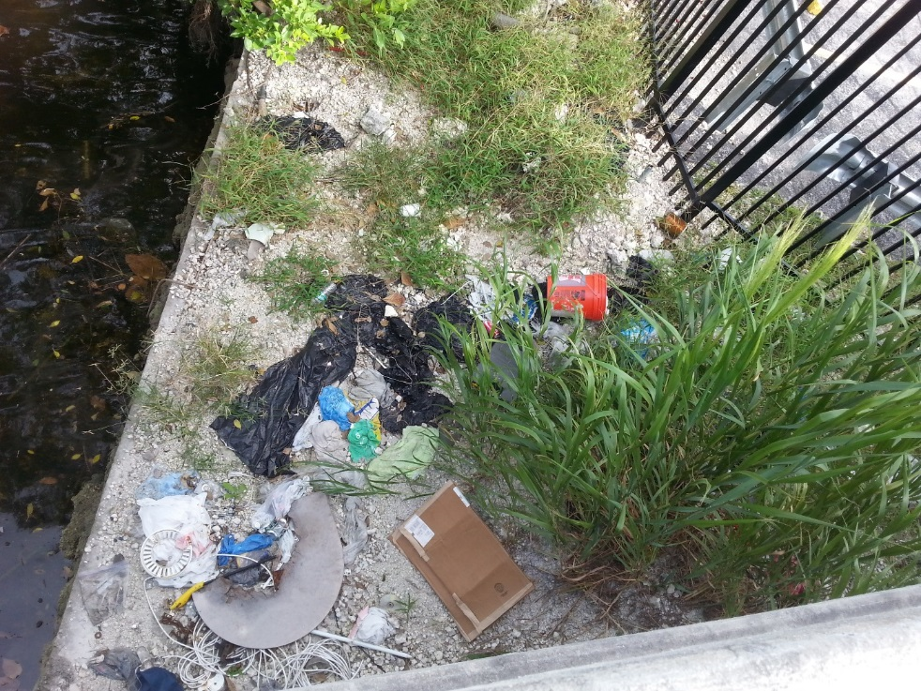
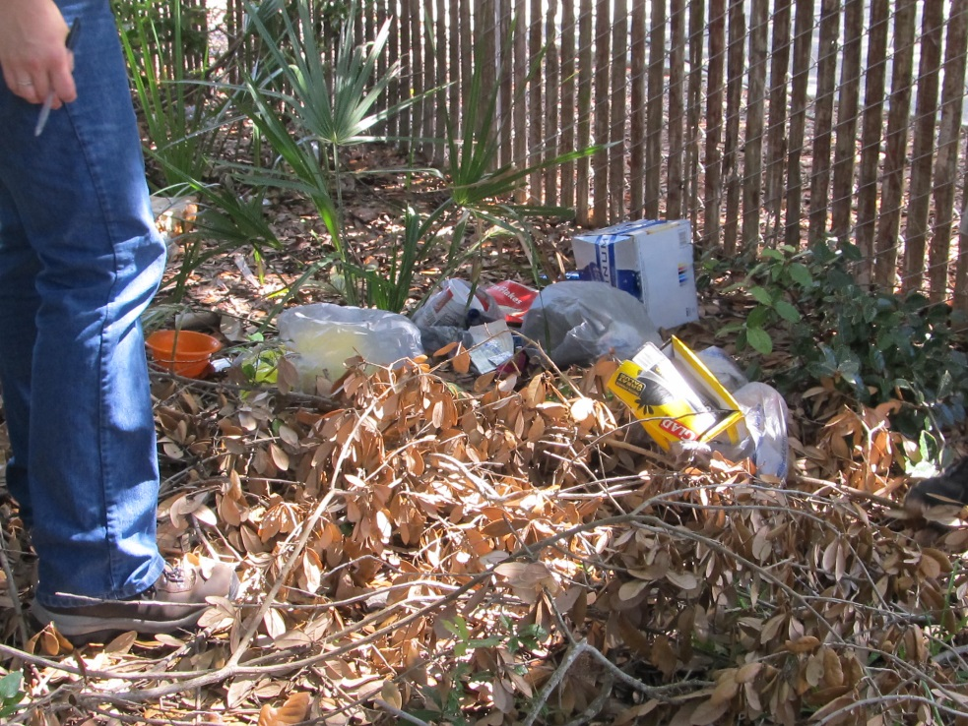
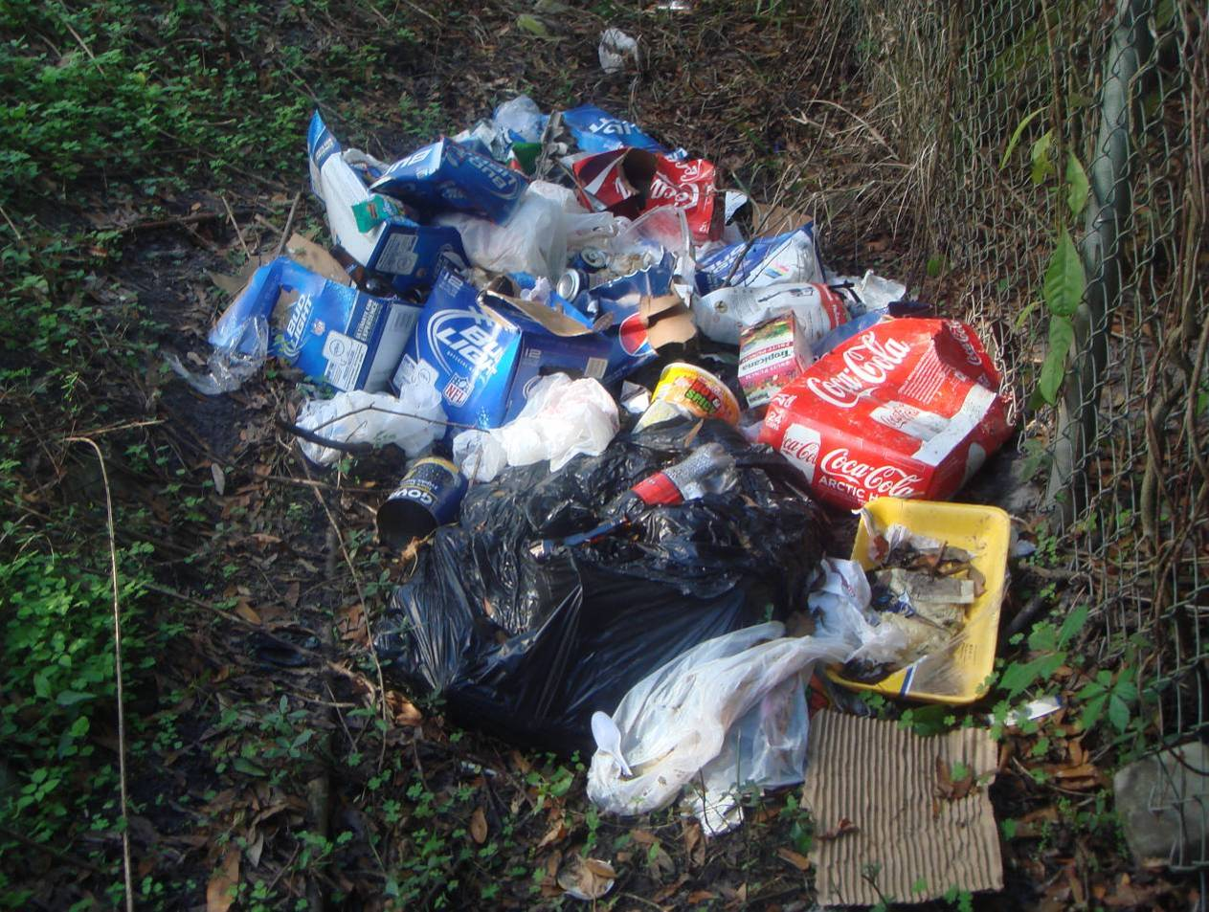
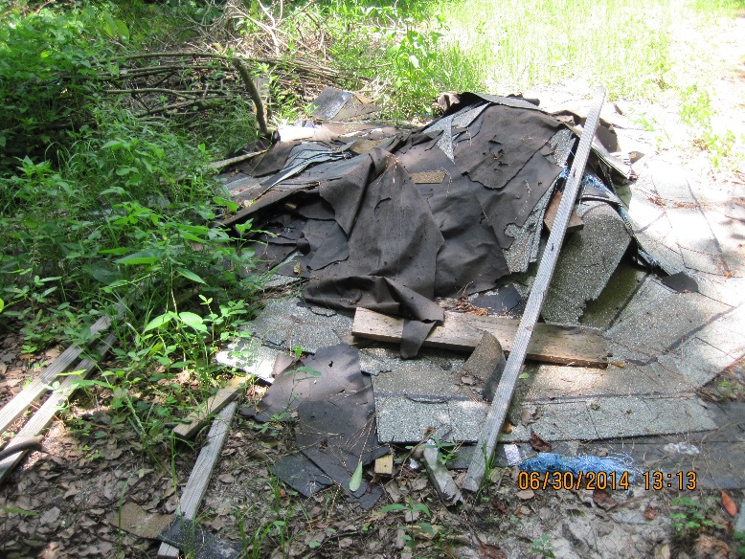
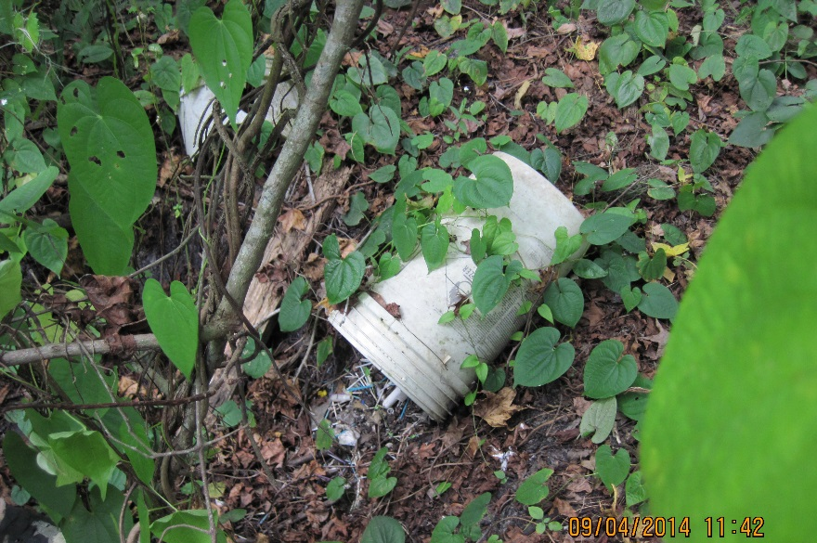
Dumping Sites
Notes:
Get’em cleaned up.
Often found beside fences, in low lying areas, and out-of-sight areas.

Slide 6
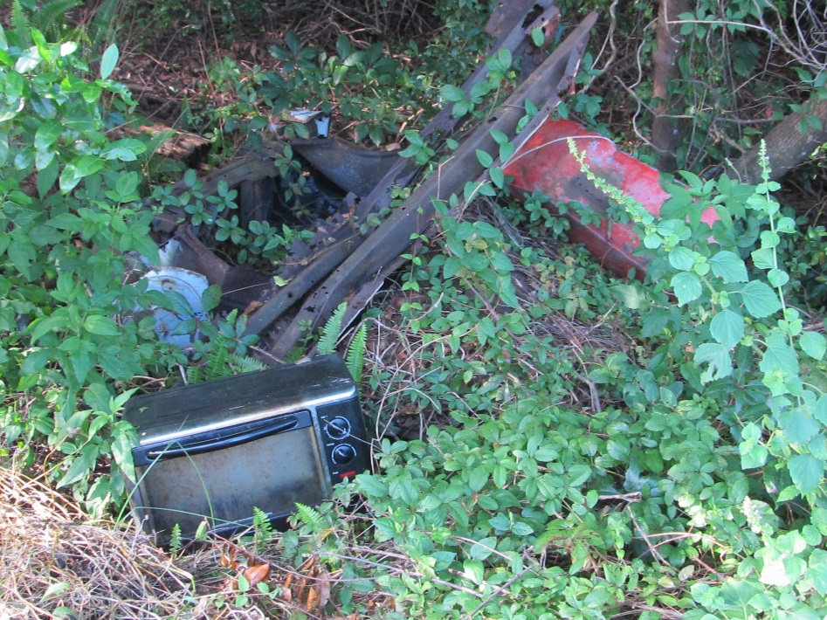
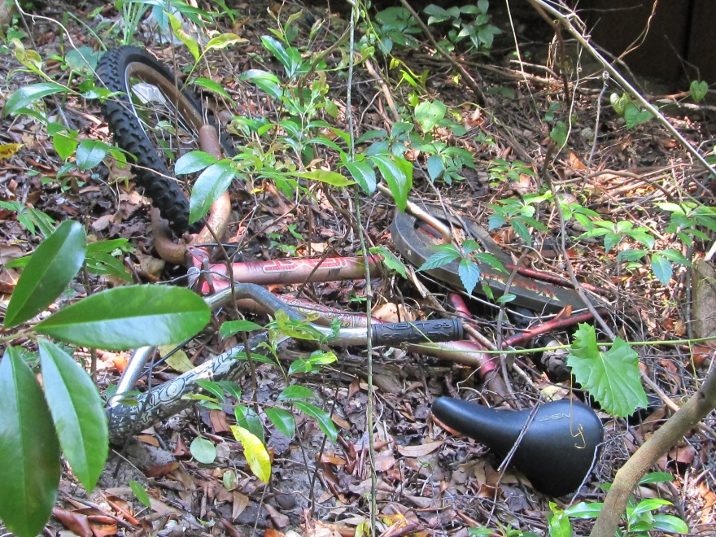
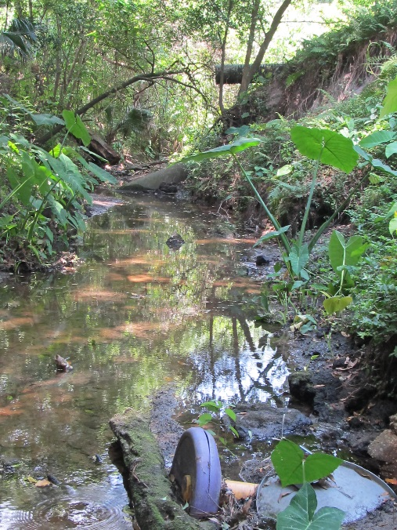
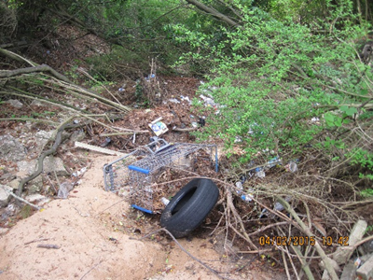
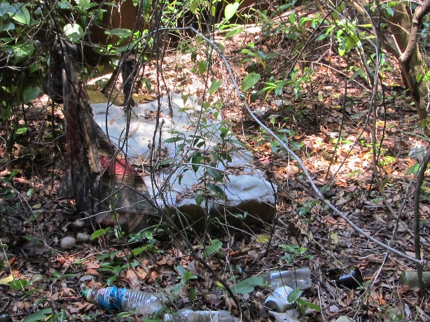
Bulk trash

Slide 7
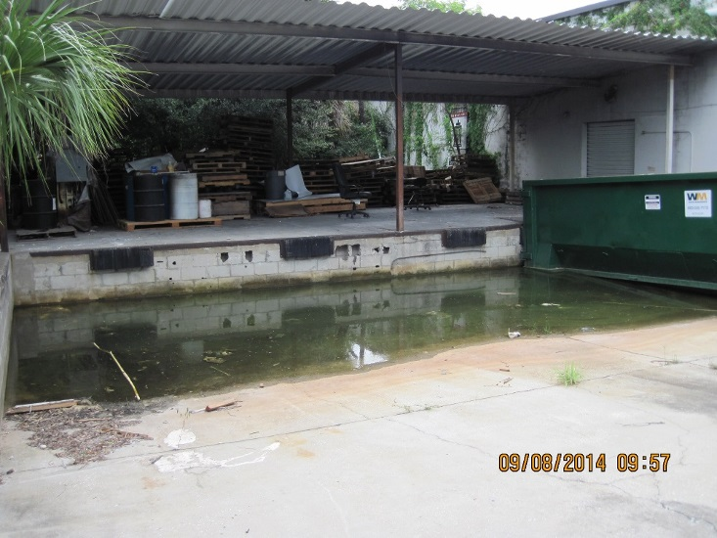
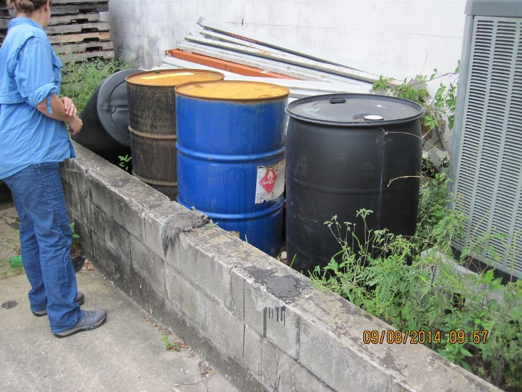
Closed for business
Notes:
Pooling water in the bottom of delivery docks indicate the stormgrate is blocked.
To the right of the dock we noticed these drums. The labels indicated poisonous substances inside and two of them were rusting.
A young possum was lying next to the drum, dead. Yikes!

Slide 8
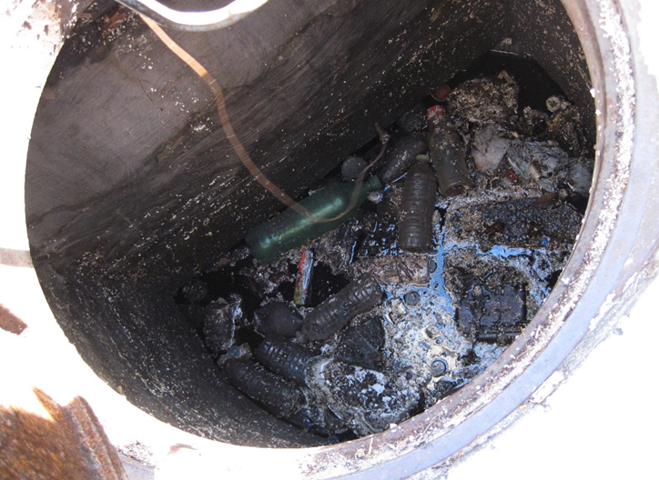
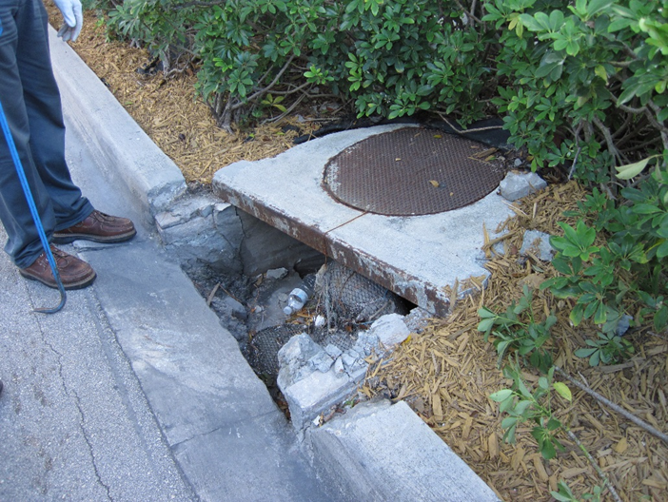
Trash in storm drains
Notes:
Symptoms of a problem below

Slide 9
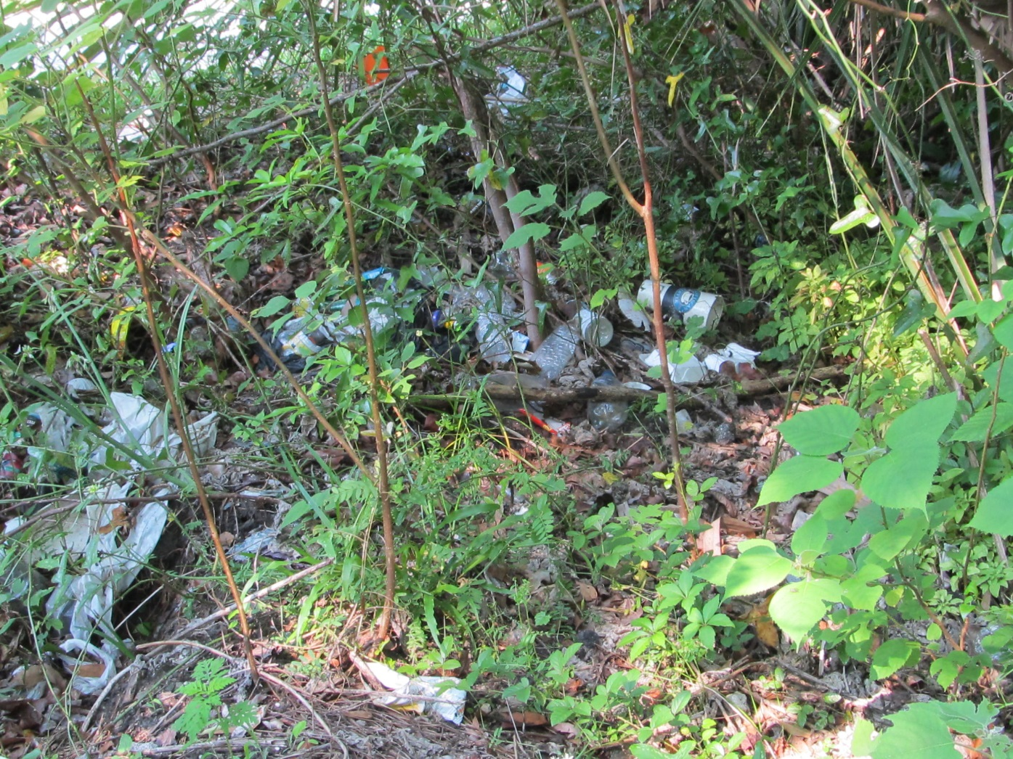
Societal Expectations
Notes:
Ever notice that a ditch or stream near a heavily traveled walking path often contains the same kind of litter? Habitual littering. Why it's so tempting to throw trash on the ground?
It’s societal expectations that lead the majority of people to litter or not litter.
Someone sees an environment that is highly littered, they are more likely to litter.
If there is not litter or just one piece of litter, they are significantly less likely to litter.
If they see someone disapproving of litter, they are least likely to litter.
“One study took place in a library parking lot. People left the library, and there was a piece of paper on their windshield. The thing that most affected people was when they saw someone nearby reaching down and picking up a piece of litter with a disapproving look. When they got to their own cars, not one person littered. If they didn’t see anyone picking up litter, 33 percent littered. We went from a third of the subjects littering to zero, when they saw an example of someone like them who picked up litter and showed disapproval” Robert Cialdini (cho’wl-deeny), emeritus professor of psychology and marketing at Arizona State University and author of Influence: The Psychology of Persuasion.
http://www.theatlantic.com/health/archive/2014/08/littering-and-following-the-crowd/374913/

Slide 10

Segment 2: Ask why

Slide 11
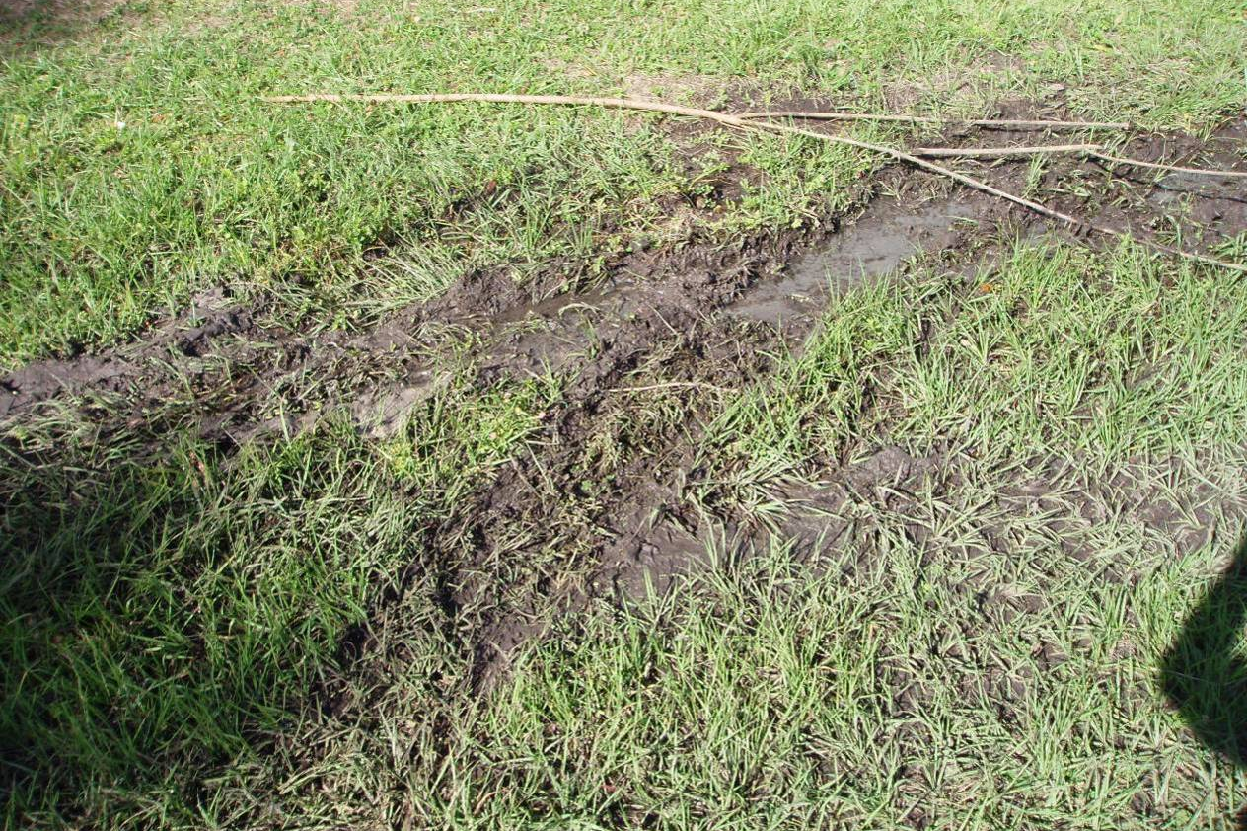
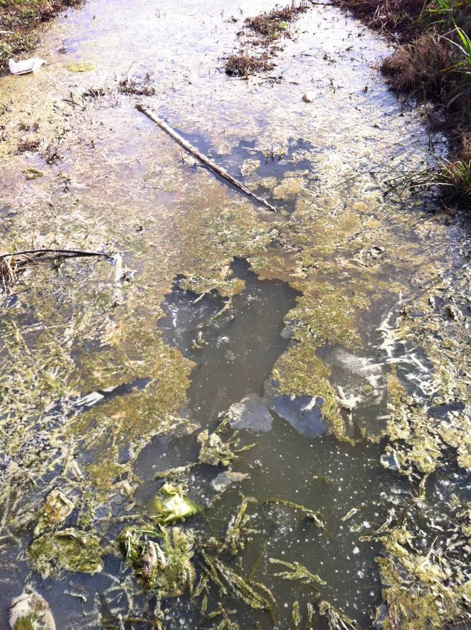
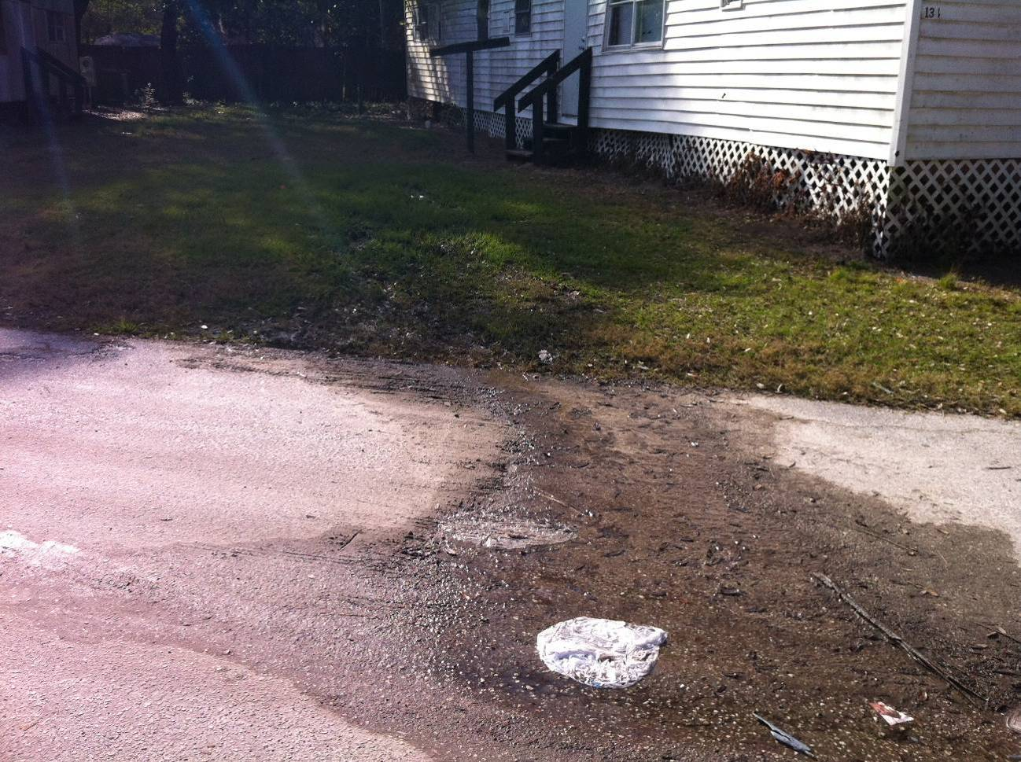
It all tells a story
Notes:
Why is this muddy and wet? Nothing else here is wet.
Pictures on the left were from the initial visit at a trailer park next to the sampling station on the creek. The pic on the right was take a few weeks later of the ditch that connects the trailer park to the stream. It was confirmed the ditch was full of sewage. The park was in receivership, but people were moving into the abandoned trailers which had no utilities. So, they made their own sewage disposal system.

Slide 12
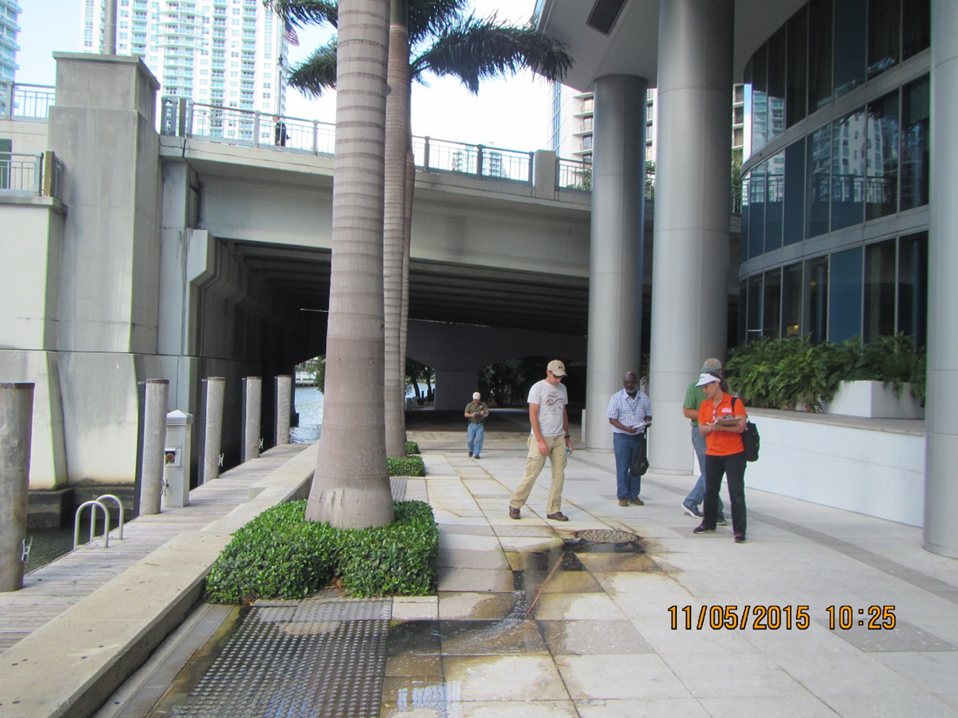
Trust your nose.
Notes:
The river is to the left about 4’ lower than the river-walk. The team was standing under the bridge in the background making notes when, someone smelled sewage and followed the smell to this area in front of a restaurant and hotel.
Within a matter of a few minutes, people in business suits, poodles following their rollerblading mammas, and tourists looking for a bite to eat were observed walking/rolling through this puddle.

Slide 13
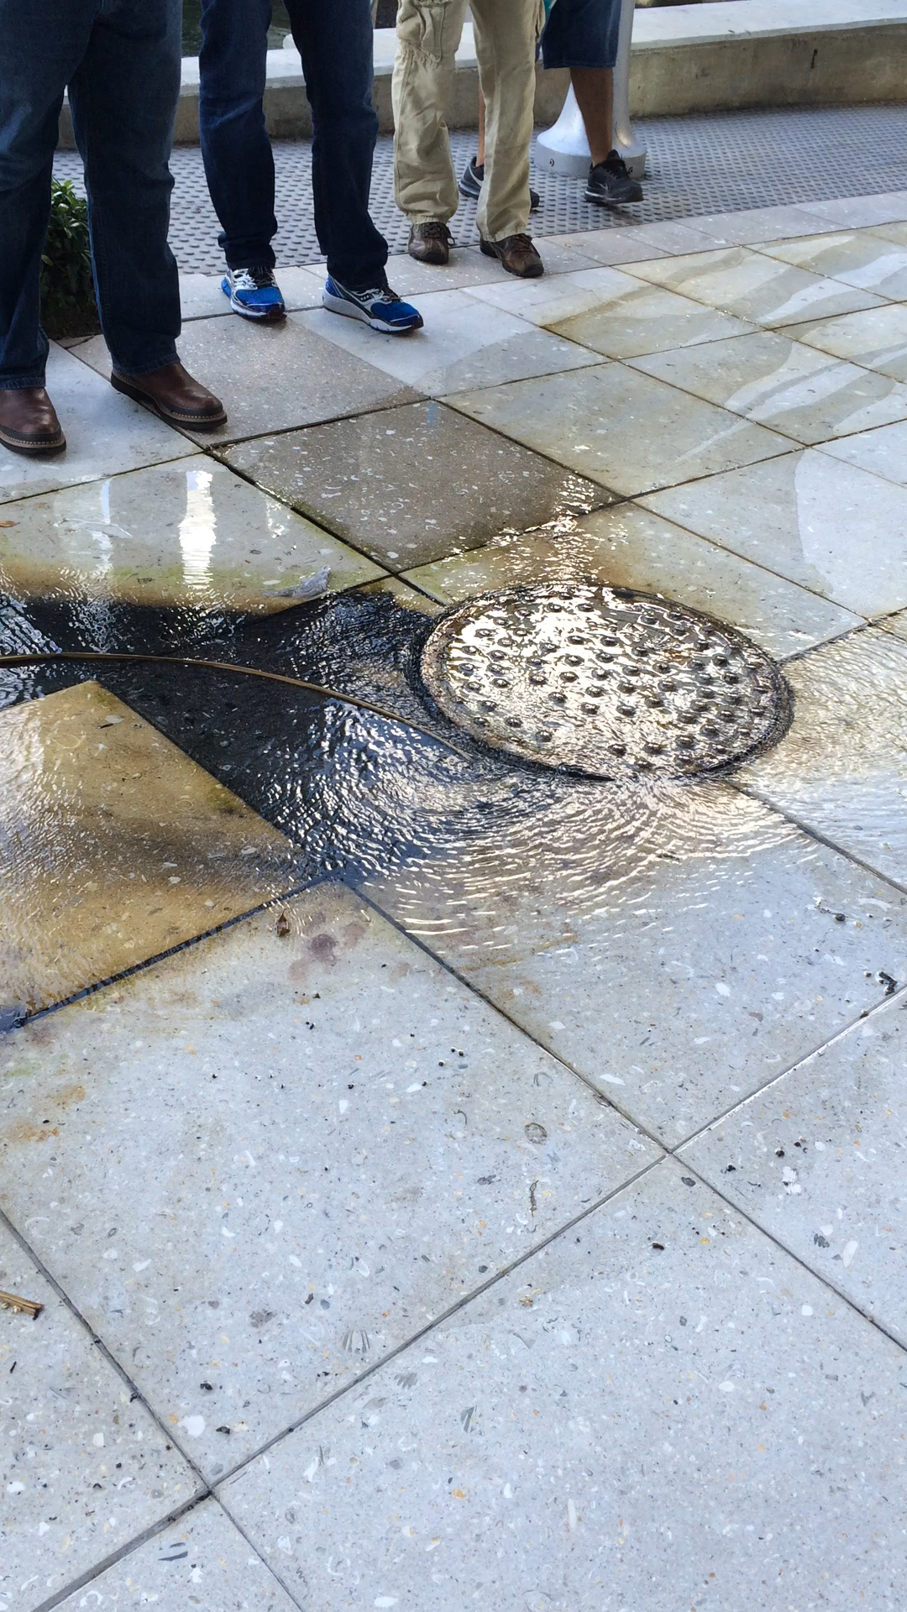
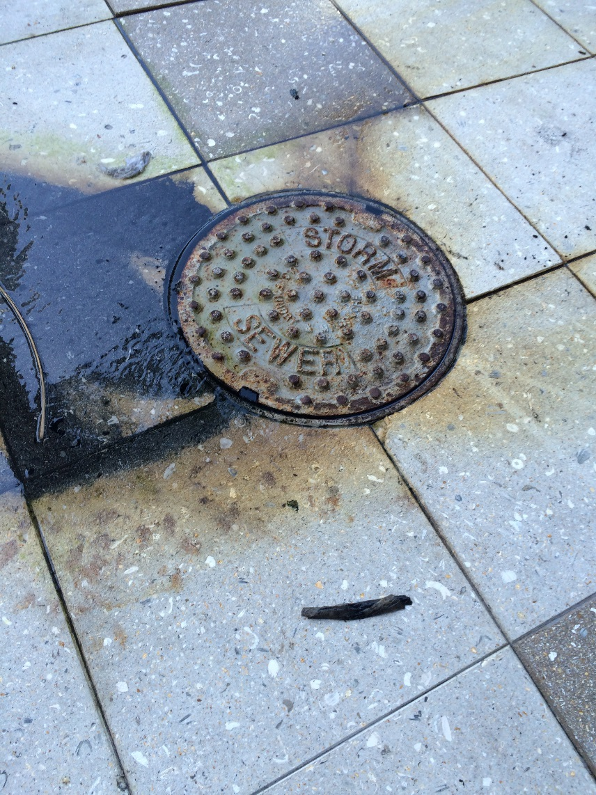
Question everything.
Notes:
It says storm water. So, we dismiss it as a suspect. The odor must be from something else.
For months, no one tied the odor to the obvious black stain on the pale sidewalk.
No one questioned why storm water had been bubbling up from the rim of the manhole. What is a manhole? According to Oxford Dictionaries, a manhole is “a small covered opening in a floor, pavement, or other surface to allow a person to enter.”
Remember, the river is at a lower elevation (4 feet lower) than this sidewalk, yet the water is coming out the manhole which is supposed to be an open cavity for a person to climb down into the conveyance system. Looks like something is blocked, backed up, or overloaded.
When the manhole cover was removed, more water gushed out. The odor of sewage overwhelmed the team and pieces of toilet tissue were observed.
The storm sewer which was designed to store and slowly release rain water back into the ground was full of a mixture of rainwater and raw sewage. We took a sample of the water and the FIB were a magnitude over the state criteria for ambient water quality. Inspections discovered 2 problems. A sewage pipe in the parking garage was broken and sewage was traveling across the parking deck to a storm drain connected to this system. And during construction, 2 toilets were connected directly to this system instead of the sanitary sewer system.
When you observe something, look for what is out of place. Question everything. Call the city or county when you notice a problem, but it’s not clear what the problem is.

Slide 14

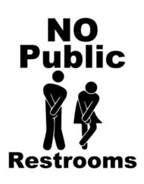
Segment 3: Complex Issue
Notes:
https://www.etsy.com/search?q=no+public+restrooms
http://www.lisahelpsvictoria.ca/city_of_victoria_housing_trust_fund_building_it_another_way
Whether or not there is a pubic restroom nearby, beware of coming into contact with human waste.

Slide 15
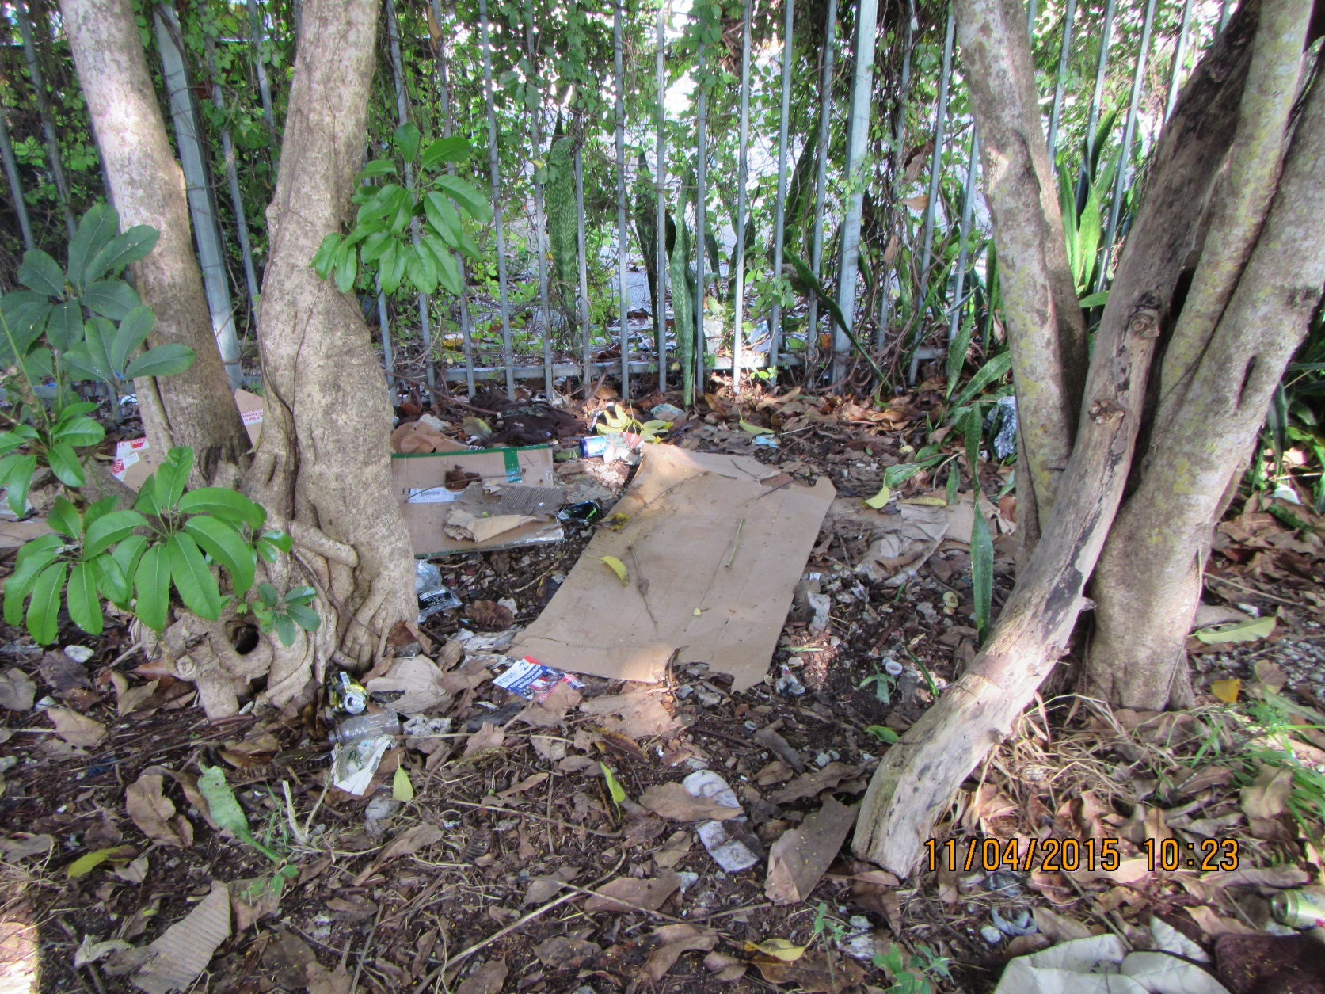
Danger!
Notes:
Homeless palates among landscaping = indication of great dangers in the vicinity.
Human waste is usually nearby. Various reasons: no restroom available, marking territory, destroying someone else’s property.
Depending on the situation, beware of needles too. Call DOH if needles, aka “sharps”, are observed.

Slide 16
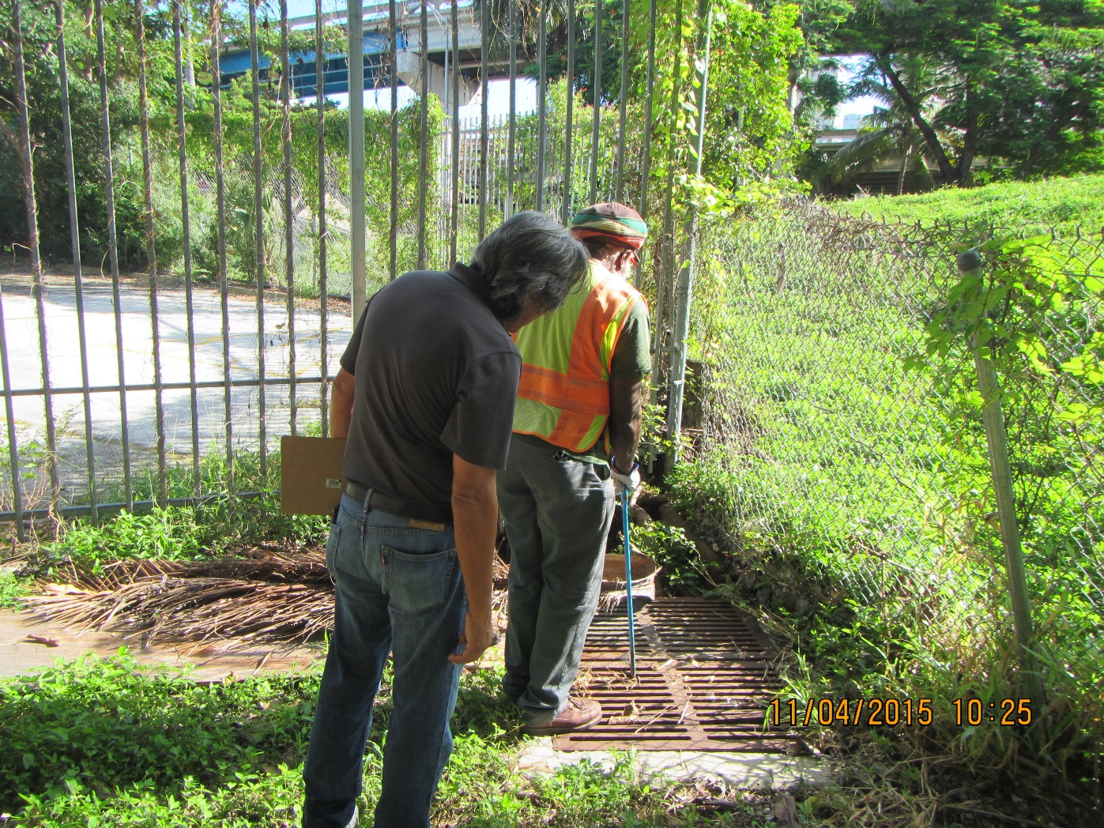
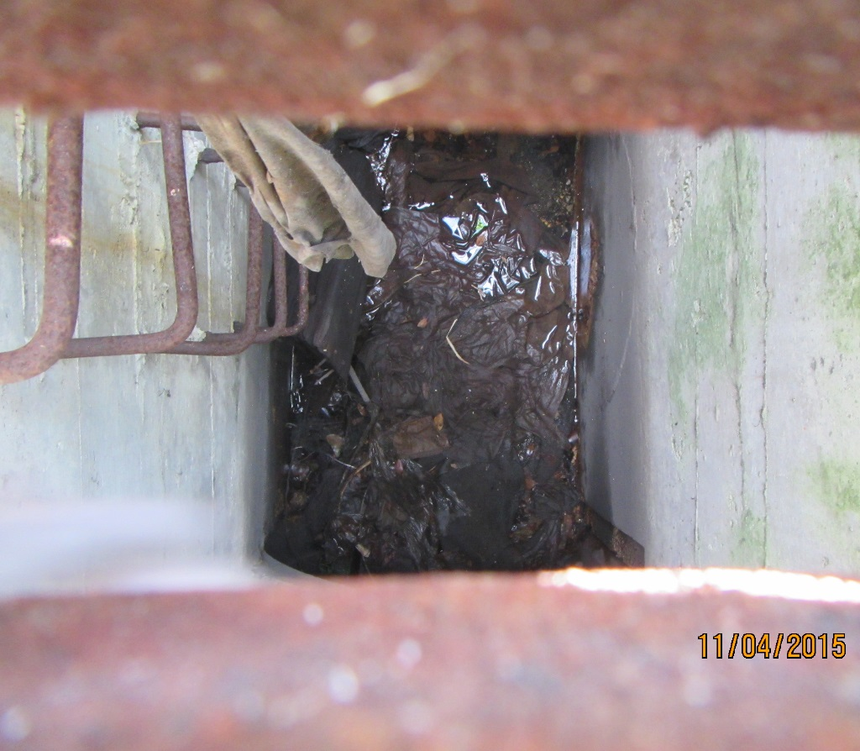
Where would you go?
Notes:
If I were on the streets, I’d probably try to use a storm grate like this one. It’s off the beaten path providing some privacy and the waste doesn’t accumulate where people walk. If you’re looking for a source of bacteria in storm water, consider where homeless people are often seen. Look inside secluded storm grates for waste paper/ toilet tissue/ napkins / paper towels / rags as seen here.

Slide 17
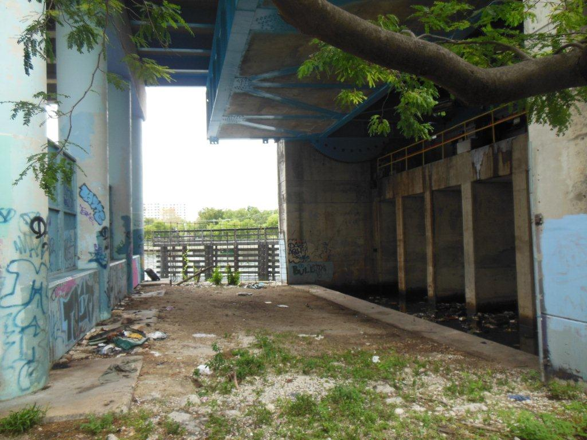
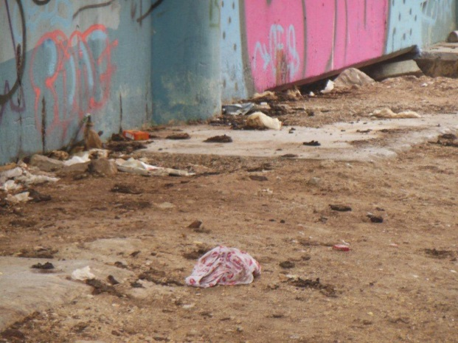
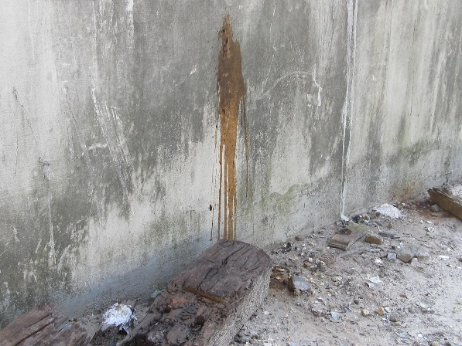
Or here?
Notes:
Secluded underpasses are also dangerous due to feces and sharps.

Slide 18
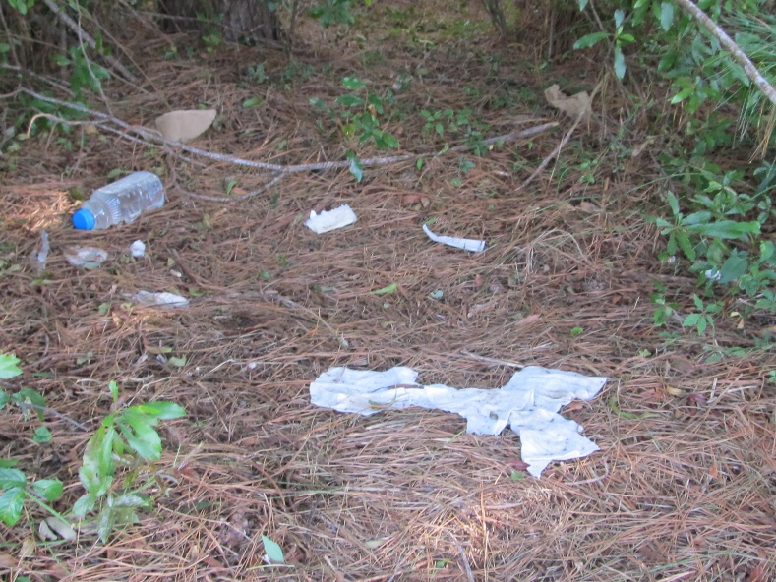
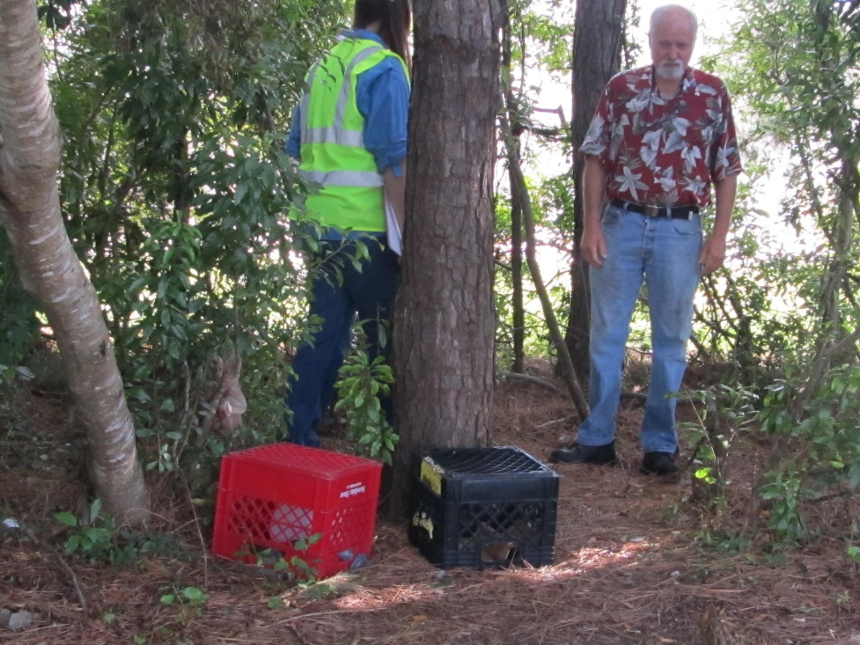
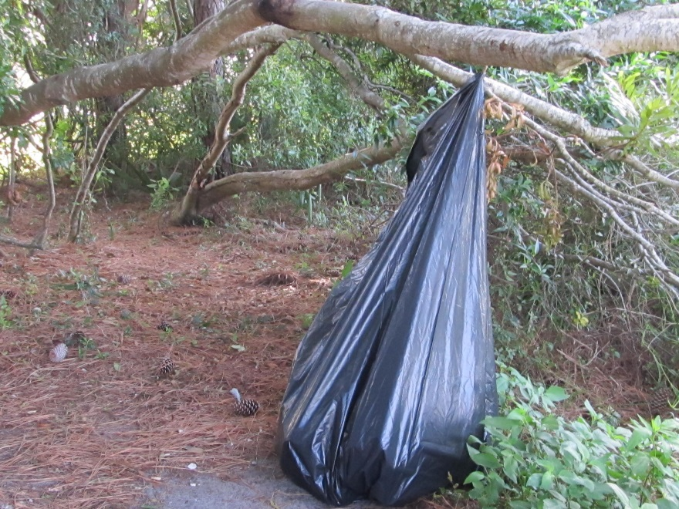
Or here.

Slide 19
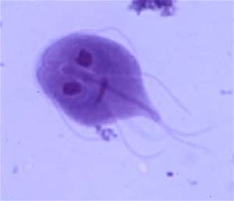
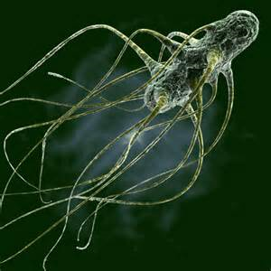
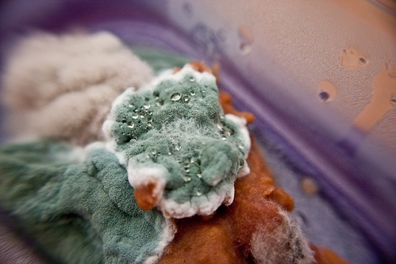
Segment 4: Food
Notes:
Bing images search for giardia, salmonella, and bacteria on bread

Slide 20
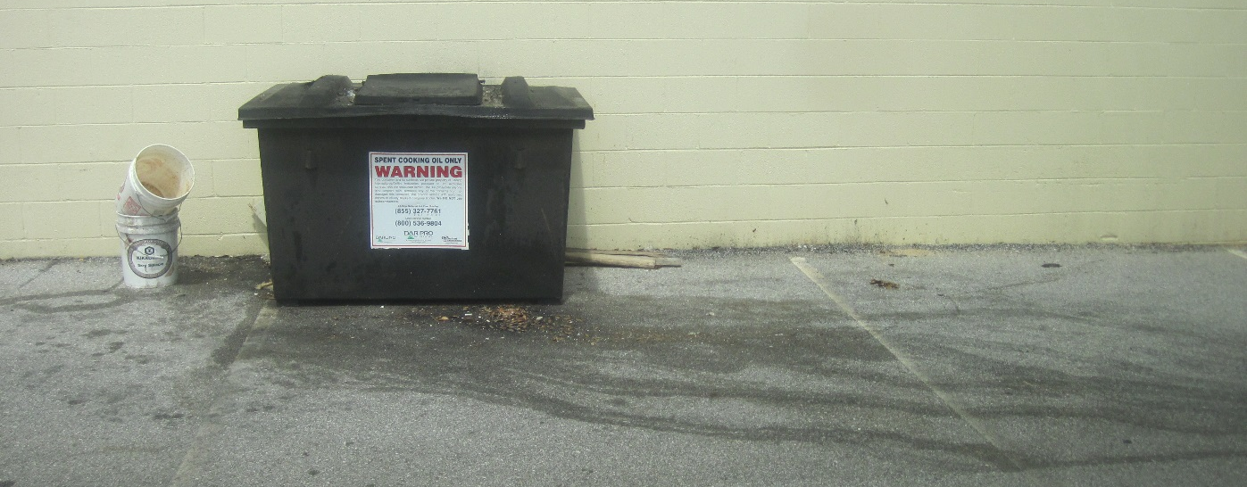
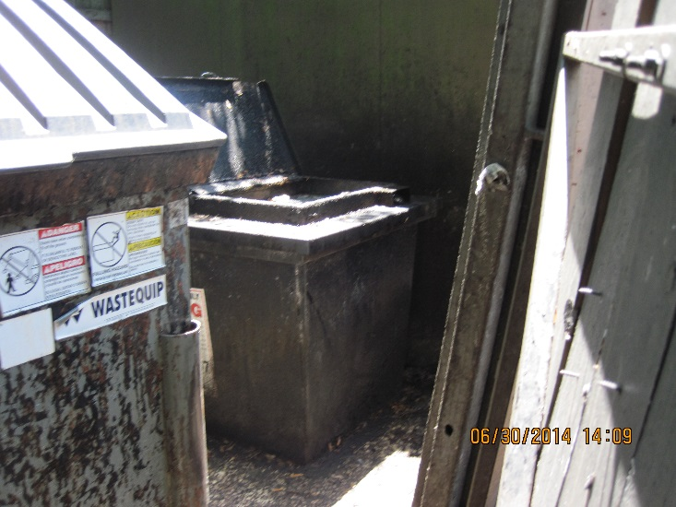
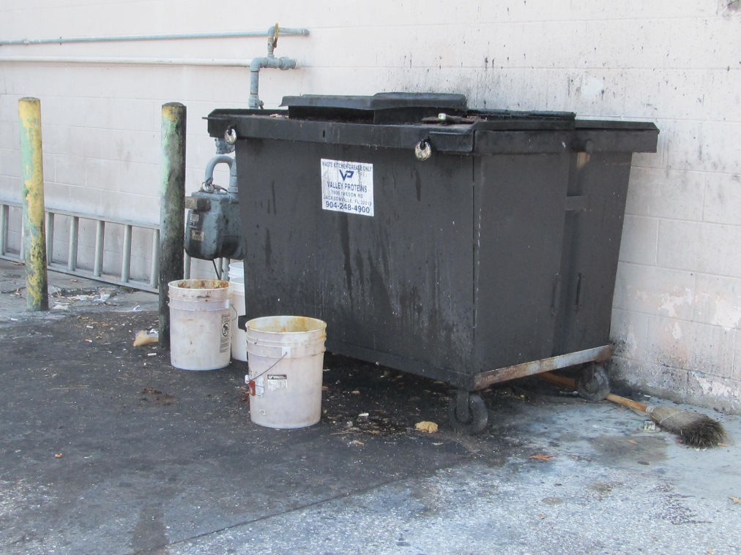
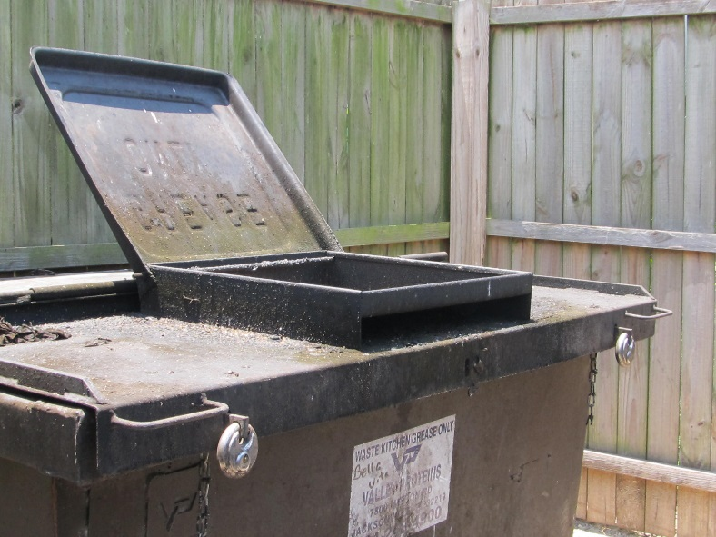
Food Grease Recycling
Notes:
Asphalt staining. Spillage on ground and outside. Open lid.

Slide 21
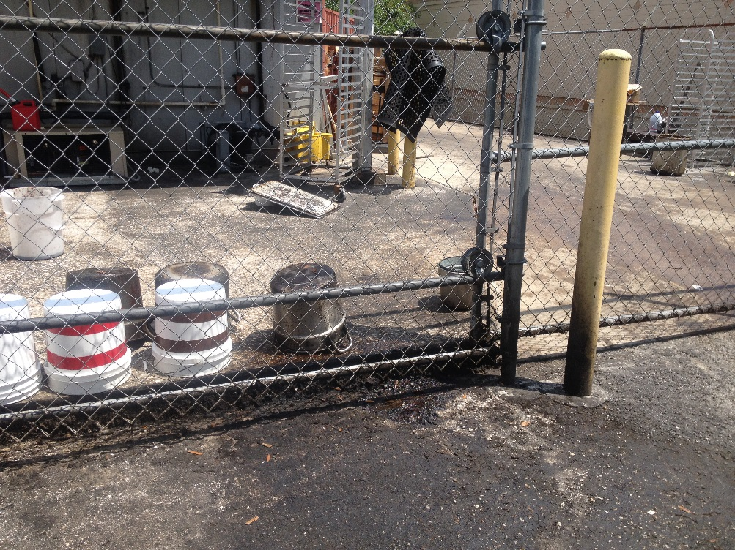
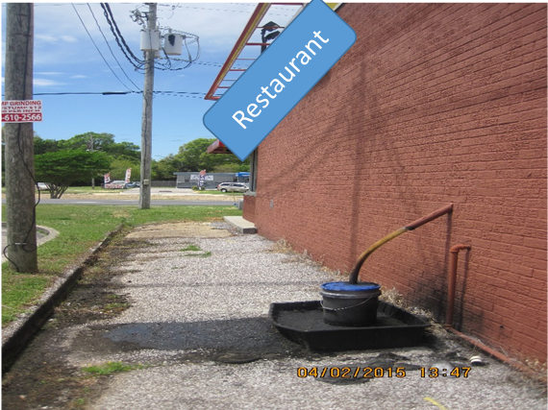
Grease on the ground
Notes:
Left: Pots and pans behind a restaurant appear to be dumped and hosed outback per the staining on asphalt. Grease and bits of food are washed into the stormdrains and streams which provides food for bacteria to proliferate.
Right: this restaurant had a pipe from the hood of the grill through the wall and outside to this bucket in a pan. It was overflowing onto the asphalt and exposed to rainfall. They changed the configuration as soon as they were notified.

Slide 22
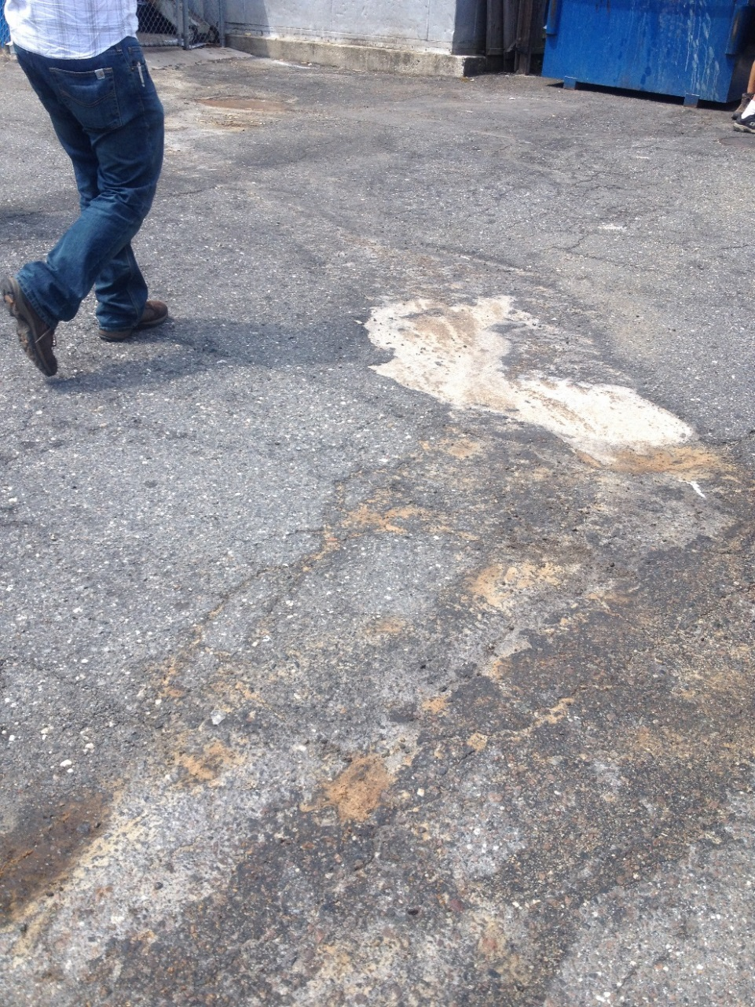
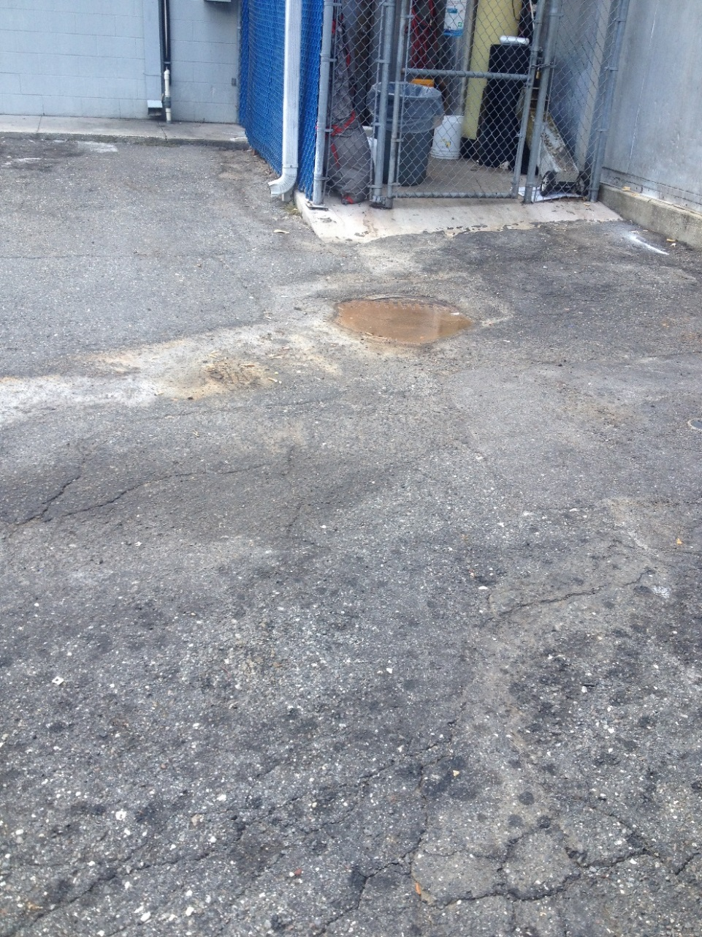
Overflowing grease trap?
Notes:
Staining on asphalt is a clear indication of a problem. Staining always runs toward a stormwater collection area.

Slide 23
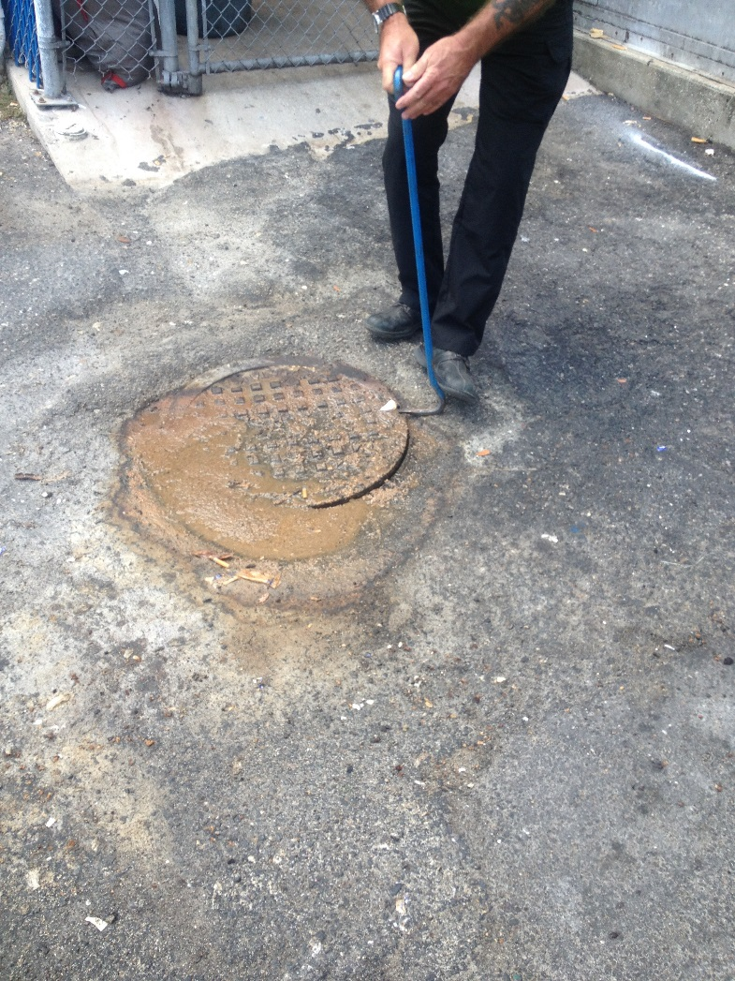
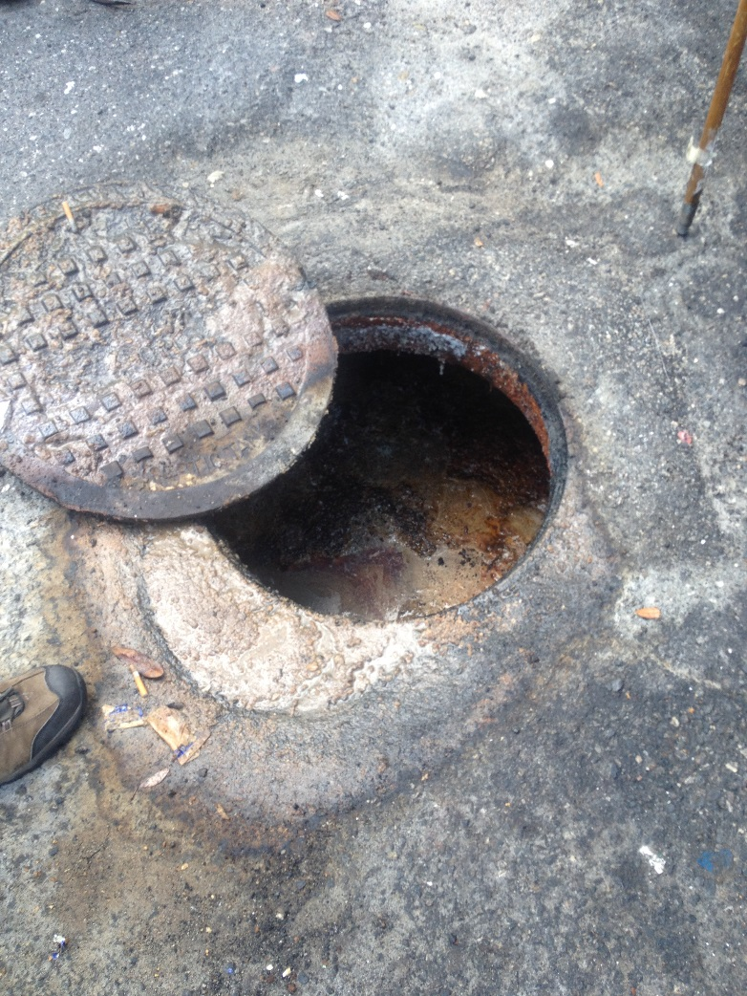
Sloppy pump-out & rug washing
Notes:
Turns out, the grease trap had been maintained aka pumped at the correct frequency. The problems appeared to be kitchen rug washing on the asphalt and spillage from the grease trap pump out truck.

Slide 24


Fried breading on storm grate
Notes:
Bio-degradable does not equal good for the environment.
People take short cuts because they either don’t know any better or they don’t care.
Breading on a storm grate indicates grease or the junk in the bottom of the fryer was disposed of down the drain instead of in the garbage. We see it a lot in stormwater ditches and lakes out back of restaurants, especially if they are overgrown.

Slide 25


Seafood and Bait
Notes:
Crab shacks, bait shops, fish packing facilities all have trash that draws flies and grows bacteria. If not handled properly, these sites can become a nuisance.
Also, consider where people are throwing fish carcasses after fileting. A stagnate ditch probably isn’t a good choice.

Slide 26




Food Dumpsters
Notes:
Drips on outside. No body want’s to touch it the dumpster or it’s lid. Lids often open. Food waste on ground. Staining always leads to stormdrains.

Slide 27



Outdoor Parks Trash Can Design
Notes:
All trash cans should be lined (with a bag) to contain ooze and enable transportation to dump or incinerator- Blue plastic drum turned into a trash can has no lid and has holes drilled in the bottom to allow rainwater to drain out: ooze attracts flies & stinks!!! Staining on asphalt= bacteria laden ooze in stormwater.
Trash cans need to be made of something that will not rust or rot. (white trash can- bottoms all rusted out)
Brand new designer trash cans with design that helps trash fall inside and not blow out, but it catches rain too. Ideally outdoor trash cans should be covered to keep the rain out.

Slide 28

Segment 5: Observation skills
Notes:
http://artimagesfrom.com/famous-surrealism-art/api.ning.com*files*2NqNaKkF7eKJA7G-R316b-1NhpA-0zAUzL48B4tQollHZT6IrH8Vh6L8-GjVA*8lz8FozDe0gE1YWDM1tq5oP2F16Lmiivb2*highlevels.jpg/
Painting “high levels” by Ben Goossens
What’s clouding your view?
I feel like I walk and drive around with my head in the clouds most of the time. How about you?
Well, there are times that we’re motivated to look for problems such as …

Slide 29




Pet Waste
Notes:
Where to look:
Empty lots
Cut-throughs to parks
Parks
Right of ways along ditches
Ditches
Behind privacy fences (flingers- bagged and unbagged)
Cat feeding stations. How many cats in this photo?

Slide 30

What’s natural
Notes:
When we hear the term “rookeries” we usually think of a BUNCH of native birds nesting close together for weeks, usually in just a few trees, usually over or near water. If it’s natural, let it be.
Domestic breed cats are not a natural part of the environment. They love to live in storm water culverts and drainage systems that are usually dry. They also like secluded wooded areas near civilization. For example, this patch of greenery is next to a small park near downtown Miami.
Cat feeding stations. How many cats in this photo?
At least 3 are visible. There were at least 8 at this site while we were there. You can see through the fence there were empty trays that were used to sit food out for the cats. No indication they had been spayed or neutered (no tipped ears).
Non-native species in abundances have the potential to overload the natural system with waste. However, before eradicating species like muscovy ducks and cats, one should determine through monitoring if there is a measurable impact to waterquality. This is a sensitive issue and there are various options to be considered if the evidence suggests an environmental impact.

Slide 31

Look closely, what’s odd?

Slide 32

Discolored Water
Notes:
The milky side where the sample is being taken was two magnitudes higher fecal coliform counts than the side closer to the bottom of the photo, the clearer water.
We smelled sewage in the vicinity, so we started looking for the source.

Slide 33

Maybe this sewer pipe upstream is corroded?
Notes:
Then we sampled upstream and downstream of the pipe, and later on the utility dye tested, and pressure tested the pipe. No problems were identified.

Slide 34


Homemade Solutions
Notes:
A littler further upstream on the storm drain system this pipe was located thanks to a discussion with a neighbor. It was discharging sewage water. The residents were from a culture where this is a normal solution to a failing OSTDS. With education, they were more than willing to eliminate the pipe and correct the OSTDS problem.

Slide 35







Illicit Discharge Pipes
Notes:
Look for illicit discharge pipes! Report them!
Top left and middle- sewage pipes coming out of campers parked near the homes on these lots. Someone is probably living in the camper long term. Usually they are not plumbed legally. Often plumbed to a ditch. Top right bottom left sewage pipes coming out of old mobile homes. Bottom center we’re not sure what this pipe discharges. It lined up with some campers and some trailers from tractor trailers. Bottom right, we’re not sure what discharges either. Small diameter like this is usually from an air conditioner, but it could also be a drain from the drainfield when it gets soggy so it’s best to verify the problem.

Slide 36


Gray Water
Notes:
Top left- pipe coming out from the house onto the lawn over the drainfield.
Bottom right- pipe runs a long distance to a laundry house of an apartment complex.
Both were discharging gray water, not sewage, but these are not legal discharges.

Slide 37



Always Question Pipes
Notes:
Left- This photo shows a situation that begs for investigations. These fences line a deep canal with a narrow sloping right of way. This is where many residents will fling pet waste over the fence. Yard debris are often disposed of out of sight, out of mind. And, pipes are often run underground until they reach the other side of the fence.
The photos on the right and bottom: This vacant old club had a yacht docked next to it for years. The pipe appears to have a coupler on the end. We’re not sure if it drains to the sewer or provided drinking water. Ideally, the pipe would be capped or removed all together so there is no chance of sewage discharge or taking in river water.

Slide 38

Segment 6: Safety First
Notes:
Do not do this at home.
But, do think creatively about where bacteria sources may be reaching the stormwater conveyances.
Confined spaces are potentially dangerous for multiple reasons. Inside this culvert was graffiti and at the outfall seen here, there was a sandwich in a baggie and some other lunch materials, this is a hang-out for at least one youth. (FYI, from the entrance, you could see sunlight, so there was an exit just around the bend.)

Slide 39





Private Lift Stations
Notes:
Private lift station safety issue: Are the wells locked? Is the electric panel locked?
Is there a red light with a lightbulb in side?
Is there a phone number clearly posted incase of a sanitary sewer overflow?
Note: Public utilities are moving toward constant reporting from lift stations to operators so that an impending overflow can be stopped. Telemetry reports problems directly to cell phones of operators, so most of those stations do not have red warning lights anymore.
Private lift stations come in a plethora of different styles. They are commonly found along waterbodies and ditches since they are receive sewage by gravity flow. Few cities and counties have adequate programs to inspect them. Many property owners forget about them.
Upper left: This one was found overflowing numerous times after downstream sampling results were very high. The system has been fixed and hasn’t overflowed now in a couple years.
Center bottom and right. This one had been overflowing without notice. We found evidence on the ground and in the rim of the unlocked well.

Slide 40


Clean Out Caps
Notes:
Sewer clean out caps are meant to be on the sewer pipes. Often removed to allow more air flow and faster drainage, to allow outflows, and to drain yards of excess stormwater. Yikes! Report missing clean out caps to the sewer utility. They usually don’t own them, but they can educate the property owner of the importance of keeping them screwed on.

Slide 41



Danger!
Notes:
Sanitary sewer components with unsafe coverings. Kids could fall in and rain can cause an overflow.

Slide 42

Super-saturated and ponding drainfields
Notes:
Safety issue: children like to play in mud puddles.
A symptom of super-saturated drainfields are pooling water and the presence of dollar weed where it would not normally be growing.
DOH- Wet boots test!

Slide 43






Accountability
Notes:
Accountability increases when people report concerns. Under funded inspection programs can justify their requests for increased funding when the number of cases increases. When you report a problem, you not only fix the issues you see, but you promote long term restoration.
Safety issues: WWTF fenced on 2 sides. Wet well missing grate on top. The lowest manhole overflows during every rain event, the new lot owner didn’t know it was sewage. The pond berms were failing allowing partially treated sewage to flow off site and into the creek.

Slide 44


Medical Waste
Notes:
Animal blood is a code enforcement issue.
Human blood is a DOH issue.
Hypodermic needles are DOH issues.

Slide 45



Segment 6: Going the extra mile
Notes:
Dumpsters were too full. The garbage truck came while we were there, so we watched. Would there be trash on the ground when he pulled away?

Slide 46


Great job!
Notes:
The driver emptied the dumpster and set it down. He noticed the bags of trash on the ground in the upper left photo. He parked the truck, got out, and picked up the bags of trash on the ground…by hand!!! I had to shake his hand and thank him after witnessing his personal choice “disapprove” of the current trash conditions.
Picking up trash by hand is dangerous. It’s made less dangerous if you have the correct safety equipment. So, if you see a problem, report the location and the problem to the city or county so they can fix the issue, both short term and long term.

Slide 47


Questions
2013
Anita Nash
Environmental Consultant
Division of Environmental Assessment and Restoration
Florida Department of Environmental Protection
2600 Blairstone Rd., Tallahassee, FL 32399
(850) 245-8545

