Slide 1
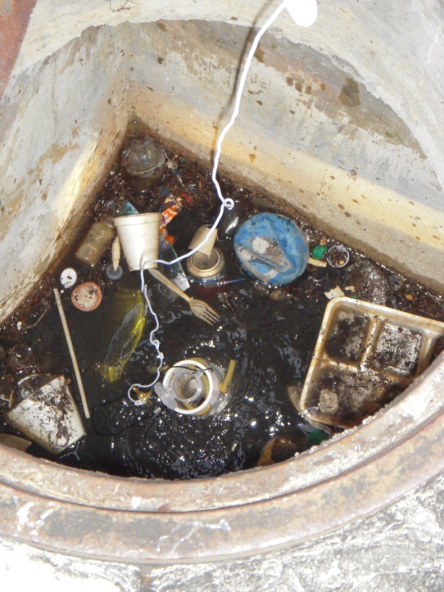
Walk the Waterbody Training
General Version
Photo: Miami River Commission

Slide 2
Today’s Topics
Why Walk
Objectives
Steps to Completing the Field Event
Post Event Follow Up
Additional Resources and Information

Slide 3
Why Walk the Waterbody?
There is a fecal coliform impairment or TMDL.
Good first step to determining sources and identifying easy to implement management actions.
Identify uncertainties and future options for more effective adaptive management.

Slide 4
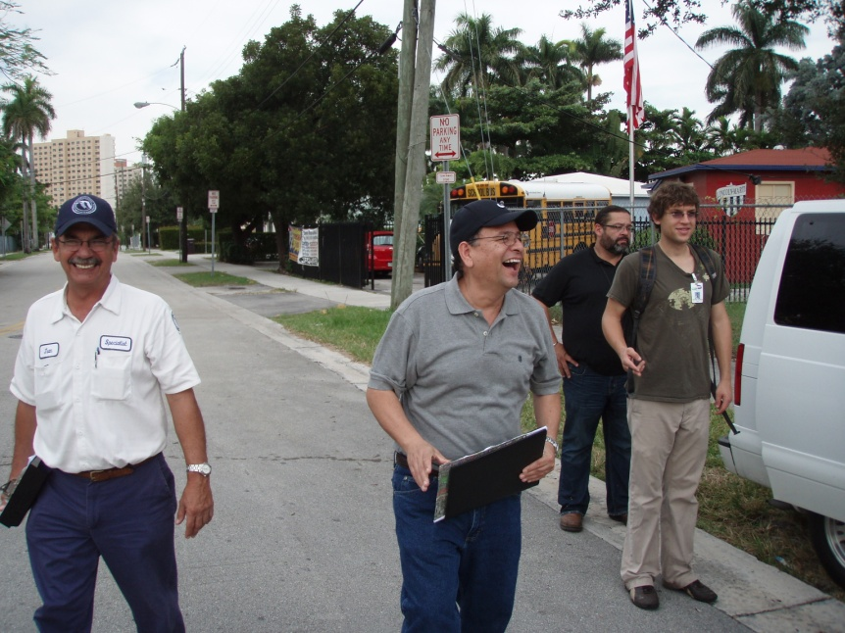
Why Walk Continued
Contributes to improved communication between and within agencies.
Increased public awareness.
Photo: Miami River Commission

Slide 5
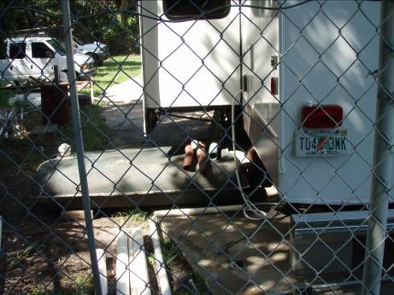
Objectives
Walking your Waterbody
Photo: PBS&J

Slide 6
Objectives of Walk the Waterbody
Utilize existing programs and ongoing activities to address “low hanging fruit.”
Have all agencies with jurisdictional authority to collaborate simultaneously pre-event, in the field, and for post event follow up.
Categorize conditions of watershed.
  Hydrology;
  Contributing ditches and branches; and
  Flood prone areas.
Notes:
Its hard for stakeholders to claim there are no problems when everyone can see them in the field

Slide 7
Objectives Continued
Implement management actions to eliminate sources and locate potential sources.
Identify sampling needs:
  Fill in knowledge gaps; and
  Identify location of suspected sources.
Establish follow-up protocol when a source is located.
Determine potential next steps.

Slide 8
A quick Reminder
Just in Case

Slide 9
Fecal Coliform & Impaired Waters Rule
IWR for determining fecal coliform bacteria impairment :
  The most probable number (MPN) or membrane filter (MF) counts per 100 ml of fecal coliform bacteria shall not exceed a monthly average of 200, nor exceed 400 in 10 percent of the samples, nor exceed 800 on any one day.
Notes:
The State surface water quality standard is all three – if we shoot for an in stream concentration of 400 – there should be no impairment – as we don’t usually have the number of samples required for determining geomean

Slide 10
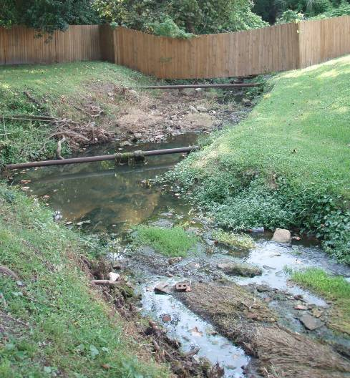
Step by Step
Planning & Execution of the Field Event
Photo: PBS&J

Slide 11
Walk the Waterbody Steps
  Lead Entity
  Stakeholder Identification
  Data Collection and Assimilation
  Maps on the Table (MOT)
  Synthesize Data from MOT
  Pre-Field Investigation
  Field Event
  Summary Document Creation
  Action Items Implementation

Slide 12
Identifying Stakeholders
There must be a lead agency, typically:
  MS4 permittee;
  Municipality; or
  Utility.
How to identify partner agencies:
  Characterize sources:
    MS4 co-permittees that discharge to WBID;
    Septic tanks: Department of Health;
    Wastewater utility; and
    Agriculture;
    Road ditch maintenance.
  Check TMDL.
Notes:
Additional Partner Agencies: WMD, FDEP, WCD, IFAS, HOA

Slide 13
  Data Collection and Assimilation
Collect stormwater infrastructure data:
  Inlets and outfalls
  Ponds
  Ditches
  Underground conveyance
  Best management practices (BMPs)
Gather sewer infrastructure (private & public):
  Pump stations
  Force and gravity mains
  SSO
Notes:
Sewer: ARV’s, manholes, laterals- pipe material

Slide 14
  Data Collection and Assimilation
Identify septic tank locations:
  Repair permits
  Industrial permits
Locate specialty farms, kennels, or other animal operations.
Water quality sampling:
  Sampling stations
  Sampling frequency
  Sampling results

Slide 15
  Data Collection and Assimilation
Hydrology:
  Wetlands
  Streams
  Ponds
Areas of special concern:
  Landfill
  Transfer station
  Dog parks
  Homeless populations

Slide 16
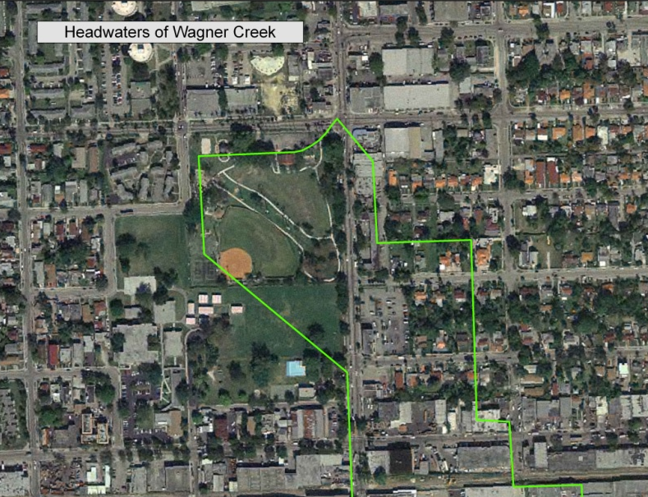
Data Collection and Assimilation
Make maps in large format and multiple copies:
  Water quality sampling locations;
  Stormwater;
  Wastewater; and
  Combined dataset.
Notes:
Note: Using the Adobe Interactive .pdf map is a huge help in MOT. Allows for information to recorded directly in the map at that location rather than trying to cross walk notes to locations identified on the map. More advanced technology requiring proficient GIS tech and software.

Slide 17
Maps on the Table
All hands on deck, a representative from each agency needs to attend.
Divide into teams, if appropriate. There should be one representative from each agency per team.
Elect a note taker.
Elect a presenter:
  Potential sources
  General information
Notes:
If there is a large group with multiple representatives; divide into teams. Generally, no more than 6 in a team- more than that is ineffective for participation

Slide 18
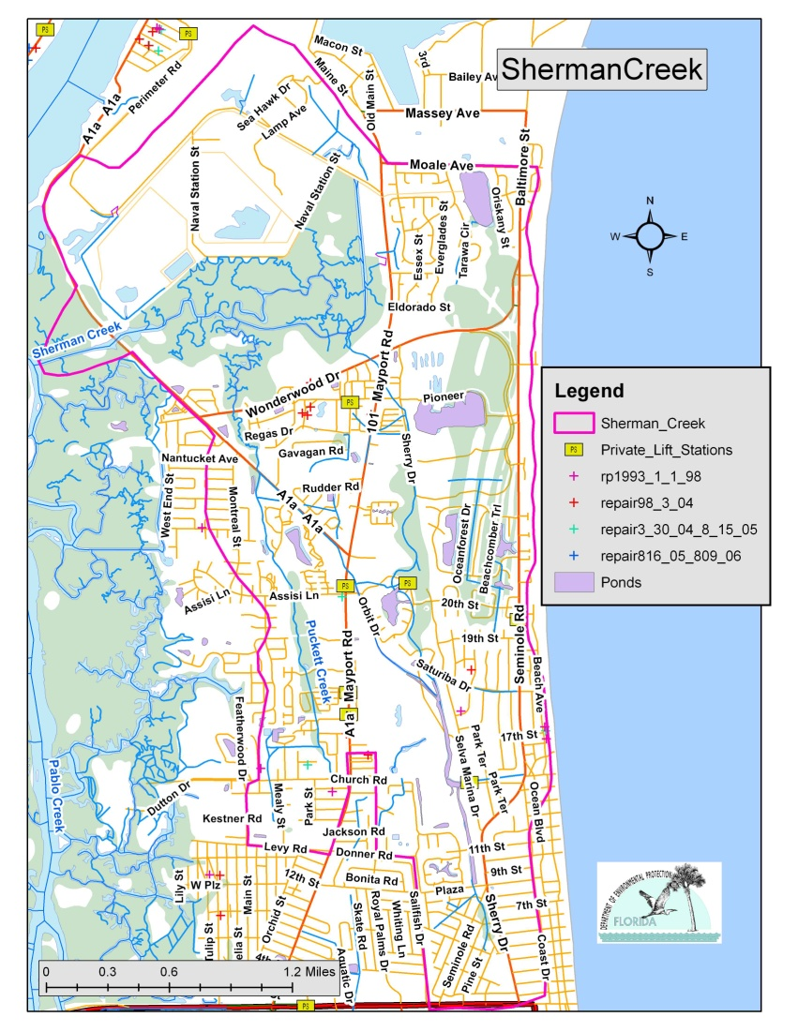
Maps on the Table Continued
Review maps as team and identify:
  Hydrology characteristics, and
  Known areas of concern.
Team members should be marking areas of concern on the maps themselves.
Notes:
We will review what we are looking for as areas of concern and potential sources in a few slides

Slide 19
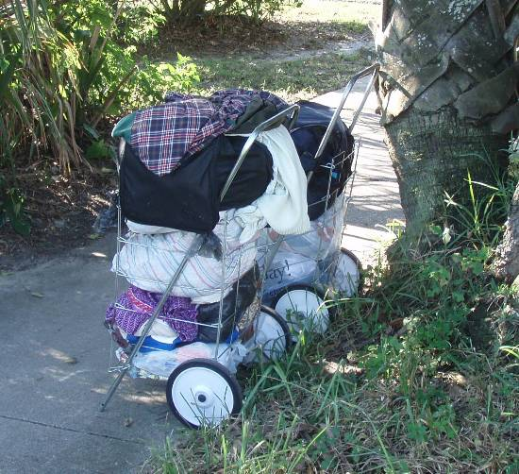
MOT Continued
Note taker should be recording the map notations.
After the team review, the presenter should review the teams findings to the group.
Photo: PBS&J

Slide 20
MOT Next Steps
Elect field representatives.
  Representative from each entity.
    Consider if there is more than one side of the house (stormwater vs. public works).
  Participants should have infrastructure knowledge and have access to facilities (gated stormwater ponds, pump stations, etc.).
  Sampling staff:
    Should have necessary sampling equipment, and
    Should be familiar with sampling SOP.

Slide 21
Field Planning
Spaces for field event are limited, as it is imperative all field participants ride in one vehicle.
  Yes, that means one vehicle.
  12 passenger van is recommended.
Remember you may need to coordinate with local law enforcement if you may be in areas that may have safety concerns.

Slide 22
Field Planning
Participants should plan on bringing:
  Lunch (there is no time to stop at restaurant);
  Sunscreen and bug repellent;
  Appropriate field clothing;
  Water; and
  Agency contact numbers.
Equipment for field:
  GPS;
  Camera;
  Sampling equipment, coolers, and ice;
  Large format maps.
Notes:
Note to coordinator- first thing in the morning @ meeting location determine if someone has not brought lunch- try to fins a break location early am that will allow for someone to grab something-

Slide 23
Pre Field Survey before Walking with Group
Lead agency needs to complete a pre-field survey and identify:
  Event day meeting location with appropriate parking.
  Route from headwaters downstream.
  Focus areas.
  Lunch location.
  Areas of concern (map and pre-investigation).
  Access issues.
Notes:
During pre event- rule out areas that do not require the larger field day inspection: Areas with sources but not close to surface waters, etc

Slide 24
Walking the Waterbody
Designate a documentation team or teams:
  Primary note taker who coordinates GPS points, photos, and sampling locations.
  GPS – take GPS points.
  Camera – take pictures.
Imperative that the precise record (order) of GPS coordinates, photos, and notes is captured in the field.
Other participants should also be taking pictures.
Notes:
One person can’t and shouldn't handle all three, direct group, etc. Note taker should be someone who understands what needs to be recorded with a photo, GPS point , and sample (never a sample without other two pieces).

Slide 25
When Walking What are we Looking For?
Flood prone areas
Evidence of pet waste
Water fowl
Chickens or other hobby animals
Ruminant populations
Septic tanks
  Ponding
  Strong smell
  Close to surface waters
Notes:
NOTE: Just because you smell sewage at pump station or manhole does not mean there is a problem- a certain amount of odor is normal

Slide 26
Looking Continued
Wastewater
  Any infrastructure in close proximity to surface waters:
    Pump Stations:
      Alarms;
      Contact Information;
    Manholes; and
    Air release valves (ARVs).
Branches and contributing ditches.

Slide 27
Still Looking
Erosion or wash out
Dense tree canopy
Dense vegetation in stream
Stagnant water
Homeless
Animals in water:
  Horses
  Cattle
  Raccoons
Notes:
Dense Tree Canopy or Vegetation in stream can contribute to regrowth by not having UV penetration

Slide 28
It’s a lot of Looking
Stormwater
  Potential Illicit Connections
  Stormwater Drains:
    Free of debris,
    In repair, and
    Smell of sewage (cross- connections).
  Inlets:
    Free of debris, and
    Proximity to wastewater infrastructure.
  Outfalls:
    Ponds, and
    Underground conveyances.
Notes:
If inlets are blocked it could contribute to flooding conditions= failing WW and septic systems
Stormwater outfalls from underground conveyances may have high fecal numbers because of the accumulation of sediments and lack of UV penetration could equal regrowth

Slide 29
When You See a Discharge
Take a sample:
  At point, and
  Downstream and/or upstream.
If it is a serious infraction – Call it in!
  Illegal discharge
  Turbidity
  SSO
Take GPS point and pictures.
Notes:
Special Note: Don’t get bogged down in sampling a lot of ground to cover

Slide 30
When You See Potential Sources
Take pictures.
Capture area with GPS point.
Notes should indicate:
  What it is or may be.
  Who may be associated with corrective action, such as:
    County not FDOT, or
    Department of Business & Professional Regulation not local Utility.
Notes:
You get one shot and characterizing the effort after requires organized information and plenty of documentation

Slide 31
Important!!!!
Remember samples must be on ice while waiting for delivery.
Samples must meet holding times (6 hours)!!
Samples must be processed in NELAP certified laboratory.
Arrangements to have samples picked up for delivery to lab.
Chain of custody must still be maintained.

Slide 32
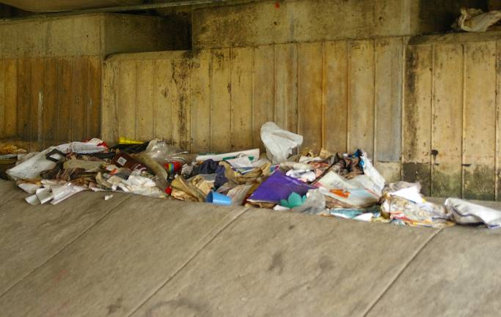
Post Event
Summary, Reporting & Follow-up
Photo: PBS&J

Slide 33
First Steps to Summarize Field Event
Post process GPS coordinates.
Create shapefile of coordinates.
Edit shapefile to include description or information about point.
Process pictures by adding labels so you can later recall what the picture was showing.
Obtain sample results from lab.

Slide 34
Hold Follow Up Meeting with Participants
Review the findings from the field:
  Pictures
  Sample results
  Follow up actions associated with jurisdictional authority:
    Actions associated with permit obligations:
      Observed SSO – Utility, or
      Potential Illicit Connection – MS4.
    Housekeeping of Existing Infrastructure:
      Broken infrastructure or in need of maintenance:
        Broken stormwater grate.
      General maintenance:
        Clogged stormwater drains.

Slide 35
Follow Up Meeting with Participants, Cont.
  Coordinated community follow up actions.
    Additional source investigations.
    Sampling:
      Increased sampling frequency (quarterly to monthly).
      New stations:
        Information gaps (only two trend stations in WBID).
        Investigate potential source - Add sampling station to help identify source location , not intended to be a fixed sampling location .
      Follow up sampling after high count.
      Specialized sampling :
        MST.
        Boron or other indicators.
    Increased maintenance.
    Other source solutions.

Slide 36
Coordinated Community Follow Up
Lead entity should host a follow up discussion to review the community follow up actions.
This meeting should prioritize actions that eliminate sources.
Agencies and partnerships of entities should volunteer for those actions that are closely related to their missions and authority.

Slide 37
Reporting
Create table of follow up actions and indicate appropriate entities for management actions.
Create mechanism to ensure all jurisdictional items are completed.
Prioritize community follow up actions:
  Identify which community follow up actions will occur near term, and
  Actions for future implementation.

Slide 38
Reporting Continued
This information should be recorded in a way that information can be provided to the Department to demonstrate:
  Identified sources;
  Completed management actions to remove sources;
  Non-human sources;
  Projects or activities to address identified source and source assessment and identification; and
  Future steps.

Slide 39
Reporting continued
The Department is working on a document template for inserting Walk the Waterbody results that will be available in March.

Slide 40
Additional Resources and Information
References, Case Studies

Slide 41
Additional Resources
Tributary Pollution Assessment Manual (PBS&J).
LSJ Technical Reports:
  Miramar Creek
  Big Fishweir Creek
  Long Branch
  Hogan Creek
  Williamson Creek
  Red Bay Branch

Slide 42
Additional Resources
The Department has developed a fecal coliform guidance document that is a great source of tools and information. It will be posted next month: http://www.dep.state.fl.us/water/watersheds/bmap.htm
Contracting with consultant to obtain better information such as:
  Develop sampling program,
  MST work to identify human sources,
  Water Quality Data Analysis.

Slide 43
Questions
Anita Nash
Florida Department of Environmental Protection
850-245-8545
Anita.Nash@dep.state.fl.us

