Slide 1
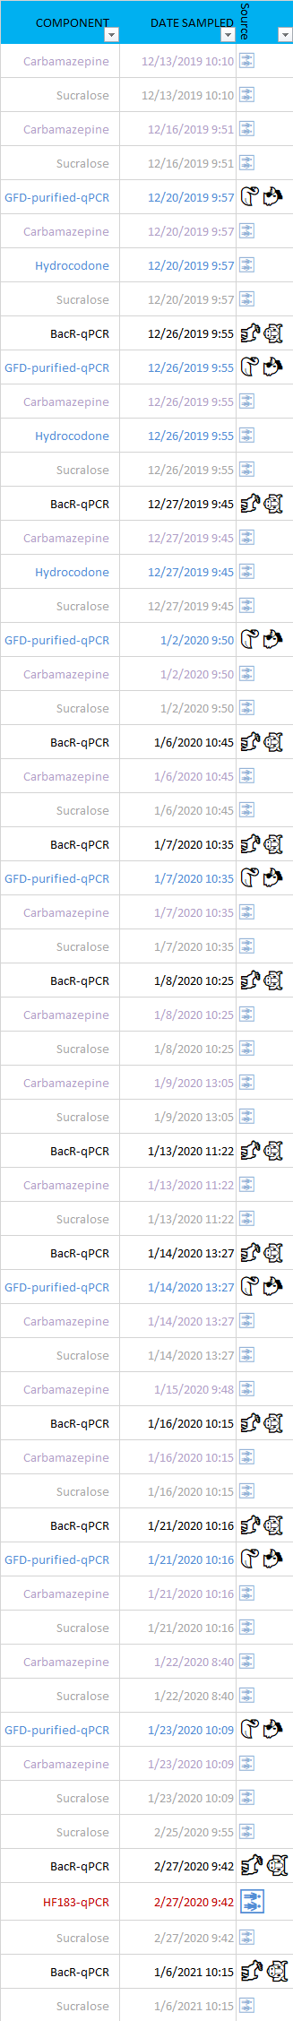
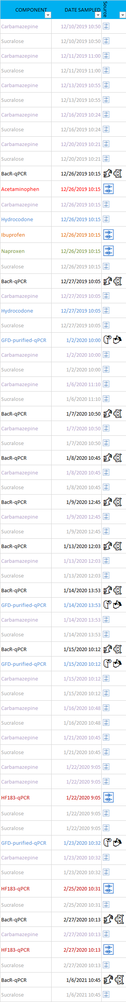
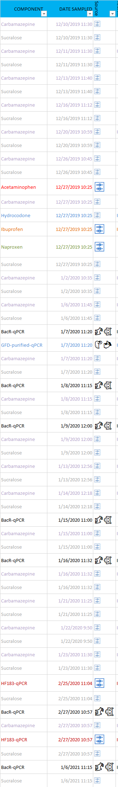
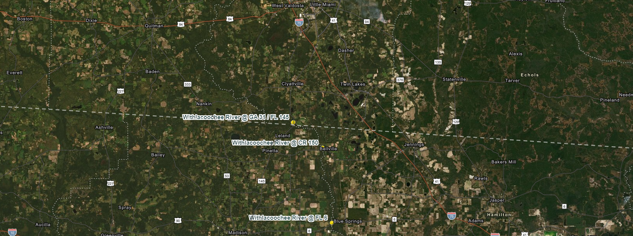
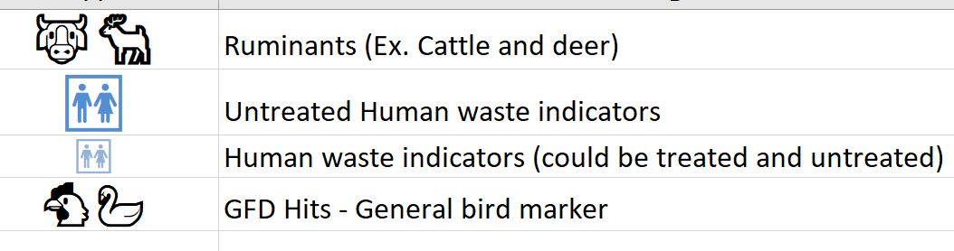
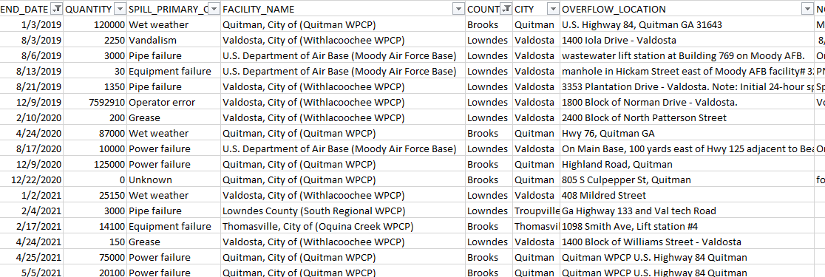
Withlacoochee @ GA 31/FL 145
Withlacoochee @ CR 150
Withlacoochee @ CR 6
Symbology
SSO Records
Main Sampling Stations
Interactive AGO link, Click here.
Dec 3^{rd -}9^{th,} 2019
2019 – 2021 Marker and Tracer Hits (above)
SSOs (right)

Slide 2
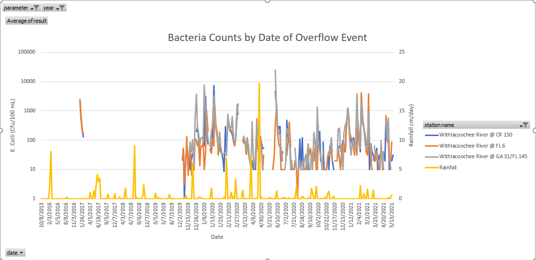
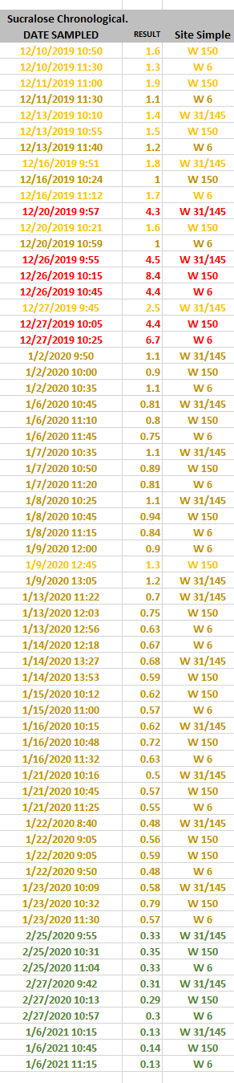
Sucralose
Dec. 3, 2019 – Valdosta Spill (lift station contractor error) 7.5 mill gallons discharged to Sugar Creek, last one we sampled in response to notice of spill.
  Seems the plume hit FL around Dec.20 th and lasted about 8 days.
Other SSOs occurred since then in other counties.
City of Valdosta’s Consent Order has reference to M&T monitoring that needs occur, in response to future spills in GA, ref. Withlacoochee and Mudd Creek water pollution control plan.
Mark when Upgrades at Valdosta facility occurred.
Note the big spills on this too.
Mark the most recent one, L/S failure.
Katrina, provide dates for the spills required to report to us. Daily rain vs daily results (can OSTDS be causing FIB?) Are first flush rains causing
How much more likely is it that a spike occurs after a rain event of a certain size?

Slide 3
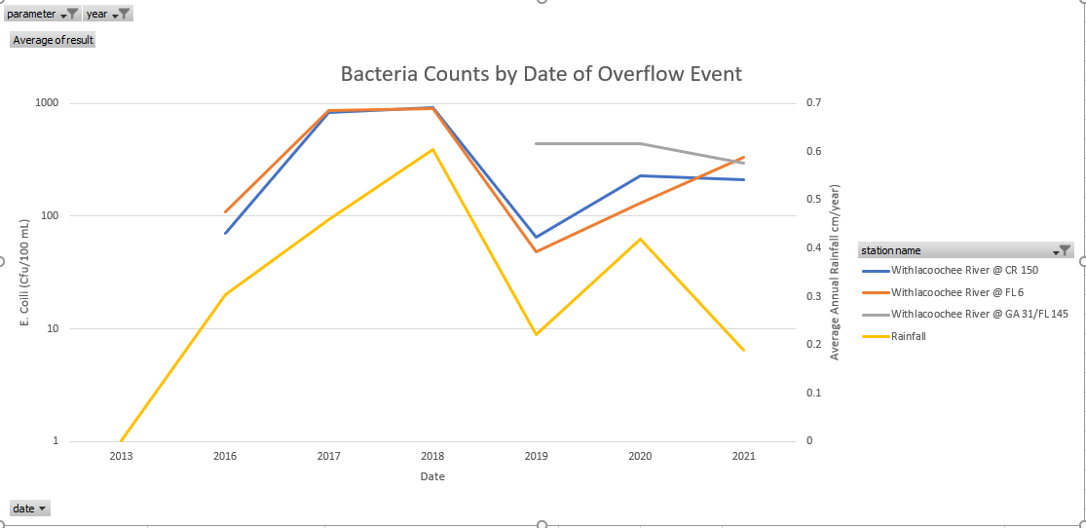

Slide 4
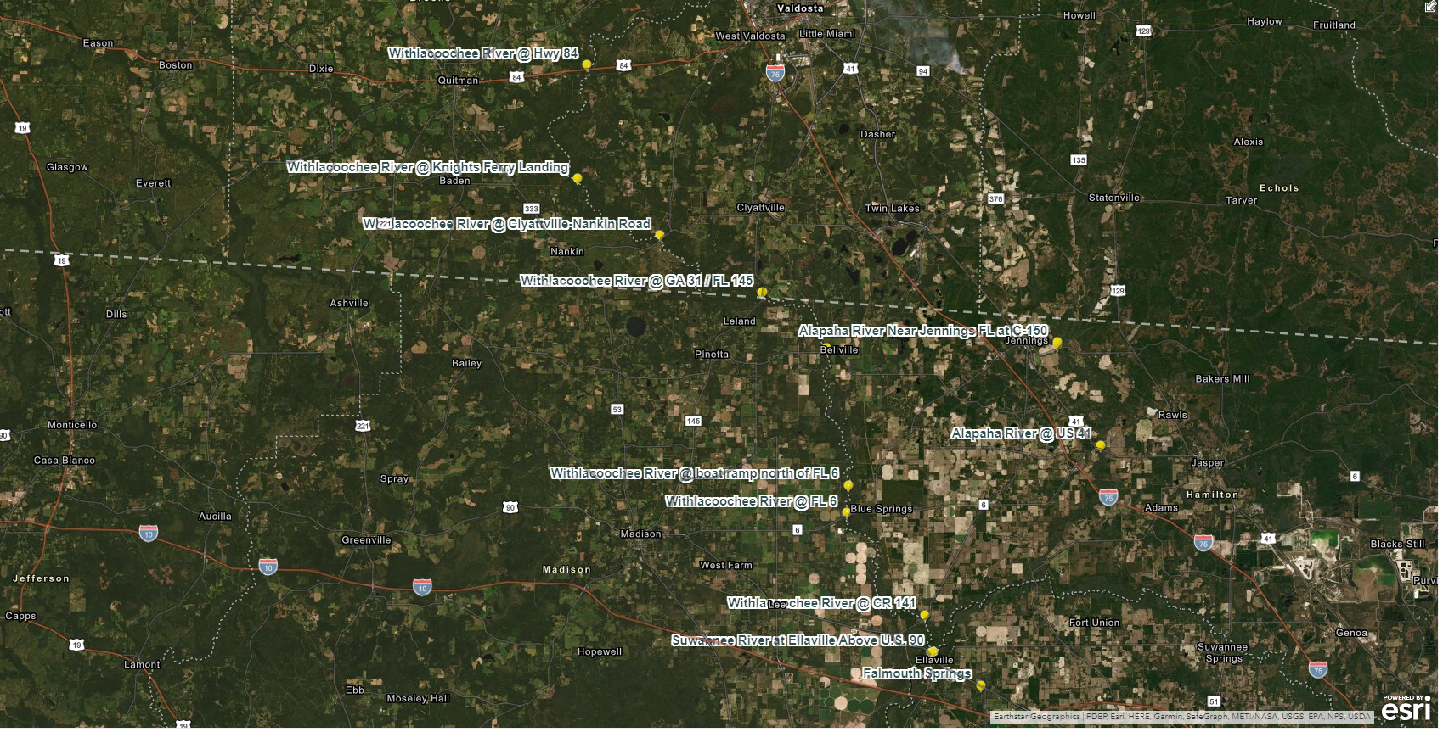
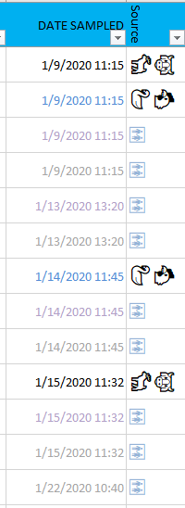
State Line
Withlacoochee @ CR 141

Slide 5
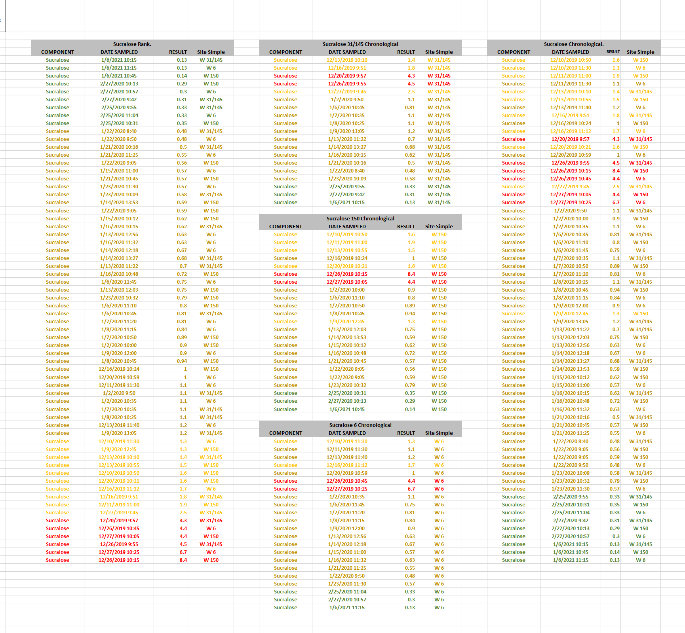
Sucralose evaluation for Dec. 2019 through Jan 2021.
Sucralose values for all 3 sites seem to have the same median value. * would be good to plot each site.
Ranking sucralose shows the greatest values were during christmas week of 2019.
Chronological comparison of suralose shows values have been generally coming down since Christmas week of 2019.
Presence of untreated waste indicators correlate most with Christmas of 2019.
Carb and Sucra are most common.
BacR was more frequent than HF-183.
GFD was more frequent than HF-183.
FIB values are generally low, with occasional short lived spikes.
These are the estimated dates of the Valdosta spills that triggered monitoring events in FL.
Date of Overflow Event
2/27/2014
3/17/2014
3/24/2014
4/15/2014
4/18/2014
1/23/2015
2/25/2015
8/28/2015
11/3/2015
11/5/2015
2/4/2016
4/2/2016
1/22/2017
8/13/2018
12/2/2018
12/15/2018
12/3/2019

Slide 6
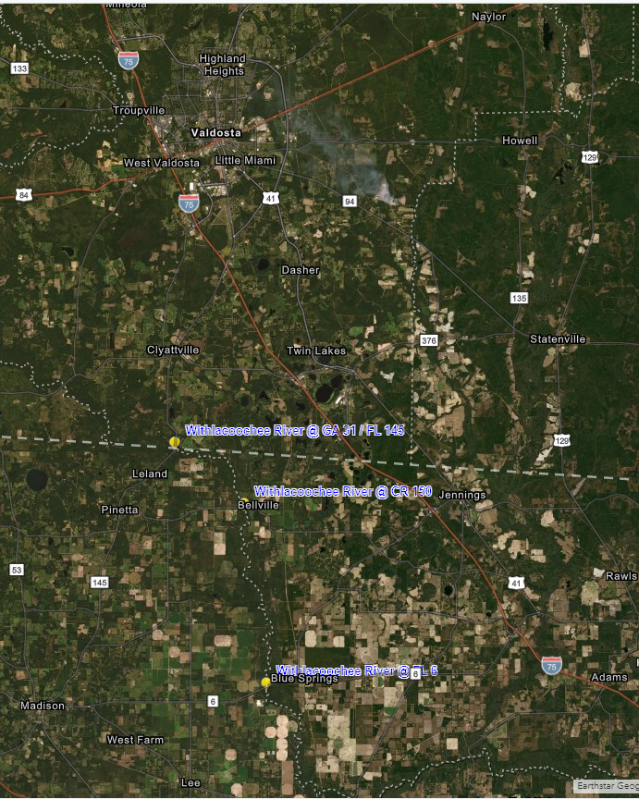
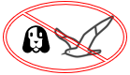
Results from the 7.5 million gal. spill in Valdosta
12/20/19 through 12/27/19 Detected tracers indicating untreated human waste and qPCR markers indicating animal waste coming into FL
  🚻 Human waste tracers detected.
    Acetaminophen, Ibuprofen, high levels of sucralose, hydrocodone, and carbamazepine
  🐮🦌 Ruminant and 🐔🦢 general bird markers, (BacR and GFD) were detected.
  🚻 Human waste marker, (HF-183) was not detected during this event
    possibly because it may break down during the 35-mile travel down river from Valdosta to the state line
  Gull and canine markers,
  (GULL2 and DG3) were not detected.

