Slide 1
Summary of Withlacoochee Monitoring Data Near the Florida and Georgia State Line
Gregory DeAngelo, Deputy Director of Division of Environmental Assessment and Restoration for the Florida Department of Environmental Protection; and Anita Nash, Environmental Consultant
October 12th,2021

Slide 2
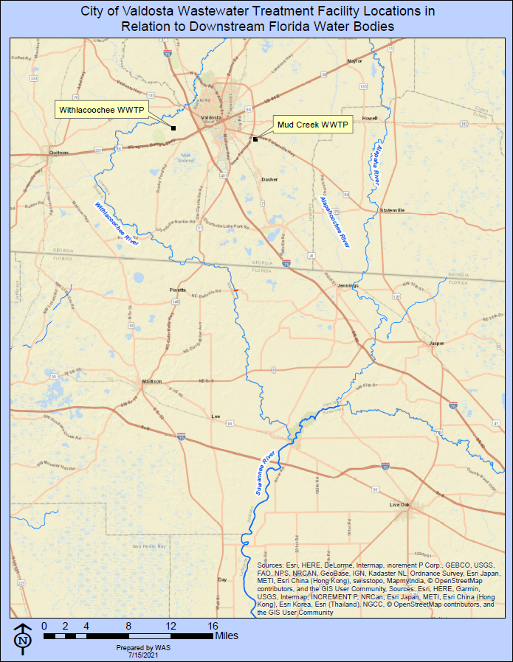
Monitoring Background
History
City of Valdosta’s combined sewer system and wastewater treatment facilities periodically experienced overflows of untreated wastewater during past rain events
Each spill event discharged wastewater to local creeks and wetlands
  These make their way to Withlacoochee and Alapaha rivers downstream in Florida, ultimately to Suwannee River near Ellaville

Slide 3
Monitoring Background
History
In response to reoccurring spill events, coordinated sampling effort on behalf of DOH, SRWMD and DEP began in March 2014
  DOH responsible for issuing health advisories for affected counties
  Advisory could be issued when Escherichia coli ≥ 410 MPN/100 mL or Fecal Coliform ≥ 800 MPN/100 mL
Resulted in a total of 219 sampling events carried out by the three agencies to date
  Includes 39 different bacteria, chemical tracer and genetic marker analytes

Slide 4
Monitoring Background
History
City entered consent order with Georgia Environmental Protection Division to address issues (December 2013)
  Withlacoochee treatment facility and force main relocated due to flooding events, additional storage basins constructed
  Evaluation and repair/rehabilitation of sanitary sewer system
  Procedures established to ensure Florida entities are notified of spills

Slide 5
Monitoring Background
History
As improvements pursued over time, occurrence of spill events became extremely limited
Most recent event: July 7 spills were wet weather, relatively small, and the first reported spills since December 3, 2019, a result of human error during maintenance
Following this incident, DOH in Madison and Hamilton counties has monitored 3 sites on Withlacoochee River twice weekly through May 18, 2021, now reduced to once weekly
Additionally, DEP has continuously collected monthly routine samples for Trend Monitoring Network on each of these 3 rivers
New consent order in 2020 to resolve violations and improve remaining issues

Slide 6
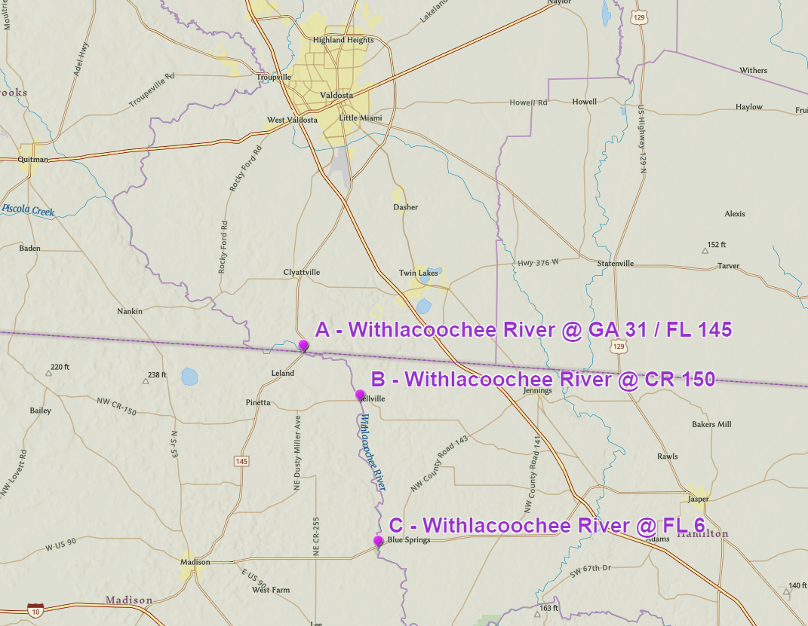
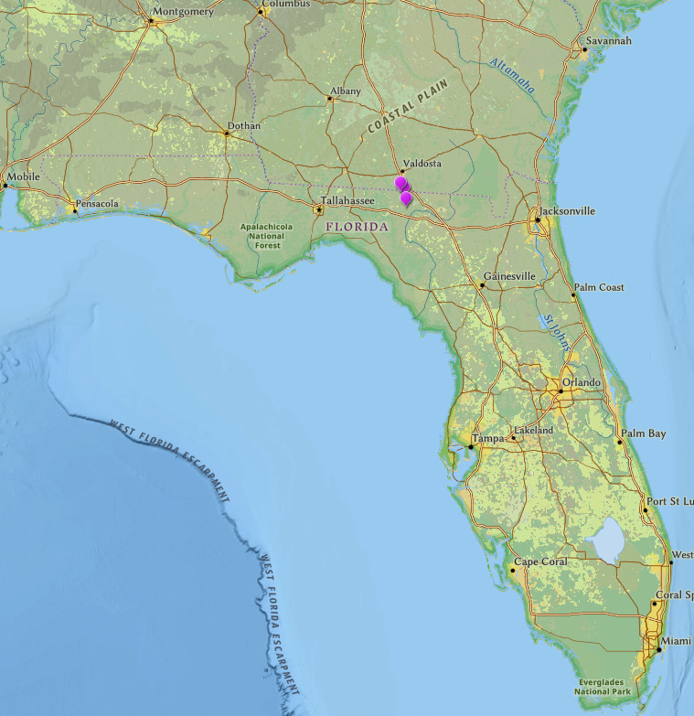
Withlacoochee River
Appx. 35 miles of river from Valdosta, GA to the Florida-Georgia state line
Valdosta
FL/GA State line
Locator Map
Map of Valdosta to Florida—Georgia state line and 3 sample points
Interactive AGO link, click here.
Notes:
You can click the link to go to the interactive AGO with the sampling stations for this project.

Slide 7
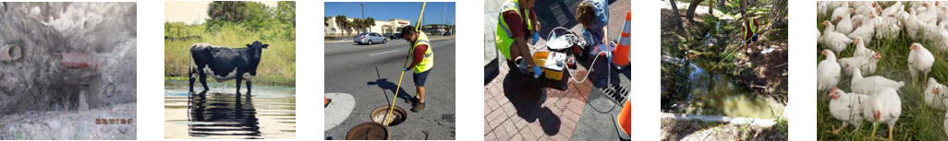
Microbial Source Tracking
FDEP tools
Initial sampling for fecal indicator Bacteria (FIB)
  E. coli
Desktop exploration of potential sources
  Review of historic bacteria results
  Geographic Information Systems (GIS)
Walk the Watershed
  Boots on the ground in affected drainage with local experts
Source specific monitoring
  Quantitative Polymerase Chain Reaction (q-PCR) DNA analysis
  Analytical Chemistry
Detection/quantification of:
  host-associated DNA markers of fecal contamination
  chemical tracers of human fecal contamination
Work with responsible parties through focused programs
Link to Reducing Pathogens Story Map
Link to FDEP Restoring Bacteria-Impaired Waters Toolkit
Notes:
qPCR is quantitative polymerase chain reaction and is a technology used for analyzing DNA using PCR.

Slide 8

Microbial Source Tracking
Analytes used by FDEP during Withlacoochee Event Response Sampling (2019 -2021)
Chemical tracers of human waste:
Acetaminophen (Tylenol®)*
Ibuprofen (Advil®)*
Naproxen (Aleve®)*
Hydrocodone (opiate analgesic)
Sucralose (Splenda®)
Carbamazepine (mood stabilizer)
qPCR markers used to detect waste from specific source types:
Human waste marker HF-183 🚻
  Bacteroidales
Ruminant waste marker BacR 🦌🐮
  citation (Reischer, 2006)
  Species Bacteroides
Dog waste marker DG3 🐕
  Citation (Green, 2014)
  Species Bacteroides
Bird waste markers
  Gull2 citation (Sinigalliano, 2010)
    Catellicoccus marimammalium
  GFD 🐔🦢 citation (Green, 2012)
    Unclassified Helicobacter sp.
🚻
🐮
🦌
🐔
🦢
🚻
💩
* Analyte often removed from waste stream during wastewater treatment processes and these analytes cling to organics and settle out of the water column when exposed to the environment for days.
Notes:
qPCR is quantitative polymerase chain reaction and is a technology used for analyzing DNA using PCR.
Sucralose and Acetaminophen notes:
Sucralose
Artificial sweetener
Is not broken down through digestion or wastewater treatment processes
In 2012, FDEP conducted a study of Florida wastewater treatment facility effluents and detected sucralose concentrations between 10 and 40 parts per billion in 49 facility effluents
In 2017, FDEP performed another WWTF study and found sucralose ranged between 15 and 88 ppb in 23 facility effluents
FDEP laboratory detection limit is approximately 10 parts per trillion
Found in reuse/reclaimed water that is used for landscape irrigation at concentrations equivalent to WWTF effluent concentrations
The detection of sucralose in surface water does not indicate the presence of untreated wastewater, only that there has been some mixing of wastewater (treated or untreated) and the surface water
Additional markers that are not so recalcitrant to degradation by common wastewater treatment processes are needed to help discriminate treated from untreated wastewater sources
Acetaminophen (Tylenol®), Ibuprofen (Advil®), Naproxen (Aleve®)
Pain relievers are present in WWTF influents in relatively high concentrations similar to sucralose
Unlike sucralose, pain relievers are readily removed by common wastewater treatment processes and are therefore often absent from, or significantly reduced in, final effluents

Slide 9
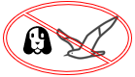
Source Specific Indicators Detected
Summary of findings in 23 samples taken Dec. 2019 through Jan. 2021 near the state line.
🚻
🐮
🦌
🐔
🦢
Indicators of treated or untreated human waste were detected at all 3 stations during most sample events
Ruminant waste and bird waste were also detected (likely cattle and chicken waste)
The sources appear to be in GA
Canine marker not detected
Gull marker not detected
Station | Carbamazepine | Sucralose | Hydrocodone | Naproxen | Ibuprofen | Acetaminophen | HF183-qPCR | BacR-qPCR | GFD-purified-qPCR
A - 31/145 | 15 | 17 | 3 | 0 | 0 | 0 | 1 | 10 | 7
B - 150 | 21 | 23 | 2 | 1 | 1 | 1 | 3 | 10 | 4
C - 6 | 20 | 22 | 1 | 1 | 1 | 1 | 2 | 7 | 1
Indicator of: | Treated and Untreated Human Waste |  |  | Untreated Human Waste (I Qualified HF-183 can be deer and dog too) |  |  |  | Ruminants (cows, deer, goats, etc.) | General bird (chickens and others.)
Number of tracer and marker detects in 23 samples taken Dec. 2019 through Jan. 2021 near the state line
Notes:
It’s possible the untreated sewage indicators were present initially in Valdosta spill plumes, but they can settle out of the water column or break down before they reach the state line.
The 7.5-million-gallon spill of Dec. 2019 was the only time we detected the untreated sewage indicators at the state line.

Slide 10
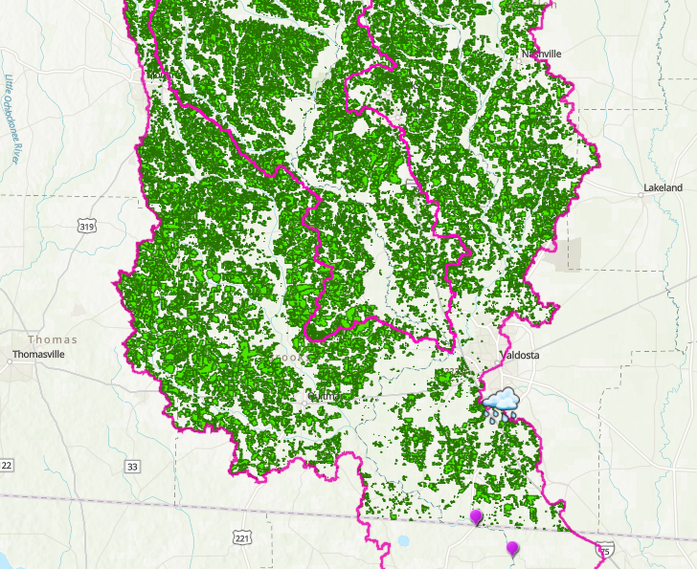
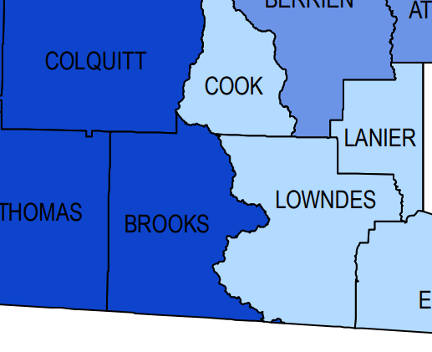
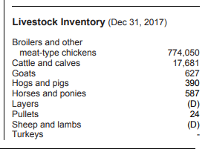
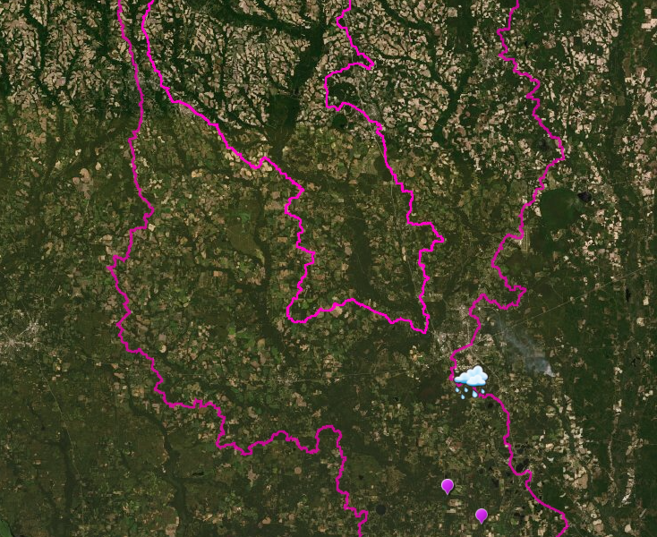
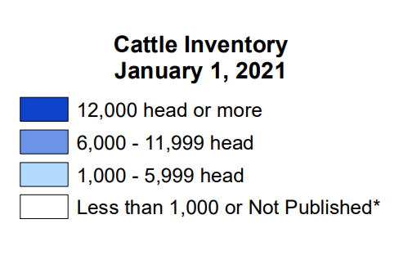
Agricultural Land Uses
Withlacoochee watershed in GA 🐮 🐔
Valdosta
FL/GA State line
USDA estimates 17,500 cattle
and calves in Brooks County
USDA 2021 Cattle Estimates
USDA 2017
Livestock Estimates for Brooks County
Notes:
There are no permitted FL CAFOS in the contributing area of FL between the state line and the SR 6 station.
USDA – (Using Brooks County as an example for livestock numbers)
-Cattle number for Brooks County and corresponding map: https://www.nass.usda.gov/Statistics_by_State/Georgia/Publications/County_Estimates/index.php
-Brooks County Livestock Inventory (2017) https://www.nass.usda.g
USDA estimates for Brooks County are in the vicinity of 17,500 head of cattle and 774,000 meat chickens, data for the other counties are available online. Additionally, FL Department of Agriculture should focus on enrolling producers in BMP program in this area, ov/Publications/AgCensus/2017/Online_Resources/County_Profiles/Georgia/cp13027.pdf

Slide 11
Evaluation of rain prior to spikes in bacteria levels
E. coli >800 cfu/100mL occurred on 14 days during 2017-2021
The rain within 5 days of the spike was varying 2-16 cm
The rain within in 6-10 days prior, was low, usually 0-3, with 2 exceptions up to 6 cm
The rain for the prior 30 days was generally 10-22 cm
Rain after a dry period may be driving runoff resulting in spikes
Advisory Date | Appx. Date of spike | Prior 30 days of rain | Total rain during 10 days prior (cm) | Rain previous 5 days (cm) | Rain 5 days prior to spike (cm) | Magnitude of spike (estimated)
1/24/2017 | 1/24/2017 | 15 | 11 | 0 | 11 | 2,000
12/17/2018 | 12/5/2018 | ? | 22 | 6 | 16 | 4,000
12/19/2019 | 12/24/2019 | 16 | 11 | 5 | 6 | 3,000
1/7/2020 | 1/5/2020 | 18 | 4 | 1 | 3 | 6,000
 | 1/13/2020 | 19 | 2 | 0 | 2 | 6,000
 | 2/28/2020 | 17 | 4 | 1 | 3 | 2,000
6/9/2020 | 6/8/2020 | 16 | 13 | 1 | 12 | 12,000
10/2/2020 | 10/1/2020 | 6 | 3 | 0 | 3 | 1,000
1/6/2021 | 1/5/2021 | 22 | 13 | 0 | 13 | 2,000
1/29/2021 | 1/28/2021 | 21 | 6 | 3 | 3 | 4,000
2/12/2021 | 2/11/2021 | 10 | 3 | 1 | 2 | 4,000
9/2/2021 | 8/31/2021 | 19 | 8 | 3 | 5 | 3,000
~10-20“
Varying
Low
Sometimes heavy rain, sometimes not, always > than days 6-10 prior to spike

Slide 12
Withlacoochee River
Summary of findings
💩
Valdosta
🐮
Waste sources are pointing toward agriculture and some additional human waste in GA
Rain after a dry period may be driving runoff resulting in spikes
💩
💩
🐔
🐮
🐔
💩
💩
🐔
🐮
Locator Map
FL/GA State line
🐮
Map of Valdosta to Florida—Georgia state line and 3 sample points
Interactive AGO link, click here.
Notes:
The emojis represent the idea that there are likely cattle, chicken, and human unpermitted point and non-point sources throughout the watershed between Valdosta and the state line.
You can click the link to go to the interactive AGO with the sampling stations for this project.
An example estimate of velocity from 6/8/20:
Withlacoochee River at Pinetta (CR150): flow 2280 cfs, velocity ~1.1 mph
Suwannee at Ellaville: flow 10,000 cfs, velocity ~1.7 mph

Slide 13
Withlacoochee River
Summary of findings
The Withlacoochee River is currently being assessed as part of the department’s 2020-2022 Biennial Assessment
Through this process, the department’s Watershed Assessment Section (WAS) identifies waterbodies that are not meeting applicable water quality standards and designated uses based on the Surface Waters Quality Standards, Chapter 62-302, Florida Administrative Code (F.A.C.) and the Impaired Waters Rule, Chapter 62-303, F.A.C.
Monitoring data from the coordinated sampling effort on the Withlacoochee River were incorporated into these current draft assessments, and a segment of the river was determined to be impaired for Escherichia coli (E. coli) based on the monthly geometric mean criterion of 126 counts/100 mL

Slide 14
Withlacoochee River
Summary of findings
Two sampling locations have monthly geometric mean E. coli values that exceed the criterion:
  Withlacoochee River @ CR 150 (monthly geomean=201 MPN/100 mL, February 2020)
  Withlacoochee River @ GA 31/FL 145 (monthly geomean=258 MPN/100 mL, February 2020)
The waterbody segment “WBID 3315” – Withlacoochee River above Suwannee River is being proposed as an addition to the State’s Verified List of Impaired Waters and the Clean Water Act section 303(d) list

Slide 15
Monitoring Frequency
Recommendation 1:
Based on the FIB data, continuing sampling 2-3xs per week probably isn’t going to tell us much because spikes come and go quickly
Long term changes can be detected by watching the DEP monthly Trend data
Recreational advisories would be timelier based on sanitary sewer spills or heavy rains instead of waiting for FIB lab results
Notes:
DOH told Katrina that the advisory can be issued based on 800 MPN/100mL for FC as well, not just the 410 for E. coli, although they understand E. coli is the applicable state wq standard for freshwater. Also, they have issued precautionary swim advisories for saltwater (like for beaches if they expect spills due to a storm); they have not historically done it in freshwater but that doesn’t rule out the possibility either.
Recommendation 1: Based on the FIB data, continuing sampling 2-3xs per week probably isn’t going to tell us much because spikes come and go quickly. Less frequent sampling seems reasonable. Advisories would be timelier based on sanitary sewer spills or heavy rainfall rather than waiting on FIB lab results.

Slide 16
Cattle and Chicken Waste Runoff
Recommendation 2:
Develop a relationship with the GA agricultural community to reduce animal waste runoff during heavy rains
Ensure FDACS enrolls and verifies local agriculture
Notes:
Recommendation 2: Work with GA agricultural community to reduce animal waste runoff during heavy rains. USDA estimates for Brooks County are in the vicinity of 17,500 head of cattle and 774,000 meat chickens, data for the other counties are available online. Additionally, FL Department of Agriculture should focus on enrolling producers in BMP program in this area, which is under Suwannee River BMAP. There are no permitted confined animal feeding operations in the FL portion of the watershed north of SR 6.

Slide 17
Valdosta Spill Response
Recommendation 3:
Follow the Valdosta wastewater treatment facility’s future source identification spill response monitoring results

Slide 18

Questions

Slide 20
Additional Slides

Slide 21
Withlacoochee River
Appx. 35 miles of river from Valdosta, GA to the Florida-Georgia state line
Concern that spurred event response sampling
💩
Spill
Valdosta
FL/GA State line
Locator Map
Map of Valdosta to Florida—Georgia state line and 3 sample points
Optional Animated Slide 6
Interactive AGO link, click here.
Notes:
Click 1 adds note: Concern that spurred spill response sampling.
Spill and poo emoji appears in Valdosta
Poo emoji moves down river to FL
You can click the link to go to the interactive AGO with the sampling stations for this project.
Otherwise, click 2 advances the slide.

Slide 22
Agricultural land uses
Withlacoochee watershed in GA
USDA 2021 Cattle Estimates
USDA 2017 Livestock Estimates
for Brooks County
Valdosta
USDA estimates 17,500 cattle and calves in Brooks County
FL/GA State line
Optional Animated Slide 10
Notes:
Slide shows land use (crops mostly0
Click 1 shows aerial
Click 2 shows blue USDA Cattle by county map
Click 3 shows land use again
Click 4 advances the slide
There are no permitted FL CAFOS in the contributing area of FL between the state line and the SR 6 station.
USDA
-Cattle number for Brooks County and corresponding map: https://www.nass.usda.gov/Statistics_by_State/Georgia/Publications/County_Estimates/index.php
-Brooks County Livestock Inventory (2017) https://www.nass.usda.gov/Publications/AgCensus/2017/Online_Resources/County_Profiles/Georgia/cp13027.pdf

Slide 23
Withlacoochee River
Summary of findings
Analysis of data from event response sampling
💩
Valdosta
🐮
Waste sources are pointing toward agriculture and some additional human waste in GA
Rain after a dry period may be driving runoff resulting in spikes
💩
💩
🐔
🐮
🐔
💩
💩
🐔
🐮
Locator Map
FL/GA State line
🐮
Map of Valdosta to Florida—Georgia state line and 3 sample points
Optional Animated Slide 12
Interactive AGO link, click here.
Notes:
Click 1 adds note: Analysis of data from event response sampling
Raindrops appear and travel south
At the same time, poo emoji appears in Valdosta
Chicken, cow, and more poo emojis appear through out landscape.
All emojis move down river to FL and fade out.
You can click the link to go to the interactive AGO with the sampling stations for this project.
Otherwise click 2 advances the slide.

