Slide 1

Indian River Lagoon Technical BMAP Meeting
April 8, 2011
TMDL Seagrass Target Assessment

Slide 2
Biological Response Goal: Seagrass Depth Recovery
Independent of Nutrient Loads

Slide 3
TMDL Biological Response Goal
The intent of the total maximum daily loads (TMDLs) for total nitrogen (TN) and total phosphorus (TP) in the Indian River Lagoon (IRL) is to recover the deeper seagrass habitats.
The biological response of the seagrasses is the most important factor to evaluate the success of the TMDLs.
The load reduction requirements themselves will not determine TMDL success; assessment of success is based on whether the seagrasses can grow at target depths.

Slide 4
Restoration Targets
Complete seagrass recovery is considered to have seagrasses grow at 100% of the depth limit (DL) of the union coverage of the following mapping years: 1943, 1986, 1989, 1992, 1994, 1996 and 1999.
The TMDL DL targets are 90% of that 1943-1999 union coverage DL or 10% less than the cumulative frequency distribution of the 1943 – 1999 union coverage DLs.

Slide 5
Scale for Assessment
Project Zones

Slide 6
Project Zones
Success in achieving the TMDL DL targets will be assessed based on a project zone scale.
While FDEP desires to have all three sub-lagoons achieve seagrass recovery, it is possible to have success in smaller assessment areas.
Project zones are hydrologically connected areas and incoming loads would be expected to affect the entire area.

Slide 7
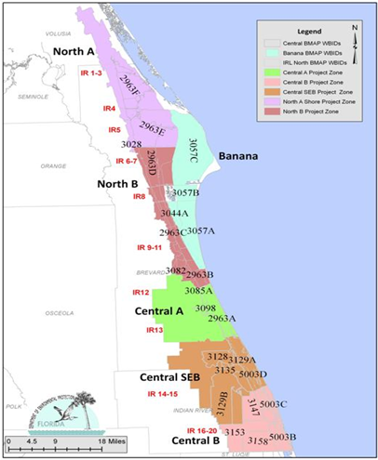
Project Zones

Slide 8
Overview of Technical Steps for TMDL Seagrass Depth Limit Assessment

Slide 9
Establishing the Deep Edge of Seagrass Beds
The seagrass shapefiles were edited to only have categories 9113 and 9116, which are seagrass beds and not algae.
A GIS function of Dissolve was used to eliminate multiple areas of seagrass coverage to create one smoothed area. This was applied to:
  TMDL union coverage (1943-1999);
  Union of assessment years (2003, 2005, 2006, 2007); and
  Each of the assessment years individually.

Slide 10
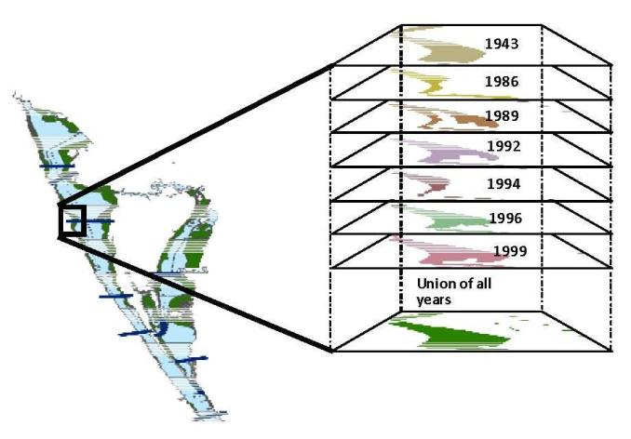
Union Coverage

Slide 11
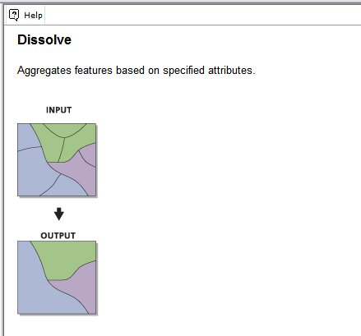
GIS Function of Dissolve

Slide 12
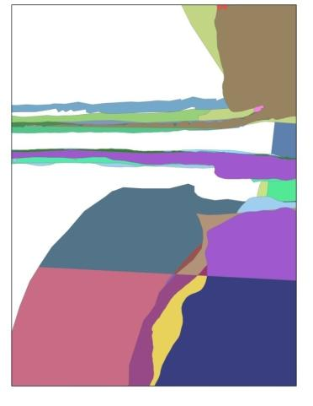

Example of Dissolve Function
Composite Before Dissolve
Composite After Dissolve

Slide 13
Establishing the Deep Edge Continued
After the Dissolve, each of the polygons (total area) was then transformed into a polyline (perimeter only).
Then using this polyline file a 15 meter buffer was applied around the line in order to establish the deep edge of the seagrass beds.
After the deep edge files were created each file was clipped to the project zones.

Slide 14
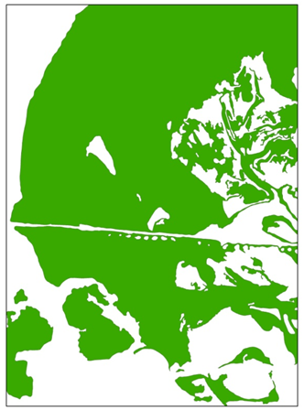
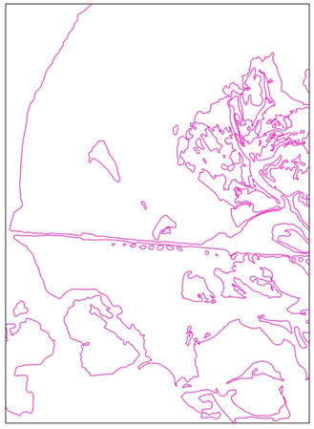
Example of Polyline
Dissolved Seagrass Polygon
Polygon to Polyline

Slide 15
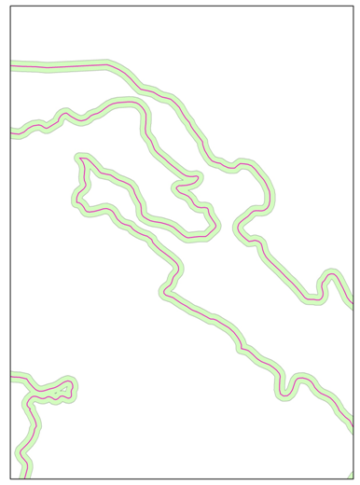
Polyline and 15 Meter Buffer
Pink line is Polyline
Green line is 15 M Buffer

Slide 16
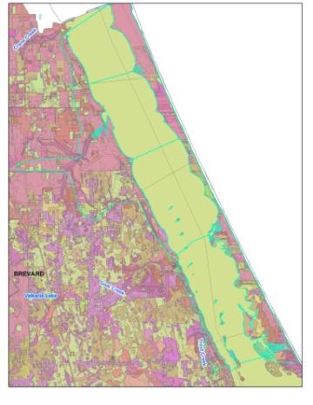
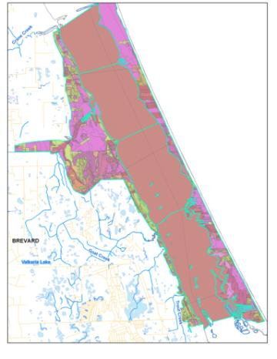
Example of GIS Clip Function
Before Clip
After Clip

Slide 17
Measuring Depth of Deep Edge
Using the bathymetry data points, the GIS function of Erase was used to remove bathymetric points located within dredged areas.
This step was performed because we do not expect seagrass to grow in dredged areas.
The bathymetry minus dredged area files were then intersected with each of the clipped deep edge buffer files by project zone.

Slide 18
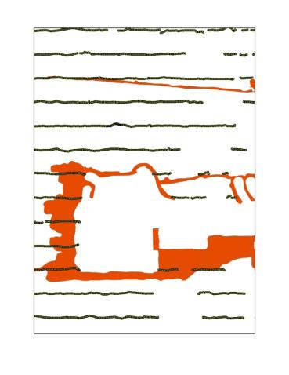

Example of GIS Erase Function
Full Bathymetry
Bathymetry Minus Dredge

Slide 19
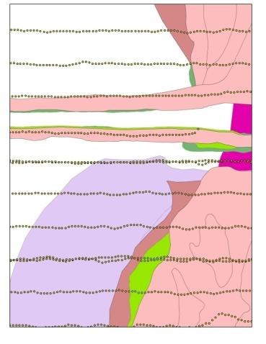
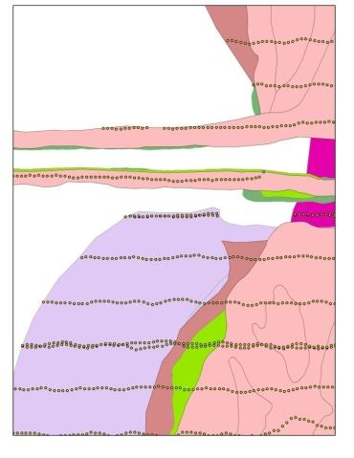
Example of Intersect
Before Intersection
After Intersection

Slide 20
Evaluation Steps to Measure DL Compliance
Step 1 and Step 2

Slide 21
Evaluation Steps for TMDL Compliance
Using data results from the GIS processing, the actual determination of TMDL compliance is a two-step evaluation method:
  Step 1: For each assessment unit, generate the cumulative frequency distribution of the maximum seagrass depth-limits at each transect.
  Step 2: Determine the seagrass mapping year median depth-limit value.

Slide 22
TMDL Compliance: Step 1
Generate cumulative frequency (CF) distribution graphs to compare the TMDL years to the composite of the evaluation years:
  Consistent with the method used to develop the depth-limit targets.
  Over 50% of the composite evaluation year’s distribution curve must lie on or to the right of the TMDL curve.

Slide 23
Summary of Step 1 Compliance
Project Zone | Step 1 Compliant?
Banana River Lagoon (BRL) | Yes
North A | No
North B | No
Central A | Yes
Central SEB | Yes
Central B | Yes

Slide 24
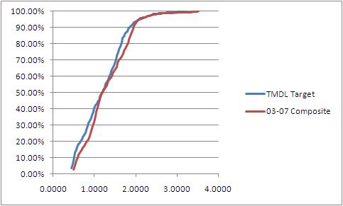
BRL CF Distribution Curve

Slide 25
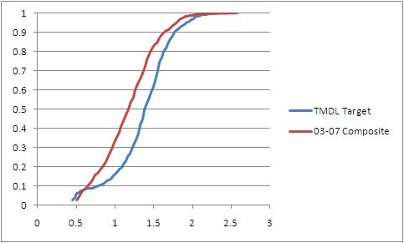
Project Zone North A CF Distribution

Slide 26
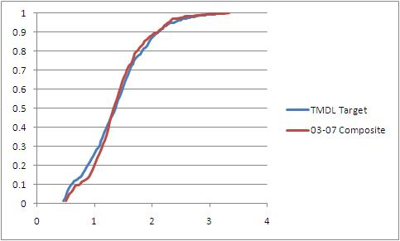
Project Zone North B CF Distribution

Slide 27
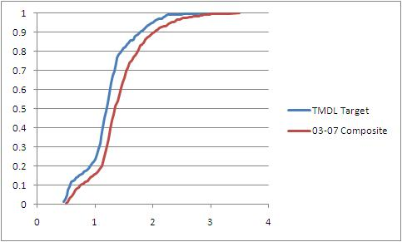
Project Zone Central A CF Distribution

Slide 28
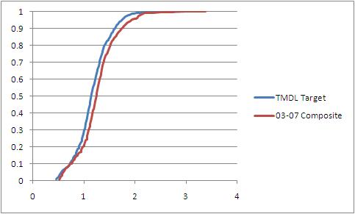
Project Zone Central SEB CF Distribution

Slide 29
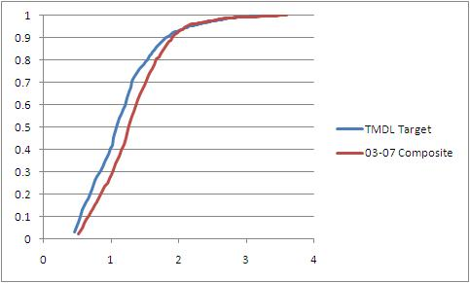
Project Zone Central B CF Distribution

Slide 30
TMDL Compliance: Step 2
Assessment of each mapping year’s median relative to the TMDL median depth-limit target:
  Must meet or exceed the TMDL median depth-limit target to meet the Step 2 requirement.
  This ensures that one exceptional year does not overpower other years.
Three of the four medians of the assessment years’ seagrass coverages must meet or exceed the median TMDL DL target in order for a project zone to be Step 2 compliant.

Slide 31
Step 2 Compliance Summary
The years where the median exceeds the TMDL median are highlighted and a determination of Step 2 compliance is included.
Year | BRL | North A | North B | Central A | Central SEB | Central B
TMDL Median | 1.192 | 1.411 | 1.370 | 1.219 | 1.147 | 1.092
2003 | 1.111 | 0.958 | 1.263 | 1.233 | 1.121 | 1.122
2005 | 1.111 | 1.080 | 1.263 | 1.202 | 1.152 | 1.122
2006 | 1.141 | 1.080 | 1.324 | 1.233 | 1.182 | 1.122
2007 | 1.172 | 1.080 | 1.294 | 1.324 | 1.213 | 1.244
Step 2 Compliant? | No | No | No | Yes | Yes | Yes

Slide 32
Application of TMDL Seagrass Target Evaluation in BMAPs
BRL, North IRL, and Central IRL

Slide 33
Central IRL Project Zones Project Collection
Stakeholders in the Central A, Central SEB, and Central B project zones are meeting TMDL DL targets and will not be asked to make any additional reductions at this time.
FDEP will continue to ask stakeholders to provide completed and any planned projects to characterize TN and TP reductions that have already occurred and will be achieved during the first BMAP cycle.
Documenting known load reductions will further the understanding of how compliance was achieved and maintained.

Slide 34
Central IRL Target Reassessment
FDEP will use the 2009 and 2011 seagrass mapping data, when available, to reassess whether these project zones continue to be compliant.
If these project zones continue to meet the TMDL DL targets there will be six mapping years or nine calendar years (2003 – 2011) indicating a continuing trend of success.
If during this assessment the project zones no longer meet Step 1 and Step 2 compliance, FDEP will then ask for stakeholders to make nutrient reductions and a BMAP will be developed.

Slide 35
Stakeholders in Central IRL
Brevard County
City of Fellsmere
City of Fort Pierce
City of Melbourne
City of Palm Bay
City of Sebastian
City of Vero Beach
City of West Melbourne
FDOT District 4
FDOT District 5
Fellsmere Water Control District (WCD)
Fort Pierce Farms WCD
Indian River County
Indian River Farms WCD
Melbourne-Tillman WCD
North St. Lucie River WCD
Sebastian River Improvement District
St. Lucie County
Town of Grant-Valkaria
Town of Indialantic
Town of Indian River Shores
Town of Malabar
Town of Melbourne Beach
Town of Melbourne Village
Town of Orchid
Turnpike Authority
Vero Lakes WCD

Slide 36
BRL and North IRL
Stakeholders in the BRL, North A, and North B project zones will be required to achieve TN and TP reductions in this first five-year BMAP period.
Reductions are required because these areas are not meeting the TMDL DL targets.
Two BMAPs will be developed, one for Banana and one for North IRL.
Project collection will continue and detailed allocations will be developed for the North IRL.

Slide 37
BRL and North IRL Reassessment
In year four of the BMAP, TMDL DL targets will be reassessed using 2009, 2011, and 2013 mapping data for these project zones.
As none of these project zones meet median DL targets for any of the most recent four mapping years (2003-2007), the earliest opportunity for achievement of the Step 2 requirement of three out of four mapping years that meet or exceed the TMDL median would be in this next data set.
If these project zones are compliant using the 2007-2013 mapping years, FDEP will not ask stakeholders to make additional TN and TP reductions in the next iteration of the BMAP.

Slide 38
TMDL Target Success and Reassessment
FDEP will apply a methodology similar to what is being used in the Central project zones for reassessment if BRL and North IRL meet TMDL targets after the first cycle of the BMAP.
Data from the 2015 and 2017 seagrass mapping years will be evaluated to determine if the project zones continue to meet the TMDL target.
If the project zones do not continue to pass the Step 1 and Step 2 assessments and meet DL targets, then FDEP will ask stakeholders to make further nutrient reductions in another iteration of the BMAP.

Slide 39
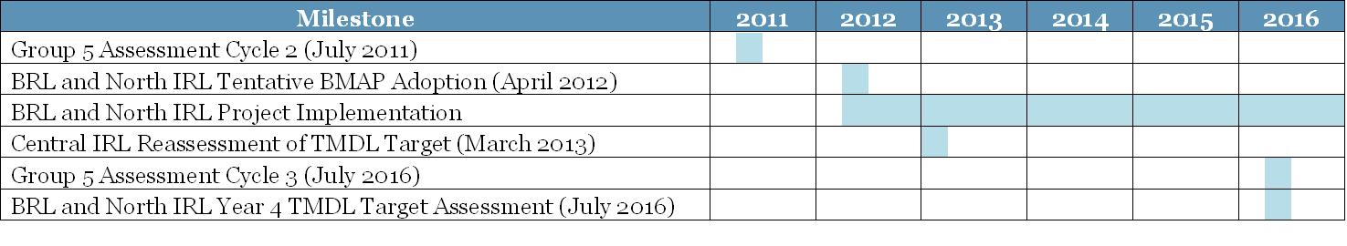
Timeline for BMAP Assessment

Slide 40
Reminder – TMDL Goal
The intent of the TMDLs for TN and TP in the IRL Basin is to recover the deeper seagrass habitats.
The biological response of the seagrasses is the most important factor to evaluate the success of the TMDLs.
The load reduction requirements themselves will not determine TMDL success; assessment of success is based on whether the seagrasses can grow at target depths.

Slide 41
Questions on TMDL Seagrass DL Evaluation?
Up Next, The Revised Detailed Allocation Process and Final Allocations for Banana River Lagoon

