Slide 1
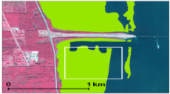
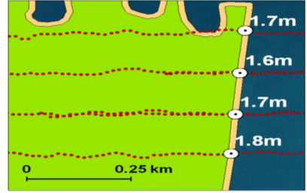


Slide 2
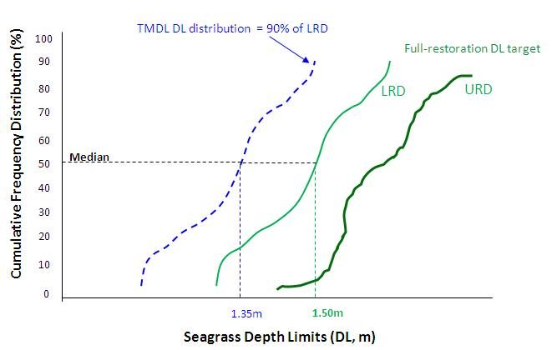
Conceptual Illustration

Slide 3
Median depth-limit thresholds per segment
Segment | LRD Median | TMDL Median
North IR1-3 | 1.60 | 1.44
North IR4 | 1.57 | 1.41
North IR5 | 1.72 | 1.55
North IR6-7 | 1.54 | 1.38
North IR8 | 1.57 | 1.41
North IR9-11 | 1.81 | 1.63
Central IR12 | 1.51 | 1.36
Central IR13 | 1.35 | 1.22
Central IR14-15 | 1.33 | 1.20
Central IR16-20 | 1.18 | 1.06
Central IR21 | 1.52 | 1.37
BRL BR1-2 | 1.75 | 1.58
BRL BR3-5 | 1.57 | 1.41
BRL BR6 | 1.63 | 1.47
BRL BR7 | 1.42 | 1.27
Range of median LRD DL thresholds: 1.18 to 1.81m
Range of median TMDL DL thresholds: 1.06 to 1.63m

Slide 4
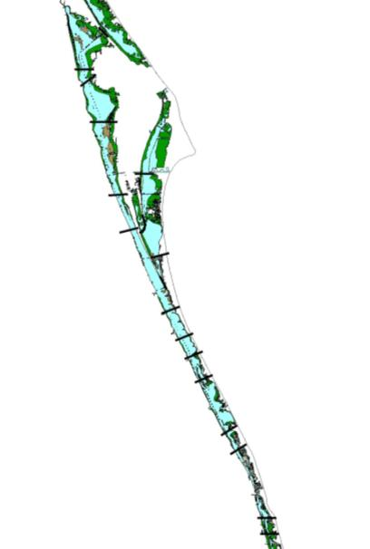
Mosquito Lagoon
Figure 36 in Draft FDEP NNC Report (August 30, 2010)
WHAT IS THIS ALL ABOUT?
IR1-3
IRL NNC Map
IR4
Titusville
IR5
‘86,’03, ’05, ‘06, ‘07
The figure illustrates a portion of the NNC development method intended to be consistent with a reference approach and with nutrient TMDLs.
1. Select segment-yrs in which median seagrass DLs = TMDL median DLs (50th prctl of the DL distribution).
2. Cull out water quality data associated with selected seg-yr; then aggregate data per sublagoon (BRL, NIRL, CIRL) for analysis.
IR6-7
BR1-2
‘06
IR8
BR3-5
‘98
’03,’05, ‘06, ‘07
IR9-11
BR6
‘06
BR7
Melbourne
IR12
‘07
‘96,’99,‘01, ’03,’05, ‘06, ‘07
IR13
‘96,’01, ’05, ‘06, ‘07
IR14-15
IR16-20
’01,’03, ’05, ‘06, ‘07
Vero Beach
IR21
’03, ‘06, ‘07

Slide 5
...AND WHAT IT’S NOT
This NNC analysis and Fig. 36 was not intended to identify segments that met the TMDL seagrass DL target.
Definition of TMDL seagrass DL target:
The TMDL depth target consists of 2 sets of threshold criteria (evaluated as a 2-step method) against which a multi-year assessment of seagrass depth limits is conducted within Project Zones and within a specified assessment period.
The NNC analysis, as illustrated by Fig. 36, did not satisfy the target definition.
The NNC analysis did not...
      use the target criteria
      conduct any multi-year assessment/consistency test
      use Project Zones

Slide 6
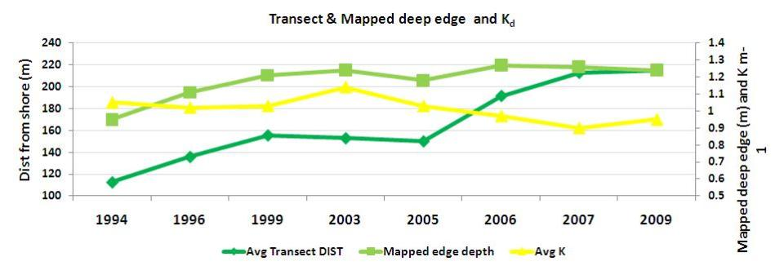
Mapped seagrass deep edge (m)
Lagoon-wide
1.4
1.2
1.0
0.8
0.6
0.4
0.2
0.0
Lagoon-wide

Slide 7
Lagoon-wide (Brevard & Indian River Counties only)
16
3-yr moving annual averages
Chlorophyll a (μg/L)
Turbidity (NTU)
6
14
5
12
10
4
8
3
6
Chl a levels steadily declined
Both Turbidity and Chl a abruptly declined after ‘04
’04 hurricanes
2
4
2
1
0
0
30
Spring (Feb – May), 3-yr moving averages
25
Spring Rainfall (in)
Color (PCU)
Titusville
20
Melbourne
Vero Beach
15
10
’04 hurricanes
Since 1998, Spring rainfall amounts and Lagoon color declined by ~30%
5
0
89-91
90-92
91-93
92-94
93-95
94-96
95-97
96-98
97-99
98-00
99-01
00-02
01-03
02-04
03-05
04-06
05-07
06-08

Slide 8
Vero Beach 3-yr moving average annual rainfall
-- affects Vero and Sebastian segments --
70
61.3”
60
48.9”
50
40
3- yr moving average (in)
30
20
10
0
‘89 - 91
‘93 - 95
‘95 - 97
‘97- 99
‘99 - 01
‘01 - 03
‘03 - 05
‘05 - 07
‘91 - 93
‘06 - 08
Years
A general 12.4” drop in rainfall volume between early and recent decade – translates to >20% reduction in TSS, TN and TP loadings/yr

Slide 9
Pollutant Load Abatement Actions
-- Central IRL –
    WWTP discharge reductions (1996-99)
    Local gov’t projects (2 counties, many municipalities)
    Tributary Muck Removal & Trap Creation (Crane, Turkey, Sebastian)
    C-1, MS-1 operational restraint for small magnitude storms
    Vero Beach Main Canal Vegetative Removal System
    Upper St. Johns R. Basin Project

Slide 10
3-yr moving average of annual discharge volume from USJRB C-54 to Sebastian R.
80
removed storms >15-yr return frequency:
‘94 TS Gordon, ‘04 hurricanes, ‘08 TS Fay *
60
Completion of major elements of Project
USJRB Project changed the rainfall -discharge relationship whereby low magnitude storms do not induce discharge to IRL
3- yr moving avg of annual discharge volume (x10⁶ m³)
*
40
*
*
5.3 billion gallons
20
*
*
*
0
83-85
85-87
87-89
89-91
91-93
93-95
95-97
97-99
99-01
01-03
03-05
05-07
07-09
Years

Slide 11
Possible load reductions over the past decade are likely to have been substantial...especially in Central IRL
    By general source type:
      WWTP discharge (1996-99)
        1985-90: >20% of external loads
        1996-99: < 2% of external loads
      Atmospheric deposition
      Watershed runoff (20 – 25% avg. annual reduction in Central IRL)
      Local and regional projects
Weather-related
Central IRL – VERY ROUGH Estimates
“current” TN loading: ~59 kg TN/ha open water
TMDL: ~36 kg TN/ha
Past Decade: ~42 kg TN/ha

