Slide 1
Indian River Lagoon Technical BMAP Meeting
January 14, 2011

Slide 2
Review of IRL BMAP Elements
The main stem IRL total maximum daily loads (TMDLs) are adopted.
TMDL are intended to help seagrasses grow to 90% of the full restoration depth.
TMDLs were established using seagrass depth-limit data through 1999.
The proposed allocation process is based on achieving the load reductions in a 15-year phased approach (33% each 5-year cycle).

Slide 3
Concerns and More Recent Data
Reductions are based on the depth of seagrasses through 1999, but more recent data are available.
Stakeholders expressed concerns about whether recent improvements should change the necessary reductions.
The SJRWMD numeric nutrient criteria (NNC) map indicated that there are areas of the IRL that may be meeting depth-limit (DL) targets based on newer data.

Slide 4
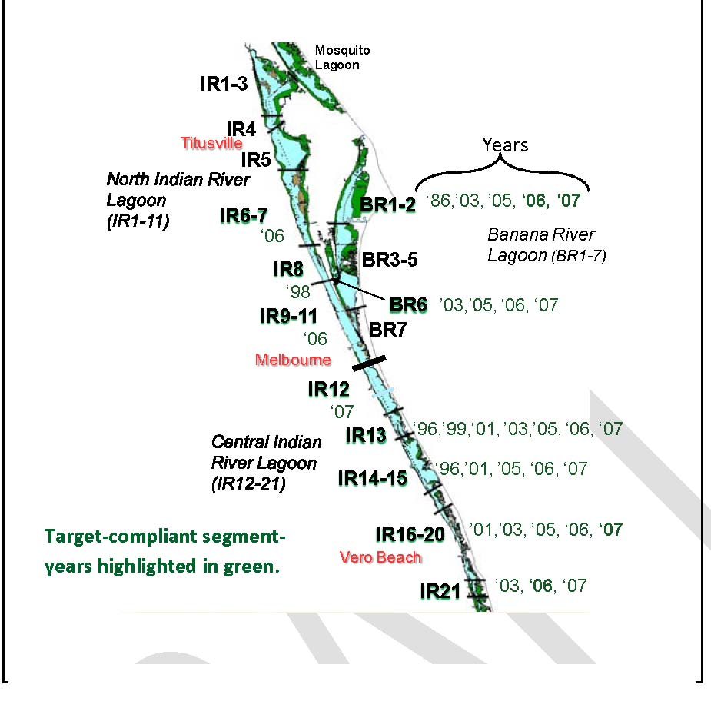
SJRWMD Map Created for the NNC Process

Slide 5
IRL BMAP Status
The SJRWMD NNC map is encouraging but used other datasets than those used for the TMDLs.
  Data used to create the map were not solely based on TMDL criteria; and
  Additional factors specific to NNC (light availability, acres, etc.) were included in the analysis, thus making it unsuitable for TMDL compliance evaluation.
  We are hopeful that the results of the evaluation will allow us to adjust the reduction requirements, but we need to conduct an analysis specific to the TMDL criteria using the newer data.

Slide 6
IRL BMAP Status continued
The Department has been working with the SJRWMD to ensure that the correct methodology for TMDL evaluation is being employed in the assessment.
When this analysis is complete the Department will use the results to revise the allocation approach, ensuring we do not ask more reductions than necessary.
Although results are unavailable we wanted to inform stakeholders about the progress and review some of the technical considerations.

Slide 7
Overview of Technical Steps

Slide 8
Challenges Encountered in Early Iterations
Line bathymetry data would be difficult to use because of reliability concerns.
  Solution: Use the SJRWMD Bathymetry Transect Point file.
Challenge of processing different types of GIS data such as line, point, and polygon to complete a meaningful assessment.
  Solution: Use the GIS function to perform an intersect.

Slide 9
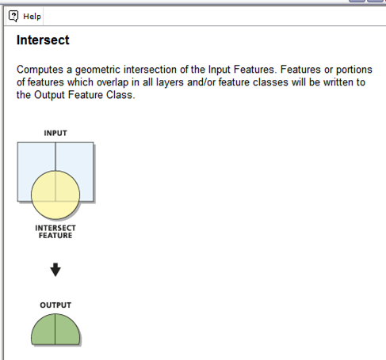
Solution: Intersection

Slide 10
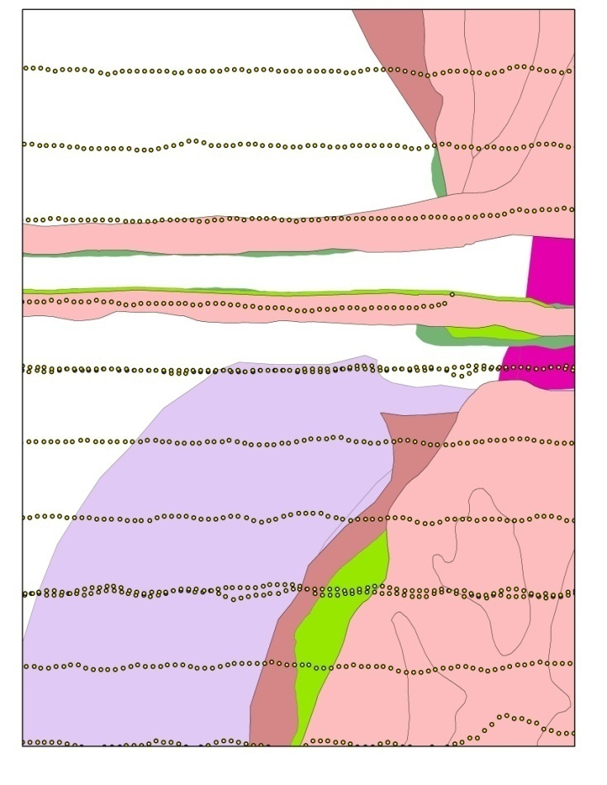
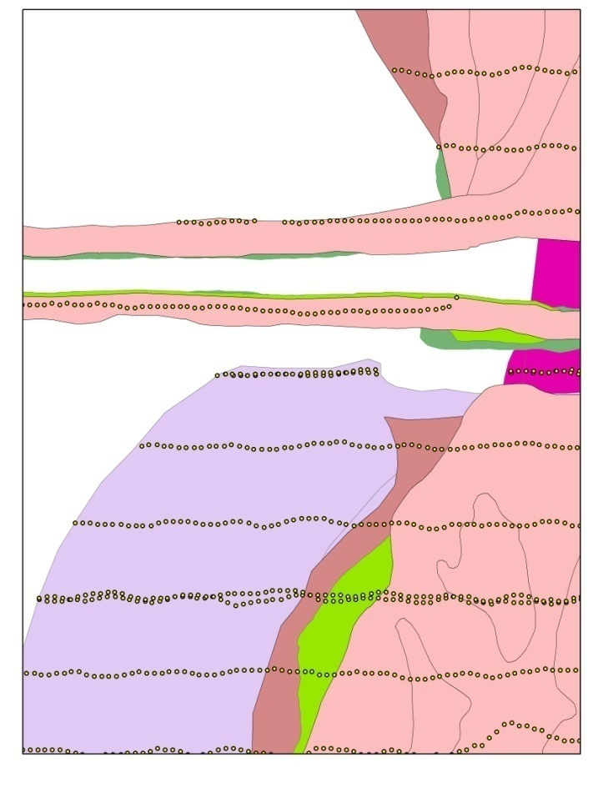
Example of Intersect
Before Intersection
After Intersection

Slide 11
Challenges Encountered in Early Iterations cont.
Multiple attributes within the intersected bathymetry point file and seagrass union coverage created a data skew.
  Solution: After the TMDL seagrass years (‘43, ‘86, ‘89, ‘92, ‘94, ‘96, ’99) are merged into one file, a second GIS processing step must occur called “dissolve” to remove the multiple attributes and create one attribute file.

Slide 12
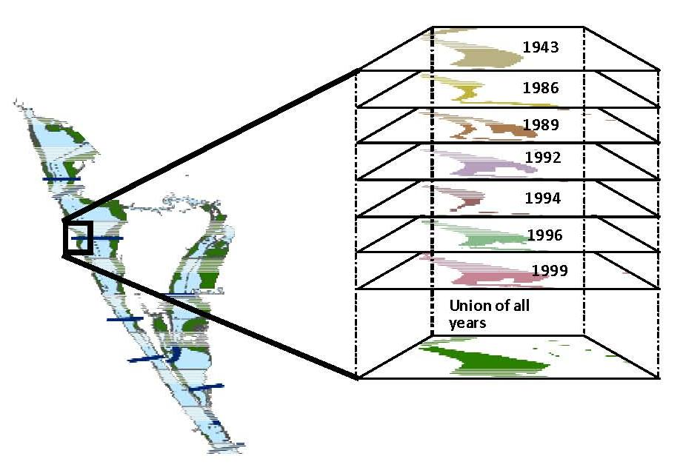
Union Coverage

Slide 13
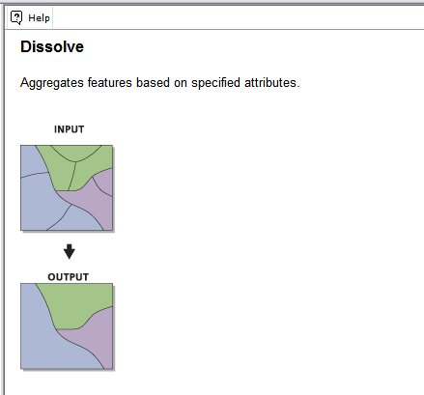
Solution: Dissolve

Slide 14
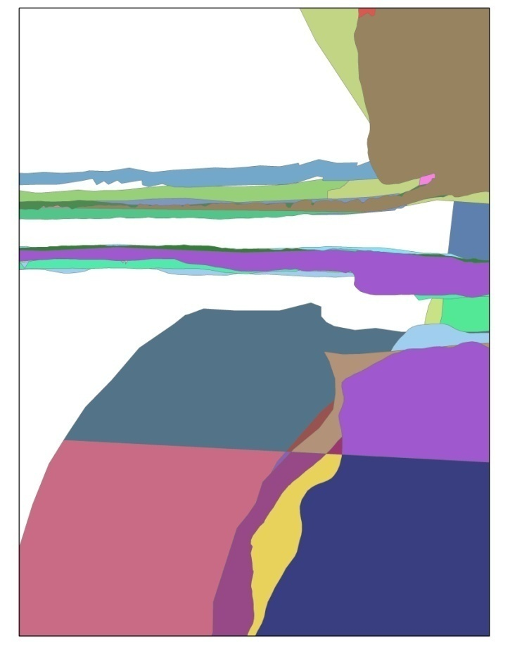

Example of Dissolve
Composite before Dissolve
Composite After Dissolve

Slide 15
Challenges Encountered in Early Iterations
Are we evaluating the correct areas for depth limit evaluation?
  Solution: Use the dredged areas shapefile, provided by the SJRWMD to remove the bathymetry points within these dredged areas.
  Solution: Modify the dataset in the intersected file to only contain depth points between 0.1 m - 3.5 m; as seagrass only grow at these depth ranges.
  Solution: Create a buffer around the mapped seagrass beds (7.9 m inside and 7.9 m outside) to ensure capture of all points nearest the deep edge.

Slide 16
Technical Steps Needed to Complete the Evaluation
Redo the GIS processing:
  Merge the TMDL mapped seagrass ( ‘43, ‘86, ‘89, ‘92, ‘94, ‘96, ‘99) files to create the union coverage and perform the dissolve function;
  Create 7.9 m buffers in the mapped seagrass beds;
  Intersect with the point bathymetry file;
  Remove the bathymetric points in the dredged areas;
  Remove bathymetric points below 0.1 m and above 3.5 m; and
  Perform each step above for the mapped seagrass years (‘03, ‘05, ‘06, ‘07).

Slide 17
Evaluation Steps for TMDL Compliance
Using data results from GIS processing, the actual determination of TMDL compliance is a two-step evaluation method:
  Step 1: For each assessment unit, generate the cumulative frequency distribution of the maximum seagrass depth-limits at each transect.
  Step 2: Determine the seagrass mapping year median depth-limit value.

Slide 18
TMDL Compliance: Step 1
Generate cumulative frequency distribution graphs to compare the TMDL years to the evaluation years:
  Consistent with the method used to develop the depth-limit targets.
  Over 50% of the evaluation year’s distribution curve must lie on or to the right of the TMDL curve.

Slide 19
TMDL Compliance: Step 2
Assessment of each mapping year median relative to the TMDL median depth-limit target:
  Must meet or exceed the TMDL median depth-limit target to meet the Step 2 requirement.
  This ensures that one exceptional year does not overpower other years.

Slide 20
TMDL Depth-Limits
Ranges of Sub-lagoon Median Seagrass Depth Target (m)
North Indian River Lagoon
  1.5 m – 1.8 m
Central Indian River Lagoon
  1.2 m – 1.7 m
Banana River Lagoon
  1.4 m – 1.8 m

Slide 21
TMDL Compliance Considerations
Determine the correct evaluation scale:
  The SJRWMD spatial scale for IRL seagrass mapping is at the segment scale.
  The TMDL is written into rule at the WBID scale.
    WBIDs include multiple segments
  Project zones are areas that are hydrologically similar.
    Project zones include multiple WBIDs and segments.
  The evaluation scale must translate into an allocation approach.

Slide 22
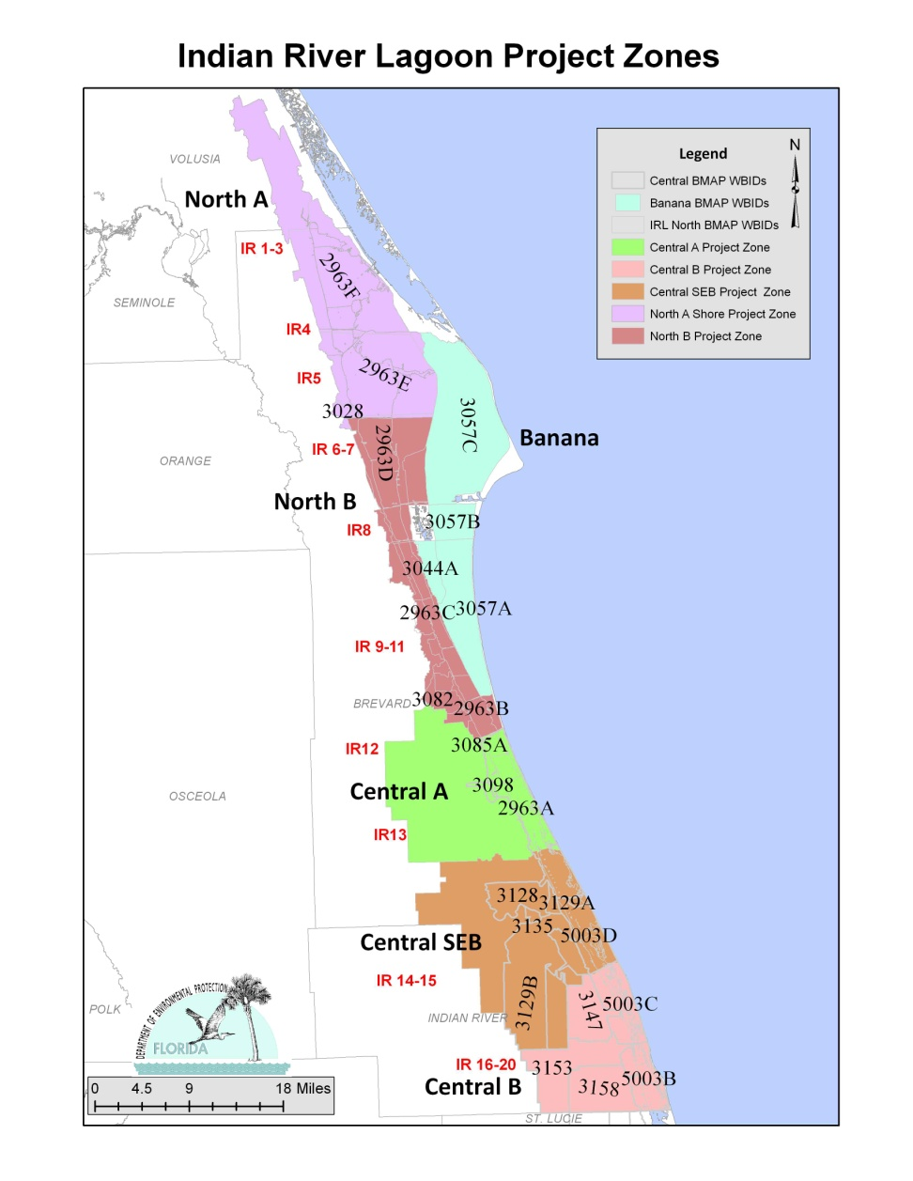
Project Zone, WBIDs, and Segments Map

Slide 23
TMDL Compliance Considerations cont.
What is the appropriate number of assessment years to determine TMDL compliance?
  Need to ensure there are enough years to truly measure improvement.
  Seagrass beds are mapped every two years.
  2001 data are not lagoon-wide as only the Central IRL has the 2001 seagrass beds mapped.
  2009 data are being processed and will be included in the next iteration.

Slide 24
Detailed Allocations
The Department intends to use the results of the TMDL compliance evaluation to adjust the detailed allocation process.
A new allocation process will be developed or the current method will be modified based upon the results.
A review of the new approach with FDEP upper management will occur to ensure it continues to meet the provisions of F.S. 403.067 to be fair and equitable.

Slide 25
Topics for Our Next Meeting
The methodology and results for the TMDL compliance evaluation.
Revised allocation approach.
Final Banana River Lagoon allocations.

Slide 26
Status of the Indian River Lagoon Tributaries Total Maximum Daily Loads
January 14, 2011

Slide 27
IRL Tributaries
FDEP has been evaluating the following IRL tributaries listed as impaired for dissolved oxygen (DO):
  Addison Creek
  Eau Gallie River
  Crane Creek
  Turkey Creek
  North Prong Sebastian River
  Sebastian River above Indian River
  Sebastian River
  C-54 Canal
  North Canal
  Main Canal
  South Canal
  Fort Pierce Farm Canal
  C-25 East Segment

Slide 28
Findings
FDEP has run multiple sensitivity analyses to determine the causative pollutant for the DO impairment.
From these analyses, it does not appear that nutrients (total nitrogen and total phosphorus) have much influence on DO in the majority of the impaired tributaries.
Algal biomass does not seem to contribute significantly to the sediment oxygen demand (SOD) in these impaired tributaries.

Slide 29
Findings continued
Analyses of the water residence time in the tributaries showed that for most impaired tributary segments, water residence time is not long enough for nutrients to stimulate significant algal biomass growth and allow for sedimentation of the biomass to contribute to SOD.
Based on the results, FDEP does not think that nutrients are an important factor that controls DO in most of the tributaries.

Slide 30
Findings continued
The nutrient reductions required for the main stem IRL TMDL will be applicable to the tributary watershed to protect the main stem seagrass.
  For most impaired tributary segments, no further nutrient reduction will be requested for addressing the DO conditions.
The C-25 East Segment and Fort Pierce Farm Canal are located outside the model boundary for the main stem.
  Chlorophyll-a does seem to be a factor in these tributaries, so nutrient load reductions may be needed.

Slide 31
Draft TMDLs
The draft TMDLs should be available in the spring.
Stakeholders will have time to review the draft TMDLs and provide comments.
A public workshop will held shortly after the draft TMDLs are released.

