Slide 1
Overview of Project Credit Guidance for the Indian River Lagoon Basin Management Action Plans
June 27, 2012

Slide 2
Agenda
Muck Removal Credit Guidance
Aquatic Vegetation Harvesting Credit Guidance
Water Control Structures Credit Guidance

Slide 3
Muck Removal Credit Guidance

Slide 4
Overview
Issues with muck in the Indian River Lagoon (IRL) Basin:
  Muck deposits contain nutrients that flux into the water column, increasing the abundance of phytoplankton, drift macroalgae, and epiphytes that attenuate light and constrain seagrass growth and extent.
  Seagrass cannot grow in areas with mucky substrate, further limiting the locations where they can exist.
  When muck is suspended within the water column, these suspended solids limit light availability and suppress seagrass growth.

Slide 5
Overview, continued
Most of the IRL Basin muck comes from upland soils. Stringent land-based source control measures are needed.
  Muck removal projects should be performed in conjunction with soil and vegetation retention programs and public awareness activities that limit the amount of material deposited into the IRL.
Muck removal projects are required to meet applicable permitting requirements and any associated evaluation and tests of the muck as specified by state and federal regulatory agencies.
This guidance is only applicable to the IRL Basin.

Slide 6
Requirement – Muck Thickness
Definition of muck: Black in color, contains clay/silt greater or equal to 50% of the sample by volume, and contains greater or equal to 5% organic matter by volume.
Average minimum thickness of 30 centimeters (about 1 foot) of material is needed to be considered a significant muck deposit technically feasible for removal and eligible for credit.
An estimate of the area of material to be removed that meets the above definition is needed.

Slide 7
Requirement – Removal and Storage
Muck must be completely removed to the natural substrate to the maximum areal extent possible.
Even a small layer (2-5 centimeters) of muck continues to flux nutrients into the water column and can significantly minimize the nutrient reduction benefits.
Muck materials must be completely removed from contact with the surface waters and disposed of in a location where they cannot enter the lagoon or its watershed drainage conveyances.
The distance from surface waters for storage will be determined on a case-by-case basis.
The composition of the muck (presence of contaminants of concern) will influence disposal options.

Slide 8
Requirement – Deposition Rates
Post-project deposition rates must be measured every 5 years and reported to FDEP in order to evaluate whether project credit can be time-extended or applied to subsequent BMAP iterations.
The amount of credit in future years may be reduced based on the rate of new deposition.

Slide 9
Flux Rates
Literature-based net flux rates will be applied to muck removal project areas for the purpose of calculating credit.
  Site-specific flux rates can be used if available and the methods for establishing those rates have been accepted by FDEP.
The net flux rate is the flux rate from the muck minus the flux rate from the normal sandy substrate.
This guidance does not address nutrient release from resuspension of sediment – just don’t have the data.
  Resuspension probably a limited source on canals and streams.
Notes:
Comment on resuspension: many of the muck areas that would be considered by stakeholders are in canals and streams whose size and orientation to prevailing winds preclude frequent or regular wind-wave resuspension. Therefore, wind resuspension would not be a major dynamic regulating nutrient flux (diffusive flux is the overwhelming major factor in these cases). Even when resuspension occurs in these physically constrained waterways, the current velocities within the waterway would need to be directed toward the lagoon (sometimes they are not) and would also need to be strong enough to overcome the settling velocities of the suspended material. Oftentimes, canals are so quiescent that I would hypothesize that an extremely small fraction of resuspended material would exit to the lagoon.
Muck areas in the open lagoon would be subject to more wind resuspension and if we did have the data we could estimate its nutrient contribution on an annual basis (as an additive contribution to diffusive flux).

Slide 10
Flux Rates, continued
Source | Muck Ammonia Flux Rate (kg/km²/yr) | Natural Substrate Ammonia Flux Rate (kg/km²/yr) | Net Ammonia Flux Rate (kg/km²/yr) | Muck Phosphorus Flux Rate (kg/km²/yr) | Natural Substrate Phosphorus Flux Rate (kg/km²/yr) | Net Phosphorus Flux Rate (kg/km²/yr)
Trefry et al., 1992 | 9,811 | 1,226 | N/A | 2,172 | 407 | N/A
Reddy et al., 2001 | N/A | 4,730 | N/A | N/A | 38 | N/A
Montgomery et al., 1979 | N/A | 220 | N/A | N/A | N/A | N/A
Average | 9,811 | 2,059 | 7,752 | 2,172 | 222 | 1,950

Slide 11
Time Limitation
Credit is time limited to a maximum of 10 years.
This initial time limit can be increased 1 year for each 30 cm depth increment above the first 30 cm up to 5 additional years. (applies to very thick deposit)
The initial time limit can be extended an additional 10 years if the stakeholder can demonstrate that effective upland source controls are in place, and the muck deposition rate averages ≤0.25 cm/year or ≤4 cm/10 year over the affected project area.
If deposition rates are greater than the above, the credit will end unless the muck is re-dredged.

Slide 12
Why Use Flux Rates
The total maximum daily loads (TMDLs) are expressed as an annual rate of loading or flux (e.g., lbs/yr).
A volume of muck does not flux its entire nutrient content within a year's time; only a fraction of that content is fluxed annually.
Therefore, credit is only assigned for the portion of the muck loading that is affecting water quality, which is equal to the amount of annual nutrient flux from the muck.
This credit is applied for an initial 10-year period (or 15 years depending on the thickness), and this time period can be extended if the new deposition rates are not significant.

Slide 13
Past Projects
Credit is limited to projects initiated on or after January 1, 2000.
Credit for past projects can be counted only if detailed information is available to calculate credit, including the amount of post-project deposition.
The amount of credit applied in this BMAP iteration may be discounted if new deposition is significant (over 10 years).
New Deposition Amount | 0-4 cm | 5 cm | 6-7 cm | 8-9 cm | >10cm
Discounted benefit of project | No discount applied | 50% | 65% | 80% | No credit applied

Slide 14
Source Control Requirements
Source control actions or programs that can be considered as a minimum for credit include:
  Erosion and sediment control ordinance;
  Landscaping ordinance;
  Street sweeping; and
  Maintaining a vegetative cover on banks of drainage features, whenever possible.
The implementation of additional best management practices or educational activities that address erosion of upland soils is encouraged.
  Construction of riparian buffers along waterways, citizen outreach programs that encourage protection of riparian areas on private property, or construction of rain gardens.

Slide 15
Sediment and Erosion Control
FDEP is considering a sediment and erosion control training workshop in the IRL area.
  We are giving consideration to enhancing the standard training with information about solutions that address basin specific problems.
To help us plan for this type of workshop:
  Is there interest?
  What types of erosion and sediment control issues do local managers face?
  Where are the problem areas?

Slide 16
Muck Collection and Characterization
This information is for general guidance. More detailed instructions will be provided in the future.
Samples of muck can be collected using several different pieces of equipment including corers, scoops, and dredge/grab samplers.
  FDEP protocols are available at: http://publicfiles.dep.state.fl.us/dear/sas/sopdoc/2008sops/fs4000.pdf.
The U.S. Army Corps of Engineers identifies several laboratory methods for characterizing the physical properties of muck.
  Grain size standard sieve test, grain size hydrometer test, grain size pipette test, and organic content/matter.

Slide 17
Muck Survey and Measurement
These are guiding principles. More detailed instructions will be provided in the future.
The muck survey and sample collection should be conducted in a manner that ensures the material characterizes the muck deposit that will be dredged.
Sediment properties vary spatially and vertically within a muck deposit. Consideration should be given to collecting samples from areas that are physically and hydraulically different from each other.
Depth of muck can be measured with a graduated metal rod pushed into the deposit to the point of refusal.

Slide 18
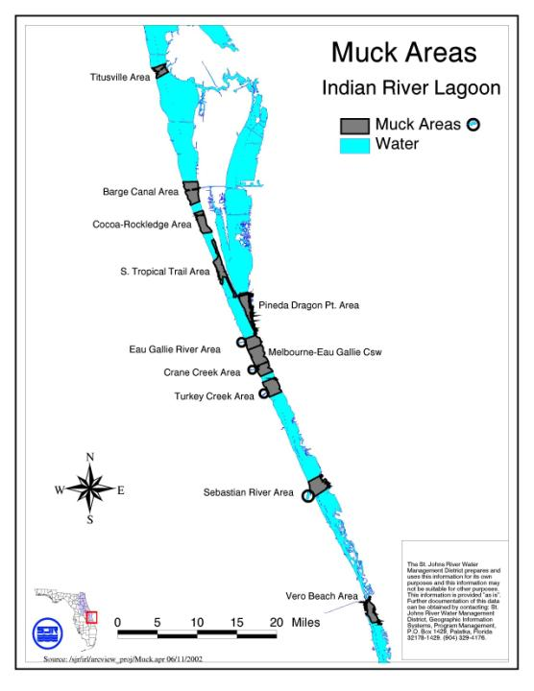
General Location of muck deposits in the IRL Basin
Map depicts muck priority areas not necessarily the size of a muck deposit
Notes:
Please explain that this is a very GENERALIZED map of muck deposit locations. The information displayed is intended to show priority areas where there is a concentration of numerous muck deposits or, in the case of South BRL, a large expansive muck deposit in its canal network. It does show that most of the IRL muck is contained in the North IRL and South BRL.

Slide 19
Example Project
An example calculation was conducted for the southern Banana River Lagoon (BRL), which is segment BR7.
  Dredging has not yet occurred in this area.
Muck sediment thickness in this area averages greater than 30 cm.
The surveyed area for the proposed project is 223 acres or 0.9 km².

Slide 20
Credit Calculation
TN net flux rate = 7,752 kg/km²/yr
TP net flux rate = 1,950 kg/km²/yr
TN credit = 7,752 kg/km²/yr * 0.9 km² * 2.2046 lbs/kg = 15,381 lbs/yr
TP credit = 1,950 kg/km²/yr * 0.9 km² * 2.2046 lbs/kg = 3,869 lbs/yr
Credit would be initially assigned for 10 years .
A time extension on the credits could be provided depended on the total thickness of the muck removed.

Slide 21
Example Project and TMDLs
The load reduction targets for segment BR7 from the TMDLs are 20,2071 lbs/yr of TN and 5,127 lbs/yr of TP.
The reductions associated with muck removal in this area achieve 77% of the TN and 76% of the TP required reductions.
Therefore, muck removal seems to be a viable option for achieving the TMDLs in this portion of the lagoon.

Slide 22
Questions on the Muck Removal Credit Guidance

Slide 23
Aquatic Vegetation Harvesting Credit Guidance

Slide 24
Overview
What are we trying to do?
  Harvest of aquatic vegetation to remove nutrients rather than recycle them through decomposition and sedimentation of plant material.
  Plants take nutrients from the sediment and water column and then recycle the nutrient when the plant dies or as leaves are shed.

Slide 25
Definition
Aquatic vegetation definition: For our purposes freshwater plants that live within the water column or on the surface of water. These plants are more likely to obtain nutrient from the aquatic environment via sediment or water. Includes both native and invasive (non-native) plants.
  Predominately angiosperms or flowering plants.
  For our purposes herbaceous-not woody-plants (green not brown).
  Algae are an aquatic plant- there are the larger algae (not phytoplankton) that may be free floating or attached to a surface (including the surface of plants).

Slide 26
Growth Forms
Free-Floating: Not rooted in the substrate, but float or drift on the water surface. Absorb nutrient from water column. Examples are duckweed and bladderwort, and the invasives water lettuce and water hyacinth.
Floating Leaved: May or may not be rooted in substrate, but leaves float on water surface. Water lilies and spatterdock are examples.

Slide 27
Growth Forms (continued)
Submersed: Submerged in water column and rooted to sediment. Obtain nutrients from sediment. Examples are eelgrass and watermilfoils (Myriophyllum) and the invasive Hydrilla.
Emergent (emersed): Plants emerge or break the surface of water. Obtain nutrients from sediment. Examples are cattails, bulrush, and maidencane.

Slide 28
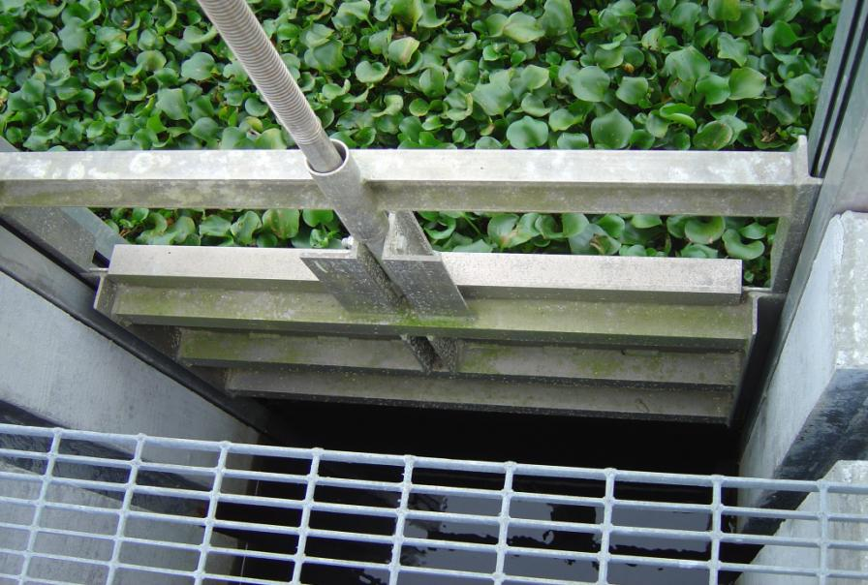
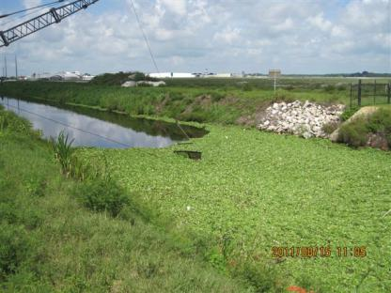
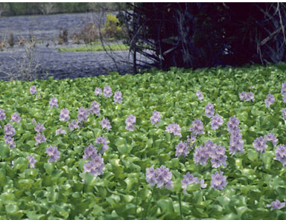
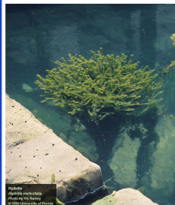
Water lettuce
Water hyacinth
Hydrilla

Slide 29
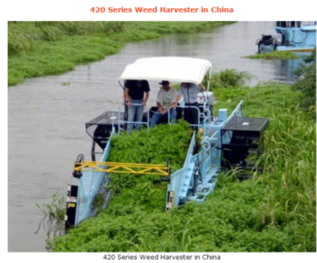
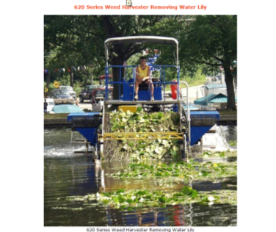
Harvesting of Vegetation
There are specifically designed harvesters and shredders.
Photos courtesy of Aquarius Systems www.aquarius-systems.com

Slide 30
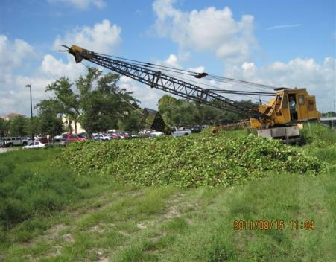
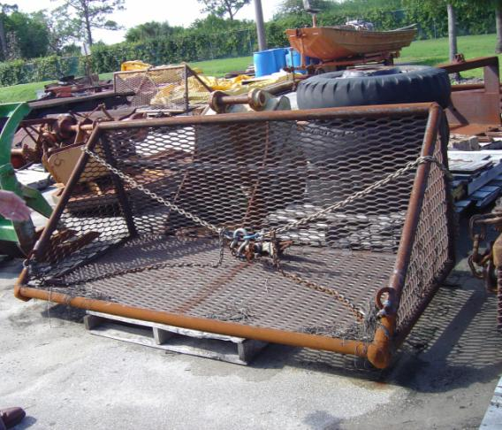
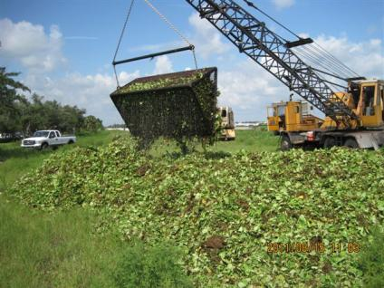
Local Examples of Harvest

Slide 31
Plant Growth Factors
Aquatic plants are largely water.
  Water hyacinth as live plant can weigh 200-300 tons per acre, but are 90-95% water weight.
Factors that influence growth and nutrient content of plants:
  Light and water clarity;
  Nutrient availability;
  Organic matter;
  Sediment fertility, composition, and stability; and
  Age of plant.

Slide 32
Plant Growth Factors, continued
Nutrient content variable because of the above factors and also by:
  Harvesting location;
  Plant species; and
  Seasonal changes.
Examples of variability:
  15-40 g/kg N and 4-10 g /kg P for large leave plants, water lettuce, and water hyacinth (Aoi and Hayashi, 1996).

Slide 33
Crediting Plant Removal
Need the following pieces of information:
  Type of plant or mix of plants present.
    Abundance of each plant. Need to decide if it is predominately a monoculture or if there are other plants in the mixture.
  Mass of wet plant material – example:
    Bucket load of plant material drained and weighed; count the number of buckets removed.
  Percent dry matter.
  TN and TP content (usually reported on a dry weight basis).

Slide 34
Nutrient Content
Method 1: Collect samples from harvest site and send to lab for analysis. Material should be representative of plants harvested. Example- plants present at harvest site are 80% species A and 20% species B, collect material proportional to presence. Total number of samples to be collected to be determined.
  Harvest from many different locations.
  Mixed stand of plants.
  Only one harvest per year.
Method 2: Library of locally collected and literature values for TN, TP, and percent dry matter.
  Multiple harvests from same area. Expect similar results.
  Limited number (monoculture) of species or recurring species composition.

Slide 35
Calculating Nutrient
Mass of wet plant material * percent of dry matter * TN or TP as mg or g/kg
  Example: 5,000 lbs of water lettuce * 0.057 (average % dry matter) * 25 g/kg TN = 7.1 lbs TN
Method 2: Mass of wet plant material * percent of dry matter * percent of TN on a dry weight basis
  Example: 5,000 lbs of water lettuce * 0.057 (average % dry matter) * 2.5% (.025) nitrogen = 7.1 pounds TN

Slide 36
Amount of Credit
Credit applied where plant removal is not part of a permit or contained within another BMP.
Credits provided with each harvest event with an annual average for BMAP credit.
Watershed BMPs that control nutrient loading applied as appropriate and to the extent possible.
Material should be spread out to expedite decomposition.

Slide 37
Amount of Credit, continued
Where plant material is disposed of will effect credits.
  100% credit of nutrient removed – disposal at a landfill or other location outside waterbody drainage area or far enough away from waterbody to prevent re-entry.
  >5% - <100% - credit increased by distance from waterbody. Evaluated case-by-case.
  0%-5% credit - Disposal on bank or within a few feet of water.

Slide 38
Questions to be Answered
Do we treat the nutrient removal capability of a rooted plant the same way as a free floating plant?
Is there a maximum frequency of harvest before ecological disruption negatively impacts fish and wildlife?
Applicability of literature values. Do they address seasonality and other temporal and spatial variables?
Effect of distance between waterbody and disposal site. What is far enough away?
Refinement of methods for sampling.

Slide 39
Expert Review
Talking to FWC Aquatic Plant Management Program – Jeff Schardt
And FWC Aquatic Habitat Restoration Program – Bruce Jaggers, John Benton
Bill Haller, University of Florida, Center for Aquatic and Invasive Plants
Additional Potential experts: Indian River Research and Education Center

Slide 40
Questions on the Aquatic Vegetation Harvesting Credit Guidance

Slide 41
Water Control Structures Credit Guidance

Slide 42
Overview
The Indian River Farms Water Control District (IRFWCD) replaced the radial arm gates in their three canals with tilting weir gates in 2004.
Tilting weir gates allow water to flow over the top of the structure while holding back any sediment that may have built up at the bottom of the weir structure.
This is an improvement from the radial arm gates that are pulled up to allow water to pass through the bottom of the structure, which also allow the sediments that have built up to pass through.

Slide 43
Overview, continued
FDEP evaluated the available water quality data that are collected by IRFWCD quarterly in their canals.
Information on BMP implementation, land use changes, land use/cover in the drainage area of each control structure, rainfall, and other factors that could affect nutrient loading to the canals have not been documented.
  It is possible that other activities within the drainage area could be influencing the water quality in the canals, in addition to the tilting weir gates.

Slide 44
Credit Determination
The TN and TP data were evaluated for the period before the tilting weir gates were installed (1996-2003) and after the tilting weir gates were installed (2005-2011).
The average TN and TP concentrations for each year in each canal were calculated.
  Each canal had one sampling location.
The averages for each period (1996-2003 and 2005-2011) were then calculated for each canal.
The average for 2005-2011 was compared to the average for 1996-2003 for each canal to determine if there was an improvement in nutrient concentrations.

Slide 45
Credit Determination, continued
The average reductions in TN and TP for each canal were then averaged to determine an overall estimate of nutrient reduction.
  While some of the reductions may be attributable to the tilting weir gates, there are likely other factors influencing load.
Location | TN Reduction (Average) | TP Reduction (Average)
Main Canal | 2.6% | -28.8%
North Canal | 10.1% | -7.2%
South Canal | 3.4% | 26.6%
Average | 5% | -3%
Note: The negative values indicate an increase in TP after the tilting weir gates were installed.

Slide 46
Provisional Credit
Based on the available data, provisional credit for water control structures, such as tilting weir gates, will be assigned as 5% for TN.
  There does not appear to be a benefit for TP from these structures.
The 5% TN credit will be applied to the total TN load that drains from the watershed to the canal with the water control structure.
As the provisional credit was calculated on limited data, additional data are needed to better assess the benefits of these structures.

Slide 47
Future Studies
It would be useful to collect future data as part of either a paired watershed study or comparison of water quality upstream and downstream of the weir.
The paired watershed study would consist of monitoring a canal without a water control structure and a canal with a water control structure to identify any benefits of the structure.
The two canals would have to receive runoff either from the same watershed or watersheds with similar land uses so that the data could be comparable and where some of the confounding factors would be removed.

Slide 48
Future Studies, continued
The other option would be to compare water quality upstream and downstream of the weir.
This would allow the effects of the weir to be isolated from other characteristics of the watershed.
This study design necessitates additional monitoring locations in each canal.
Any future study should also include collection of rainfall and flow data.

Slide 49
Questions on the Water Control Structures Guidance

