Slide 1
Indian River lagoon North
Monitoring Plan Discussion
June 18, 2010
Anita Nash

Slide 2
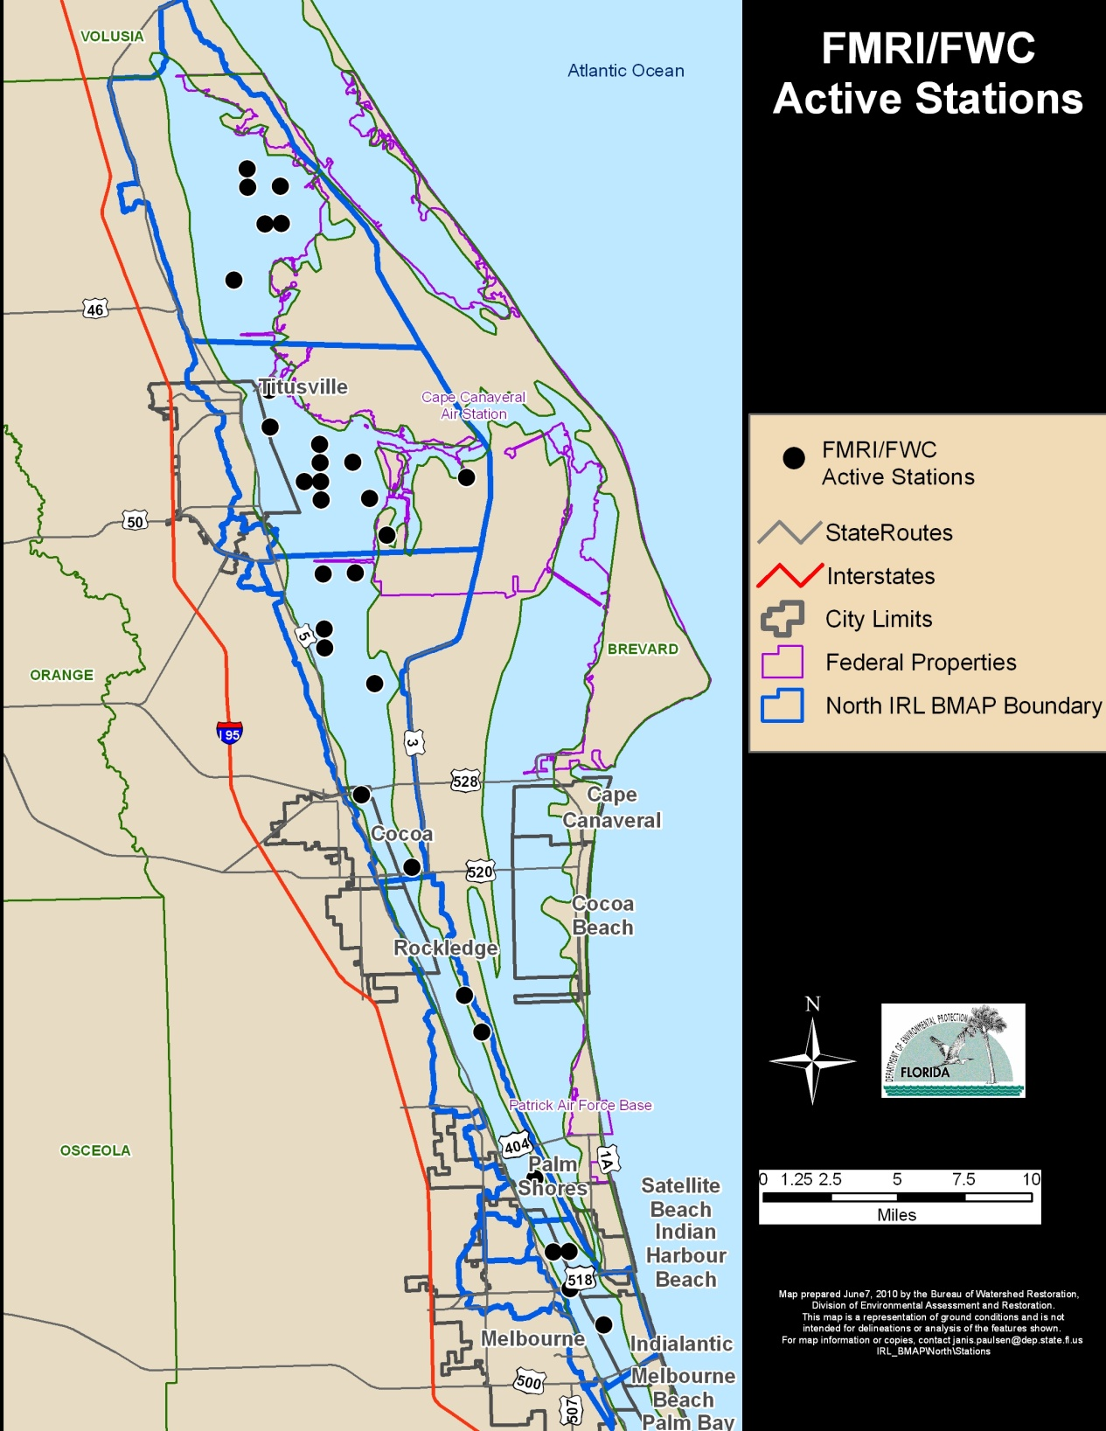
IWR Stations
These stations may or may not be part of current monitoring efforts. They were sampled at least once in the past. Inquiring to find out the current status.
Stations

Slide 3
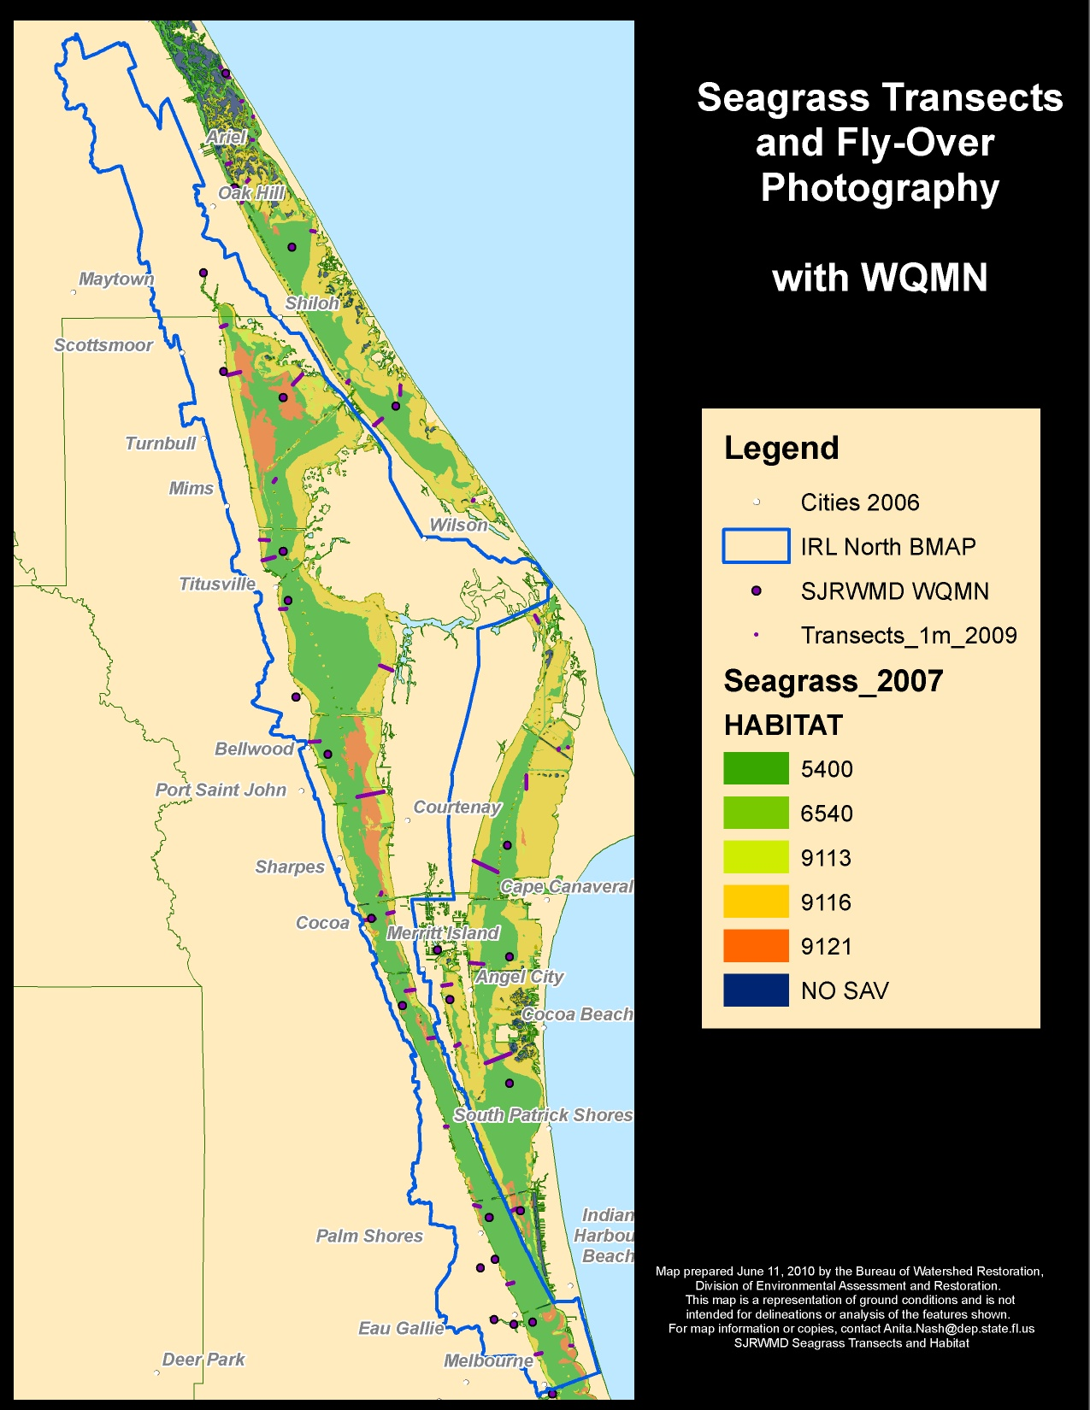
Fly Over Photography occurs once every other year.
Transects assessed frequently.

Slide 4
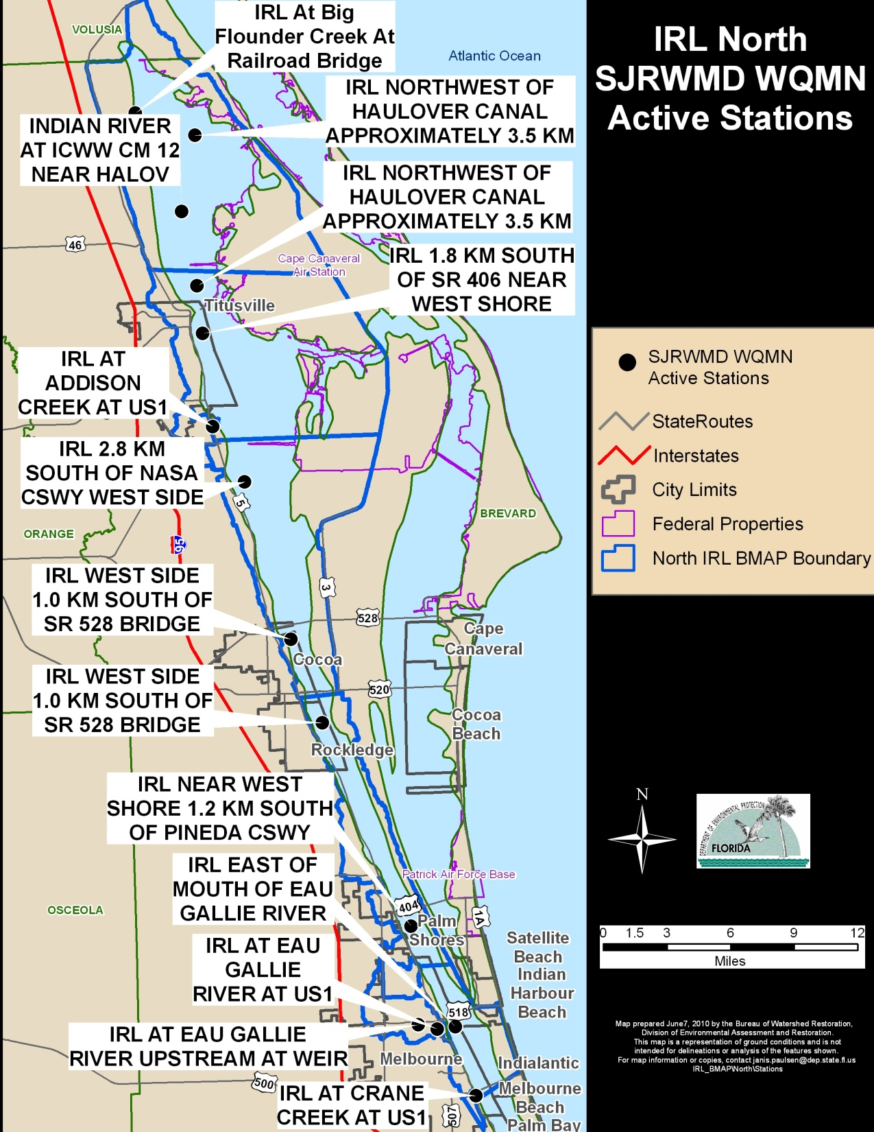
Monthly
HN4-D, Air Temp, Chl-a,b,c, Cloud Cover, Color, Conductance, DO, DOC, Nox-D, PO4-D, Pheophytin Corrected, Ratio Chl-a/Pheo, Salinity, Secchi, SiO2-D, TKN-D, TKN-T, TOC, TP-D, TP-T, TSS, Turbidity, VSS, Water Temp, Weather, Wind Direction, Speed, pH

Slide 5
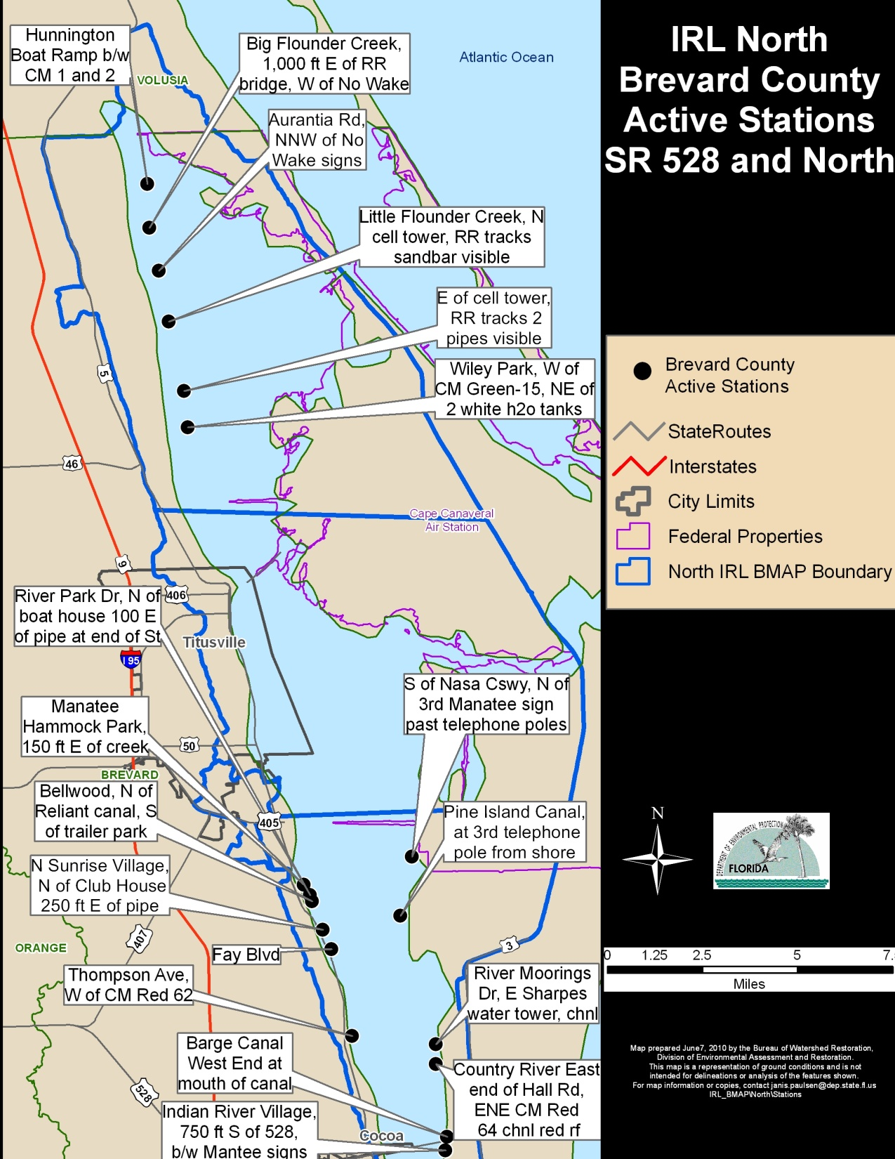
Quarterly
Water Temp., pH, DO, Specific Conductance, Salinity, Secchi, Air Temp., Cloud cover, Wind Velocity, Wind Direction, Weather Code, Cadmium, Chromium, Copper, zinc, hardness, carbonate, anions, nitrogen ammonia as N, nitrogen NitriteNO2 =NitrateNO3 as N, Total Nitrogen, Kjeldahl Nitrogen, Phosphorus as P, TSS, Turbidity, Fecal Coliform, Oil and Grease

Slide 6
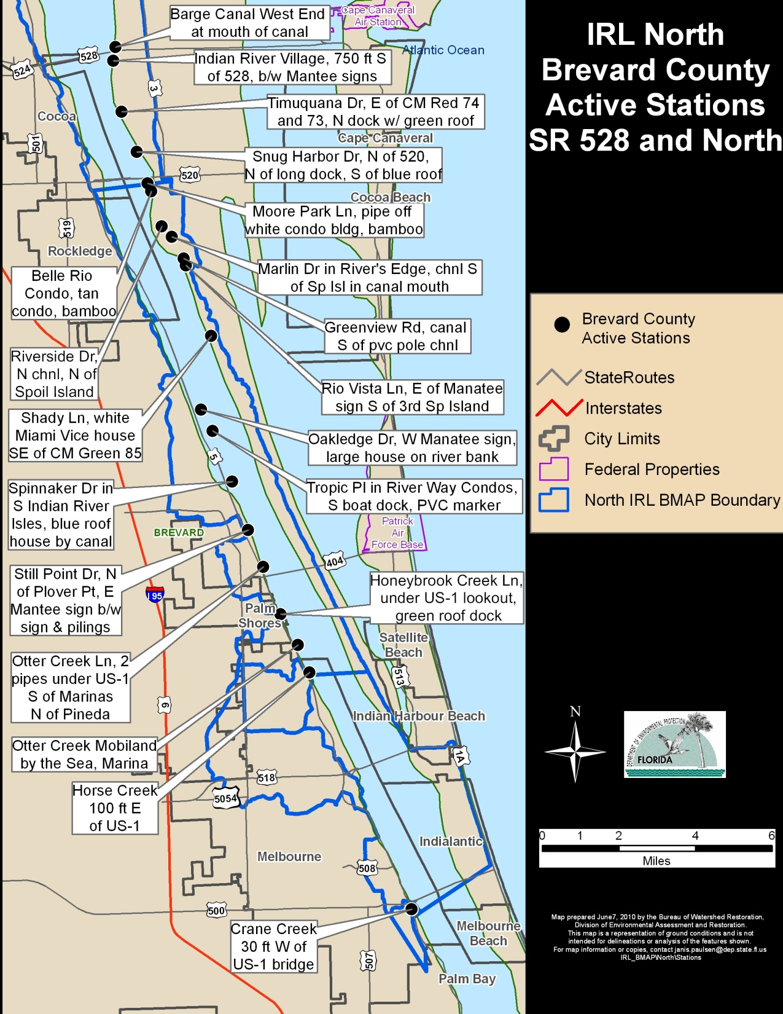
SR 528 and South
Quarterly
Water Temp., pH, DO, Specific Conductance, Salinity, Secchi, Air Temp., Cloud cover, Wind Velocity, Wind Direction, Weather Code, Cadmium, Chromium, Copper, zinc, hardness, carbonate, anions, nitrogen ammonia as N, nitrogen NitriteNO2 =NitrateNO3 as N, Total Nitrogen, Kjeldahl Nitrogen, Phosphorus as P, TSS, Turbidity, Fecal Coliform, Oil and Grease

Slide 7
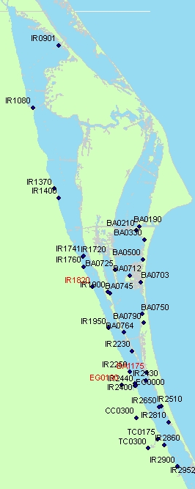
Marine Resources Council
Active Volunteer Stations
Weekly
Salinity, pH, DO, Secchi, Temperature

Slide 8
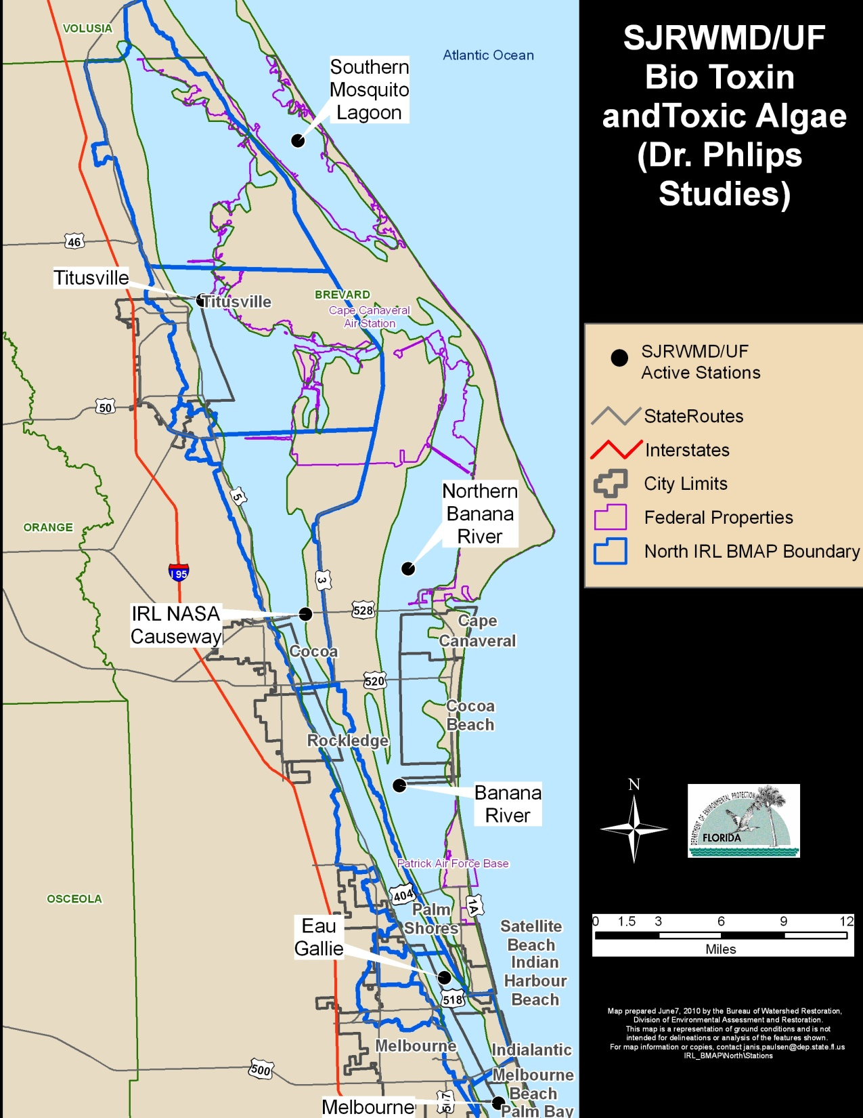
Active Stations
Every Other Week
Salinity, temperature, DO, color, turbidity, Secchi depth, PAR light extinction coefficient, TN, TP, Chlorophyll, phytoplankton composition and abundance

Slide 9
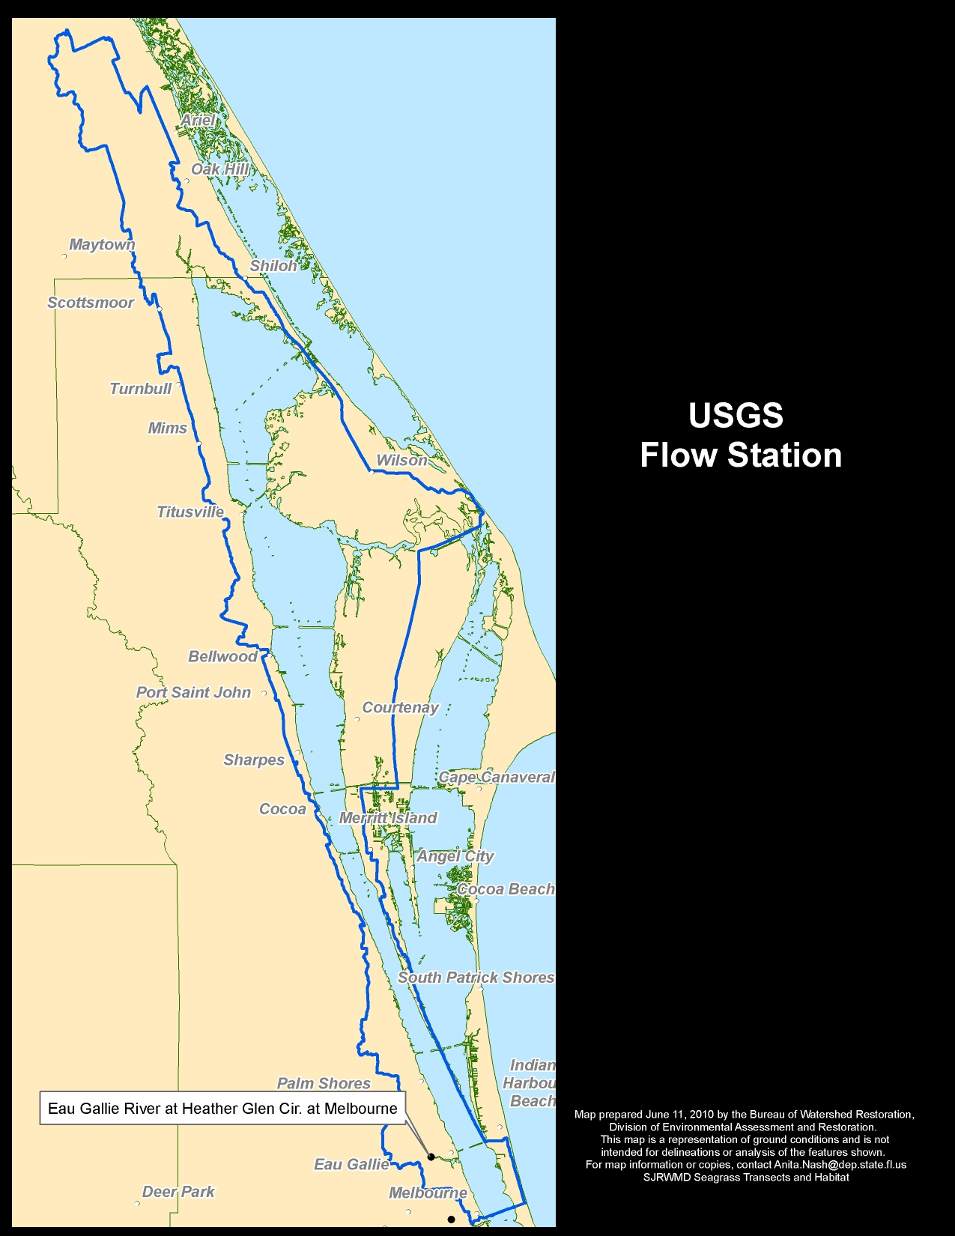
Continuous
Real Time

Slide 10
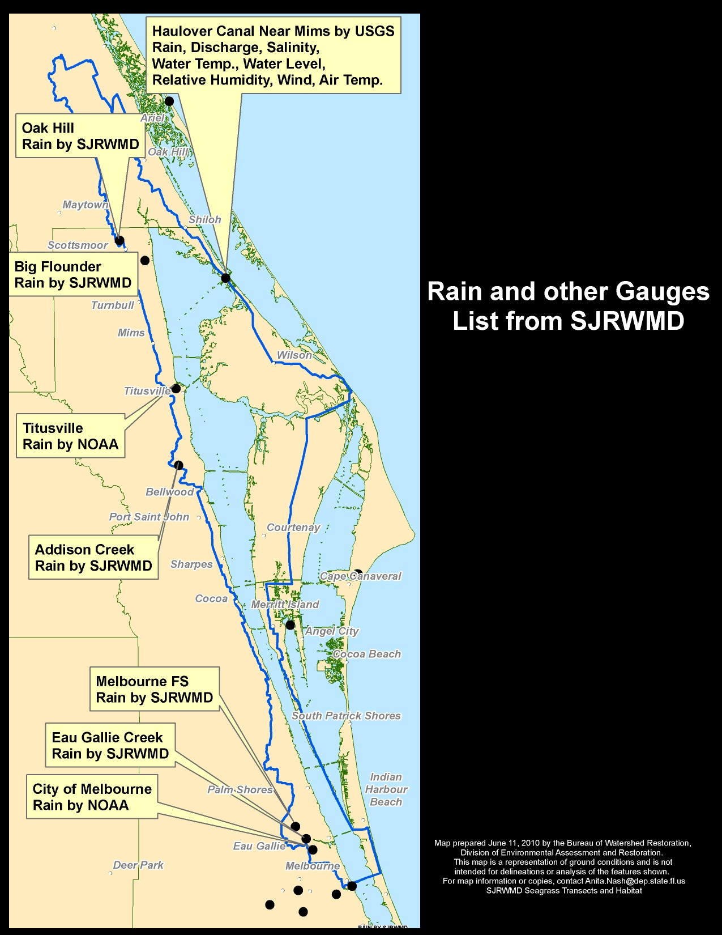
SJRWMD List of Rain Gauges etc.

Slide 11
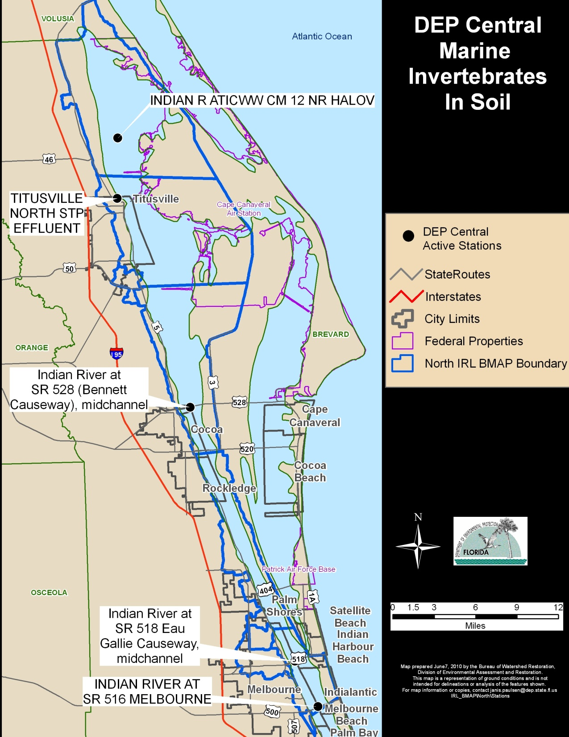
Every Other Year

Slide 12
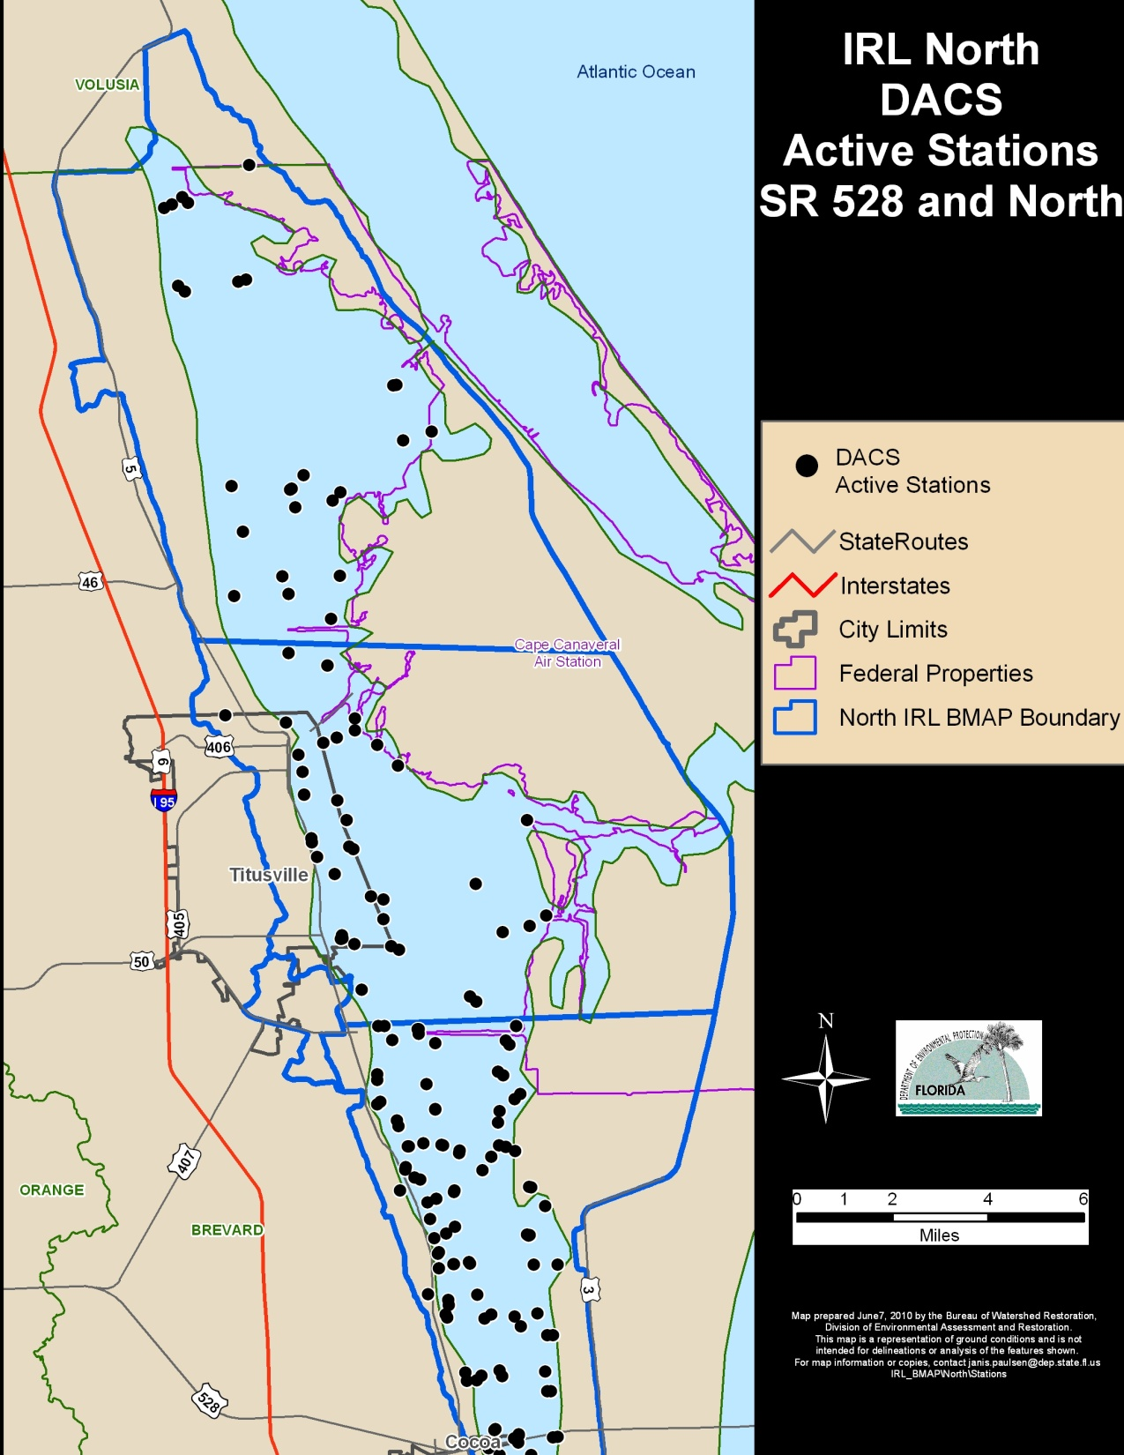
Division of Aquaculture
Sampled at a minimum 5 times per year
Additional sampling for the purpose of opening closed Clam beds
Lab:
Fecal Coliforms
Turbidity
Field:
Salinity, DO, pH, Water Temp, estimated wind velocity & direction

Slide 13
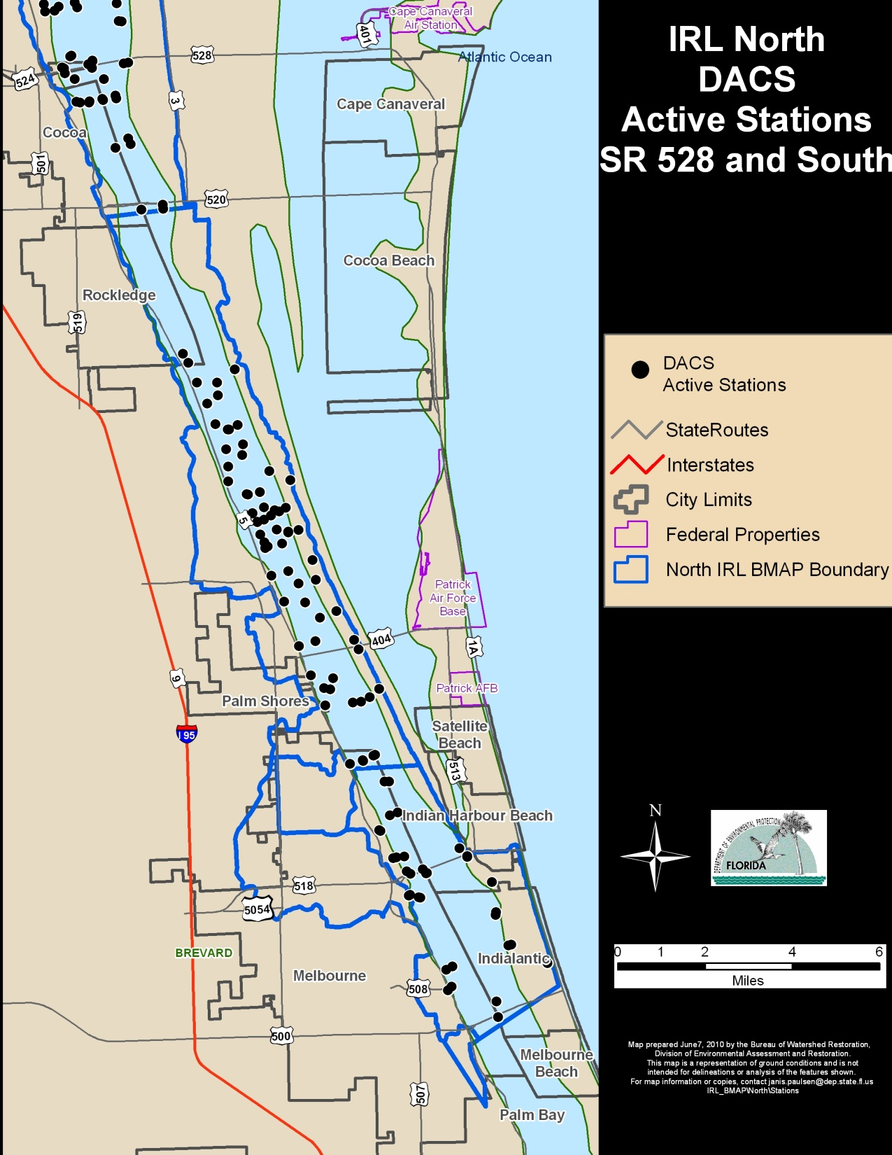
Division of Aquaculture
Sampled at a minimum 5 times per year
Additional sampling for the purpose of opening closed Clam beds
Lab:
Fecal Coliforms
Turbidity
Field:
Salinity, DO, pH, Water Temp, estimated wind velocity & direction

Slide 14
Station Meta Data
STA STORET Station
StationDescription Long Location description
WBID Water Body Identification station is inside of
LAT LONG Latitude and Longitude
NOBS Number of Observations
BD Begin Date
ED End Date
Active Is it being sampled now as part of a project
SamplingAgency Name of Project owner agency
LocalStationID Data Supplier Station ID
Station Type Water Quality, Flow, Transect, etc.
Frequency Monthly, Weekly, etc.
Parameters A list of all parameters sampled each visit
Program Name What does the data supplier call this program
Comments

Slide 15
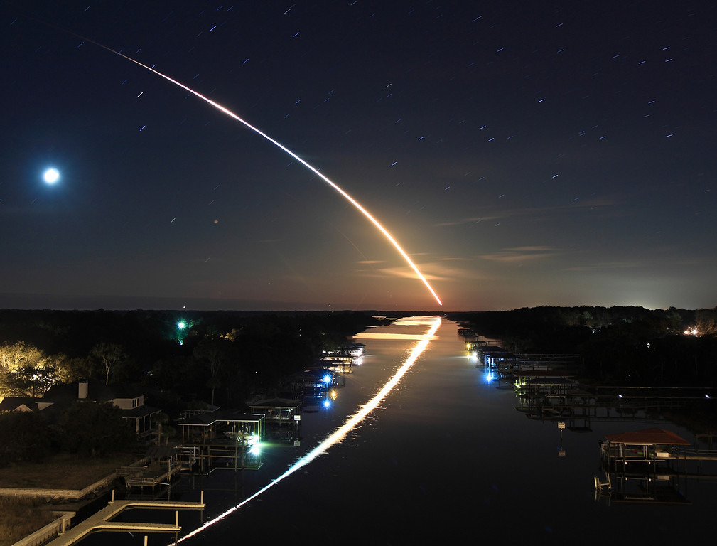
Questions and Discussion
Photo credit: a friend of a friend of a friend…etc.

