Slide 1
Indian River lagoon North
Monitoring Plan Discussion
July 9, 2010
Anita Nash
Notes:
Updated IRL-C

Slide 2
403.067 Establishment and implementation of total maximum daily loads.—5. The basin management action plan must include milestones for implementation and water quality improvement, and an associated water quality monitoring component sufficient to evaluate whether reasonable progress in pollutant load reductions is being achieved over time. An assessment of progress toward these milestones shall be conducted every 5 years, and revisions to the plan shall be made as appropriate. Revisions to the basin management action plan shall be made by the department in cooperation with basin stakeholders.
Notes:
Updated IRL-C

Slide 3
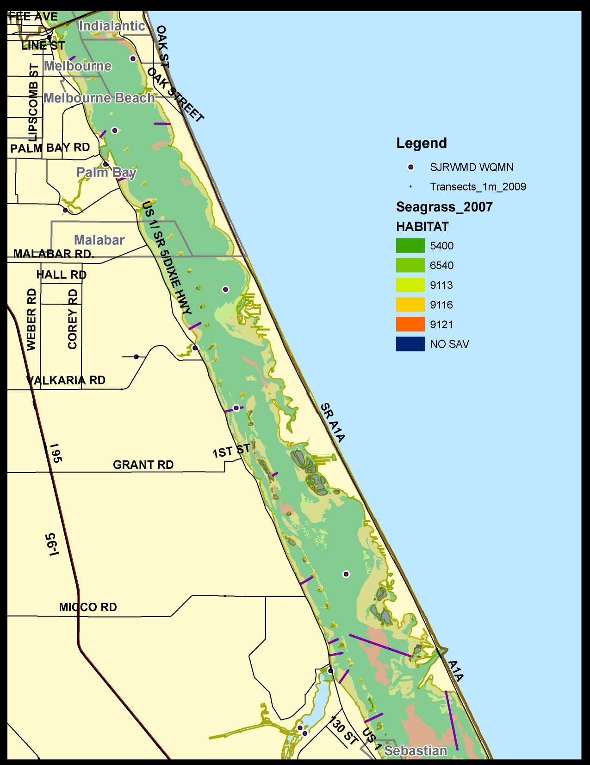
Fly Over Photography occurs approximately once every other year.
Transects assessed frequently.

Slide 4
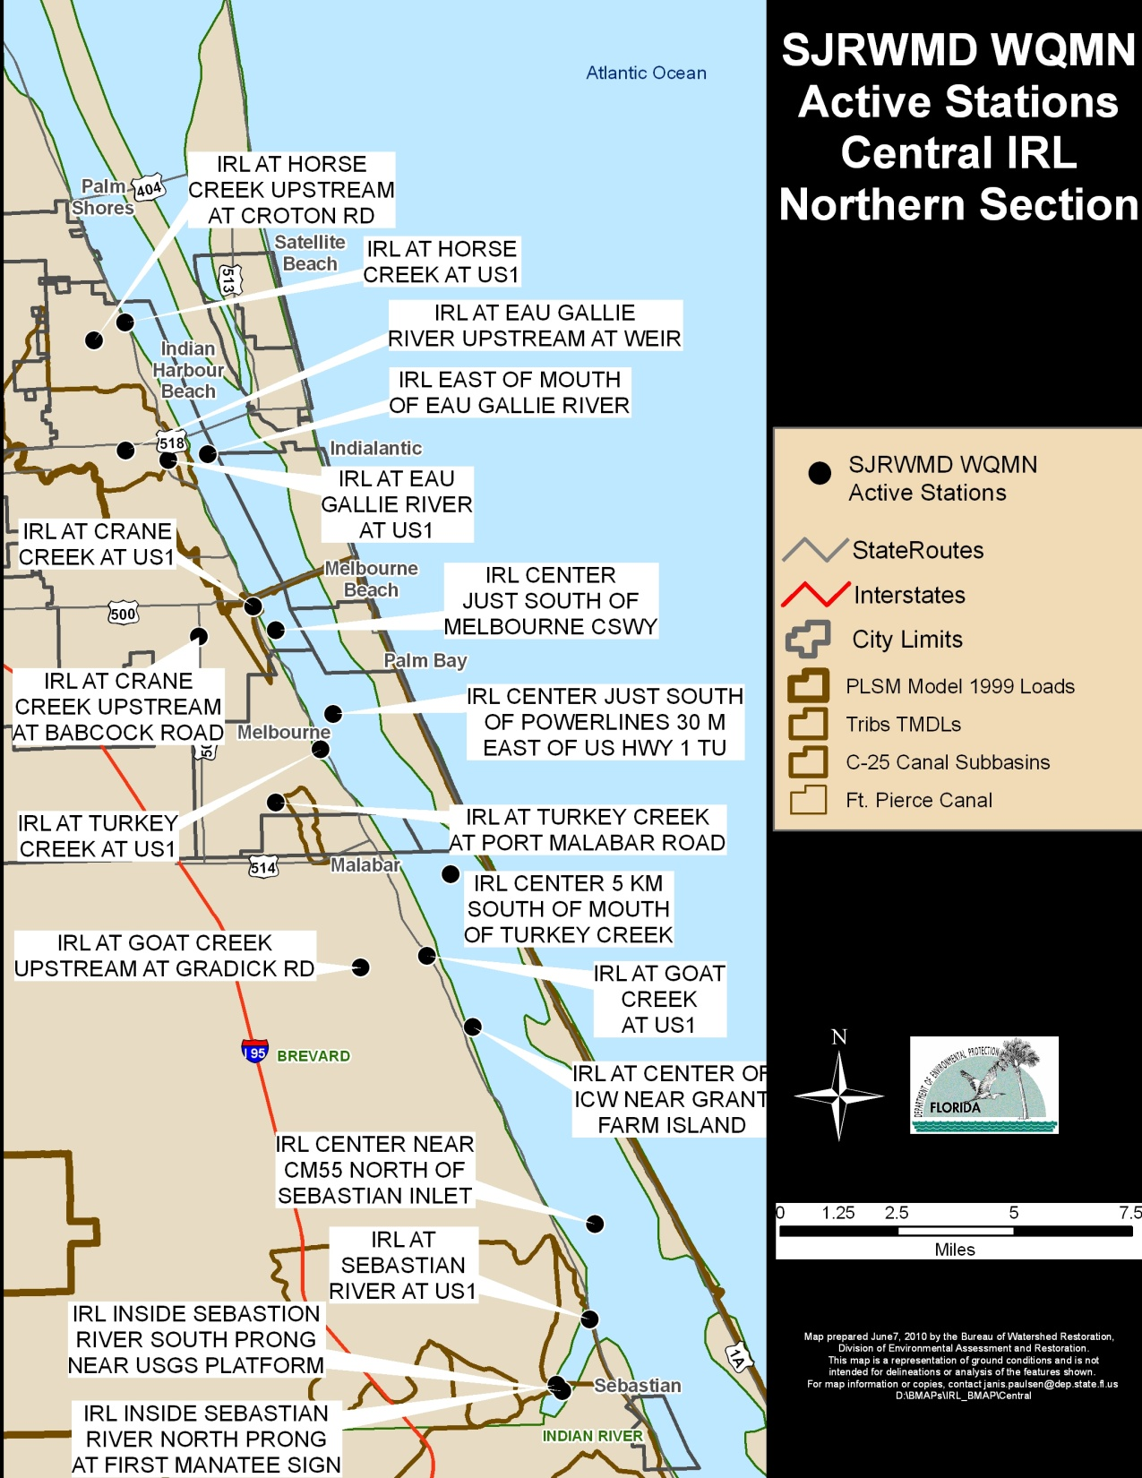
Monthly
HN4-D, Air Temp, Chl-a,b,c, Cloud Cover, Color, Conductance, DO, DOC, Nox-D, PO4-D, Pheophytin Corrected, Ratio Chl-a/Pheo, Salinity, Secchi, SiO2-D, TKN-D, TKN-T, TOC, TP-D, TP-T, TSS, Turbidity, VSS, Water Temp, Weather, Wind Direction, Speed, pH
Notes:
Updated IRL-C

Slide 5
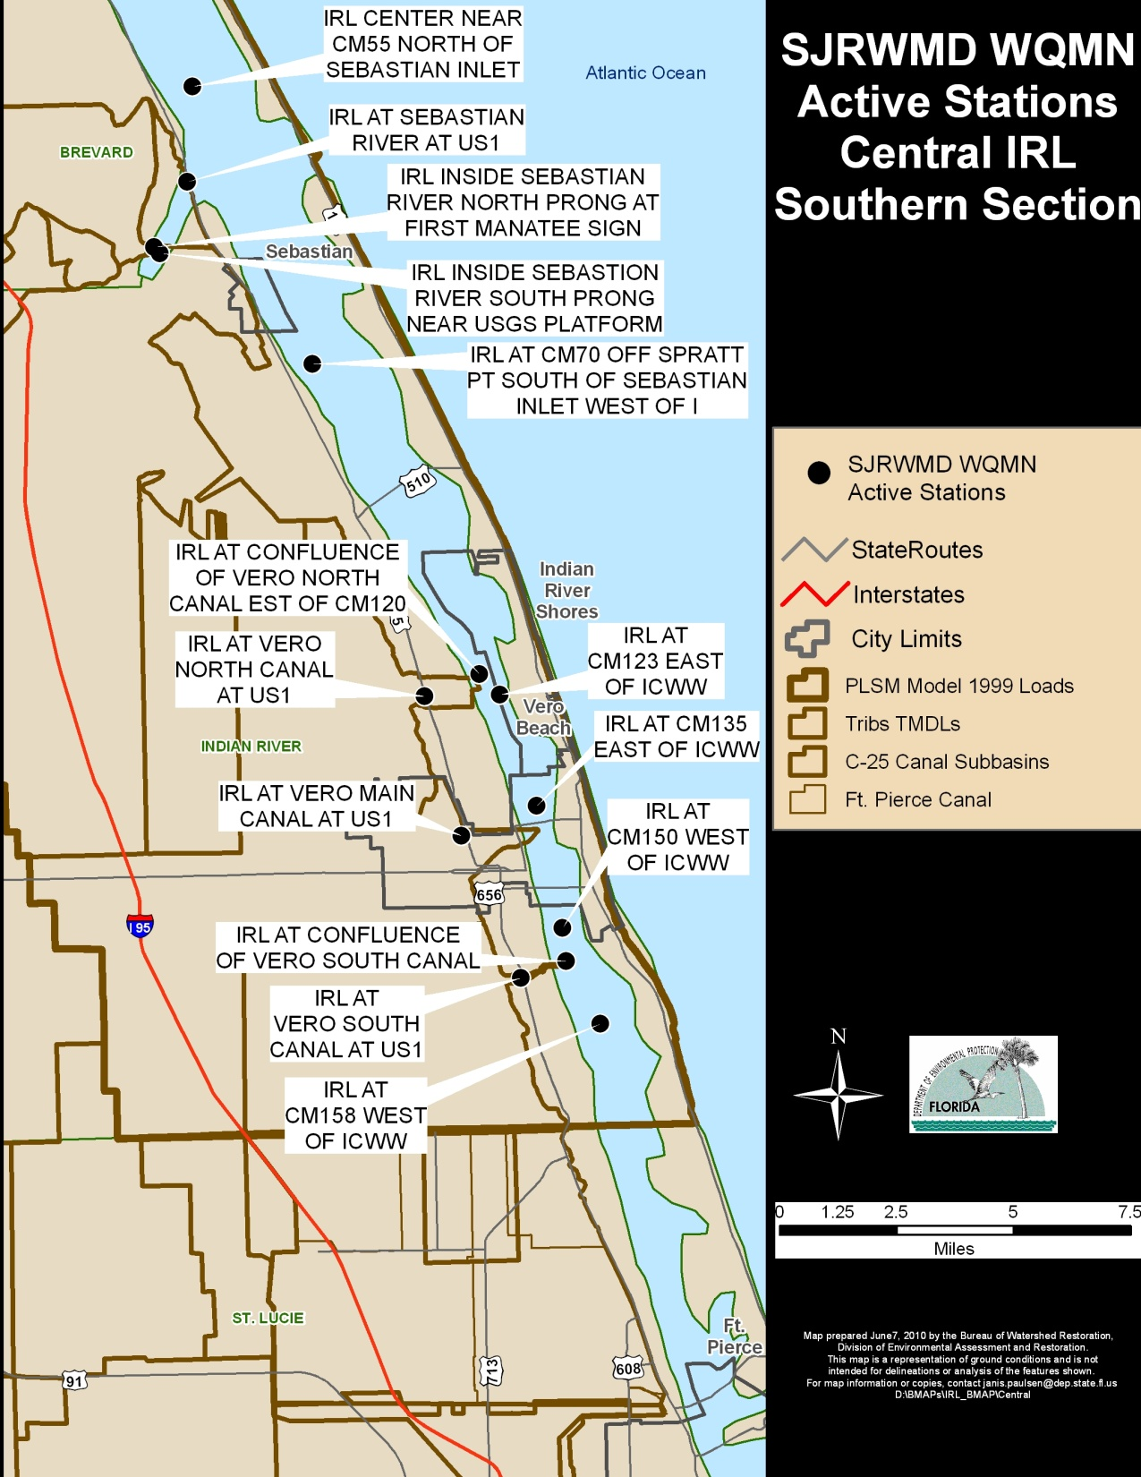
Monthly
HN4-D, Air Temp, Chl-a,b,c, Cloud Cover, Color, Conductance, DO, DOC, Nox-D, PO4-D, Pheophytin Corrected, Ratio Chl-a/Pheo, Salinity, Secchi, SiO2-D, TKN-D, TKN-T, TOC, TP-D, TP-T, TSS, Turbidity, VSS, Water Temp, Weather, Wind Direction, Speed, pH
Notes:
Updated IRL-C

Slide 6
County Sampling
Brevard County: Stormwater Sampling
Indian River County
St. Lucie County
Notes:
Updated IRL-C

Slide 7
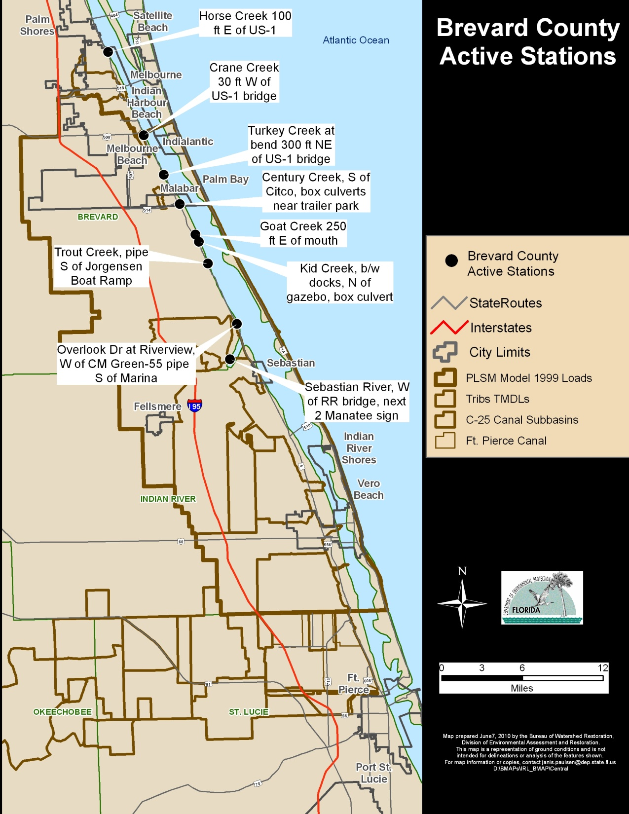
Quarterly
Water Temp., pH, DO, Specific Conductance, Salinity, Secchi, Air Temp., Cloud cover, Wind Velocity, Wind Direction, Weather Code, Cadmium, Chromium, Copper, zinc, hardness, carbonate, anions, nitrogen ammonia as N, nitrogen NitriteNO2 =NitrateNO3 as N, Total Nitrogen, Kjeldahl Nitrogen, Phosphorus as P, TSS, Turbidity, Fecal Coliform, Oil and Grease
Notes:
Updated IRL-C

Slide 8
County Sampling
Brevard County: Storm water Sampling
Indian River County:
St. Lucie County:
Notes:
Updated IRL-C

Slide 9
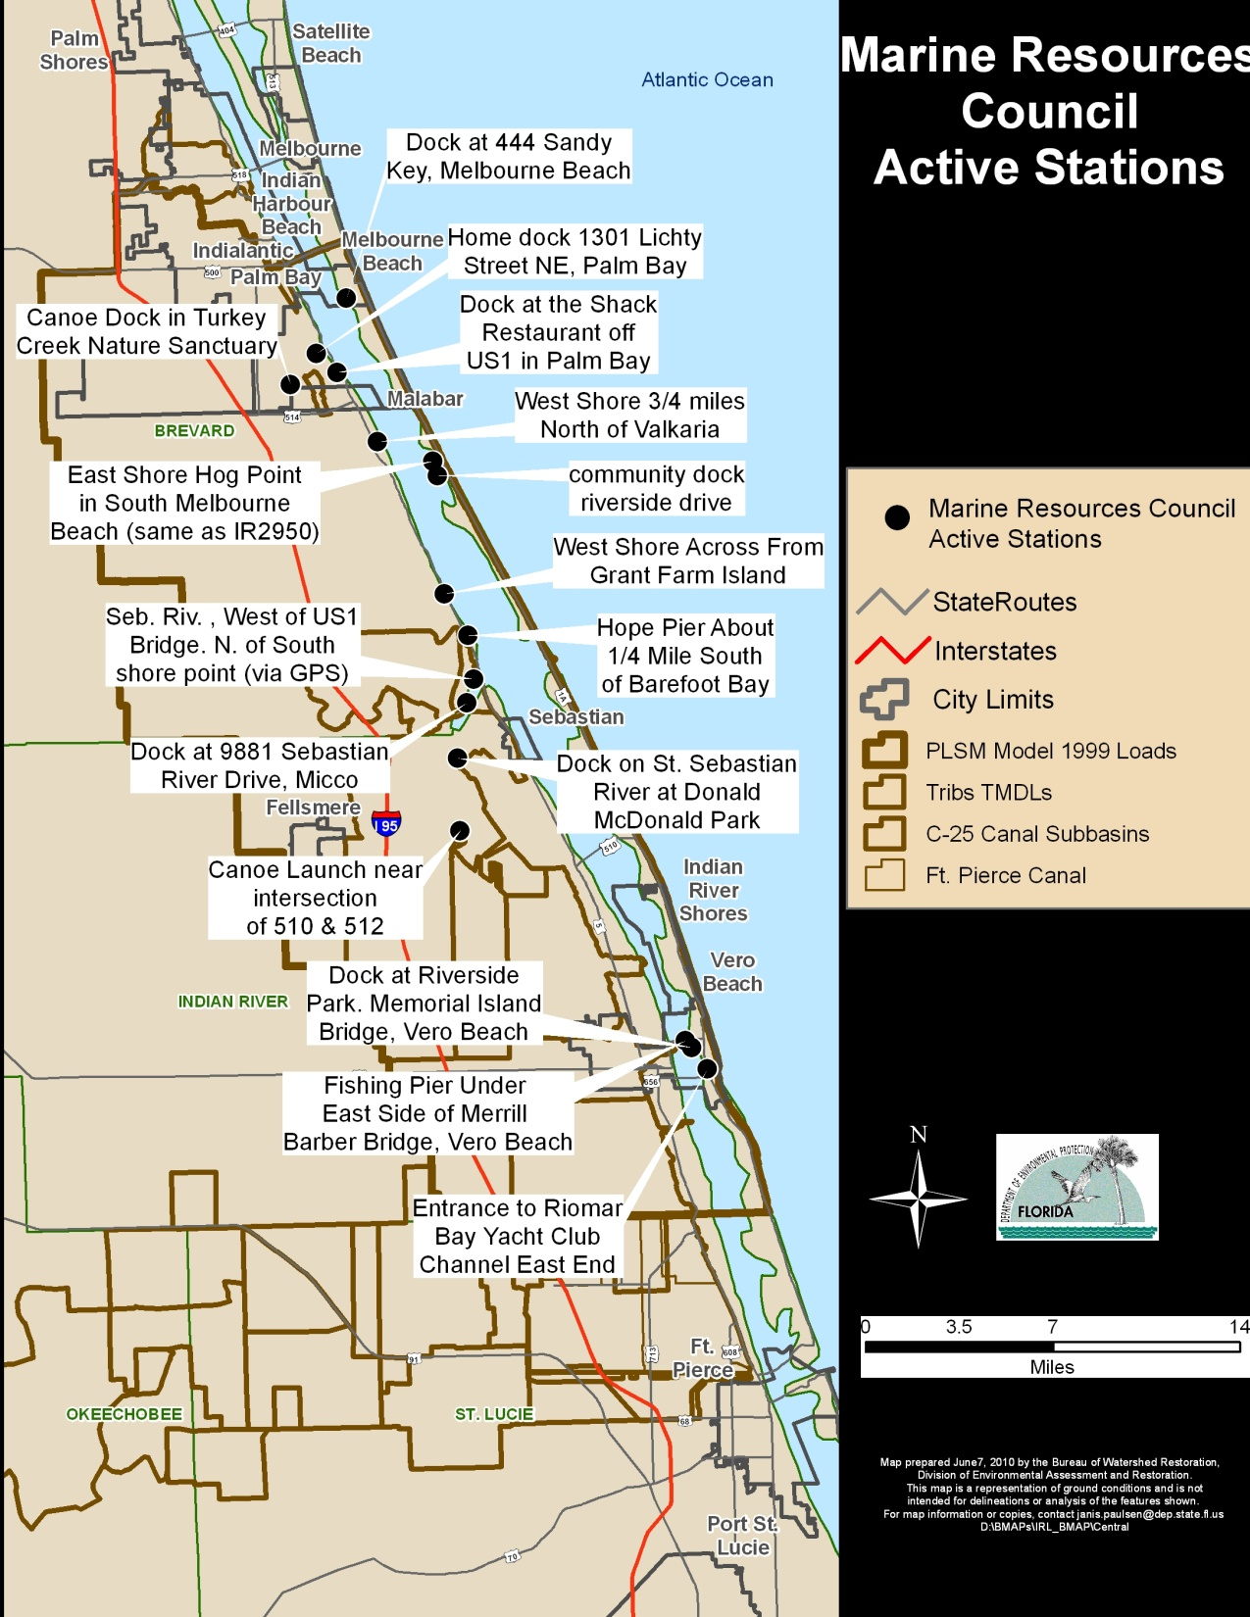
Weekly
Salinity, pH, DO, Secchi, Temperature
Notes:
Updated IRL-C

Slide 10
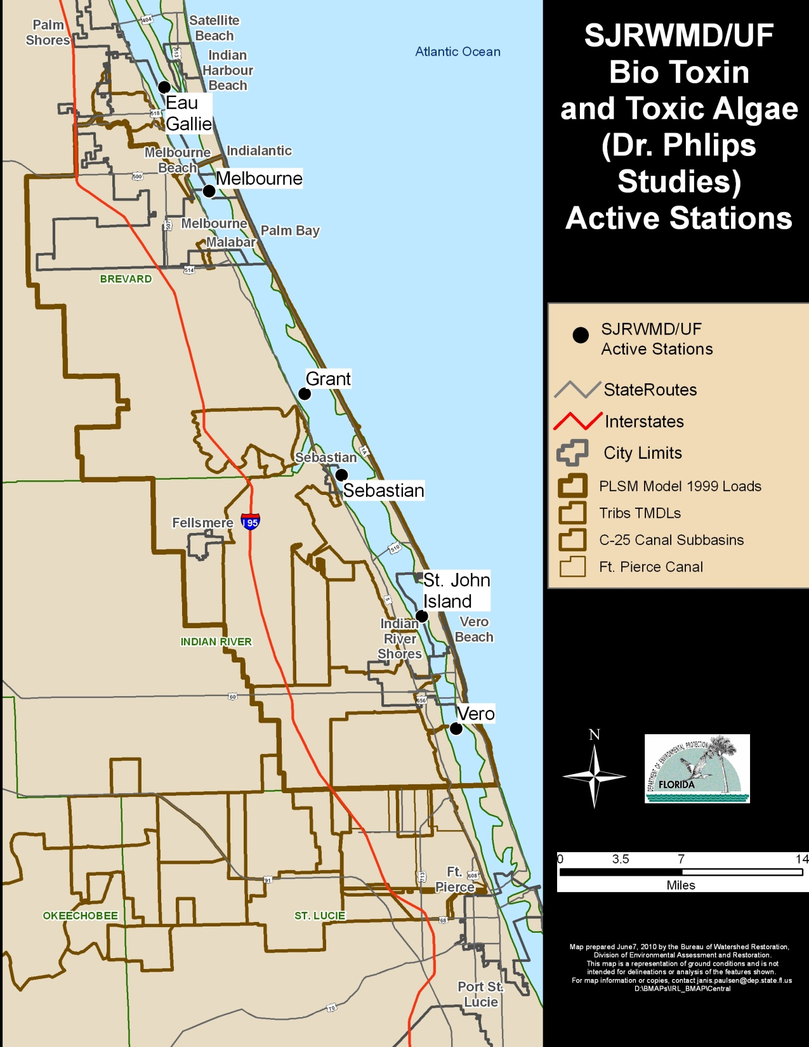
/FWRI
Every Other Week
Salinity, temperature, DO, color, turbidity, Secchi depth, PAR light extinction coefficient, TN, TP, Chlorophyll, phytoplankton composition and abundance
Notes:
Updated IRL-C

Slide 11
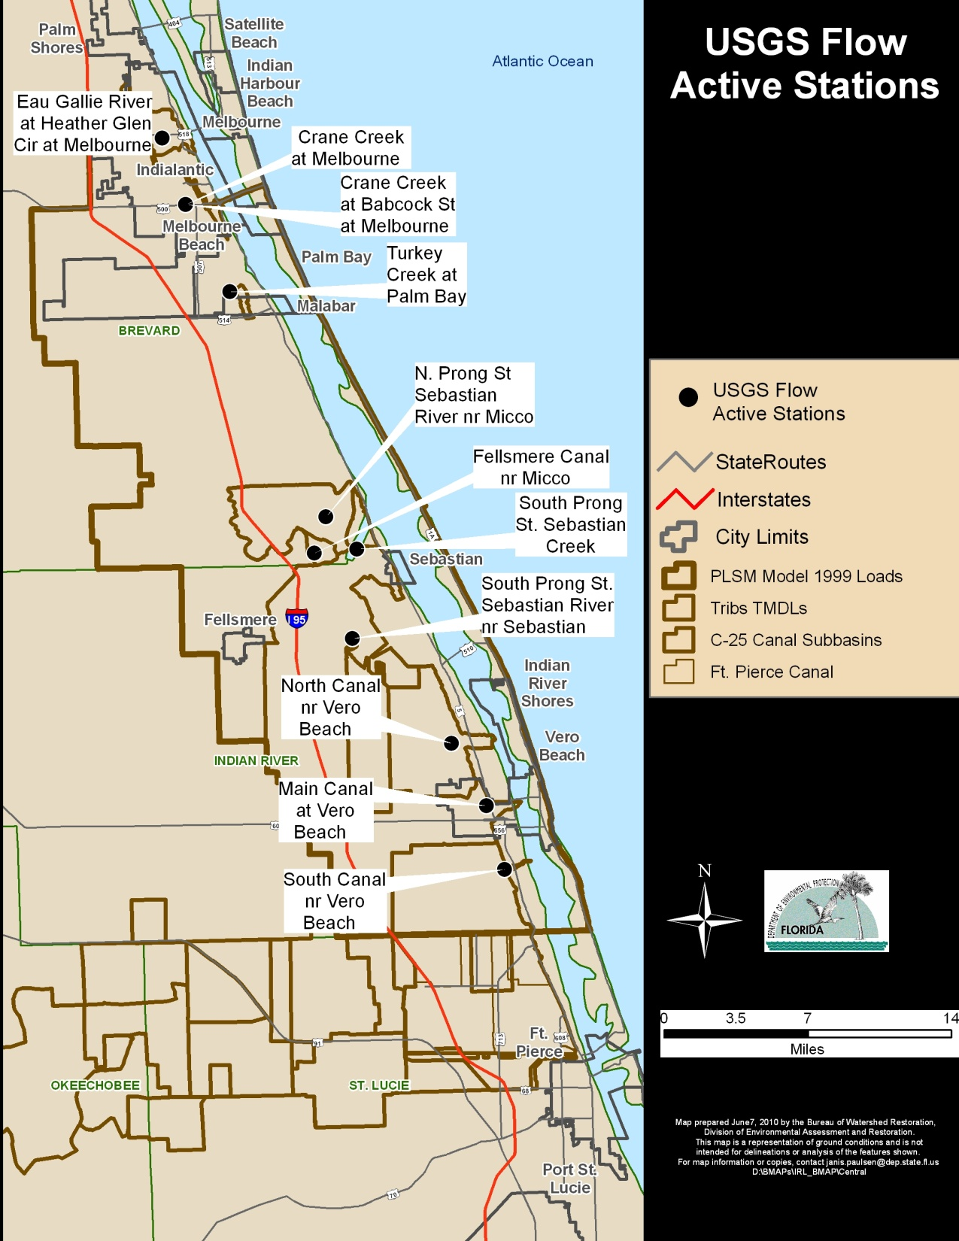
Continuous
Real Time
Notes:
Updated IRL-C

Slide 12
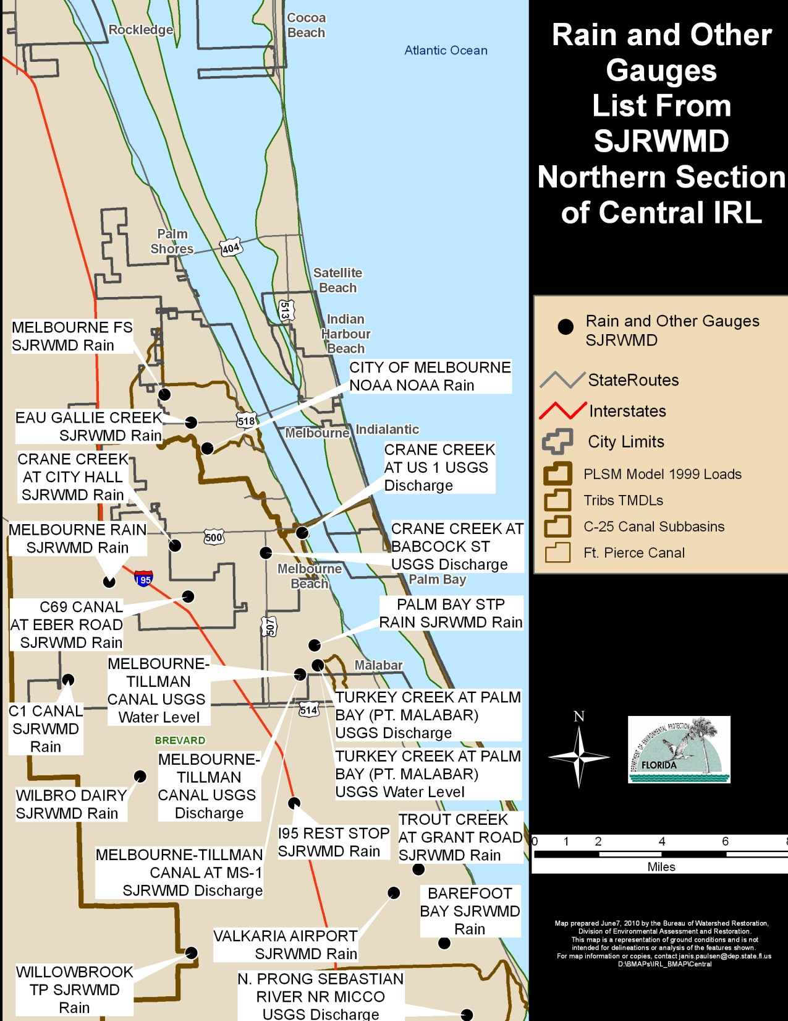
SJRWMD List of Rain Gauges etc.
Notes:
Updated IRL-C

Slide 13
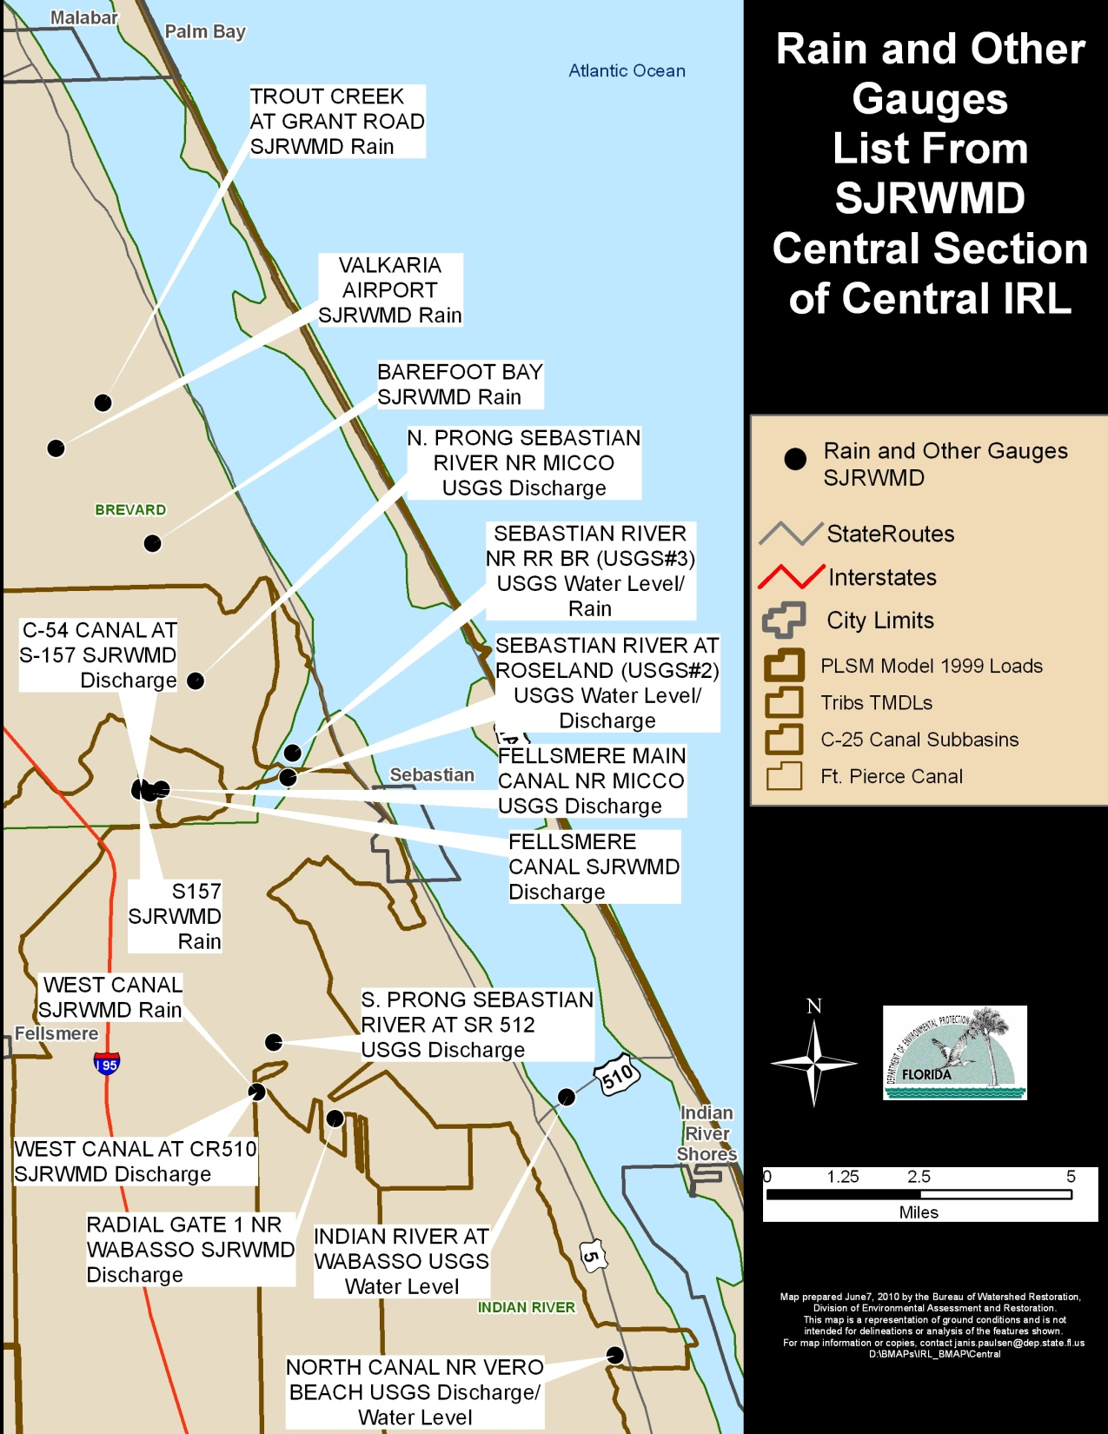
SJRWMD List of Rain Gauges etc.
Notes:
Updated IRL-C

Slide 14
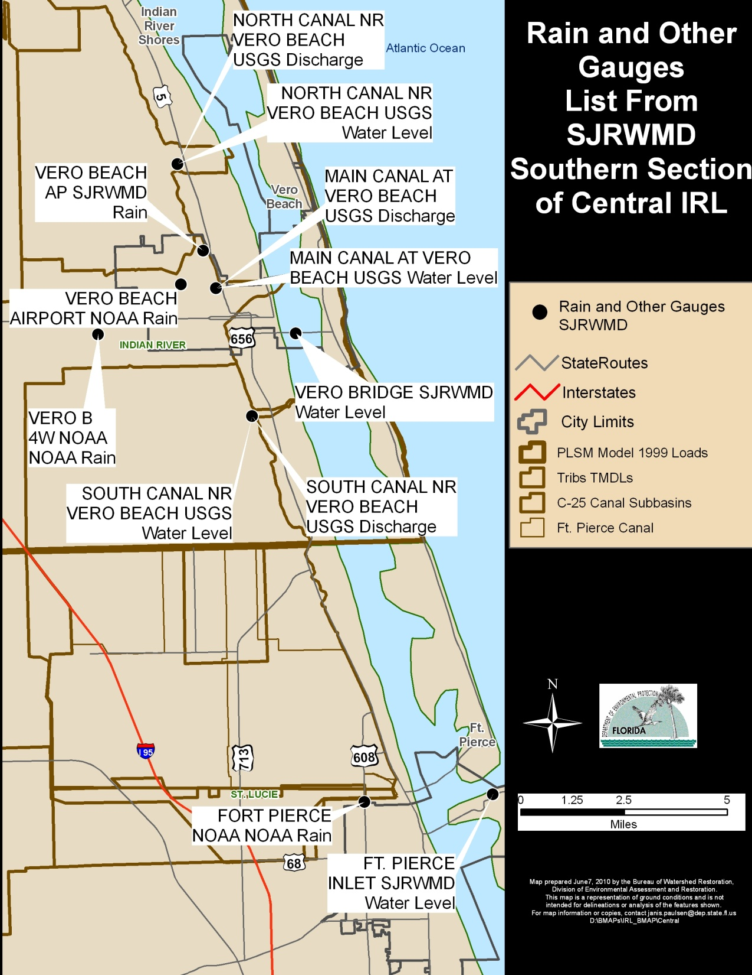
SJRWMD List of Rain Gauges etc.
Notes:
Updated IRL-C

Slide 15
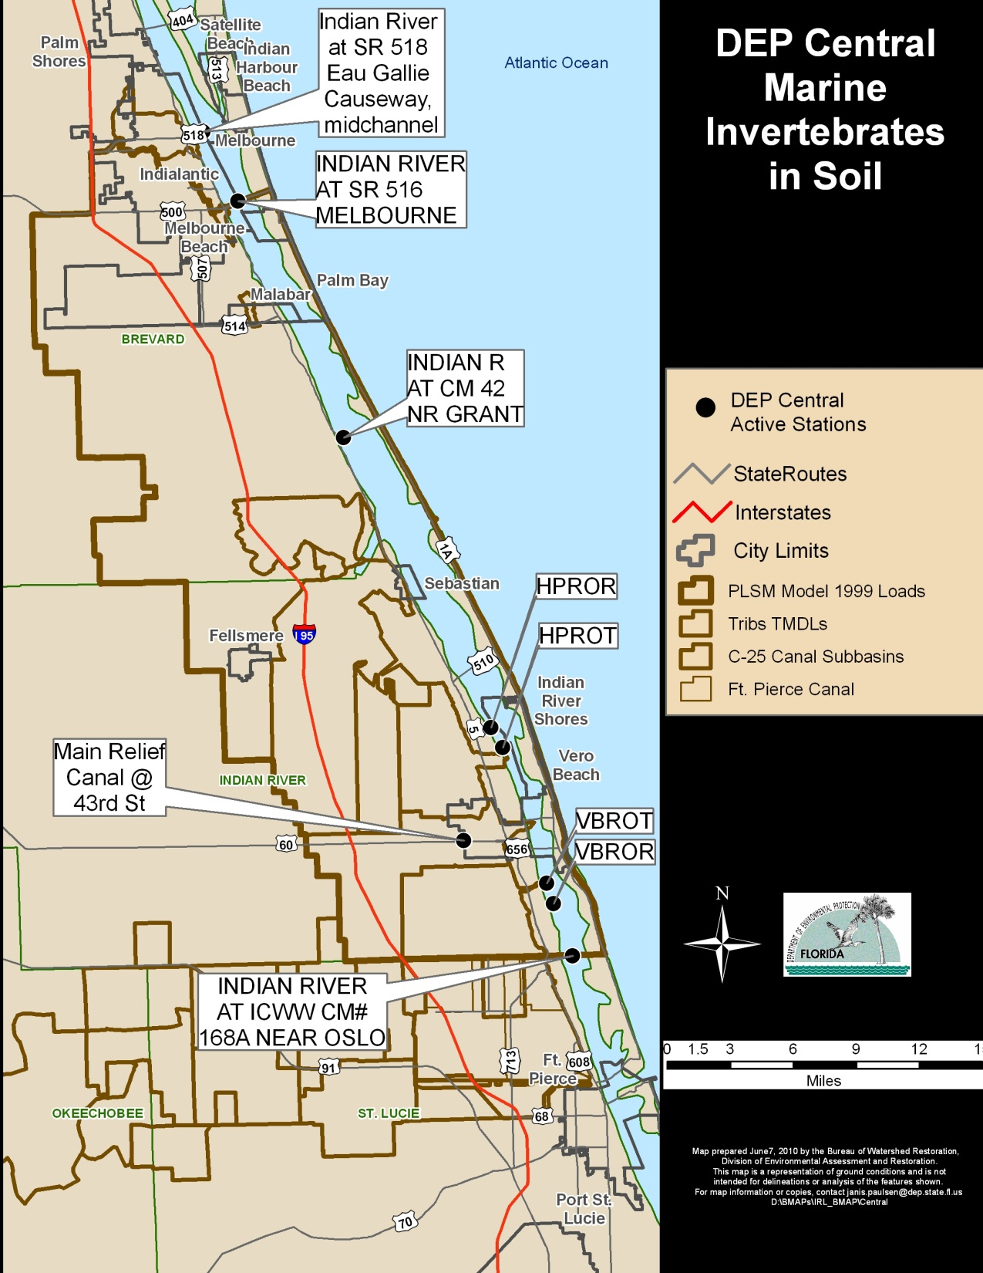
Every Other Year

Slide 16
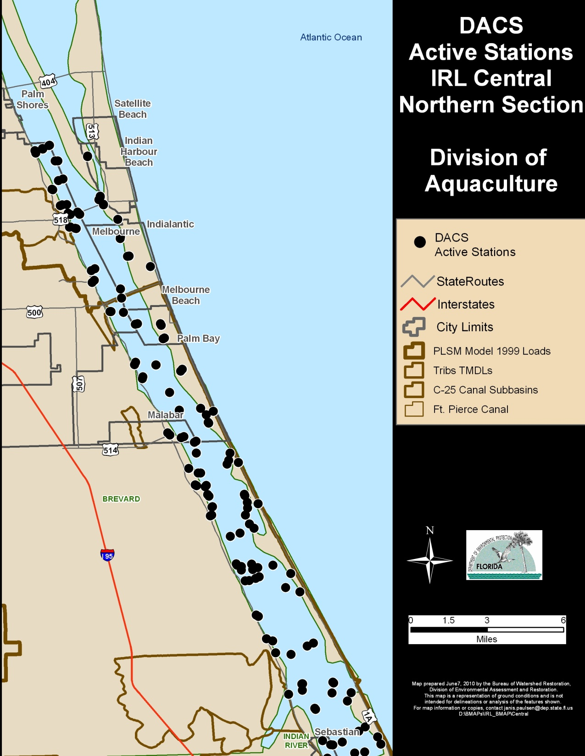
Sampled at a minimum 5 times per year
Additional sampling for the purpose of opening closed Clam beds
Lab:
Fecal Coliforms
Turbidity
Field:
Salinity, DO, pH, Water Temp, estimated wind velocity & direction
Notes:
Updated IRL-C

Slide 17
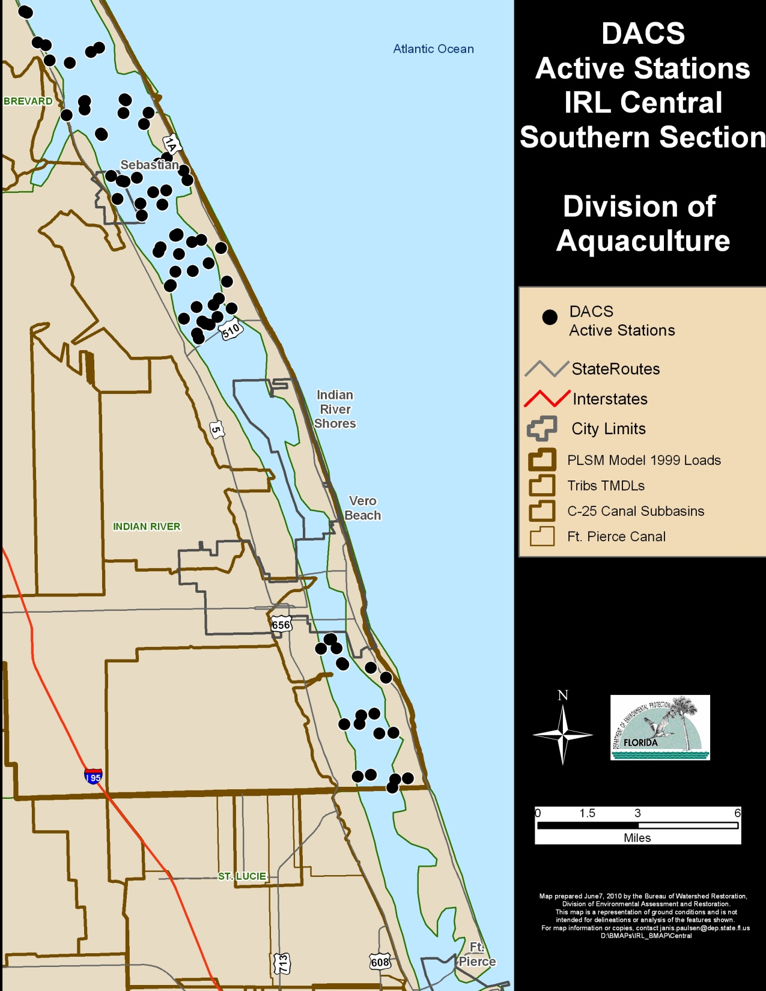
Sampled at a minimum 5 times per year
Additional sampling for the purpose of opening closed Clam beds
Lab:
Fecal Coliforms
Turbidity
Field:
Salinity, DO, pH, Water Temp, estimated wind velocity & direction
Notes:
Updated IRL-C

Slide 18
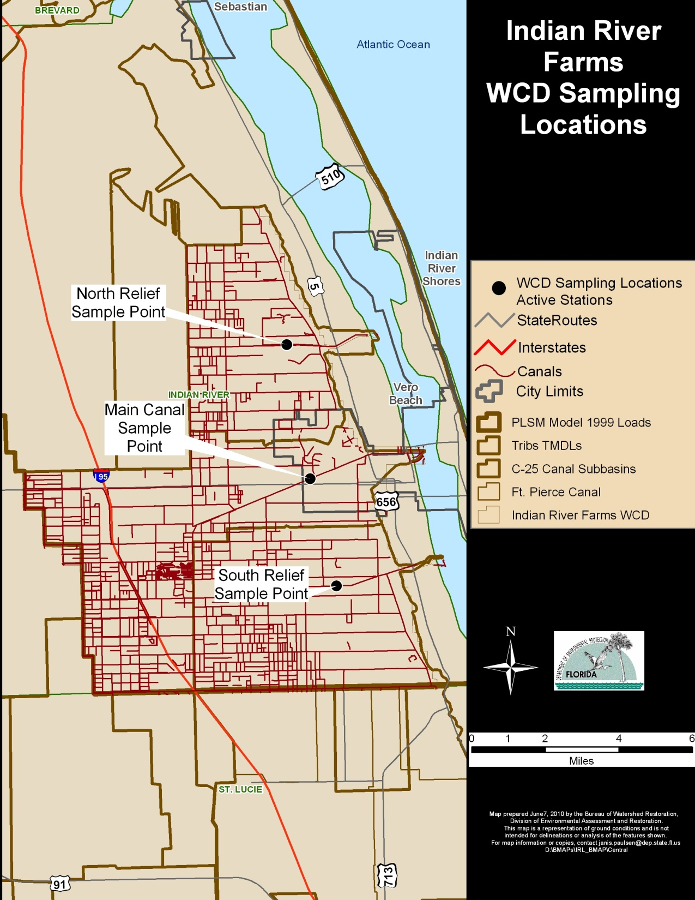
Quarterly
Pesticides, Nutrients, TSS, fecal Coliforms, BOD, Temperature, Conductance, pH, DO, Turbidity
Notes:
Updated IRL-C

Slide 19
Station Meta Data
STA STORET Station
StationDescription Long Location description
WBID Water Body Identification station is inside of
LAT LONG Latitude and Longitude
NOBS Number of Observations
BD Begin Date
ED End Date
Active Is it being sampled now as part of a project
SamplingAgency Name of Project owner agency
LocalStationID Data Supplier Station ID
Station Type Water Quality, Flow, Transect, etc.
Frequency Monthly, Weekly, etc.
Parameters A list of all parameters sampled each visit
Program Name What does the data supplier call this program
Comments

Slide 20
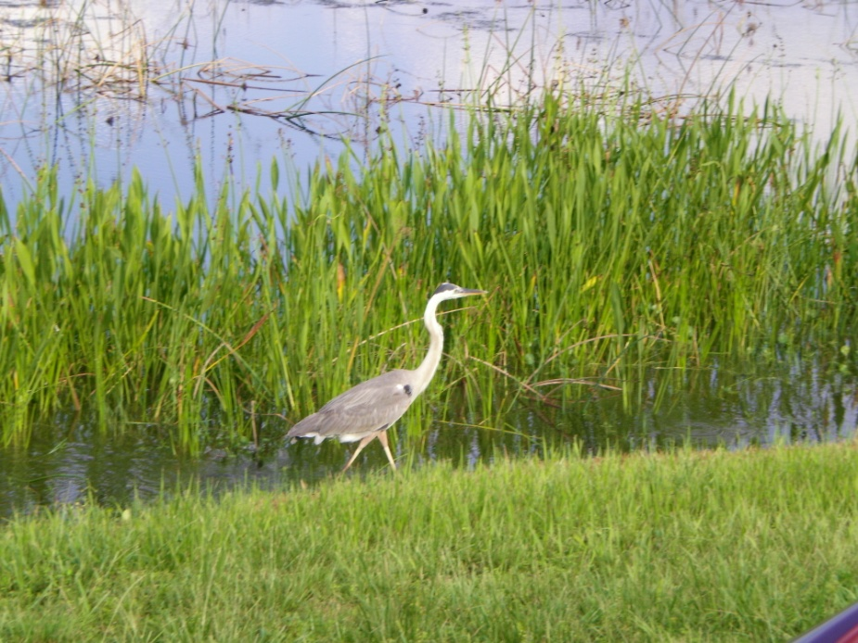
Questions and Discussion

