Slide 1

Refinement of the Lake Okeechobee Total Maximum Daily Load (TMDL) Allocation Tool
February 19, 2014

Slide 2
TMDL Allocation
Lake Okeechobee TMDL is a Total Phosphorus (TP) TMDL.
TMDL = 140 metric ton (mt)/year:
  35 mt/year direct atmospheric deposition onto the lake.
  105 mt/year watershed loads.
Need a tool to identify spatial distribution of TP loads in the Lake Okeechobee watershed:
  Land use type.
  Soil condition.
  Hydrological condition.
  Land surface topography.
  Transport attenuation.

Slide 3
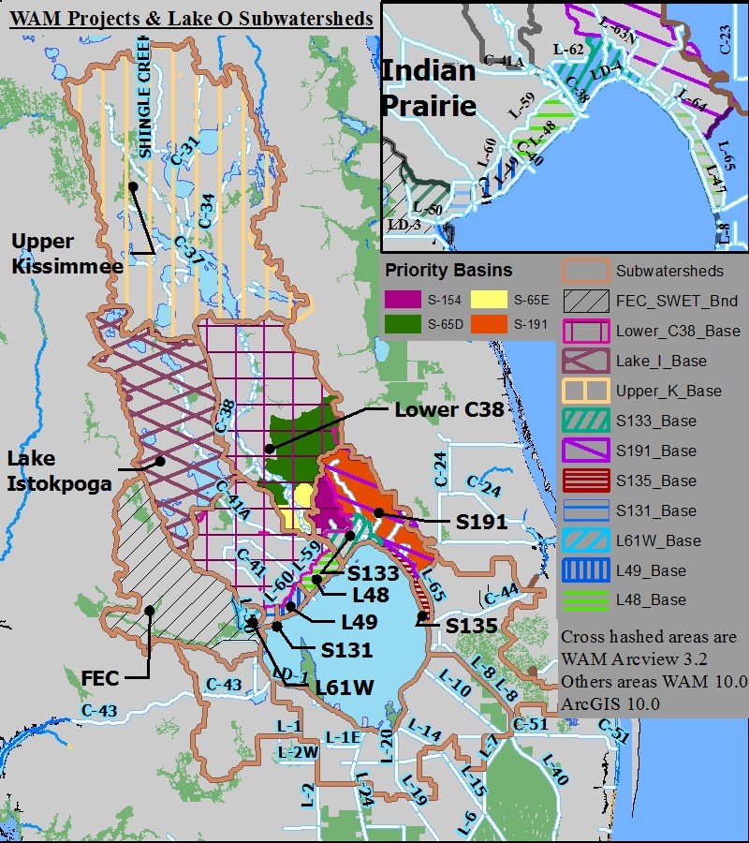
Spatial Range of the TMDL Allocation
Hydrologic boundary enhancements
examples
Focusing on the northern Lake Okeechobee Watershed.
Covers six sub-watersheds delineated by South Florida Water Management District (SFWMD):
  Upper Kissimmee.
  Lower Kissimmee (C-38).
  Lake Istokpoga.
  Indian Prairie.
  Fisheating Creek.
  Taylor Creek/Nubbin Slough.
Notes:
-These six sub-watersheds were delineated by the SFWMD as part of the Phase II Technical Plan development.

Slide 4
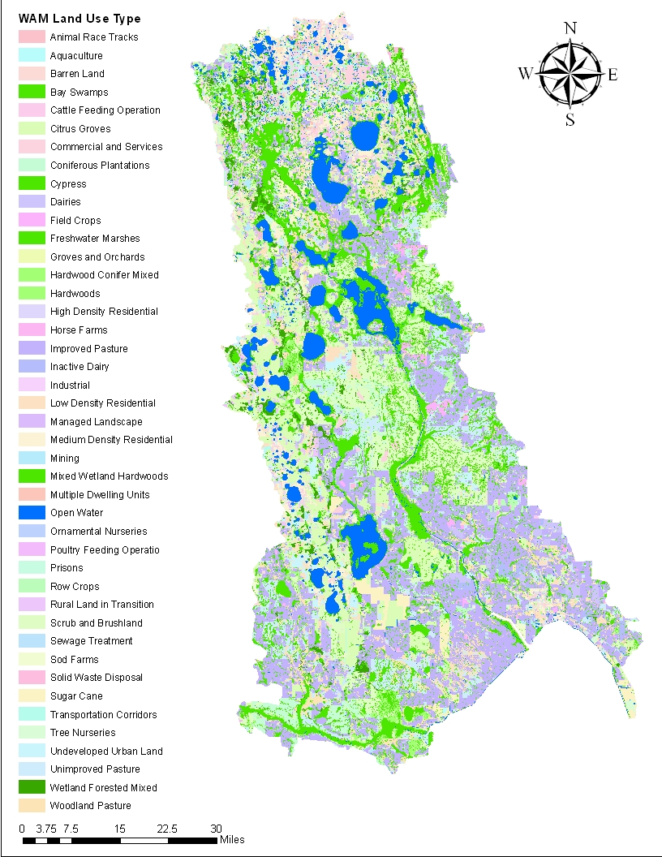
Lake Okeechobee TMDL Allocation Tool
The tool is a GIS shapefile.
The shapefile includes the following information:
  Sub-watershed.
  Land use type.
  Land use area.
  Land use specific areal loads.
  Attenuation rate.
  Final loads reaching Lake Okeechobee.

Slide 5
Structure of TMDL Allocation Tool
Land Use Type1
Land Use
Area
Land Use Specific
Areal TP Loads
Transport
Attenuation Rate
Sub-Watershed 1
(1- attenuation rate)
Sub-Watershed 2
Source TP
Loads
TP Loads Reaching
Lake Okeechobee
Sub-Watershed 3
…
Land Use Type 2
Land Use Type 3
Sub-Watershed 6
…
Land Use Type N

Slide 6
Allocation Tool Revisions
Replaced the attenuated loads with unattenuated loads to account for the ground water loads.
Replaced the in-stream attenuation with the total attenuation.
  Total attenuation rate = (Total Inlet Load – Total Outlet Load)/ Total Inlet Load
Re-calculated the attenuation rates for nutrient loads created in the Upper Kissimmee Sub-watershed and Istokpoga Sub-watershed by taking into consideration downstream attenuation in the Lower Kissimmee (C-38) Sub-watershed.

Slide 7
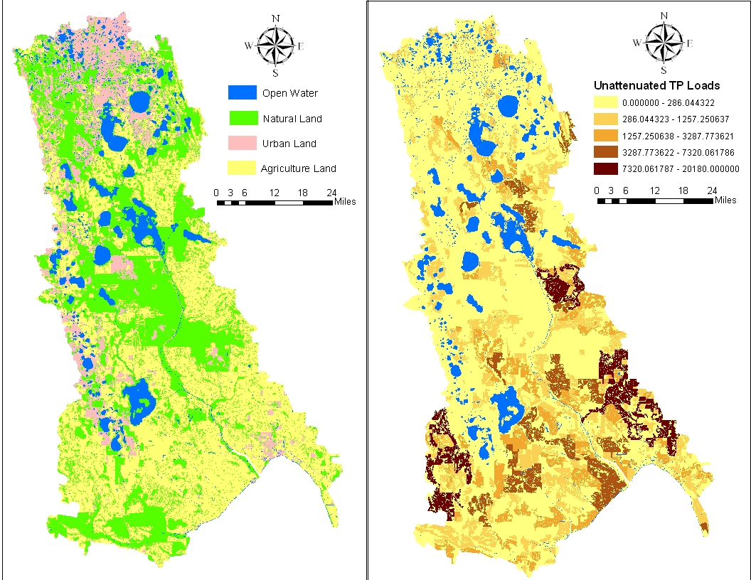
Distribution of Unattenuated TP Loads

Slide 8
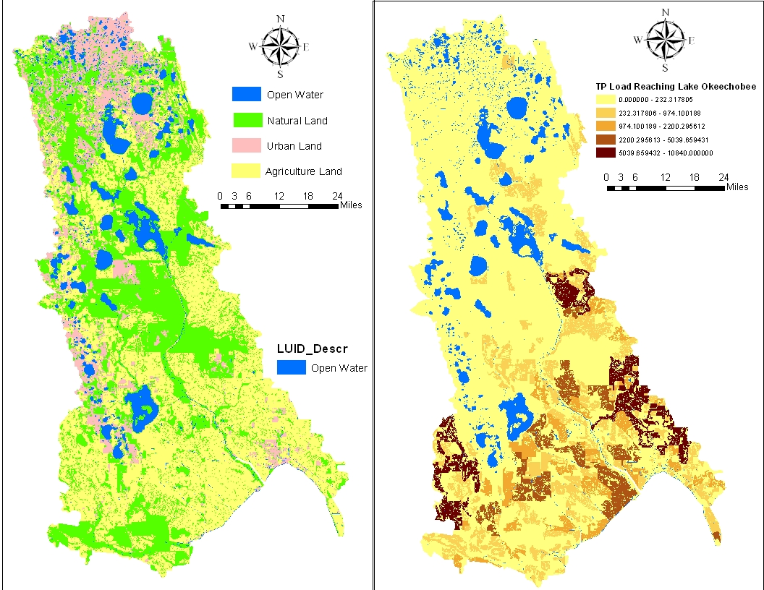
TP Loads Reaching Lake Okeechobee

Slide 9
Lake Okeechobee Sub-Watershed TP Loads under Existing Condition (2008-2009 Land Use)
Sub-Watershed | Watershed TP Loads (mt/year) | Percent Loads
Fisheating Creek | 79.0 | 19%
Indian Prairie | 72.7 | 17%
Lake Istokpoga | 18.3 | 4%
Lower Kissimmee | 103.0 | 25%
Taylor Creek/Nubbin Slough | 100.8 | 24%
Upper Kissimmee | 46.4 | 11%
Total TP Loads from Northern Lake Okeechobee Watershed | 420.2 | 100%

Slide 10
Lake Okeechobee Basin Management Action Plan (BMAP) Project Overview
February 19, 2014

Slide 11
Projects Overview
Project Calculation Methodology.
Projects by Sub-Watershed.
BMAP Approach.
Next Steps.

Slide 12
Project Collection Process
To achieve the total phosphorus (TP) reductions, each responsible stakeholder should have provided projects and programs that reduce nutrient loads.
The following projects were included:
  Completed projects since January 1, 2009.
  Additional planned efforts through 2019.

Slide 13
Project Requirements
Credit is only applied to projects that have treatment above and beyond any permitted requirements.
All projects must treat nutrients (TP, TN, or both).
All projects must be within the Lake Okeechobee Watershed.
The Geographic Information System (GIS) files for the watershed boundaries are located on the FTP site.

Slide 14
Types of Projects
Standard stormwater treatment best management practices (BMPs) include:
  Retention BMPs.
  Wet detention ponds.
  Treatment trains.
  Dry detention.
  Baffle boxes (1st generation).
  Nutrient (2nd generation) baffle boxes.
  Swales.
  Alum injection.
  Stormwater reuse.
  Stormceptor devices.
  Continuous deflective separation (CDS) units.
  Street sweeping.
  Catch basin inserts/inlet filters.
  Septic tank phase out.

Slide 15
Types of Projects, continued
Provisional BMPs include:
  Public education and outreach efforts.
  Muck removal/restoration dredging.
  Aquatic vegetation harvesting.
  Water control structures.

Slide 16
Project Calculations
The Department used the GIS or other map files provided by the stakeholders showing the areas treated by each project.
The map files were overlaid with the BMAP GIS model and clipped.
The clipped information was used to calculate the total TP loading (kg/yr) going to the project for treatment.
The load reduction for the project was then calculated by multiplying the total load from the model by the project efficiency.
  Information on the efficiencies for urban BMPs was previously distributed to the stakeholders.
  Agricultural BMP efficiencies were based on a study by Del Bottcher.

Slide 17
Project Calculations, continued
Load reductions associated with education and outreach efforts were calculated based on the total urban area within the jurisdiction.
  The urban area was identified using the urban land use codes from the land use coverage in the model.
Load reductions for street sweeping, catch basin clean out, and other BMP clean out was based on the Florida Stormwater Association spreadsheet tool.
  The weight or volume of material collected was provided by the stakeholders and input into the spreadsheet.

Slide 18
Project Load Reductions Calculated to Date
For projects submitted to date, reductions were calculated by the Department.
  Spreadsheets with each entity’s projects and credits are posted on the FTP site at:
  http://publicfiles.dep.state.fl.us/DEAR/BMAP/LakeOkeechobee/ProjectCalcs/.
Each entity’s project sheet includes multiple tabs:
  Summary with all projects and associated reductions.
  Wet pond calculations (if needed).
  Retention BMP calculations (if needed).
  Model information for each project area.
  On project sheets, yellow highlighting indicates that additional information is needed to calculate benefit.
Notes:
Note that green highlighting is where we have map files but need to create GIS files

Slide 19
Project Load Reductions
Sub-Watershed | TP Reductions Total (MT/yr)
Fisheating Creek | 7.19
Indian Prairie | 7.04
Lake Istokpoga | 1.83
Lower Kissimmee | 9.85
Taylor Creek/Nubbin Slough | 32.59
Upper Kissimmee | 5.25
TOTAL | 63.76
Notes:
Add a map instead?

Slide 20
Fisheating Creek
Stakeholder | Calculated Nutrient Reduction Benefit (MT/YR) | Project Types
Agriculture | 7.1644 | Assumes 100% BMP Enrollment
Highlands County* | 0.0295 | Public Education
SUB-WATERSHED TOTAL (MT/YR) | 7.1939

Slide 21
Indian Prairie
Stakeholder | Calculated Nutrient Reduction Benefit (MT/YR) | Project Types
Agriculture | 7.0109 | Assumes 100% BMP Enrollment
Highlands County* | 0.0296 | Public Education, Wet Detention
SUB-WATERSHED TOTAL (MT/YR) | 7.0405
Notes:
DEP needs to complete analysis of Highlands County and associated municipalities submitted projects. Istokpoga Marsh project reductions are not included.

Slide 22
Lake Istokpoga
Stakeholder | Calculated Nutrient Reduction Benefit (MT/YR) | Project Types
Agriculture | 1.4744 | Assumes 100% BMP Enrollment
Highlands County* | 0.3131 | Wet Detention, Public Education, Street Sweeping, Online Retention, Alum Treatment
Polk County | 0.0271 | Education and Outreach
Spring Lake Improvement District | 0.0179 | Stormwater Treatment Area
SUB-WATERSHED TOTAL (MT/YR) | 1.8325
Notes:
Still working on numbers for projects in Highlands County and its municipalities.

Slide 23
Lower Kissimmee
Stakeholder | Calculated Nutrient Reduction Benefit (MT/YR) | Project Types
Agriculture | 9.5595 | Assumes 100% BMP Enrollment
Highlands County* | 0.136 | Public Education
Osceola County | 0.0025 | Public Education
Polk County | 0.0227 | Public Education
SFWMD | 0.129 | ASR, Restoration
SUB-WATERSHED TOTAL (MT/YR) | 9.8497

Slide 24
Taylor Creek/Nubbin Slough
Stakeholder | Calculated Nutrient Reduction Benefit (MT/YR) | Project Types
Agriculture | 10.3316 | Assumes 100% BMP Enrollment
FDOT D1 | 0.1207 | Wet Detention, Street Sweeping, STA
SFWMD | 22.1459 | STA, HWTT
SUB-WATERSHED TOTAL (MT/YR) | 32.5982
Notes:
Still need to evaluate DOT STA. Note – need to coordinate with FDACS on changes in ag to conservation lands. Still some ag in this area that needs to be enrolled.

Slide 25
Upper Kissimmee
Stakeholder | Calculated Nutrient Reduction Benefit (MT/YR) | Project Types
Agriculture | 2.6405 | Assumes 100% BMP Enrollment
City of Edgewood | 0.0004 | Wet Detention, Public Education
City of Kissimmee | 0.4689 | Wet Detention, Public Education, Street Sweeping, Dry Detention, Baffle Boxes, Stormwater Reuse
City of Orlando | 0.8056 | Wet Detention, Public Education, Street Sweeping, Catch Basin Inserts/Filters, Baffle Boxes
FDOT D5 | 0.2389 | Wet and Dry Detention, Street Sweeping
Orange County* | 0.4906 | Wet Detention, Public Education, Street Sweeping, Dry Detention, Baffle Boxes, Alum Injection, CDS Unit, Sediment Inactivation
Osceola County | 0.4868 | Wet Detention, Public Education, Street Sweeping, Stormwater Reuse
Polk County | 0.1135 | Wet Detention, Public Education
SUB-WATERSHED TOTAL (MT/YR) | 5.2452
Notes:
Orlando also included septic tank phase out and research projects, but we need to determine TP reduction for septic. Also, CDS Units and Alum injection projects that weren’t included b/c finished before 2009
Still have to calculate reductions for DOT projects, Alum Injection, CDS Unit and Sediment Activation projects for Orange County
Should be noted that a lot of work is ongoing and completed in this sub-watershed. Higher attenuation with respect to Lake Okeechobee, but significant impacts to upper chain such as lake toho

Slide 26
Other Projects
The Department is working with FDACS to evaluate benefits of structural agricultural BMPs (cost-share).
The Department is evaluating nutrient reduction benefits associated with ongoing dispersed water management (DWM) and Florida Ranchlands Environmental Services Projects (FRESP).
Sub-watershed | # of Ongoing FRESP Projects | # of Ongoing DWM Projects
Fisheating Creek | 2 | 0
Indian Prairie | 2 | 1
Lake Istokpoga | 1 | 0
Lower Kissimmee | 0 | 0
Taylor Creek/Nubbin Slough | 1 | 0
Upper Kissimmee | 0 | 1
Notes:
In addition to the submitted projects, we are working with agencies, local governments and others to identify/inventory other projects that are providing nutrient reduction benefits
Please provide feedback
(Q for staff: are we also including estimated load reductions – I’m sorry I forgot what was decided)

Slide 27
BMAP Approach
Using a phased approach, achieve 40% of total needed TP load reductions in the first 5 years of the BMAP (Phase 1).
  126 MT/yr reduction.
Project reductions estimated to date are about 50% of Phase 1 goal, or 20% of the total needed reductions.
  63.76 MT/yr reduction from project benefits quantified.
Notes:
Looking at 50% watershed wide, talked about priority subwatersheds

Slide 28
Sub-watershed Project Summary
Projects will continue to be identified, with special focus on sub-watersheds closest to the lake.
Sub-watershed | Total Project Nutrient Reduction Benefit | % of Total Estimated Project Benefit
Fisheating Creek | 7.19 | 11.28%
Indian Prairie | 7.04 | 11.04%
Lake Istokpoga | 1.83 | 2.87%
Lower Kissimmee | 9.85 | 15.45%
Taylor Creek/Nubbin Slough | 32.59 | 51.13%
Upper Kissimmee | 5.25 | 8.23%
TOTAL | 63.76 | 100%
Notes:
Fisheating Creek, Indian Prairie and Taylor Creek are the sub-watersheds closest to the lake.
Looking at additional projects in these areas

Slide 29
Additional Project Submittal
For stakeholders who have not yet submitted projects or have additional projects, please submit the provided forms located at http://publicfiles.dep.state.fl.us/DEAR/BMAP/LakeOkeechobee/Meetings/TechMeeting_Aug2013/ProjectCollection/.
The spreadsheet must be completed to the extent possible for each project.
Projects that are part of a treatment train should be noted in the appropriate columns.
For permitted projects, permit numbers must be provided.
Please provide additional completed projects or missing project information to FDEP by March 1, 2014.

Slide 30
Next Steps
Updated project calculations will be discussed at the March 19, 2014 meeting.
The Department will continue to meet with stakeholders to identify projects.
Please provide feedback and ideas.

Slide 31
Questions?
Lake Okeechobee Watershed BMAP Coordinators
  Kim Dinkins
  Phone: (850) 245−8825
  E-mail: Kimberleigh.Dinkins@dep.state.fl.us
  Katie Hallas
  Phone: (850) 245−8432
  E-mail: Katie.Hallas@dep.state.fl.us

Slide 32
Lake Okeechobee Basin Management Action Plan (BMAP) Monitoring Plan
February 19, 2014

Slide 33
Presentation Overview
Overview of need for monitoring plan.
Review of monitoring plan development process.
Identification of monitoring plan objectives.
Review of existing/historical monitoring in watershed.
Discussion of selected sampling stations, parameters, and frequency.
Discussion of additional monitoring needs.
Overall BMAP next steps.

Slide 34
Why do we need a monitoring plan?
Subparagraph 403.067(7)(a)5:
  “The basin management action plan must include milestones for implementation and water quality improvement, and an associated water quality monitoring component sufficient to evaluate whether reasonable progress in pollutant load reductions is being achieved over time.”

Slide 35
Review of Monitoring Plan Development Process

Slide 36
What are some important considerations for the monitoring plan?
Total maximum daily load (TMDL) parameter(s) addressed in the BMAP.
Goals and objectives for monitoring to determine success of the BMAP.
Core and supplemental parameters that should be assessed related to the impairment.
Important assumptions made in TMDL development.
Existing stations.
Responsible entities.

Slide 37
Monitoring Plan Development Process
Step 1: Establish objectives.
Step 2: Identify existing and historical monitoring in the basin.
Step 3: Discuss sampling parameters and frequency.
Step 4: Identify monitoring and research needs associated with the BMAP that will adequately assess progress towards achieving the plan’s objectives.
Step 5: Develop monitoring plan to be included in BMAP document.
Notes:
Step 2: Compile historic and current monitoring locations for discussions.
Discuss which stations are key to the BMAP monitoring network.
Identify where gaps occur.
Developing the monitoring plan requires following these steps sequentially. The objectives need to be established first so that the appropriate water quality parameters can be determined. Then, the monitoring network can be established based on the needs to meet the objectives. The data must be collected following standard operating procedures to meet the QA/QC requirements for data storage. This will be discussed in more detail at the next monitoring meeting.

Slide 38
Identification of Monitoring Plan Objectives

Slide 39
Monitoring Plan Objectives
Primary Objective
  Continue to track trends in total phosphorus (TP) concentrations and loads by sub-watershed.
Secondary Objectives
  Continue to identify areas within the watershed with high TP loading to better focus management efforts.
  Continue to measure effectiveness of individual or collective projects in reaching TMDL target-pollutant loadings.

Slide 40
Review of Existing/Historical Monitoring in Watershed

Slide 41
Existing Monitoring in the Basin
To develop the monitoring plan, the existing monitoring in the watershed must be identified.
The existing monitoring locations were compiled into maps for discussions on which stations are key for the BMAP monitoring network and to identify where there are gaps in the network.
A spreadsheet was provided to submit monitoring station information.

Slide 42
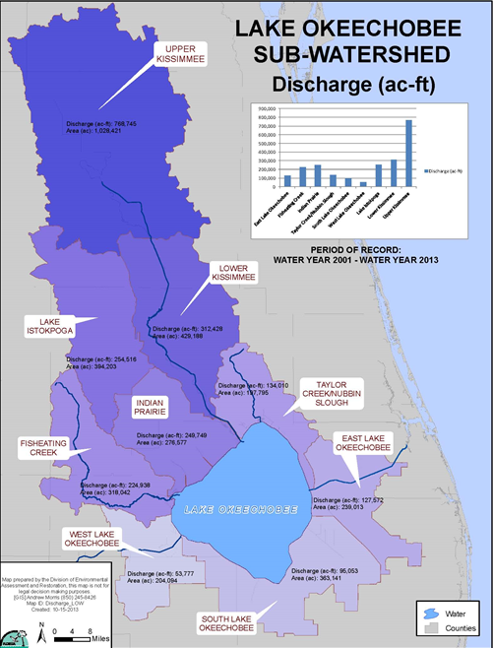
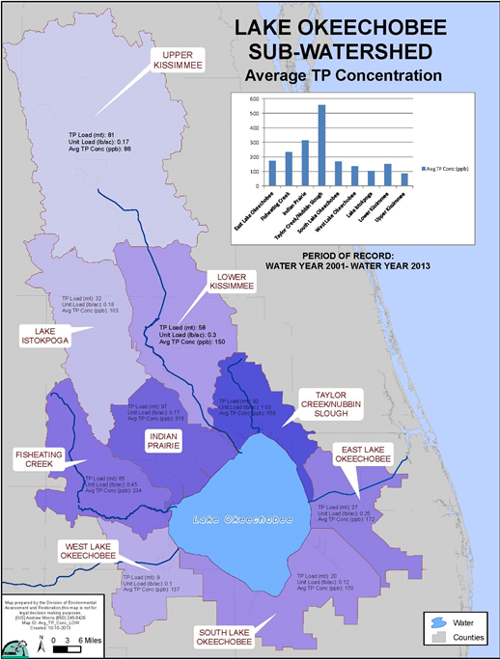

Slide 43
Discussion of Selected Sampling Stations, Parameters, and Frequency

Slide 44
Existing Monitoring
The Department reviewed monitoring information received from the following stakeholders:
  South Florida Water Management District (SFWMD).
  United States Geological Survey (USGS).
  Osceola County.
  Orange County.
  City of Orlando.
  City of Kissimmee.

Slide 45
SFWMD Monitoring
Project Description | Number of Stations | Parameters
Kissimmee River Autosamplers/Grabs | 3 | Various
Kissimmee River Pools | 1 | Various
Lake Istokpoga (In-Lake) | 1 | Various
Lake Okeechobee (Littoral) | 1 | Various
Lake Okeechobee (Pelagic) | 8 | Various
Lake Okeechobee Structures (Auto Samplers) | 9 | Various (mainly total phosphorus)
Lake Okeechobee Structures Permit (Grab) | 31 | Various
N/A | 3 | Various
Source Control | 24 | Total phosphate
Source Control (Upper Kissimmee Basin) | 5 | Total phosphate
Notes:
-These are all from the Toho Plan.

Slide 46
SFWMD Monitoring, continued
Project Description | Number of Stations | Parameters
Tributary Trend Site | 18 | Total Kjeldahl nitrogen, total phosphate, nitrite/nitrate
Upper Chain of Lakes | 1 | Various
Upper Chain of Lakes (In-Lake) | 2 | Various
Upper Chain of Lakes (Tributaries) | 1 | Various
Notes:
-Total of SFWMD sites = 112

Slide 47
USGS Monitoring
Number of Stations | Sampling Frequency | Parameters
2 | Monthly | Flow
Notes:
-These are all from the Toho Plan.

Slide 48
Osceola County Monitoring
Number of Stations | Sampling Frequency | Parameters
4 (Lake Toho Nutrient Reduction Plan) | Monthly | Total phosphorus, nitrate/nitrite, total Kjeldahl nitrogen, dissolved oxygen, pH, temperature, conductivity
19 ( Monitoring Network) | Monthly or as flow permits | Total phosphate, total Kjeldahl, nitrate/nitrite
Notes:
-These are all from the Toho Plan.

Slide 49
Osceola County/SFWMD Monitoring
Number of Stations | Sampling Frequency | Parameters
1 | Monthly | Chlorophyll, total suspended solids, alkalinity, turbidity, chlorides, color, nitrite, orthophosphate, total Kjeldahl, total phosphate, nitrite/nitrate, conductivity, dissolved oxygen, temperature, pH
Notes:
-These are all from the Toho Plan.

Slide 50
Orange County Monitoring
Number of Stations | Sampling Frequency | Parameters
3 | Quarterly | Total phosphorus, nitrate/nitrite, total Kjeldahl nitrogen, dissolved oxygen, pH, temperature, conductivity
Notes:
-These are all from the Toho Plan.

Slide 51
Orlando/Orange County Monitoring
Number of Stations | Sampling Frequency | Parameters
2 | Quarterly | Total phosphorus (TP), nitrate/nitrite, total Kjeldahl nitrogen, dissolved oxygen, pH, temperature, conductivity
Notes:
-These are all from the Toho Plan.

Slide 52
City of Orlando Monitoring
Number of Stations | Sampling Frequency | Parameters
38 | Quarterly | Secchi, pH, dissolved oxygen, temperature, specific conductance, alkalinity, biochemical oxygen demand, nitrite, nitrate, ammonia, total Kjeldahl nitrogen, total nitrogen, total phosphorus, total dissolved solids, total suspended solids, total volatile suspended solids, chlorophyll-a corrected, turbidity, color

Slide 53
City of Kissimmee Monitoring
Number of Stations | Sampling Frequency | Parameters
8 | Quarterly | Total phosphorus, nitrate/nitrite, total Kjeldahl nitrogen, dissolved oxygen, pH, temperature, conductivity

Slide 54
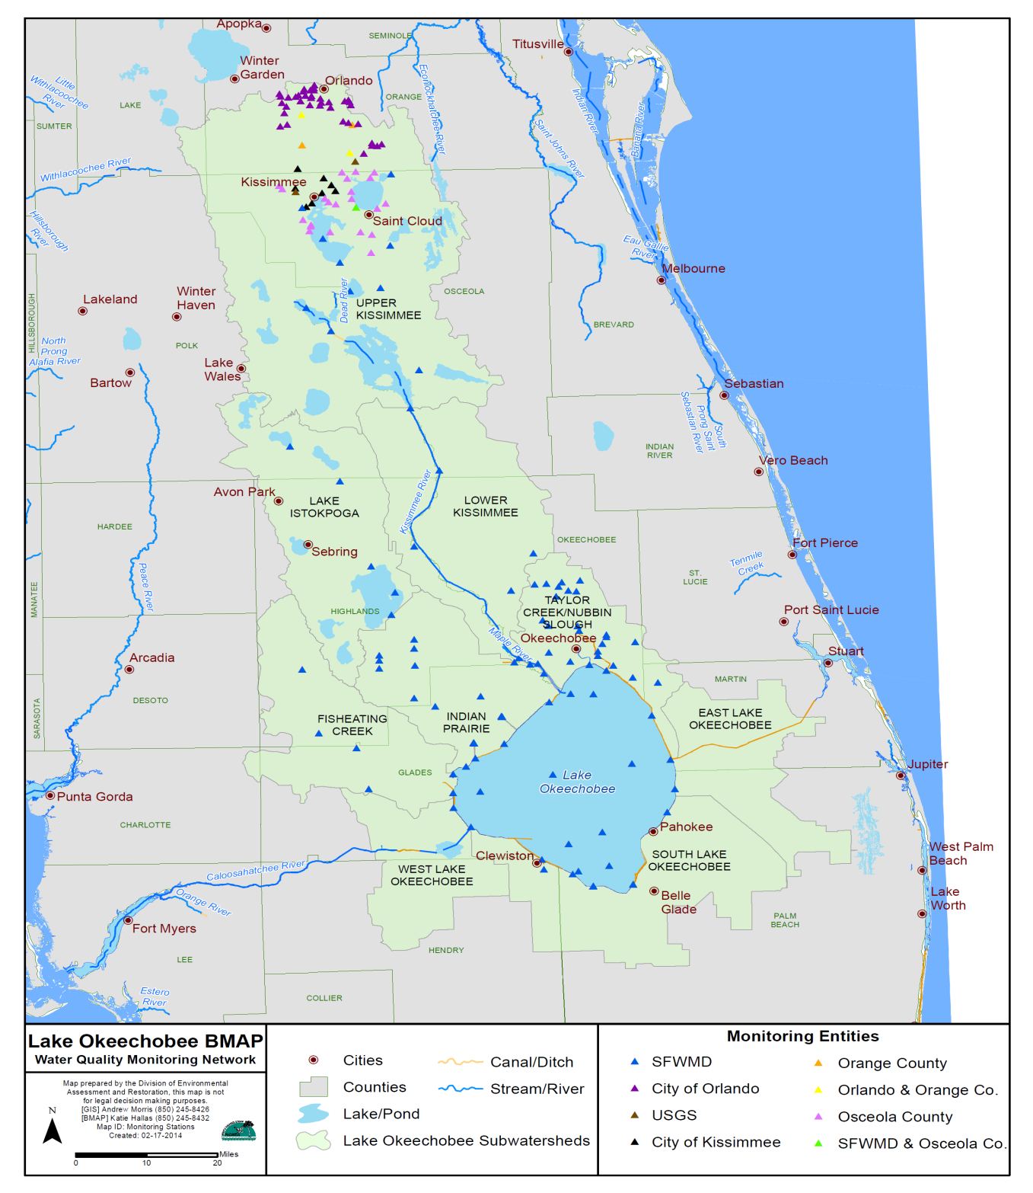
Lake Okeechobee
Watershed Monitoring

Slide 55
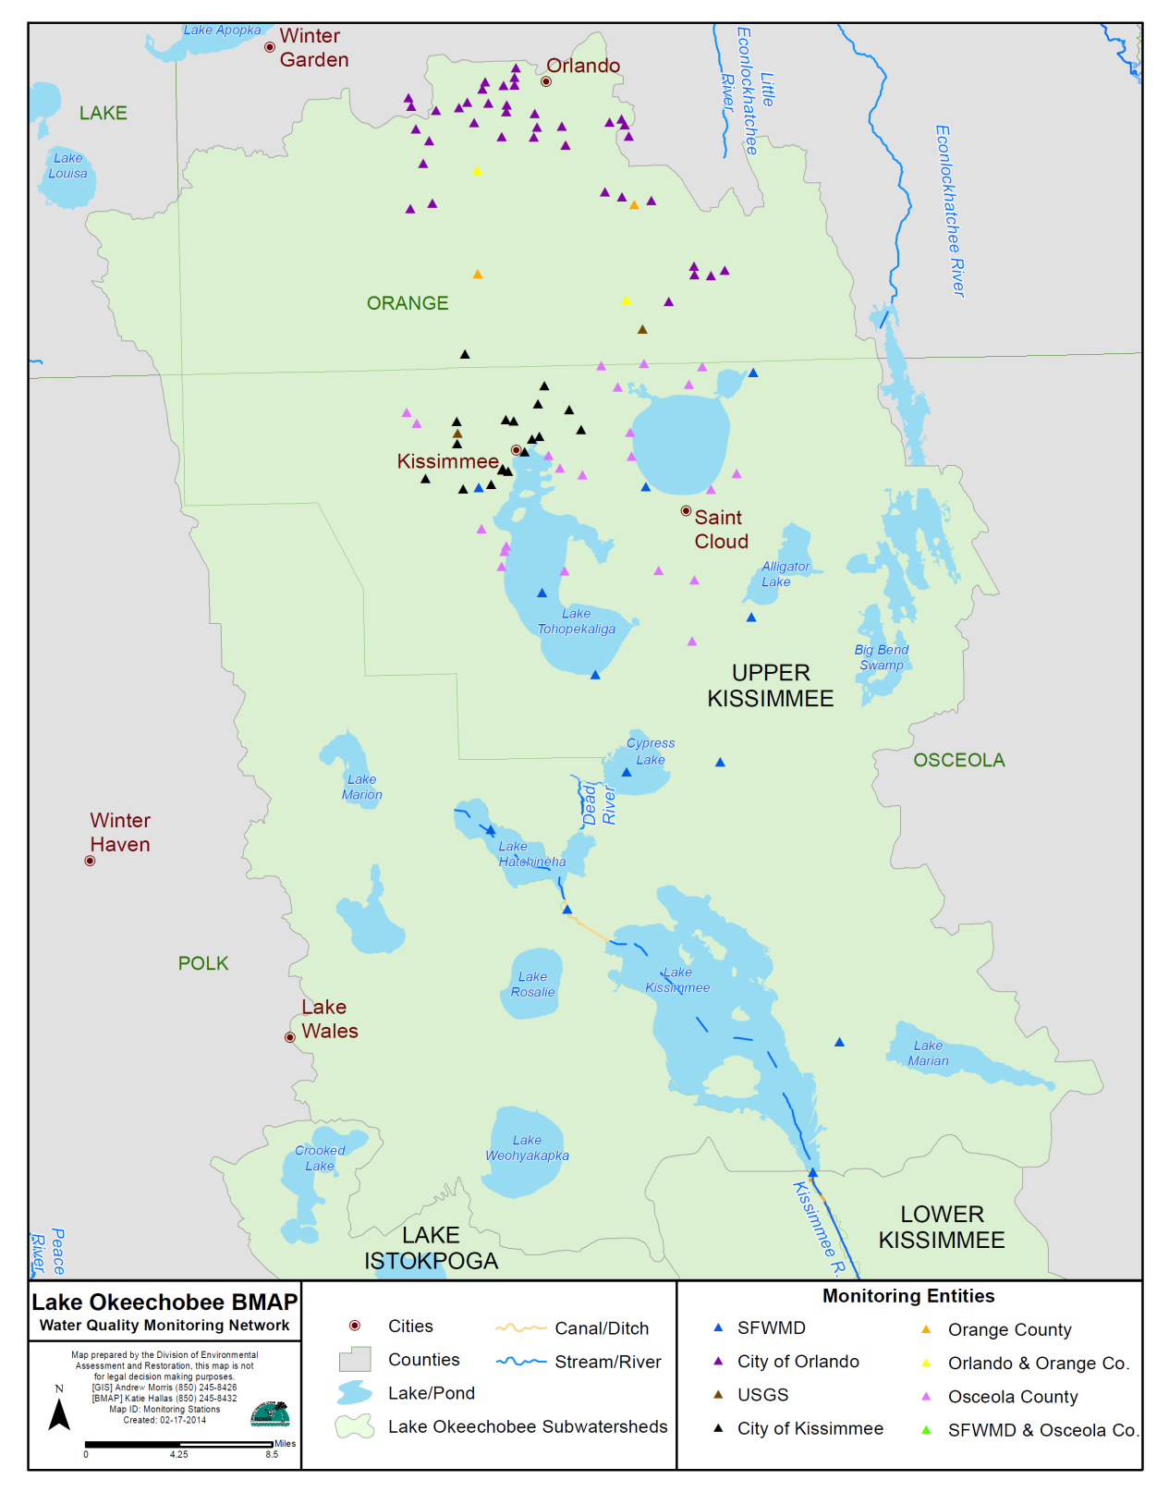
Upper Kissimmee
Sub-Watershed Monitoring

Slide 56
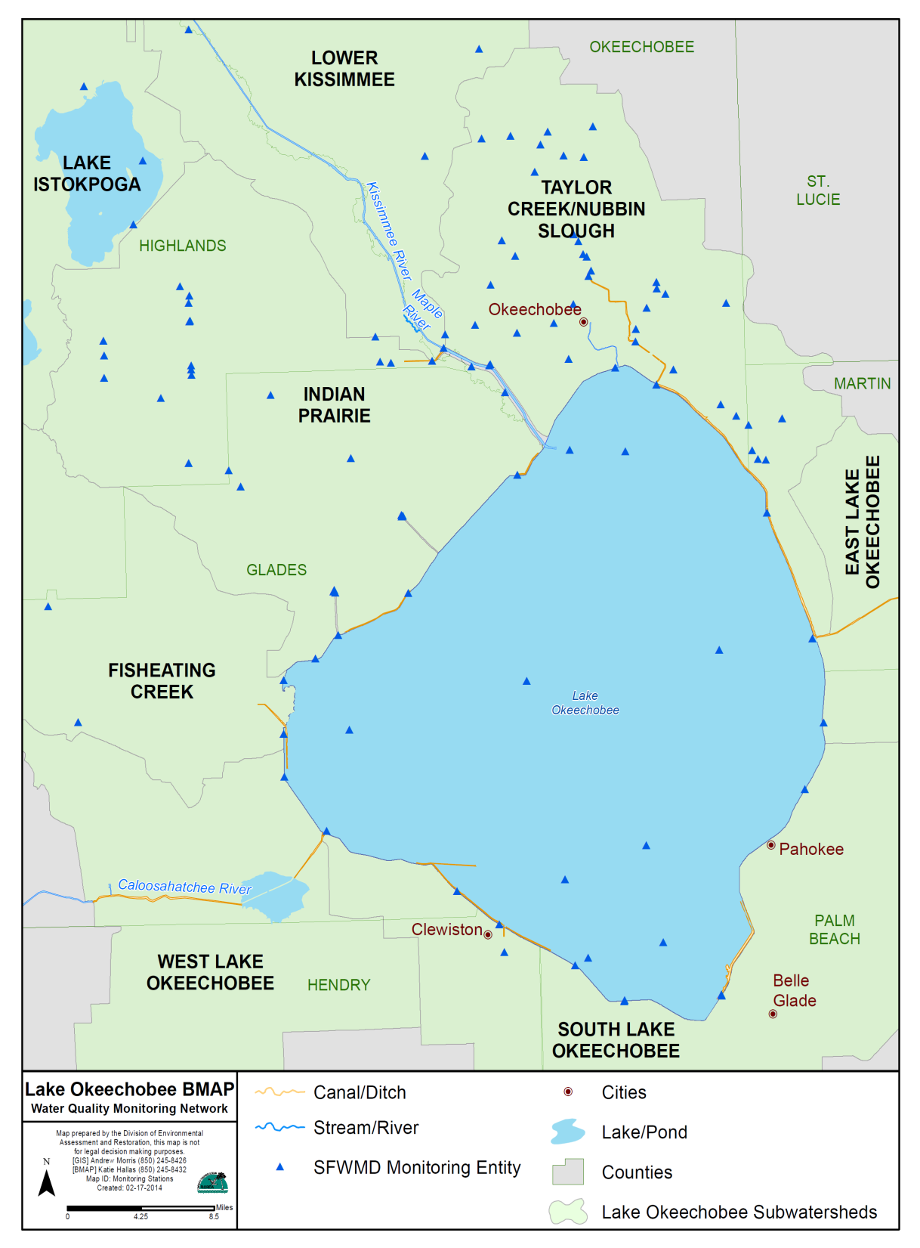
Indian Prairie and Taylor Creek/Nubbin Slough Sub-Watershed Monitoring

Slide 57
Discussion of Additional Monitoring Needs

Slide 58
Additional Monitoring/Research Needs
What are the monitoring needs that should be included in the BMAP monitoring plan?
What about research needs?
  E.g., hot spot analysis.

Slide 59
Action Items/Contact Information
Send monitoring ideas and comments to Katie Hallas and Kim Dinkins by Friday, February 28, 2014.
Katie Hallas
  Basin Coordinator
  E-mail: Katie.Hallas@dep.state.fl.us
  Phone: 850-245-8432
Kim Dinkins
  Basin Coordinator
  E-mail: Kimberleigh.Dinkins@dep.state.fl.us
  Phone: 850-245-8825

Slide 60
Overall BMAP Next Steps

Slide 61
Overall BMAP Next Steps
Projects
  Additional stakeholder one-on-one meetings will be held to develop new projects.
  Funding mechanisms will be discussed.
Monitoring
  A revised plan will be developed that incorporates internal and stakeholder comments and recommendations.
BMAP Document
  Document will be developed and draft chapters will be presented at upcoming meetings.
  Document will be released for public comment.
BMAP Adoption
  A public meeting will be held on the final draft BMAP.
  The BMAP will then be presented to the Department Secretary for signing and adoption.

Slide 62

Questions

