Slide 1

Refinement of the Lake Okeechobee Nutrient Load Estimation Tool
April 16, 2014

Slide 2
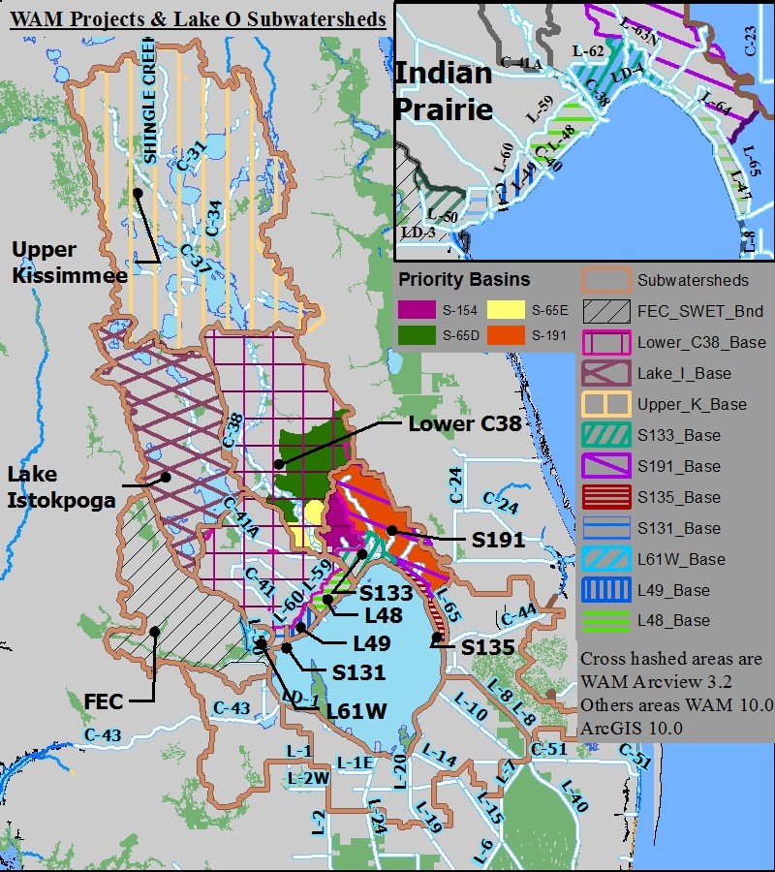
Spatial Range of the Load Estimation Tool
Hydrologic boundary enhancements
examples
Focusing on the northern Lake Okeechobee Watershed
Covers six sub-watersheds delineated by South Florida Water Management District (SFWMD):
  Upper Kissimmee
  Lower Kissimmee (C-38)
  Lake Istokpoga
  Indian Prairie
  Fisheating Creek
  Taylor Creek/Nubbin Slough
Notes:
-These six sub-watersheds were delineated by the SFWMD as part of the Phase II Technical Plan development.

Slide 3
The Goal of Developing the Load Estimation Tool
Examine nutrient loads spatial distribution in each sub-watershed.
Evaluate near field and far field effects of nutrient caused by the transport attenuation.
Estimate the total existing nutrient loads.
Calculate nutrient load reduction achieved by existing stormwater projects.
Help identify hot spots of nutrient loads for potential stormwater projects.

Slide 4
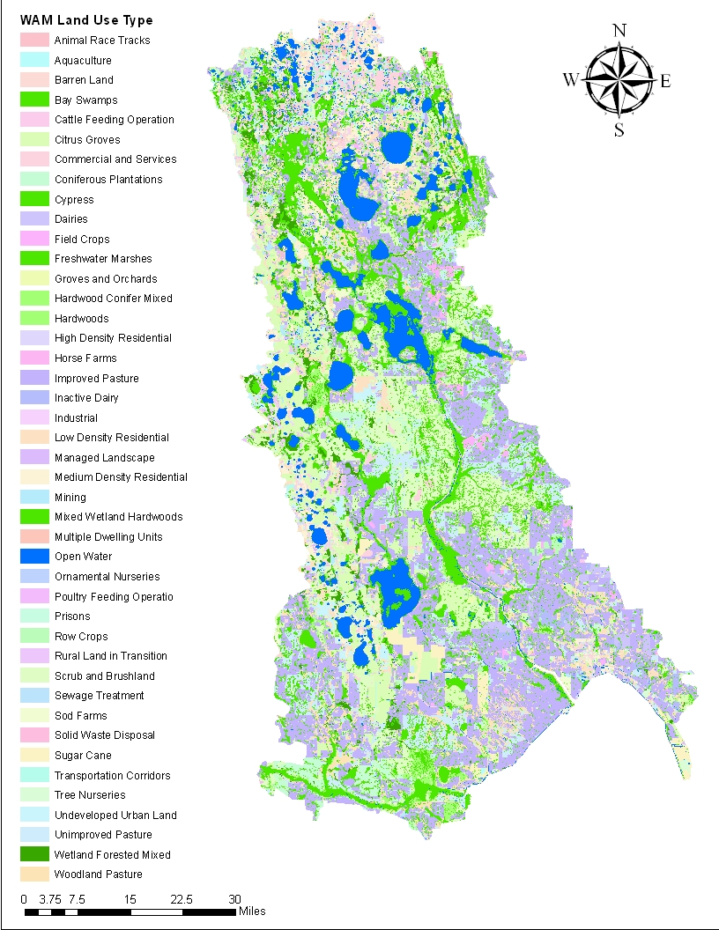
Lake Okeechobee Load Estimation Tool
The tool is a GIS shapefile.
Based on loading output from the Watershed Assessment Model (WAM)
The shapefile includes the following information:
  Sub-watershed
  Land use type
  Land use area
  Land use specific areal loads
  Attenuation rate
  Final loads reaching Lake Okeechobee

Slide 5
Structure of the Load Estimation Tool
Land Use Type1
Land Use
Area
Land Use Specific
Areal TP Loads
Transport
Attenuation Rate
Sub-Watershed 1
(1- attenuation rate)
Sub-Watershed 2
Source TP
Loads
TP Loads Reaching
Outfall of subwatershed
Sub-Watershed 3
…
Land Use Type 2
Land Use Type 3
Sub-Watershed 6
…
Land Use Type N

Slide 6
Refinement #1
Tool Refinement
Remove the Downstream Attenuation

Slide 7
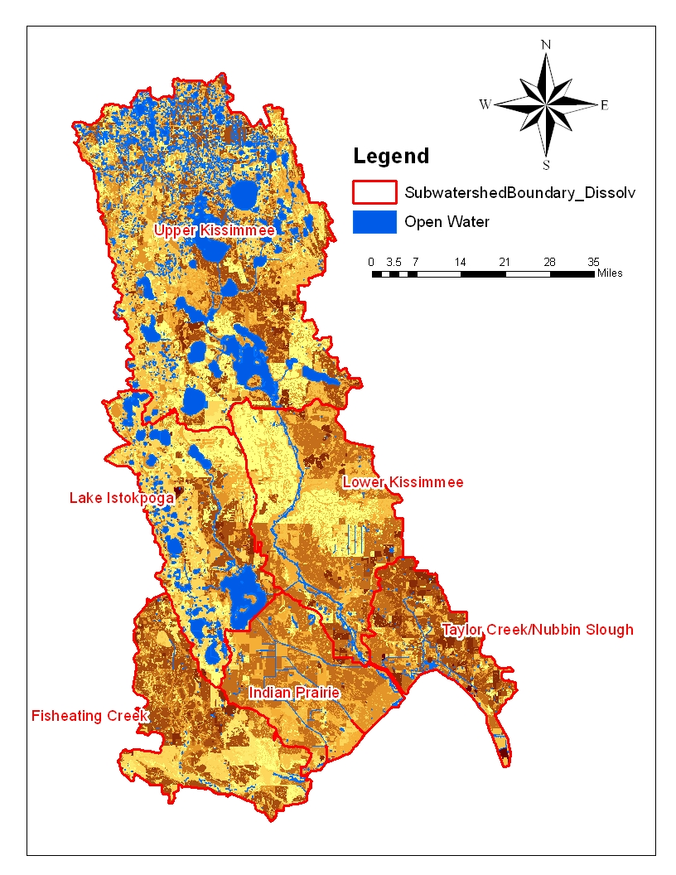
Downstream Attenuation
Directly to Lake Okeechobee
  Lower Kissimmee
  Fisheating Creek
  Indian Prairie
  Taylor Creek/Nubbin Slough
Going through downstream segment
  Upper Kissimmee
  Lake Istokpoga

Slide 8
Lake Okeechobee Sub-Watershed TP Loads under Existing Condition with Downstream Attenuation
Sub-Watershed | Watershed TP Loads (metric tons/year) | Percent Loads
Fisheating Creek | 79.0 | 19%
Indian Prairie | 72.7 | 17%
Lake Istokpoga | 18.3 | 4%
Lower Kissimmee | 103.0 | 25%
Taylor Creek/Nubbin Slough | 100.8 | 24%
Upper Kissimmee | 46.4 | 11%
Total TP Loads from Northern Lake Okeechobee Watershed | 420.2 | 100%

Slide 9
Downstream Attenuation
The total attenuation for the Lower Kissimmee sub-watershed was applied to the Upper Kissimmee and Lake Istokpoga sub-watersheds.
The downstream attenuation applied was about 30%.
The applied downstream attenuation may overestimate the real in-stream attenuation.
The downstream attenuation for Upper Kissimmee and Lake istokpoga sub-watershed was removed.

Slide 10
Lake Okeechobee Sub-Watershed TP Loads under Existing Condition without Downstream Attenuation
Sub-Watershed | TP Loads with DS Attenuation (tons/year) | TP Loads without DS Attenuation (tons/year) | Percent Loads
Fisheating Creek | 79.0 | 79.0 | 18%
Indian Prairie | 72.7 | 72.7 | 16%
Lake Istokpoga | 18.3 | 26.2 | 6%
Lower Kissimmee | 103.0 | 103.0 | 23%
Taylor Creek/Nubbin Slough | 100.8 | 100.8 | 22%
Upper Kissimmee | 46.4 | 66.6 | 15%
Total TP Loads from Northern Lake Okeechobee Watershed | 420.2 | 448.3 | 100%

Slide 11
Refinement #2
Tool Refinement
Hot Spot Identification

Slide 12
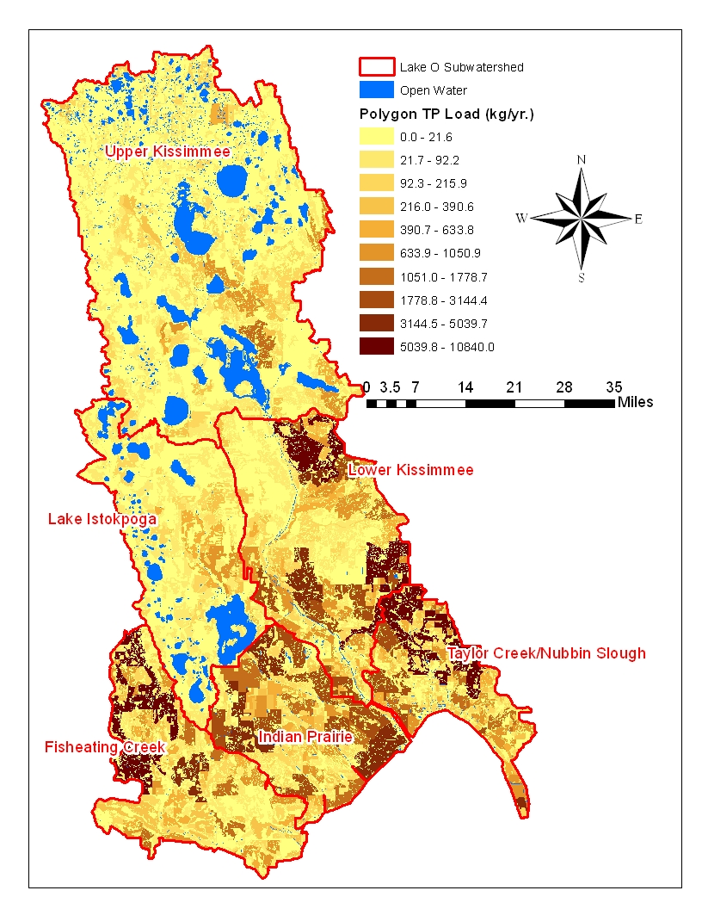
TP Load Hot Spot 1
The highest total TP loads from land use polygons were originally considered as the TP load hot spot.

Slide 13
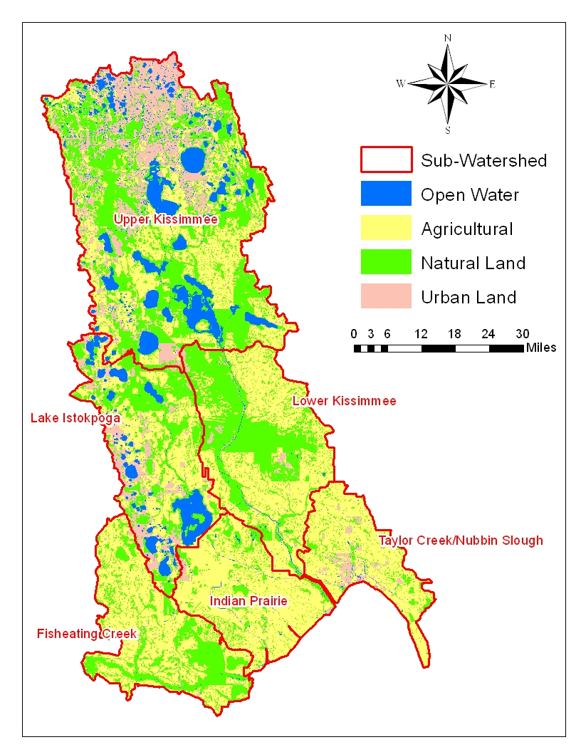
TP Load Hot Spot 1

Slide 14
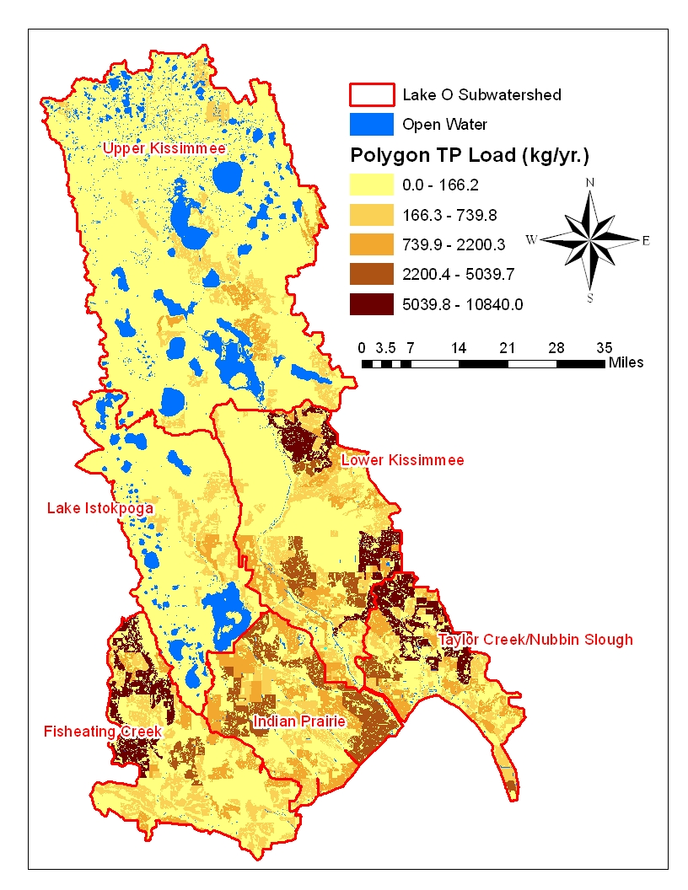
TP Load Hot Spot 1
The highest total TP loads from land use polygons were originally considered as the TP load hot spot.

Slide 15
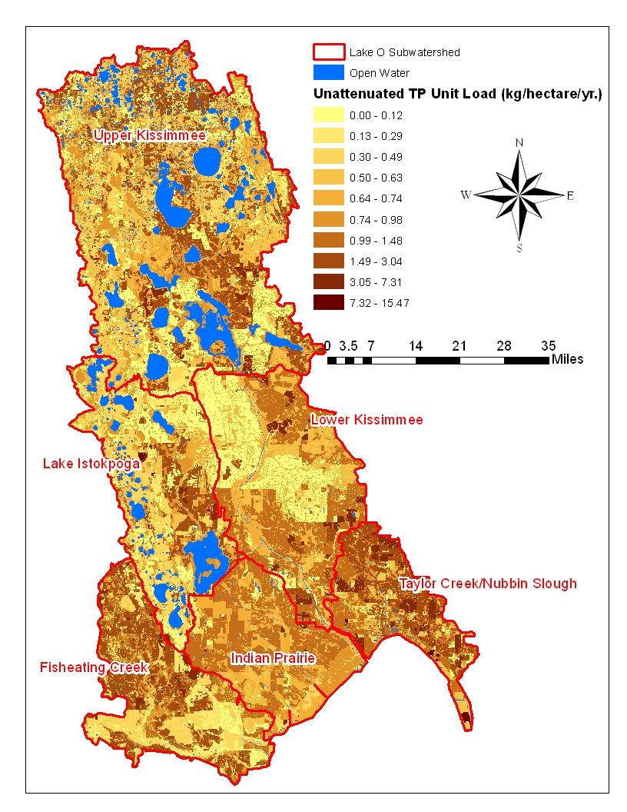
TP Load Hot Spot 2
The highest unit TP loads (TP/hectare/year) were considered as the TP load hot spot.

Slide 16
TP Load Hot Spot 2

Slide 17
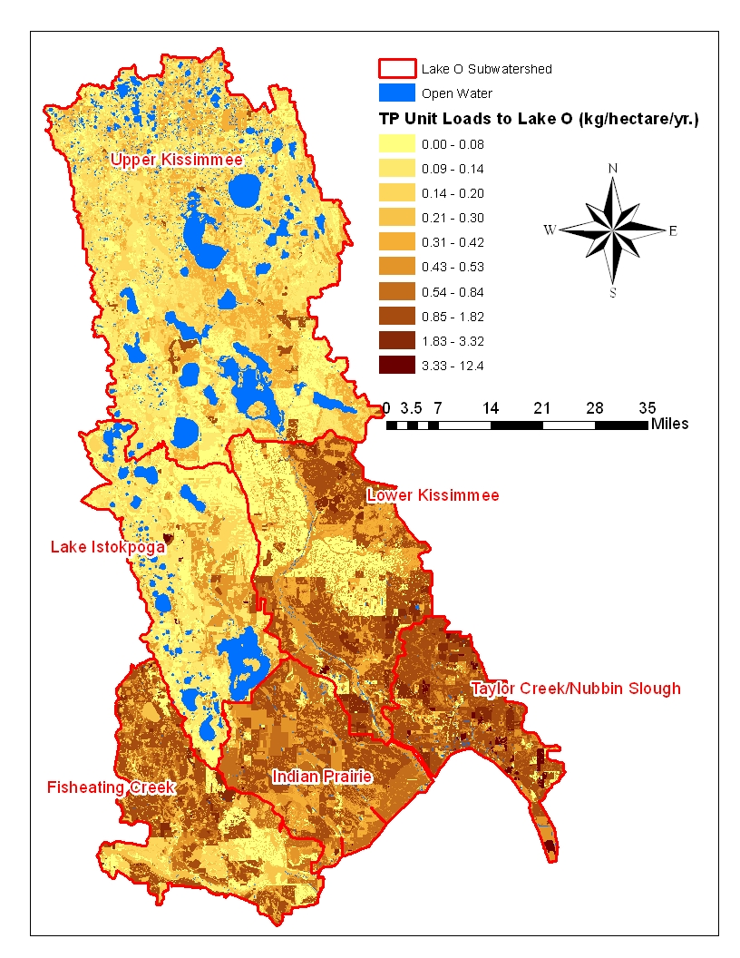
TP Load Hot Spot 2

Slide 18
The highest unit TP loads (TP/hectare/year) reaching Lake Okeechobee as the TP load hot spot.

Slide 19
The highest unit TP loads (TP/hectare/year) reaching Lake Okeechobee as the TP load hot spot.

Slide 20
Decision
Use areal unit load after attenuation as a way to identify hot spots.
More detailed land use information needs to be collected to refine the WAM loads simulation

Slide 21
Questions?

