Slide 1
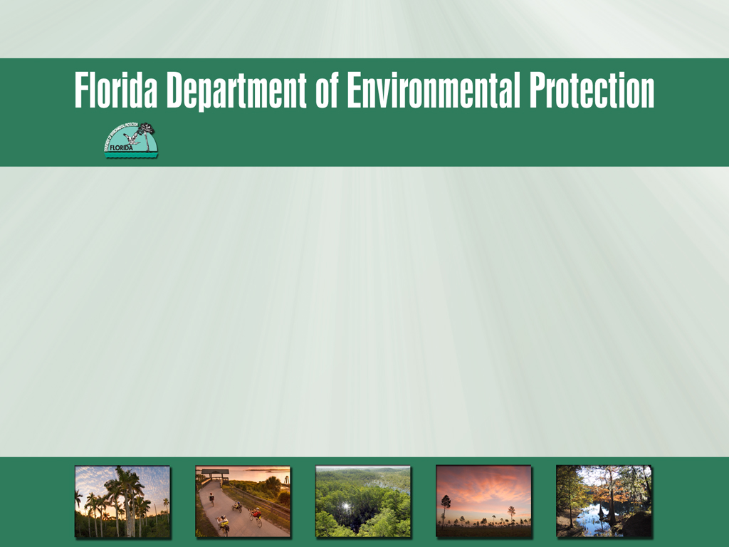
Water Resource Funding in Florida
April 16, 2014
Notes:
This presentation will mainly cover programs managed by FDEP that may be able to assist you in funding projects to implement the BMAP.

Slide 2
Presentation Overview
Nonpoint Source Grants:
  Environmental Protection Agency (EPA) 319(h).
  Total Maximum Daily Load (TMDL) Water Quality Restoration.
  Application process for 319(h) or TMDL Grants.
Storm, Waste, and Drinking Water Funding:
  Clean Water State Revolving Fund (SRF) Loan Program.
  Small Community Wastewater Facilities Grants Program.
  Drinking Water SRF Loan Program.
Other Funding Sources:
  Legislative appropriation.

Slide 3
Nonpoint Source Grants

Slide 4
EPA 319(h) Grant
Clean Water Act federally funded grant.
Administered by Department with EPA oversight.
Awarded on annual basis.
Fiscal year (FY) 2014 national funding level of ~$164.5 million for all 50 States and eligible Indian tribes.
Florida typically receives ~4% of total 319(h) funds→ between $5-6 million.
Notes:
FDEP solicits, selects, and administers specific projects all over the State.
At least half of Florida’s funds must be used for projects.

Slide 5
319(h) FY 2015 Schedule
February to March 2014 – Project application proposals sent to stakeholders.
May 23, 2014 - Project application proposals due to Department for review and ranking.
September 30, 2014 – Selected projects will be sent to EPA for approval, status letters mailed to all applicants, and match funds can be expended starting October 1, 2014 for selected projects.
Fall 2015 – EPA approves projects and notification letters will be sent to grant recipients. Contract execution process begins.
September 30, 2019 – All contractual projects, monitoring, invoicing etc. should be completed by this date.
Notes:
Project proposals received after May 23rd may be excluded from the selection process.
PLAN AHEAD: Can take up to two years from application to ability to expend funds
Should be ready to spend funds w/in one year of contract execution.
Have land acquisition & liability issues resolved.
Be prepared to document project construction and results
When possible, finalize design and permitting prior to receiving 319 grant

Slide 6
319(h) Eligible Project Types
Urban stormwater retrofits.
Septic tank pollution abatement.
Silvicultural best management practices (BMPs).
Agricultural BMP development, monitoring, and/or evaluation.
Erosion / sediment control.
Low impact development.
Nonpoint source education and BMP training.
Notes:
The majority of funding is used to support the construction of stormwater treatment facilities; however,
funding has also been used for demonstration projects (for agricultural and urban best management practices),
training opportunities, and education programs.

Slide 7
319(h) Eligible Applicants
State agencies.
Local governments.
Colleges.
Universities.
Non-profit organizations.
Public utilities.
State water management districts.

Slide 8
319(h) Evaluation Criteria
Emphasis is placed upon:
Project/BMP effectiveness monitoring.
Implementation of EPA-approved watershed plans or basin management action plans (BMAPs).
Handling of pollutant(s) of concern in verified impaired water bodies.
Cost-effectiveness per pound of pollutants removed.
Cooperative projects.
Innovative BMPs and/or use of a treatment train approach.
Project-related public education.

Slide 9
319(h) Funding Requirements
Eligible for 319(h) grant funds:
Construction.
Project-related monitoring.
Project-related public education.
Not eligible for funds:
Design.
Engineering.
Land acquisition.
Activity required by federal permit.
Urban stormwater activities that directly implement municipal separate storm sewer system (MS4) permit.

Slide 10
319(h) Funding Requirements
Match expenditure funds:
Projects should include a minimum 40% non-federal match, and 319(h) funding may not exceed 60% of the total eligible project cost.
Eligible match:
  In-kind services (e.g., staff time, contract administration).
  Design.
  Engineering.
  Monitoring.
  Public education.
Ineligible for match:
  Alternative federal funding.
  Land acquisition.
Notes:
While you are encouraged to seek out and obtain funding from all sources,
including federal sources, federal funding and other federal in-kind services
cannot be counted as match.

Slide 11
TMDL Water Quality Restoration Grant
  Annual state legislature funding to Department for implementation of BMPs that reduce pollutant loads to verified impaired waters from urban stormwater discharges.
  Set out by rule in Chapter 62-305, Florida Administrative Code (F.A.C.) and authorized by Section 403.890(2), Florida Statutes (F.S.).
  Department typically receives ~$3 million annually for statewide distribution.

Slide 12
TMDL Water Quality Restoration Grant
  Schedule:
  Application deadlines are March 1st, July 1st and November 1st each year.
  Applications can be submitted at any time and for more than one project for the next review period.
  Projects not selected for funding will remain in the pool of projects that will be ranked for one year from the date of submittal.
  Match funds can be expended after notice of award.

Slide 13
TMDL Grant Eligible Project Types
  Eligible Project Types:
  Urban stormwater retrofits.
  Urban research and demonstration BMPs.
Project Requirements:
Must be at least at the 60% design phase.
Permitted or the permit has been scheduled for approval at the next meeting of the governing board or Department.
Storm event monitoring required to determine the actual load reduction.
Construction must be completed within three years of legislative funding appropriation to ensure fund remains available.

Slide 14
TMDL Grant Eligible Applicants
State agencies.
Local governments.
Colleges.
Universities
Non-profit organizations.
Public utilities.
State water management districts.

Slide 15
TMDL Grant Evaluation Criteria
Emphasis is placed upon:
Project/BMP effectiveness monitoring.
Implementing EPA-approved watershed plans, BMAPs, or TMDLs.
Addressing pollutant(s) of concern in verified impaired water bodies.
Cost-effectiveness based on the cost per pound of total nitrogen and/or total phosphorus removed per acre treated.
Innovative BMPs and/or use of a treatment train approach.
Project-related public education.
Dedicated stormwater management funding source.
  E.g., Local government sponsor has a stormwater utility fee.

Slide 16
TMDL Grant Funding Requirements
Eligible for funds:
Construction.
Project-related monitoring.
Project-related public education.
Ineligible for funds:
Design.
Engineering.
Salary.
Land acquisition.

Slide 17
TMDL Grant Funding Requirements
Match expenditure funds:
Match amount must be equal to or greater than grant amount.
At least 25% of the match amount must be provided by local government.
  Water management districts are not considered local government for match funding purposes.
Eligible Match:
In-kind services (e.g., staff time, contract administration).
Design.
Engineering.
Monitoring.
Public education.
Land acquired recently for stormwater/water quality restoration.

Slide 18
Application Process for 319(h) or TMDL Grant
Contact Department to be put on the grant notification list.
Know the deadlines.
Submit a correct application form.
  Go to the nonpoint source/TMDL websites or email Department for the correct application.
  Follow instructions provided.
  Read evaluation criteria provided.

Slide 19
Contacts/Websites
Contacts:
Kate Brackett: 850-245-8682, Kathryn.Brackett@dep.state.fl.us
Connie Becker: 850-245-8505, Connie.Becker@dep.state.fl.us
Websites:
FDEP 319 Grant Website:
  http://www.dep.state.fl.us/water/nonpoint/319h.htm
EPA Region 4 Website:
  http://www.epa.gov/region4/water/nps
FDEP TMDL Grant Website:
  http://www.dep.state.fl.us/water/watersheds/tmdl_grant.htm

Slide 20
Storm, Waste, and Drinking Water Funding

Slide 21
Clean Water SRF
Florida’s largest financial assistance program for water infrastructure, capitalized by federal grants through EPA.
Provides low-interest loans to local governments for stormwater and wastewater facilities:
  ~$200 million annually, with a $25 million segment cap.
Revolves using state and federal appropriations, loan repayments, investment earnings, and bond proceeds.
Interest rates on loans are below market rates and vary based on the economic wherewithal of the community (based on an affordability index, the market rate, and a population factor).
  Maximum rate is the market rate.
  For non-point source projects – 60% of the market rate.
  Basic financing rate adjusted quarterly.
  Rate fixed after agreement is signed.
Notes:
There are alternative State and Federal funding sources that local
governments/stakeholders can turn to for help in projects that are
not eligible or not selected for 319(h) or TMDL Grant funding.
The next few slides outlines a few that are included in the
Water Resource Funding in Florida brochure, mostly administered by FDEP.
Clean water SRF: began in 1988 and has received the cap grant and required
20% state match every year since, until 2010.

Slide 22
Clean Water SRF Loan Eligibility
Program Goals:
Protect public health, water quality, and promote alternative water supply projects.
Assist local communities in correcting non-compliance.
Facilitate small community projects that might not otherwise be built.
Assure perpetuity of the funds.
Eligible Project Types (Plan/Design/Build/Upgrade):
  Wastewater, reuse, stormwater, nonpoint source pollution control, and estuary facilities.
Certain agricultural BMPs may qualify for funding.
Eligible Applicants:
  Local governments = loans to control wastewater, stormwater and non-point source pollution.
  Non-governmental parties = loans to control stormwater pollution related to agricultural operations.
Notes:
The highest priority of the program is to protect public health and the environment.
Projects that can document either of these outcomes will eventually be funded.
Historically, loans have been primarily for wastewater projects, but have had many
successful stormwater projects. Only two non-point source projects have been funded to date.
BMAPs are a new tool they plan to use for this documentation;
Assisting system in correcting a compliance issue is also a priority.
Whatever is fund, they must always ensure the perpetuity of the funds,
so it is important to provide adequate documentation on how the loan is to be repaid.
Generally, you must be a local government to be eligible for the CWSRF.
Non-point source and estuary projects can be private, but the revenue source
to repay the loan must still be demonstrated.

Slide 23
Clean Water SRF Loan Terms
Term Length = Useful life of the project.
  10 years for non-governmental sponsors.
  20 years for a local government.
  30 years for financial hardship communities (Affordability Index less than 100).
Repayment begins six months after project work is scheduled for completion.
Payback consists of equal semiannual repayments.
A dedicated revenue source to repay the loan is required.
Excess revenue, debt service reserve and other loan security features may vary depending on the source and predictability of the pledged revenue.
Notes:
The vast majority of loans are for 20 years. As you can see here there are a couple exceptions.
Repayments start six months after the scheduled completion date for the project,
and this date is normally fixed in the original loan agreement.
Generally the interest rate is 50 to 60 percent of the market rate.
It can be lower and it can be higher. The interest rate is fixed at the time of the loan.
If additional funds are needed, the interest rate for the additional funds is fixed
at the time the increase is made.

Slide 24
Clean Water SRF Loan Contact Information
Tim Banks
Phone: 850-245-8360
E-mail: Timothy.Banks@dep.state.fl.us
Program website: www.dep.state.fl.us/water/wff/cwsrf.
Notes:
The vast majority of loans are for 20 years. As you can see here there are a couple exceptions.
Repayments start six months after the scheduled completion date for the project,
and this date is normally fixed in the original loan agreement.
Generally the interest rate is 50 to 60 percent of the market rate.
It can be lower and it can be higher. The interest rate is fixed at the time of the loan.
If additional funds are needed, the interest rate for the additional funds is fixed
at the time the increase is made.

Slide 25
Small Community Wastewater Construction Grants Program
Small Community Wastewater Facilities Grants Program
Funded with legislative appropriations and ½ of the interest from loan repayments.
Designed to work hand-in-hand with the SRF program and to subsidize the sponsor’s loan repayments.
Provides grants to fund the construction of wastewater facilities:
    Must be in Incorporated municipalities with 10,000 or fewer people, and
    Per capita income levels below Florida’s average per capita income.
A local match is required.
Notes:
There is also a grant program that is funded from a portion of the financing rate
on CWSRF loans. These grants are limited to wastewater projects for small
financially disadvantaged municipalities.
The deadlines for this program are July 1st of each year for submittal
of a complete Request for Inclusion form and August 31st for completing
all readiness to proceed requirements. If a loan is desired to fund the local share,
the June 1st deadline for readiness to proceed applies.

Slide 26
Small Community Wastewater Construction Grants Program
Small Community Wastewater Facilities Grants Program
Linked to the Clean Water SRF program and is highly competitive.
Generally, projects get a Clean Water SRF loan and the grant provides a subsidy to the loan. If the sponsor chooses not to go through the loan process, the local share must come from the municipalities own funds.
Notes:
There is also a grant program that is funded from a portion of the financing rate
on CWSRF loans. These grants are limited to wastewater projects for small
financially disadvantaged municipalities.
The deadlines for this program are July 1st of each year for submittal
of a complete Request for Inclusion form and August 31st for completing
all readiness to proceed requirements. If a loan is desired to fund the local share,
the June 1st deadline for readiness to proceed applies.

Slide 27
Small Community Wastewater Facilities Grant Contact Information
Tim Banks
Phone: 850-245-8360
E-mail: Timothy.Banks@dep.state.fl.us
Program website: www.dep.state.fl.us/water/wff/cwsrf.
Notes:
The vast majority of loans are for 20 years. As you can see here there are a couple exceptions.
Repayments start six months after the scheduled completion date for the project,
and this date is normally fixed in the original loan agreement.
Generally the interest rate is 50 to 60 percent of the market rate.
It can be lower and it can be higher. The interest rate is fixed at the time of the loan.
If additional funds are needed, the interest rate for the additional funds is fixed
at the time the increase is made.

Slide 28
Drinking Water SRF Loan Program
  Provides low-interest loans to local governments and certain private utilities to plan, design, and build or upgrade drinking water systems.
~$70 million annually, with a $20 million segment cap.
Discounted assistance for small communities may be available.
Interest rates on loans are typically 40% below market rates.

Slide 29
Drinking Water State Revolving Fund Loan Program Contact Information
Paul Brandl
Phone: 850-245-8373
E-mail: Paul.Brandl@dep.state.fl.us
Program website: www.dep.state.fl.us/water/wff/cwsrf

Slide 30
Other Funding Sources

Slide 31
Other Funding Sources
Florida Legislature may solicit applications directly for “Community Budget Issue Request” projects, including water projects, in anticipation of upcoming legislative sessions.
  Opportunity to secure legislative sponsorship of project funding through the state budget.
  In other years, the legislature will not solicit projects but may include them in the budget in any event.
  Contact your local legislative delegation to determine whether there are opportunities available to fund your project
  Information on contacting Senators and Representatives is available at www.leg.state.fl.us.
Other state and federal level programs that offer the possibility of water infrastructure funding:
  Listed in the Water Resource Funding in Florida brochure, located at this website: http://www.dep.state.fl.us/water/waterprojectfunding/index.htm.

Slide 32

Comments and Questions

