Slide 1
Florida Department of Agriculture and Consumer Services
Best Management Practices
(BMPs)
Bonnie Wolff Pelaez
Office of Agricultural Water Policy
floridaagwaterpolicy.com
April 16, 2014

Slide 2
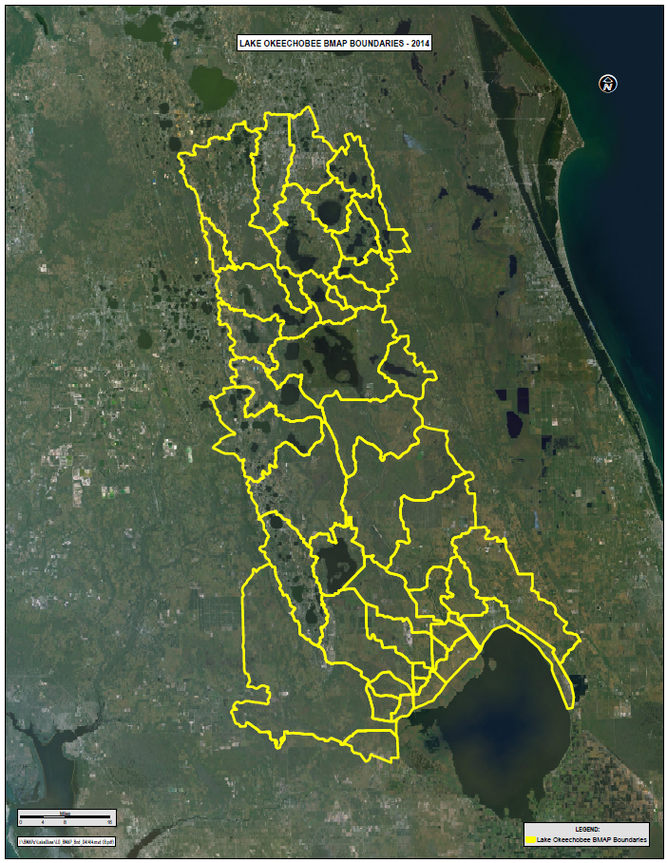
Notes:
Millenia Mall, WDW, Orlando Intl, Hwy 50 Estuaries 85%of Lake Wales Ridge 3 WMDs

Slide 3
Agricultural Producer Options
Monitor discharges, at own expense, and prove compliance with state water quality standards
Participate in FDACS BMP program and receive presumption of compliance with state water quality standards
Notes:
Prove and pay for on a continual basis If it can’t be proved, then BMPs will be required and prescribed With BMPs, you agree to certain practices up front

Slide 4
FDACS Best Management Practices
Practical, Cost Effective Actions
Designed to benefit water quality and water conservation while maintaining or even enhancing agricultural production
Demonstrates agriculture’s commitment to water resource protection
Notes:
Statutory definition Can’t be so expensive as to put a producer out of business Without soil and water, these producers wouldn’t have a business

Slide 5
2 Categories of BMPs
Management Practices
Structural Practices
Notes:
Things that you do – move feeders away from water courses, cattle rotation, evaluate soil fertility needs Construction

Slide 6
BMPs - Management Practices
Nutrient Management and Recordkeeping
N – Nitrogen
P – Phosphorus
Irrigation Management and Recordkeeping
Notes:
Nutrient Management is common to all N-plant vigor and growth, amino acids to build proteins P-component of DNA, essential plant nutrient, limiting nutrient for crops due to scarcity, Fl one of largest deposits in the world IFAS recommendations JUSTIFICATION

Slide 7
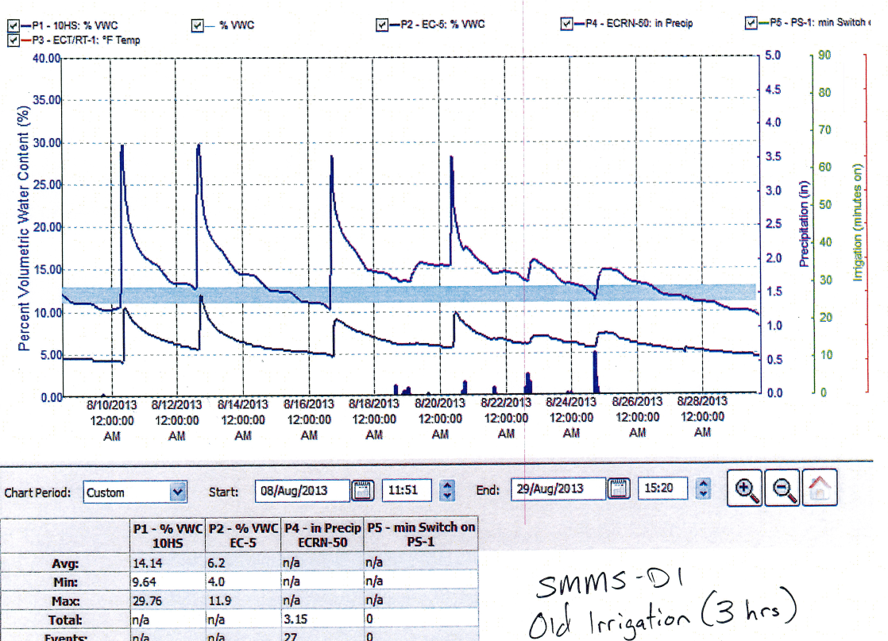
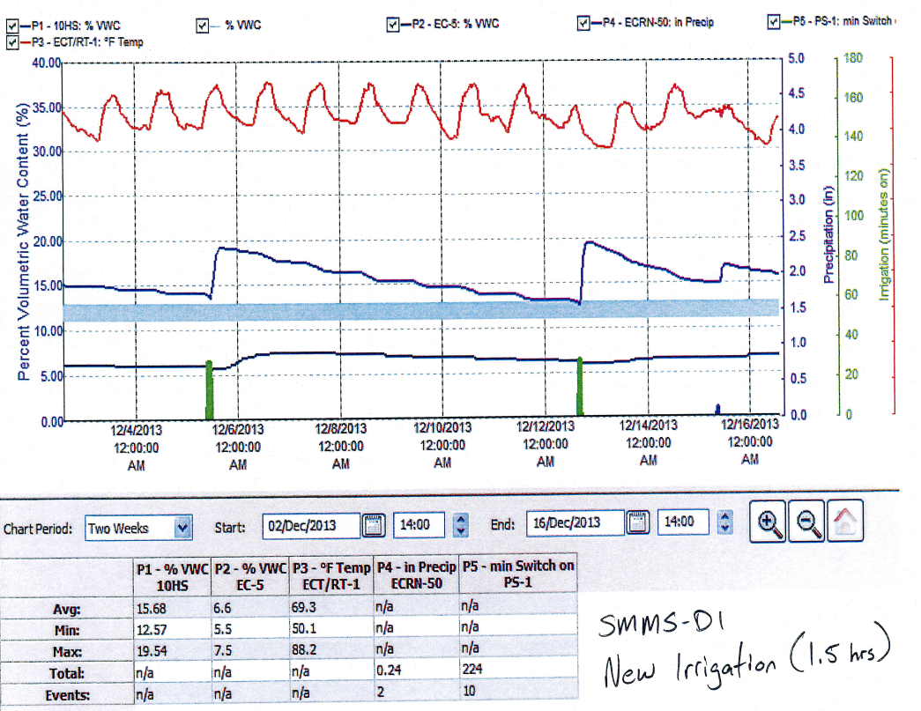
Soil Moisture Probes
Notes:
Huge water and diesel savings Huge successes Keeps nutrients in the root zone

Slide 8
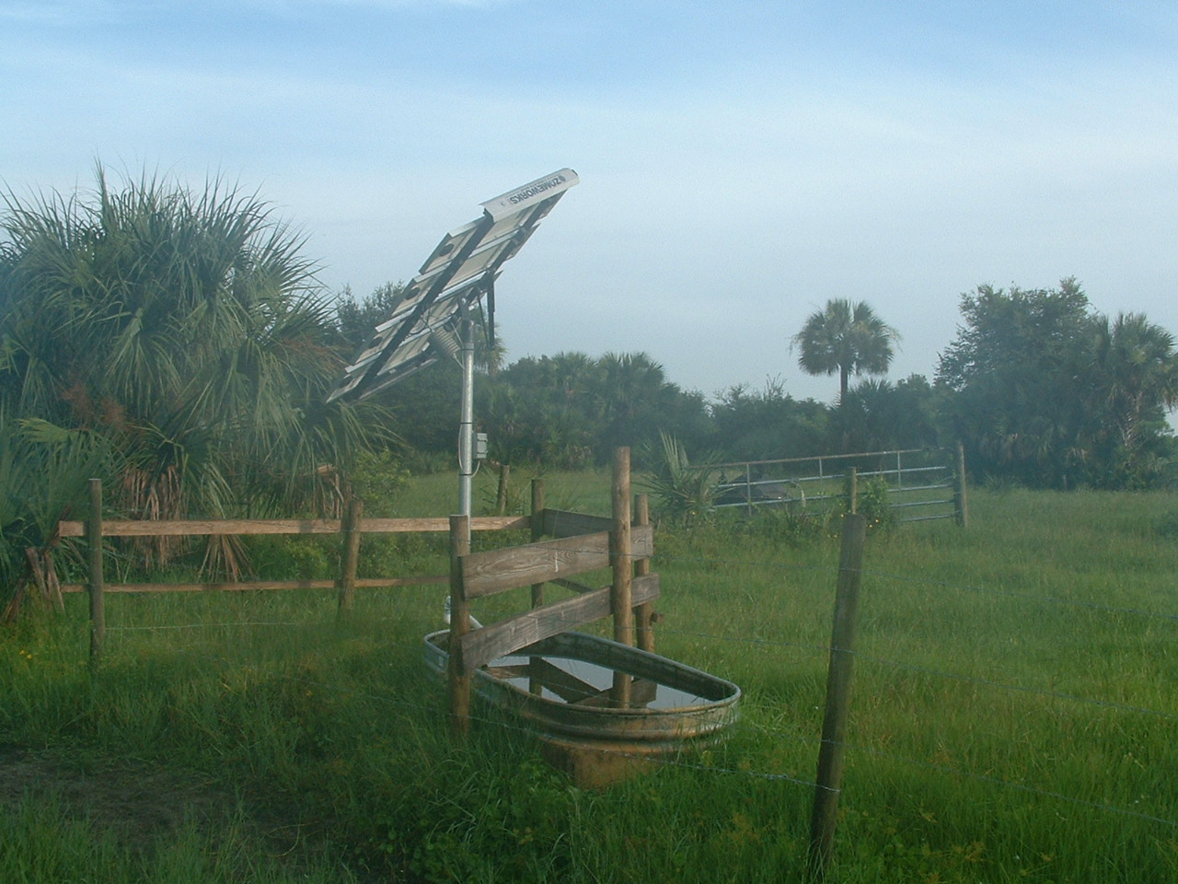
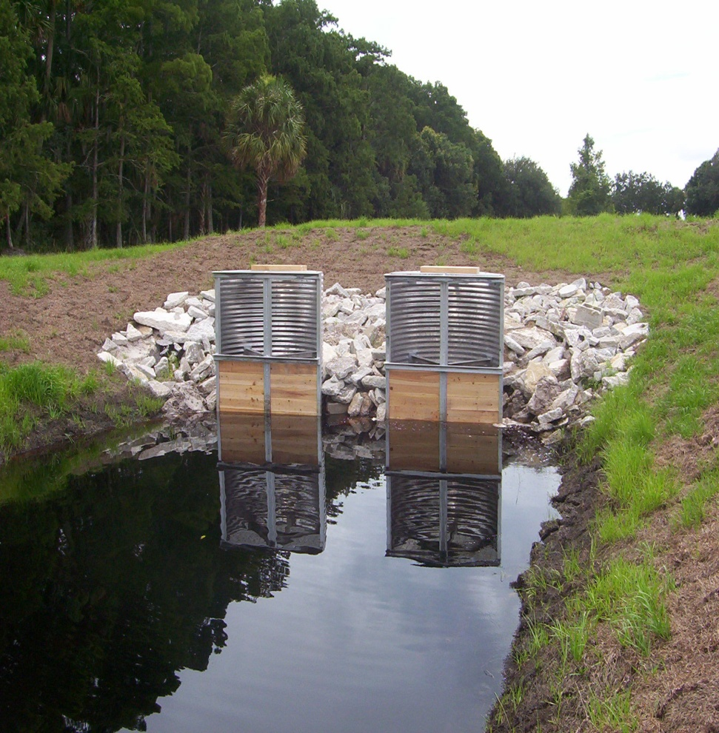
BMPs – Structural Practices
Alternative Livestock Watering Systems
Interior Ranch Fencing
Sediment and Erosion Control Measures
Structures for Water Control

Slide 9
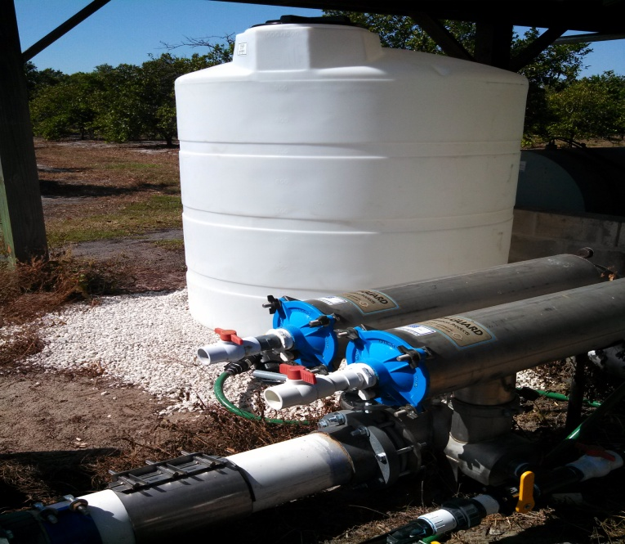
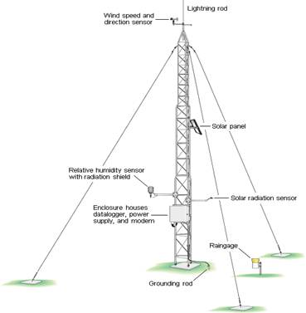
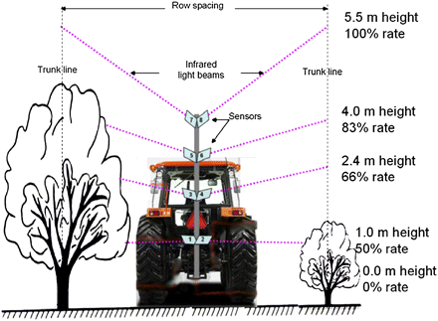
BMPs – Structural Practices
Chemigation/Fertigation Systems
Variable Rate Technology/Precision Agriculture
Weather Stations

Slide 10

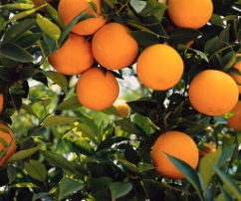
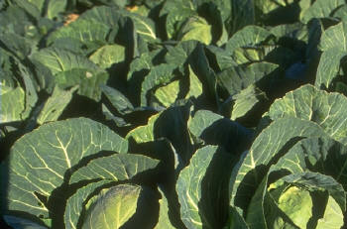
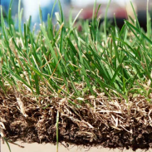

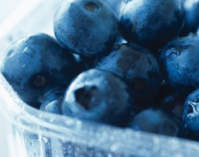
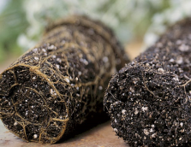
FDACS BMP Enrollment Process
Water Quality BMP Manuals
  Cow Calf
  Citrus
  Vegetable and Agronomic Crops
  Sod
  Commercial Equine
  Specialty Fruit and Nut Crops
  Container Nursery (being updated to include in-ground)
Notes:
Management Tools Each has prescriptive nutrient guidelines from IFAS

Slide 11
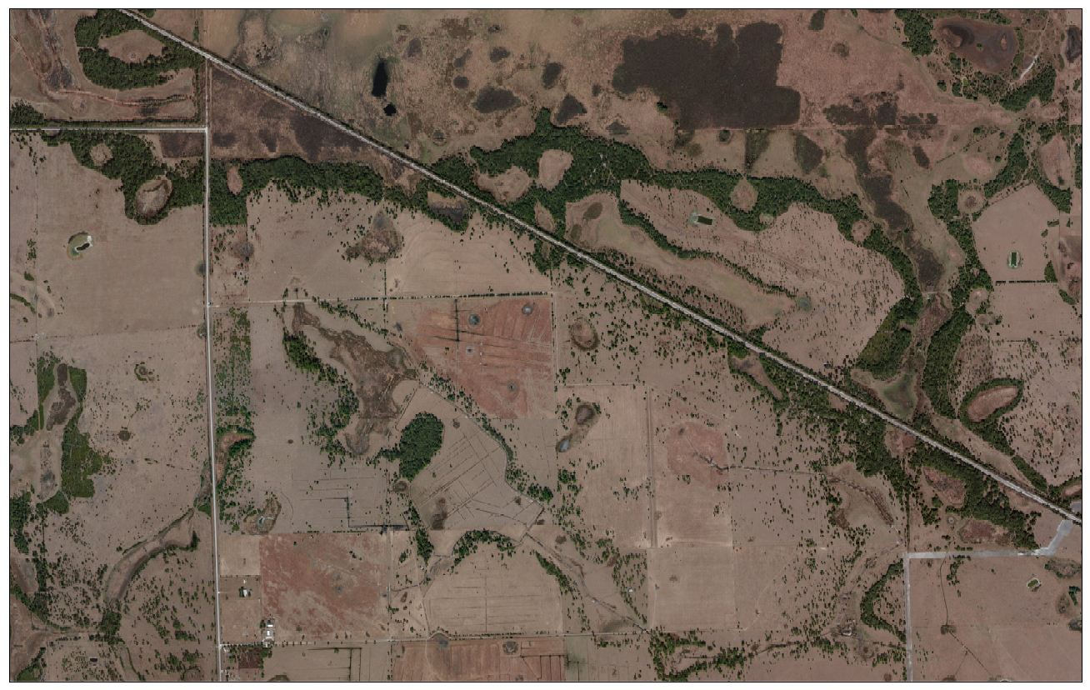
Cow Calf Enrollment Process
Notes:
Assessment begin with a map for a birds eye view Discussion of water movement, cattle movement, problem areas Cow calf properties vary, managed vs native

Slide 12
Cow Calf Assessment Process
Site Specific Assessment
Determine water features and flow patterns
Evaluate opportunities for water storage
Discuss availability of cattle water
Review feeding and/or mineral box placement
Complete checklist and determine appropriate BMPs, as needed
Sign Notice of Intent (NOI) to implement BMPs

Slide 13
Cow Calf Assessment Process, Cont’d
90 day Follow-up
Assist with Securing Engineering and/or Cost Share
Evaluate Opportunities for Easements
Assist with Setting up Recordkeeping System
Manage Construction Projects
Implementation Assurance and Reporting to Department of Environmental Protection
Notes:
Discuss regulations affecting property Plans for construction, quotes, hired engineer Soil and tissue tests reminders Easements or other programs

Slide 14
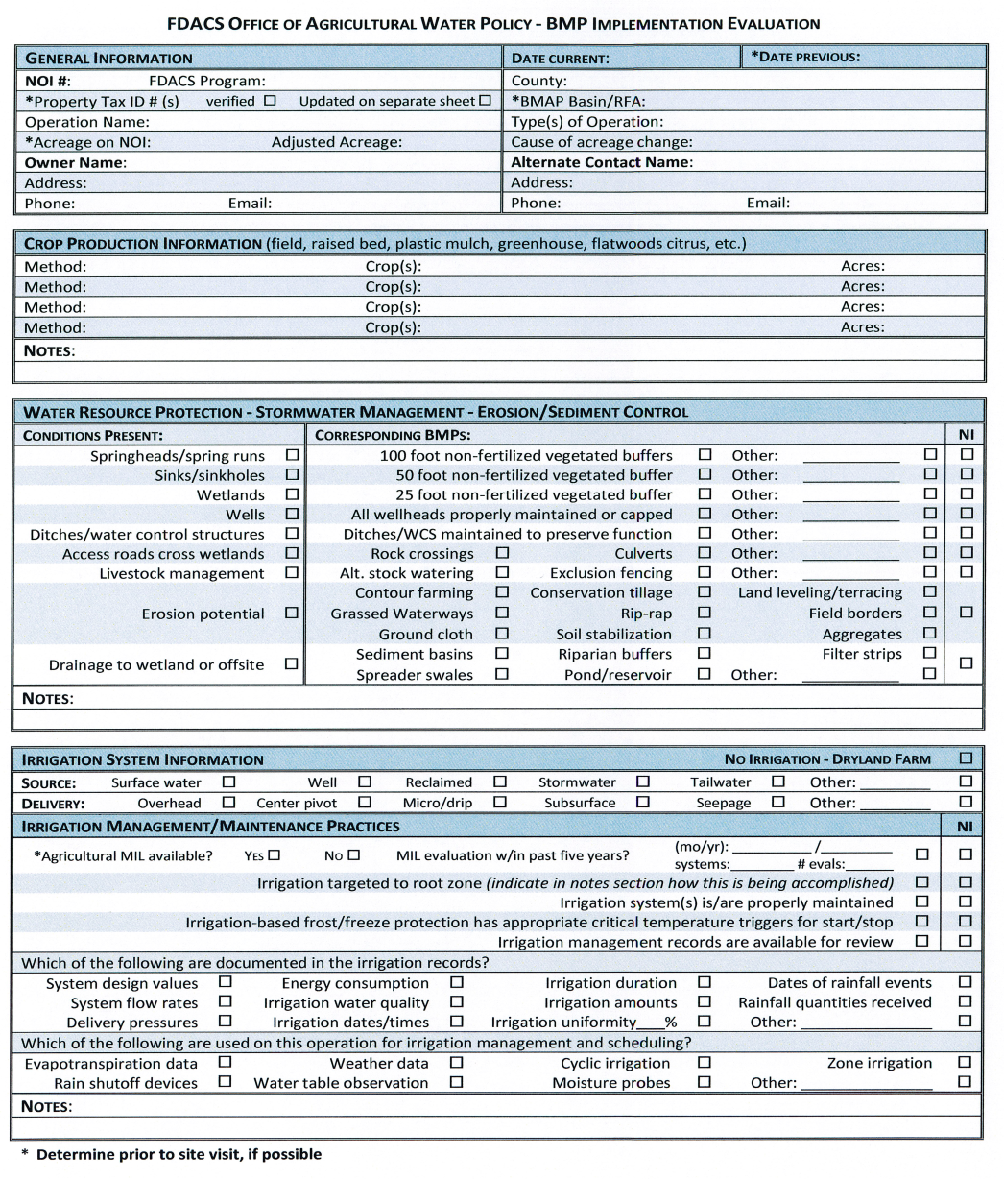
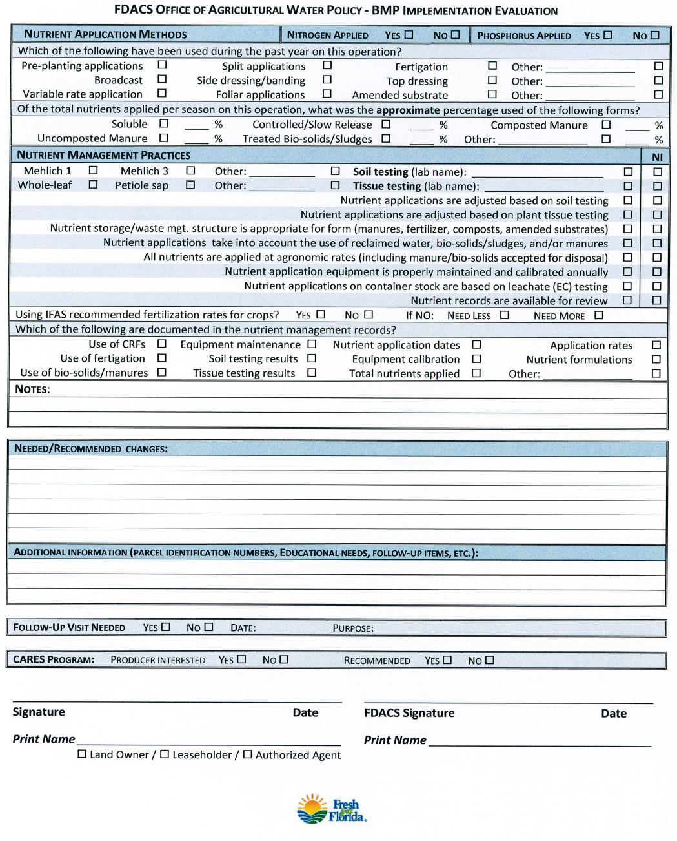
Implementation Assurance

Slide 15
BMP Enrollment Success
Notes:
92% - Several areas to reassess – Ridge and Indian River Citrus Areas

Slide 16
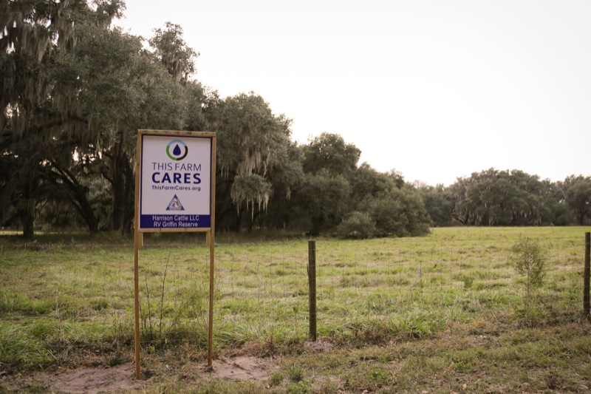

Slide 17
Thank You!
Bonnie Wolff Pelaez
Environmental Manager
Office of Agricultural Water Policy
(863) 462-5881
Bonnie.WolffPelaez@FreshFromFlorida.com

