Slide 1

Project Operations
Nicodemus Slough Project
Inflow Pump #2
Inflow Pump #1
Lake
Okeechobee
Eastern Basin
Western
Basin
Central Basin
S-E
C-5
Southeastern Basin
includes Nicodemus Slough Flowage Easement
S-W
S-342
Riser structure with operable boards
Berms between basins
Offsite Discharge Structures
Nicodemus Slough Flowage Easement

Slide 2
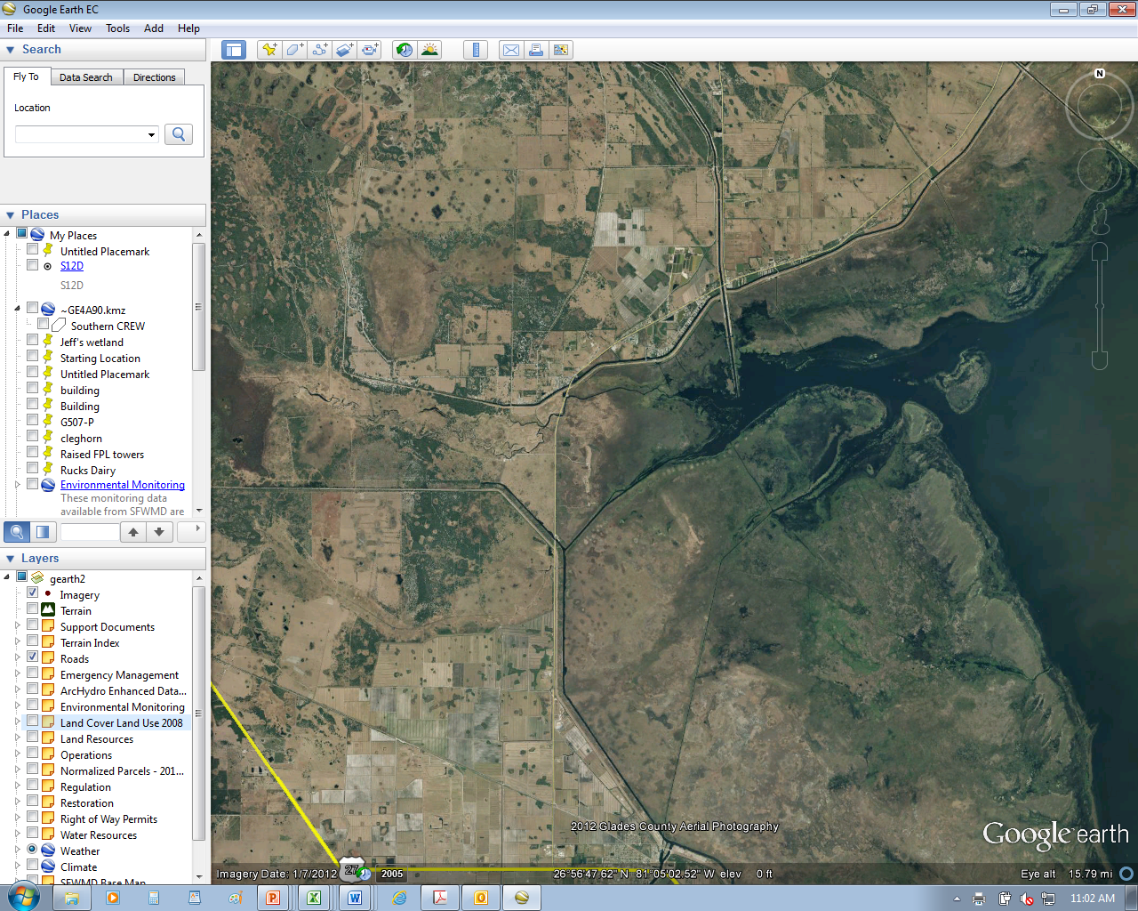
FISH EATING CREEK
NICODEMUS SLOUGH
LAKE OKEECHOBEE
C-5 CULVERT
RIM CANAL

