Slide 1
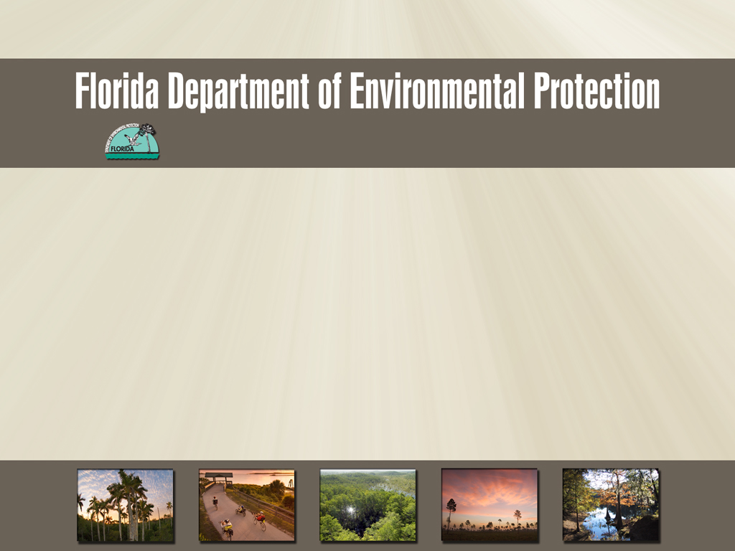
Northeast District-SWAMP
Basin Management Action Plan 1&2 summary of activities
Jeremy Parrish
March 14,2013

Slide 2
Bmap monitoring for fecal coliform
Monitor aproximately 10 wbids
20-30 sites monthly
Jea analyze samples, cost savings for the State of Florida
Additional follow up sampling contract lab
Sampled 280 fecal coliform samples for BMAP 1&2- in 2012

Slide 3
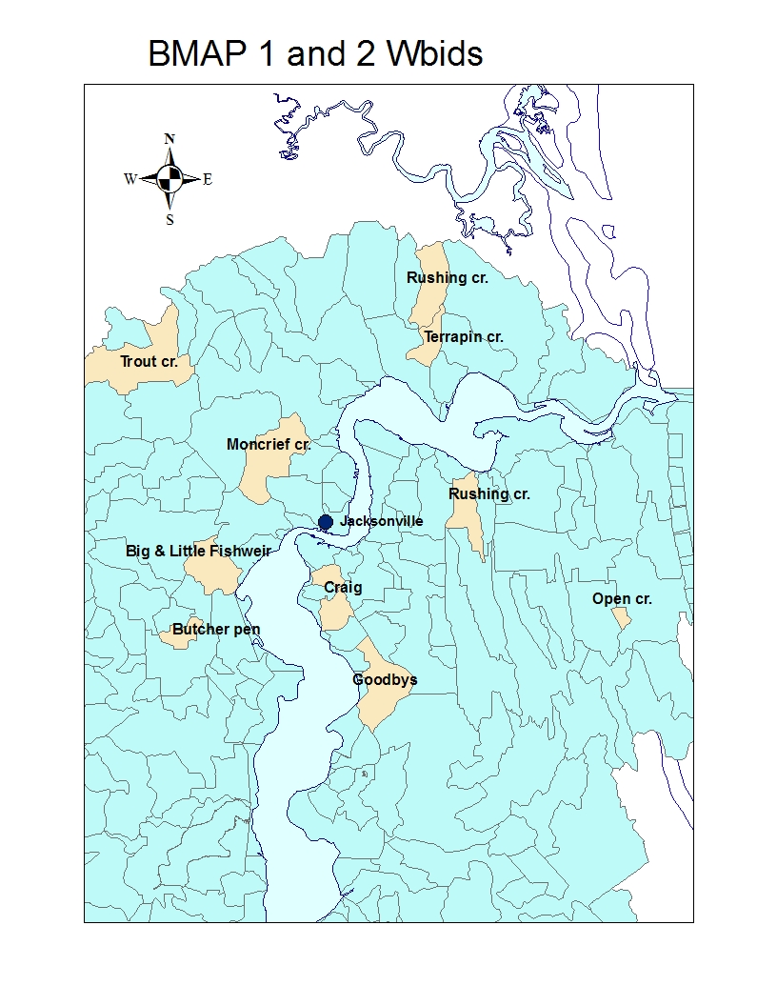
FDEP Bmap wbids
BMAP 1
2204-Terrapin creek
2299-Open creek
2326-Goodbys creek
2322-Butcher pen creek
2280-Big fishweir, Little fishweir creeks
BMAP 2
2228-Moncrief creek
2297-Craig creek
2203-Trout creek
Newly added
2189-Rushing creek
2246-Jones creek
2306-New rose creek

Slide 4
Tat-group “Monthly reporting”
Monthly tat meetings- collaboration between entities
Report monthly results
Review high results
Review follow ups
Any findings of suspected sources
STORET | WBID | STATION | DATE | #CFU/100ML
20030695 | 2299A | OPEN CREEK AT SAN PABLO ROAD | 1/15/2013 | 530
20030715 | 2246 | JONES CR @ ARLINGTON EXP EAST FORK | 1/15/2013 | 4800
20030722 | 2246 | JONES CR @ ARLINGTON EXP WEST FORK | 1/15/2013 | 440
20030671 | 2246 | JONES CREEK AT MONUMENT ROAD | 1/15/2013 | 440
20030490FLA | 2204 | TERRAPIN CR @ BLASSIUS RD | 1/15/2013 | 580
20030603 | 2189 | RUSHING CR. TRIB @ HOLSTEIN DR | 1/15/2013 | 4200
20030600 | 2189 | RUSHING CR. WEST BR @ NEW BERLIN RD. | 1/15/2013 | 770

Slide 5
Follow up sampling of Coliform as a possible human contamination threshold
Targeted sampling above 5000cfu/ml
Correlations to high counts as follows:
Tidal movement
Stagnant flow
High storm flow
Entrained in the sediments
Wildlife contributions
Future considerations using surrogate sucralose as a follow up human contamination indicator
Notes:
Conclusions, Explanations, hypothesis on why over 5000

Slide 6
Reconn sampling new wbids
Sampled wbids for consideration to include as new supplemental sites to dropped sites which had low counts
Wbids reconned sampled and reported on were:
New rose
Governors creek
Mill creek
Tacito creek
Jones creek
Rushing creek
Tat group leaders decided to continue with New Rose Cr., Jones Cr., Rushing Cr. as having higher coliform numbers

Slide 7
Tat Ranking
Started in 2007-FDEP reported to group (Banks)
Compile fecal data from 75 wbids from the
Storet database
Data providers-FDEP, COJ, JEA, City of Atlantic Beach, Jax Beaches, Mayport
Compile data in three levels of coliform values
>800, >5000, >10000
Rank according to percentages of sample results above these values
Name | #obs | #>800 | %>800 | Rank
MILLER CREEK | 136 | 110 | 80.9% | 3
BUTCHER PEN CREEK* | 132 | 108 | 81.8% | 2
CRAIG CREEK | 121 | 102 | 84.3% | 1
BIG FISHWEIR CREEK | 182 | 135 | 74.2% | 6
HOGAN CREEK* | 143 | 90 | 62.9% | 9
WILLIAMSON CREEK* | 91 | 57 | 62.6% | 10
CHRISTOPHER BRANCH | 73 | 52 | 71.2% | 7
MIRAMAR CREEK | 78 | 54 | 69.2% | 8
UNNAMED DITCHES | 4 | 3 | 75.0% | 4
RED BAY BRANCH | 22 | 13 | 59.1% | 12

Slide 8
Source tracking
Recurring high fecal values at sites Big Fishweir East at Park st. , as well as Little Fishweir at Oak st.
Walk the wbid Pat Oconnor, Jeremy Parrish
Noting any potential sources, photographing, sampling, and any side flows or pipes
Noting blockages from trash/debris.
20030951 | 2280 | BIG FISHWEIR CR SF EAST PARK ST. | 7/12/2012 | 26000
NA | NA | Big fishweir 100m north Blanding at Jersey | 7/26/2012 | 5500
NA | NA | Bigfishweir 100m down from glenwood | 7/30/2012 | 6000
NA | NA | Side tributary to big fishweir btwn. Glenwood and park | 7/30/2012 | 6000
NA | NA | Big fishweir above west park | 7/30/2012 | 6000
Notes:
6000 too numerous to count, outcome nothing obvious

Slide 9
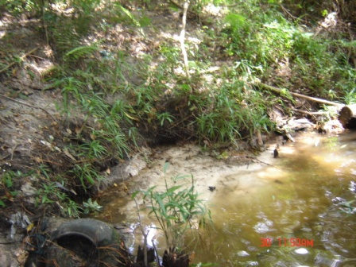
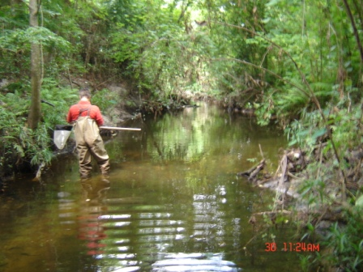
Big Fishweir at Park
Construction debris
Wading / Walking wbid
Notes:
Construction debris, trash observed

Slide 10
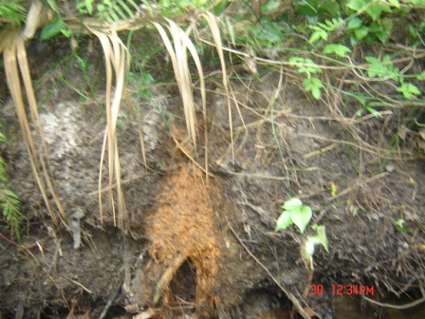
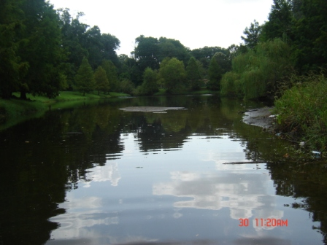
Big Fishweir at park
Side discharges from low spots/ or possibly from lawns with french drains
Stormwater pond part of flow of Big Fishweir creek
Notes:
Drainage from the side, stormwater pond in flow of creek

Slide 11
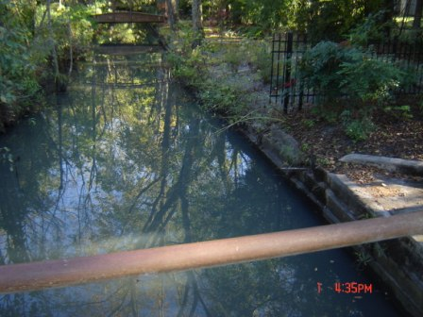
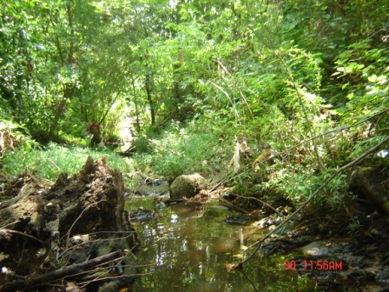
Little fishweir at Oak, Big Fishweir at Park
Altered flow-Concrete channelized , Tidal flow back and forth sediment
Natural but has blockages- construction debris, and logs
Notes:
Little fishweir oak and Big fishweir at Park

Slide 12
Stormwater conveyance removal of blockage
Butcherpen creek- Beginning of 2012
Removal of shopping cart and debris in stormwater conveyance at headwaters of Butcher pen creek
Increased flow and prevented sediment buildup
Reduction in coliform values

Slide 13
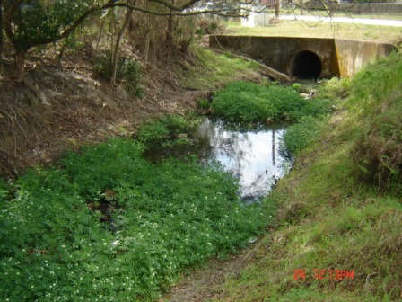
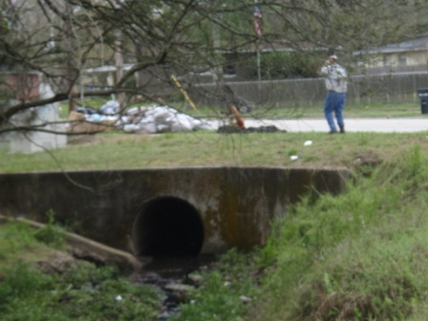
Clean up at Butcher pen
Notes:
Removed lodged shopping cart in the storm conveyance and debris blockage

Slide 14
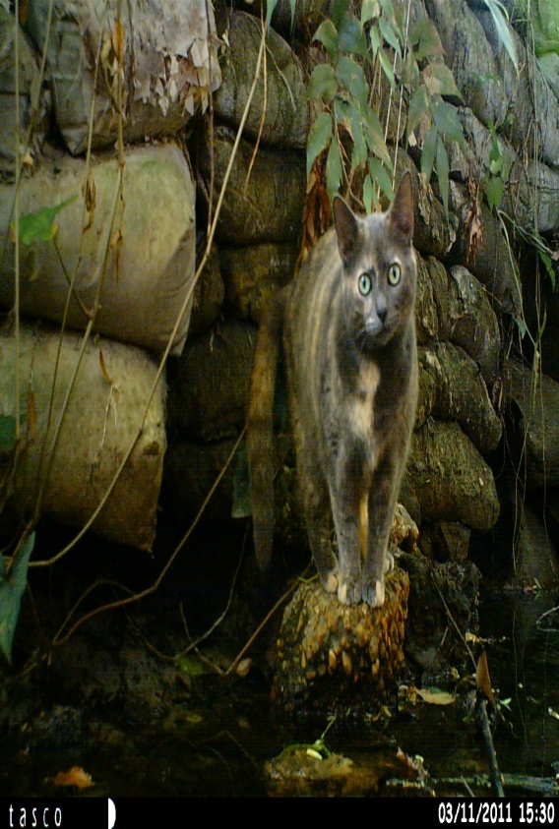
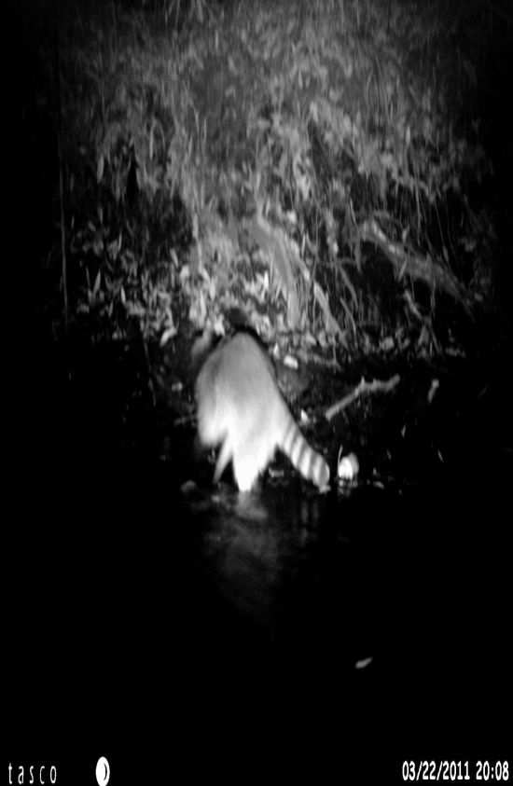
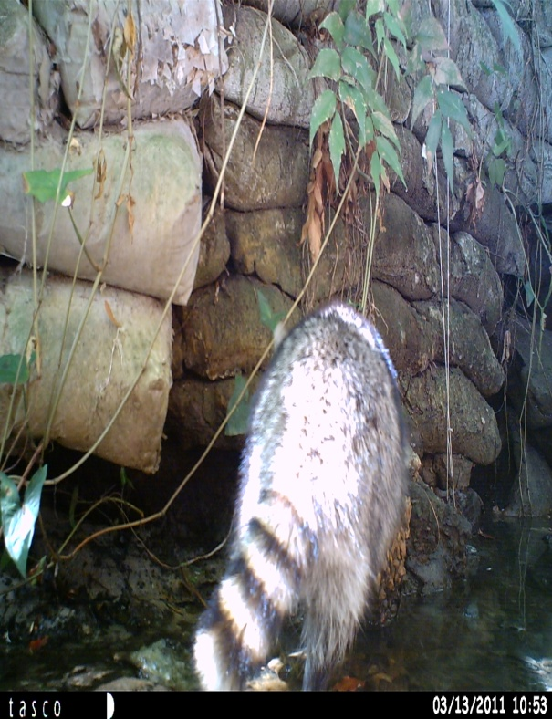
Wildlif
Questions?

