Slide 1
Lower St. Johns River (LSJR) Tributaries Septic Tank Enforcement Project
Zhan Bennett
Environmental Manager
OSTDS/WBID Programs

Slide 2
Failing or malfunctioning septic tanks are considered a contributing factor to nonpoint source pollution.
The purpose of this project was to identify old and malfunctioning septic systems to enforce their abandonment, repair, modification, replacement or connection to a central sewerage system.

Slide 3
The project consists primarily of door-to-door inspections and public education on the care and use of septic systems.
During the course of this project, DOH staff completed:
7,368 inspections
679 re-inspections
5,942 sites delivered public education materials
121 Enforcement cases
The most common violations observed were broken or improperly sealed tank lids and illegal laundry discharge.

Slide 4
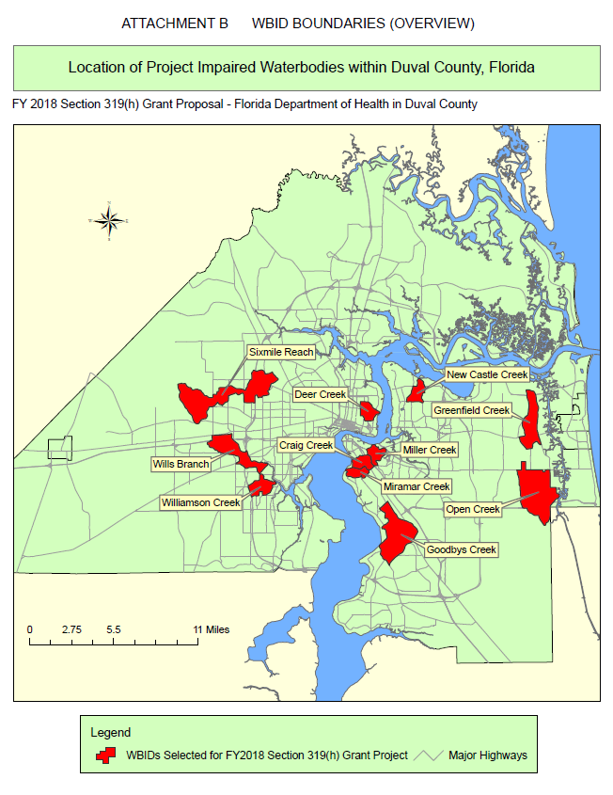
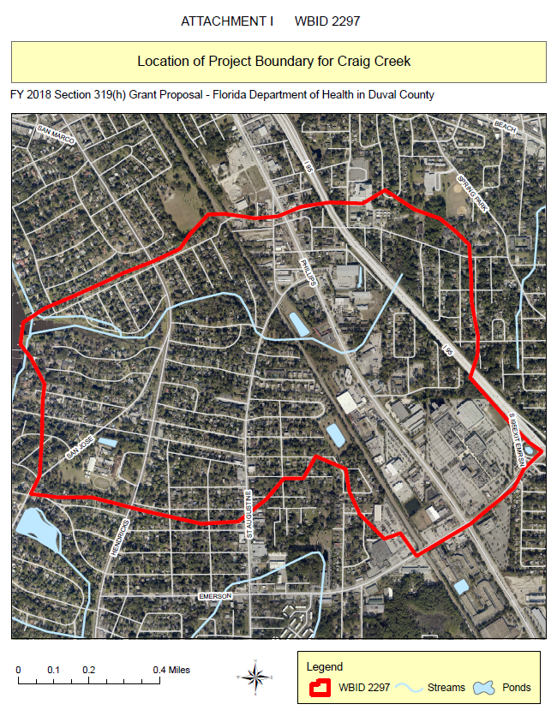

Slide 5
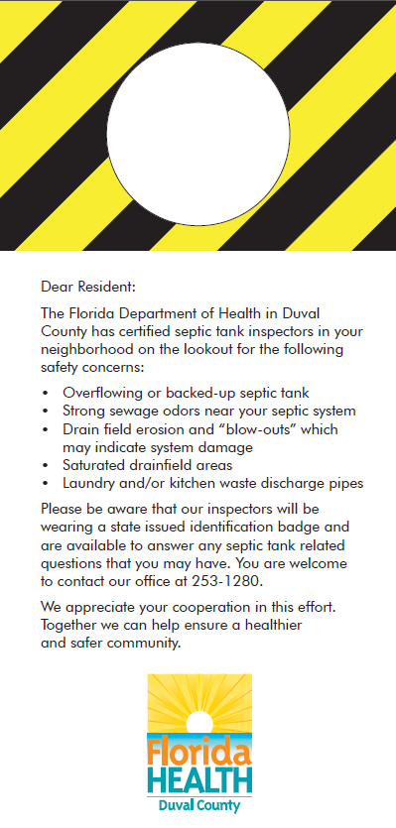
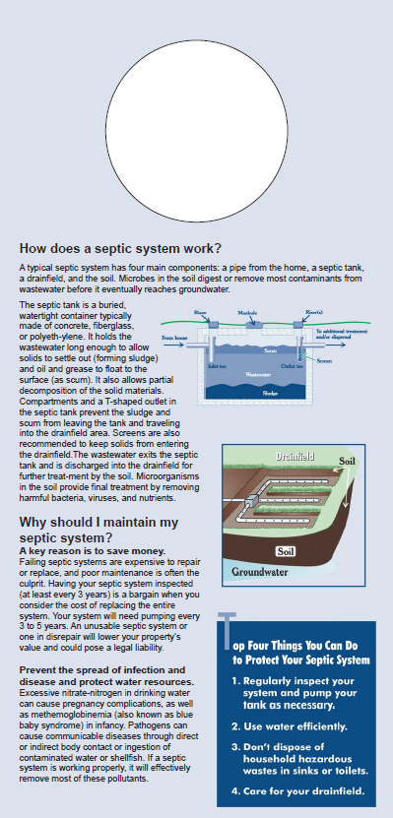
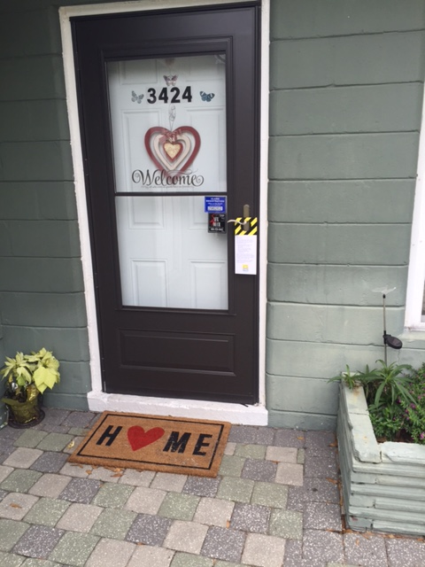
Door-to-Door Flyers

Slide 6
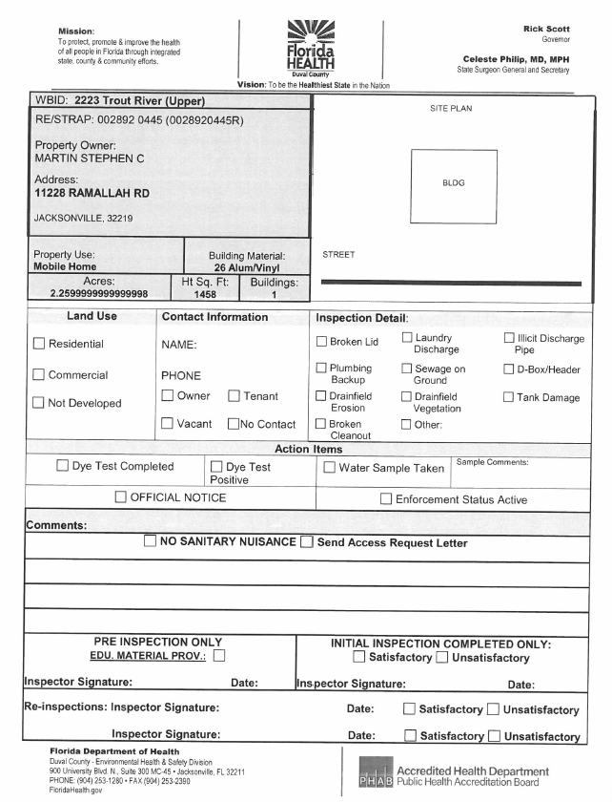
WBID Field Inspection Sheet

Slide 7
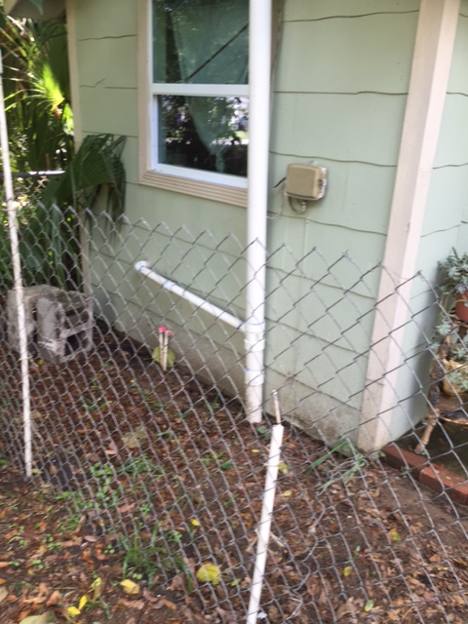
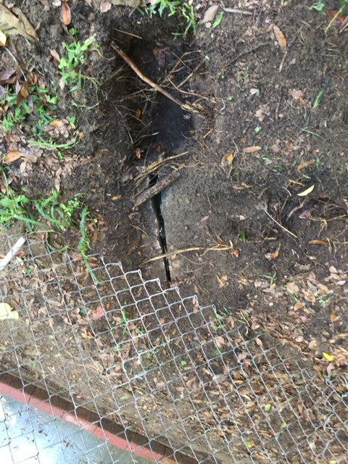
Unsatisfactory Inspection
Cracked septic tank lid.
Unauthorized connection from shed.
Sewage on ground.

Slide 8
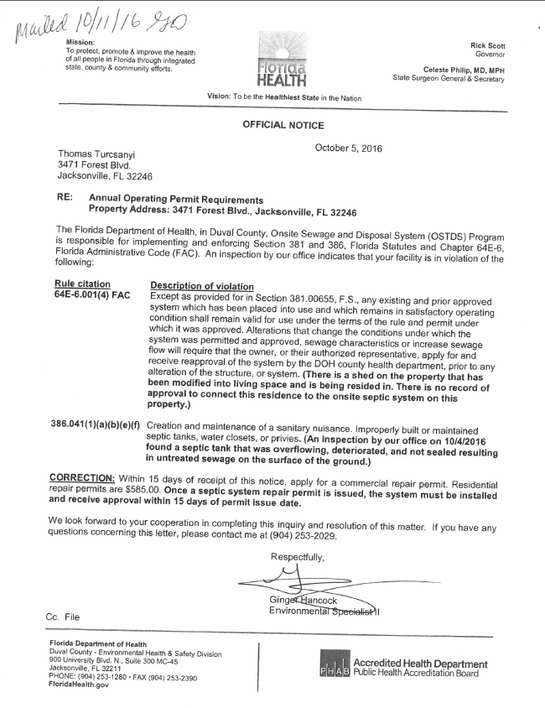
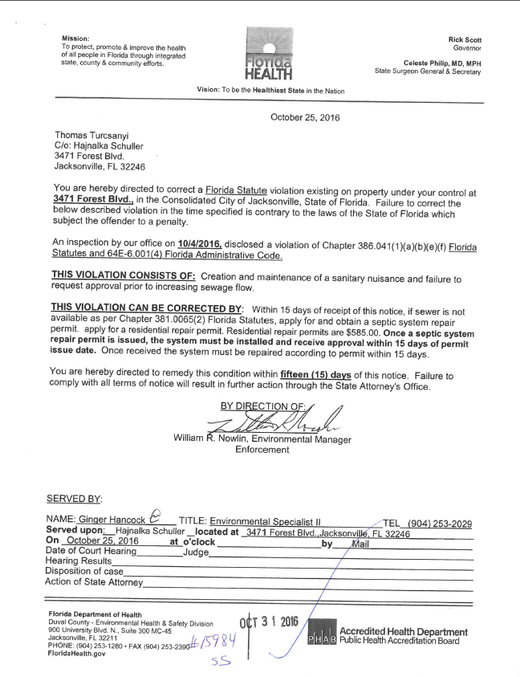
Enforcement

Slide 9
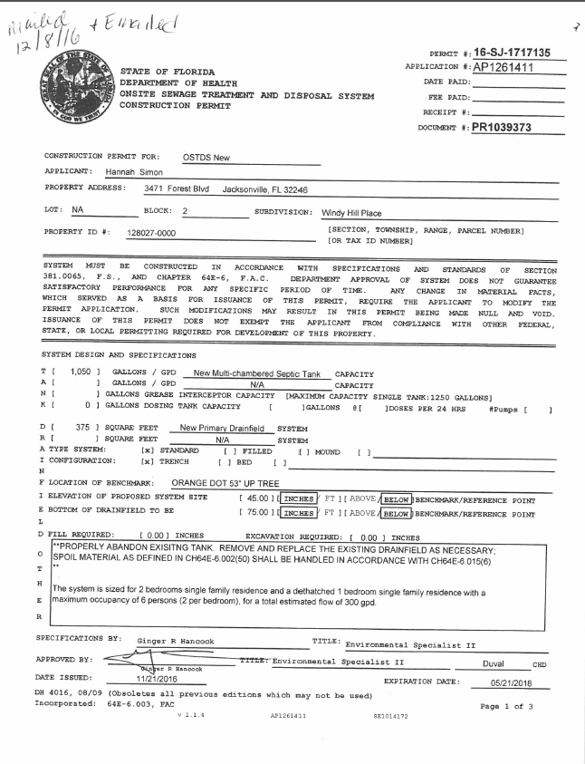
Permit

Slide 10
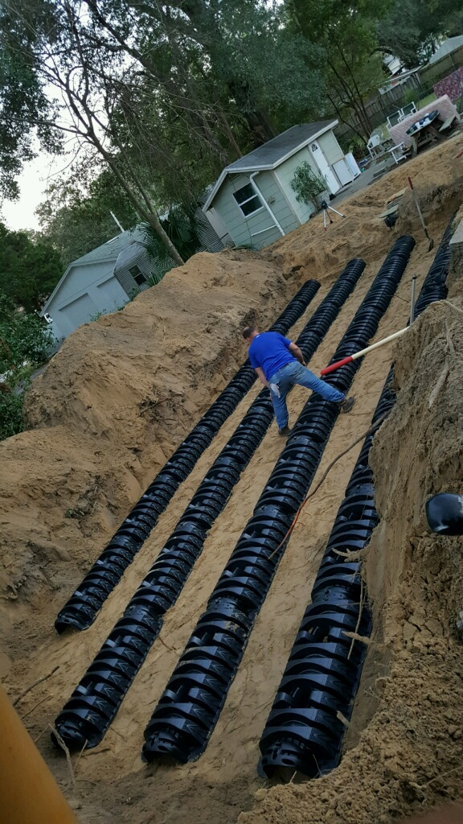
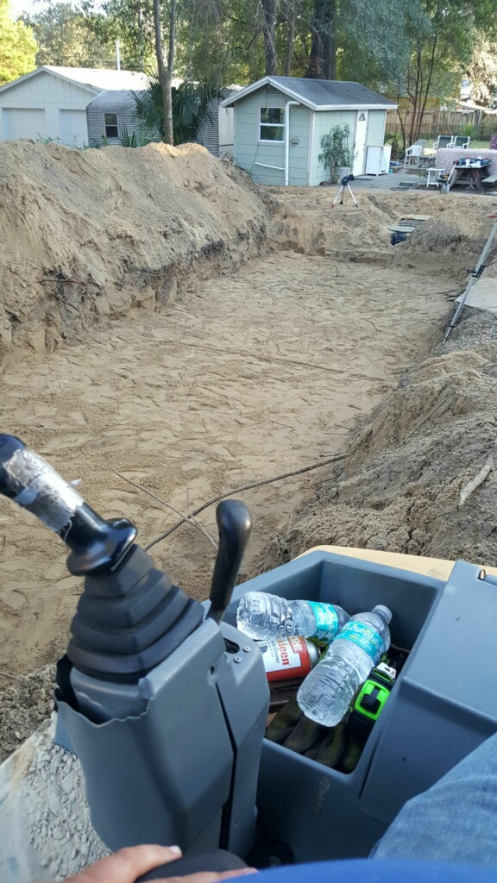
Installation
Drainfield installation.

Slide 11
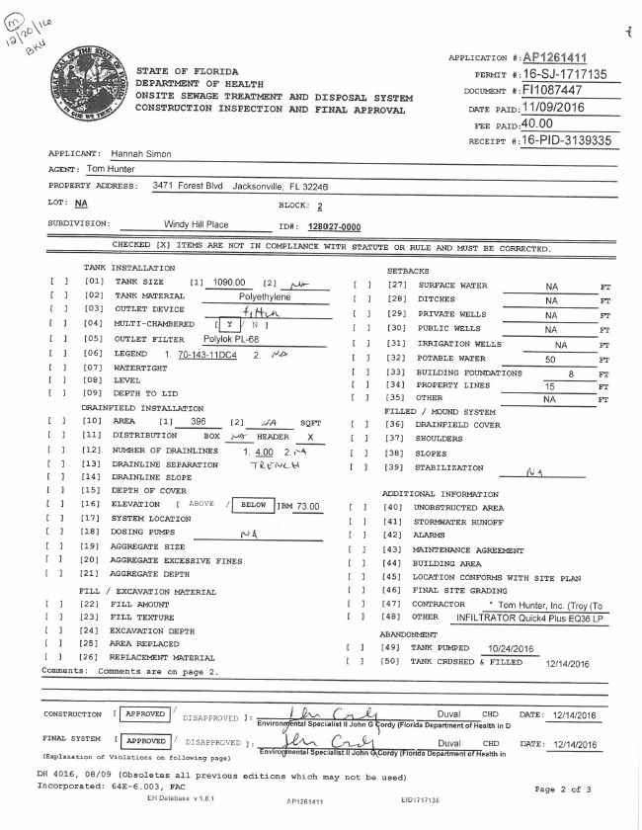
Final
Approval

Slide 12
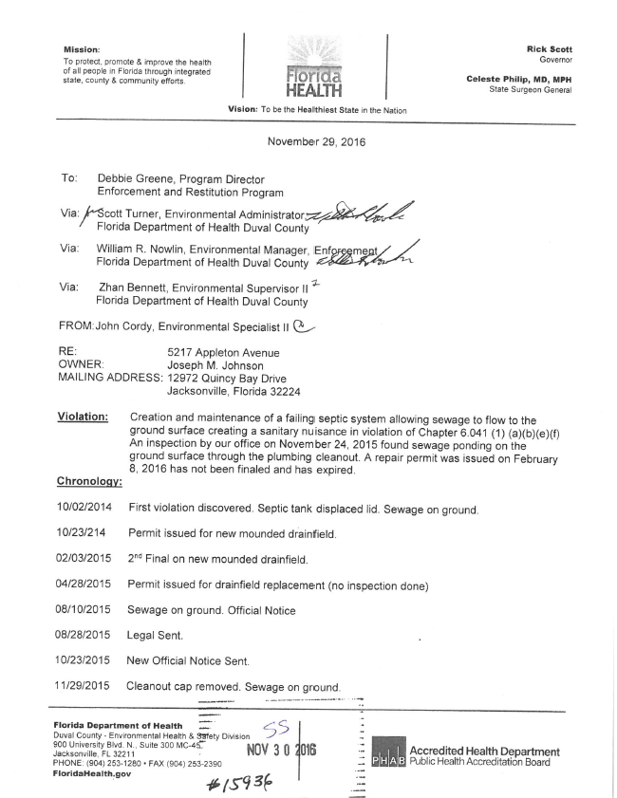
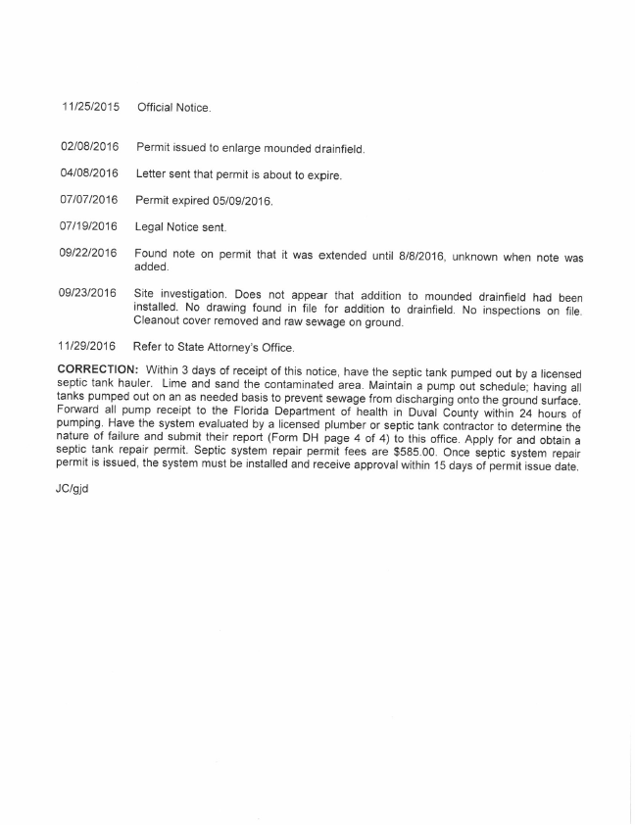
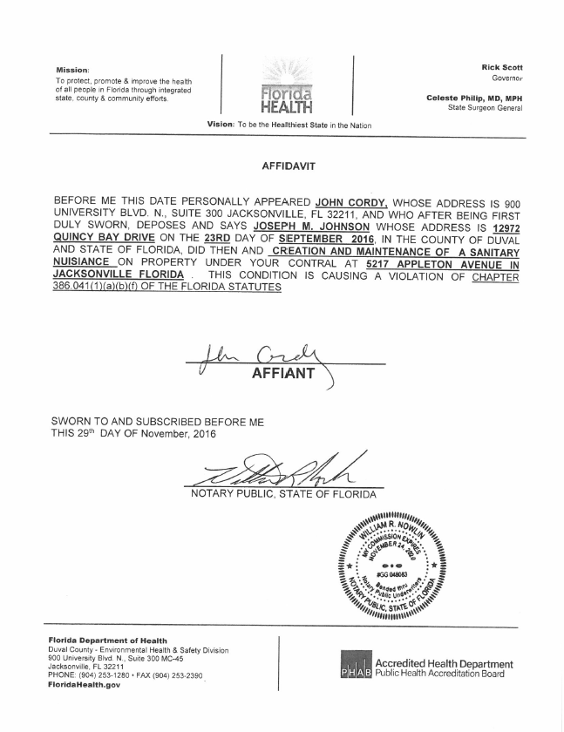
Uncompliant Owner Sent to S.A. Office

Slide 13
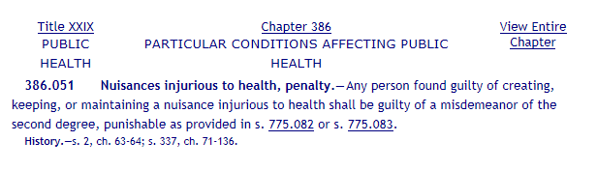
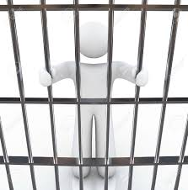
Penalty

Slide 14
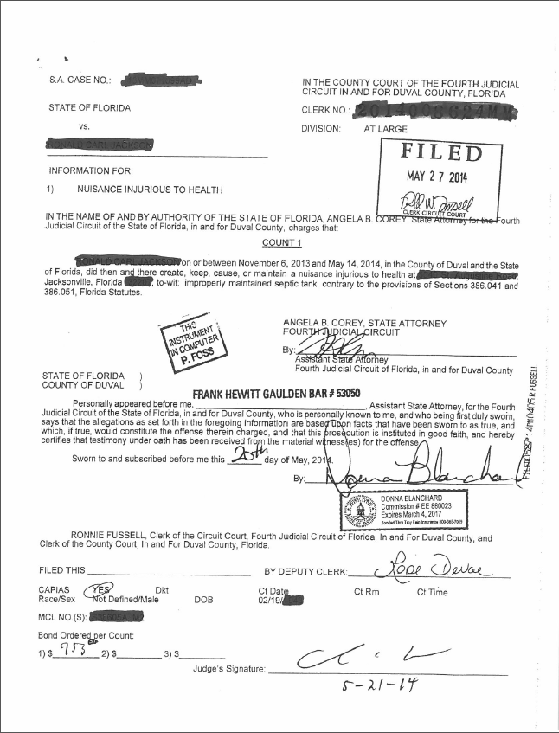
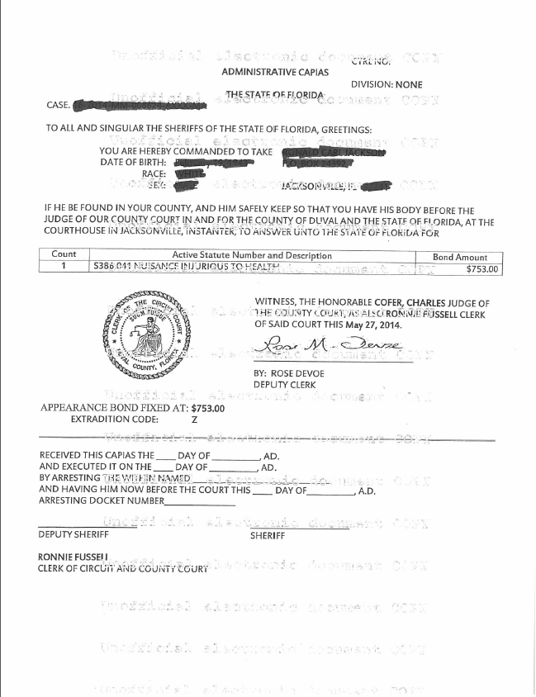
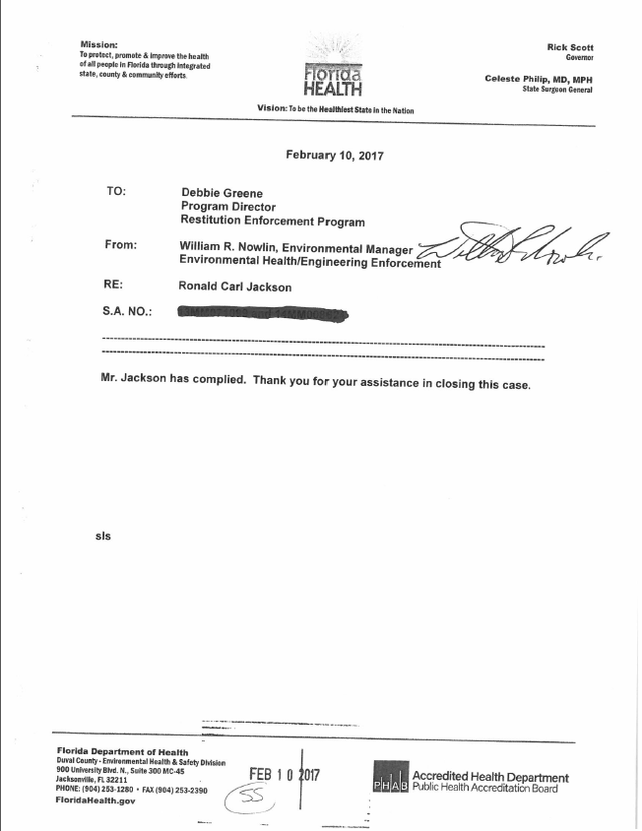
State Attorney’s Office

Slide 15
Contact Information
Zhan Bennett
Environmental Manager, OSTDS/WBID Programs
(904) 253-2023
Zhan.Bennett@flhealth.gov

