Slide 1
Middle Trout River BMAP Hydrology Overview
January 13, 2011

Slide 2
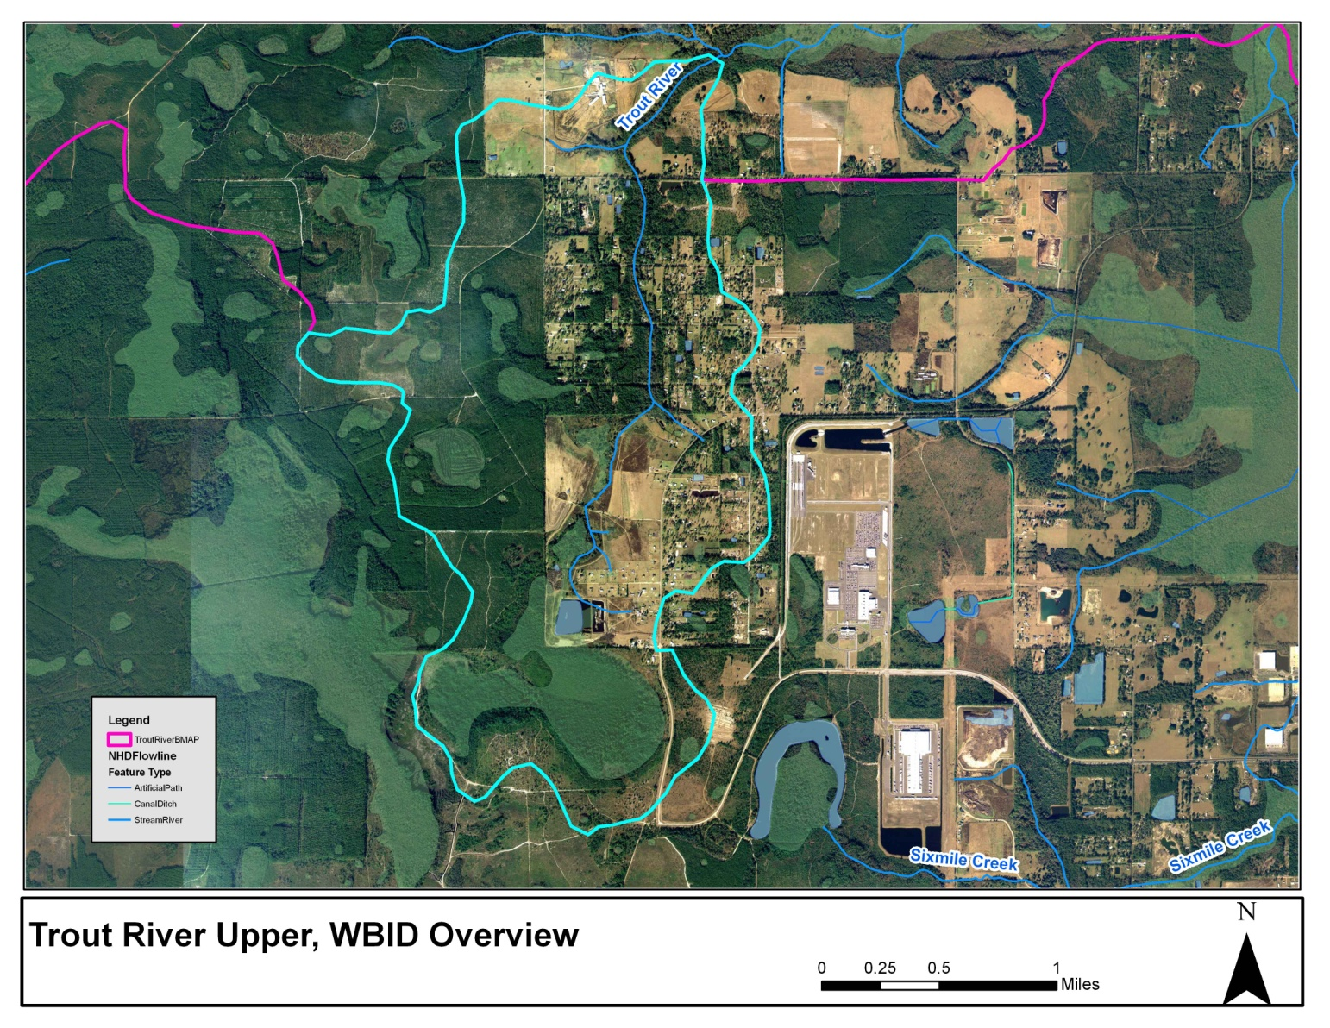
Upper Trout River Overview

Slide 3
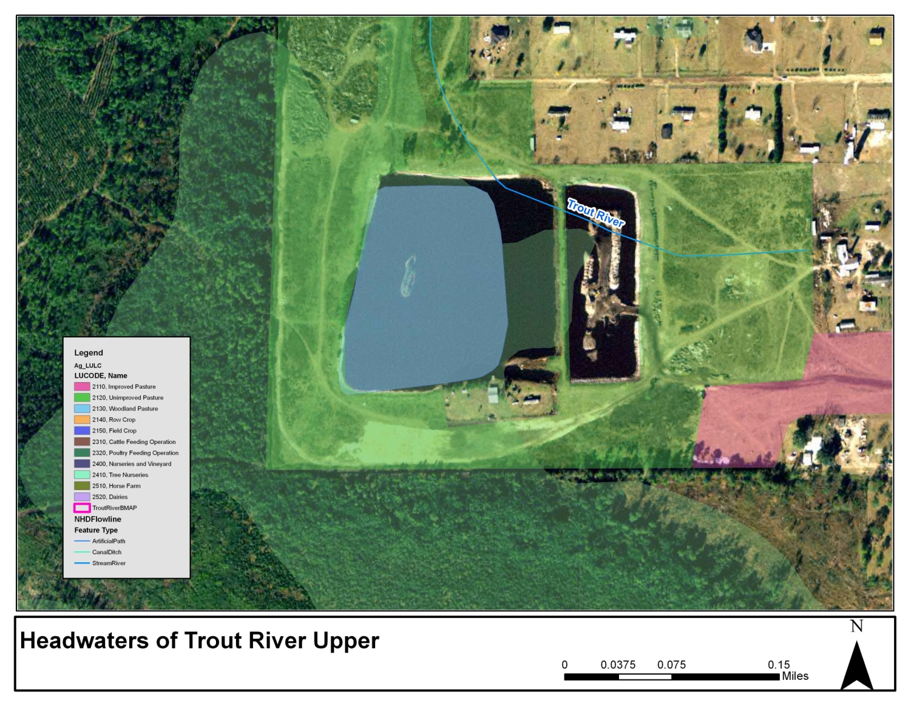
Upper Trout River Headwaters

Slide 4
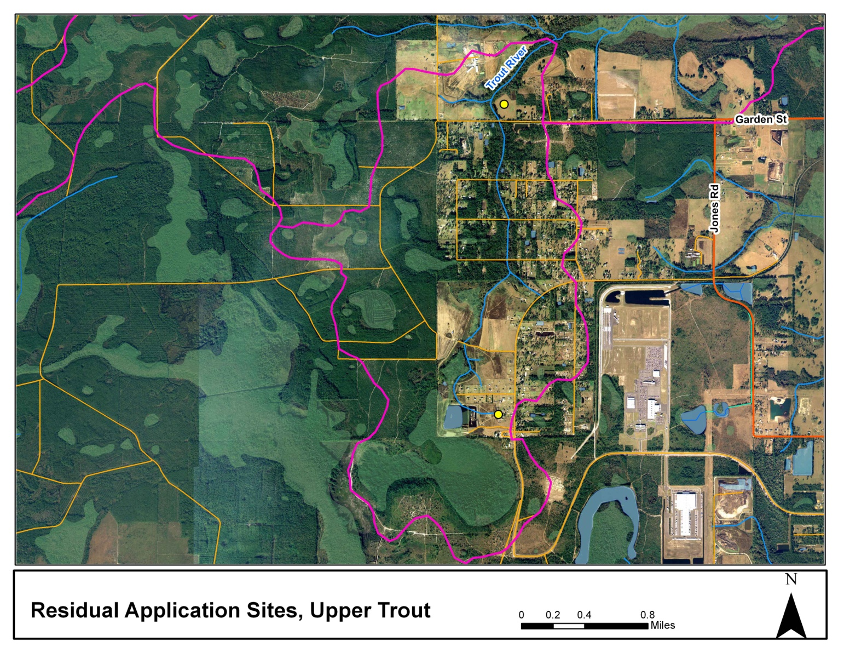
Upper Trout River Residual Application Sites

Slide 5
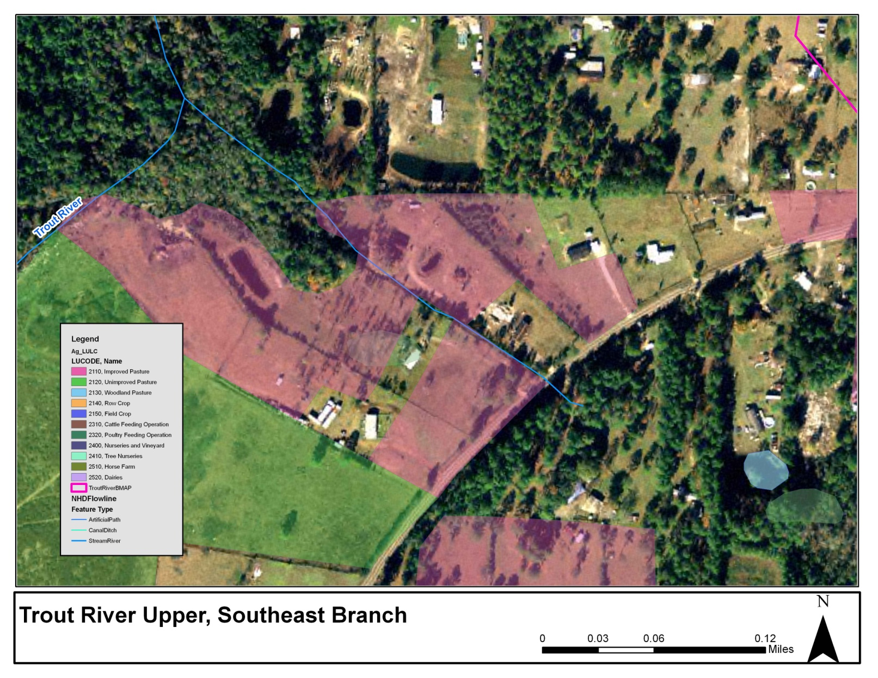
Upper Trout River Southeastern Branch

Slide 6
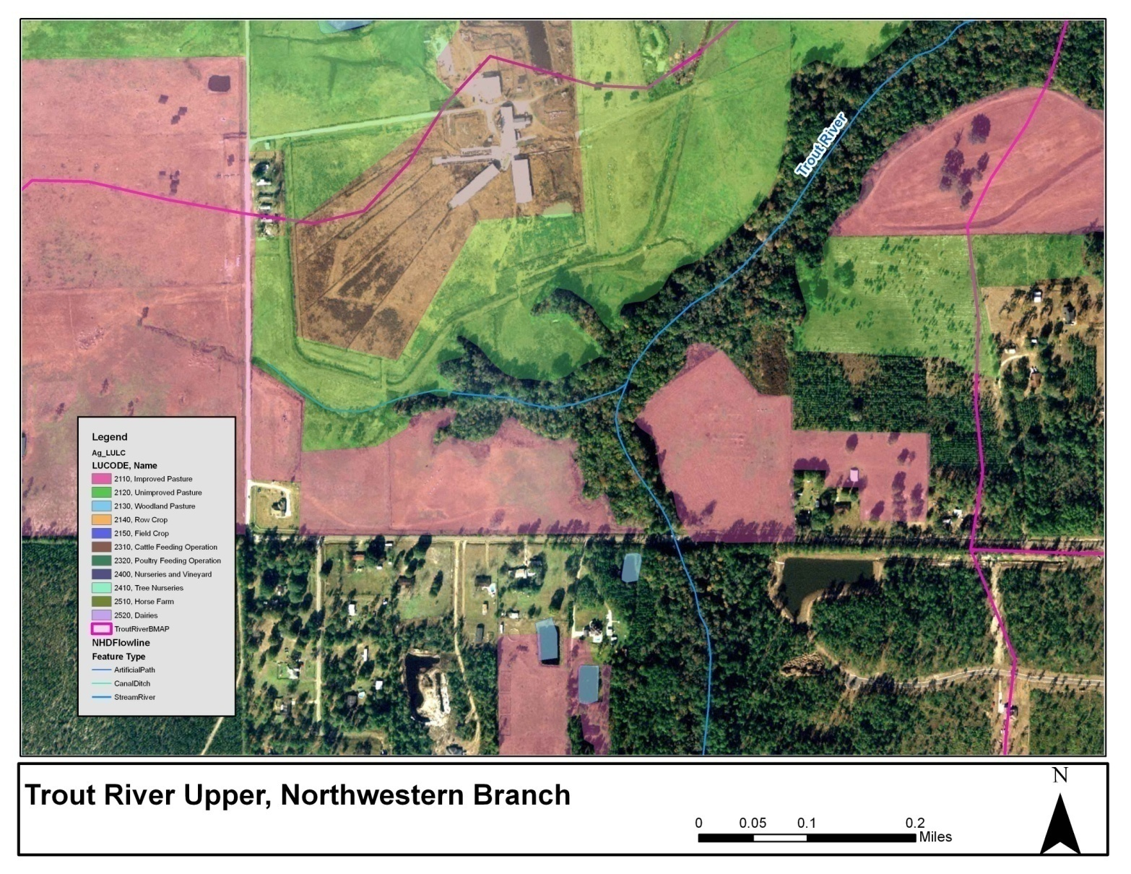
Upper Trout River Northwestern Branch

Slide 7
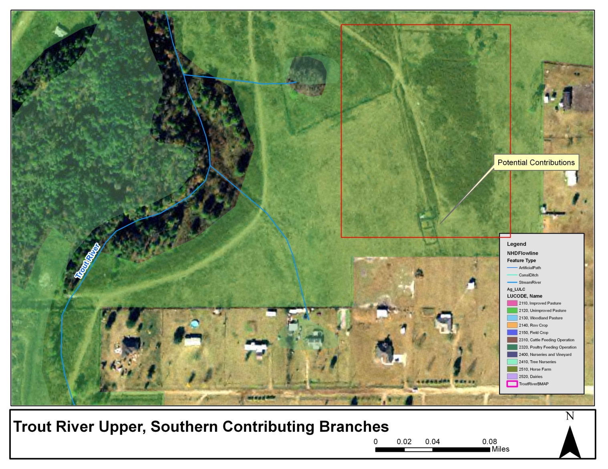
Upper Trout River Southern Branches

Slide 8
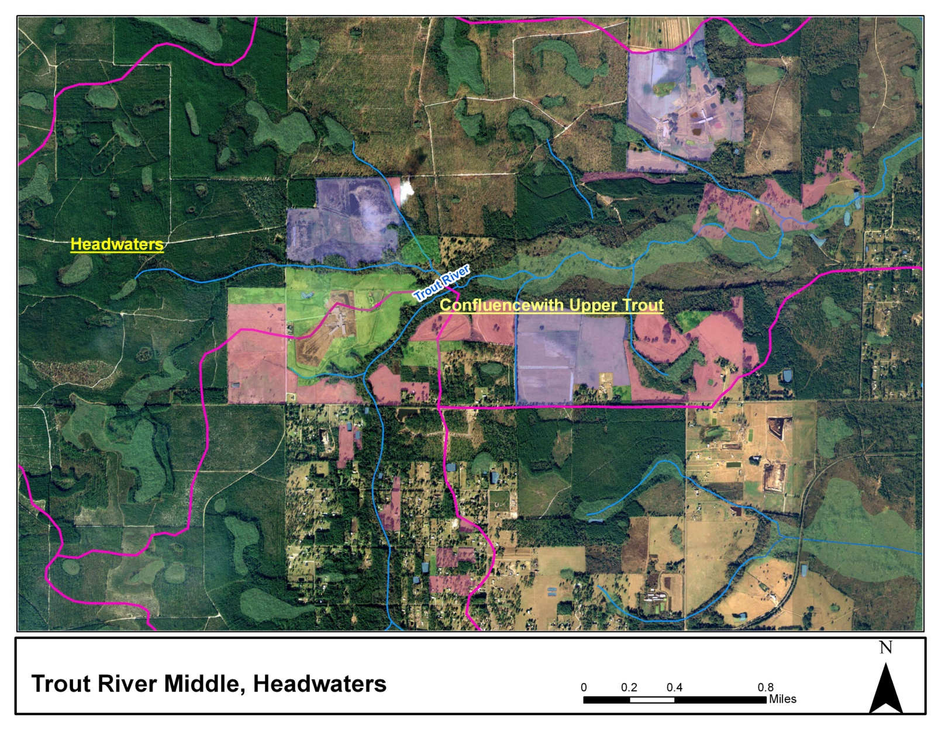
Middle Trout River Headwaters

Slide 9
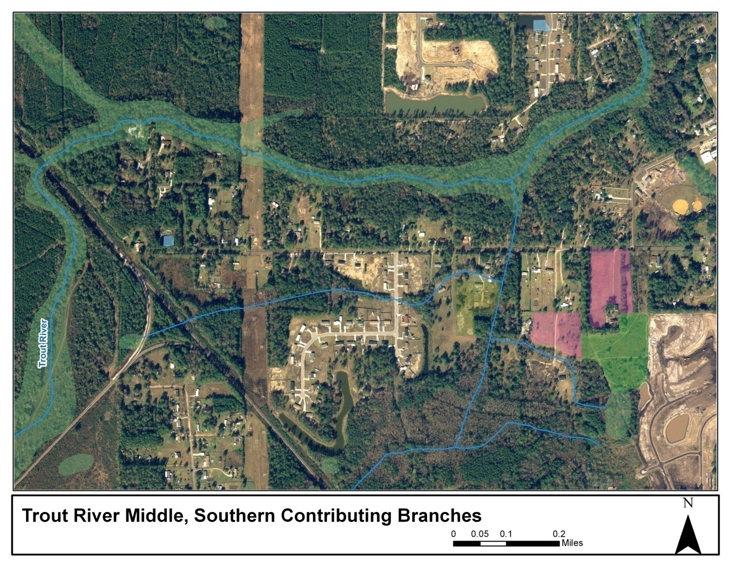
Middle Trout River Southern Branches

Slide 10
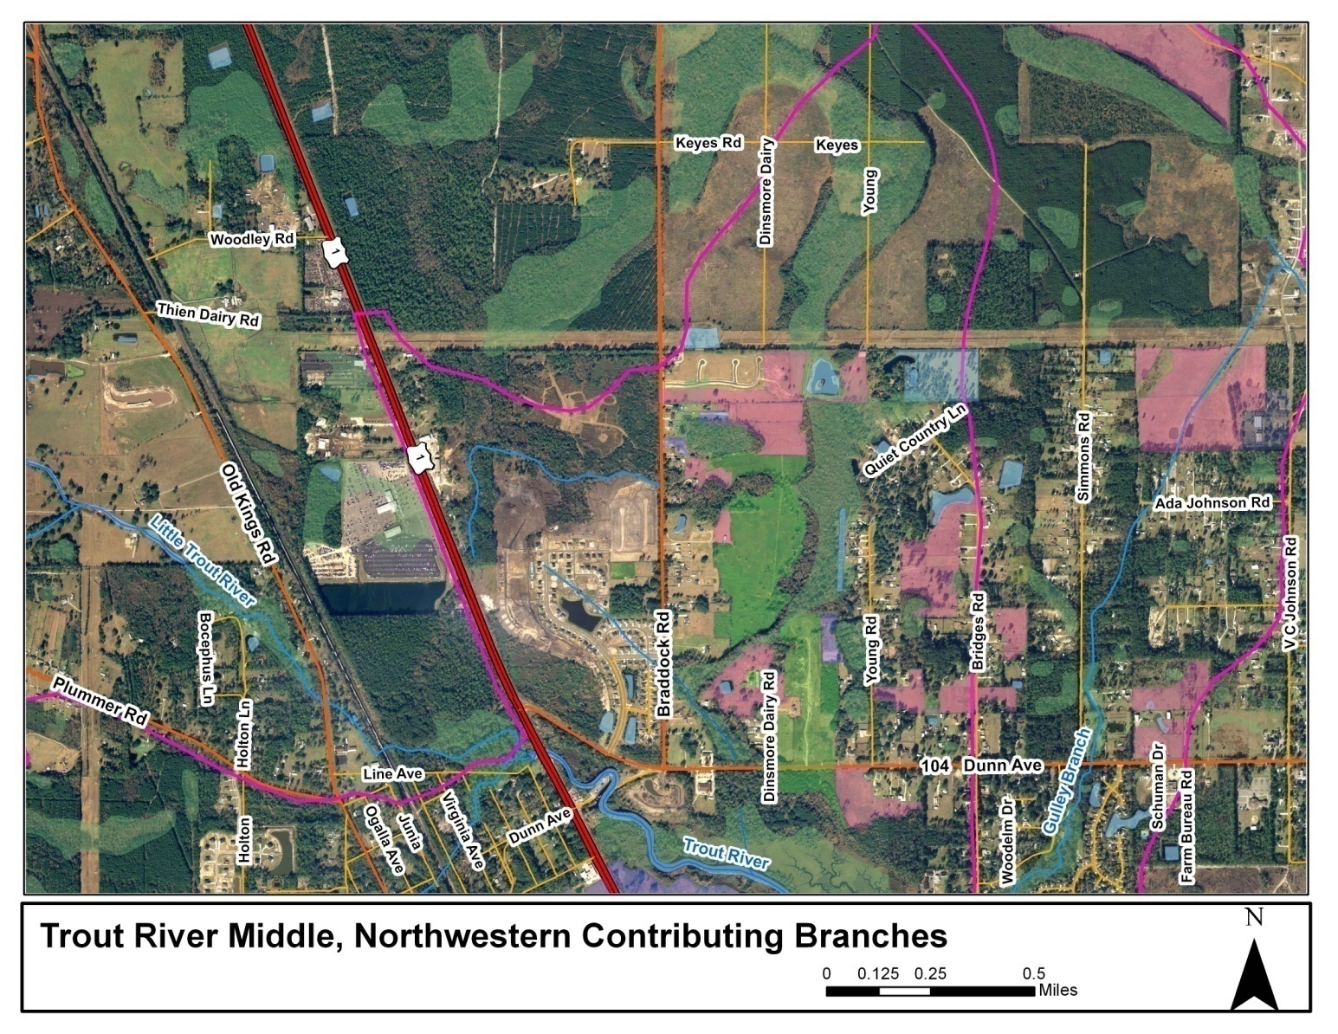
Middle Trout River Northwestern Branches

Slide 11
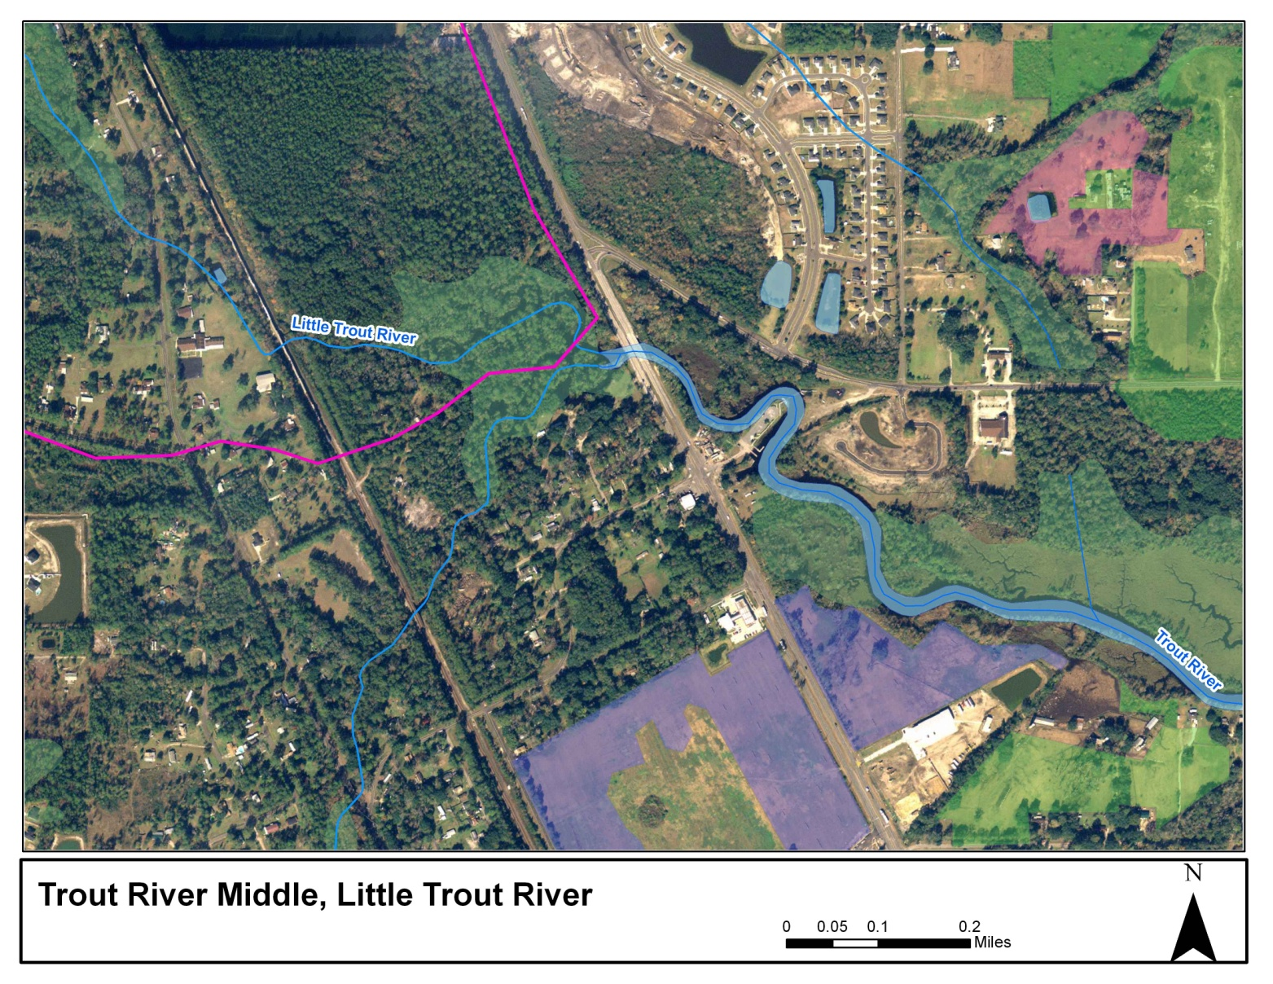
Middle Trout River Confluence with Little Trout River

Slide 12
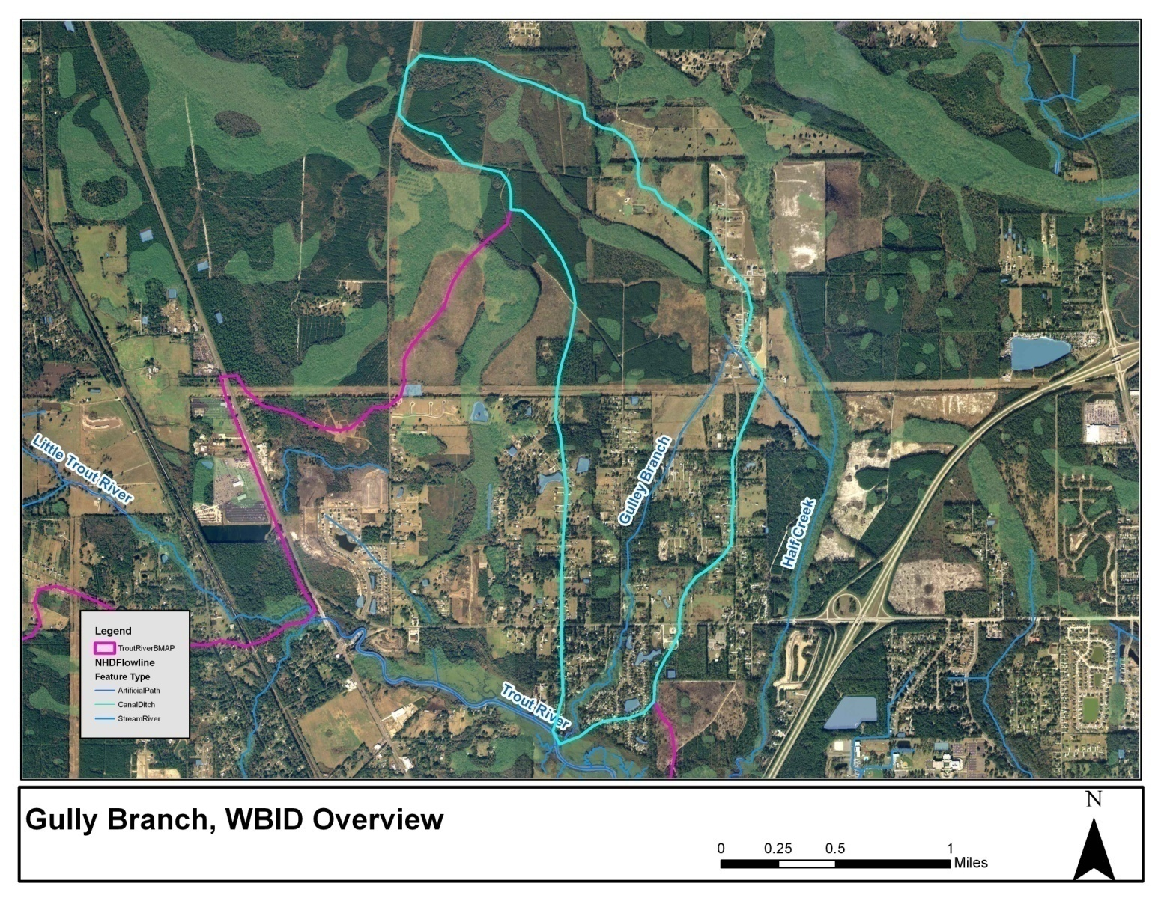
Gulley Branch Overview

Slide 13
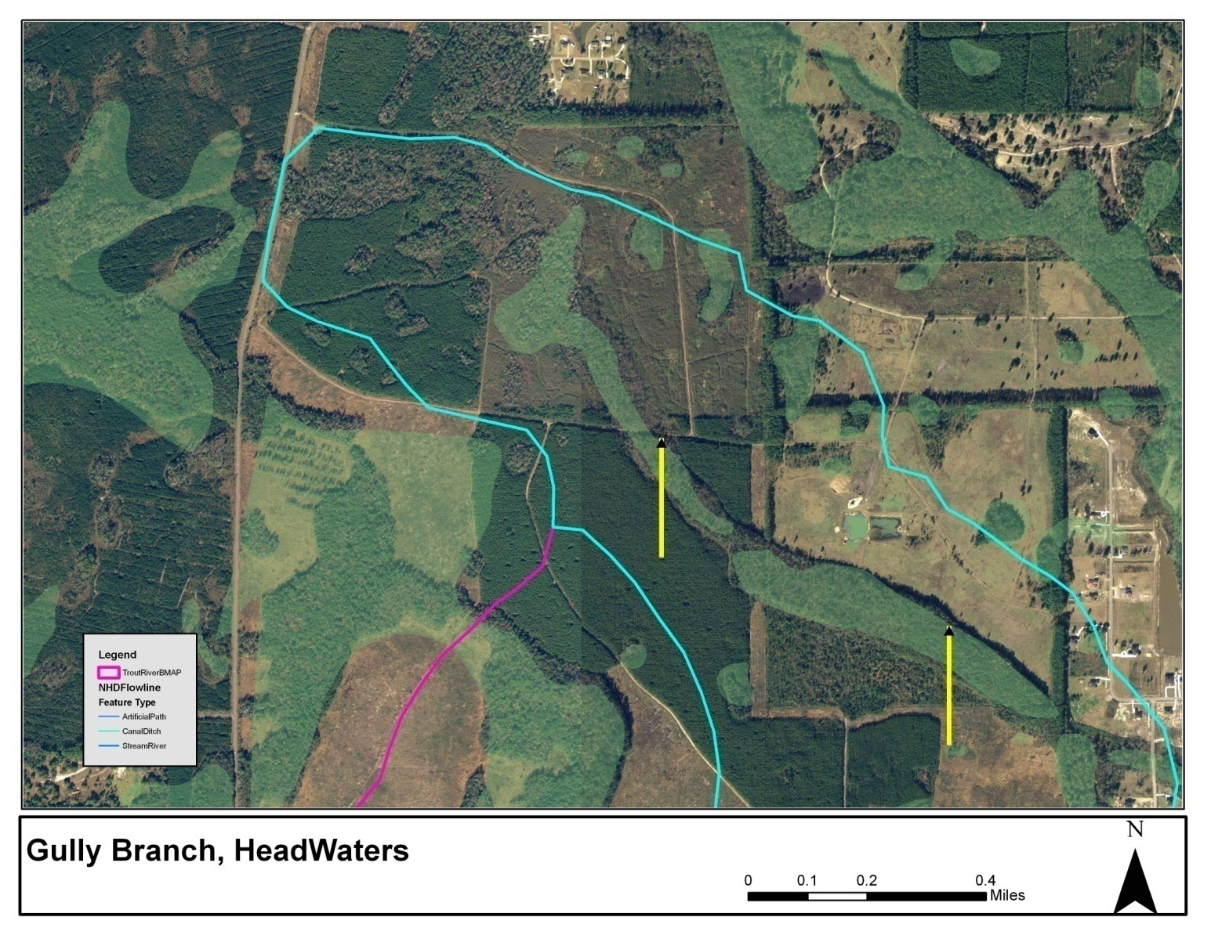
Gulley Branch Headwaters

Slide 14
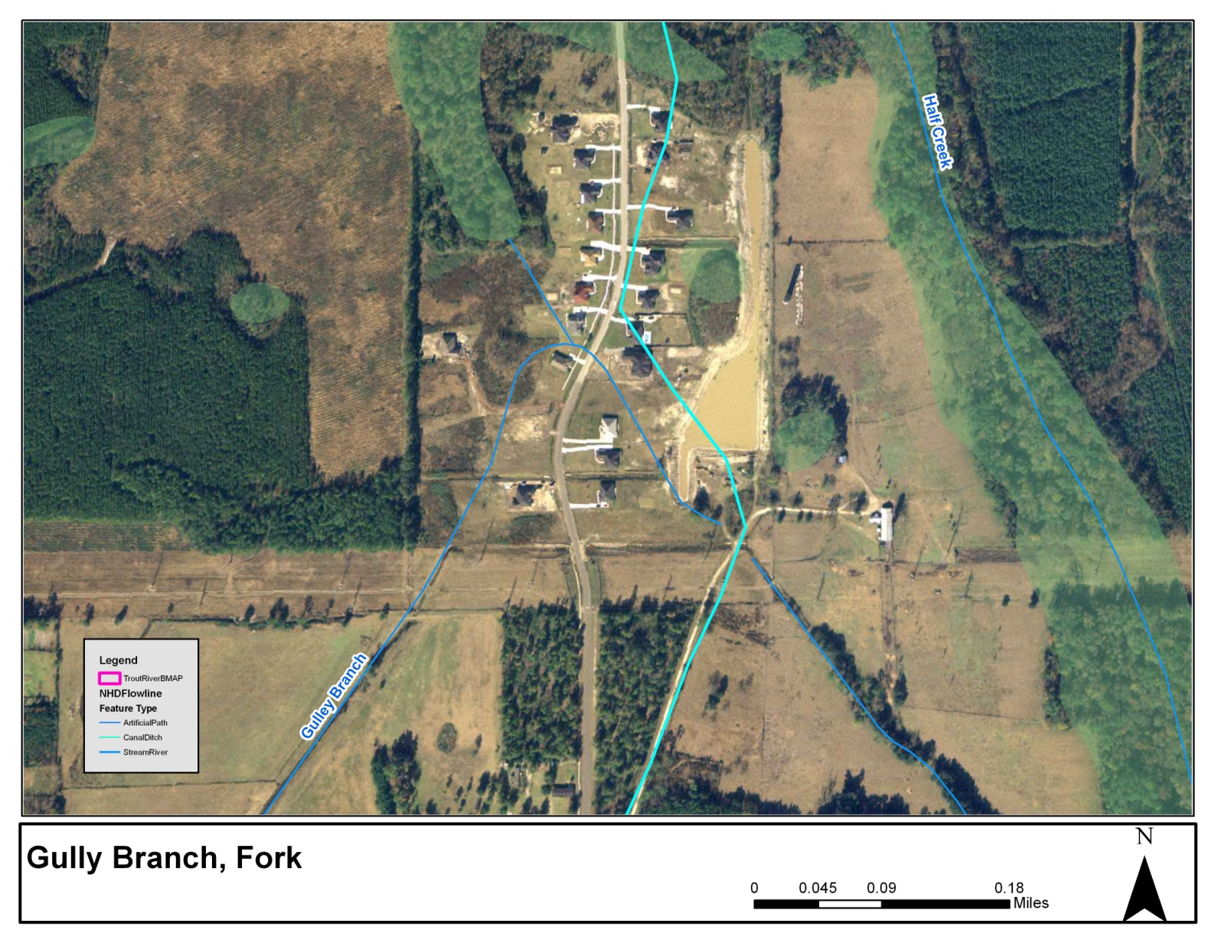
Gulley Branch Fork

Slide 15
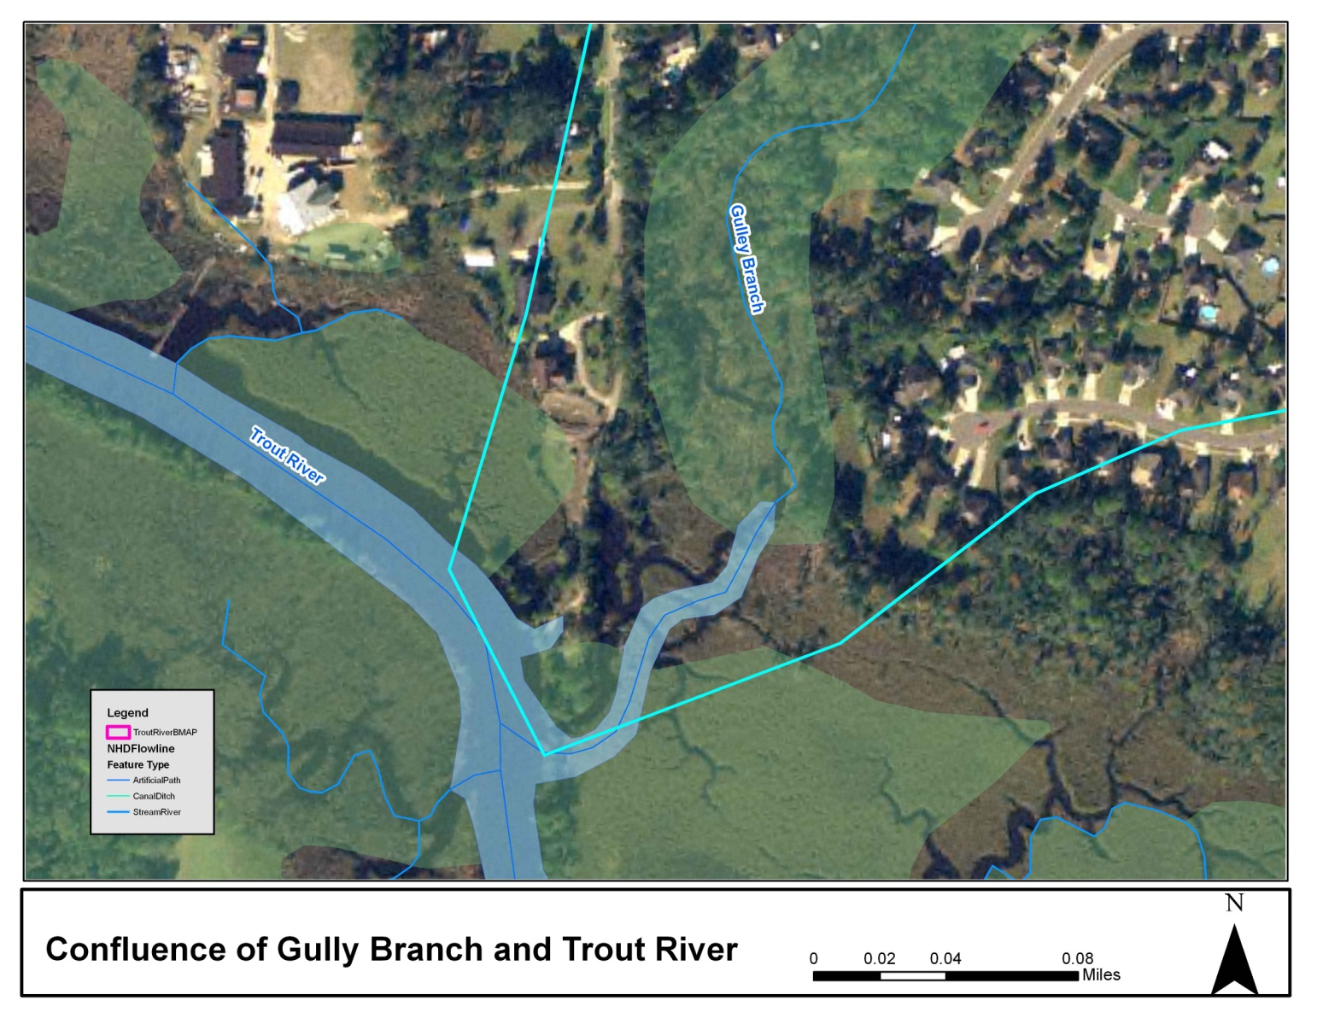
Gulley Branch Confluence with Middle Trout

Slide 16
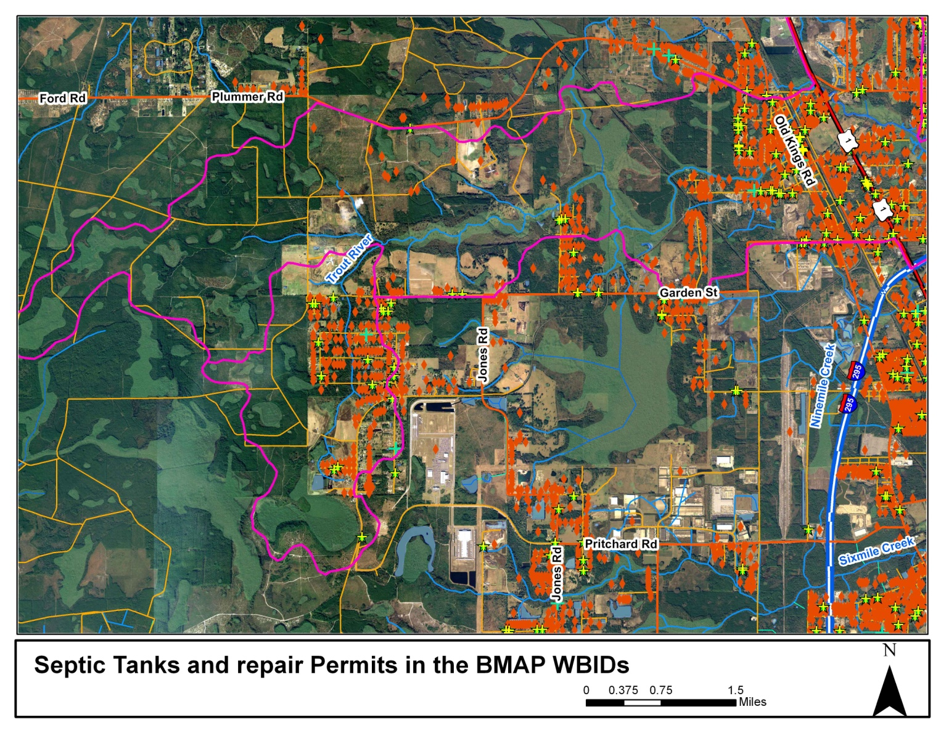
Septic Tanks and Repair Permits in BMAP

