Slide 1
City of Jacksonville
Master Stormwater Management Plan (MSMP)
Water Quality Analysis for the Trout River Basin
January 13, 2011

Slide 2
Agenda
Background on Modeling Tool (WMM)
WMM Modeling Framework
Methodology for MSMP
Application for Trout River Basin

Slide 3
Watershed Management Model (WMM)
Initially developed as spreadsheet tool for FDEP in late 1980s
Windows-based version developed in 1990s as part of Rouge River Nationwide Wet Weather Demonstration Project
Public domain model available at Rouge River website:
http://www.rougeriver.com/proddata/wmm.html

Slide 4
Model Description
Supports development of watershed management plans and establishes overall framework for assessing pollution control strategies
  Existing and projected future pollution loads
  Best management practices (BMPs) for reducing pollution loads
Designed for evaluation of average annual and seasonal pollution loads
Notes:
WMM is a useful tool for supporting the development of watershed management plans, and establishing an overall framework for assessing alternative pollution control strategies.
Some of the typical uses of WMM include:
Calculation of existing and projected future pollution loads. This is useful to characterize current conditions and to predict the potential increase in flow and pollution loading as future development occurs in the watershed.
Evaluation of Best Management Practices (BMPs) for reducing pollution loads. This may include installation of structural BMPs that are retrofit to treat existing development as well as accounting for the BMPs that are expected to be applied to new development.
The model now has a user-friendly, Windows-based format. Originally, the model was developed in the Lotus spreadsheet software. It migrated to a Windows-based format as part of the Rouge River Nationwide Wet Weather Demonstration project in the 1990s.
The strength of the model is in conducting evaluations of average annual and/or seasonal flows and pollution loads.

Slide 5
Model Limitations
Annual and seasonal flow and load results only (no time series output)
Single pervious runoff coefficient for all subbasins in project area
Single annual or seasonal rainfall and baseflow values for all subbasins in project area
Not appropriate for short-term impacts or relatively small tributary areas
Notes:
Like all models, WMM has a number of limitations. These include the following:
The model is useful for calculating annual and seasonal flows and loads only. As such, it cannot be used for continuous simulation and will not calculate time series of flows and concentrations from the watershed.
The model applies a single runoff coefficient for pervious land in the project area. In reality, this runoff coefficient may vary in different parts of the watershed due to differences in soil type or topography
The model applies a single value for rainfall quantity and baseflow quantity in the project area. If the project area is large enough to include areas that exhibit significantly different
rainfall quantities, then the project area would have to be split into several model applications to apply different rainfall quantities to different parts of the project area.
Based on these limitations, it would not be appropriate to apply the model to assess short-term impacts or to relatively small tributary areas, or to very large watersheds with differing rainfall amounts.

Slide 6
Model Calculations
Surface runoff flows and loads
  Loads with BMPs
  Loads without BMPs
Baseflow flows and loads
Failing septic tank loads
Point source flows and loads
Notes:
The slides that follow will present the calculations related to the analyses of flows and parameter loads in WMM. These calculations include the following:
Calculation of surface runoff flows and loads. This includes the calculation of uncontrolled loads (i.e., without BMPs) and calculation of loads with controls.
Calculation of baseflow flow quantity and pollutant loads.
The model can also account for loads for failing septic tanks and wastewater point sources but that was not done in the MSMP application and will not be discussed further in this presentation.

Slide 7
Surface Runoff - Flow
Annual runoff for land use L depends on:
  Pervious runoff coefficient C_{p}
  Impervious runoff coefficient C_{I}
  Annual rainfall I
  Imperviousness of land use (IMP_{L}) as a fraction
R_{L} = [ C_{p} + (C_{I} – C_{p}) IMP_{L} ] * I
Notes:
The following slides present calculations for surface runoff flow quantity and water quality parameter loads, beginning with the calculation of runoff flow quantity.
WMM calculates annual runoff volumes for the pervious/impervious areas in each land use category by multiplying the average annual rainfall volume by a runoff coefficient. A runoff coefficient of 0.90 is typically used for impervious areas (i.e.,90 percent of the rainfall is assumed to be converted to runoff from the impervious fraction of each land use). A pervious area runoff coefficient of 0.10 is typically used.
To calculate the average annual stormwater runoff for a particular land use type, WMM uses the following information:
The runoff coefficient for pervious land, designated as C _{p}
The runoff coefficient for impervious land, designated as C _{i}
The average annual rainfall depth, designated as I
The imperviousness of the landuse type, as a fraction, designated as IMP _{L}
Using the equation presented here, WMM calculates the annual surface runoff.

Slide 8
Surface Runoff – Flow Example
Annual runoff for following conditions:
  Pervious runoff coefficient C_{p} = 0.10
  Impervious runoff coefficient C_{I} = 0.85
  Annual rainfall I = 50 inches/year
  Imperviousness of land use (IMP_{L}) = 30% = 0.30
  R_{L} = [ 0.10 + (0.85 – 0.10) 0.30 ] * 50 =
  16.3 inches/year
Notes:
This is an example that presents the calculation based on a specific set of values.
In this example, the following conditions apply:
The pervious runoff coefficient is equal to 0.10 (which means that 10% of rainfall on pervious land is converted to surface runoff)
The impervious runoff coefficient is equal to 0.85 (that is, 85% of rainfall on impervious land is converted to surface runoff)
The average annual rainfall is 50 inches per year
The imperviousness of the landuse is 30%, or 0.30 as a fraction.
Using the values above, and the equation shown previously, an average surface runoff quantity of 16.3 inches per year is calculated for that landuse.

Slide 9
Surface Runoff - Load
Annual load for land use L and pollutant depends on:
  Annual runoff R_{L} (inches/year) for land use L
  Pollutant Event Mean Concentration (EMC_{L}) (mg/l) for land use L
  Unit conversion constant K ( = 0.2266)
M_{L} = EMC_{L} * R_{L} * K
Notes:
To calculate the average annual surface runoff load for a particular landuse type and water quality parameter (pollutant) , WMM uses the following information:
The average annual surface runoff for the landuse (calculated as shown previously)
The Event Mean Concentration (EMC) associated with the surface runoff from that landuse. WMM presumes that the parameter concentration units are in milligrams per liter.
A unit conversion constant which equals 0.2266.
Using the equation presented here, WMM calculates the annual surface runoff load for the particular landuse and water quality parameter. The resulting load is in units of pounds per acre per year.

Slide 10
Surface Runoff - Load Example
Annual load for following conditions:
  Annual runoff R_{L} (inches/year) = 16.3
  Pollutant Event Mean Concentration (EMC_{L}) (mg/l) = 0.40
  Unit conversion constant K ( = 0.2266)
M_{L} = 0.40 * 16.3 * 0.2266 =
1.5 pounds per acre per year
Notes:
This example is a continuation of the previous flow calculation example, where we will now calculate the parameter load.
In this example, the following conditions apply:
The annual runoff from this landuse is 16.3 inches per year from the previous calculation.
The EMC for the water quality parameter or pollutant is 0.40 milligrams per liter.
Using those values and the unit conversion factor, an average annual surface runoff load of 1.5 pounds per acre per year is calculated.

Slide 11
Surface Runoff – Load Reduction by BMPs
Annual runoff load with BMPs M_{LB} for land use L and pollutant depends on:
  Annual load M_{L} without BMPs (pounds/acre/year) for land use L
  Fraction AC of land use L that is controlled by BMPs
  Removal efficiency REM as a fraction
M_{LB} = M_{L} * (1 - AC * REM)
Notes:
The previous calculation demonstrates how an uncontrolled load is calculated.
To determine the average annual surface runoff load for a particular landuse type and water quality parameter (pollutant) , when some or all of the surface runoff is treated by a BMP, WMM uses the following information:
The average annual uncontrolled surface runoff load for the landuse (calculated as shown previously)
The fraction of the landuse that is controlled by a BMP (fraction designated as AC)
Removal efficiency associated with the BMP (efficiency designated as REM)
Using the equation presented here, WMM calculates the annual surface runoff load with BMP controls for the particular landuse and water quality parameter. The resulting load is in units of pounds per acre per year.

Slide 12
Surface Runoff – Load Reduction by BMPs Example
Annual load with BMPs M_{LB} for land use L and pollutant for following conditions:
  Annual load M_{L} = 1.5 pounds/acre/year
  Fraction AC of land use L that is controlled by BMPs = 40% = 0.40
  Removal efficiency REM as a fraction = 50% = 0.50
M_{LB} = 1.5 * (1 – 0.40 * 0.50) =
1.2 pounds/acre/year
Notes:
This example is a continuation of the previous flow and uncontrolled load calculation example, where we will now calculate the controlled parameter load.
In this example, the following conditions apply:
The uncontrolled load for the landuse is 1.5 pounds per acre per year from the previous calculation.
The fraction of the landuse that is controlled by the BMP is 40% or 0.4.
The removal efficiency associated with the BMP for the water quality parameter is 50%, or 0.50.
Using those values, the calculated average annual load with some BMP treatment is 1.2 pounds per acre per year. In this case, the load reflects a 20% reduction is surface runoff load, based on treating 40% of the runoff at a removal efficiency of 50%.

Slide 13
Baseflow
Annual baseflow for land use L depends on:
  Annual baseflow B_{p} (inches/year) for pervious land area
  Imperviousness of land use (IMP_{L}) as a fraction
B_{L} = B_{p} * (1 – IMP_{L})
Notes:
The following slides present calculations for baseflow flow quantity and water quality parameter loads, beginning with the calculation of baseflow flow quantity.
In the calculation of the average annual baseflow quantity for a particular land use type, WMM uses the following information:
The average annual baseflow quantity for pervious land area, designated as B _{p}
The imperviousness of the landuse type, as a fraction, designated as IMP _{L}
Using the equation presented here, WMM calculates the annual baseflow flow quantity.

Slide 14
Baseflow - Example
Annual baseflow for following conditions:
  Annual baseflow B_{p} (inches/year) = 7.0
  Imperviousness of land use (IMP_{L}) = 30% = 0.30
B_{L} = 7.0 * (1 – 0.30) = 4.9 inches/year
Notes:
This is an example that presents the calculation of baseflow flow quantity based on a specific set of values.
In this example, the following conditions apply:
The average annual baseflow associated with pervious land area is 7 inches per year
The imperviousness of the landuse is 30%, or 0.30 as a fraction.
Using the values above, and the equation shown previously, an average annual baseflow flow quantity of 4.9 inches per year is calculated for that landuse.
Recall that, in the previous example calculation, the average annual surface runoff flow quantity was 16.3 inches per year. As you can see, for this relatively high level of landuse imperviousness (30%), the surface runoff makes up most of the total flow from this landuse, and baseflow is a smaller fraction of the total flow.

Slide 15
Baseflow - Load
Annual load for land use L and pollutant depends on:
  Annual baseflow B_{L} (inches/year) for land use L
  Pollutant Event Mean Concentration (EMC_{L}) (mg/l) for land use L baseflow
  Unit conversion constant K ( = 0.2266)
M_{L} = EMC_{L} * B_{L} * K
Notes:
The calculation of the average annual baseflow load for a particular landuse type and water quality parameter (pollutant) is exactly the same as the surface runoff calculation. WMM uses the following information:
The average annual baseflow flow quantity for the landuse (calculated as shown previously)
The Event Mean Concentration (EMC) associated with the baseflow from that landuse. WMM presumes that the parameter concentration units are in milligrams per liter.
A unit conversion constant which equals 0.2266.
Using the equation presented here, WMM calculates the average annual baseflow load for the particular landuse and water quality parameter. The resulting load is in units of pounds per acre per year.

Slide 16
Baseflow – Load Example
Annual load for land use L and pollutant for following conditions:
  Annual baseflow B_{L} (inches/year) = 4.9
  Pollutant Event Mean Concentration (EMC_{L}) (mg/l) for land use L baseflow = 0.10
  Unit conversion constant K ( = 0.2266)
M_{L} = 0.10 * 4.9 * 0.2266 =
0.11 pounds/acre/year
Notes:
This example is a continuation of the previous baseflow flow quantity calculation example, where we will now calculate the parameter load.
In this example, the following conditions apply:
The average annual baseflow flow quantity from this landuse is 4.9 inches per year from the previous calculation.
The baseflow EMC for the water quality parameter or pollutant is 0.10 milligrams per liter.
Using those values and the unit conversion factor, an average annual surface runoff load of 0.11 pounds per acre per year is calculated.
Recall that, in the previous example calculation, the average annual uncontrolled surface runoff load was 1.4 pounds per acre per year. As you can see, for this relatively high level of landuse imperviousness (30%), the surface runoff makes up almost all of the load from this landuse, and baseflow is a small fraction of the total load.

Slide 17
WMM WQ Constituents
1. Biochemical Oxygen Demand (BOD)
2. Chemical Oxygen Demand (COD)
3. Total Suspended Solids (TSS)
4. Total Dissolved Solids (TDS)
5. Total Phosphorus (TP)
6. Dissolved Phosphorus (DP)
7. Total Kjeldahl Nitrogen (TKN)
8. Nitrite plus Nitrate
(NO2 + NO3)
9. Lead (Pb)
10. Copper (Cu)
11. Zinc (Zn)
12. Cadmium (Cd)
13. Fecal Coliform

Slide 18
Application for MSMP
Average annual rainfall
Pervious and impervious runoff coefficients
Baseflow quantity
Land uses and imperviousness
Surface runoff and baseflow quality
Existing BMP coverage
BMP removal efficiencies

Slide 19
Average Annual Rainfall
Month | Season | Average Rainfall (inches) | Percent of Average Annual Rainfall
January | Dry | 3.17 | 6.1%
February | Dry | 3.45 | 6.6%
March | Dry | 3.81 | 7.3%
April | Dry | 2.90 | 5.5%
May | Dry | 3.41 | 6.5%
June | Wet | 5.79 | 11.1%
July | Wet | 6.50 | 12.4%
August | Wet | 7.04 | 13.4%
September | Wet | 7.70 | 14.7%
October | Wet | 3.97 | 7.6%
November | Dry | 2.04 | 3.9%
December | Dry | 2.58 | 4.9%
Annual Total |  | 52.36 | 100.0%
Wet Season Total |  | 31.00 | 59.2%
Dry Season Total |  | 21.36 | 40.8%

Slide 20
Hydrologic Input – Based on Ortega River, Pablo Creek Gage Data
Measured Streamflow
  Runoff = 7 - 11 in/yr
  Baseflow = 9 – 12 in/yr
Suggested Model Inputs
  Impervious C = 0.85
  Pervious C = 0.12
  Pervious baseflow = 10.2 in/yr

Slide 21
WMM Average Annual Flow
Land Use | % DCIA | Average Annual Runoff (inches/year) | Average Annual Baseflow (inches/year) | Total (inches/year)
Forest, Open and Park | 1% | 6.7 | 10.1 | 16.8
Pasture | 1% | 6.7 | 10.1 | 16.8
Agricultural and Golf Courses | 1% | 6.7 | 10.1 | 16.8
Low Density Residential | 8% | 9.3 | 9.4 | 18.7
Medium Density Residential | 23% | 15.1 | 7.9 | 22.9
High Density Residential | 65% | 31.2 | 3.6 | 34.7
Light Industrial, Commercial, and Institutional | 81% | 37.3 | 1.9 | 39.2
Heavy Industrial | 81% | 37.3 | 1.9 | 39.2
Water | 20% | 13.9 | 8.2 | 22.1
Wetlands | 1% | 6.7 | 10.1 | 16.8

Slide 22
Runoff EMCs
Land Use | BOD (mg/l) | COD (mg/l) | TSS (mg/l) | TDS (mg/l) | TP (mg/l) | DP (mg/l) | TKN (mg/l) | NOXN (mg/l) | Lead (mg/l) | Copper (mg/l) | Zinc (mg/l) | Cadmium (mg/l) | Fecal Coliform (#/100 ml)
Forest, Open and Park | 7 | 44 | 11 | 100 | 0.08 | 0.03 | 0.9 | 0.3 | 0.001 | 0.001 | 0.000 | 0.001 | 11,000
Pasture | 10 | 48 | 20 | 100 | 0.35 | 0.14 | 2.0 | 0.5 | 0.005 | 0.004 | 0.023 | 0.000 | 20,000
Agricultural and Golf Courses | 13 | 78 | 36 | 100 | 0.64 | 0.26 | 2.6 | 0.6 | 0.005 | 0.004 | 0.023 | 0.000 | 30,000
Low Density Residential | 10 | 61 | 45 | 117 | 0.39 | 0.24 | 1.4 | 0.9 | 0.016 | 0.016 | 0.060 | 0.003 | 32,200
Medium Density Residential | 10 | 61 | 45 | 117 | 0.39 | 0.24 | 1.4 | 0.9 | 0.016 | 0.016 | 0.060 | 0.003 | 32,200
High Density Residential | 13 | 87 | 64 | 73 | 0.37 | 0.17 | 1.4 | 0.4 | 0.015 | 0.014 | 0.113 | 0.001 | 21,800
Light Industrial, Commercial, and Institutional | 7 | 48 | 51 | 91 | 0.20 | 0.12 | 1.0 | 0.7 | 0.025 | 0.018 | 0.091 | 0.004 | 11,300
Heavy Industrial | 11 | 73 | 75 | 164 | 0.37 | 0.15 | 1.3 | 0.6 | 0.041 | 0.025 | 0.207 | 0.003 | 11,300
Water and Wetlands | 7 | 44 | 5 | 100 | 0.06 | 0.03 | 0.7 | 0.2 | 0.000 | 0.000 | 0.000 | 0.000 | 11,000

Slide 23
Baseflow Concentrations
Parameter | Units | Concentration
BOD | (mg/l) | 1.2
COD | (mg/l) | 7
TSS | (mg/l) | 5
TDS | (mg/l) | 135
TP | (mg/l) | 0.09
DP | (mg/l) | 0.06
TKN | (mg/l) | 0.82
NOXN | (mg/l) | 0.05
Lead | (mg/l) | 0.001
Copper | (mg/l) | 0.001
Zinc | (mg/l) | 0.01
Cadmium | (mg/l) | 0
Fecal Coliform | (#/100 ml) | 237

Slide 24
Existing BMP Coverage
Tributary area of known regional BMP projects
Review of aerial maps
Analysis of parcel data
  Parcels developed after 1984 assumed to have BMPs

Slide 25
BMP Removal Efficiencies
Literature values (e.g., Harper)
Variable efficiency for retrofit wet detention project depending on mean residence time
Mean Residence Time (days) | TP Removal Efficiency | TKN Removal Efficiency | NOXN Removal Efficiency
> 16 days | 65% | 35% | 46%
12 – 16 days | 60% | 30% | 40%
8 – 12 days | 55% | 26% | 35%
6 – 8 days | 50% | 23% | 31%
4 – 6 days | 45% | 19% | 25%
2 – 4 days | 38% | 14% | 18%
< 2 days | 17% | 5% | 7%

Slide 26
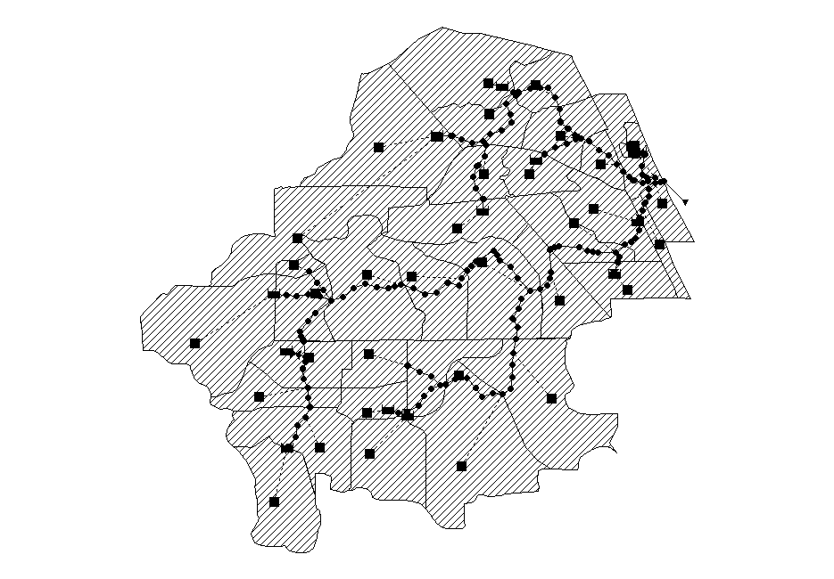
Trout River Basin
Loads calculated for each SWMM hydrologic unit
Total of 28.9 sq. mi., 34 hydrologic units

Slide 27
WMM Average Annual Nutrient Loads
Total load at watershed outlet (sum of individual hydrologic unit loads)
Some reduction in runoff loads due to BMPs on existing development

Slide 28
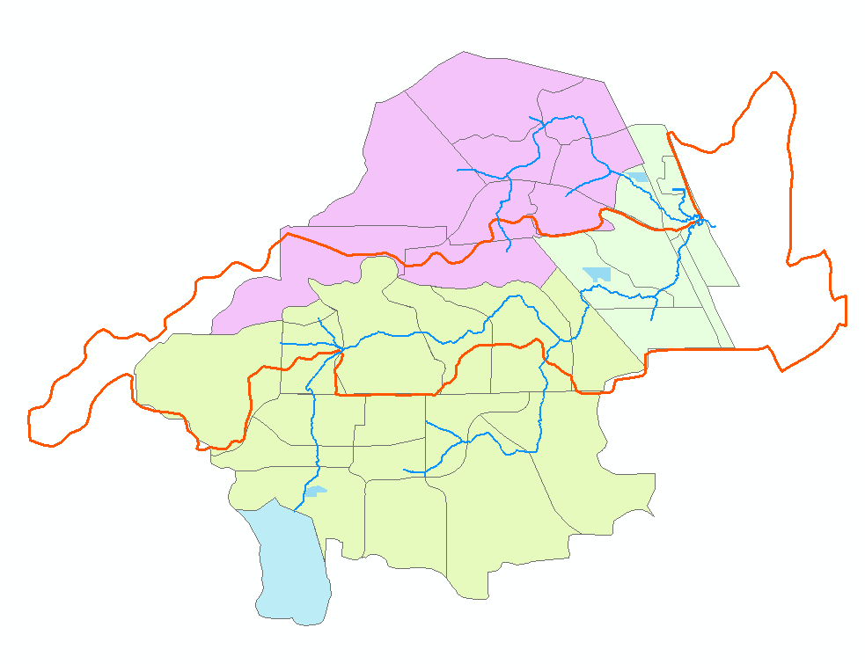
WMM Alternatives
Alternative Feature | Alt 1 | Alt 2 | Alt 3
Trib Area (sq mi) | 7.0 | 17.8 | 1.5
Pond Surface Area (ac) | 14 | 27 | 14
Mean Residence Time (days) | 4 - 6 | 4 - 6 | > 16

Slide 29
WMM Alternative Nutrient Loads
Total N reduction of 500 to 3,400 lb/yr for individual alternatives
Total P reduction of 100 to 800 lb/yr for individual alternatives
Alt 1 + Alt 2: 4,700 lb TN, 1,100 lb TP reduction

Slide 30
Summary
WMM is a Windows-based public domain model capable of estimating average annual or seasonal loads for various land use and BMP alternative scenarios
Applied to MSMP study to develop existing average annual loads and to evaluate alternative projects
Result show up to 1,100 lb/yr TP and 4,700 lb/yr TN load reduction for evaluated projects

