Slide 1
Middle Trout River Field Overview
March 10, 2011

Slide 2
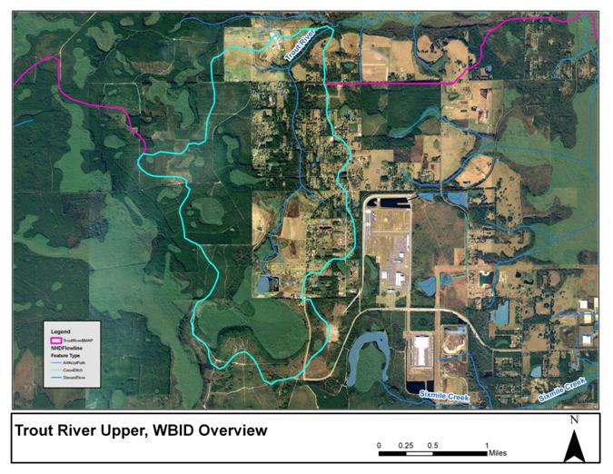
Upper Trout River Overview
Notes:
Agriculture is still active in this area but have moved from large producers to smaller hobby farm parcels

Slide 3
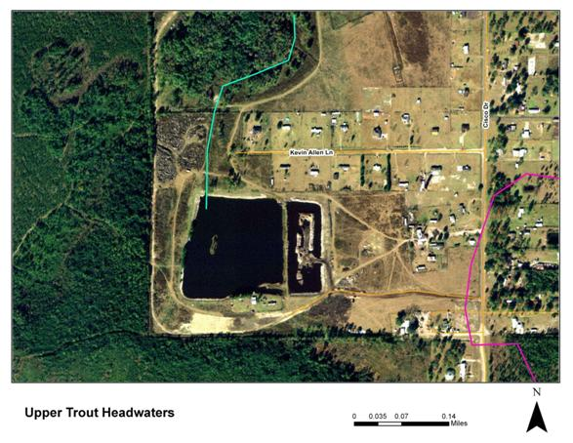
Upper Trout River Headwaters
Land use is still agricultural with cattle.
It appears the pond is separated with a berm.
FDACS will need to verify what kind of operation, the size of the operation, and more information about the pond.

Slide 4
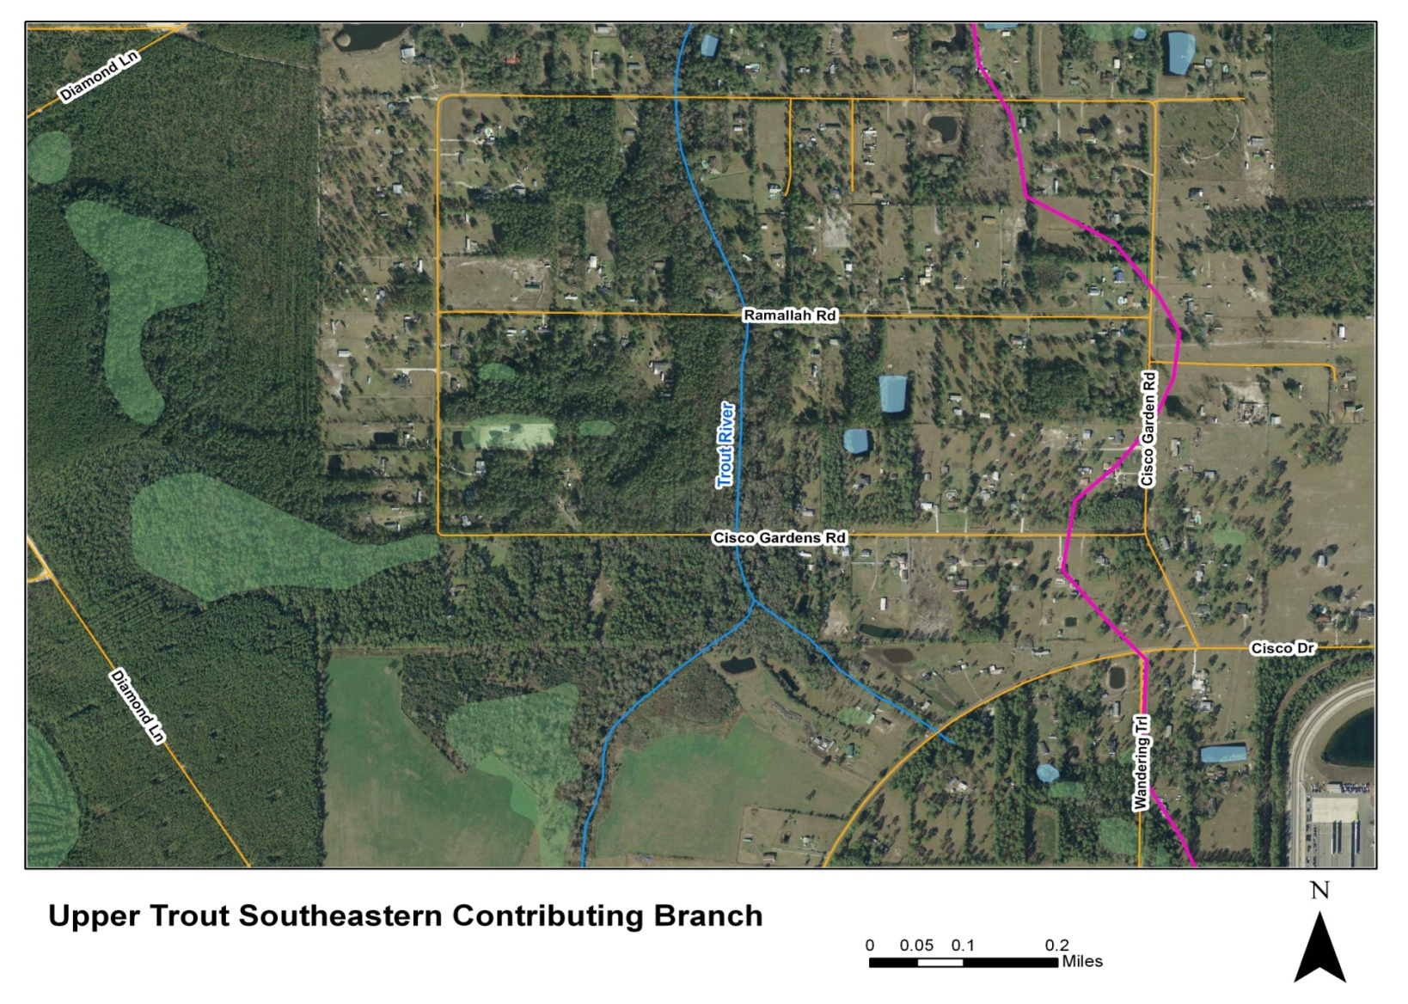
Upper Trout River Southeastern Branch
Notes:
Light residential/rural residential – small spots of medium density residential

Slide 5
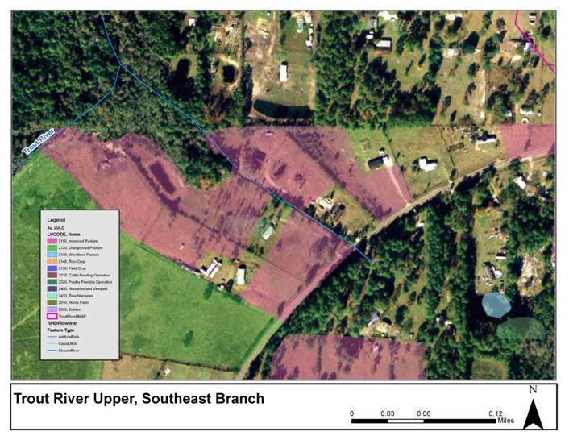
Upper Trout River Southeastern Branch

Slide 6
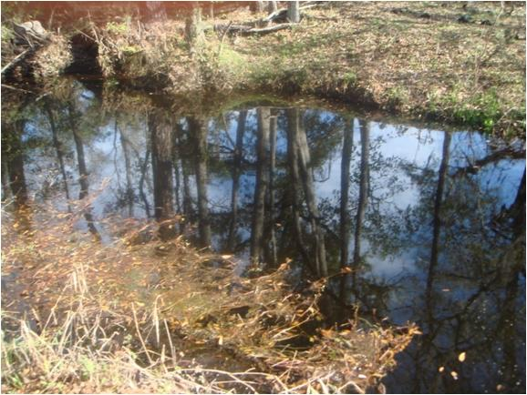
Southeastern Branch at Cisco
Notes:
High tannic waters- multiple inputs in high water conditions

Slide 7
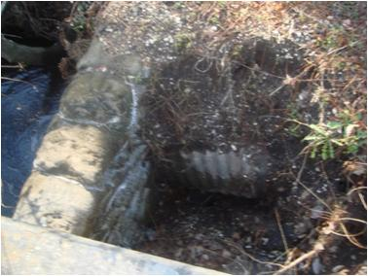
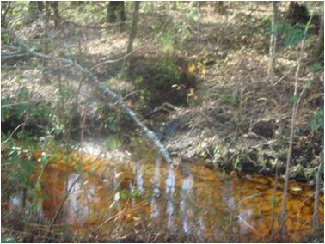
Cisco Garden Road and Upper Trout
Notes:
It appears there can be a high volume of water through this area

Slide 8
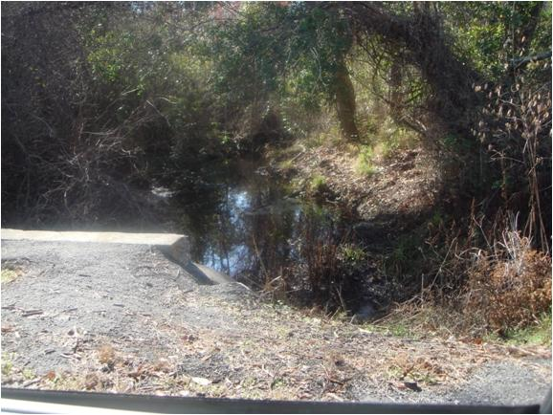
Upper Trout Crossing at Ramallah

Slide 9
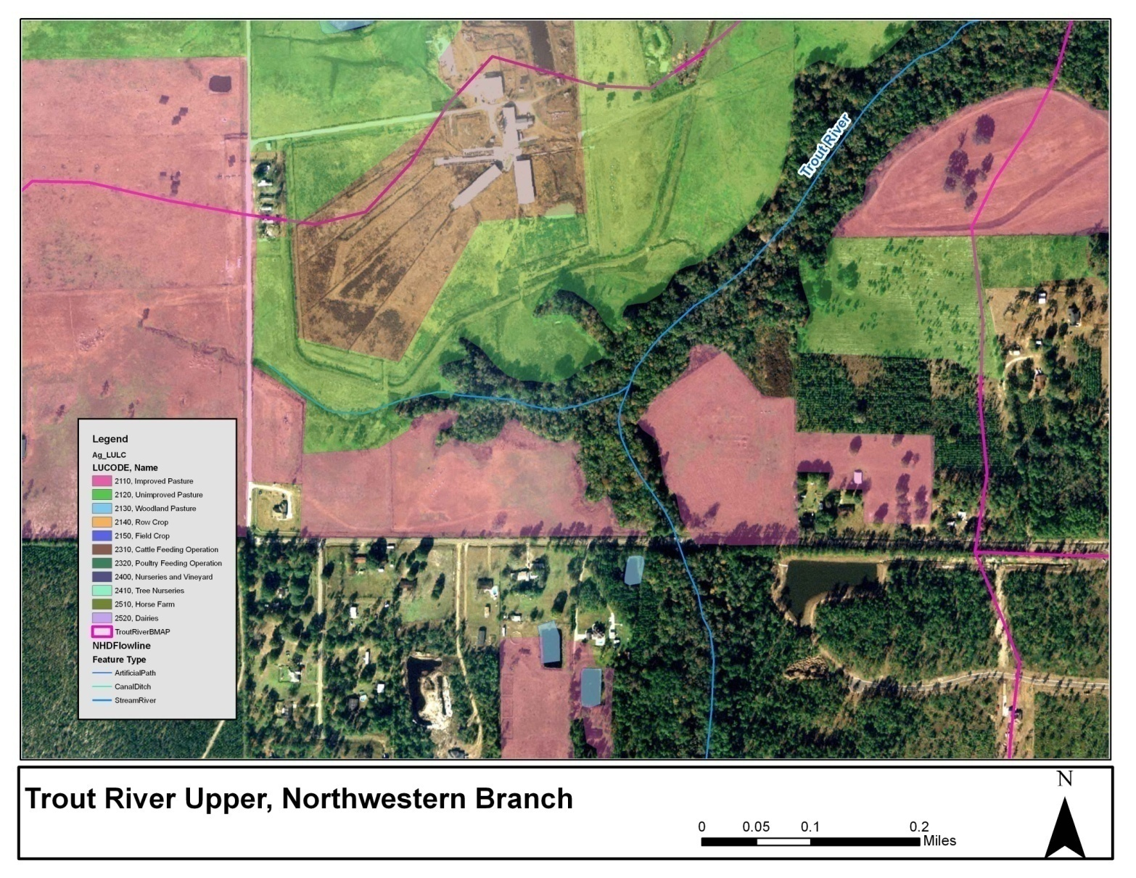
Upper Trout River Northwestern Branch

Slide 10
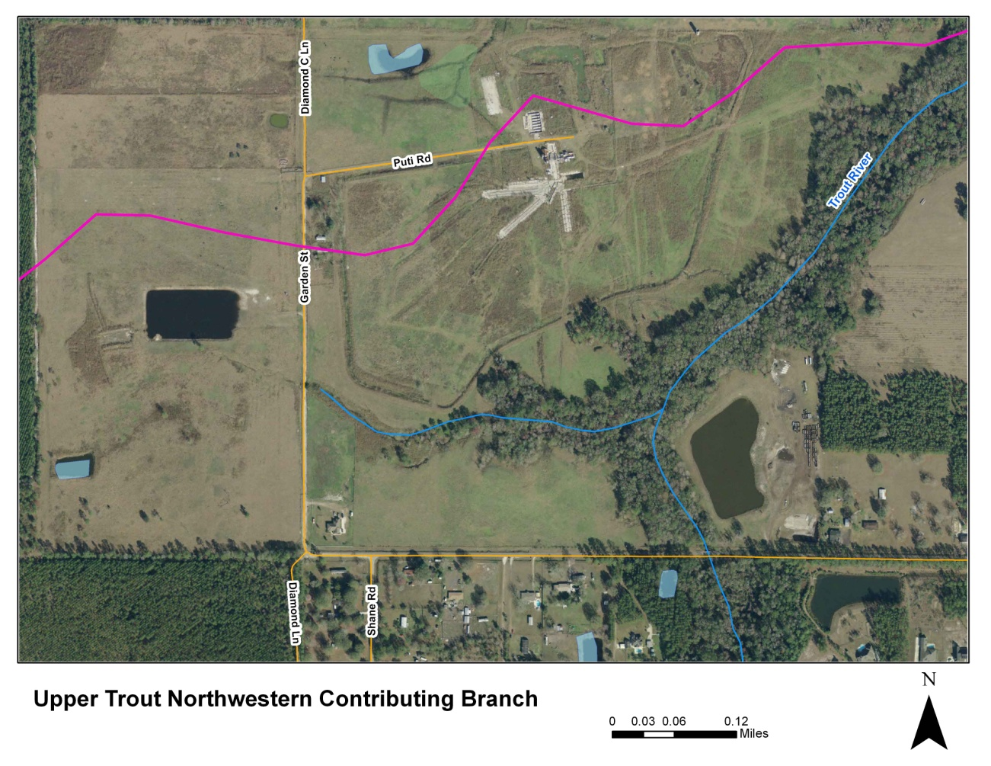
Headwater Upper Trout Contributing Branch
Unclear if this is still an active operation.
It does appear to be two separate parcels.
No access, private property.
It appears the ponds are the headwaters for Upper Trout contributing branch.
It appears the ponds on the north side of the facility and the ditch surrounding the property discharges into Upper Trout just below the confluence with the contributing branch.
Follow up by FDACS.

Slide 11
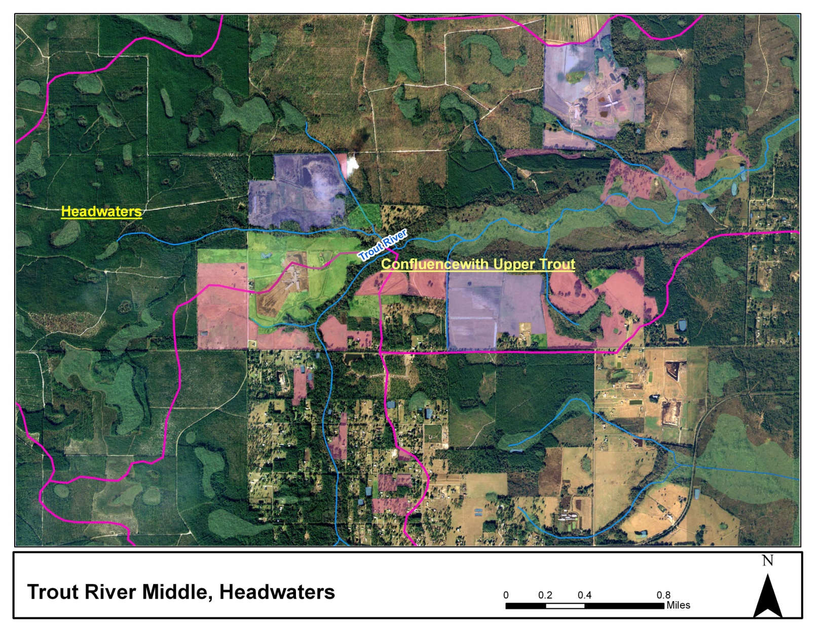
Middle Trout River Headwaters

Slide 12
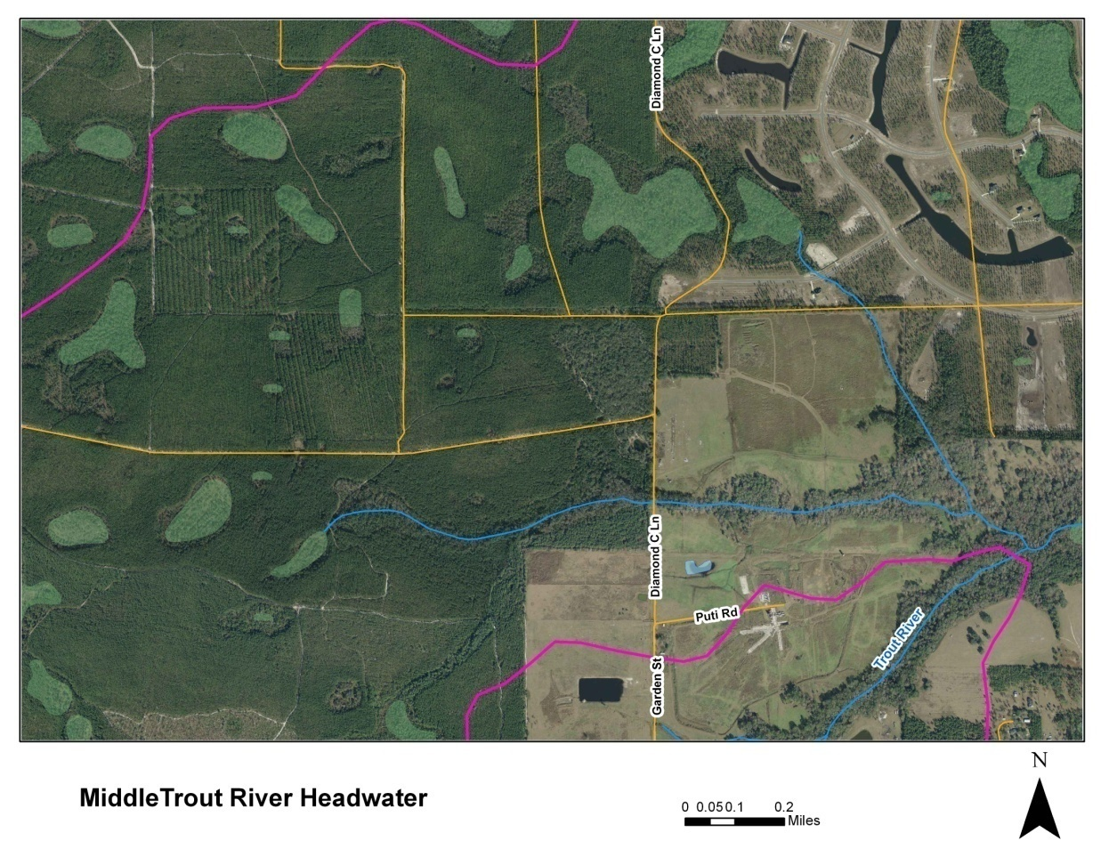
Middle Trout Headwater Access Issue
Attempted to find access to headwaters via Cary State Forest. Need to follow up with Division of Forestry.

Slide 13
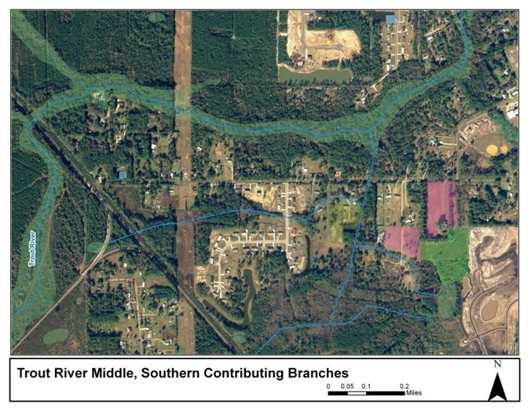
Middle Trout River Southern Branches

Slide 14
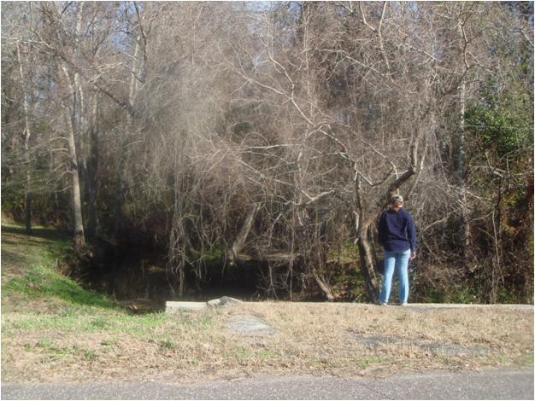
Middle Trout Southern Branch and Garden St
Notes:
Ag land use – large pond- all private prop access

Slide 15
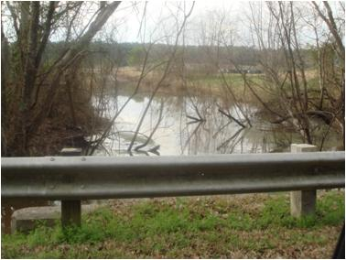
Middle Trout and Ninemile Creek
High water conditions can cause water to flow NW toward Trout River rather than Ninemile Creek in the Garden Street and Imeson area.
Coordinating with NED and FDACS to determine if there are potential sources in this area of the watershed.

Slide 16
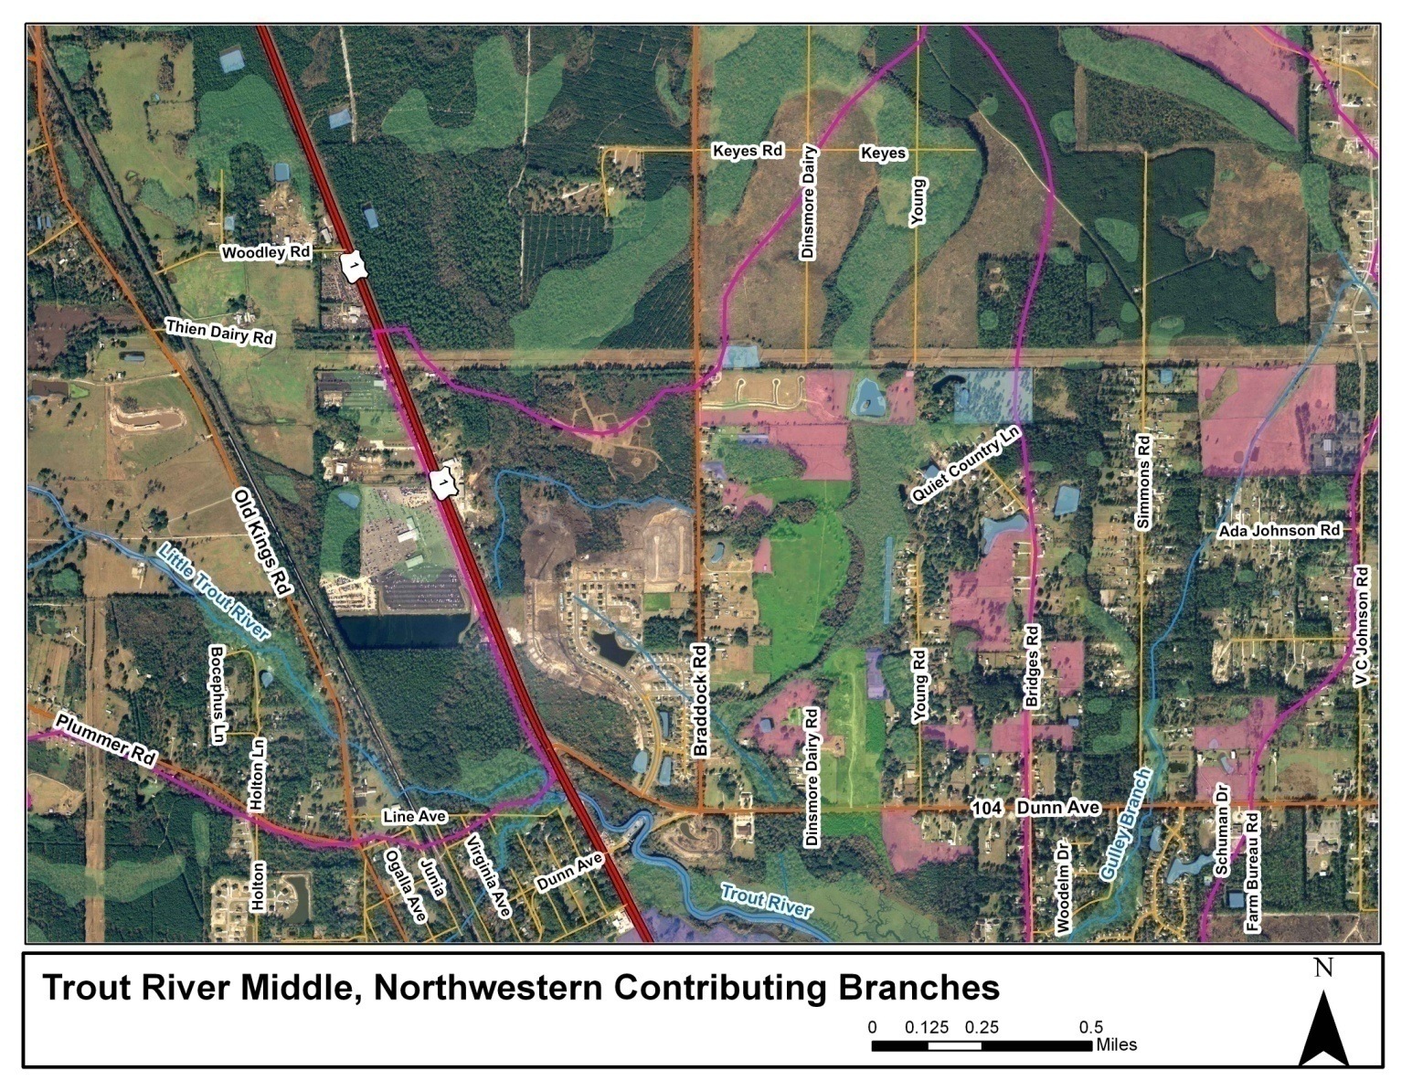
Middle Trout River Northwestern Branches

Slide 17
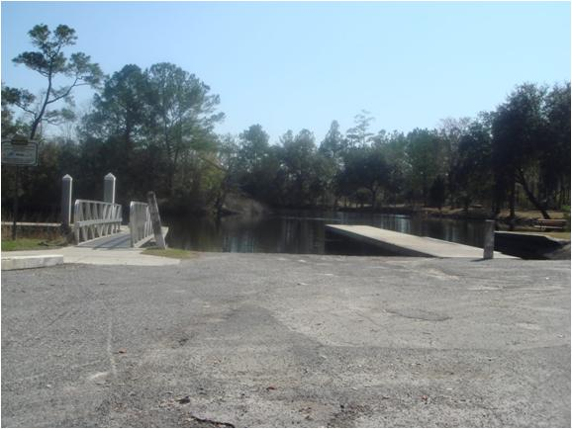
Boat Ramp at Middle Trout and Old Kings
Notes:
Small house across from ramp- private prop no access on that side of the river

Slide 18
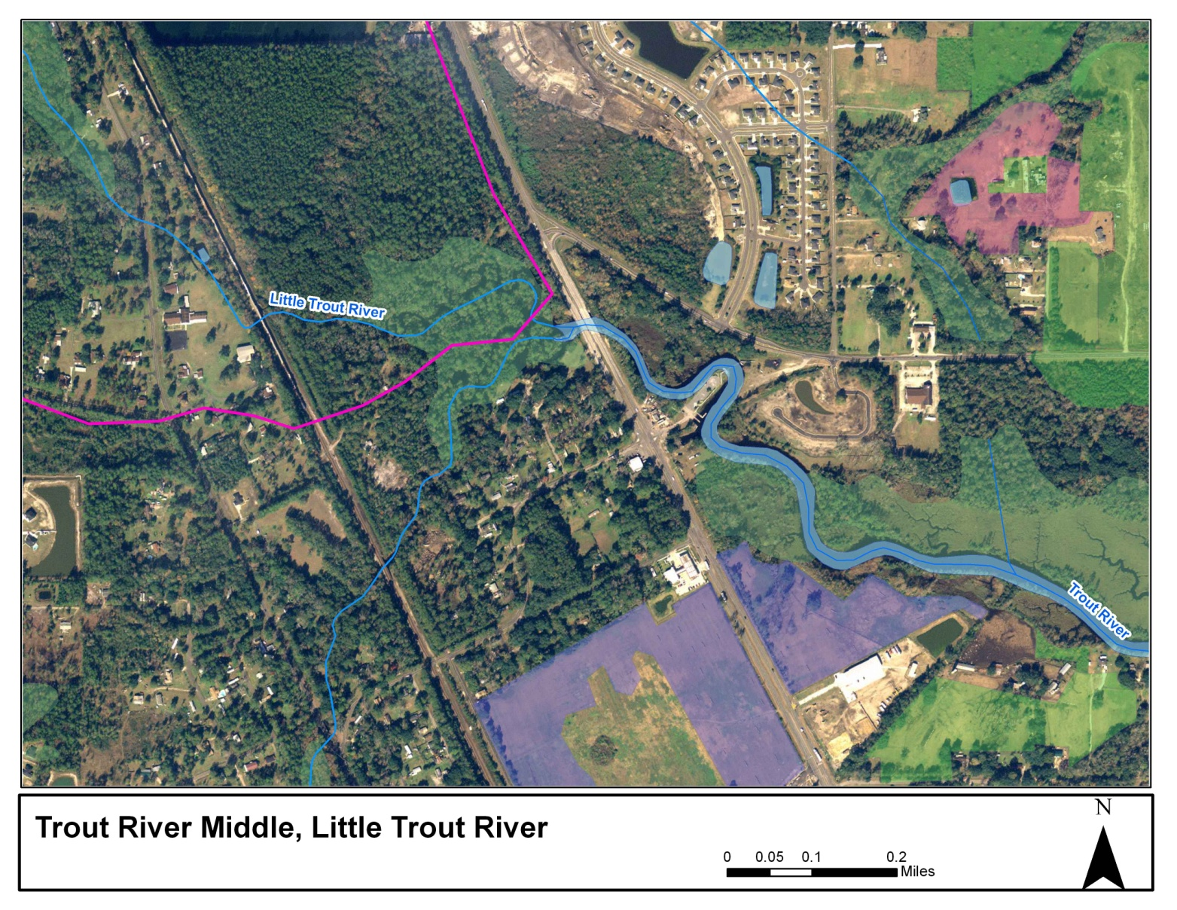
Middle Trout River Confluence with Little Trout River

Slide 19
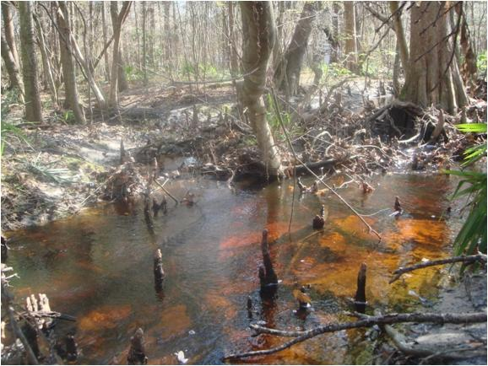
Little Trout River and Bocephus Street
Notes:
Tannic waters, light residential

Slide 20
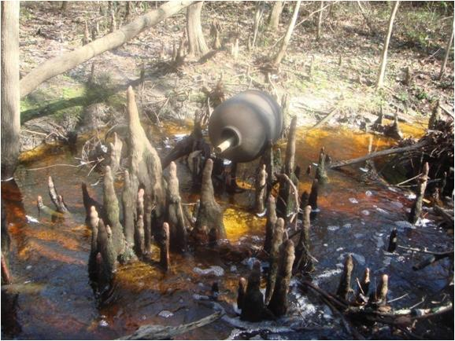
Little Trout Just North Old Kings Road
Notes:
Can have times of high volume and flow

Slide 21
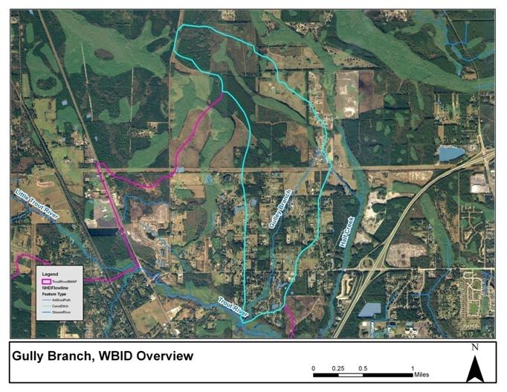
Gulley Branch Overview

Slide 22
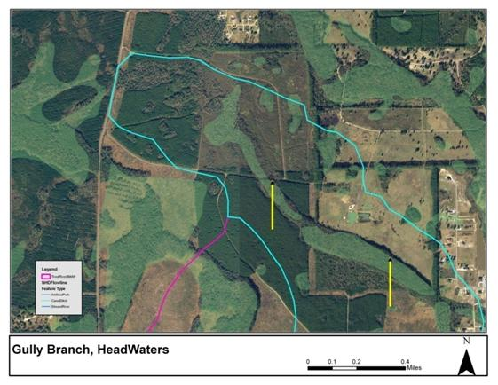
Gulley Branch Headwaters
Access issues to getting at headwaters due to private property restrictions.

Slide 23
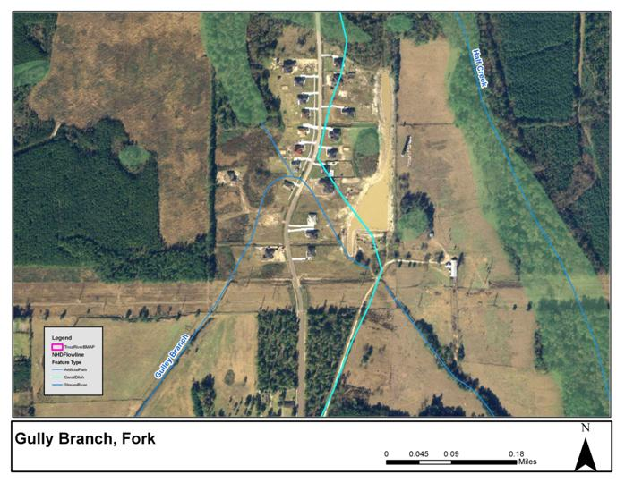
Gulley Branch Fork

Slide 24
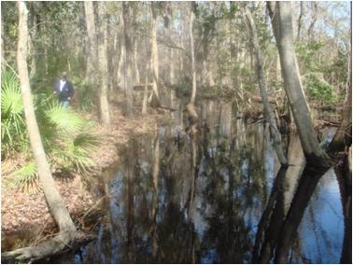
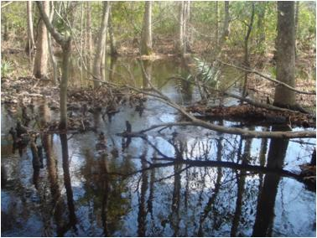
Gulley Branch Headwaters at Fork
Notes:
Behind development – some new connections to stormwater ponds??

Slide 25
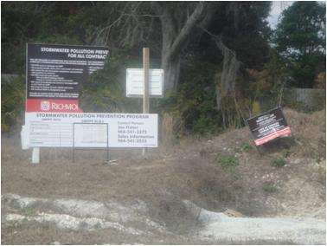
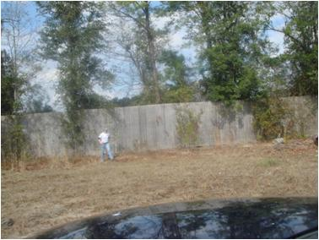
Construction at Development at Fork
Notes:
Gully Branch headwaters behind fence- construction incomplete?

Slide 26
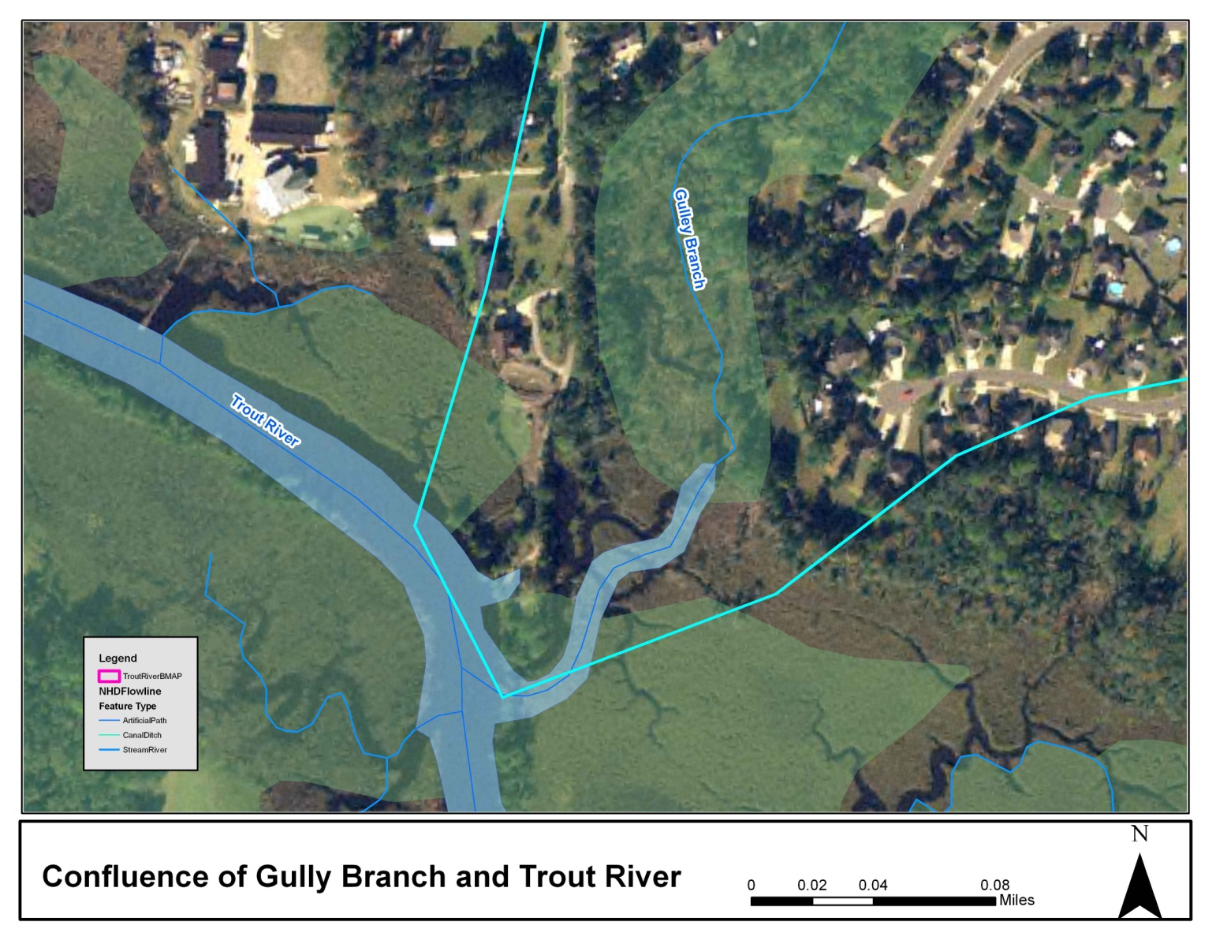
Gulley Branch Confluence with Middle Trout

Slide 27
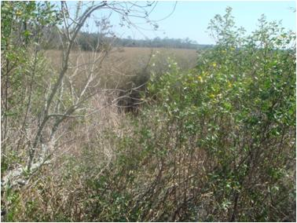
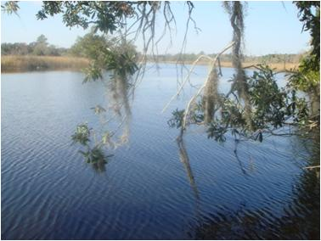
Gulley Branch and Middle Trout River
Notes:
Extreme tidal all the way to fork- unclear which way trout was flowing- appeared as if it was moving west

Slide 28
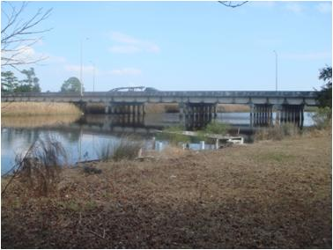
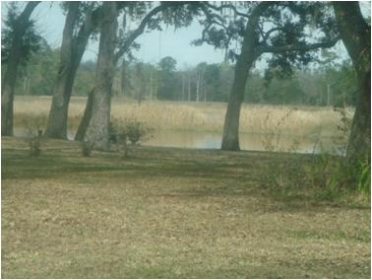
Middle Trout and Lower Trout

