Slide 1
Watershed Planning & Coordination Section
Katie Hallas, Environmental Consultant
Middle Trout River BMAP Monitoring Plan

Slide 2
Presentation Overview
Overview of need for monitoring plan
Review of monitoring plan development process
Identification of monitoring plan objectives
Review of existing monitoring stations in watershed
Discussion of sampling parameters & frequency

Slide 3
1. Overview of Need for Monitoring Plan

Slide 4
Why include a monitoring plan in a BMAP?
Subparagraph 403.067(7)(a)5:
  “The basin management action plan must include milestones for implementation and water quality improvement, and an associated water quality monitoring component sufficient to evaluate whether reasonable progress in pollutant load reductions is being achieved over time.”

Slide 5
2. Review of Monitoring Plan Development Process

Slide 6
What are some important considerations for the monitoring plan?
TMDL parameter(s) addressed in the BMAP;
Goals & objectives for monitoring to determine success of the BMAP;
Core & supplemental parameters that should be assessed related to the impairment;
Important assumptions made in TMDL development;
Specific allocations to sources (where applicable);
Existing stations; &
Responsible entities.

Slide 7
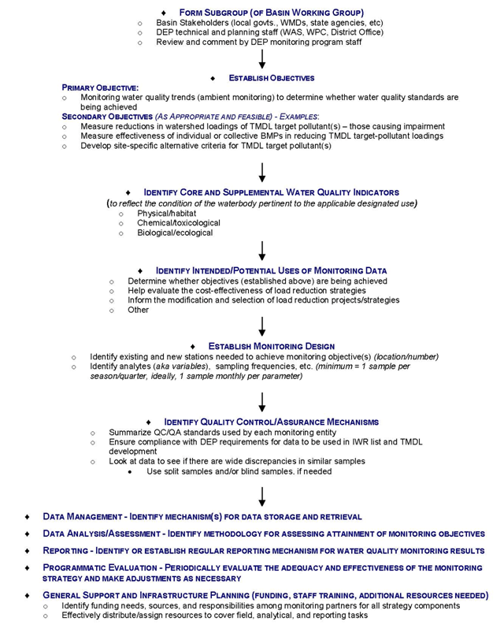

Slide 8
Step 1: Identify existing monitoring in the basin.
Compile historic & current monitoring locations for discussions.
Discuss which stations are key to the BMAP monitoring network.
Identify where gaps occur.

Slide 9
Step 2: Establish objectives.
Primary objective(s)
  Necessary to evaluate success of BMAP.
Secondary objective(s)
  May help contribute to future TMDL &/or BMAP refinements.

Slide 10
3. Identification of Monitoring Plan Objectives

Slide 11
Monitoring Plan Objectives
Primary objective
  To track inputs & trends in TN & TP in the Middle Trout River & Little Trout River.
Secondary objective
  To identify areas within the watershed with high loadings of nutrients to better focus management efforts.

Slide 12
4. Review of Existing Monitoring Stations

Slide 13
What data have been collected?
The data were pulled from STORET for WBIDs:
  2203-Middle Trout River;
  2223-Upper Trout River; &
  2206-Little Trout River.
  Note: There are no stations in WBID 2201-Gulley Branch.
The data were pulled from January 1, 1996 through September 30, 2011.
Notes:
-The January 1, 1996 date was chosen because the cycle 1 verification period for Group 2 waters was January 1, 1996 through June 30, 2003.
-The cycle 2 verification period for Group 2 waters was January 1, 2001 through June 30, 2008.
-The stations were sampled for a wide variety of parameters, including but not limited to ALK, Al, Be, Cl, Cu, Fe, DO, DO saturation, dissolved solids, fixed solids, Fl, N (various species), P (various species), pH, S, Se, true color, turbidity, velocity (wind & stream), & wind direction.

Slide 14
WBID 2203-Middle Trout
Org ID | Station ID | Collection Agency | Latitude | Longitude | Primary Type | Data Available
21FLA | 20030123 | FDEP, NED | 30 26 16.8 | 81 45 48.6 | River/Stream | 2000: May, September 2001: January 2002: April, May, June, August, October, November, December 2006: November 2007: February, March, April, July, August, September, November 2008: March
21FLA | 20030753 | FDEP, NED | 30 25 52.6 | 81 46 6.9 | River/Stream | 2002: April, May, June, August, October, November 2004: January, July 2006: November 2007: February, March, April, July, August, September, November 2011: June
21FLA | 20030047 | FDEP, NED | 30 25 45.218 | 81 46 10.356 | River/Stream | 2006: November 2007: February, March, April, July, August, September, November
21FLGW | 27947 | FDEP | 30 25 32.838 | 81 47 13.617 | River/Stream | 2005: September
21FLGW | 36634 | FDEP | 30 25 32.609 | 81 47 13.544 | River/Stream | 2009: May
21FLGW | 38193 | FDEP | 30 25 32.89 | 81 47 13.747 | River/Stream | 2009: November
21FLJXWQ | TR123 | COJ | 30 26 12.6959 | 81 45 41.1839 | River/Stream | 1999: January, March, April, May, August, October, December 2000: January, March, April, June, September, December 2001: March, June, August, December 2002: March, May, August, December 2003: March, June, September, December 2004: March, June, September, December 2005: March, June, September, December 2006: January, June, July, December 2007: March, June, July, August, December 2008: January, May, July, October, December 2009: February, May, August, December 2010: January, May, July, November 2011: February, May
21FLJXWQ | TREE10 | COJ | 30 25 51.888 | 81 46 6.78 | River/Stream | 2002: May, July, August, September, December 2003: April, July, August, September, November 2004: February, May, August, September, December 2005: March, April, June, July, August, September, December 2006: January, March, May, June, July, August, September, December 2007: March, June, July, August, December 2008: January, April, July, October, December 2009: February, May, August, December 2010: January, June, July, November 2011: February, May
Sampled in 2011
Notes:
-Only 21FLA (FDEP, NED), TR123 (COJ), & TREE10 (COJ) have collections in 2011.
-FDEP, NED stands for Florida Department of Environmental Protection, Northeast District.
-FDEP stands for Florida Department of Environmental Protection.
-COJ stands for the City of Jacksonville.
-FDEP, NED has proposed to monitor at the bold, italicized stations for fecal coliform BMAPs. These stations are indicated by the bold, italicized text. Marcy & I met with them on October 19th, and they agreed to monitor for suite A parameters as well as N & P. -0123 will be monitored quarterly, -0753 & -0047 will be monitored monthly.

Slide 15
WBID 2223-Upper Trout
Org ID | Station ID | Collection Agency | Latitude | Longitude | Primary Type | Data Available
21FLSJWM | SJB-SL-1013 | SJRWMD | 30 22 48.775 | 81 50 48.358 | Lake | No data
21FLA | 20030751 | FDEP, NED | 30 24 26.1 | 81 50 32.6 | River/Stream | 2002: April, May, June, July, August, September, October, November, December 2007: January, February, March, April, May, June, July, August, September, October 2008: March 2011: March, April
21FLA | 20030752 | FDEP, NED | 30 23 54.9 | 81 50 28.6 | River/Stream | 2002: April, May, June, July, August, September, October, November, December 2007: January, February, March, April, May, June, July, August, September, October 2008: March
21FLGW | 14805 | FDEP | 30 22 48.775 | 81 50 48.358 | Lake | 2002: August
21FLGW | 39326 | FDEP | 30 24 7.385 | 81 50 33.35 | River/Stream | 2010: November
Sampled in 2011
Notes:
-Only 21FLA (FDEP, NED) has a collection in 2011.
-FDEP, NED stands for Florida Department of Environmental Protection, Northeast District.
-FDEP stands for Florida Department of Environmental Protection.
-COJ stands for the City of Jacksonville.
-SJRWD stands for St. Johns River Water Management District.

Slide 16
WBID 2206-Little Trout
Org ID | Station ID | Collection Agency | Latitude | Longitude | Primary Type | Data Available
21FLSJWM | TREE10 | SJRWMD | 30 26 23 | 81 46 7 | River/Stream | 2005: April, June, August, September
21FLA | 20030739 | FDEP, NED | 30 26 24.1 | 81 46 20.7 | River/Stream | 2002: March, April, May, June, July, August, September, October, November, December 2004: February, March, April, May, June 2007: January, February, March, April, May, June, July, August, September, October
No Stations
Sampled in 2011
Notes:
-FDEP, NED stands for Florida Department of Environmental Protection, Northeast District.
-FDEP stands for Florida Department of Environmental Protection.
-COJ stands for the City of Jacksonville.
-SJRWD stands for St. Johns River Water Management District.

Slide 17
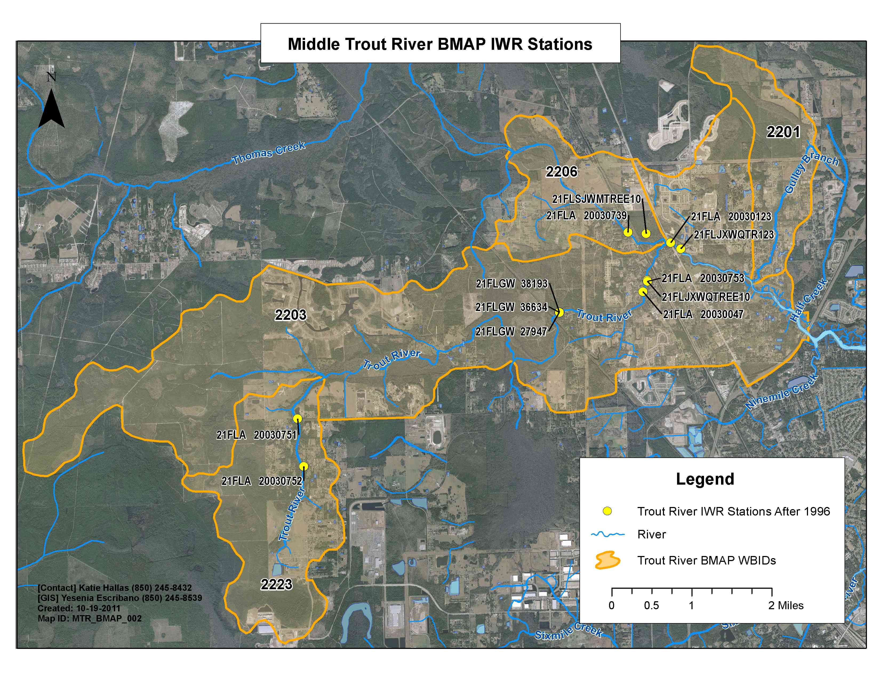
Sampling Locations
Notes:
-The map does not show three stations in the Upper Trout WBID (2223): SJB-SL-1013 (no data), 14805 (FDEP), or 39326 (FDEP). These were not found in data miner.

Slide 18
5. Discussion of Sampling Parameters & Frequency

Slide 19
Recommended Parameters
Core Parameters | Supplemental Parameters
Total Phosphorus (P) | Total Suspended Solids (TSS)/Turbidity
Orthophosphate as P | Alkalinity
Nitrate/Nitrite as N | --
Nitrogen, Ammonia | --
Total Kjeldahl Nitrogen (TKN) | --
Dissolved Oxygen (DO) | --
pH | --
Temperature | --
Specific Conductance | --

Slide 20
Existing Data
Review existing spreadsheet. Is this correct?
Review the monitoring collection sheet:
  Sampling entity
  Station number
  Latitude/Longitude
  Begin Date/End Date
  Currently Sampled (yes/no)
  Station Type
  Sampling Frequency
  Sampling Parameters
Review due by Monday, November 14th.

Slide 21
Questions?
Contact information
Katie Hallas
  Phone: 850-245-8432
  E-mail: Katie.Hallas@dep.state.fl.us

