Slide 1
October 25, 2011
Little Trout River Watershed

Slide 2
Little Trout River Watershed
Little Trout River is waterbody identification (WBID) number 2206.
The land uses in the watershed are predominately:
  Agriculture;
  Low density residential; and
  Wetlands.
There is some wastewater and stormwater infrastructure.
The major roadways are U.S. 1 and Old Kings Road.

Slide 3
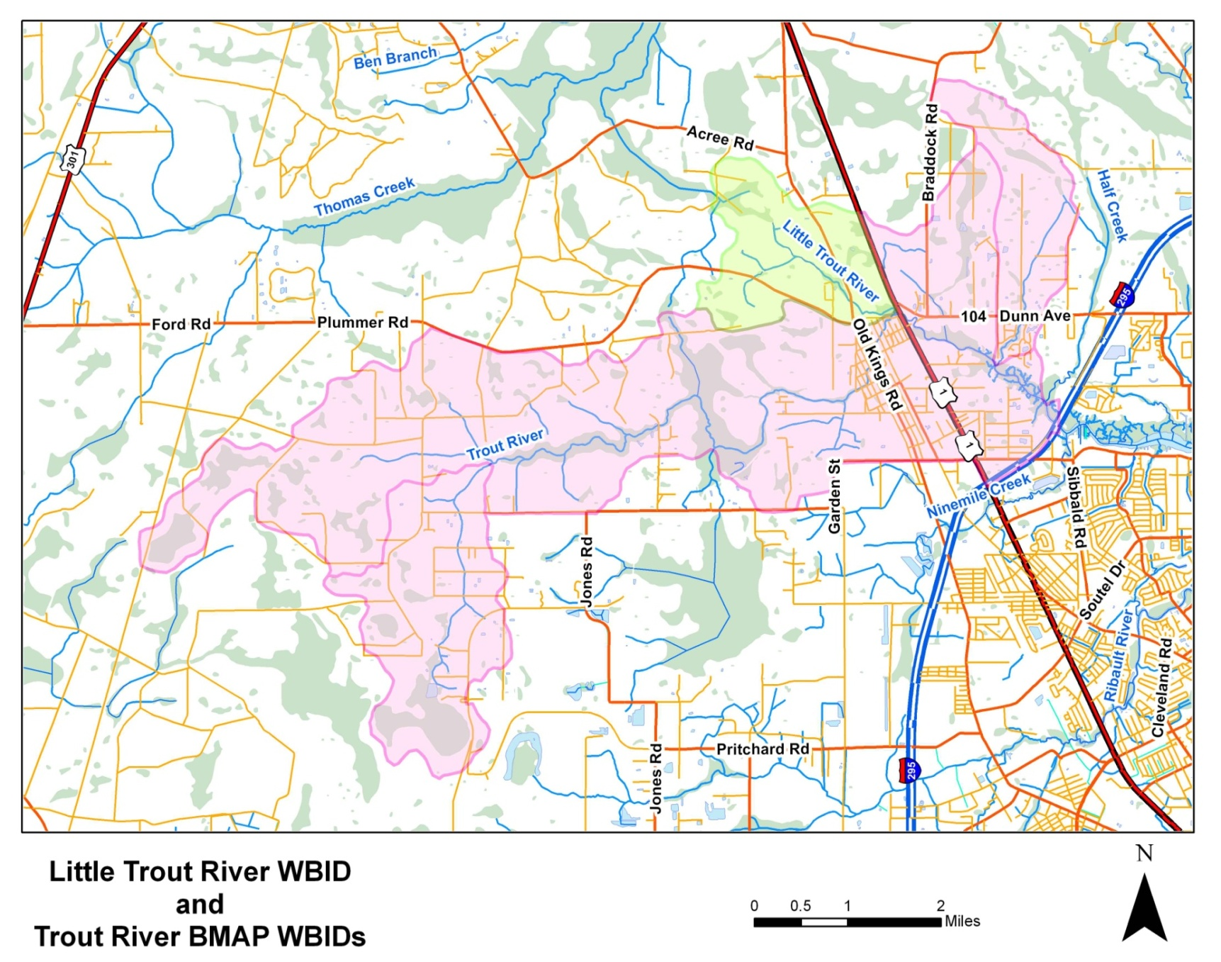
Map of the Little Trout River WBID

Slide 4
Little Trout River Impairment
Little Trout River was verified impaired for dissolved oxygen (DO) in 2008.
  Causative pollutants were determined to be total phosphorus (TP) and biochemical oxygen demand (BOD).
A total maximum daily load (TMDL) has not yet been drafted to address the DO impairment.

Slide 5
Little Trout River and the BMAP
Little Trout River connects to the Middle Trout River.
Including the Little Trout River watershed in the BMAP would provide a greater area for projects to address the Middle Trout River TMDL.
  The total required reductions for the BMAP would not change.
BMAP activities in the Little Trout River watershed may help to address the DO impairment and allow for delisting; therefore, a TMDL would not be needed.
If Little Trout River is included in the Middle Trout River BMAP it may be eligible for listing in FDEP’s category 4e.

Slide 6
Category 4e
  Category 4e means that the waterbody is, “Impaired, but recently completed or ongoing restoration activities are underway to restore the designated uses of the waterbody.”
Little Trout River would move from the verified impaired list for not attaining a designated use (category 5) to the delist list for restoration activities underway (category 4e).
Category 4e would push back the deadline for a TMDL and, if the proposed activities are adequate to restore the Little Trout River, a TMDL may not be needed in the future.
  FDEP is scheduled to assess Group 2 waterbodies in 2013. Little Trout River could be moved to the delist list at that time.

Slide 7
Category 4e Requirements
The stakeholders must demonstrate that there are sufficient projects underway in the Little Trout River watershed to justify a category 4e listing.
Projects in the watershed should not only include ongoing activities (education and outreach, street sweeping, and stormwater maintenance) but also projects that will occur in the next five years to address nutrients.
Adequate projects must be submitted for FDEP to support a category 4e listing to the U.S. Environmental Protection Agency .

Slide 8
Projects in the Little Trout River
Information is needed from the stakeholders on what projects are planned in the Little Trout River Watershed:
  City of Jacksonville (COJ);
  Florida Department of Transportation (FDOT); and
  Florida Department of Agriculture and Consumer Services (FDACS).

Slide 9
Determination on Including Little Trout River in the BMAP

Slide 10
Project Collection
October 25, 2011

Slide 11
Projects to Address Urban Loads
The projects received from stakeholders to date include:
  COJ Trout River Wet Detention Facility;
  COJ/FDOT county-wide education efforts;
  FDOT monthly street sweeping on six miles of roadway;
  FDOT’s 18 catch basins; and
  FDOT’s cessation of fertilizer use.

Slide 12
Project Credit
Description | Project TN Reduction (lbs/yr) | Project TP Reduction (lbs/yr)
Trout River Wet Detention Facility (Alt 2) | 3,395.00 | 813.00
Public Education Activities | 632.14 | 128.89
Street Sweeping Program | See note | See note
Catch Basins | See note | See note
Cessation of fertilizer use | 459.56 | 96.53
TOTAL | 4,486.70 | 1,038.42
Note: Project credit for street sweeping and catch basins will be calculated using the Florida Stormwater Association (FSA) methodology. FDOT is providing the necessary information to calculate project credit.

Slide 13
Credit Comparison to Required Reductions
Based on the urban stormwater projects received to date for which credit can be calculated:
  The required 30% TN reduction from urban areas has been achieved.
  465.26 pounds of TP are still needed to achieve the 70% TP reductions from urban areas.
    However, a portion of this load will be met through street sweeping and catch basin credits.
Parameter | Total Urban Reductions Required (lbs/yr) | Total Project Reductions (lbs/yr) | Remaining Urban Reductions (lbs/yr)
TN | 3,160.68 | 4,486.70 | -1,326.02 (credit)
TP | 1,503.68 | 1,038.42 | 465.26

Slide 14
Projects to Address Agricultural Loads
The agricultural required reductions are 2,332.88 lbs/yr of TN and 755.86 lbs/yr of TP.
FDEP and FDACS have been discussing the agricultural lands in the watershed.
  The next discussion will be on November 1st.
FDACS is looking at the land use coverage from the TMDL to determine the acreage of active agricultural operations.
FDACS will also provide information on how many acres have already signed Notices of Intent (NOIs).
A plan to meet the agricultural reductions will then be determined.

Slide 15
Discussion of Additional Projects to Achieve the Remainder of the Reductions

