Slide 1
October 25, 2011
Middle Trout River BMAP Overview

Slide 2
Trout River
The Trout River is part of the Trout River Planning Unit in the Lower St. Johns River (LSJR) Basin.
Trout River has been divided into three waterbody identification numbers (WBIDs) by the Florida Department of Environmental Protection (FDEP):
  Upper Reach – WBID 2223
  Middle Reach – WBID 2203
  Lower Reach – WBID 2203A
The focus of this TMDL and BMAP are on the Middle Reach (WBID 2203).

Slide 3
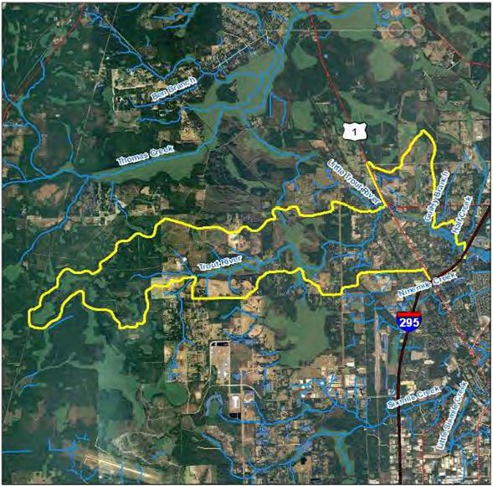
Location of WBID 2203

Slide 4
Verification of Impairment
Middle Trout River was verified impaired by FDEP in both the Cycle 1 (January 1, 1996 through June 30, 2003) and Cycle 2 (January 1, 2001 through June 30, 2008) assessments.
Middle Trout River is impaired for dissolved oxygen (DO) with the causative pollutants of total nitrogen (TN) and total phosphorus (TP).
  Note: The Middle Trout River is also included in the LSJR Tributaries BMAP II for its fecal coliform impairment.

Slide 5
Sources
The TMDL identified sources of nutrients as follows:
  City of Jacksonville (COJ) and Florida Department of Transportation (FDOT) Phase I municipal separate storm sewer system (MS4);
  Septic tanks;
  Agricultural runoff;
  Urban nonpoint source runoff;
  Natural areas; and
  Contributing WBIDs to the watershed (Upper Trout River [WBID 2223] and Gulley Branch [WBID 2201]) .

Slide 6
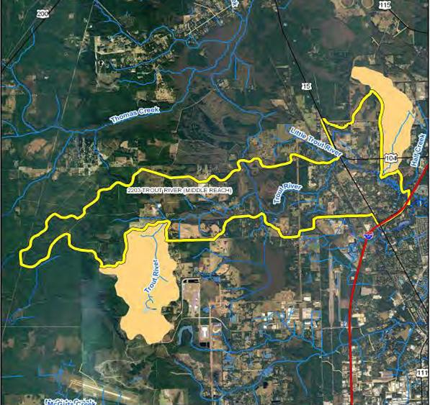
Overall Watershed

Slide 7
TMDL Development Process
The Main Stem LSJR TMDL requires between a 30% and 50% reduction in anthropogenic TN loads to the marine portion of the river.
The Middle Trout River model was used to estimate the DO concentration with the historic temperature following a 30% reduction in TN and reductions in TP.
The model predicted that with a 30% reduction in TN and a 70% reduction in TP, the mean DO concentration would be 5.1 mg/L.
The main focus of the BMAP will be on TP reductions, although TN reductions will also be quantified.

Slide 8
Summary of Urban Required Reductions
Source | TN (lbs/yr) | TP (lbs/yr)
Middle Trout – Septic Tanks | 2,650.00 | 1,104.00
Middle Trout – Urban and Built-up | 5,875.65 | 795.99
Upper Trout – Urban | 792.95 | 94.31
Gulley Branch – Urban | 1,217.00 | 153.82
Total Urban Load | 10,535.60 | 2,148.12
Required Percent Reduction | 30% | 70%
Urban Required Reduction | 3,160.68 | 1,503.68

Slide 9
Summary of Agricultural Required Reductions
Source | TN (lbs/yr) | TP (lbs/yr)
Middle Trout – Agriculture | 5,023.78 | 703.51
Upper Trout – Agriculture | 2,000.27 | 274.64
Gulley Branch – Agriculture | 752.23 | 101.65
Total Agriculture Load | 7,776.28 | 1,079.80
Required Percent Reduction | 30% | 70%
Agriculture Required Reduction | 2,332.88 | 755.86

Slide 10
Allocations
Stakeholders are identifying projects located within the watershed to reduce nutrients.
FDEP quantified the reductions from the projects received so far.
  Additional projects are needed to meet the reductions.
At this time, FDEP does not anticipate that detailed allocations will be necessary for this BMAP.

Slide 11
Questions?

