Slide 1

Lakes Harney and Monroe
Basin Management Action Plan
BMAP Kickoff Meeting
October 21, 2010

Slide 2
Meeting Overview
Components of a Basin Management Action Plan (BMAP)
BMAP Process
Lakes Harney and Monroe Total Maximum Daily Loads (TMDLs)
Approach for the Lakes Harney and Monroe BMAP

Slide 3
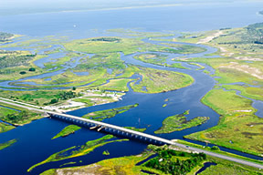
Components of a BMAP
Used by permission of the SJRWMD

Slide 4
Key BMAP Components
TMDLs being addressed
Assumptions
Considerations identified for next iteration
Future growth
Allocations to responsible sources
Projects to meet the TMDL
  Individual or regional
  Structural or nonstructural
  Must be maintained as permitted

Slide 5
Key BMAP Components, cont’d
Funding sources
Monitoring plan (water quality and project efficiency)
Process to monitor progress towards the TMDL
Implementation timeline and commitments
Appendices with supporting information

Slide 6
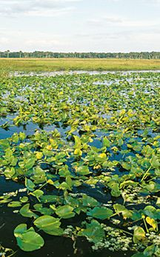
BMAP Process
Used by permission of the SJRWMD

Slide 7
BMAPs
A BMAP is developed collaboratively with stakeholders to meet provisions in Section 403.067(7), Florida Statutes ( F.S.).
For point sources, BMAPs are enforceable through wastewater and municipal separate storm sewer system (MS4) National Pollutant Discharge Elimination System (NPDES) permits.
For nonpoint sources, BMAP projects are enforceable.
For agriculture, best management practices (BMPs) or monitoring is required.
BMAPs are adopted by FDEP Secretarial Order.

Slide 8

BMAPs, continued
The BMAP must include a complete plan to show how the TMDL will be met.
Considerations for improving the TMDL and BMAP in the next iteration should be identified.
Used by permission of the SJRWMD

Slide 9
Agriculture
Agriculture will be assigned its own load reduction.
    Producers will be required to implement appropriate BMPs or a monitoring plan, developed by FDEP, to show that the producer not having an impact.
The Florida Department of Agriculture and Consumer Services (FDACS) is a partner in the BMAP process.
Agricultural land use makes up:
  3% of land use in the Lake Harney basin; and
  3% of land use in the Lake Monroe basin.

Slide 10
BMAP Responsibilities
Responsibility for reductions can apply to all sources:
  Wastewater treatment facilities (WWTFs);
  Phase I and Phase II MS4s;
  Urban areas outside an MS4 (non-MS4);
  Nonpoint sources;
  Agriculture; and
  Power plants.

Slide 11
BMAP Responsibilities, con’t
Lack of funding does not mean “no action required.”
Facilities that have already upgraded may need to do more.
Current available BMPs alone may not result in the reductions needed. Additional actions may be necessary such as:
  Potential use of regional or cooperative projects.
  Water retention.
  Ideas for project and innovations are welcome.

Slide 12
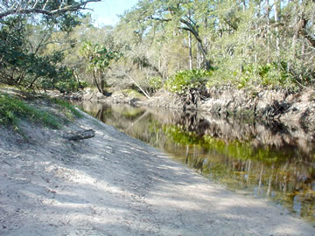
Lakes Harney and Monroe
Total Maximum Daily Load
Used by permission of the SJRWMD

Slide 13
What is a TMDL?
A TMDL is the maximum amount of a pollutant that a waterbody can assimilate and still meet water quality standards.
TMDLs are developed for waterbodies that have sufficient data to demonstrate they are not meeting applicable water quality standards.
There are two parts to a TMDL:
  A target based on water quality standards; and
  Load reductions for pollutants that are necessary to ensure that the established target is met.

Slide 14
Parameters of Concern
For each of the waterbody identification (WBID) numbers in the TMDL, the water quality parameters of concern are:
WBID | Waterbody Segment | Parameters of Concern
2964A | Lake Harney | Dissolved oxygen (DO) and Nutrients
2964 | SJR Downstream of Lake Harney | DO
2893F | SJR Above Lake Jesup | DO
2893E | SJR Above Lake Monroe | DO and Nutrients
2893D | Lake Monroe | DO and Nutrients
2893C | SJR Above Wekiva River | DO and Nutrients

Slide 15
Targets for Lakes Harney and Monroe TMDL
Florida’s narrative nutrient criteria (water quality standard) requires that the nutrient concentrations of a waterbody shall not be altered as to cause an imbalance of natural populations of aquatic flora or fauna.
For the WBIDs in the Lakes Harney and Monroe TMDL, nutrient targets were established to restore healthy chlorophyll-a levels and Trophic State Index (TSI) values.
Each WBID has a concentration of total nitrogen (TN) and total phosphorus (TP) to achieve the targets.

Slide 16
Targets, continued
The target for each WBID is as follows:
WBID | Waterbody Segment | TN (mg/L) | TP (mg/L) | Chlorophyll-a or TSI
2964A | Lake Harney | 1.18 | 0.07 | 51 (TSI)
2964 | SJR Downstream of Lake Harney | 1.18 | 0.07 | 5.8 μg/L
2893F | SJR Above Lake Jesup | 1.18 | 0.07 | 5.8 μg/L
2893E | SJR Above Lake Monroe | 1.18 | 0.07 | 9.1 μg/L
2893D | Lake Monroe | 1.18 | 0.07 | 54 (TSI)
2893C | SJR Above Wekiva River | 1.18 | 0.07 | 9.1 μg/L

Slide 17
Sources in the TMDL
WWTFs
MS4s
Nonpoint stormwater sources
Agriculture
Failing septic tanks within 50 feet of a waterbody
Groundwater
Atmospheric deposition directly on the waterbodies
Upstream river sources
Lake Jesup sources

Slide 18
Sources, continued
Reductions are only required for:
  WWTFs (assigned an allocation in the TMDL);
  MS4s;
  Nonpoint stormwater sources;
  Agriculture; and
  Failing septic tanks within 50 feet of a waterbody.
Groundwater and atmospheric deposition are considered natural background.
Reductions for upstream river sources and Lake Jesup sources will be achieved through other plans.

Slide 19
Components of a TMDL
A TMDL includes the following components:
  Wasteload allocation (WLA) for point sources:
    Wastewater (ww); and
    Stormwater (sw).
  Load allocation (LA) for nonpoint sources.

Slide 20
TMDL Required Reductions
WBID | Parameter | TMDL (lbs/yr) | WLAww (lbs/yr) | WLAsw | LA (lbs/yr)
2964 A | TN | 3,355,570 | 0 | 39% | 3,355,570
 | TP | 241,026 | 0 | 33% | 241,026
2964 + 2893F | TN | 3,741,990 | 0 | 37% | 3,741,990
 | TP | 276,141 | 0 | 32% | 276,141
2893D + 2893E | TN | 4,171,255 | 0 | 38% | 4,171,255
 | TP | 315,512 | 0 | 31% | 315,512
2893C | TN | 4,202,340 | 19,342 | 37% | 4,182,998
 | TP | 318,236 | 2,345 | 31% | 315,891

Slide 21
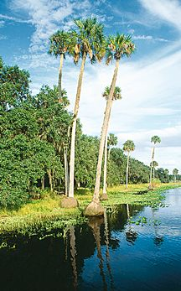
Approach for the Lakes Harney and Monroe BMAP
Used by permission of the SJRWMD

Slide 22
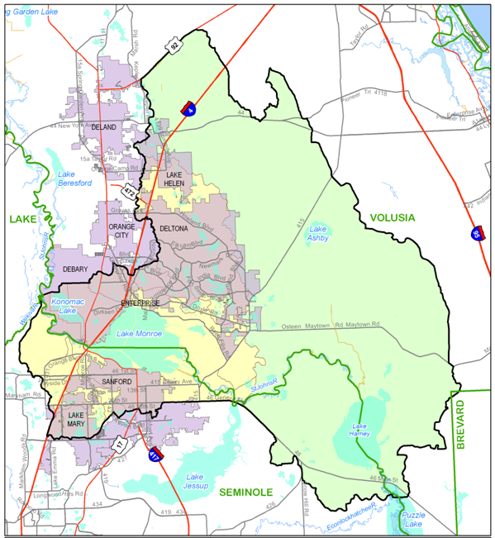
Lakes Harney and Monroe
BMAP Watershed

Slide 23
Stakeholders in the BMAP
Sanford North WWTF
MS4s
  Seminole County
  City of Lake Mary
  City of Sanford
  FDOT Turnpike District
  FDOT District 5
  Brevard County
  Lake County
  Volusia County
  City of DeBary
  City of Deltona
  City of Lake Helen
Non-MS4s
  City of Enterprise
  City of Orange City
  City of DeLand
Agriculture

Slide 24

Groups and Meeting Format
Technical meetings
Management briefings
One-on-one meetings
Used by permission of the SJRWMD

Slide 25
Technical Meetings
Technical meetings will be held on a monthly basis, as needed.
The purpose of the meetings is for fact-finding by technical staff to provide supporting information for the BMAP.
All technical meetings will be noticed in the Florida Administrative Weekly (FAW) and open to the public, in conformance with the Sunshine Law.

Slide 26
Management Briefings
Separate meetings will be held with management level representatives.
The purpose of these meetings is for FDEP to brief the decision makers on the BMAP process and obtain feedback on the BMAP approach.
All technical meetings will be noticed in the FAW and open to the public, in conformance with the Sunshine Law.

Slide 27
Sunshine Law
Florida's Government-in-the-Sunshine Law provides a right of access to governmental proceedings.
The Sunshine law requires that:
  Meetings must be open to the public;
  Reasonable notice of such meetings must be given; and
  Minutes of the meeting must be taken.
The BMAP meetings are public meetings under the Sunshine law but do not have designated members.
By not having a set membership for the BMAP meetings, stakeholders will not be limited in their BMAP discussions with other stakeholders.

Slide 28

Next Meeting
Next meeting date: November 18, 2010.
  Ideas for a meeting location?
Review of TMDL model by FDEP and SJRWMD.
Used by permission of the SJRWMD

Slide 29
Questions?
Samantha Budd, Basin Coordinator
Florida Department of Environmental Protection
Samantha.Budd@dep.state.fl.us
850-245-8418
Tiffany Busby, Facilitator
Wildwood Consulting
TLBusby@wildwoodconsulting.net
904-797-2721

