Slide 1

Dissolved Oxygen and Nutrient TMDLs for Impaired Waters in the Middle St. Johns River Basin
Xueqing Gao Ph.D.
Watershed Evaluation and TMDL Section
Florida Department of Environmental Protection
November 18, 2010

Slide 2
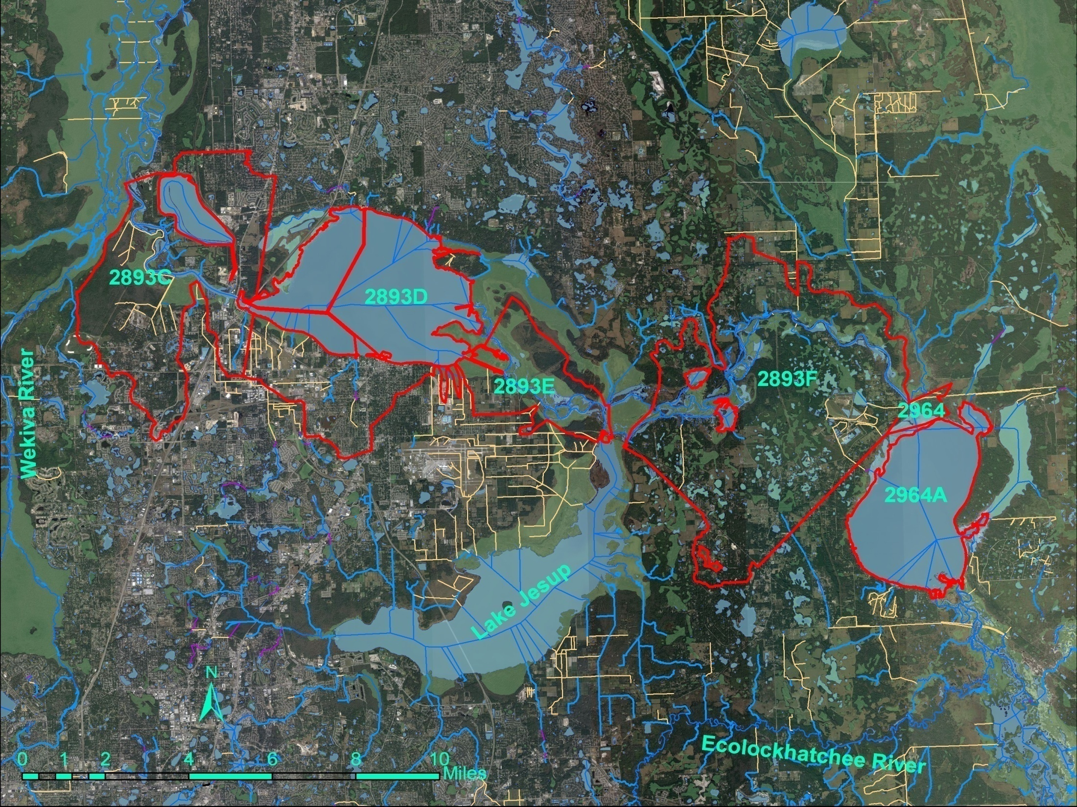
Identifying Impaired Water Segments
(Middle St. Johns River Main Stem)

Slide 3
Nutrient Assessment Threshold
State Nutrient Criteria:
  In no case shall nutrient concentrations of a body of water be altered so as to cause an imbalance in natural populations of aquatic flora or fauna (62-302 F.A.C).
  Numeric threshold: annual average Chl a of 20 µg/L for streams, and a Trophic State Index (TSI) of 60 for lakes with the color level higher than 40 PCU (62-303 F. A. C.).
  Exceeding the historic minimum or significant increase in trophic state in the verified period can also be used to verify nutrient impairment.
  Other information indicating an imbalance in flora or fauna due to nutrient enrichment can also be considered (62-303 F. A. C).

Slide 4
Dissolved Oxygen Assessment
State criteria of DO for Class III freshwater: Shall not be less than 5.0 mg/L. Normal daily and seasonal fluctuations above the level shall be maintained (62-302 F.A.C).
DO impairment verification: DO concentration is lower than the 5.0 mg/L criteria for more than 10% of the time with 90% confidence level using binomial distribution. Causative pollutant needs to be identified (62-303 F.A.C).

Slide 5
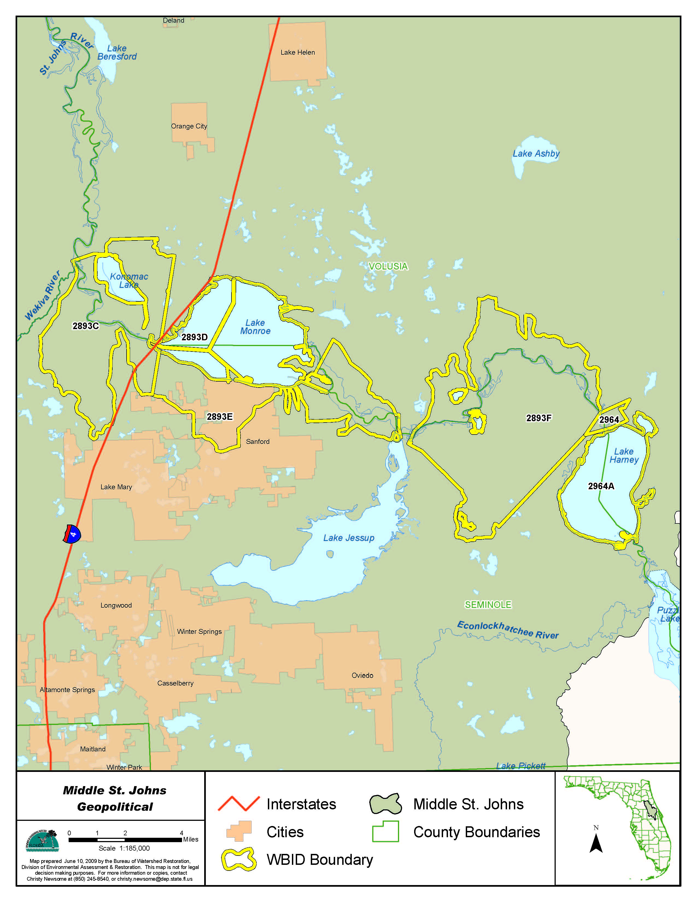
Lake Harney (2964A) and Lake Monroe (2893D) were verified for nutrient impairments based on paleolimnological results and DO impairment.
St. Johns River downstream of Lake Harney (2964) and St. Johns River upstream of Lake Jesup (2893F) were verified for DO impairments linking to nutrients.
St. Johns River above Lake Monroe (2893E) was verified for nutrient impairment because annual average Chl a concentrations exceed 20 µg/L in both 1st and 2nd cycle assessments. Impaired for DO.
St. Johns River above Wekiva River (2893C) was verified for nutrient impairment in 1st cycle assessment. The 2nd cycle assessment had not enough data to delist it. Impaired for DO.

Slide 6
Topics
Establishing water quality targets:
  Different river segments need different water quality targets?
  Developing the targets
Establishing target nutrient loads:
  Source identification
  Model setup and Calibration
  Target load simulation

Slide 7
Developing Water Quality Targets for Impaired Segments of the Middle St. Johns River

Slide 8
Different Water Quality Targets Needed for Different River Segments?

Slide 9
Relative Location to Lake Jesup Outlet | Waterbody
Upstream Segments | Lake Harney (2964A)
 | St. Johns River Downstream of Lake Harney (2964)
 | St. Johns River above Lake Jesup (2893F)
Downstream Segments | St. Johns River above Lake Monroe (2893E)
 | Lake Monroe (2893D)
 | St. Johns River above Wekiva River (2893C)

Slide 10
Difference in Chl a Concentrations in Upstream and Downstream Segments
 |  | 2964A | 2964 | 2893F | 2893E | 2893D | 2893C
Quantiles
100.0% | Maximum | 70.87 | 72.24 | 89.70 | 115.00 | 165.05 | 115.96
99.5% |  | 70.87 | 72.24 | 89.70 | 115.00 | 165.05 | 115.96
97.5% |  | 39.95 | 55.45 | 54.35 | 85.09 | 128.12 | 110.56
90.0% |  | 20.03 | 26.31 | 28.50 | 55.06 | 46.46 | 45.07
75.0% | Quartile | 9.19 | 10.00 | 10.45 | 22.94 | 29.02 | 25.17
50.0% | Median | 4.18 | 3.49 | 2.37 | 7.53 | 11.80 | 12.15
25.0% | Quartile | 1.93 | 1.60 | 1.20 | 2.88 | 4.21 | 4.51
10.0% |  | 1.19 | 1.00 | 1.00 | 1.40 | 1.91 | 1.62
2.5% |  | 1.00 | 1.00 | 1.00 | 1.00 | 1.29 | 1.03
0.5% |  | 1.00 | 1.00 | 1.00 | 1.00 | 1.00 | 1.00
0.0% | Minimum | 1.00 | 1.00 | 1.00 | 1.00 | 1.00 | 1.00

Slide 11
Difference in TP Concentrations in Upstream and Downstream Segments
 |  | 2964A | 2964 | 2893F | 2893E | 2893D | 2893C
Quantiles
100.0% | Maximum | 0.26 | 0.36 | 0.30 | 0.25 | 0.29 | 0.31
99.5% |  | 0.26 | 0.36 | 0.30 | 0.25 | 0.29 | 0.31
97.5% |  | 0.20 | 0.23 | 0.23 | 0.23 | 0.22 | 0.21
90.0% |  | 0.13 | 0.16 | 0.14 | 0.15 | 0.14 | 0.13
75.0% | Quartile | 0.10 | 0.10 | 0.10 | 0.12 | 0.10 | 0.11
50.0% | Median | 0.07 | 0.07 | 0.07 | 0.09 | 0.08 | 0.08
25.0% | Quartile | 0.05 | 0.05 | 0.05 | 0.07 | 0.06 | 0.07
10.0% |  | 0.04 | 0.03 | 0.04 | 0.05 | 0.05 | 0.05
2.5% |  | 0.04 | 0.02 | 0.04 | 0.04 | 0.04 | 0.03
0.5% |  | 0.04 | 0.01 | 0.03 | 0.01 | 0.04 | 0.01
0.0% | Minimum | 0.04 | 0.01 | 0.03 | 0.01 | 0.04 | 0.01

Slide 12
Difference in TN Concentrations in Upstream and Downstream Segments
 |  | 2964A | 2964 | 2893F | 2893E | 2893D | 2893C
Quantiles
100.0% | Maximum | 2.95 | 2.86 | 3.39 | 4.39 | 3.63 | 3.04
99.5% |  | 2.95 | 2.86 | 3.39 | 4.39 | 3.63 | 3.04
97.5% |  | 2.20 | 2.76 | 2.97 | 3.51 | 2.97 | 2.50
90.0% |  | 1.88 | 2.12 | 2.09 | 2.63 | 2.14 | 2.00
75.0% | Quartile | 1.58 | 1.59 | 1.68 | 1.90 | 1.75 | 1.79
50.0% | Median | 1.33 | 1.29 | 1.42 | 1.54 | 1.47 | 1.43
25.0% | Quartile | 1.12 | 1.11 | 1.17 | 1.23 | 1.32 | 1.19
10.0% |  | 1.02 | 0.99 | 1.07 | 1.12 | 1.15 | 1.09
2.5% |  | 0.93 | 0.90 | 0.92 | 0.88 | 0.96 | 0.95
0.5% |  | 0.82 | 0.31 | 0.82 | 0.72 | 0.84 | 0.55
0.0% | Minimum | 0.82 | 0.31 | 0.82 | 0.72 | 0.84 | 0.55

Slide 13
Difference in the Functional Relationship between Chl a and Nutrients in Upstream and Downstream Segments
Report Figure 3.1
Report Figure 3.2

Slide 14
What Causes the Difference?
Different morphology of the receiving water
Water residence time
Color and turbidity
Different nutrient compositions
Influence from other waterbodies

Slide 15
What Causes the Observed Difference?
 | Lake Harney (WBID 2964A) Representing Upstream Condition |  | Lake Monroe (WBID 2893D) Representing Downstream Condition
 | Mean | Standard Deviation | Mean | Standard Deviation
Surface Area (acres) | 7,935 | N/A | 8,814 | N/A
Mean Depth (ft) | 7 | N/A | 6 | N/A
Maximum Depth (ft) | 15 | N/A | 16 | N/A
Drainage Area (square miles) | 2070 | N/A | 2624 | N/A
Flow (30-day mean, cfs) | 2038 | 1935 | 2472 | 2316
Water Residence Time (days) | 15 | N/A | 23 | N/A
Secchi (ft) | 2.34 | 0.86 | 1.98 | 0.53
Turbidity (NTU) | 3.31 | 2.61 | 4.87 | 3.75
Color (PCU) | 182.4 | 106.9 | 170.4 | 114.14
pH | 7.65 | 0.55 | 7.64 | 0.69
Temperature (⁰C) | 23.97 | 5.11 | 23.61 | 5.11
TN (mg N/L) | 1.37 | 0.32 | 1.52 | 0.43
TKN (mg N/L) | 1.28 | 0.29 | 1.45 | 0.42
NH3+4 (mg N/L) | 0.04 | 0.04 | 0.05 | 0.05
NO2+3 (mg N/L) | 0.09 | 0.10 | 0.07 | 0.07
DIN (mg N/L) | 0.13 | 0.09 | 0.12 | 0.12
TP (mg P/L) | 0.07 | 0.04 | 0.08 | 0.03
SRP (mg P/L) | 0.03 | 0.02 | 0.03 | 0.03
Notes:
Since the stream has fairly similar nutrient compositions to the lake, lake data were used as surrogates for streams.

Slide 16
What Causes the Observed Difference?
The difference between Chl a concentrations of Lake Jesup and the St. Johns River was much larger than the difference between nutrient concentrations of the lake and the river segments:
Lake Jesup outflow accounted for average 10% of the flow through the Middle St. Johns River.
Dilution was the factor that caused the observed upstream and downstream difference in Chl a concentration.

Slide 17
Different Targets Needed for Upstream and Downstream Segments?
Same nutrient targets were established for both the upstream and downstream segments.
Different achievable Chl a concentrations are expected for the upstream and downstream segments due to the output from Lake Jesup
Higher Chl a/TN and Chl a/TP ratios in Lake Jesup than in the river segments is natural because the lake has higher water residence time (about 3 months) than those of the river segments (15 to 23 days).

Slide 18
Establishing Water Quality Targets

Slide 19
Nutrient Targets for Impaired St. Johns River Segments
Not enough data to establish nutrient target for the river segments directly
River segments have similar TN and TP concentrations to lake segments.
Nutrient targets were established for Lake Harney and Lake Monroe and applied to all the stream segments.
Nutrient targets were established using three methods.

Slide 20
Nutrient Targets for Impaired St. Johns River Segments
Method | TN (mg/L) | TP (mg/L)
Nutrient TSI Equal to 60 (Huber et al. 1982) | 1.22 | 0.068
Paleolimnological Studies (Anderson, et al. 2004) /TN-TP Correlation | 1.18 | 0.060
75th Percentile Reference Lake Method (Paul and Gerritsen 2002) | 1.11 | 0.073
Final Targets (median) | 1.18 | 0.068 (0.07)
Notes:
Audience may ask the question if 0.07 for TP is the target, the median value of the river segments above Lake Jesup is already 0.07, why should TP reduction be needed? We need to clarify that the 0.07 TP as target is set up for annual average, not long-term average. For water quality assessment purpose, water quality target needs to be met every year, not just as a long-term average.

Slide 21
Achievable Chl a Concentrations or TSIs for Impaired St. Johns River Segments
WBIDs | Achievable Chl a or TSI
Lake Harney (2964A) | 51 (TSI)
2964 | 5.8 µg/L
2893F | 5.8 µg/L
2893E | 9.1 µg/L
2893D | 54 (TSI)
2893C | 9.1 µg/L

Slide 22
How about DO?

Slide 23
Achievable DO Concentration
Report Figure 3.5-A for Upstream Segments
DO = 5.0 mg/L
TP = 0.07 mg/L
DO = 5.0 mg/L
Report Figure 3.5-B for Downstream Segments
TP = 0.07 mg/L
Notes:
All the data used for analysis are in the 10 year period from 1996 through 2007.

Slide 24
Natural Factors Influencing DO Concentration
Report Figure 3.7-A for Upstream Segments
Report Figure 3.7-B for Downstream Segments

Slide 25
Establish Target Nutrient Loadings

Slide 26
Source Identification
Point Sources vs. Nonpoint Sources
Notes:
Talking about

Slide 27
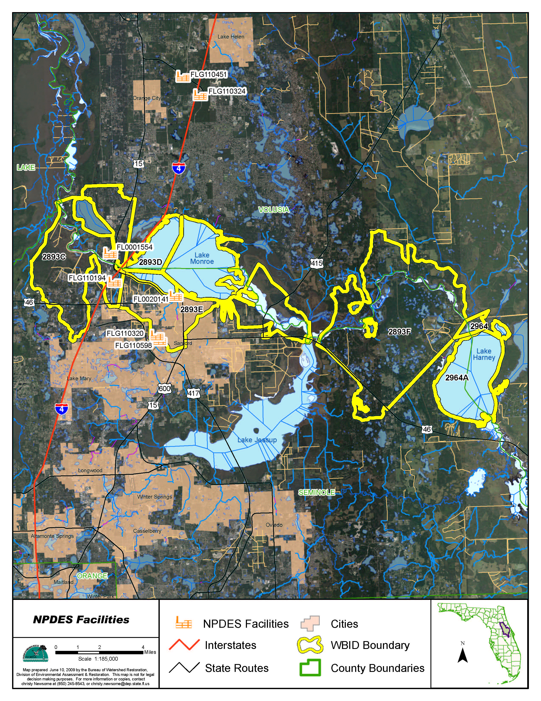
Point source discharges:
Seven NPDES permitted facilities were identified in the drainage basin immediately adjacent to the impaired Middle St. Johns River segments
Five of them are under generic permit, which does not require routine monitoring.
The vast majority of the discharge from Sanford Power Plant is once-through cooling water from the St. Johns River.
TMDL allocation was calculated only for Sanford/North Wastewater Treatment Facility.

Slide 28
MS4 Permits Identified in The Drainage Basin Immediately Adjacent to Impaired Middle St. Johns River Segments
MS4 Permit Phase | Permit Name | Permit Number | County
I | Seminole County | FLS000038 | Seminole
I | City of Lake Mary | FLS000038 | Seminole
I | City of Sanford | FLS000038 | Seminole
II | FDOT Turnpike District | FLR04E049 | Multiple
II | FDOT District 5 | FLR04E024 | Multiple
II | Brevard County | FLR04E052 | Brevard
II | Lake County | FLR04E106 | Lake
II | Volusia County | FLR04E033 | Volusia
II | City of DeBary | FLR04E120 | Volusia
II | City of Deltona | FLR04E099 | Volusia
II | City of Lake Helen | FLR04E125 | Volusia

Slide 29
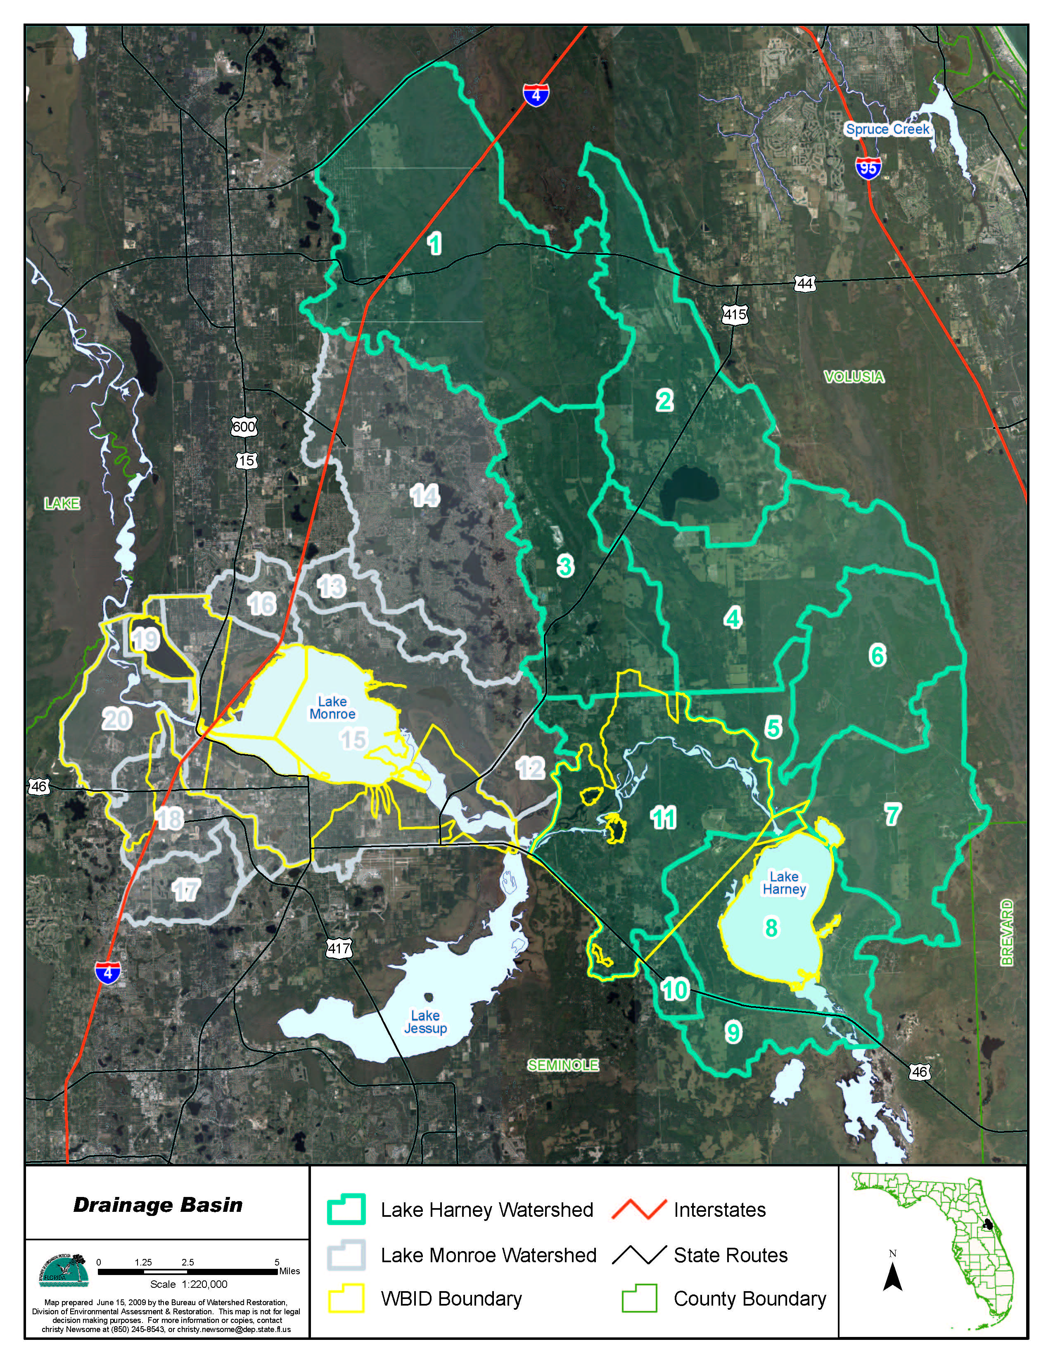
Nonpoint source loadings were simulated using an HSPF model set up by SJRWMD.
Model domain includes two drainage basins and 19 sub-basins.
Loadings from the Upper St. Johns River basin and the Econlockhatchee River basin, and loadings from Lake Jesup were considered boundary conditions.
The model uses 13 land use classes.
Loading contributions from different land uses, ground water input, septic tanks, wastewater sprayfield, point source discharge, and atmospheric deposition directly onto receiving water surface, and effects of BMPs were considered.

Slide 30
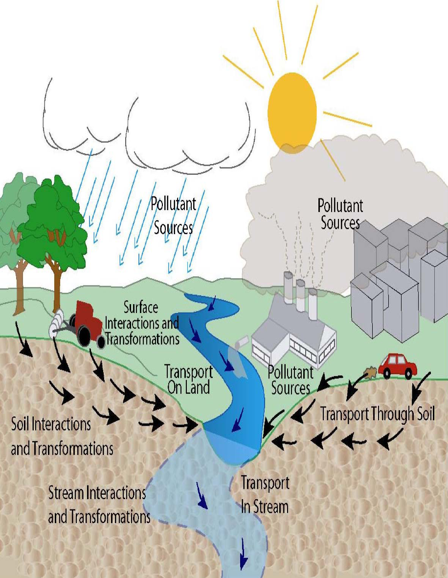
HSPF Model

Slide 31
What HSPF Model Can Do
Watershed Nonpoint Loading Simulation
  Water quantity – surface and subsurface
  Sediment erosion/solids loading
  Runoff quality
  Inputs needed by instream simulation
Instream Simulation
  Hydraulics
  Sediment transport
  Sediment-contaminant interactions
  Atmospheric direct deposition
  Water quality constituents and processes
  Point source accommodation
  Lake /reservoir simulation
  Benthal processes and impacts

Slide 32
HSPF Major Modules
PERLND | IMPLND | RCHRES | BMP
Snow | Snow | Hydraulics | Flow
Water (Runoff, Interflow, Baseflow) | Water (Runoff) | Conservative | Any constituents simulated in PERLND, IMPLND or RCHRES
Sediment | Solids | Temperature
Quality | Quality | Sediment
Pesticide |  | Nonconservative
Nitrogen |  | BOD/DO
Phosphorus |  | Nitrogen
Tracer |  | Phosphorus
 |  | Carbon
 |  | Plankton

Slide 33
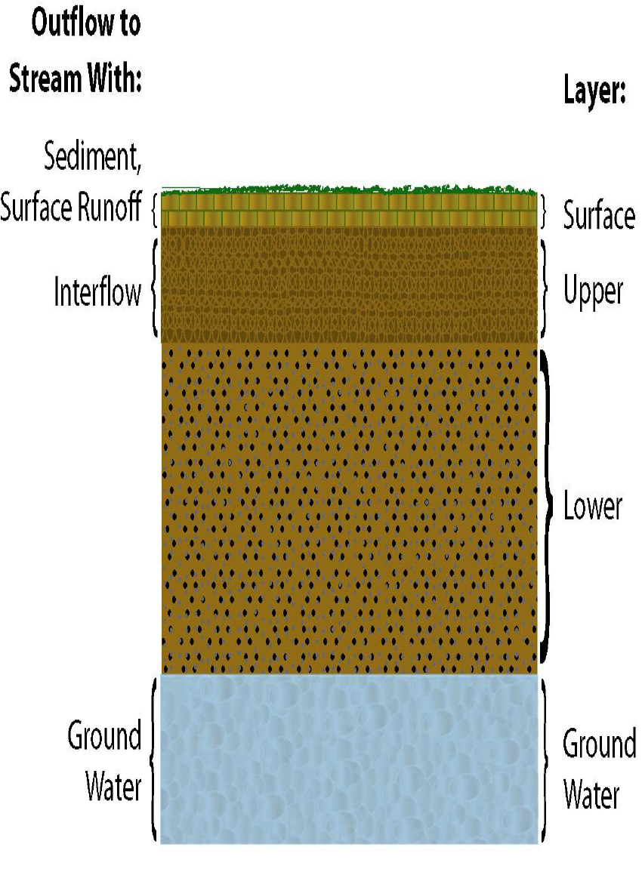
Flow and Loading Are Mostly Landuse Based
Notes:
Upper zone storage nominal, lower zone storage nominal, lower zone evapotranspiration potential, and soil infiltration capacity determine the total amount of runoff can be created, the runoff path slope, the roughness of the land surface, and ground water recession rate influence the hydrograph.
Different landuse also influence the sediment erosion and sorption rate and pollultant build-up and wash-off rates.

Slide 34
Operation Group | Operation ID | Landuse /BMP Description
PERLND | 281 | Low Density Resident
PERLND | 282 | Medium Density Resid
PERLND | 283 | High Density Resident
PERLND | 284 | Industrial
PERLND | 285 | Mining
PERLND | 286 | Open Land
PERLND | 287 | Pastureland
PERLND | 288 | Agricultural General
PERLND | 289 | Agricultural Tree Crop
PERLND | 290 | Rangeland
PERLND | 291 | Forest
PERLND | 292 | Water
PERLND | 293 | Wetland
IMPLND | 281 | Low Density Resident_Impervious
IMPLND | 282 | Middle Density Resident_Impervious
IMPLND | 283 | High Density Resident_Impervious
IMPLND | 284 | Industrial_Impervious
RCHRES | 206 | Dry Pond
RCHRES | 207 | Wet Pond
RCHRES | 10 | Receiving Water
Notes:
Watershed loading simulation is based on subbasin. Within each subbasin, a modelers can use the operation group and operation ID combinations to define landuses. Hydrology model parameters, water quality loading parameters are mostly assigned to the model based on different landuse types.

Slide 35
Operation Group | Operation ID | Acreage | Receiving Waters | Receiving Water ID | Masterlink ID
PERLND | 281 | 246 | RCHRES | 10 | 2
PERLND | 281 | 48 | RCHRES | 206 | 22
PERLND | 281 | 7 | RCHRES | 207 | 42
PERLND | 282 | 5 | RCHRES | 10 | 2
PERLND | 282 | 5 | RCHRES | 206 | 22
PERLND | 282 | 5 | RCHRES | 10 | 23
PERLND | 283 | 0 | RCHRES | 10 | 2
PERLND | 284 | 3 | RCHRES | 10 | 2
PERLND | 284 | 4 | RCHRES | 206 | 22
PERLND | 284 | 4 | RCHRES | 10 | 23
PERLND | 285 | 0 | RCHRES | 10 | 2
PERLND | 286 | 0 | RCHRES | 10 | 4
PERLND | 287 | 239 | RCHRES | 10 | 2
PERLND | 287 | 1 | RCHRES | 206 | 22
PERLND | 287 | 1 | RCHRES | 10 | 23
PERLND | 288 | 37 | RCHRES | 10 | 2
RCHRES | 206 |  | RCHRES | 10 | 35
RCHRES | 207 |  | RCHRES | 10 | 45
Notes:
Talk about the general removal efficiencey! Also talk about possible use of the model output to set up a spreadsheet for allocation calculation.

Slide 36
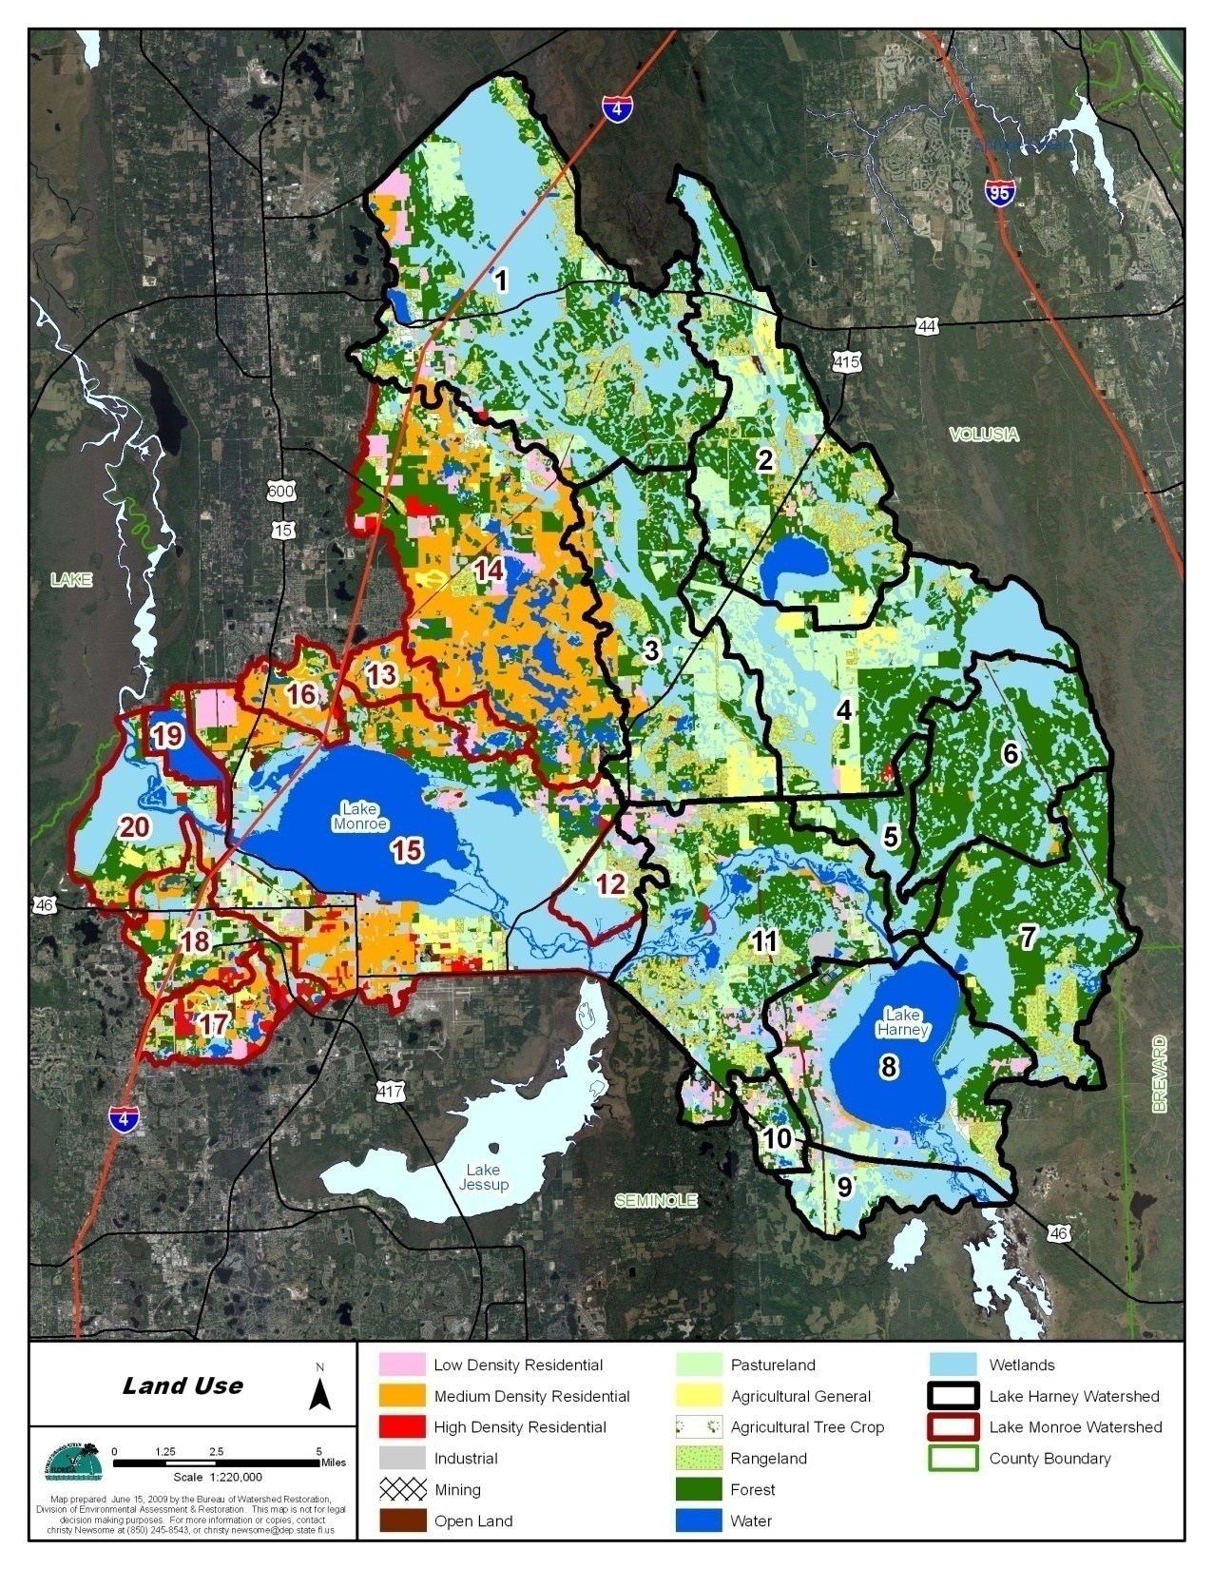
Percent Landuse Distribution
Landuse Types | Harney Drainage Area | Monroe Drainage Area
Agricultural General | 2% | 2%
Agricultural Tree Crop | 1% | 1%
Pasture | 10% | 5%
High Density Residential | 0% | 3%
Industrial | 1% | 6%
Low Density Residential | 4% | 7%
Medium Density Residential | 1% | 28%
Mining | 0% | 1%
Open Land | 1% | 2%
Rangeland | 9% | 6%
Forest | 33% | 18%
Water | 0% | 2%
Wetland | 38% | 19%
Total | 100% | 100%
Make a landuse table here.

Slide 37
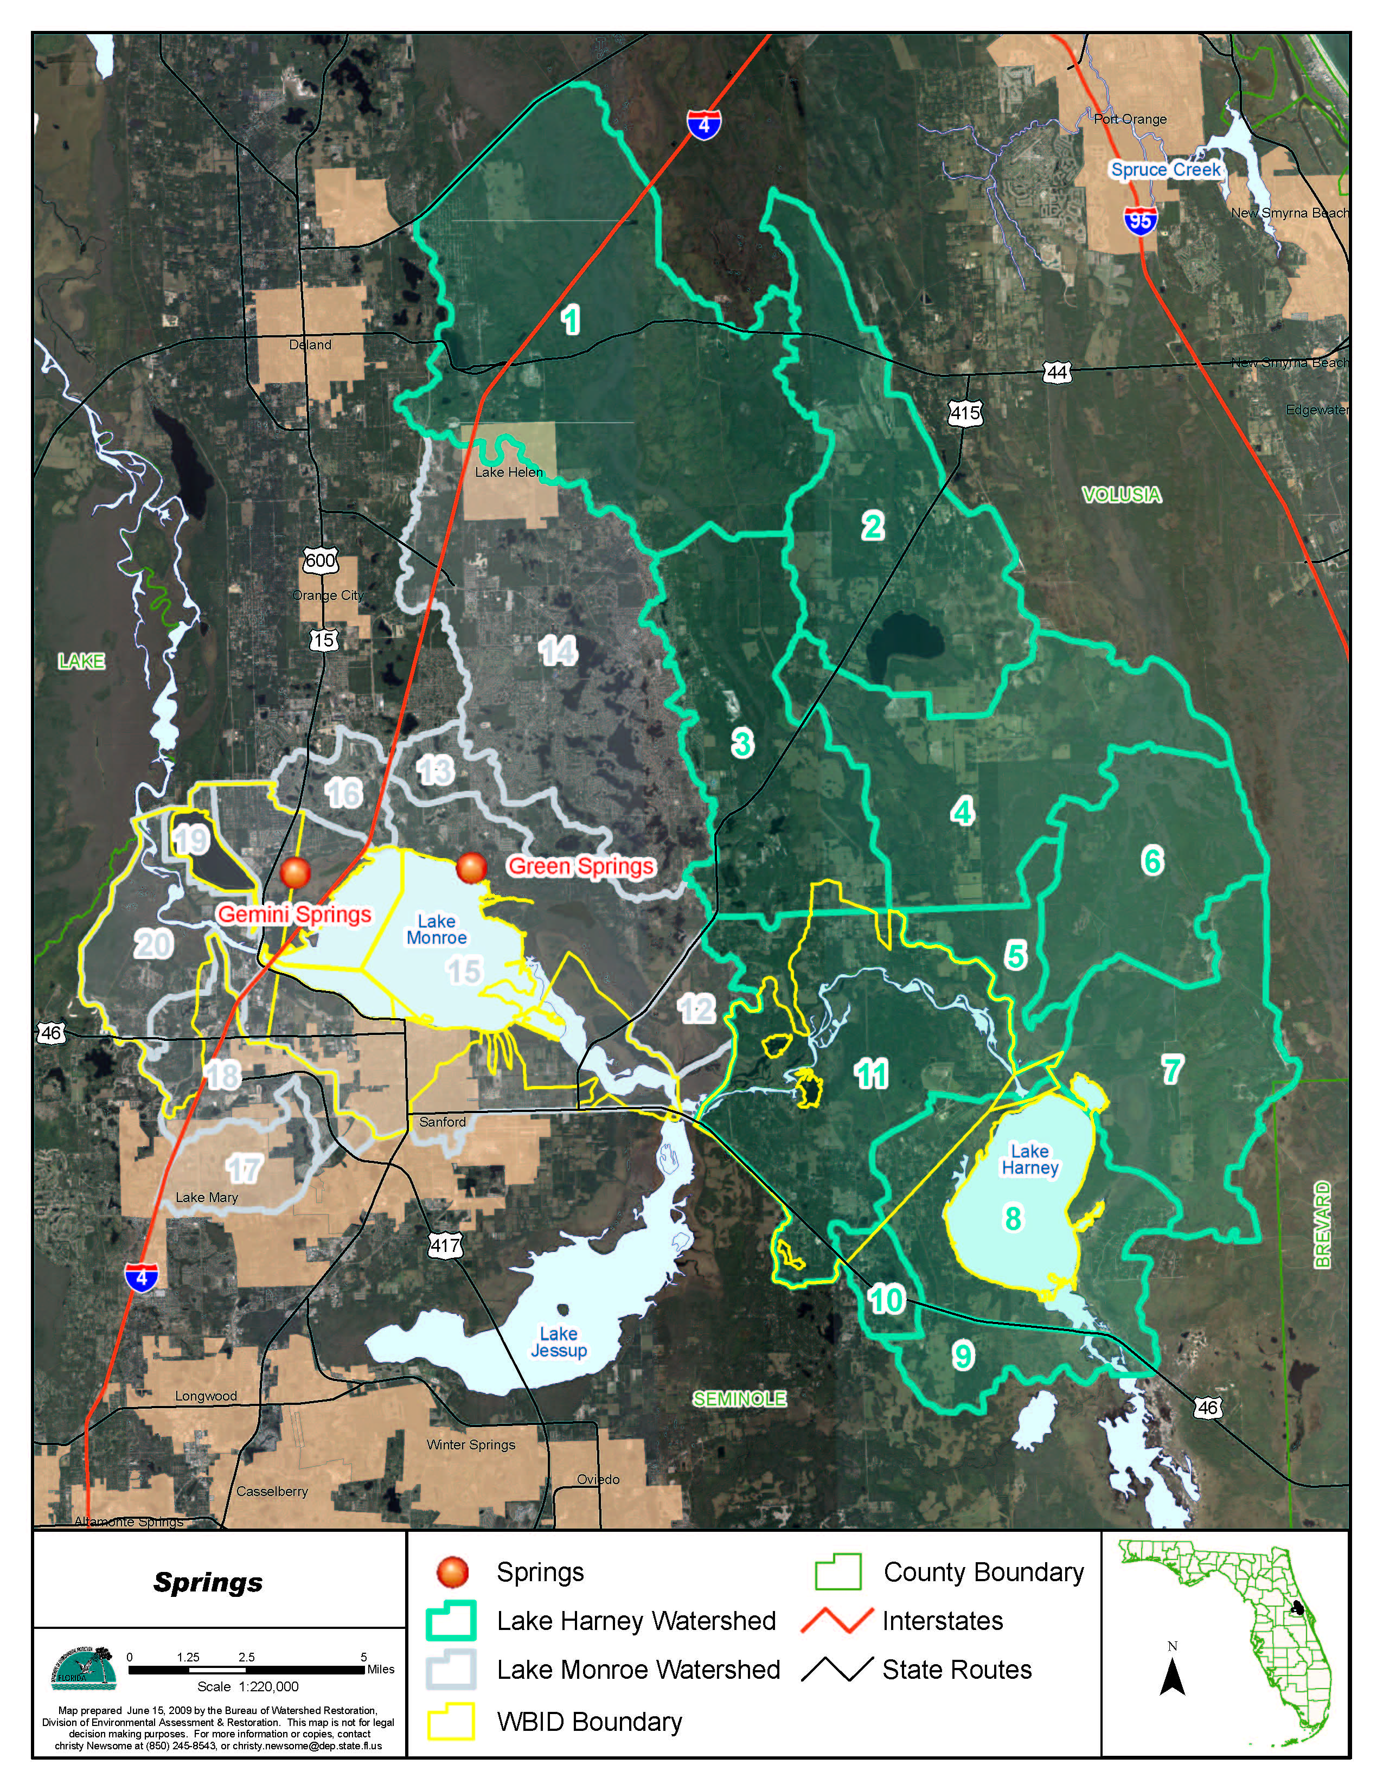
Locations of Two Floridan Aquifer Springs Discharging into Impaired St. Johns River Segments
Notes:
Discuss how the loading was estimated and enter directly into the receiving water.

Slide 38
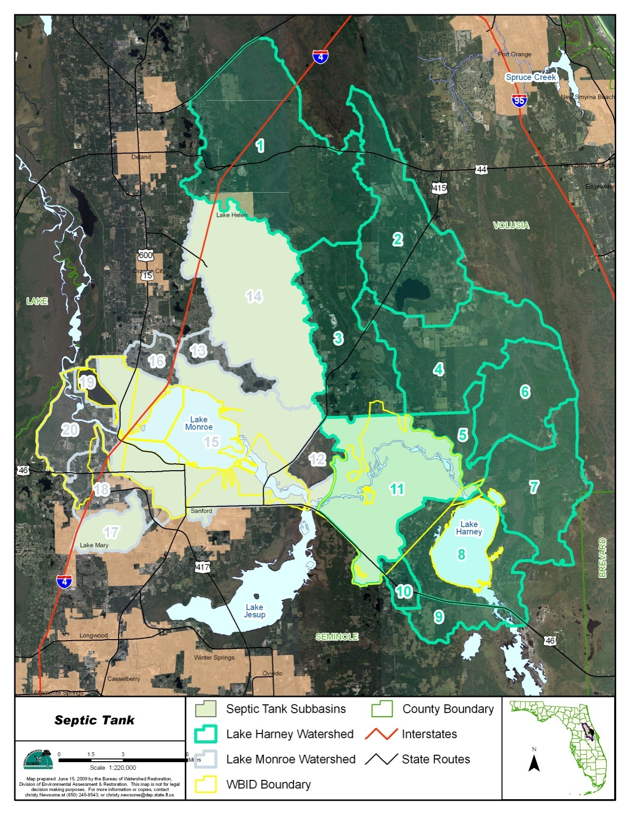
Septic Tank Contribution
  The number of failed septic tanks for Seminole and Volusia Counties were obtained form a DOH web site.
  Per acre residential area failed septic tank numbers were calculated.
  Assuming that failed septic tanks will have effect within 50 feet of the receiving water, the total areas of the residential areas within 50 feet to any receiving waters were calculated.
  Total number of failed septic tanks within 50 feet to receiving water was calculated.

Slide 39
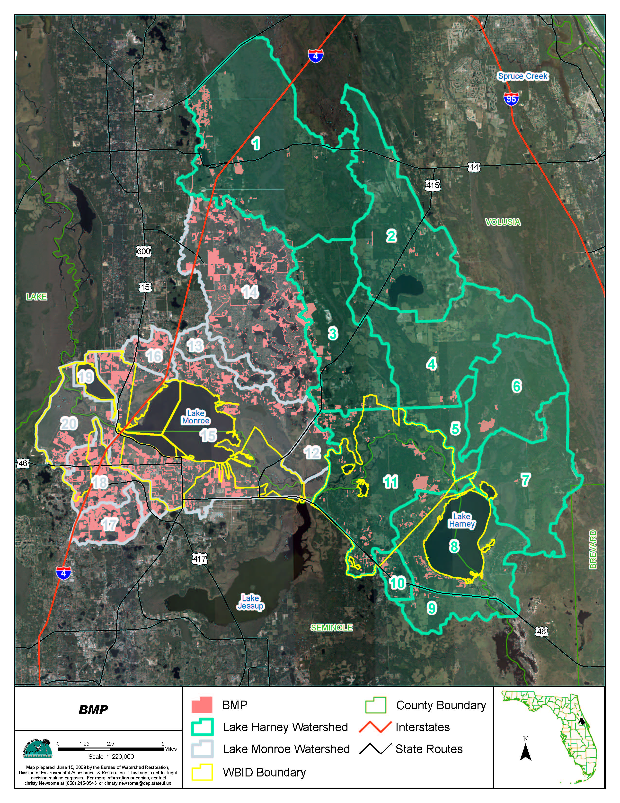
Three types of BMPs were included in the HSPF model simulation:
  Swale
  Wet Detention Pond
  Dry Detention Pond
BMP information was provided by SJRWMD (Huang, et al. 2007)
Pollutant | Dry Pond | Wet Pond | Swale
TSS | 50% | 80% | 80%
NH4 | 5% | 25% | 15%
NO3 | 5% | 25% | 15%
PO4 | 20% | 55% | 30%
BOD | 20% | 35% | 30%

Slide 40
Atmospheric Direct Deposition
Wet deposition
  Primarily composed of NH4 and NO3.
  0.25 mg/L of NH4 and 1.08 mg/L of NO3 were used based on an NADP site located in Orland (Site F32)
  0.009 mg/L of PO4 was used based on studies by Brezonik, et al. (1983)
Dry deposition
  Nitrogen flux rate of 150 mg/m²/year
  Phosphorus flux rate of 20 mg/m²/year
  Similar to Lake Apopka results

Slide 41
Establish the Relationship between Concentration and Loading through Model Calibration

Slide 42
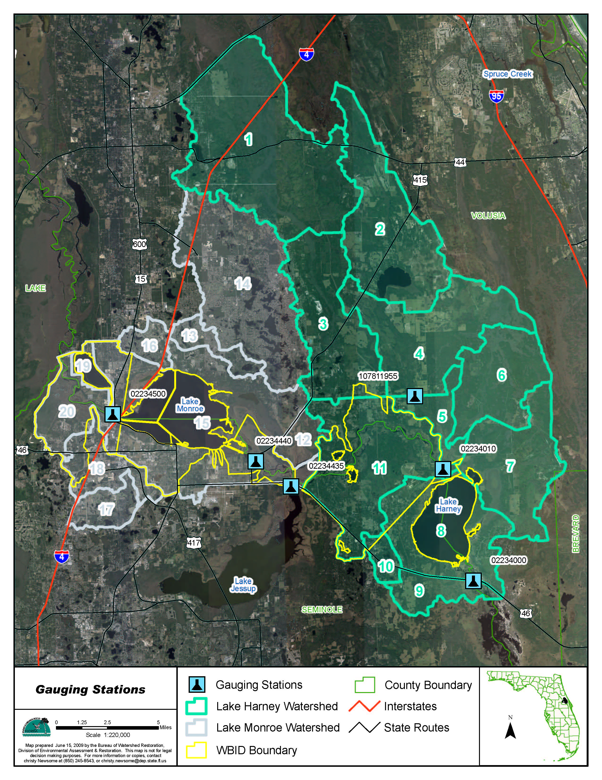
Notes:
Indicating which gauge(s) were used for model calibration.

Slide 43
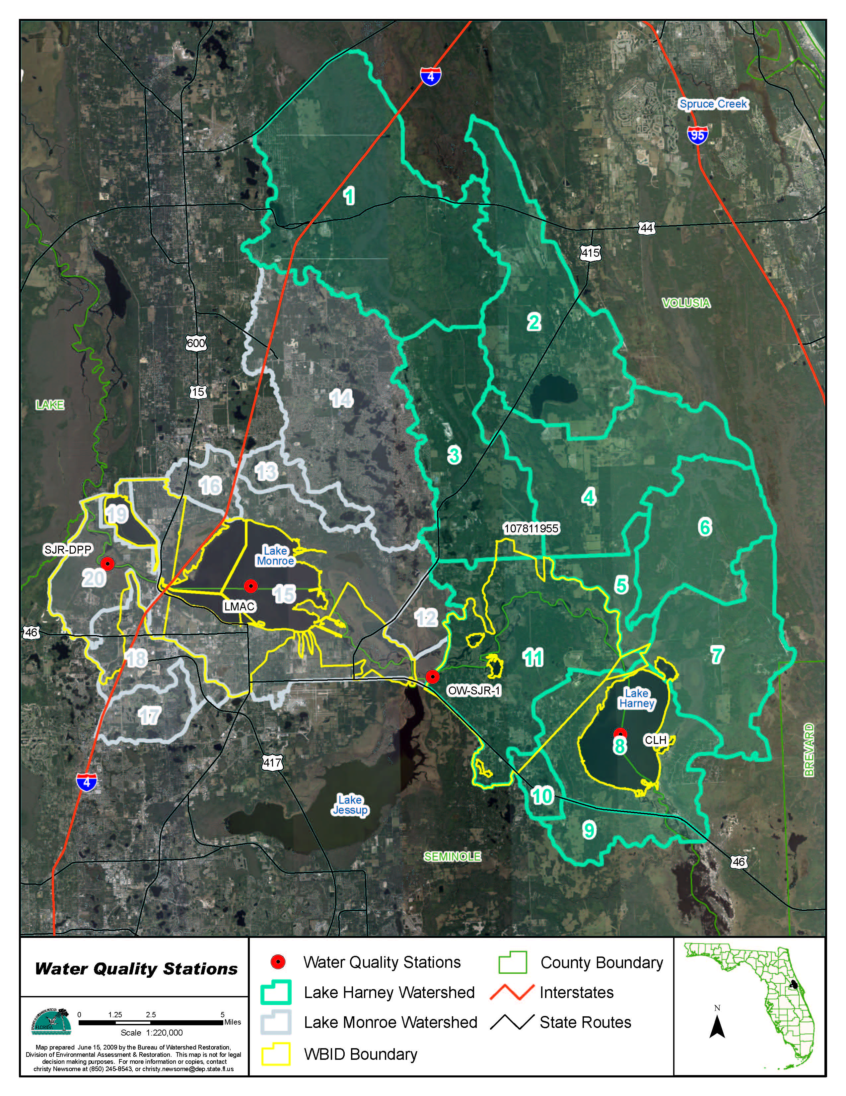
Notes:
Talk about which stations were used for WQ calibration.

Slide 44
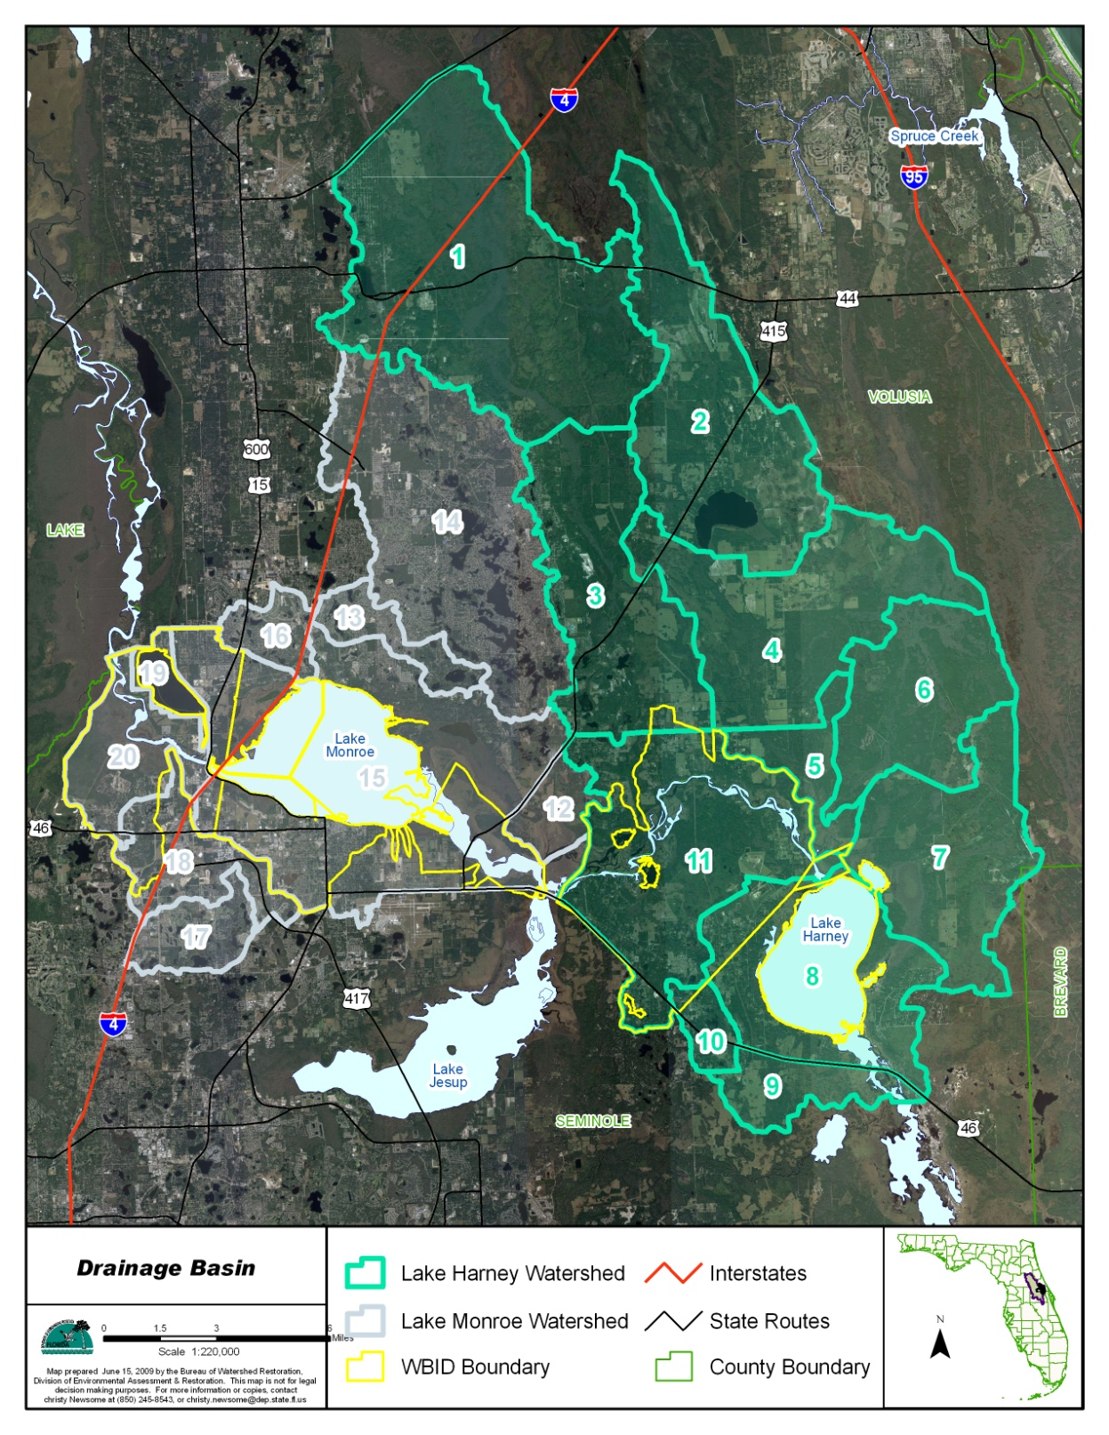
Results Summary
  HSPF simulates inputs and outputs for flow and nutrient loadings for each subbasin.
  Flow and loadings from multiple subbasins into impaired river segments were summarized.
  Flow and loadings were than aggregated into different categories including loadings from immediate drainage basin, loadings from upstream segments, loadings from atmospheric deposition, and from point source.

Slide 45
TN Existing Loadings
 | Type | Upstream Input | Watershed Input | Direct Rainfall | Point Source Contribution | Total Load
RCHRES 8 (2964A) | Load (lbs/yr.) | 5,419,279 | 58,918 | 45,309 | 0 | 5,523,506
 | Percent Load | 98.1% | 1.1% | 0.8% | 0.0% | 100.0%
RCHRES 11 (2964, 2893F) | Load (lbs/yr.) | 5,487,271 | 442,488 | 19,663 | 0 | 5,949,422
 | Percent Load | 92.2% | 7.4% | 0.3% | 0.0% | 100.0%
RCHRES 15 (2893E, 2893D) | Load (lbs/yr.) | 6,460,359 | 157,910 | 65,318 | 0 | 6,683,587
 | Percent Load | 96.7% | 2.4% | 1.0% | 0.0% | 100.0%
RCHRES 20 (2893C) | Load (lbs/yr.) | 6,620,591 | 59,591 | 8,342 | 31,197 | 6,719,721
 | Percent Load | 98.5% | 0.9% | 0.1% | 0.5% | 100.0%

Slide 46
TP Existing Loading
 | Type | Upstream Input | Watershed Input | Direct Rainfall | Point Source Contribution | Total Load
RCHRES 8 (2964A) | Load (lbs/yr.) | 352,415 | 3,268 | 2,127 | 0 | 357,810
 | Percent Load | 98.5% | 0.9% | 0.6% | 0.0% | 100.0%
RCHRES 11 (2964, 2893F) | Load (lbs/yr.) | 357,182 | 45,128 | 910 | 0 | 403,220
 | Percent Load | 88.6% | 11.2% | 0.2% | 0.0% | 100.0%
RCHRES 15 (2893E, 2893D) | Load (lbs/yr.) | 437,597 | 19,228 | 3,125 | 0 | 459,950
 | Percent Load | 95.1% | 4.2% | 0.7% | 0.0% | 100.0%
RCHRES 20 (2893C) | Load (lbs/yr.) | 452,765 | 6,337 | 403 | 3,449 | 462,954
 | Percent Load | 97.8% | 1.4% | 0.1% | 0.7% | 100.0%

Slide 47
Summary of Existing Loadings
The total TN loadings from the model boundary (Upper St. Johns River, Econlockhatchee River, and Lake Jesup) was about 5,930,216 lbs/yr. The total TN loadings through the downstream most segment (2893C) was about 6,719,721 lbs/yr. The TN loading from the model boundaries accounted for about 88% of the total load.
The total TP loadings from the model boundary (Upper St. Johns River, Econlockhatchee River, and Lake Jesup) was about 386,792 lbs/yr. The total TP loadings through the downstream most segment (2893C) was about 462,954 lbs/yr. The TP loading from the model boundaries accounted for about 84% of the total load.
Nutrient loadings in the impaired St. Johns River segments are dominated by the boundary loadings.

Slide 48
Total Maximum Daily Load (TMDL)

Slide 49
HSPF Model Simulation for The TMDL
Nutrient loadings from the following model components were adjusted until the TN and TP concentrations in the impaired river segments met the target concentrations:
  Boundary nutrient loadings from the Upper St. Johns River basin and the Econlockhatchee River basin were adjusted to target.
  Boundary nutrient loadings from Lake Jesup assumed same percent reduction for Lake Jesup nutrient TMDLs.
  Nutrient loadings from human landuse areas within the HSPF model domain were adjusted to target.
  The percent reductions of nutrient loadings applied to all the nonpoint sources were also applied to loadings from the Sanford/North Wastewater Treatment Facility.
  Atmospheric deposition loadings were not changed.
  Loadings from the Floridan Aquifer springs were not changed.

Slide 50
Existing Loadings and TMDLs from Nonpoint Sources
Water Segments | TN Loading (lbs/yr.) |  |  | TP Loading (lbs/yr.)
 | Existing Loading | Target Loading | Percent Reduction | Existing Loading | Target Loading | Percent Reduction
2964A | 5,523,505 | 3,355,570 | 39% | 357,810 | 241,026 | 33%
2964 + 2893F | 5,949,422 | 3,741,990 | 37% | 403,221 | 276,141 | 32%
2893E + 2893D | 6,683,586 | 4,171,255 | 38% | 459,950 | 315,512 | 31%
2893C | 6,688,523 | 4,182,998 | 37% | 459,504 | 315,891 | 31%
Notes:
Calculate percent reduction for upstream, watershed, and point soruce, separately.

Slide 51
TMDL Allocation

Slide 52
TMDL formula
TMDL =∑ WLA + ∑ LA –MOS
  WLA: waste load allocation, including allocations for wastewater facility and MS4 stormwater facilities.
  LA: load allocation, including load allocations to all the nonpoint sources.
  MOS: margin of safety

Slide 53
TMDL Components for Impaired Middle St. Johns River Segments – Upstream Segments
WBID | Parameter | TMDL (lbs/yr) | WLA_{NPDES wastewater} (lbs/yr) | WLA_{MS4} | LA (lbs/yr) | MOS
2964A | TN | 3,355,570 | 0 | 39% | 39% | Implicit
 | TP | 241,026 | 0 | 33% | 33% | Implicit
2964 + 2893F | TN | 3,741,990 | 0 | 37% | 37% | Implicit
 | TP | 276,141 | 0 | 32% | 32% | Implicit
2964A: Lake Harney
2964: St. Johns River Downstream of Lake Harney
2893F: St. Johns River above Lake Jesup

Slide 54
TMDL Components for Impaired Middle St. Johns River Segments
WBID | Parameter | TMDL (lbs/yr) | WLA_{NPDES wastewater} (lbs/yr) | WLA_{MS4} | LA (lbs/yr) | MOS
2893D + 2893E | TN | 4,171,255 | 0 | 38% | 38% | Implicit
 | TP | 315,512 | 0 | 31% | 31% | Implicit
2893C | TN | 4,202,340 | 19,342 | 37% | 37% | Implicit
 | TP | 318,236 | 2,345 | 31% | 31% | Implicit
2893E: St. Johns River above Lake Monroe
2893D: Lake Monroe
2893C: St. Johns River above Wekiva River

Slide 55
Margin of Safety
Regional ground water input was not considered in the HSPF model.
For most river segments, sediment nutrient release is considered zero.
These assumptions overestimated the loading from the drainage basin to provide margin of safety.

Slide 56
DO TMDL for Smith Canal

Slide 57
Identify Impaired Water Segment

Slide 58
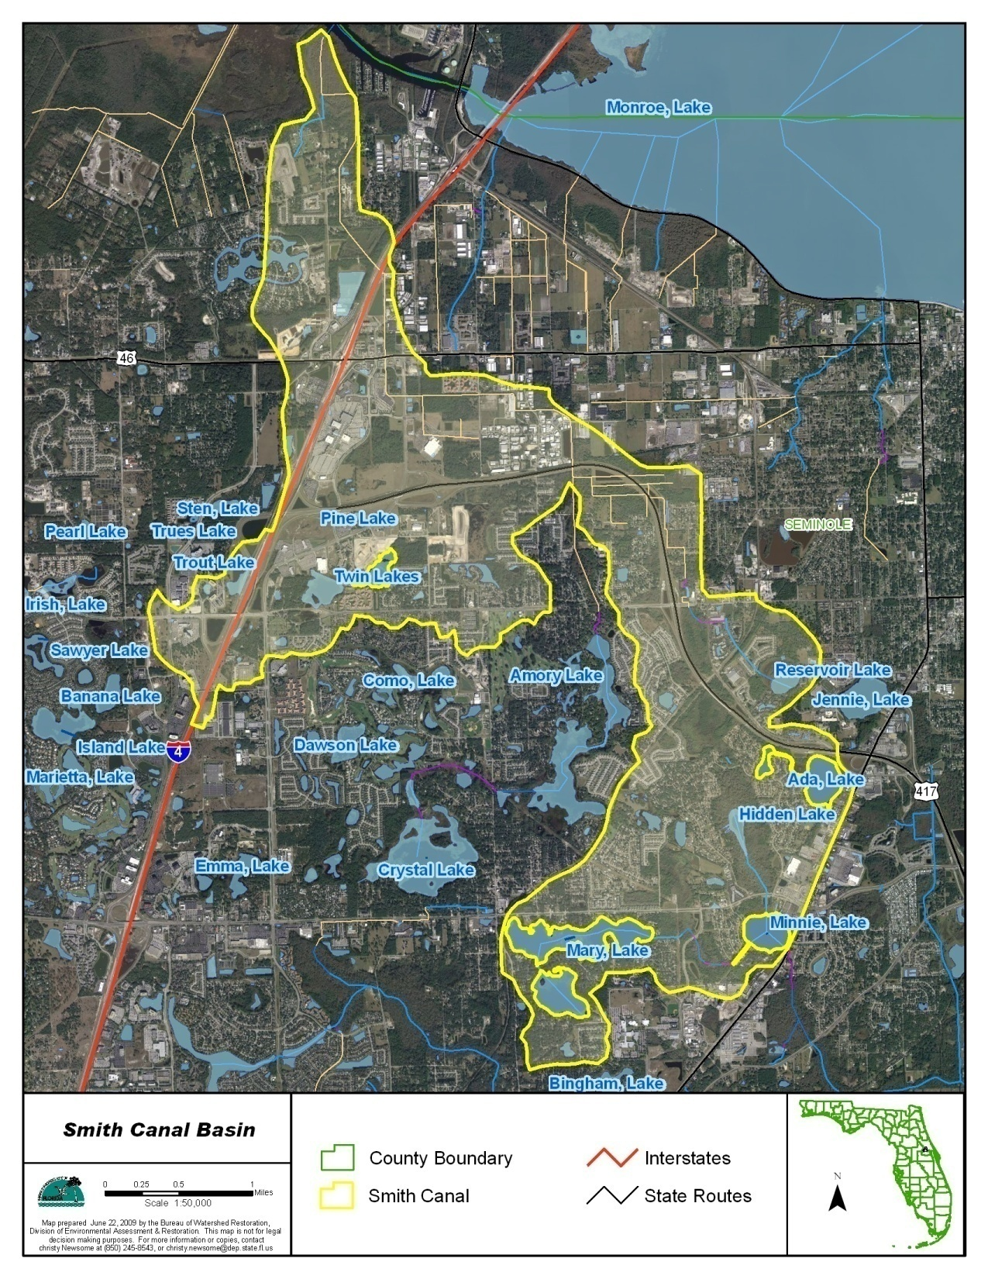
Smith Canal was verified for the low DO impairment. TP was considered the causative pollutant

Slide 59
Developing Water Quality Targets for Smith Canal

Slide 60
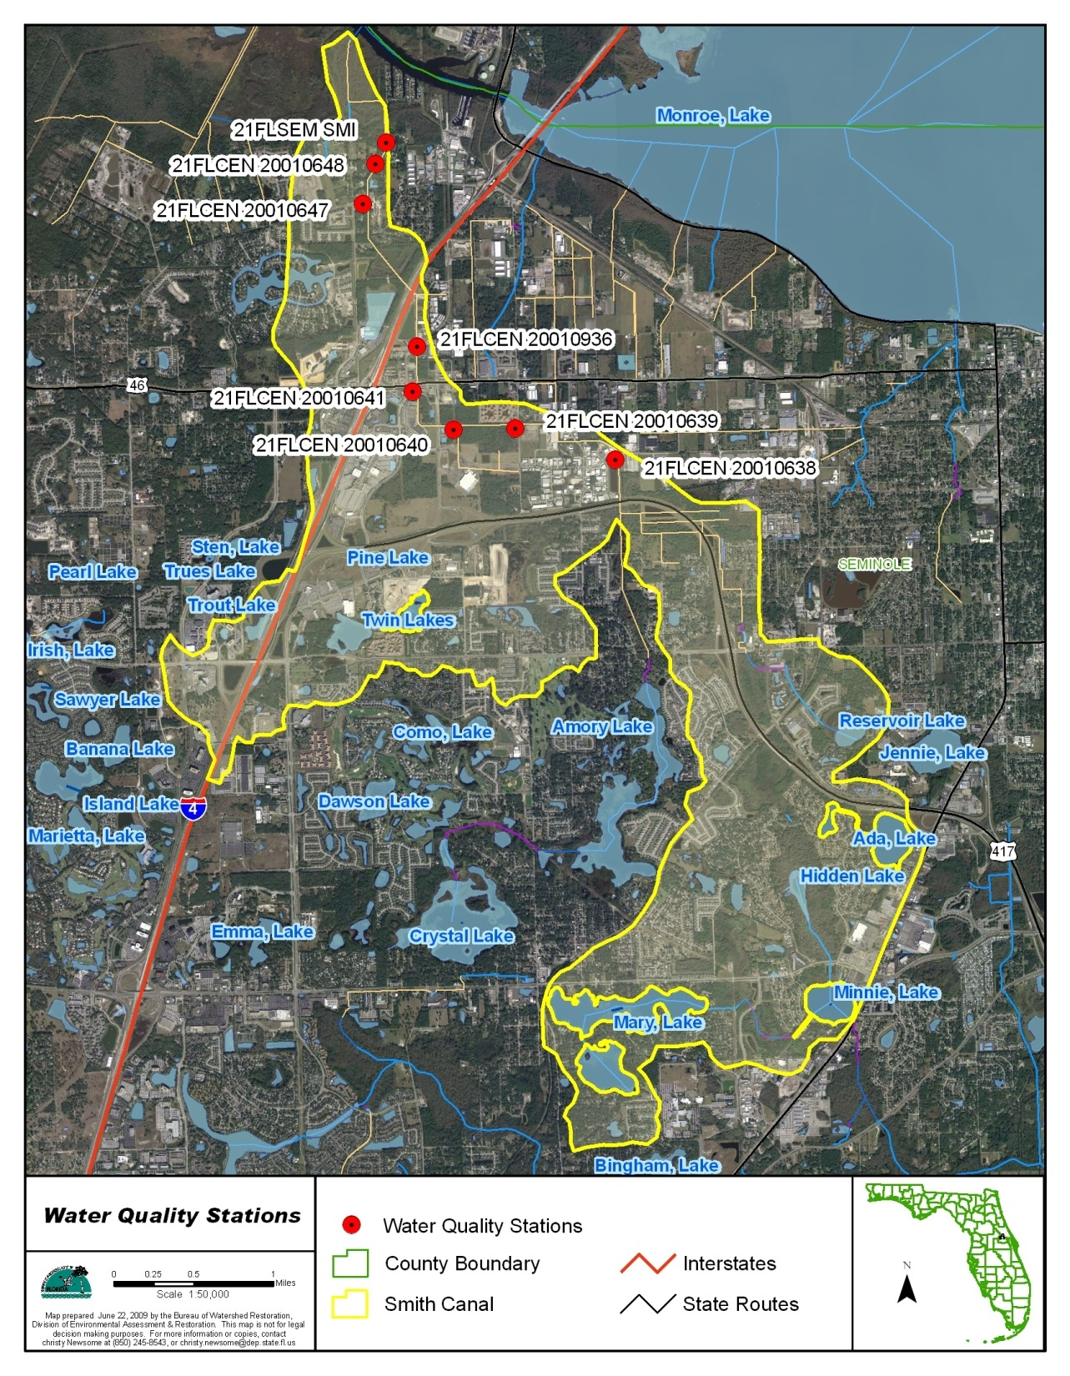
DO, TN, and TP concentrations from eight water quality stations located in Smith Canal were analyzed.

Slide 61
Correlation between DO and TP Concentrations Were Observed for Data Collected in Months from February to November
10th percentile quantile equation
TP Target = 0.10 mg/L
Based on this relation, a TP concentration of 0.10 mg/L was established as the target nutrient concentration to improve the DO condition in Smith Canal.

Slide 62
TMDL Components for Smith Canal
WBID | Parameter | TMDL (lbs/yr) | WLA_{wastewater} (tons/year) | WLA _{MS4} | LA | MOS
2962 | TP | 4,291 | N/A | 26% | 26% | Implicit

Slide 63
Acknowledgement
Dr. Sherry Brandt-Williams (SJRWMD)
Drs. Yanbing Jia and Xiaoqing Huang (SJRWMD)
Ms. May Lehmensiek (SJRWMD)
Ms. Jennifer Gihring (FDEP)
Ms. Chris Ferraro (FDEP – Central District Office)
Mr. Michael Hatcher and Marc Harris (FDEP)
Ms. Christy Newsome and Ms. Janis Paulsen

