Slide 1
Lakes Harney and Monroe Basin Management Action Plan (BMAP)
January 20, 2011

Slide 2
Projects Eligible for Credit

Slide 3
Project Credit
Detailed allocations for total nitrogen (TN) and total phosphorus (TP) reductions to responsible entities will be determined through the BMAP process.
To achieve these reductions, each responsible entity will provide projects and programs that reduce nutrient loads.
Pounds reduced will be subtracted from the total allocation for those projects completed January 1, 2003 and later.
Credit only counts for treatment above and beyond any permitted requirements.

Slide 4
BMAP Project Information
Lead entity and any project partners;
Project name;
Project location, type, and brief description;
Links to National Pollutant Discharge Elimination System (NPDES) permits (if any);
Acres treated;
Estimated cost and funding sources;
Implementation schedule and completion dates; and
TN and TP load reductions from the project.

Slide 5
Project Maintenance
In order to receive credit, projects must be operated and properly maintained as permitted.
Operation and maintenance records may be requested as part of the project review process.
For projects that are not operated as permitted, FDEP may:
  Reduce the credit associated with the project; or
  Require maintenance of the project for full credit in the BMAP.

Slide 6
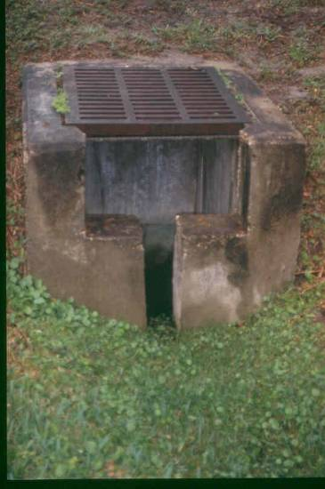
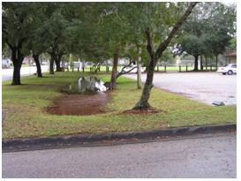
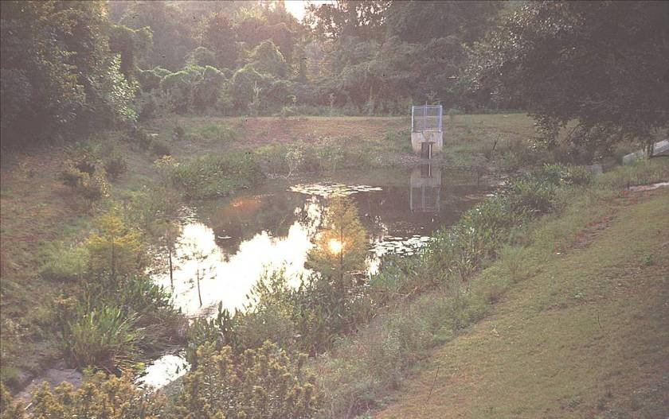
Types of Projects
Standard stormwater treatment best management practices (BMPs) include:
  Retention BMPs (such as basins and exfiltration trenches);
  Wet detention ponds;
  Treatment trains;
  Dry detention;
Dry retention system
Wet detention pond
Dry detention system

Slide 7
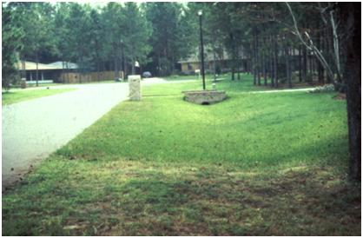
Types of Projects, con’t
  Baffle box (1st generation);
  Nutrient baffle box (2nd generation);
  Catch basin inserts/inlet filters;
  Grass swales – both with and without swale blocks or raised culverts; and
  Alum injection.
Grass swale

Slide 8
Types of Projects, cont’d
Provisional BMPs include:
  Stormceptor;
  Continuous deflective separation (CDS) unit (TP only);
  Public education and outreach efforts; and
  Street sweeping.

Slide 9
Public Education and Outreach
Up to a 6% reduction in TN and TP from the entity’s starting load can be obtained for education efforts:
  Florida Yards and Neighborhoods Program;
  Local codes and ordinances for landscaping, irrigation, fertilizer, and pet waste management;
  Public service announcements (PSAs);
  Informational Pamphlets;
  Website; and
  Inspection program and call-in number for illicit discharges.

Slide 10
Street Sweeping
Credit will be based on the information from the Florida Stormwater Association (FSA) study.
The FSA study will provide Florida-specific information on street sweeping.
  In other BMAPs (such as Lake Jesup) street sweeping estimates were based on data from outside Florida and credit, therefore, was discounted due to uncertainties.
The draft FSA report should be available in February and more information will be provided on credit calculations for the BMAP once the report is available.

Slide 11
Future Growth Considerations

Slide 12
Addressing Future Growth
Section 403.067(7)(a)(2), Florida Statutes, requires: BMAPs to:
  “…identify the mechanisms by which potential future increases in pollutant loading will be addressed.”
The BMAP will not include an allocation for new development.
New discharges cannot increase existing load and must meet “net environmental improvement” for the Environmental Resource Permit (ERP) program requirements.

Slide 13
ERP Requirements
Any ERP application must include documentation of compliance with state water quality standards (WQS).
The project cannot adversely affect the quality of receiving waters such that WQS will be violated.
Conditions for issuance include not causing harm to water resources or causing violations of WQS.
Since impaired waters do not meet WQS, there cannot be an increased load of pollutants of concern.
New development must result in a “net environmental improvement” from existing loads.

Slide 14
Reducing Loads from Growth
Local governments are encouraged to pursue low impact development (LID) standards and Florida friendly landscaping to further minimize the impacts of existing development, new development, and retrofit projects through local development regulations (LDRs).

Slide 15
LID Measures
LID is an approach to development that uses land planning, design practices, and technologies to conserve and protect natural resources and reduce infrastructure costs.
LID measures can help to reduce loads from associated with future growth.
Nutrient reduction credit cannot be assigned for LID; however, these activities could reduce required load reductions in future BMAP iterations.
More information can be found at: http://lowimpactdevelopment.org/ .

Slide 16
Questions?

