Slide 1
Dissolved Oxygen TMDL for Smith Canal
Lakes Harney and Monroe BMAP
January 20, 2011

Slide 2
Smith Canal
Smith Canal is waterbody identification (WBID) number 2692.
This waterbody is located in northwest Seminole County and drains about 10 square miles.
Smith Canal is about 6 miles long and flows northwest to the St. Johns River about 1.4 miles upstream of the outlet to Lake Monroe.
The watershed includes portions of the cities of Sanford and Lake Mary.

Slide 3
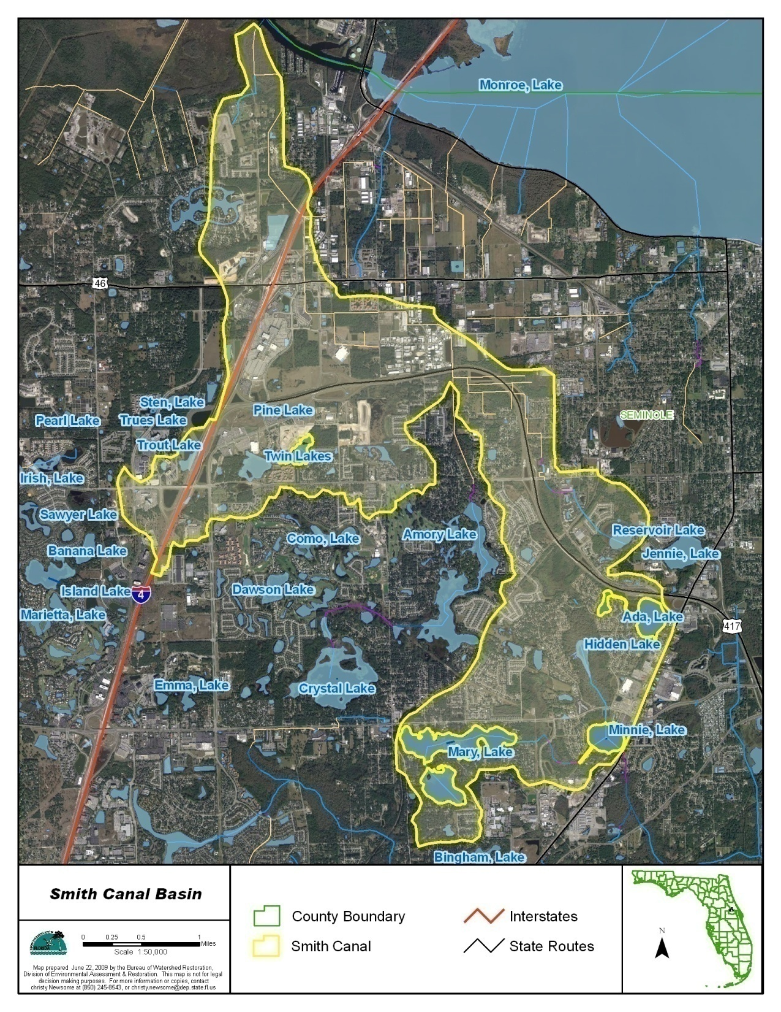

Slide 4
Impairment
The Smith Canal WBID was verified impaired by the Florida Department of Environmental Protection (FDEP) for dissolved oxygen (DO).
  During the verified period (January 1, 2001 through June 30, 2008) 28 of the 62 DO measurements were less than the state water quality standard of 5 mg/L.
Total phosphorus (TP) was determined to be the causative pollutant for this DO impairment.

Slide 5
Monitoring Stations
Eight (8) water quality monitoring stations provided the data for the Smith Canal TMDL.
Data for DO, TP, total nitrogen (TN), and biochemical oxygen demand (BOD) were analyzed.
Monthly Mean and Standard Deviation of DO in Smith Canal, 1999-2008

Slide 6
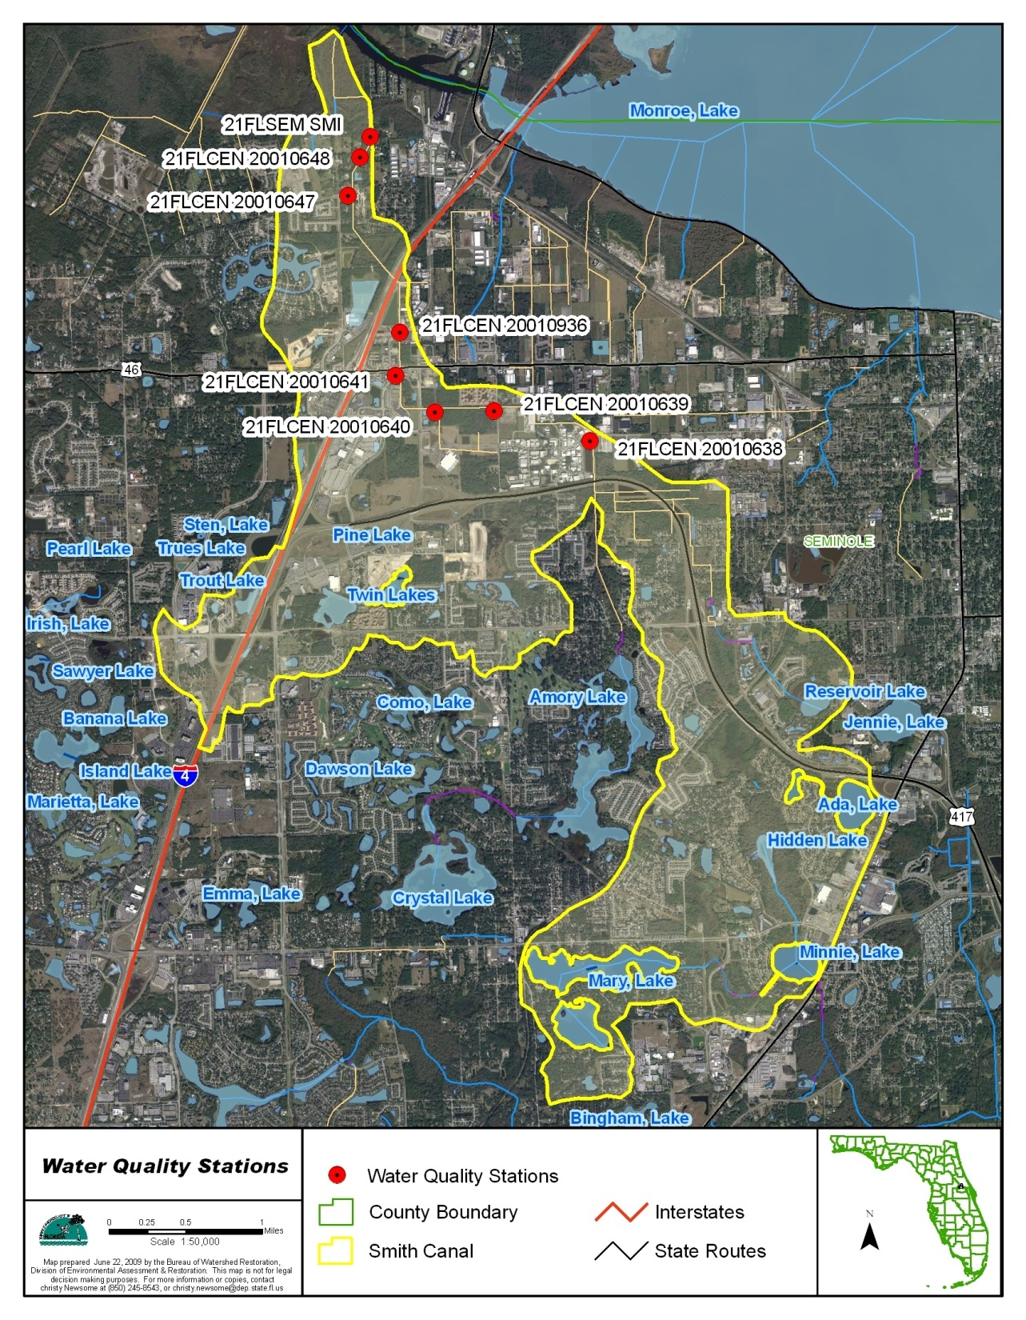

Slide 7
Data Analysis
DO concentrations met the state standards during the cold months.
  Therefore, data from December and February were excluded from the analysis (no January data were available).
A significant negative correlation was found between DO and TP concentrations
No significant relationship was found between DO and TN concentrations.
DO appears to be mainly influenced by TP.
TMDL implementation measures to reduce TP would also help control TN.

Slide 8
10th percentile quantile equation
Based on this relationship, a TP concentration of 0.10 mg/L was established as the target concentration to improve the DO condition in Smith Canal.
Notes:
Remind Samantha to review why the 10th percentile quantile was used (to ensure that DO fell below 5 mg/L less than 10 percent of the time). The original equation (black line) would have provided at TP concentration of 0.187 mg/L at a DO of 5 mg/, so the 10th quantile/0.1 mg/L quite a bit more conservative.

Slide 9
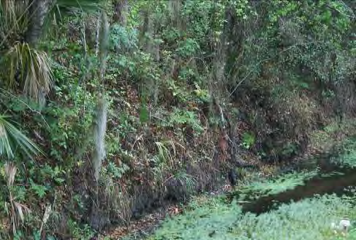
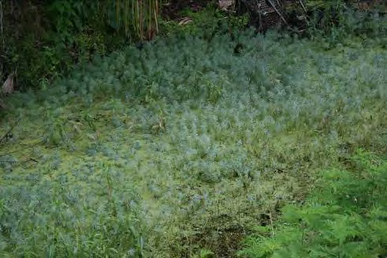
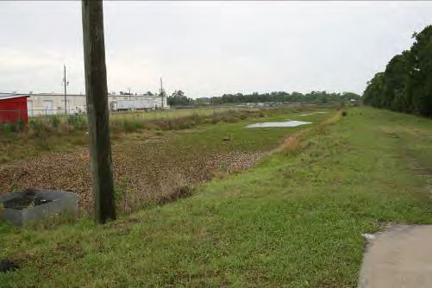
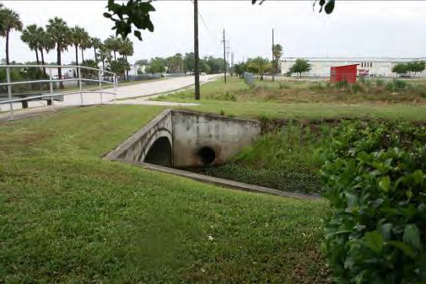
Forested area along Smith Canal near Station 21FLCEN20010639
Aquatic Plants Growing Densely in Smith Canal near Station 21FLCEN20010639
Aquatic Plants Growing a Stormwater Pond near Station 21FLCEN20010638
Outlet of the Stormwater Pond

Slide 10
Sources
No wastewater treatment facilities.
Seminole County/Florida Department of Transportation (FDOT) Phase I municipal separate storm sewer system (MS4), with co-permittees Sanford and Lake Mary;
Stormwater runoff;
Septic tanks; and
Atmospheric deposition.

Slide 11
Source Loading
The Smith Canal TMDL was developed using the same Hydrologic Simulation Program – Fortran (HSPF) model as the Lakes Harney and Monroe TMDL.
The model includes three major modules:
  PERLND – analyzes surface runoff, interflow, and groundwater flow for pervious land areas;
  IMPLND – analyzes surface runoff from impervious areas; and
  RCHRES – simulates flow routing and water quality in the receiving waters.
The Smith Canal watershed is included in subwatersheds 6 and 7 in the HSPF model (the Lake Monroe drainage basin).

Slide 12
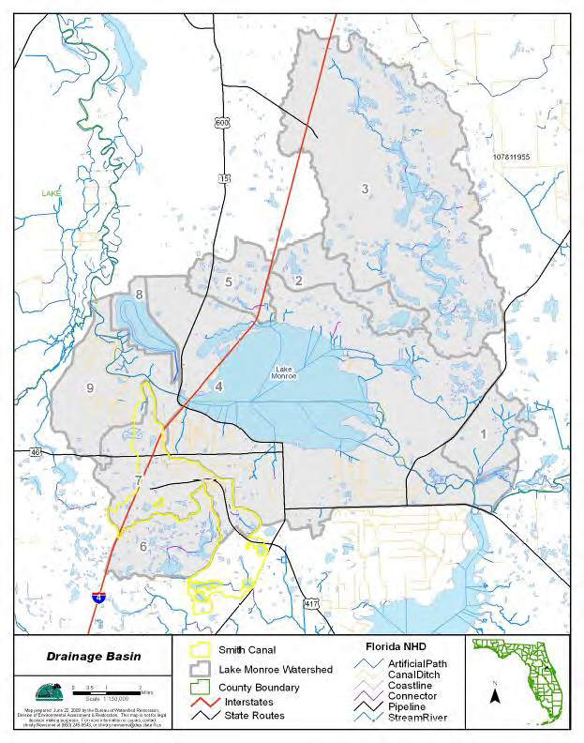

Slide 13
Land Uses
The total watershed that discharges to Smith Canal is about 9,993 acres.
Urban land uses (low-, medium-, and high-density residential, and industrial and commercial) make up 4,217 acres or 42.2% of the watershed area.
Agricultural land uses are about 1,125 acres or 11.3% of the watershed.
Natural land uses (forest, water, and wetlands) are 2,990 acres or 30% of the total watershed.

Slide 14
Land Uses, continued
Land Use | Acreage | % Acreage
Low-Density Residential | 559 | 5.6%
Medium-Density Residential | 1,646 | 16.5%
High-Density Residential | 871 | 8.7%
Industrial and Commercial | 1,141 | 11.4%
Mining | 56 | 0.6%
Open Land | 410 | 4.1%
Pasture | 496 | 5.0%
Agriculture General | 419 | 4.2%
Agriculture Tree Crop | 210 | 2.1%
Rangeland | 1,195 | 12.0%
Forest | 1,812 | 18.1%
Water | 119 | 1.2%
Wetlands | 1,059 | 10.6%
Total | 9,993 | 100%

Slide 15
Septic Tanks
Failing septic tanks in the basin were estimated using repair permit information for Seminole County from the Florida Department of Health (FDOH).
The average number of failing tanks per residential acre was determined for the entire county.
This average number of failing tanks per acre was multiplied by the acres of residential area in the Smith Canal watershed.
The result was an estimate of 29 failing tanks in the watershed.
All of these failing tanks were more than 50 feet from surface waters and were therefore modeled only as part of the residential load.

Slide 16
Atmospheric Deposition
Atmospheric deposition on the land is included in the nonpoint source loadings from land uses.
Atmospheric deposition on water is modeled explicitly.
  Ammonia and nitrate concentrations were assumed to be the mean values from the Orlando National Atmospheric Deposition Program monitoring station.
  The phosphate concentration came from Brezonik et al (1983).
  The dry deposition rates were the same used in the Lake Apopka area.
The annual loadings from the above sources were evenly allocated as monthly input in the model.

Slide 17
Best Management Practices
Best management practices (BMPs) in the watershed were simulated in the model.
BMPs were generally categorized as dry detention ponds, wet detention ponds, or swales.
Water Quality Constituent | Dry Detention Pond | Wet Detention Pond | Swale
TSS | 50% | 80% | 80%
Total Ammonia | 5% | 25% | 15%
Nitrate + Nitrite | 5% | 25% | 15%
PO4 | 20% | 55% | 30%
BOD | 20% | 35% | 30%

Slide 18
Determination of the Target
The target TP loading into Smith Canal was estimated by adjusting the phosphate-related coefficient rate for human-influenced land uses in the model to meet the TP target concentration of 0.1 mg/L.
Background conditions (with no anthropogenic sources) were also modeled with TP concentrations ranging from 0.068 to 0.095 mg/L.
  Therefore, the TP target of 0.1 mg/L does not fall below natural background conditions.
Meeting the target TP concentration requires a 26% reduction from the existing condition for anthropogenic sources in the watershed (approximately 5,800 lbs/yr of TP).

Slide 19
Smith Canal TMDL
WBID | Parameter | TMDL (lbs/yr) | WLA_{wastewater} (lbs/yr) | WLA _{MS4} (%) | LA (%) | MOS
2962 | TP | 4,291 | N/A | 26% | 26% | Implicit

Slide 20
Questions?

