Slide 1
Lakes Harney and Monroe BMAP Monitoring Plan Development
October 20, 2011

Slide 2
Existing Monitoring
Existing monitoring in the watershed is conducted by:
  City of Deltona;
  Seminole County;
  St. Johns River Water Management District (SJRWMD); and
  Volusia County.

Slide 3
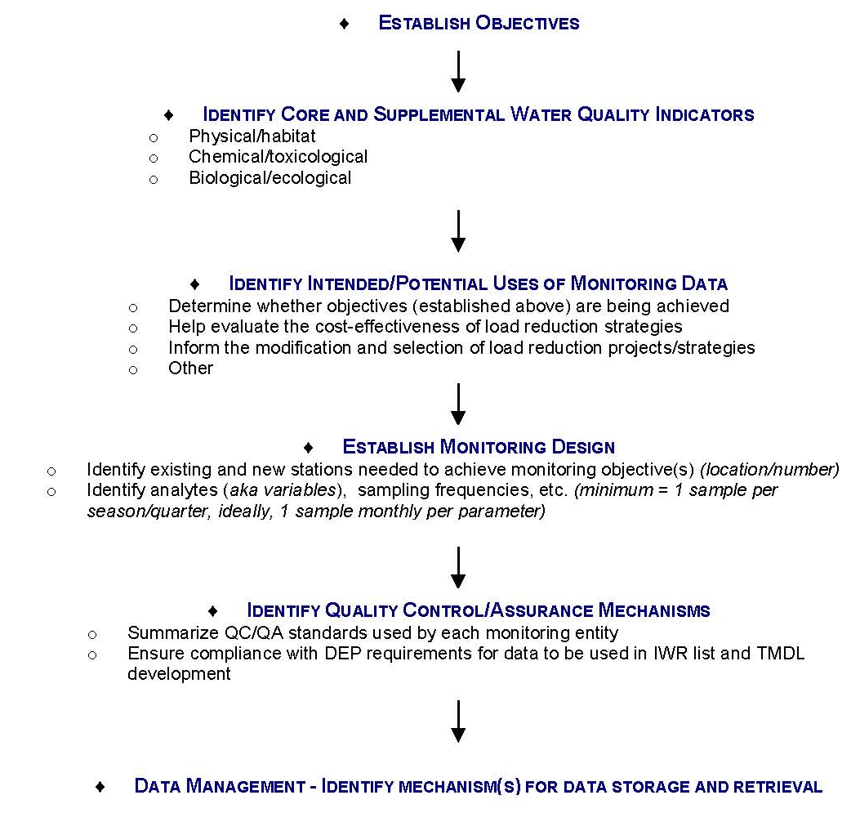
Monitoring Plan Development

Slide 4
Review Monitoring Plan Objectives
Primary Objective:
  Track inputs and trends in total nitrogen (TN) and total phosphorus (TP) loads in the major tributaries and Smith Canal.
Secondary Objective:
  Identify areas within the watershed with high loadings of nutrients to better focus management efforts.

Slide 5
Water Quality Parameters
Recommended parameters for discussion:
Core Parameters | Supplemental Parameters
Total phosphorus (as P) | Total suspended solids (TSS)
Orthophosphate as P | Biochemical oxygen demand (BOD)
Nitrate/nitrite as N
Total Kjeldahl nitrogen (TKN)
Chlorophyll-a
Dissolved oxygen (DO)
Temperature
Specific conductance
pH - field

Slide 6
Sampling Frequency
Current sampling frequencies:
  Quarterly – Deltona, Seminole County (water quality stations), SJRWMD (1 station), Volusia County (15 stations)
  Bimonthly – SJRWMD (1 station)
  Monthly – SJRWMD (8 stations), Volusia County (4 stations)
  Annually – Seminole County (biology stations)
What frequency is needed to achieve the monitoring plan objectives?

Slide 7
QA/QC and Data Storage
Water quality data collection will be conducted in a manner consistent with the Florida Department of Environmental Protection’s (FDEP) standard operating procedures (SOPs) for quality assurance/quality control (QA/QC).
The SOPs can be found at: http://www.dep.state.fl.us/labs/library/lab_sops.htm.
The Florida STORET database will serve as the primary resource for storing ambient data.
Stakeholders will regularly upload their BMAP data to STORET.

Slide 8
QA/QC, continued
These QA/QC requirements are important to ensure that FDEP can use the data in future water quality assessments.
Data must be in STORET for FDEP to use the information in the assessments.
STORET uploads are only appropriate for data that represent ambient conditions.
  Other data (biological, storm event, continuous flow), if collected, will be maintained by the entity that collected the samples.

Slide 9
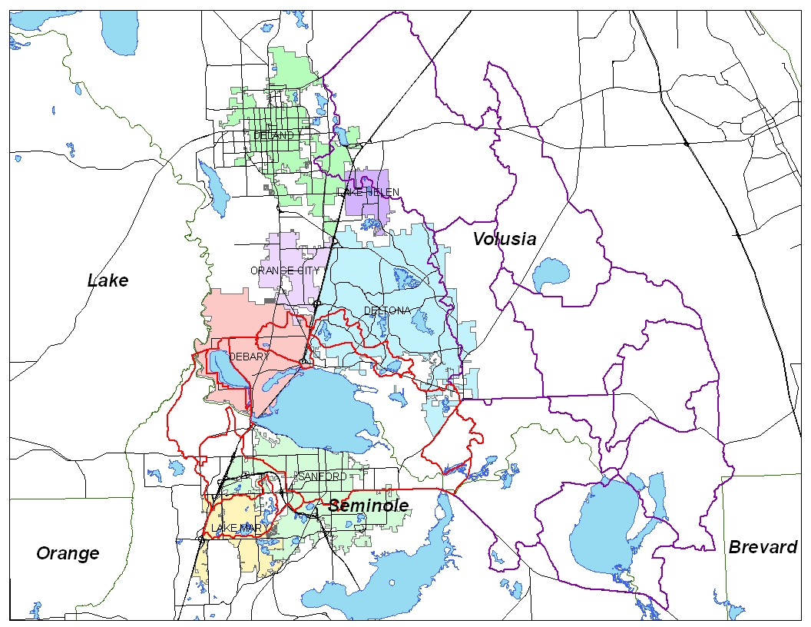

Slide 10
Monitoring Network
Determine the monitoring network:
  Identify existing stations that are necessary to achieve the monitoring objective.
  Identify gaps in the monitoring:
    Determine if existing stations can be moved to fill a gap; or
    Determine if a stakeholder is able to add a new station to fill a gap.
Review the monitoring maps and identify the monitoring network for the NRP.

Slide 11
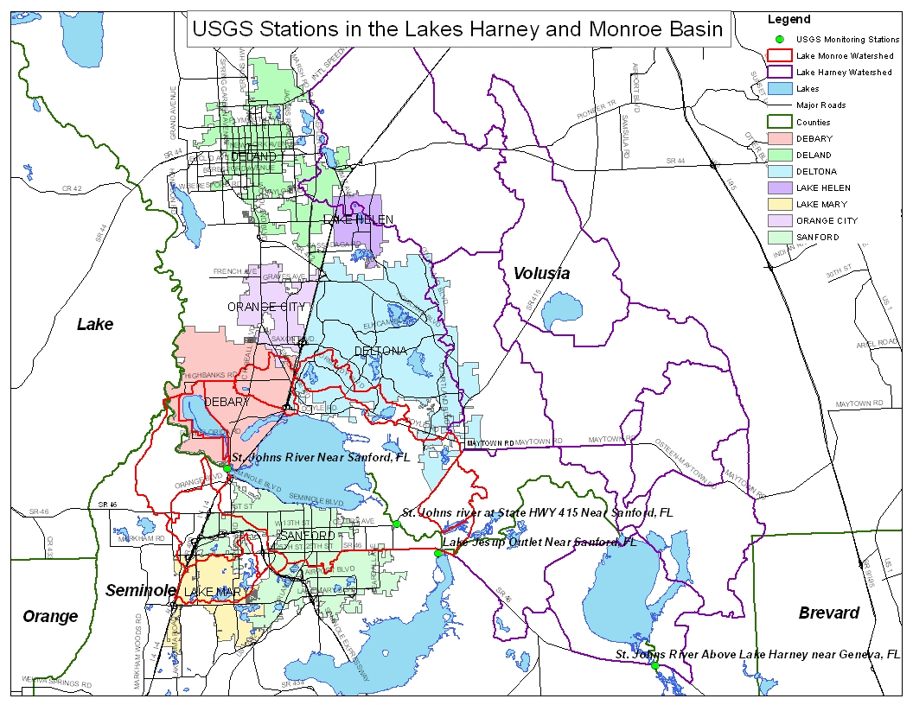

Slide 12
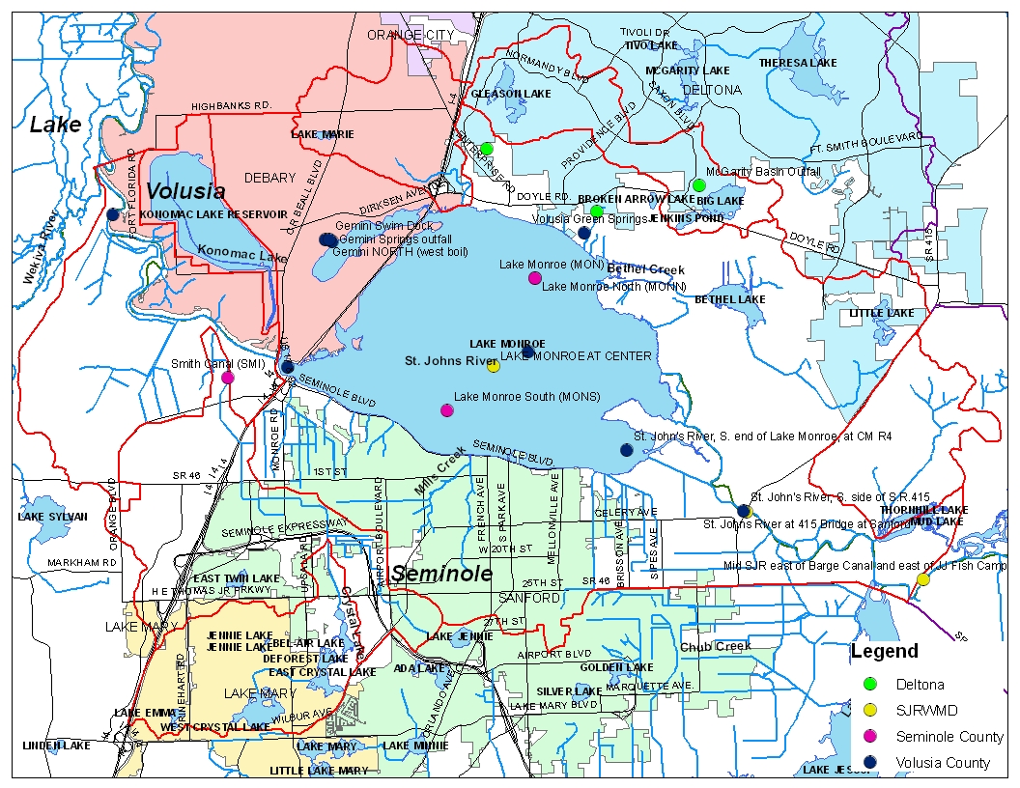

Slide 13
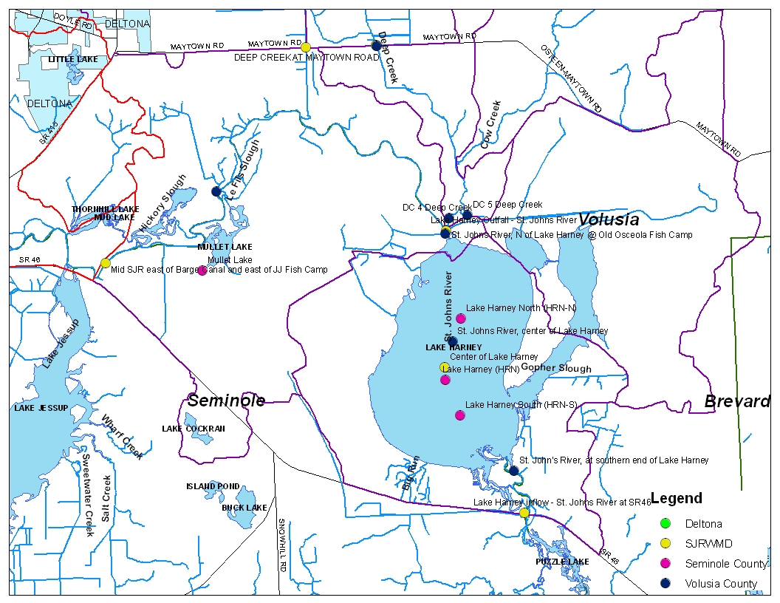

Slide 14
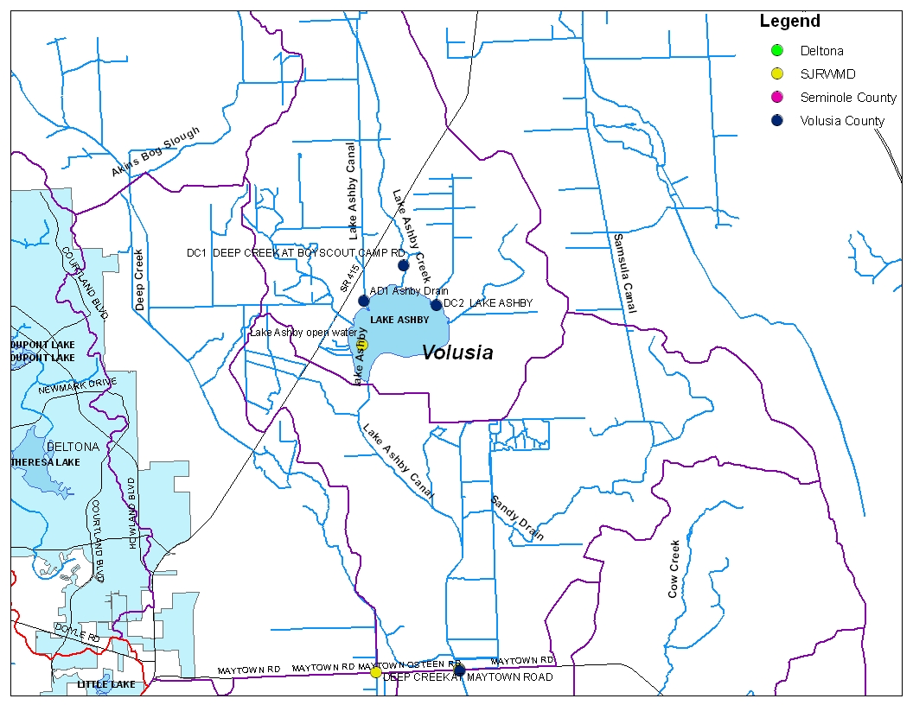

Slide 15
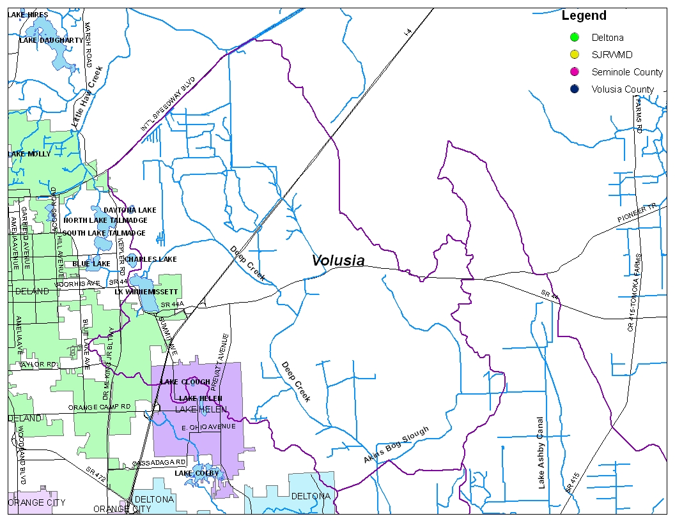

Slide 16

Questions

