Slide 1
Lakes Harney and Monroe Basin Management Action Plan
Policy Makers Briefing
November 17, 2011

Slide 2
Meeting Overview
Lakes Harney and Monroe Total Maximum Daily Loads (TMDLs)
Lakes Harney and Monroe Basin Management Action Plan (BMAP)
BMAP Progress to Date

Slide 3
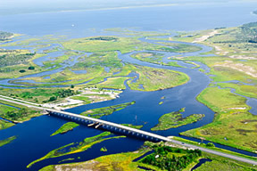
Lakes Harney and Monroe TMDL
Used by permission of the SJRWMD

Slide 4
What is a TMDL?
A TMDL is the maximum amount of a pollutant that a waterbody can assimilate and still meet water quality standards.
TMDLs are developed for waterbodies that have sufficient data to demonstrate they are not meeting applicable water quality standards.
There are two parts to a TMDL:
  A target based on water quality standards; and
  Load reductions for pollutants that are necessary to ensure that the established target is met.

Slide 5
Lakes Harney and Monroe TMDL
The TMDL was adopted in December 2009.
The impaired waterbodies in the TMDL include:
  Lake Harney;
  Lake Monroe; and
  Middle St. Johns River between the inlet of Lake Harney and the confluence of the river and the Wekiva River.
The total watershed area is 216,486 acres.

Slide 6
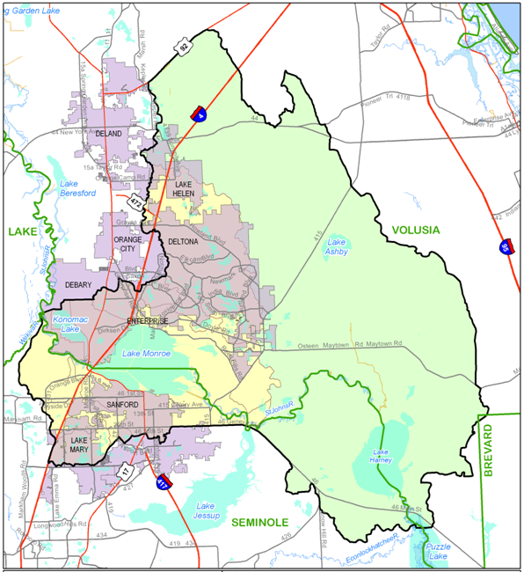
Notes:
The map shows the entire watershed (or drainage) area for this section of the St. Johns River. The area that drains to the river is the focus of this BMAP. The Lake Harney watershed is much larger and mostly unincorporated area. The Lake Monroe watershed is more developed. Note that a very small portion of Brevard County and Lake County are included in the watershed. These areas only have natural land uses (water, wetlands, and forest) so these counties were not included in the BMAP allocations.

Slide 7
Parameters of Concern
For each of the waterbody identification (WBID) numbers in the TMDL, the water quality parameters of concern are:
WBID | Waterbody Segment | Parameters of Concern
2964A | Lake Harney | Dissolved oxygen (DO) and Nutrients
2964 | SJR Downstream of Lake Harney | DO
2893F | SJR Above Lake Jesup | DO
2893E | SJR Above Lake Monroe | DO and Nutrients
2893D | Lake Monroe | DO and Nutrients
2893C | SJR Above Wekiva River | DO and Nutrients
Notes:
All of these WBIDs and their impairments are being addressed in this BMAP.

Slide 8
Targets for Lakes Harney and Monroe TMDL
Florida’s narrative water quality standard requires that the nutrient concentrations of a waterbody shall not be altered as to cause an imbalance of natural populations of aquatic flora or fauna.
For the WBIDs in the Lakes Harney and Monroe TMDL, nutrient targets were established to restore healthy chlorophyll-a levels and Trophic State Index (TSI) values.
The TMDLs established a concentration of total nitrogen (TN) and total phosphorus (TP) in each WBID to achieve the target chlorophyll-a and TSI.
Notes:
For bullet #2, explain why high chl-a and TSI are undesirable.

Slide 9
Sources in the TMDL
Wastewater treatment facilities (WWTFs);
Municipal separate storm sewer systems (MS4s);
Nonpoint stormwater sources;
Agriculture;
Failing septic tanks within 50 feet of a waterbody;
Groundwater;
Atmospheric deposition directly on the waterbodies;
Upstream St. Johns River and Econolockhatchee River sources; and
Lake Jesup sources.
Notes:
It is important to recognize all the potential sources to the waterbody. For one, it helps us fairly allocate reductions among the sources. Also, it helps to understand what sources are outside our control and what sources we can reduce.

Slide 10
Sources, continued
Reductions are only required for:
  WWTFs (assigned an allocation in the TMDL);
  MS4s;
  Nonpoint stormwater sources;
  Agriculture; and
  Failing septic tanks within 50 feet of a waterbody.
Groundwater and atmospheric deposition are considered natural background.
Reductions for upstream river sources and Lake Jesup sources will be achieved through other plans.
Notes:
Therefore, the reductions in this BMAP are not very large compared to reductions needed from upstream. It is important that they understand that the stakeholders in those upstream areas will be responsible for those reductions. We are focusing here on only the reductions needed within this basin. Additional reductions will be needed to meet the chl-a and TSI targets, but those reductions will be assigned to upstream sources and, for Lake Jesup, have already been assigned in the Lk. Jesup BMAP.

Slide 11
Components of a TMDL
A TMDL includes the following components:
  Wasteload allocation (WLA) for point sources:
    Wastewater (ww); and
    Permitted stormwater (sw).
  Load allocation (LA) for nonpoint sources.
Notes:
This distinction is important here because stormwater from permitted MS4 systems are considered to be point sources even though stormwater is discharged from many location. The wasteload allocations in the BMAP will be linked to the MS4 permits in the basin. Nonpoint sources as defined in the TMDL are the other stormwater sources such as agriculture and urban stormwater from areas outside an MS4 system.

Slide 12
TMDL Required Reductions
WBID | Parameter | TMDL (lbs/yr) | WLAww (lbs/yr) | WLAsw | LA (lbs/yr)
2964 A | TN | 3,355,570 | 0 | 39% | 3,355,570
 | TP | 241,026 | 0 | 33% | 241,026
2964 + 2893F | TN | 3,741,990 | 0 | 37% | 3,741,990
 | TP | 276,141 | 0 | 32% | 276,141
2893D + 2893E | TN | 4,171,255 | 0 | 38% | 4,171,255
 | TP | 315,512 | 0 | 31% | 315,512
2893C | TN | 4,202,340 | 19,342 | 37% | 4,182,998
 | TP | 318,236 | 2,345 | 31% | 315,891
Notes:
Make sure to describe what the wastewater sources are.

Slide 13
Smith Canal
Smith Canal is WBID 2692 and is within the larger Harney-Monroe watershed.
Smith Canal is about 6 miles long and flows northwest to the St. Johns River about 1.4 miles upstream of the outlet to Lake Monroe.
  Located within subbasins 6 and 7 of the Lake Monroe basin.
The watershed includes portions of Seminole County and the cities of Sanford and Lake Mary.
Smith Canal was verified impaired for DO with the causative pollutant of TP.
Notes:
A small portion of the Smith Canal WBID does extend outside the Harney-Monroe model boundary; that area is being addressed in the Lake Jesup BMAP.

Slide 14
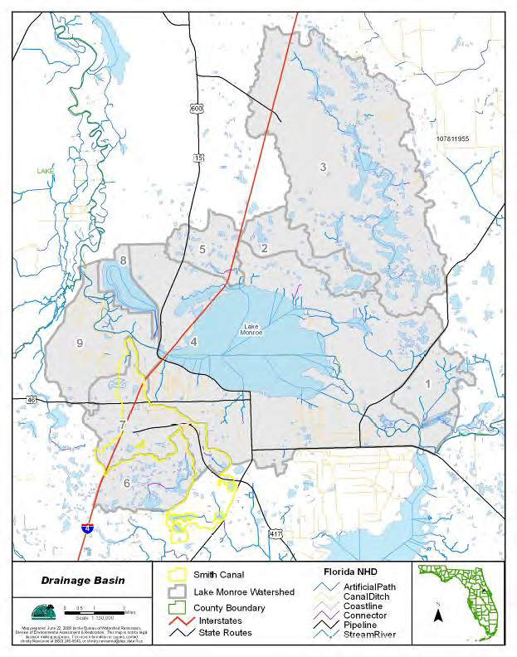

Slide 15
Sources in the Smith Canal TMDL
Seminole County/Florida Department of Transportation (FDOT) Phase I MS4, with co-permittees Sanford and Lake Mary;
Stormwater runoff;
Septic tanks; and
Atmospheric deposition.

Slide 16
Smith Canal TMDL
Since Smith Canal is located in the Lakes Harney and Monroe Basin and is impaired for nutrients, this TMDL will also be addressed by the BMAP.
The Lakes Harney and Monroe reductions were applied to this area, as well.
The Smith Canal TMDL is as follows:
WBID | Parameter | TMDL (lbs/yr) | WLA ww (lbs/yr) | WLA sw (%) | LA (%)
2962 | TP | 4,261 | N/A | 26% | 26%
Notes:
The first step to achieving the reductions here will be to use the Harney-Monroe required reductions. Additional reductions may be needed in the Smith Canal watershed in the future if water quality in this area does not improve.

Slide 17
Regulatory and Cost Implications of TMDLs
Once a TMDL is adopted, stakeholders are required to implement projects to address their portion of the responsibility for the impairment.
Stakeholders must commit the necessary funding to achieve the TMDL—meeting water quality standards is not optional.
TMDL reductions can be linked to WWTF and MS4 permits.

Slide 18
Comments and Questions on the TMDLs
Allocation Stakeholders:
  Seminole County
  Volusia County
  City of DeBary
  City of Deltona
  City of Sanford
  FDOT District 5
  Agriculture
De Minimus Stakeholders:
  City of DeLand
  City of Lake Helen
  City of Orange City
  Turnpike Authority
Other Interested Parties

Slide 19
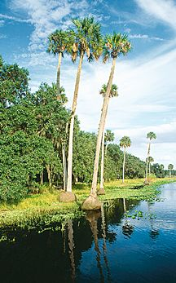
Lakes Harney and Monroe BMAP
Used by permission of the SJRWMD

Slide 20
BMAPs
A BMAP is developed collaboratively with stakeholders to meet provisions in Section 403.067(7), Florida Statutes (F.S.).
For point sources, BMAPs are enforceable through wastewater and MS4 National Pollutant Discharge Elimination System (NPDES) permits.
For nonpoint sources, BMAP projects are enforceable through the BMAP itself.
For agriculture, best management practices (BMPs) or monitoring is required.
BMAPs are adopted by FDEP Secretarial Order.
Notes:
Use this slide as an opportunity to explain that for MS4 permittees and wastewater facilities, the BMAP becomes a compliance schedule to meet the reductions assigned. Without a BMAP, EPA or FDEP could assign a compliance schedule, so a big benefit to a BMAP is that the stakeholders can outline their own project schedule and show EPA that they are compliant with the TMDL as long as they are compliant with the reduction schedule in the BMAP. The TMDL (Sanford WWTF) and BMAP reductions are linked to the NPDES permits, so while the BMAP is developed collaboratively, it does become a regulatory mechanism once it is adopted.

Slide 21
Key BMAP Components
TMDLs being addressed;
Assumptions and considerations;
Future growth;
Allocations to responsible sources;
Projects to meet the TMDL;
Monitoring plan;
Process to assess progress towards the TMDL;
Implementation timeline and commitments; and
Appendices with supporting information.
Notes:
BMAP components are designed to establish a watershed management plan for the pollutant of concern (in this case, nutrients). It shows how the TMDL reductions will be accomplished, how we are going to report progress and how we will monitor the system and its response. The BMAP is scheduled to be updated every five years with annual reports documenting progress for the year and any changes to the project plans.

Slide 22
BMAP Approach
Schedule: The TMDL reductions will be achieved over a 15-year period.
The first iteration of the BMAP will cover a 5-year period.
  Approximately mid-2012 through mid-2017.
Each entity is required to achieve 50% of their TN and TP reductions in this first iteration.
  The remainder of the reductions will be achieved by the end of the 15-year timeline.
Notes:
EPA expects the state to create plans that address the impairments in 15 years or less. The 15-year timeframe provides the maximum amount of time to secure funding to implement the projects to make 100% of the reductions.

Slide 23
BMAP Approach, continued
This iterative approach allows for project implementation to achieve reductions while monitoring occurs to better understand the watershed.
An important consideration is that the watershed makes up a small percentage of the total loading to the impaired waterbodies:
  Approximately 3% of the TN loads and 4% of the TP loads.
  Reductions from the Upper St. Johns River, Econlockhatchee River, and Lake Jesup are key to meeting the water quality targets.

Slide 24
Stakeholders in the BMAP
Sanford North WWTF
MS4s
  Seminole County
  Volusia County
  City of DeBary
  City of Deltona
  City of Lake Helen
  City of Lake Mary
  City of Sanford
  FDOT District 5
  Turnpike Authority
Non-MS4s
  City of DeLand
  City of Orange City
Agriculture

Slide 25
Addressing Future Growth
Section 403.067(7)(a)(2), Florida Statutes, requires: BMAPs to:
  “…identify the mechanisms by which potential future increases in pollutant loading will be addressed.”
The BMAP will not include an allocation for new development.
New discharges cannot increase existing load and must meet “net environmental improvement” for the Environmental Resource Permit (ERP) program requirements.
Notes:
doesn’t force them to make additional reductions to provide a buffer for future growth.

Slide 26
Reducing Loads from Growth
Local governments are encouraged to pursue measures to control loads from future growth such as:
  Low impact development (LID) standards;
  Florida friendly landscaping; and
  Modifications to local development regulations.
Notes:
Maybe chat a little about source control and how that is more efficient and much more cost effective than removing nutrients already in the system.

Slide 27
Comments and Questions on the BMAP
Allocation Stakeholders:
  Seminole County
  Volusia County
  City of DeBary
  City of Deltona
  City of Sanford
  FDOT District 5
  Agriculture
De Minimus Stakeholders:
  City of DeLand
  City of Lake Helen
  City of Orange City
  Turnpike Authority
Other Interested Parties

Slide 28

BMAP Progress to Date
Used by permission of the SJRWMD

Slide 29
Allocations

Slide 30
Target Load per Acre Approach
Target loads per acre for TN and TP were determined for the entire BMAP basin.
The target loads per acre were then multiplied by each entity’s acreage to determine the total allowable TN and TP loading.
This approach was selected to focus reductions on those areas with the highest TN and TP loadings in the watershed.

Slide 31
Calculating Starting Loads
Starting loads are the TN and TP loading estimates for each entity based on the TMDL model.
Each entity’s starting load was determined using the jurisdictional boundaries provided by the stakeholders.
Natural areas were removed from the stakeholders’ starting loads because the TMDL does not require load reductions from natural land uses.
All loads from agricultural land uses were assigned to agriculture, not the local governments.

Slide 32
De minimus Entities
De minimus entities are those stakeholders with such small loadings that they are not significant contributors.
DeLand, Lake Helen, Orange City, and Turnpike Authority were identified as de minimus.
  Each contribute less than 1% of the total load and combined they contribute approximately 1% of the total load.
These entities were not assigned an allocation for the first iteration of the BMAP.
The loads associated with these entities were not reallocated to the other stakeholders in the basin.

Slide 33
Target Load per Acre for TN
Entity | Acres | TN Target (lbs/acre/yr) | Target Load (lbs/yr) | TN Starting Load (lbs/yr) | TN Required Reduction (lbs/yr) | % TN Reduction
Agriculture | 20,250.3 | 4.34 | 87,886.3 | 130,168.2 | 42,281.9 | 32.5%
DeBary | 3,720.3 | 4.34 | 16,146.1 | 19,906.5 | 3,760.4 | 18.9%
Deltona | 4,189.5 | 4.34 | 18,182.4 | 25,399.8 | 7,217.4 | 28.4%
FDOT | 1,762.3 | 4.34 | 7,648.4 | 10,112.0 | 2,463.6 | 24.4%
Lake Mary | 1,639.2 | 4.34 | 7,114.1 | 6,572.0 | 0.0 | 0.0%
Sanford | 4,764.6 | 4.34 | 20,678.4 | 41,398.4 | 20,720.0 | 50.1%
Seminole County | 6,027.2 | 4.34 | 26,158.0 | 34,105.1 | 7,947.1 | 23.3%
Volusia County | 5,356.2 | 4.34 | 23,245.9 | 26,511.6 | 3,265.7 | 12.3%
DeLand - de minimus | 37.5 | 4.34 | 162.8 | 192.0 | 0.0 | 0.0%
Lake Helen - de minimus | 347.8 | 4.34 | 1,509.5 | 2,052.4 | 0.0 | 0.0%
Orange City - de minimus | 18.9 | 4.34 | 82.0 | 105.4 | 0.0 | 0.0%
Turnpike - de minimus | 342.5 | 4.34 | 1,486.5 | 1,240.1 | 0.0 | 0.0%
Total | 48,456.3 | N/A | 210,300.3 | 297,763.5 | 87,656.1 | N/A
Notes:
Sanford has higher reductions because they are very urban and right on Lake Monroe. The purpose of the target load per acre approach is to focus on those areas of high loading that have the most impact on the impaired waterbodies.

Slide 34
Target Load per Acre TP
Entity | Acres | TP Target (lbs/acre/yr) | Target Load (lbs/yr) | TP Starting Load (lbs/yr) | TP Required Reduction (lbs/yr) | % TP Reduction
Agriculture | 20,250.3 | 0.80 | 16,200.2 | 29,970.4 | 13,770.2 | 45.9%
DeBary | 3,720.3 | 0.80 | 2,976.2 | 3,149.0 | 172.8 | 5.5%
Deltona | 4,189.5 | 0.80 | 3,351.6 | 4,128.2 | 776.6 | 18.8%
FDOT | 1,762.3 | 0.80 | 1,409.8 | 1,325.3 | 0.0 | 0.0%
Lake Mary | 1,639.2 | 0.80 | 1,311.4 | 948.9 | 0.0 | 0.0%
Sanford | 4,764.6 | 0.80 | 3,811.7 | 6,490.8 | 2,679.1 | 41.3%
Seminole County | 6,027.2 | 0.80 | 4,821.8 | 5,132.7 | 310.9 | 6.1%
Volusia County | 5,356.2 | 0.80 | 4,285.0 | 3,828.7 | 0.0 | 0.0%
DeLand - de minimus | 37.5 | 0.80 | 30.0 | 14.8 | 0.0 | 0.0%
Lake Helen - de minimus | 347.8 | 0.80 | 278.2 | 297.0 | 0.0 | 0.0%
Orange City - de minimus | 18.9 | 0.80 | 15.1 | 16.6 | 0.0 | 0.0%
Turnpike - de minimus | 342.5 | 0.80 | 274.0 | 108.5 | 0.0 | 0.0%
Total | 48,456.3 | N/A | 38,765.0 | 55,410.9 | 17,709.6 | N/A

Slide 35
Allocations for the First BMAP Iteration
Entity | TN 1st Iteration Reductions (50%) (lbs/yr) | TP 1st Iteration Reductions (50%) (lbs/yr)
Agriculture | 21,140.9 | 6,885.1
DeBary | 1,880.2 | 86.4
Deltona | 3,608.7 | 388.3
FDOT | 1,231.8 | 0.0
Lake Mary | 0.0 | 0.0
Sanford | 10,360.0 | 1,339.6
Seminole County | 3,973.5 | 155.5
Volusia County | 1,632.8 | 0.0
DeLand – de minimus | 0.0 | 0.0
Lake Helen – de minimus | 0.0 | 0.0
Orange City – de minimus | 0.0 | 0.0
Turnpike – de minimus | 0.0 | 0.0
Total | 43,828.0 | 8,854.8

Slide 36
Project Collection and Credit (how everyone will meet their allocation)

Slide 37
Project Collection
To achieve the TN and TP required reductions, each responsible entity provided projects and programs that reduce nutrient loads.
Projects completed since January 1, 2003 and later are eligible for credit.
All projects must be located in the Lakes Harney and Monroe BMAP Basin and must address nutrients.
Credit only counts for treatment above and beyond any permitted requirements.

Slide 38
Types of Projects Eligible for Credit
Retention BMPs (such as basins and exfiltration trenches);
Wet detention ponds;
Treatment trains;
Dry detention;
Baffle box (1st generation);
Nutrient baffle box (2nd generation);
Catch basin inserts/inlet filters;
Grass;
Alum injection;
Stormceptor;
Continuous deflective separation (CDS) unit (TP only);
Public education and outreach efforts; and
Street sweeping.
Notes:
The common stormwater treatment controls are eligible for credit if they are reducing existing loads (and not just abating new development) for net improvement. Also, source control efforts can be counted for credit such as street sweeping, catch basin clean outs and public education efforts that focus on keeping sources from getting into the stormwater. Individual prevention measures can really add up—lawn litter, fertilizer, pet waste, and trash and debris in the gutter are all controllable sources. The more a community prevents these sources from entering the water, the cleaner the stormwater will be and the less projects needed to treat the stormwater.

Slide 39
Progress Towards TP Reductions
Entity | TP Total Required Reduction (lbs/yr) | TP Credit for Completed Projects (lbs/yr) | % TP Reductions Achieved
DeBary | 172.8 | 2,207.0 | 1,277.2%
Deltona | 776.6 | 1,229.9 | 158.4%
FDOT | 0.0 | 497.3 | 100%
Lake Mary | 0.0 | 58.6 | 100%
Sanford | 2,679.1 | 4,897.3 | 100%
Seminole County | 310.9 | 1,905.9 | 182.8%
Volusia County | 0.0 | 385.3 | 613%
DeLand – de minimus | 0.0 | 0.7 | 100%
Lake Helen – de minimus | 0.0 | 4.5 | 100%
Orange City – de minimus | 0.0 | 0.2 | 100%
Turnpike – de minimus | 0.0 | 14.4 | 100%
Total | 3,939.4 | 11,174.1 | 283.6%
Notes:
These are for the urban stakeholders only. More TP reductions have been achieved then the total TP required reductions. Note that DeBary’s high load reduction is from the fact that they had noncontributing areas that we treated as 100% retention.

Slide 40
Progress Towards TN Reductions
Entity | TN Total Required Reduction (lbs/yr) | TN Credit for Completed Projects (lbs/yr) | % TN Reductions Achieved | TN Remaining Reductions (lbs/yr)
DeBary | 3,760.4 | 13,561.7 | 360.3% | 0.0
Deltona | 7,217.4 | 7,151.3 | 99.1% | 66.1
FDOT | 2,463.6 | 2,031.7 | 82.5% | 431.9
Lake Mary | 0.0 | 371.0 | 100.0% | 0.0
Sanford | 20,720.0 | 12,973.9 | 62.6% | 7,746.1
Seminole County | 7,947.1 | 7,637.8 | 96.1% | 309.3
Volusia County | 3,265.7 | 2,213.6 | 67.8% | 1,052.1
DeLand – de minimus | 0.0 | 9.1 | 100.0% | 0.0
Lake Helen – de minimus | 0.0 | 30.8 | 100.0% | 0.0
Orange City – de minimus | 0.0 | 1.3 | 100.0% | 0.0
Turnpike – de minimus | 0.0 | 21.6 | 100.0% | 0.0
Total | 45,374.2 | 46,003.8 | 101.4% | 9,605.5
Notes:
These are for the urban stakeholders only. Although overall 100% of the TN required reductions have been achieved, each entity must still meet their total required reductions. All stakeholders have submitted enough projects to meet the 50% required reductions for the first BMAP iteration.

Slide 41
Progress Towards Agricultural Reductions
In the first five year BMAP period, the Florida Department of Agriculture and Consumer Services (FDACS) is proposing to implement BMPs on 90% of the agricultural lands.
This achieves 53.1% of the TN and 27.9% of the TP required reductions.
FDACS and FDEP are working on a plan to achieve the balance of the reductions.
  An approach will be outlined in the BMAP.

Slide 42
Monitoring Plan

Slide 43
Purpose of the Monitoring Plan
A monitoring plan is a required component in a BMAP.
The main purpose of the monitoring plan is to track trends in water quality to show progress towards achieving the TMDLs.
Other objectives can be identified and addressed through the BMAP monitoring plan.

Slide 44
Monitoring Plan Development
The technical stakeholders provided information on existing monitoring stations in the basin.
The technical stakeholders have established the monitoring plan objectives:
  Primary objective: Track inputs and trends in TN and TP loads in the major tributaries and Smith Canal.
  Secondary objective: Identify areas within the watershed with high loadings of nutrients to better focus management efforts.

Slide 45
Monitoring Plan Development, continued
The technical stakeholders determined that monthly samples are needed.
The technical stakeholders have identified what should be tested—they have different lists for the tributaries and for lake monitoring.
The technical stakeholders started to identify the stations for the monitoring network.
Discussions on the monitoring plan will continue at the December technical meeting.

Slide 46
Local Monitoring is Important
The monitoring data are used to measure reductions and refine the model.
The monitoring data is very valuable for putting projects in the best locations for cost effectiveness.
While monitoring takes effort and some lab analysis, it is an investment for making good project decisions and site selection.
Notes:
Note that it is not required to measure the reductions from each project. The project reductions are calculated based on the design. Because we are not monitoring each project, having a reasonable monitoring network of lake and stream conditions is important to track conditions and progress.

Slide 47
Regulatory and Cost Implications of BMAPs
As part of the BMAP, the allocation stakeholders commit to:
  An implementation schedule for achieving the TMDLs;
  Projects and the associated funding to achieve required reductions; and
  Monitoring and the associated funding to track progress towards the TMDLs.
BMAP requirements are enforceable by FDEP through WWTF and MS4 permits and the BMAP itself.

Slide 48
Comments and Questions on BMAP Progress
Allocation Stakeholders:
  Seminole County
  Volusia County
  City of DeBary
  City of Deltona
  City of Sanford
  FDOT District 5
  Agriculture
De Minimus Stakeholders:
  City of DeLand
  City of Lake Helen
  City of Orange City
  Turnpike Authority
Other Interested Parties

