Slide 1
Project Collection Process
Lakes Harney and Monroe BMAP Meeting
April 21, 2011

Slide 2
Project Collection Process
To achieve the total nitrogen (TN) and total phosphorus (TP) reductions, each responsible stakeholder will provide projects and programs that reduce nutrient loads.
Projects will be collected in two steps:
  Completed projects, since January 1, 2003; and
  Additional planned efforts to meet the balance of the required reductions.

Slide 3
Project Collection Process, continued
Information on completed projects is due by June 17, 2011.
FDEP will then evaluate the projects and determine appropriate credit.
Allocations to the responsible stakeholders are currently being determined and will be discussed with the entities before being finalized.
If completed projects are insufficient to meet TN and/or TP allocations, the stakeholder will need to provide additional projects.

Slide 4
Project Requirements
Credit is only applied to projects that have treatment above and beyond any permitted requirements.
All projects must treat nutrients (TN, TP, or both).
All projects must be within the Lakes Harney and Monroe watershed.
  The Geographic Information System (GIS) files for the watershed boundaries are located the FTP site.

Slide 5
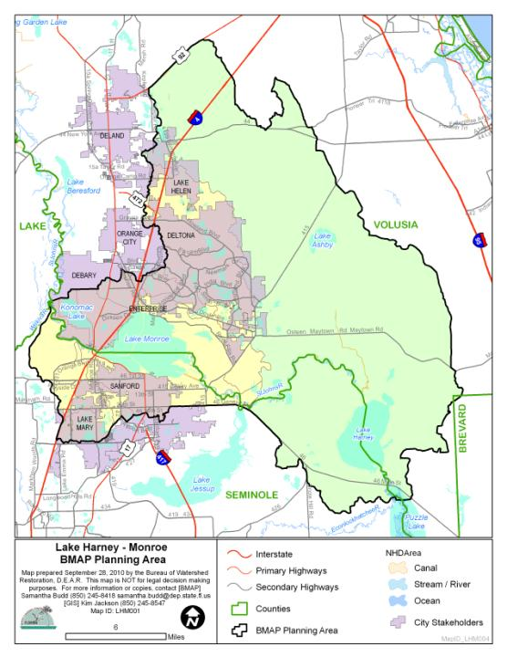

Slide 6
Types of Projects
Standard stormwater treatment best management practices (BMPs) include:
  Retention BMPs;
  Wet detention ponds;
  Treatment trains;
  Dry detention;
  Baffle box (1st generation);
  Nutrient (2nd generation) baffle box;
  Catch basin inserts/inlet filters;
  Swales;
  Alum injection;
  Stormwater reuse;
  Stormceptor; and
  Continuous deflective separation (CDS) units.

Slide 7
Types of Projects, continued
Provisional BMPs include:
  Floating islands;
  Public education and outreach efforts; and
  Street sweeping.

Slide 8
Retention BMPs
The efficiency for retention BMPs depends on whether the BMP is on-line or off-line and the inches of retention provided.
Credit will be assigned for TN and TP as follows:
  Off-line Retention 0.25 treatment volume – 40%
  Off-line Retention 0.50 treatment volume – 62%
  Off-line Retention 0.75 treatment volume – 75%
  Off-line Retention 1.00 treatment volume – 84%
  On-line Retention 0.25 treatment volume – 30%
  On-line Retention 0.50 treatment volume – 52%
  On-line Retention 0.75 treatment volume – 65%
  On-line Retention 1.00 treatment volume – 74%

Slide 9
Wet Detention Ponds
Credit for wet detention ponds will be based on the mean annual residence time of the pond.
The residence time will be used in the equations in Figures 13.2 and 13.3 of the Draft Stormwater Treatment Applicant’s Handbook.
This handbook can be accessed at: http://publicfiles.dep.state.fl.us/dwrm/stormwater/stormwater_rule_development/docs/ah_rule_draft_031710.pdf.

Slide 10
TP for Wet Detention Ponds
Figure 13.2 Removal Efficiency of Total Phosphorus in Wet Detention Ponds as a Function of Residence Time

Slide 11
TN for Wet Detention Ponds
Figure 13.3 Removal Efficiency of Total Nitrogen in Wet Detention Ponds as a Function of Residence Time

Slide 12
Other Standard BMPs
Standard BMPs | TP % Reduction | TN % Reduction
BMP treatment trains using a combination of BMPs | Use BMP Treatment Train (TT) equation: BMP TT Efficiency = Eff₁ +((1-Eff₁)*Eff₂) | Use BMP Treatment Train (TT) equation: BMP TT Efficiency = Eff₁ +((1-Eff₁)*Eff₂)
Dry detention | 10 | 10
Baffle box | 2.3 | 0.5
Nutrient baffle box (2nd generation) | 15.5 | 19.05
Catch basin inserts/inlet filters | Evaluated on a case-by case basis | Evaluated on a case-by case basis
Grass swales with swale blocks or raised culverts | Use on-line retention BMPs above | Use on-line retention BMPs above
Grass swales without swale blocks or raised culverts | 50% of value for grass swales with swale blocks or raised culverts | 50% of value for grass swales with swale blocks or raised culverts
Alum injection | 90 | 50
Stormwater reuse | Estimate amount water not discharged annually because used for irrigation. | Estimate amount water not discharged annually because used for irrigation.
Stormceptor | 13 | 2
CDS units | 10 | Not applicable

Slide 13
Provisional BMPs
Florida-specific studies are currently being conducted to determine the efficiencies for these types of BMPs.
The credit assigned for these BMPs will be for this first iteration of the BMAP and could change in the future based on new information.
Floating islands, or managed aquatic plant systems (MAPS), will receive a 20% reduction credit for TN and TP.
  At least 5% of the pond must be covered with floating islands and the plants must be harvested annually to receive this credit.

Slide 14
Public Education Activities
Up to a 6% credit from the TN and TP baseline loads for:
  Participation in Florida Yards and Neighborhoods (FYN);
  Local ordinances for fertilizer, irrigation, landscaping, and pet waste management;
  Public service announcements (PSAs);
  Informational pamphlets and presentations;
  Websites; and
  Illicit discharge program and call-in number.

Slide 15
Public Education Credit
A form has been provided to the stakeholders for details on their educational activities.
Credit will be calculated as follows:
  When all six types of activities are conducted, entities receive the full 6% reduction credit.
  If there are only PSAs, websites, brochures, and illicit connection program, this is 1% reduction credit.
  Only FYN is a 3% reduction credit.
  All four ordinances is a 2% reduction credit.
  Other combinations are analyzed on a case-by-case basis for credit.

Slide 16
Street Sweeping
Street sweeping credit will be based on the Florida Stormwater Association (FSA) study.
The report has been drafted and the final report should be available in April 2011.
Information on street sweeping credit calculations will be provided once the FSA study is final.

Slide 17
Project Spreadsheet
Each entity must fill out the project spreadsheet with requested details.
The table must be completed to the extent possible for each project.
Projects that are part of a treatment train should be noted in the appropriate columns.
For those permitted projects, permit numbers must be provided.

Slide 18
Project Spreadsheet, continued
The location of the project area is needed for structural BMPs.
The map can be submitted as a Geographic Information System (GIS) file, Computer Aided Design (CAD) file, or hard copy.
This information must show the project location and area treated.
The map file name must indicate the project number from the project spreadsheet.

Slide 19
Project Spreadsheet, continued
Review project spreadsheet:
  Project Collection Template 042111_Distribution.xls

Slide 20
Additional Project Information
Stakeholders may submit available design/engineering information to help with project credit calculations.
Available monitoring data can be provided to support additional project credit.
FDEP may request additional information on the project design to help with credit calculations.
FDEP may also request maintenance records for certain projects.

Slide 21
Project Maintenance
In order to receive credit, projects must be operated and maintained as permitted.
For projects that are not properly maintained, FDEP may:
  Reduce the credit associated with that project; or
  Require maintenance of the project for full credit in the BMAP.

Slide 22
Timeline for Project Submittals
FDEP provides information to stakeholders – April 21, 2011.
Spreadsheets for completed projects due to FDEP – June 17, 2011.
Tentative next meeting to discuss allocations – June 16, 2011.

Slide 23
Contacts
Questions about project collection sheets and supporting project files:
  Samantha Budd, Samantha.Budd@dep.state.fl.us or
  850-245-8418.
  Marcy Policastro, mpolicastro@wildwoodconsulting.net or
  904-829-0394.
Send completed spreadsheets to:
  Marcy Policastro, mpolicastro@wildwoodconsulting.net

Slide 24

Questions
Notes:
Added a graphic.

