Slide 1
Lakes Harney and Monroe BMAP
Allocation Process, Project Credit, and Monitoring Plan
September 15, 2011

Slide 2
Review of the BMAP Allocation Process

Slide 3
Calculating Starting Loads
The first step was to remove all the natural land use acres and loadings from the GIS base map. The TMDL does not require load reductions for the natural areas; therefore, the stakeholders are not required to make reductions for these land uses.
The individual entity shapefiles were then created by clipping out each jurisdiction from the GIS base map as follows:
  Florida Department of Transportation (FDOT) roads and right-of-ways;
  Turnpike Authority roads and right-of-ways;
  Areas with agricultural land uses (land use land cover code 2000);
  Municipalities each to its own jurisdictional boundary; and
  Remaining area assigned to each county using the jurisdictional boundaries.

Slide 4
Calculating Starting Loads
The individual entity shapefiles generated from this process were then used to calculate the total acres and TN and TP loading.
The entity shapefiles are located on the FTP site in the “GIS” folder in the “Entity Starting Loads” subfolder.

Slide 5
Starting Loads
Entity | Area (acres) | TN Starting Load (lbs/yr) | TP Starting Load (lbs/yr)
Agriculture | 20,250.3 | 130,168.2 | 29,970.4
DeBary | 3,720.3 | 19,906.5 | 3,149.0
DeLand | 37.5 | 192.0 | 14.8
Deltona | 4,189.5 | 25,399.8 | 4,128.2
FDOT | 1,762.3 | 10,112.0 | 1,325.3
Lake Helen | 347.8 | 2,052.4 | 297.0
Lake Mary | 1,639.2 | 6,572.0 | 948.9
Orange City | 18.9 | 105.4 | 16.6
Sanford | 4,764.6 | 41,398.4 | 6,490.8
Seminole County | 6,027.2 | 34,105.1 | 5,132.7
Turnpike Authority | 342.5 | 1,240.1 | 108.5
Volusia County | 5,356.2 | 26,511.6 | 3,828.7
Natural Background | 137,104.5 | 409,606.8 | 16,154.2
Total | 185,560.9 | 707,370.4 | 71,565.2

Slide 6
De minimus Entities
The starting loads were sorted for TN and TP loads, from highest to lowest, to identify de minimus loadings.
DeLand, Lake Helen, Orange City, and Turnpike Authority each contribute less than 1% of the total load and combined they contribute approximately 1% of the total load.
These entities are considered to be de minimus and will not be assigned an allocation for the first phase of the BMAP. These stakeholders may receive allocations in future iterations.
The loads associated with these entities will not be reallocated to the other stakeholders in the basin.

Slide 7
De minimus Entities
Entity | Area (acres) | TN Starting Load (lbs/yr) | % of Total Starting Load
Agriculture | 20,250.3 | 130,168.2 | 43.7%
Sanford | 4,764.6 | 41,398.4 | 13.9%
Seminole County | 6,027.2 | 34,105.1 | 11.5%
Volusia County | 5,356.2 | 26,511.6 | 8.9%
Deltona | 4,189.5 | 25,399.8 | 8.5%
DeBary | 3,720.3 | 19,906.5 | 6.7%
FDOT | 1,762.3 | 10,112.0 | 3.4%
Lake Mary | 1,639.2 | 6,572.0 | 2.2%
Lake Helen | 347.8 | 2,052.4 | 0.7%
Turnpike Authority | 342.5 | 1,240.1 | 0.4%
DeLand | 37.5 | 192.0 | 0.1%
Orange City | 18.9 | 105.4 | 0.0%
Total | 48,456.3 | 297,763.5 | 100.0%
Entity | Area (acres) | TP Starting Load (lbs/yr) | % of Total Starting Load
Agriculture | 20,250.3 | 29,970.4 | 54.1%
Sanford | 4,764.6 | 6,490.8 | 11.7%
Seminole County | 6,027.2 | 5,132.7 | 9.3%
Deltona | 4,189.5 | 4,128.2 | 7.5%
Volusia County | 5,356.2 | 3,828.7 | 6.9%
DeBary | 3,720.3 | 3,149.0 | 5.7%
FDOT | 1,762.3 | 1,325.3 | 2.4%
Lake Mary | 1,639.2 | 948.9 | 1.7%
Lake Helen | 347.8 | 297.0 | 0.5%
Turnpike Authority | 342.5 | 108.5 | 0.2%
Orange City | 18.9 | 16.6 | 0.0%
DeLand | 37.5 | 14.8 | 0.0%
Total | 48,456.3 | 55,411.0 | 100.0%

Slide 8
Required Reductions
TN Required Reductions from the TMDL
Lakes Harney and Monroe Basin | Main Stem Upstream Input (lbs/yr) | Lake Jesup Input (lbs/yr) | Watershed Input (lbs/yr) | Direct Rainfall (lbs/yr) | Point Source Contribution (lbs/yr)
Starting Load | 23,436,117 | 551,383 | 718,907 | 138,632 | 31,197
Allowable Load | 14,411,709 | 275,692 | 625,781 | 138,632 | 20,902
Required Reduction | 9,024,408 | 275,691 | 93,126 | 0 | 10,295
TP Required Reductions from the TMDL
Lakes Harney and Monroe Basin | Main Stem Upstream Input (lbs/yr) | Lake Jesup Input (lbs/yr) | Watershed Input (lbs/yr) | Direct Rainfall (lbs/yr) | Point Source Contribution (lbs/yr)
Starting Load | 1,562,680 | 37,279 | 73,961 | 6,565 | 3,449
Allowable Load | 1,061,760 | 24,604 | 55,642 | 6,565 | 2,311
Required Reduction | 500,920 | 12,675 | 18,319 | 0 | 1,138

Slide 9
Target Load per Acre
A target load per acre was determined for the entire BMAP basin. This target load per acre was then multiplied by each entity’s acreage to determine the total allowable loading.
The difference between the starting load and allowable load is the reduction required for each entity.
The target loads per acre were calculated by dividing the TMDL target load for the anthropogenic sources by the total anthropogenic acres.

Slide 10
Target Load per Acre, continued
The target loads per acre are 4.34 lbs/ac/yr for TN and 0.80 lbs/ac/yr for TP.
Anthropogenic Acres | Target TN Load (lbs/yr) | Target TN Load/Acre (lbs/ac/yr) | Target TP Load (lbs/yr) | Target TP Load/Acre (lbs/ac/yr)
48,456.3 | 210,073.5 | 4.34 | 38,946.3 | 0.80

Slide 11
Target Load per Acre for TN
Entity | Acres | TN Target (lbs/acre/yr) | Target Load (lbs/yr) | TN Starting Load (lbs/yr) | TN Required Reduction (lbs/yr) | % TN Reduction
Agriculture | 20,250.3 | 4.34 | 87,886.3 | 130,168.2 | 42,281.9 | 32.5%
DeBary | 3,720.3 | 4.34 | 16,146.1 | 19,906.5 | 3,760.4 | 18.9%
Deltona | 4,189.5 | 4.34 | 18,182.4 | 25,399.8 | 7,217.4 | 28.4%
FDOT | 1,762.3 | 4.34 | 7,648.4 | 10,112.0 | 2,463.6 | 24.4%
Lake Mary | 1,639.2 | 4.34 | 7,114.1 | 6,572.0 | 0.0 | 0.0%
Sanford | 4,764.6 | 4.34 | 20,678.4 | 41,398.4 | 20,720.0 | 50.1%
Seminole County | 6,027.2 | 4.34 | 26,158.0 | 34,105.1 | 7,947.1 | 23.3%
Volusia County | 5,356.2 | 4.34 | 23,245.9 | 26,511.6 | 3,265.7 | 12.3%
DeLand - de minimus | 37.5 | 4.34 | 162.8 | 192.0 | 0.0 | 0.0%
Lake Helen - de minimus | 347.8 | 4.34 | 1,509.5 | 2,052.4 | 0.0 | 0.0%
Orange City - de minimus | 18.9 | 4.34 | 82.0 | 105.4 | 0.0 | 0.0%
Turnpike - de minimus | 342.5 | 4.34 | 1,486.5 | 1,240.1 | 0.0 | 0.0%
Total | 48,456.3 | N/A | 210,300.3 | 297,763.5 | 87,656.1 | N/A
TMDL required reduction | N/A | N/A | N/A | N/A | 93,126.0 | N/A

Slide 12
Target Load per Acre TP
Entity | Acres | TP Target (lbs/acre/yr) | Target Load (lbs/yr) | TP Starting Load (lbs/yr) | TP Required Reduction (lbs/yr) | % TP Reduction
Agriculture | 20,250.3 | 0.80 | 16,200.2 | 29,970.4 | 13,770.2 | 45.9%
DeBary | 3,720.3 | 0.80 | 2,976.2 | 3,149.0 | 172.8 | 5.5%
Deltona | 4,189.5 | 0.80 | 3,351.6 | 4,128.2 | 776.6 | 18.8%
FDOT | 1,762.3 | 0.80 | 1,409.8 | 1,325.3 | 0.0 | 0.0%
Lake Mary | 1,639.2 | 0.80 | 1,311.4 | 948.9 | 0.0 | 0.0%
Sanford | 4,764.6 | 0.80 | 3,811.7 | 6,490.8 | 2,679.1 | 41.3%
Seminole County | 6,027.2 | 0.80 | 4,821.8 | 5,132.7 | 310.9 | 6.1%
Volusia County | 5,356.2 | 0.80 | 4,285.0 | 3,828.7 | 0.0 | 0.0%
DeLand - de minimus | 37.5 | 0.80 | 30.0 | 14.8 | 0.0 | 0.0%
Lake Helen - de minimus | 347.8 | 0.80 | 278.2 | 297.0 | 0.0 | 0.0%
Orange City - de minimus | 18.9 | 0.80 | 15.1 | 16.6 | 0.0 | 0.0%
Turnpike - de minimus | 342.5 | 0.80 | 274.0 | 108.5 | 0.0 | 0.0%
Total | 48,456.3 | N/A | 38,765.0 | 55,410.9 | 17,709.6 | N/A
TMDL required reduction | N/A | N/A | N/A | N/A | 18,319.0 | N/A

Slide 13

Questions

Slide 14
Project Credit and Timeline to Achieve Reductions

Slide 15
Project Collection
All stakeholders provided completed project information.
Credit for these projects was calculated by FDEP.
  Spreadsheets with each entity’s projects and credits are posted on the FTP site at: http://publicfiles.dep.state.fl.us/DEAR/BMAP/MiddleStJohns/LakeHarneyMonroe/Meetings/2011_(9)September/Entity_Credit_Sheets/.
The credit for projects submitted was compared to the allocations for the urban stormwater sources.
  The agriculture allocations are being addressed separately.

Slide 16
Progress Towards TP Reductions
Entity | TP Required Reduction (lbs/yr) | TP Credit for Completed Projects (lbs/yr) | % TP Reductions Achieved | TP Remaining Reductions (lbs/yr)
DeBary | 172.8 | 0.0 | 0.0% | 172.8
Deltona | 776.6 | 1,215.2 | 156.5% | -438.6
FDOT | 0.0 | 307.1 | 100.0% | -307.1
Lake Mary | 0.0 | 58.6 | 100.0% | -58.6
Sanford | 2,679.1 | 4,884.2 | 182.3% | -2,205.1
Seminole County | 310.9 | 1,887.6 | 607.1% | -1,576.7
Volusia County | 0.0 | 242.2 | 100.0% | -242.2
DeLand - de minimus | 0.0 | 0.7 | 100.0% | -0.7
Lake Helen - de minimus | 0.0 | 4.5 | 100.0% | -4.5
Orange City - de minimus | 0.0 | 0.2 | 100.0% | -0.2
Turnpike - de minimus | 0.0 | 14.4 | 100.0% | -14.4
Total | 3,939.4 | 8,614.7 | 218.7% | -4,675.3

Slide 17
Progress Towards TN Reductions
Entity | TN Required Reduction (lbs/yr) | TN Credit for Completed Projects (lbs/yr) | % TN Reductions Achieved | TN Remaining Reductions (lbs/yr)
DeBary | 3,760.4 | 0.0 | 0.0% | 3,760.4
Deltona | 7,217.4 | 7,132.2 | 98.8% | 85.2
FDOT | 2,463.6 | 1,105.4 | 44.9% | 1,358.2
Lake Mary | 0.0 | 371.0 | 100.0% | -371.0
Sanford | 20,720.0 | 12,973.9 | 62.6% | 7,746.1
Seminole County | 7,947.1 | 7,637.8 | 96.1% | 309.3
Volusia County | 3,265.7 | 1,488.1 | 45.6% | 1,777.6
DeLand - de minimus | 0.0 | 9.1 | 100.0% | -9.1
Lake Helen - de minimus | 0.0 | 30.8 | 100.0% | -30.8
Orange City - de minimus | 0.0 | 1.3 | 100.0% | -1.3
Turnpike - de minimus | 0.0 | 21.6 | 100.0% | -21.6
Total | 45,374.2 | 30,771.2 | 67.8% | 14,603.0

Slide 18

Discuss Timeline for Achieving Remainder of Reductions

Slide 19
Proposed Timeline for Discussion
Total timeline to achieve TMDL required reductions – 10 years.
First BMAP iteration – 5 years with each entity achieving at least 50% of their required reductions.
TP required reductions for the urban stakeholders have already been met!
TN reductions remaining for first BMAP iteration:
Entity | TN Reduction Needed to Achieve 50% (lbs/yr)
DeBary | 1,880.2
Deltona | 0.0
FDOT | 126.4
Sanford | 0.0
Seminole County | 0.0
Volusia County | 144.8
Total | 2,151.4

Slide 20
Submittal of Additional Projects
Stakeholders that still have required reductions for this iteration of the BMAP must submit additional projects by November 15th.
A project collection spreadsheet has been provided.
  This is similar to the spreadsheet that was used to collect completed projects.
FDEP will then calculate credit for the additional projects to ensure the required reductions have been achieved.

Slide 21
Project Collection Sheet
Project Number | Project Name | Lead Entity | Lead Entity's Contact Name | Contact Phone Number | Contact E-mail Address | Project Partner(s) | Project Type (select from the dropdown box) | For Retention BMPs only, On-Line or Off-Line | For Retention BMPs only, Inches of Retention
For Wet Detention Ponds only, Residence Time (days) | For Street Sweeping only, Weight of Material Collected (kg/yr) | For Catch Basins only, Weight of Material Collected (kg/yr) | For Street Sweeping and Catch Basins Only (select from dropdown box) | Project Location (Lat/Long in Decimal Degrees) | Associated Permit #, if applicable | Description of Additional Treatment Provided Beyond Permit Requirements, if applicable | Project Description | Project Footprint (Acres) | Treated Acres
Part of a Treatment Train (yes/no) | Associated Projects in Treatment Train, if applicable | Project Cost | Annual O&M Cost | Funding Source(s) | Project Status (select from the dropdown box) | Start Date of Project | Completion Date of Project | Project Area Map (select from dropdown box) | Name of Project Area Map File | Comments

Slide 22
Monitoring Plan

Slide 23
Purpose of the Monitoring Plan
A monitoring plan is a required component in a BMAP.
The main purpose of the monitoring plan is to track trends in water quality to show progress towards achieving the TMDLs.
Other objectives can be identified and addressed through the BMAP monitoring plan.

Slide 24
Existing Monitoring in the Basin
The first step in developing the monitoring plan is to identify current monitoring in the basin.
The existing monitoring locations will be compiled into maps for discussions on which stations are key for the BMAP monitoring network and to identify where there are gaps in the network.
A spreadsheet was provided to submit monitoring station information.

Slide 25
Existing Monitoring, continued
Review the monitoring collection sheet:
  Sampling Entity
  Station Number
  Station Name
  Lat/Long
  Begin Date/End Date
  Currently Sampled (yes/no)
  Station Type (water quality, biological, storm event, grab, continuous)
  Sampling Frequency
  Sampling Parameters
Information on existing monitoring stations is due by September 30th.

Slide 26
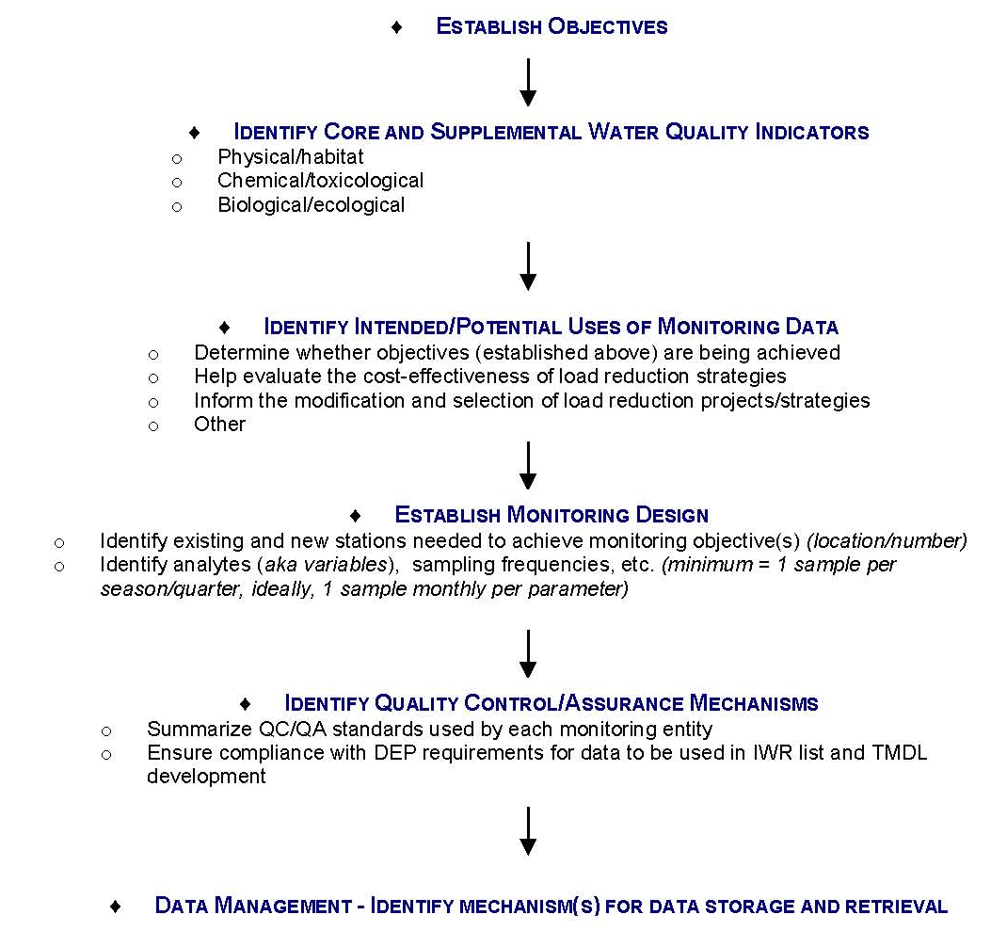
Monitoring Plan Development

Slide 27
Monitoring Plan Objectives
The second step in developing the monitoring plan is to determine the objectives of the plan.
Draft primary and secondary objectives were prepared for discussion.
Primary objectives are necessary to evaluate success of the BMAP.
Secondary objectives contribute to this evaluation, can help interpret data collected, and provide information for potential future refinements of the TMDL and/or BMAP.

Slide 28
Draft Monitoring Plan Objectives
The following objectives were drafted for discussion.
Primary Objective:
  Track inputs and trends in TN and TP loads in the major tributaries and Smith Canal.
Secondary Objective:
  Identify areas within the watershed with high loadings of nutrients to better focus management efforts.

Slide 29
Questions
Notes:
Added a graphic.

