Slide 1
Lakes Harney and Monroe and Middle St. Johns River Basin Management Action Plan
Policy Makers Briefing
March 15, 2012

Slide 2
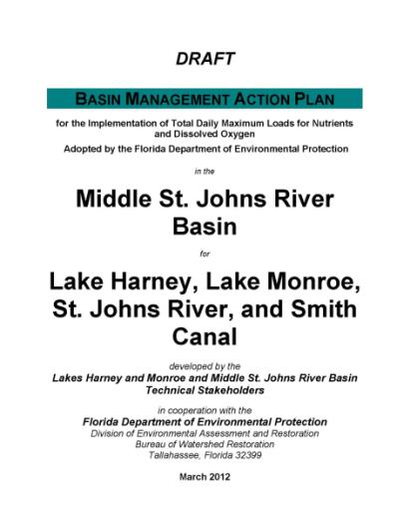
Overview of the BMAP

Slide 3
Chapter 1: Context, Purpose, and Scope of the Plan

Slide 4
Stakeholder Involvement
Technical meetings began in October 2010.
  The purpose of these meetings was for technical stakeholders to gather information to aid in BMAP development and to identify management actions to reduce nutrients.
Policy briefings began in November 2011.
  The purpose of the briefings was to obtain feedback on the BMAP process from the policy makers from each responsible BMAP entity.

Slide 5
BMAP Purpose and Scope
The purpose of the BMAP is to implement total nitrogen (TN) and total phosphorus (TP) reductions to achieve the total maximum daily loads (TMDLs) for Lake Harney, Lake Monroe, and the Middle St. Johns River (MSJR).
A separate TMDL was adopted for Smith Canal, which is largely within the BMAP basin.
  Therefore, the Smith Canal watershed was included in the BMAP.

Slide 6
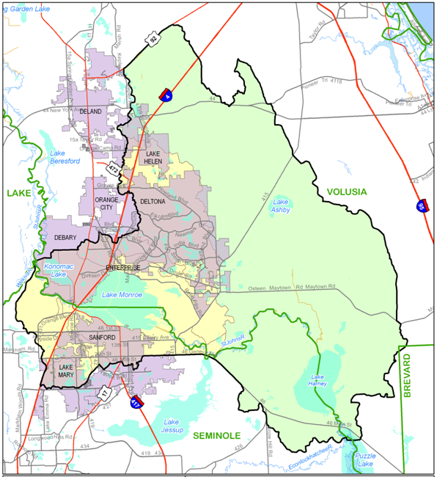
Notes:
The map shows the entire watershed (or drainage) area for this section of the St. Johns River. The area that drains to the river is the focus of this BMAP. The Lake Harney watershed is much larger and mostly unincorporated area. The Lake Monroe watershed is more developed. Note that a very small portion of Brevard County and Lake County are included in the watershed. These areas only have natural land uses (water, wetlands, and forest) so these counties were not included in the BMAP allocations.

Slide 7
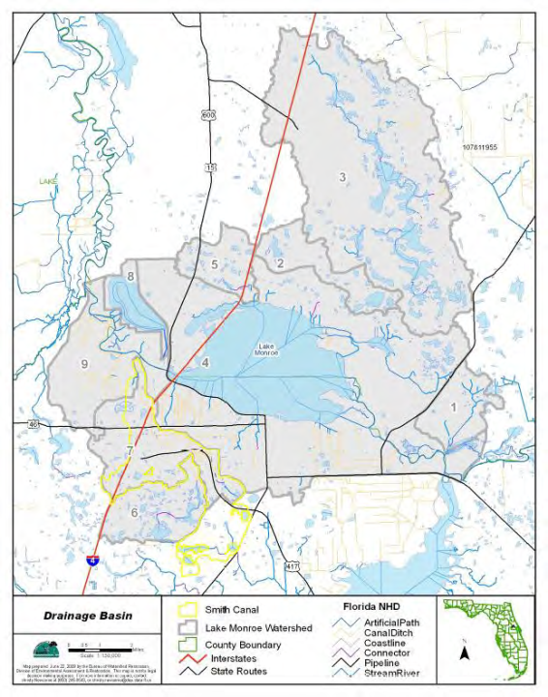
Notes:
This map shows the Smith Canal watershed in yellow. Most of this watershed overlaps with the BMAP basin. The small portion outside of the basin is included in the Lake Jesup BMAP.

Slide 8
BMAP Approach
The TMDL reductions will be achieved over a 15-year period.
The first iteration of the BMAP will cover a 5-year period.
  Approximately mid-2012 through mid-2017.
Each entity is required to achieve 50% of their TN and TP reductions in this first iteration.
  The remainder of the reductions will be achieved by the end of the 15-year timeline.
Notes:
You may want to mention that EPA expects the state to create plans that address the impairments in 15 years or less.
You will likely need to explain that because much progress has already been made, reaching 50% in the next 5 years is very achievable while making progress on the reductions. The 15-year timeframe provides the maximum amount of time to secure funding to implement the projects to make 100% of the reductions.

Slide 9
TMDLs Addressed in the BMAP
The TMDLs for the Lakes Harney and Monroe and MSJR Basin were adopted by the Florida Department of Environmental Protection (FDEP) in December 2009.
The Smith Canal TMDL was adopted by FDEP in September 2009.
The waterbodies in the basin were divided into smaller assessment units or waterbody identification (WBID) numbers.

Slide 10
Components of a TMDL
A TMDL includes the following components:
  Wasteload allocation (WLA) for point sources:
    Wastewater (ww); and
    Permitted stormwater (sw).
  Load allocation (LA) for nonpoint sources.
Notes:
This distinction is important here because stormwater from permitted MS4 systems are considered to be point sources even though stormwater is discharged from many location. The wasteload allocations in the BMAP will be linked to the MS4 permits in the basin. Nonpoint sources as defined in the TMDL are the other stormwater sources such as agriculture and urban stormwater from areas outside an MS4 system.

Slide 11
TMDL Required Reductions
WBID | Parameter | TMDL (lbs/yr) | WLAww (lbs/yr) | WLAsw | LA (lbs/yr)
2964 A | TN | 3,355,570 | 0 | 39% | 3,355,570
2964 A | TP | 241,026 | 0 | 33% | 241,026
2964 + 2893F | TN | 3,741,990 | 0 | 37% | 3,741,990
2964 + 2893F | TP | 276,141 | 0 | 32% | 276,141
2893D + 2893E | TN | 4,171,255 | 0 | 38% | 4,171,255
2893D + 2893E | TP | 315,512 | 0 | 31% | 315,512
2893C | TN | 4,202,340 | 19,342 | 37% | 4,182,998
2893C | TP | 318,236 | 2,345 | 31% | 315,891
2962 | TP | 4,300 | 0 | 26% | 26%
Notes:
Make sure to describe what the wastewater sources are. Note: The last WBID, 2962, is Smith Canal.

Slide 12
Assumptions and Considerations
Upstream contributions to the impaired waterbodies - the watershed makes up a small percentage of the total loading:
  Approximately 3% of the TN loads and 4% of the TP loads.
  Reductions from the Upper St. Johns River, Econlockhatchee River, and Lake Jesup are key to meeting the water quality targets.
Notes:
These were identified during the BMAP process as items that should be addressed in future iterations of the BMAP.

Slide 13
Assumptions and Considerations, con’t
Noncontributing areas – areas not included in the model were identified within the City of DeBary and Volusia County and there may be additional areas within Seminole County.
  Consideration will be given to adding these areas to the model to update the loading.
Basin and subbasin boundaries – more accurate topography data have been collected by Volusia and Seminole Counties.
  This information may be used to adjust boundaries, as needed.

Slide 14
Assumptions and Considerations, con’t
Agricultural land uses – there have been changes in the amount of agriculture in the basin and the types of commodities since the land use in the model.
  The agricultural load reductions will be revised in the future, as needed, based on these changes.
Updated land uses – the TMDL model includes 2004 land uses. Consideration will be given to more recent land use coverages in future iterations.

Slide 15
Addressing Future Growth
Section 403.067(7)(a)(2), Florida Statutes, requires: BMAPs to:
  “…identify the mechanisms by which potential future increases in pollutant loading will be addressed.”
The BMAP will not include an allocation for new development.
New discharges cannot increase existing load and must meet “net environmental improvement” for the Environmental Resource Permit (ERP) program requirements.
Notes:
Make sure to explain why the policy approach in the second bullet is helpful and doesn’t force them to make additional reductions to provide a buffer for future growth.

Slide 16
Reducing Loads from Growth
Local governments are encouraged to pursue measures to control loads from future growth such as:
  Low impact development (LID) standards;
  Florida friendly landscaping; and
  Modifications to local development regulations.
Notes:
Maybe chat a little about source control and how that is more efficient and much more cost effective than removing nutrients already in the system.

Slide 17
Comments and Questions on Chapter 1
Allocation Stakeholders:
  Seminole County
  Volusia County
  City of DeBary
  City of Deltona
  City of Lake Mary
  City of Sanford
  FDOT District 5
  Agriculture
De Minimus Stakeholders:
  City of DeLand
  City of Lake Helen
  City of Orange City
  Turnpike Authority
Other Interested Parties
Notes:
Ask for comments and questions from the allocation stakeholders first, then de minimus stakeholders, and then other attendees.

Slide 18
Chapter 2: Lakes Harney and Monroe and MSJR Basin Setting

Slide 19
Land Uses in the Basin
The Lake Harney basin is mainly natural land uses (72% of the area). Agricultural land uses are 22% and urban land uses are 6% of the total area.
The Lake Monroe basin is mainly urban land uses (45% of the total area). Natural land uses are about 41% and agricultural land uses are 14% of the total area.
The Smith Canal basin is 42.8% urban land uses, 46% natural land uses, and 11.3% agricultural land uses.

Slide 20
Basin Hydrology
The TMDL model includes two major basins: Lake Harney basin and Lake Monroe basin.
The Lake Harney basin is made up of 11 subbasins and the Lake Monroe basin is made up of 8 subbasin.
Subbasin 14 in the Lake Monroe basin is a closed basin.
Subbasins 9 and 10 in the Lake Harney basin drain outside the watershed.
Notes:
Subbbasin 14 is a closed basin meaning the flow and loading in this area does not affect the impaired waterbodies. Therefore, this area was not included in the allocations. Subbasins 9 and 10 drain outside the watershed and were also not included in the allocations since they are not part of the watershed loading.

Slide 21
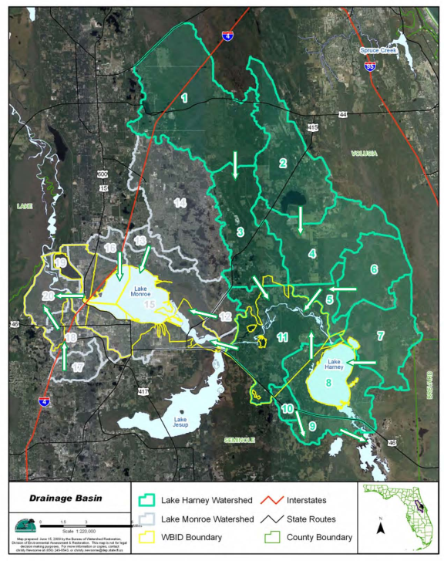
Notes:
Lake Harney basin is in green and the Lake Monroe Basin is gray. Show Subbasin 14 and note that there is no flow arrow, which indicates a closed basin. Show Subbasins 9 and 10 and note the flow areas pointing outside the watershed.

Slide 22
Water Quality Trends
The TMDL analyzed water quality from 1996 through 2007 for chlorophyll-a, dissolved oxygen (DO), TN, and TP .
High chlorophyll-a concentrations were typically observed in May to September each year.
DO concentrations below the standard of 5 mg/L were found in July to September.
There were no obvious seasonal trends for TN.
TP concentrations were typically low at the beginning of the year and reached a peak in the middle of the year.
Notes:
Conditions in the summer months are conducive to algal growth causing higher chlorophyll-a levels. The warmer months also cause a decrease in DO levels.

Slide 23
Comments and Questions on Chapter 2
Allocation Stakeholders:
  Seminole County
  Volusia County
  City of DeBary
  City of Deltona
  City of Lake Mary
  City of Sanford
  FDOT District 5
  Agriculture
De Minimus Stakeholders:
  City of DeLand
  City of Lake Helen
  City of Orange City
  Turnpike Authority
Other Interested Parties
Notes:
Ask for comments and questions from the allocation stakeholders first, then de minimus stakeholders, and then other attendees.

Slide 24
Chapter 3: Pollutant Sources and Anticipated Outcomes

Slide 25
Sources in the TMDL
Wastewater treatment facilities (WWTFs);
Municipal separate storm sewer systems (MS4s);
Nonpoint stormwater sources;
Agriculture;
Failing septic tanks within 50 feet of a waterbody;
Groundwater;
Atmospheric deposition directly on the waterbodies;
Upstream St. Johns River and Econlockhatchee River sources; and
Lake Jesup sources.
Notes:
It is important to recognize all the potential sources to the waterbody. For one, it helps us fairly allocate reductions among the sources. Also, it helps to understand what sources are outside our control and what sources we can reduce.

Slide 26
Sources, continued
Reductions are only required for:
  WWTFs (assigned an allocation in the TMDL);
  MS4s;
  Nonpoint stormwater sources;
  Agriculture; and
  Failing septic tanks within 50 feet of a waterbody.
Groundwater and atmospheric deposition are considered natural background.
Reductions for upstream river sources and Lake Jesup sources will be achieved through other plans.
Notes:
Therefore, the reductions in this BMAP are not very large compared to reductions needed from upstream. It is important that they understand that the stakeholders in those upstream areas will be responsible for those reductions. We are focusing here on only the reductions needed within this basin. Additional reductions will be needed to meet the chl-a and TSI targets, but those reductions will be assigned to upstream sources and, for Lake Jesup, have already been assigned in the Lk. Jesup BMAP.

Slide 27
Stakeholders in the BMAP
Sanford North WWTF
MS4s
  Seminole County
  Volusia County
  City of DeBary
  City of Deltona
  City of Lake Helen
  City of Lake Mary
  City of Sanford
  FDOT District 5
  Turnpike Authority
Non-MS4s
  City of DeLand
  City of Orange City
Agriculture

Slide 28
Enforcement of BMAPs
A BMAP is developed collaboratively with stakeholders to meet provisions in Section 403.067(7), Florida Statutes ( F.S.).
For point sources, BMAPs are enforceable through WWTF and MS4 National Pollutant Discharge Elimination System (NPDES) permits.
For nonpoint sources, BMAP projects are enforceable through the BMAP itself.
For agriculture, best management practices (BMPs) or monitoring is required.
BMAPs are adopted by FDEP Secretarial Order.
Notes:
Use this slide as an opportunity to explain that for MS4 permittees and wastewater facilities, the BMAP becomes a compliance schedule to meet the reductions assigned. Without a BMAP, EPA or FDEP could assign a compliance schedule, so a big benefit to a BMAP is that the stakeholders can outline their own project schedule and show EPA that they are compliant with the TMDL as long as they are compliant with the reduction schedule in the BMAP. The TMDL (Sanford WWTF) and BMAP reductions are linked to the NPDES permits, so while the BMAP is developed collaboratively, it does become a regulatory mechanism once it is adopted.

Slide 29
Anticipated Outcomes of BMAP Implementation
Improved water quality trends in the watershed tributaries and Smith Canal;
Decreased loading of TN and TP;
Increased coordination between state and local governments;
Determination of effective projects;
Enhanced public awareness of pollutant sources, pollutant impacts on water quality, and corresponding corrective actions; and
Enhanced understanding of basin hydrology, water quality, and pollutant sources.
Notes:
These are outcomes that we hope to achieve though the BMAP implementation. Note the focus on improved water quality in tributaries and Smith Canal and not the impaired waterbodies due to the large influence of sources outside the watershed.

Slide 30
Comments and Questions on Chapter 3
Allocation Stakeholders:
  Seminole County
  Volusia County
  City of DeBary
  City of Deltona
  City of Lake Mary
  City of Sanford
  FDOT District 5
  Agriculture
De Minimus Stakeholders:
  City of DeLand
  City of Lake Helen
  City of Orange City
  Turnpike Authority
Other Interested Parties
Notes:
Ask for comments and questions from the allocation stakeholders first, then de minimus stakeholders, and then other attendees.

Slide 31
Chapter 4: Detailed Allocations

Slide 32
Target Load per Acre Approach
Target loads per acre for TN and TP were determined for the entire BMAP basin.
The target loads per acre were then multiplied by each entity’s acreage to determine the total allowable TN and TP loading.
This approach was selected to focus reductions on those areas with the highest TN and TP loadings in the watershed.

Slide 33
Calculating Starting Loads
Starting loads are the TN and TP loading estimates for each entity based on the TMDL model.
Each entity’s starting load was determined using the jurisdictional boundaries provided by the stakeholders.
Natural areas were removed from the stakeholders’ starting loads because the TMDL does not require load reductions from natural land uses.
All loads from agricultural land uses were assigned to agriculture, not the local governments.

Slide 34
De minimus Entities
De minimus entities are those stakeholders with such small loadings that they are not significant contributors.
DeLand, Lake Helen, Orange City, and Turnpike Authority were identified as de minimus.
  Each contribute less than 1% of the total load and combined they contribute approximately 1% of the total load.
These entities were not assigned an allocation for the first iteration of the BMAP.
The loads associated with these entities were not reallocated to the other stakeholders in the basin.

Slide 35
Target Load per Acre for TN
Entity | Acres | TN Target (lbs/acre/yr) | Target Load (lbs/yr) | TN Starting Load (lbs/yr) | TN Required Reduction (lbs/yr) | % TN Reduction
Agriculture | 20,250.3 | 4.34 | 87,886.3 | 130,168.2 | 42,281.9 | 32.5%
DeBary | 3,720.3 | 4.34 | 16,146.1 | 19,906.5 | 3,760.4 | 18.9%
Deltona | 4,189.5 | 4.34 | 18,182.4 | 25,399.8 | 7,217.4 | 28.4%
FDOT | 1,762.3 | 4.34 | 7,648.4 | 10,112.0 | 2,463.6 | 24.4%
Lake Mary | 1,639.2 | 4.34 | 7,114.1 | 6,572.0 | 0.0 | 0.0%
Sanford | 4,764.6 | 4.34 | 20,678.4 | 41,398.4 | 20,720.0 | 50.1%
Seminole County | 6,027.2 | 4.34 | 26,158.0 | 34,105.1 | 7,947.1 | 23.3%
Volusia County | 5,356.2 | 4.34 | 23,245.9 | 26,511.6 | 3,265.7 | 12.3%
DeLand - de minimus | 37.5 | 4.34 | 162.8 | 192.0 | 0.0 | 0.0%
Lake Helen - de minimus | 347.8 | 4.34 | 1,509.5 | 2,052.4 | 0.0 | 0.0%
Orange City - de minimus | 18.9 | 4.34 | 82.0 | 105.4 | 0.0 | 0.0%
Turnpike - de minimus | 342.5 | 4.34 | 1,486.5 | 1,240.1 | 0.0 | 0.0%
Total | 48,456.3 | N/A | 210,300.3 | 297,763.5 | 87,656.1 | N/A
Notes:
Explain that Sanford has higher reductions because they are very urban and right on Lake Monroe. The purpose of the target load per acre approach is to focus on those areas of high loading that have the most impact on the impaired waterbodies.

Slide 36
Target Load per Acre TP
Entity | Acres | TP Target (lbs/acre/yr) | Target Load (lbs/yr) | TP Starting Load (lbs/yr) | TP Required Reduction (lbs/yr) | % TP Reduction
Agriculture | 20,250.3 | 0.80 | 16,200.2 | 29,970.4 | 13,770.2 | 45.9%
DeBary | 3,720.3 | 0.80 | 2,976.2 | 3,149.0 | 172.8 | 5.5%
Deltona | 4,189.5 | 0.80 | 3,351.6 | 4,128.2 | 776.6 | 18.8%
FDOT | 1,762.3 | 0.80 | 1,409.8 | 1,325.3 | 0.0 | 0.0%
Lake Mary | 1,639.2 | 0.80 | 1,311.4 | 948.9 | 0.0 | 0.0%
Sanford | 4,764.6 | 0.80 | 3,811.7 | 6,490.8 | 2,679.1 | 41.3%
Seminole County | 6,027.2 | 0.80 | 4,821.8 | 5,132.7 | 310.9 | 6.1%
Volusia County | 5,356.2 | 0.80 | 4,285.0 | 3,828.7 | 0.0 | 0.0%
DeLand - de minimus | 37.5 | 0.80 | 30.0 | 14.8 | 0.0 | 0.0%
Lake Helen - de minimus | 347.8 | 0.80 | 278.2 | 297.0 | 0.0 | 0.0%
Orange City - de minimus | 18.9 | 0.80 | 15.1 | 16.6 | 0.0 | 0.0%
Turnpike - de minimus | 342.5 | 0.80 | 274.0 | 108.5 | 0.0 | 0.0%
Total | 48,456.3 | N/A | 38,765.0 | 55,410.9 | 17,709.6 | N/A

Slide 37
Allocations for the First BMAP Iteration
Entity | TN 1st Iteration Reductions (50%) (lbs/yr) | TP 1st Iteration Reductions (50%) (lbs/yr)
Agriculture | 21,140.9 | 6,885.1
DeBary | 1,880.2 | 86.4
Deltona | 3,608.7 | 388.3
FDOT | 1,231.8 | 0.0
Lake Mary | 0.0 | 0.0
Sanford | 10,360.0 | 1,339.6
Seminole County | 3,973.5 | 155.5
Volusia County | 1,632.8 | 0.0
DeLand – de minimus | 0.0 | 0.0
Lake Helen – de minimus | 0.0 | 0.0
Orange City – de minimus | 0.0 | 0.0
Turnpike – de minimus | 0.0 | 0.0
Total | 43,828.0 | 8,854.8
Notes:
Plan on explaining the zeros.

Slide 38
Comments and Questions on Chapter 4
Allocation Stakeholders:
  Seminole County
  Volusia County
  City of DeBary
  City of Deltona
  City of Lake Mary
  City of Sanford
  FDOT District 5
  Agriculture
De Minimus Stakeholders:
  City of DeLand
  City of Lake Helen
  City of Orange City
  Turnpike Authority
Other Interested Parties
Notes:
Ask for comments and questions from the allocation stakeholders first, then de minimus stakeholders, and then other attendees.

Slide 39
Chapter 5: Management Actions

Slide 40
Project Collection
To achieve the TN and TP required reductions, each responsible entity provided projects and programs that reduce nutrient loads.
Projects completed since January 1, 2003 and later are eligible for credit.
All projects must be located in the Lakes Harney and Monroe BMAP Basin and must address nutrients.
Credit only counts for treatment above and beyond any permitted requirements.

Slide 41
Types of Projects Eligible for Credit
Retention BMPs (such as basins and exfiltration trenches);
Wet detention ponds;
Treatment trains;
Dry detention;
Baffle box (1st generation);
Nutrient baffle box (2nd generation);
Catch basin inserts/inlet filters;
Grass;
Alum injection;
Stormceptor;
Continuous deflective separation (CDS) unit (TP only);
Street sweeping; and
Public education and outreach efforts.
Notes:
I would not read all these but mention that the common stormwater treatment controls are eligible for credit if they are reducing existing loads (and not just abating new development) for net improvement. Also, source control efforts can be counted for credit such as street sweeping, catch basin clean outs and public education efforts that focus on keeping sources from getting into the stormwater. Individual prevention measures can really add up—lawn litter, fertilizer, pet waste, and trash and debris in the gutter are all controllable sources. The more a community prevents these sources from entering the water, the cleaner the stormwater will be and the less projects needed to treat the stormwater.

Slide 42
TP Reductions
Entity | TP Total Required Reduction (lbs/yr) | TP Credit for Submitted Projects (lbs/yr) | % TP Reductions Achieved
Agriculture | 13,770.2 | 6,554.0 | 47.6%
DeBary | 172.8 | 2,207.0 | 1,277.2%
Deltona | 776.6 | 1,229.9 | 158.4%
FDOT | 0.0 | 1,210.7 | 100.0%
Lake Mary | 0.0 | 58.6 | 100.0%
Sanford | 2,679.1 | 4,897.3 | 100.0%
Seminole County | 310.9 | 1,905.9 | 182.8%
Volusia County | 0.0 | 358.3 | 613.0%
DeLand – de minimus | 0.0 | 0.7 | 100.0%
Lake Helen – de minimus | 0.0 | 4.5 | 100.0%
Orange City – de minimus | 0.0 | 0.2 | 100.0%
Turnpike – de minimus | 0.0 | 14.4 | 100.0%
Total | 17,709.6 | 18,441.5 | 104.1%
Notes:
Note that DeBary’s high load reduction is from the fact that they had noncontributing areas that we treated as 100% retention. The urban stakeholders have achieved ALL of the TP required reductions. More discussion will be included on the agricultural reductions in later slides. Although more TP reductions have occurred than required, we still need reductions from the agricultural lands. The noncontributing areas may be handled differently in the iteration which would change some of the “credit” we assigned for those areas.

Slide 43
TN Reductions
Entity | TN Total Required Reduction (lbs/yr) | TN Credit for Submitted Projects (lbs/yr) | % TN Reductions Achieved
Agriculture | 42,281.9 | 36,422.6 | 86.1%
DeBary | 3,760.4 | 13,561.7 | 360.6%
Deltona | 7,217.4 | 7,151.3 | 99.1%
FDOT | 2,463.6 | 3,210.7 | 130.3%
Lake Mary | 0.0 | 371.0 | 100.0%
Sanford | 20,720.0 | 12,973.9 | 62.6%
Seminole County | 7,947.1 | 7,637.8 | 96.1%
Volusia County | 3,265.7 | 2,213.6 | 67.8%
DeLand – de minimus | 0.0 | 9.1 | 100.0%
Lake Helen – de minimus | 0.0 | 30.8 | 100.0%
Orange City – de minimus | 0.0 | 1.3 | 100.0%
Turnpike – de minimus | 0.0 | 21.6 | 100.0%
Total | 87,656.1 | 83,605.4 | 95.4%
Notes:
All of the stakeholders have submitted enough projects to meet at least the 50% of required reductions for the first BMAP iteration.

Slide 44
Progress Towards Agricultural Reductions
In the first five year BMAP period, the Florida Department of Agriculture and Consumer Services (FDACS) is proposing to implement BMPs on 90% of the agricultural lands.
Reductions were also assigned to agriculture for changes in land uses, either to urban uses or less intensive agriculture.
FDACS, FDEP, and the St. Johns River Water Management (SJRWMD) will determine a plan to achieve additional TP reductions.
Notes:
From the previous slides, agriculture has achieved 47.6% of the TP reductions and 86.1% of the TN reductions. Additional TP reductions are needed to achieve the first iteration requirements. This may be done through cost-share BMPs, which achieve more reductions, water management efforts, or regional treatment projects. Details on how the additional TP reductions will be met will be described in the annual reports.

Slide 45
Comments and Questions on Chapter 5
Allocation Stakeholders:
  Seminole County
  Volusia County
  City of DeBary
  City of Deltona
  City of Lake Mary
  City of Sanford
  FDOT District 5
  Agriculture
De Minimus Stakeholders:
  City of DeLand
  City of Lake Helen
  City of Orange City
  Turnpike Authority
Other Interested Parties
Notes:
Ask for comments and questions from the allocation stakeholders first, then de minimus stakeholders, and then other attendees.

Slide 46
Chapter 6: Assessing Progress and Making Changes

Slide 47
Purpose of the Monitoring Plan
A monitoring plan is a required component in a BMAP.
The main purpose of the monitoring plan is to track trends in water quality to show progress towards achieving the TMDLs.
Other objectives can be identified and addressed through the BMAP monitoring plan.

Slide 48
Monitoring Plan Objectives
Primary objective: Track inputs and trends in TN and TP loads in the major tributaries and Smith Canal.
Secondary objective: Identify areas within the watershed with high loadings of nutrients to better focus management efforts.
Notes:
Note the primary objective focuses on tribs and Smith Canal because we will not see major changes in water quality in the impaired waterbodies until the sources outside the watershed are reduced.

Slide 49
Monitoring by Stakeholders
The following stakeholders have agreed to continue or add monitoring in the basin:
  City of Deltona;
  City of Sanford
  Seminole County;
  SJRWMD; and
  Volusia County.
Data from several U.S. Geological Survey (USGS) stations will also be used.

Slide 50
Monitoring Network
The water quality monitoring network includes 24 water quality stations and 3 USGS flow stations.
  The water quality stations will be sampled monthly for the parameters noted in the BMAP.
Biological and vegetation monitoring is also conducted in Lakes Harney and Monroe by Seminole County and SJRWMD.
  This information will be used to improve understanding of the lakes and to identify changes due to reductions in nutrients.

Slide 51
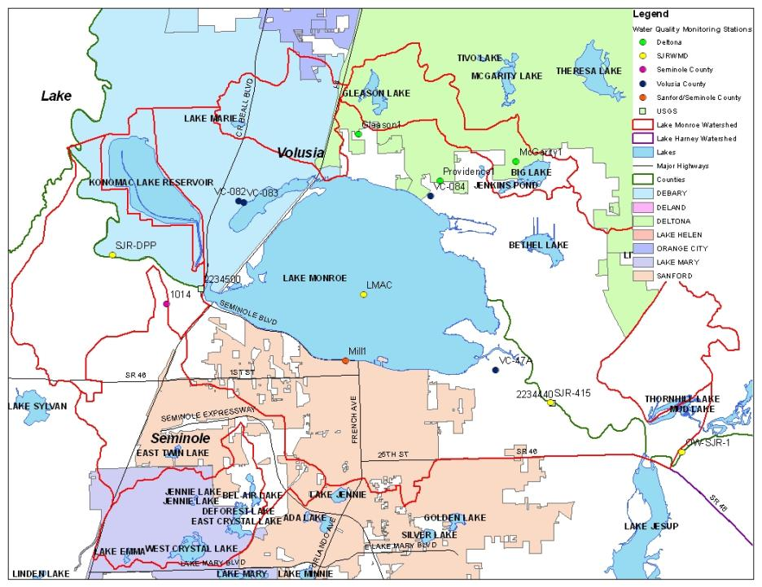
Notes:
This map shows the water quality monitoring in the Lake Monroe Basin. Provided as an example of the level of effort for the monitoring plan.

Slide 52
Tracking Implementation
FDEP will work with the stakeholders to organize the monitoring data and track project implementation.
This information will be organized into annual progress reports.
The stakeholders will meet at least annually to review progress and modify project lists and the monitoring plan, as needed.

Slide 53
Comments and Questions on Chapter 6
Allocation Stakeholders:
  Seminole County
  Volusia County
  City of DeBary
  City of Deltona
  City of Lake Mary
  City of Sanford
  FDOT District 5
  Agriculture
De Minimus Stakeholders:
  City of DeLand
  City of Lake Helen
  City of Orange City
  Turnpike Authority
Other Interested Parties
Notes:
Ask for comments and questions from the allocation stakeholders first, then de minimus stakeholders, and then other attendees.

Slide 54
Chapter 7: Commitment to Plan Implementation

Slide 55
Commitment to the BMAP
The stakeholders have worked collaboratively to develop the BMAP.
The responsible entities have committed to the activities in the BMAP to achieve TMDL reductions.
This chapter will include letters of commitment or resolutions of support for the BMAP provided by the stakeholders.

Slide 56
Letters of Commitment
Providing a letter of commitment or resolution of support for the BMAP is not required.
However, stakeholders in other basins have stated that having this letter provides a way to show support for the BMAP as staff and board/commission members change over time.
An example letter was provided. The wording and format can be modified to meet each stakeholder’s needs.

Slide 57
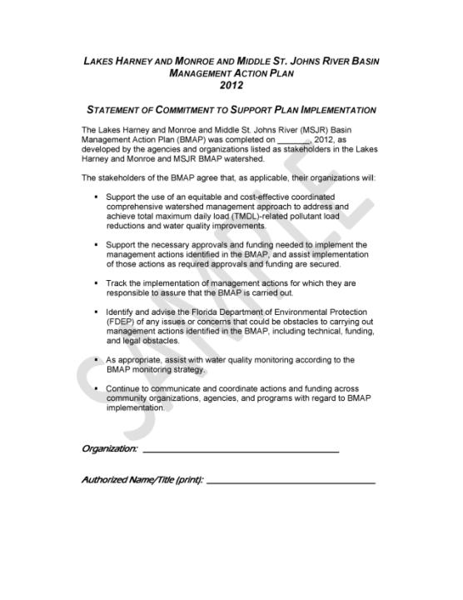
Notes:
This is the example letter of commitment provided. A hardcopy was provided as a handout and the Word version was emailed with the meeting notice.

Slide 58
Comments and Questions on Chapter 7
Allocation Stakeholders:
  Seminole County
  Volusia County
  City of DeBary
  City of Deltona
  City of Lake Mary
  City of Sanford
  FDOT District 5
  Agriculture
De Minimus Stakeholders:
  City of DeLand
  City of Lake Helen
  City of Orange City
  Turnpike Authority
Other Interested Parties
Notes:
Ask for comments and questions from the allocation stakeholders first, then de minimus stakeholders, and then other attendees.

Slide 59
Appendices

Slide 60
BMAP Appendices
Appendix A: TMDL Basin Rotation Schedule
  Explains the FDEP watershed assessment cycle.
Appendix B: Summary of Statutory Provisions Guiding BMAP Development and Implementation
  Includes excerpts from Sections 403.067(6) and (7) in Florida Statutes
Appendix C: Stakeholder Involvement in BMAP Development
  History of the technical meetings and policy briefings

Slide 61
BMAP Appendices, continued
Appendix D: Summary of EPA-Recommended Elements of a Comprehensive Watershed Plan
  Outlines key elements in a watershed plan; necessary to obtain certain types of funding.
Appendix E: Projects to Achieve the TMDL
  Important appendix – project tables for each stakeholder.
Appendix F: Glossary of Terms
Appendix G: Bibliography of Key References and Websites

Slide 62
Comments and Questions on Appendices
Allocation Stakeholders:
  Seminole County
  Volusia County
  City of DeBary
  City of Deltona
  City of Lake Mary
  City of Sanford
  FDOT District 5
  Agriculture
De Minimus Stakeholders:
  City of DeLand
  City of Lake Helen
  City of Orange City
  Turnpike Authority
Other Interested Parties
Notes:
Ask for comments and questions from the allocation stakeholders first, then de minimus stakeholders, and then other attendees.

Slide 63
Steps to BMAP Adoption and Proposed Schedule

Slide 64
Stakeholder and FDEP Staff Actions
Action | Responsible Party | Date
Policy briefing on Final Draft BMAP | FDEP, Policy Makers, and Technical Stakeholders | March 15, 2012 (Today)
Public meeting on BMAP | Public/FDEP | Early-April 2012
Public comment period closes (30 days) | FDEP | Early-May 2012
Review of public comments by staff complete | FDEP | Mid-May 2012
Letters of commitment due for inclusion in BMAP package to FDEP Secretary | Policy Makers and Technical Stakeholders | End-May 2012
Notes:
These are the steps the stakeholders are involved in to complete the BMAP. Describe what occurs in each step. Note proposed date for the public meeting – April 19th at 6:00 PM at the Deltona Library.

Slide 65
FDEP Secretarial Adoption Process
Action | Date
Brief FDEP DEAR management on BMAP | Early-June 2012
Brief FDEP Deputy Secretary on BMAP | Mid-June 2012
Brief FDEP Secretary on BMAP and obtain Secretarial approval | End-June 2012
Notify interested parties | End-June 2012
End of challenge period (21-days after notice) | End-July 2012
BMAP adopted and enforceable (if there are no challenges) | End-July 2012
Notes:
These are the steps that occur internally within FDEP to adopt the BMAP. The timeline is estimated.

Slide 66
Questions?

