Slide 1
Lakes Harney and Monroe and Middle St. Johns River Basin Management Action Plan
Public Workshop
April 19, 2012

Slide 2
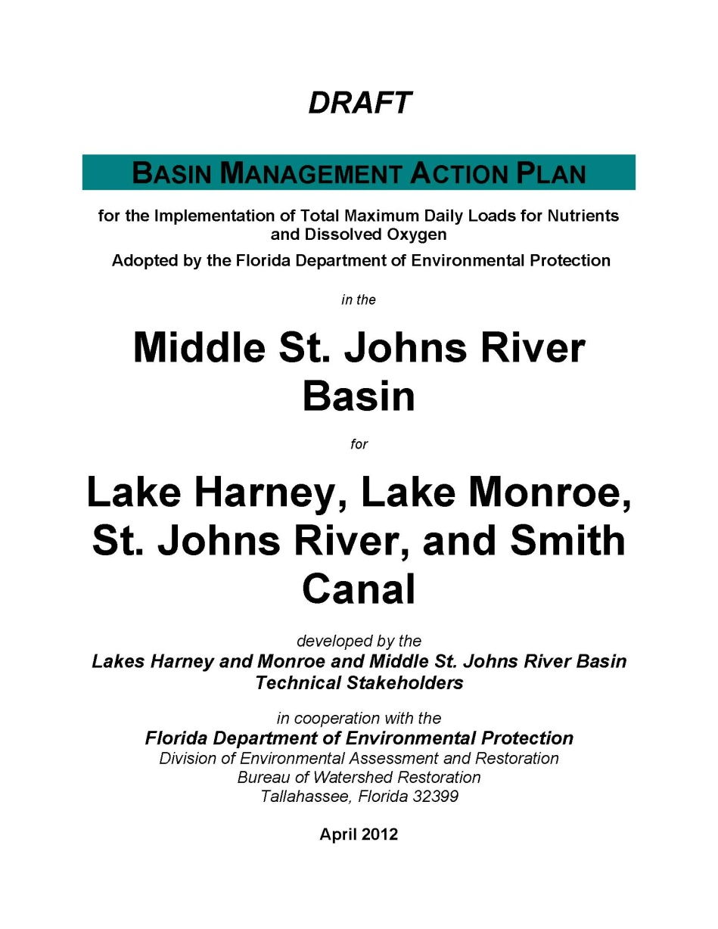
Overview of the BMAP

Slide 3
Chapter 1: Context, Purpose, and Scope of the Plan

Slide 4
Stakeholder Involvement
Technical meetings began in October 2010.
  The purpose of these meetings was for technical stakeholders to gather information to aid in BMAP development and to identify management actions to reduce nutrients.
Policy briefings began in November 2011.
  The purpose of the briefings was to obtain feedback on the BMAP process from the policy makers from each responsible BMAP entity.

Slide 5
BMAP Purpose and Scope
The purpose of the BMAP is to implement total nitrogen (TN) and total phosphorus (TP) reductions to achieve the total maximum daily loads (TMDLs) for Lake Harney, Lake Monroe, and the Middle St. Johns River (MSJR).
A separate TMDL was adopted for Smith Canal, which is largely within the BMAP basin.
  Therefore, the Smith Canal watershed was included in the BMAP.

Slide 6
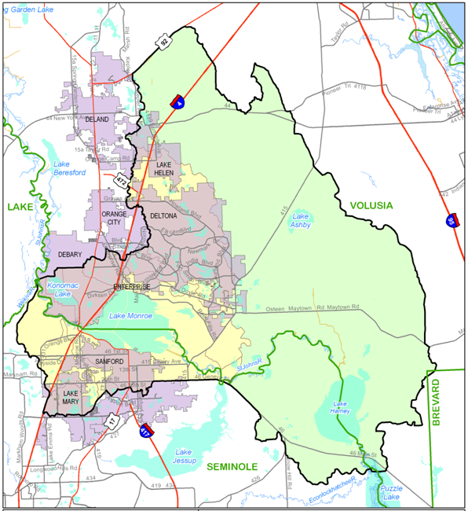

Slide 7
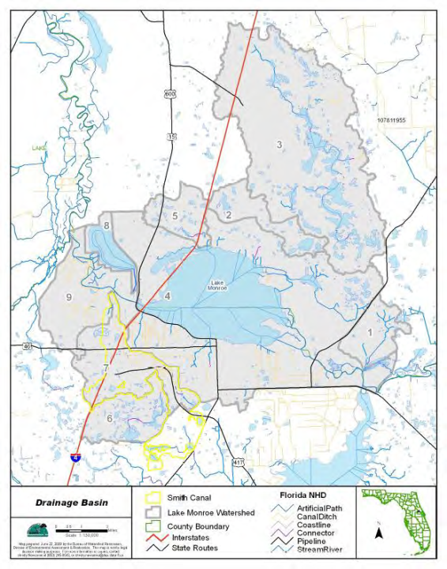

Slide 8
BMAP Approach
The TMDL reductions will be achieved over a 15-year period.
The first iteration of the BMAP will cover a 5-year period.
  Approximately mid-2012 through mid-2017.
Each entity is required to achieve 50% of their TN and TP reductions in this first iteration.
  The remainder of the reductions will be achieved by the end of the 15-year timeline.

Slide 9
TMDLs Addressed in the BMAP
The TMDLs for the Lakes Harney and Monroe and MSJR Basin were adopted by the Florida Department of Environmental Protection (FDEP) in December 2009.
The Smith Canal TMDL was adopted by FDEP in September 2009.
The waterbodies in the basin were divided into smaller assessment units or waterbody identification (WBID) numbers.

Slide 10
Components of a TMDL
A TMDL includes the following components:
  Wasteload allocation (WLA) for point sources:
    Wastewater (ww); and
    Permitted stormwater (sw).
  Load allocation (LA) for nonpoint sources.

Slide 11
TMDL Required Reductions
WBID | Parameter | TMDL (lbs/yr) | WLAww (lbs/yr) | WLAsw | LA (lbs/yr)
2964 A | TN | 3,355,570 | 0 | 39% | 3,355,570
2964 A | TP | 241,026 | 0 | 33% | 241,026
2964 + 2893F | TN | 3,741,990 | 0 | 37% | 3,741,990
2964 + 2893F | TP | 276,141 | 0 | 32% | 276,141
2893D + 2893E | TN | 4,171,255 | 0 | 38% | 4,171,255
2893D + 2893E | TP | 315,512 | 0 | 31% | 315,512
2893C | TN | 4,202,340 | 19,342 | 37% | 4,182,998
2893C | TP | 318,236 | 2,345 | 31% | 315,891
2962 | TP | 4,300 | 0 | 26% | 26%

Slide 12
Addressing Future Growth
Section 403.067(7)(a)(2), Florida Statutes, requires: BMAPs to:
  “…identify the mechanisms by which potential future increases in pollutant loading will be addressed.”
The BMAP does not include an allocation for new development.
New discharges cannot increase existing load and must meet “net environmental improvement” for the Environmental Resource Permit (ERP) program requirements.

Slide 13
Reducing Loads from Growth
Local governments are encouraged to pursue measures to control loads from future growth such as:
  Low impact development (LID) standards;
  Florida friendly landscaping; and
  Modifications to local development regulations.

Slide 14
Chapter 2: Lakes Harney and Monroe and MSJR Basin Setting

Slide 15
Land Uses in the Basin
The Lake Harney basin is mainly natural land uses (72% of the area). Agricultural land uses are 22% and urban land uses are 6% of the total area.
The Lake Monroe basin is mainly urban land uses (45% of the total area). Natural land uses are about 41% and agricultural land uses are 14% of the total area.
The Smith Canal basin is 42.8% urban land uses, 46% natural land uses, and 11.3% agricultural land uses.

Slide 16
Basin Hydrology
The TMDL model includes two major basins: Lake Harney basin and Lake Monroe basin.
The Lake Harney basin is made up of 11 subbasins and the Lake Monroe basin is made up of 8 subbasin.
Subbasin 14 in the Lake Monroe basin is a closed basin.
Subbasins 9 and 10 in the Lake Harney basin drain outside the watershed.

Slide 17
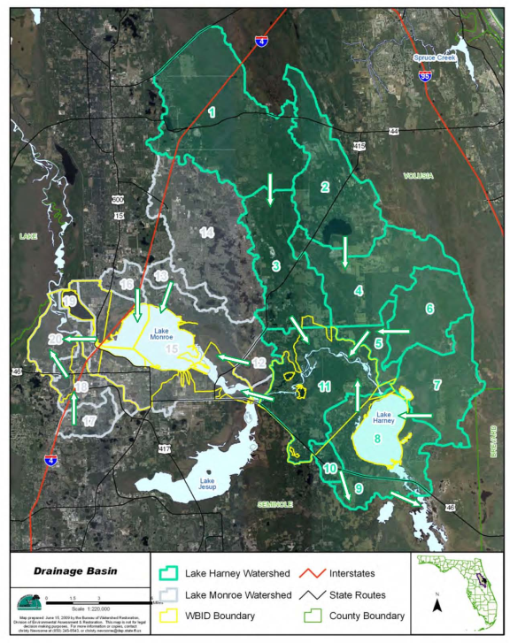

Slide 18
Chapter 3: Pollutant Sources and Anticipated Outcomes

Slide 19
Sources in the TMDL
Wastewater treatment facilities (WWTFs);
Municipal separate storm sewer systems (MS4s);
Nonpoint stormwater sources;
Agriculture;
Failing septic tanks within 50 feet of a waterbody;
Groundwater;
Atmospheric deposition directly on the waterbodies;
Upstream St. Johns River and Econlockhatchee River sources; and
Lake Jesup sources.

Slide 20
Sources, continued
Reductions are only required for:
  WWTFs (assigned an allocation in the TMDL);
  MS4s;
  Nonpoint stormwater sources;
  Agriculture; and
  Failing septic tanks within 50 feet of a waterbody.
Groundwater and atmospheric deposition are considered natural background.
Reductions for upstream river sources and Lake Jesup sources will be achieved through other plans.

Slide 21
Stakeholders in the BMAP
Sanford North WWTF
MS4s
  Seminole County
  Volusia County
  City of DeBary
  City of Deltona
  City of Lake Helen
  City of Lake Mary
  City of Sanford
  FDOT District 5
  Turnpike Authority
Non-MS4s
  City of DeLand
  City of Orange City
Agriculture

Slide 22
Enforcement of BMAPs
A BMAP is developed collaboratively with stakeholders to meet provisions in Section 403.067(7), Florida Statutes ( F.S.).
For point sources, BMAPs are enforceable through WWTF and MS4 National Pollutant Discharge Elimination System (NPDES) permits.
For nonpoint sources, BMAP projects are enforceable through the BMAP itself.
For agriculture, best management practices (BMPs) or monitoring is required.
BMAPs are adopted by FDEP Secretarial Order.

Slide 23
Anticipated Outcomes of BMAP Implementation
Improved water quality trends in the watershed tributaries and Smith Canal;
Decreased loading of TN and TP;
Increased coordination between state and local governments;
Determination of effective projects;
Enhanced public awareness of pollutant sources, pollutant impacts on water quality, and corresponding corrective actions; and
Enhanced understanding of basin hydrology, water quality, and pollutant sources.

Slide 24
Chapter 4: Detailed Allocations

Slide 25
Target Load per Acre Approach
Target loads per acre for TN and TP were determined for the entire BMAP basin.
The target loads per acre were then multiplied by each entity’s acreage to determine the total allowable TN and TP loading.
This approach was selected to focus reductions on those areas with the highest TN and TP loadings in the watershed.

Slide 26
Calculating Starting Loads
Starting loads are the TN and TP loading estimates for each entity based on the TMDL model.
Each entity’s starting load was determined using the jurisdictional boundaries provided by the stakeholders.
Natural areas were removed from the stakeholders’ starting loads because the TMDL does not require load reductions from natural land uses.
All loads from agricultural land uses were assigned to agriculture, not the local governments.

Slide 27
De minimus Entities
De minimus entities are those stakeholders with such small loadings that they are not significant contributors.
DeLand, Lake Helen, Orange City, and Turnpike Authority were identified as de minimus.
  Each contribute less than 1% of the total load and combined they contribute approximately 1% of the total load.
These entities were not assigned an allocation for the first iteration of the BMAP.
The loads associated with these entities were not reallocated to the other stakeholders in the basin.

Slide 28
Target Load per Acre for TN
Entity | Acres | TN Target (lbs/acre/yr) | Target Load (lbs/yr) | TN Starting Load (lbs/yr) | TN Required Reduction (lbs/yr) | % TN Reduction
Agriculture | 20,250.3 | 4.34 | 87,886.3 | 130,168.2 | 42,281.9 | 32.5%
DeBary | 3,720.3 | 4.34 | 16,146.1 | 19,906.5 | 3,760.4 | 18.9%
Deltona | 4,189.5 | 4.34 | 18,182.4 | 25,399.8 | 7,217.4 | 28.4%
FDOT | 1,762.3 | 4.34 | 7,648.4 | 10,112.0 | 2,463.6 | 24.4%
Lake Mary | 1,639.2 | 4.34 | 7,114.1 | 6,572.0 | 0.0 | 0.0%
Sanford | 4,764.6 | 4.34 | 20,678.4 | 41,398.4 | 20,720.0 | 50.1%
Seminole County | 6,027.2 | 4.34 | 26,158.0 | 34,105.1 | 7,947.1 | 23.3%
Volusia County | 5,356.2 | 4.34 | 23,245.9 | 26,511.6 | 3,265.7 | 12.3%
DeLand - de minimus | 37.5 | 4.34 | 162.8 | 192.0 | 0.0 | 0.0%
Lake Helen - de minimus | 347.8 | 4.34 | 1,509.5 | 2,052.4 | 0.0 | 0.0%
Orange City - de minimus | 18.9 | 4.34 | 82.0 | 105.4 | 0.0 | 0.0%
Turnpike - de minimus | 342.5 | 4.34 | 1,486.5 | 1,240.1 | 0.0 | 0.0%
Total | 48,456.3 | N/A | 210,300.3 | 297,763.5 | 87,656.1 | N/A

Slide 29
Target Load per Acre TP
Entity | Acres | TP Target (lbs/acre/yr) | Target Load (lbs/yr) | TP Starting Load (lbs/yr) | TP Required Reduction (lbs/yr) | % TP Reduction
Agriculture | 20,250.3 | 0.80 | 16,200.2 | 29,970.4 | 13,770.2 | 45.9%
DeBary | 3,720.3 | 0.80 | 2,976.2 | 3,149.0 | 172.8 | 5.5%
Deltona | 4,189.5 | 0.80 | 3,351.6 | 4,128.2 | 776.6 | 18.8%
FDOT | 1,762.3 | 0.80 | 1,409.8 | 1,325.3 | 0.0 | 0.0%
Lake Mary | 1,639.2 | 0.80 | 1,311.4 | 948.9 | 0.0 | 0.0%
Sanford | 4,764.6 | 0.80 | 3,811.7 | 6,490.8 | 2,679.1 | 41.3%
Seminole County | 6,027.2 | 0.80 | 4,821.8 | 5,132.7 | 310.9 | 6.1%
Volusia County | 5,356.2 | 0.80 | 4,285.0 | 3,828.7 | 0.0 | 0.0%
DeLand - de minimus | 37.5 | 0.80 | 30.0 | 14.8 | 0.0 | 0.0%
Lake Helen - de minimus | 347.8 | 0.80 | 278.2 | 297.0 | 0.0 | 0.0%
Orange City - de minimus | 18.9 | 0.80 | 15.1 | 16.6 | 0.0 | 0.0%
Turnpike - de minimus | 342.5 | 0.80 | 274.0 | 108.5 | 0.0 | 0.0%
Total | 48,456.3 | N/A | 38,765.0 | 55,410.9 | 17,709.6 | N/A

Slide 30
Allocations for the First BMAP Iteration
Entity | TN 1st Iteration Reductions (50%) (lbs/yr) | TP 1st Iteration Reductions (50%) (lbs/yr)
Agriculture | 21,140.9 | 6,885.1
DeBary | 1,880.2 | 86.4
Deltona | 3,608.7 | 388.3
FDOT | 1,231.8 | 0.0
Lake Mary | 0.0 | 0.0
Sanford | 10,360.0 | 1,339.6
Seminole County | 3,973.5 | 155.5
Volusia County | 1,632.8 | 0.0
DeLand – de minimus | 0.0 | 0.0
Lake Helen – de minimus | 0.0 | 0.0
Orange City – de minimus | 0.0 | 0.0
Turnpike – de minimus | 0.0 | 0.0
Total | 43,828.0 | 8,854.8

Slide 31
Chapter 5: Management Actions

Slide 32
Project Collection
To achieve the TN and TP required reductions, each responsible entity provided projects and programs that reduce nutrient loads.
Projects completed since January 1, 2003 and later are eligible for credit.
All projects must be located in the Lakes Harney and Monroe BMAP Basin and must address nutrients.
Credit only counts for treatment above and beyond any permitted requirements.

Slide 33
Types of Projects Eligible for Credit
Retention BMPs (such as basins and exfiltration trenches);
Wet detention ponds;
Treatment trains;
Dry detention;
Baffle box (1st generation);
Nutrient baffle box (2nd generation);
Catch basin inserts/inlet filters;
Grass;
Alum injection;
Stormceptor;
Continuous deflective separation (CDS) unit (TP only);
Street sweeping; and
Public education and outreach efforts.

Slide 34
TP Reductions
Entity | TP Total Required Reduction (lbs/yr) | TP Credit for Submitted Projects (lbs/yr) | % TP Reductions Achieved
Agriculture | 13,770.2 | 6,554.0 | 47.6%
DeBary | 172.8 | 2,207.0 | 1,277.2%
Deltona | 776.6 | 1,229.9 | 158.4%
FDOT | 0.0 | 1,210.7 | 100.0%
Lake Mary | 0.0 | 58.6 | 100.0%
Sanford | 2,679.1 | 4,897.3 | 100.0%
Seminole County | 310.9 | 1,905.9 | 182.8%
Volusia County | 0.0 | 358.3 | 613.0%
DeLand – de minimus | 0.0 | 0.7 | 100.0%
Lake Helen – de minimus | 0.0 | 4.5 | 100.0%
Orange City – de minimus | 0.0 | 0.2 | 100.0%
Turnpike – de minimus | 0.0 | 14.4 | 100.0%
Total | 17,709.6 | 18,441.5 | 104.1%

Slide 35
TN Reductions
Entity | TN Total Required Reduction (lbs/yr) | TN Credit for Submitted Projects (lbs/yr) | % TN Reductions Achieved
Agriculture | 42,281.9 | 36,422.6 | 86.1%
DeBary | 3,760.4 | 13,561.7 | 360.6%
Deltona | 7,217.4 | 7,151.3 | 99.1%
FDOT | 2,463.6 | 3,210.7 | 130.3%
Lake Mary | 0.0 | 371.0 | 100.0%
Sanford | 20,720.0 | 12,973.9 | 62.6%
Seminole County | 7,947.1 | 7,637.8 | 96.1%
Volusia County | 3,265.7 | 2,213.6 | 67.8%
DeLand – de minimus | 0.0 | 9.1 | 100.0%
Lake Helen – de minimus | 0.0 | 30.8 | 100.0%
Orange City – de minimus | 0.0 | 1.3 | 100.0%
Turnpike – de minimus | 0.0 | 21.6 | 100.0%
Total | 87,656.1 | 83,605.4 | 95.4%

Slide 36
Progress Towards Agricultural Reductions
In the first five year BMAP period, the Florida Department of Agriculture and Consumer Services (FDACS) is proposing to implement BMPs on 90% of the agricultural lands.
Reductions were also assigned to agriculture for changes in land uses, either to urban uses or less intensive agriculture.
FDACS, FDEP, and the St. Johns River Water Management (SJRWMD) will determine a plan to achieve additional TP reductions.

Slide 37
Chapter 6: Assessing Progress and Making Changes

Slide 38
Purpose of the Monitoring Plan
A monitoring plan is a required component in a BMAP.
The main purpose of the monitoring plan is to track trends in water quality to show progress towards achieving the TMDLs.
Other objectives can be identified and addressed through the BMAP monitoring plan.

Slide 39
Monitoring Plan Objectives
Primary objective: Track inputs and trends in TN and TP loads in the major tributaries and Smith Canal.
Secondary objective: Identify areas within the watershed with high loadings of nutrients to better focus management efforts.

Slide 40
Monitoring by Stakeholders
The following stakeholders have agreed to continue or add monitoring in the basin:
  City of Deltona;
  City of Sanford
  Seminole County;
  SJRWMD; and
  Volusia County.
Data from several U.S. Geological Survey (USGS) stations will also be used.

Slide 41
Monitoring Network
The water quality monitoring network includes 24 water quality stations and 3 USGS flow stations.
  The water quality stations will be sampled monthly for the parameters noted in the BMAP.
Biological and vegetation monitoring is also conducted in Lakes Harney and Monroe by Seminole County and SJRWMD.
  This information will be used to improve understanding of the lakes and to identify changes due to reductions in nutrients.

Slide 42
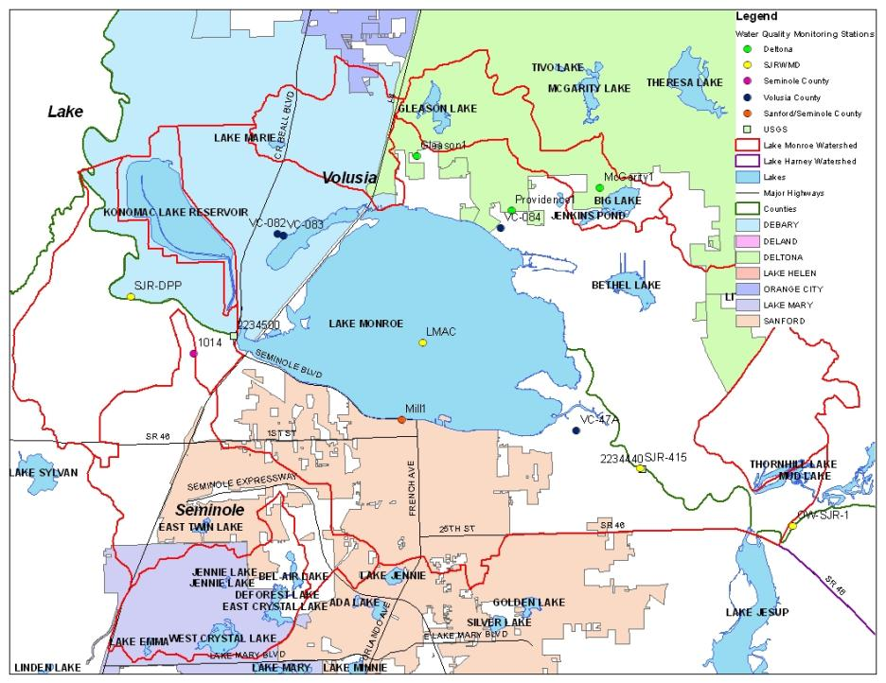

Slide 43
Tracking Implementation
FDEP will work with the stakeholders to organize the monitoring data and track project implementation.
This information will be organized into annual progress reports.
The stakeholders will meet at least annually to review progress and modify project lists and the monitoring plan, as needed.

Slide 44
Chapter 7: Commitment to Plan Implementation

Slide 45
Commitment to the BMAP
The stakeholders have worked collaboratively to develop the BMAP.
The responsible entities have committed to the activities in the BMAP to achieve TMDL reductions.
This chapter will include letters of commitment or resolutions of support for the BMAP provided by the stakeholders.

Slide 46
Steps to BMAP Adoption and Proposed Schedule

Slide 47
Stakeholder and FDEP Staff Actions
Action | Responsible Party | Date
Policy briefing on Final Draft BMAP | FDEP, Policy Makers, and Technical Stakeholders | March 15, 2012 (Completed)
Public meeting on BMAP | Public/FDEP | April 19, 2012 (Today)
Public comment period closes (30 days) | FDEP | May 19, 2012
Review of public comments by staff complete | FDEP | May 31, 2012
Letters of commitment due for inclusion in BMAP package to FDEP Secretary | Policy Makers and Technical Stakeholders | May 31, 2012

Slide 48
FDEP Secretarial Adoption Process
Action | Date
Brief FDEP DEAR management on BMAP | Early-June 2012
Brief FDEP Deputy Secretary on BMAP | Mid-June 2012
Brief FDEP Secretary on BMAP and obtain Secretarial approval | End-June 2012
Notify interested parties and place FAW notice | End-June 2012
End of challenge period (21-days after notice) | End-July 2012
BMAP adopted and enforceable (if there are no challenges) | End-July 2012

Slide 49
Public Comments on the Draft BMAP

