Slide 1
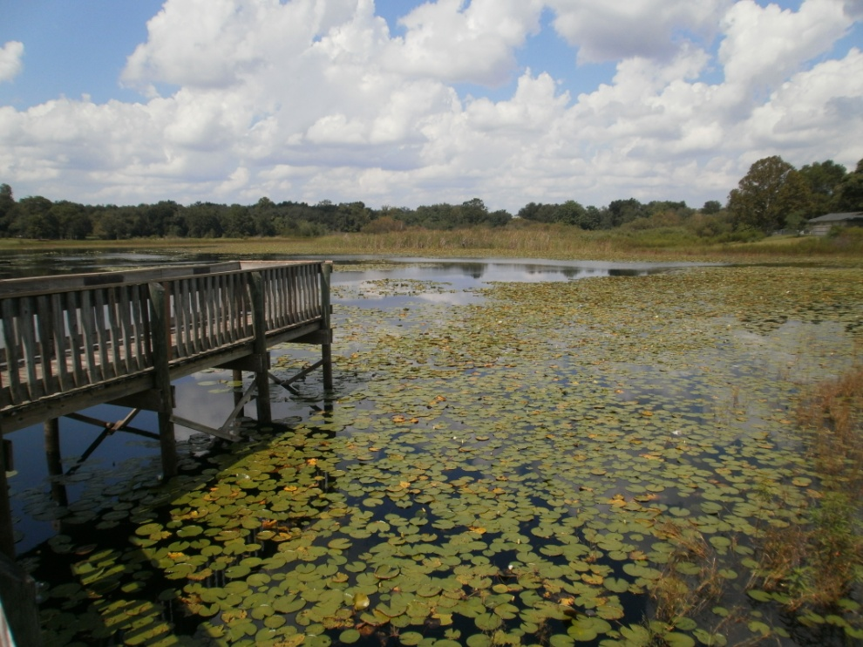

City of Casselberry
Baffle Box/Retrofit Projects
2012 Lake Jesup BMAP Annual Update
July 19, 2012

Slide 2
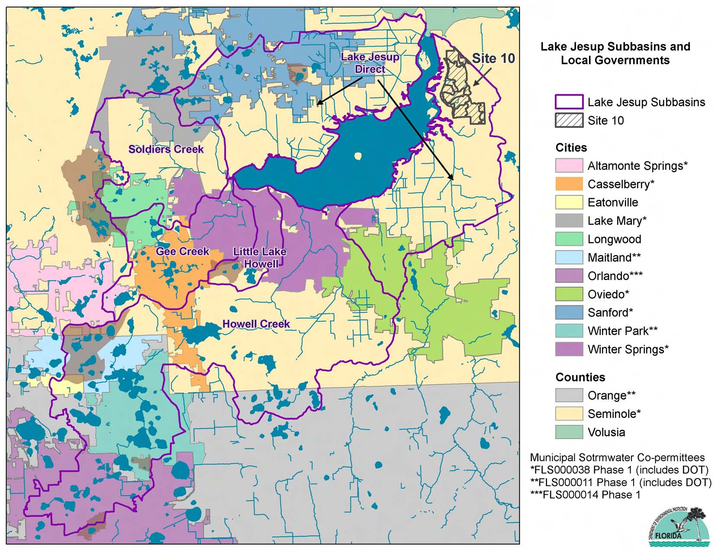

Slide 3
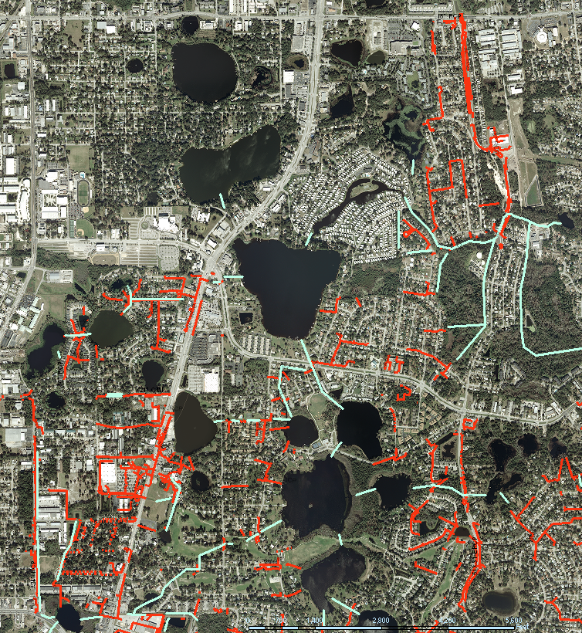
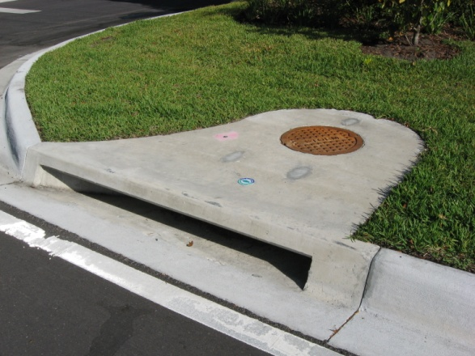

The Big Picture
Lakes & streams provide essential habitats for native trees, plants, fish, birds, and other wildlife
We all live in a watershed, and everything is connected
Runoff enters lakes directly or through inlets on streets, outfalls from ponds, canals/ditches, etc.
Runoff carries excess fertilizer, oils, sediment, and other pollutants that can harm lakes

Slide 4
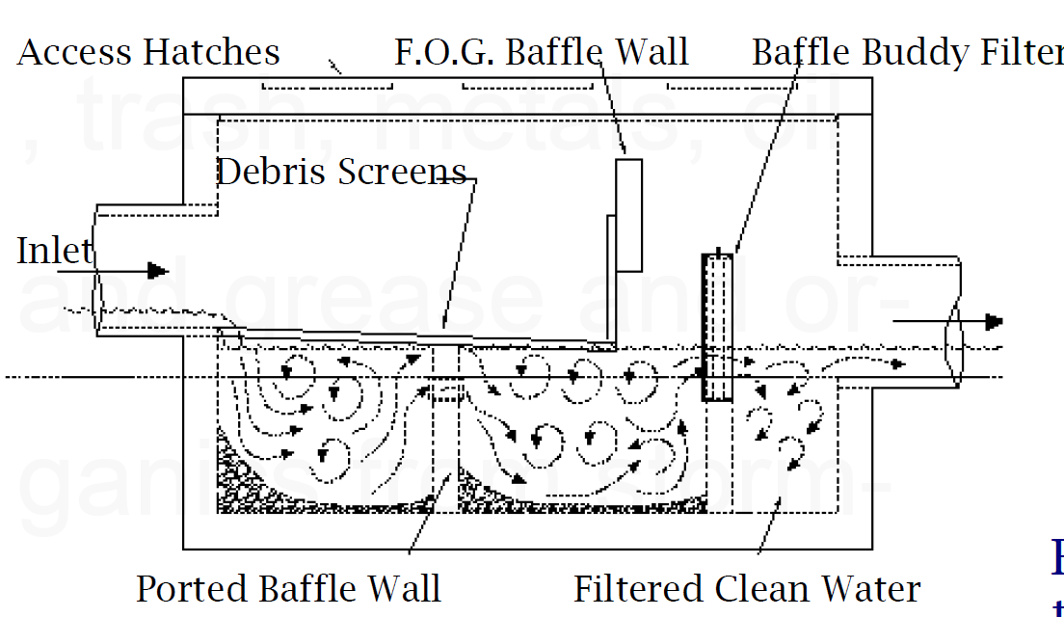
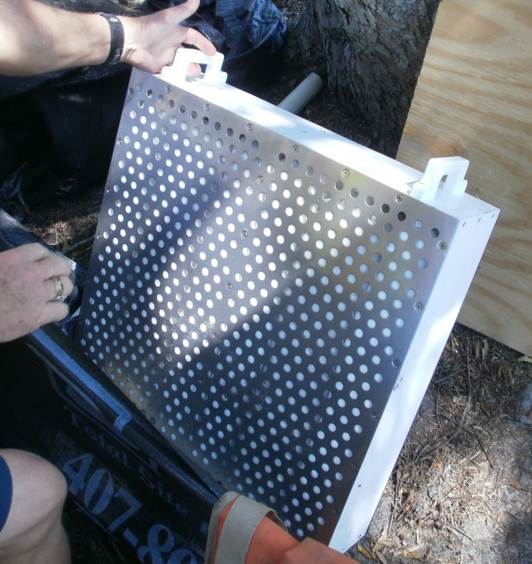
Stormwater Outfall Improvements
Retrofit project to capture sediment, debris, leaves, oils/hydrocarbons, phosphorus, etc. prior to discharge to receiving waterbodies
Baffle Boxes: Placed in-line with existing storm sewer systems
media filter cartridge

Slide 5
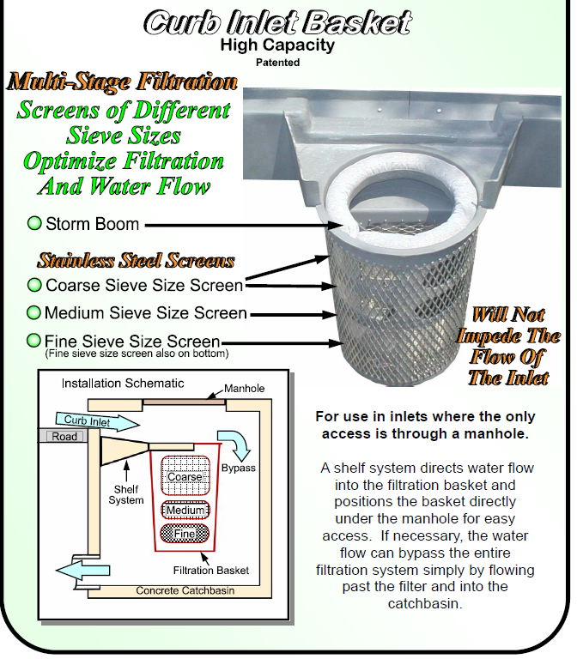
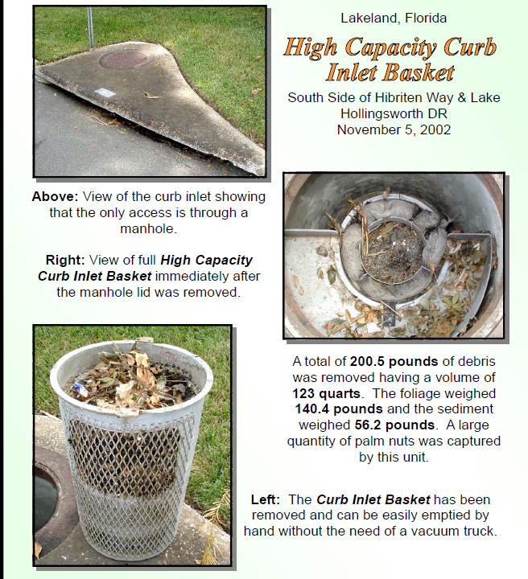
Stormwater Outfall Improvements
Retrofit project to capture sediment, debris, leaves, oils/hydrocarbons, phosphorus, etc. prior to discharge to receiving waterbodies
Inlet Baskets: retrofit for existing inlets (smaller drainage areas)

Slide 6
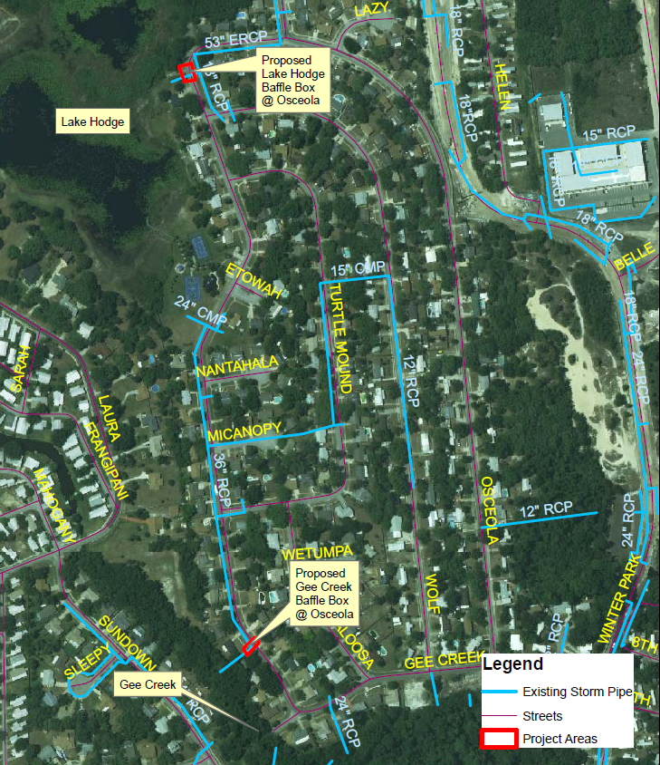
Stormwater Outfall Improvements
5 baffle boxes
  2 in Osceola Trail (Lake Hodge/Gee Creek) area

Slide 7
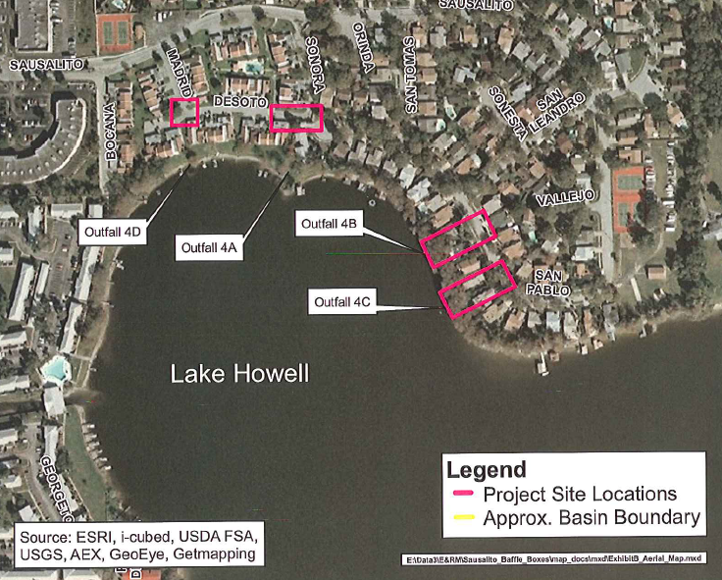
Stormwater Outfall Improvements
5 baffle boxes
  2 in Osceola Trail (Lake Hodge/Gee Creek) area
  3 in Sausalito (Lake Howell) area

Slide 8
Stormwater Outfall Improvements
5 baffle boxes
  2 in Osceola Trail (Lake Hodge/Gee Creek) area
  3 in Sausalito (Lake Howell) area
4 inlet filters (Sausalito)

Slide 9
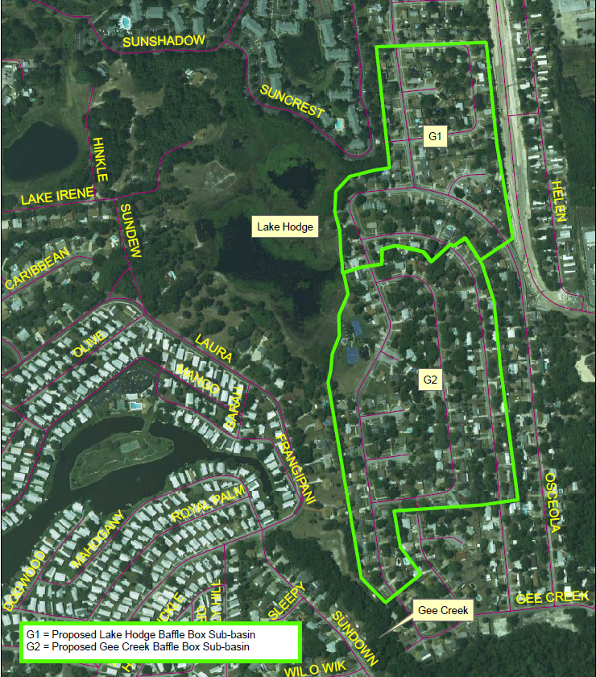
Stormwater Outfall Improvements
Treatment area approx 155 acres (largely untreated)
Residential, park, & commercial uses

Slide 10
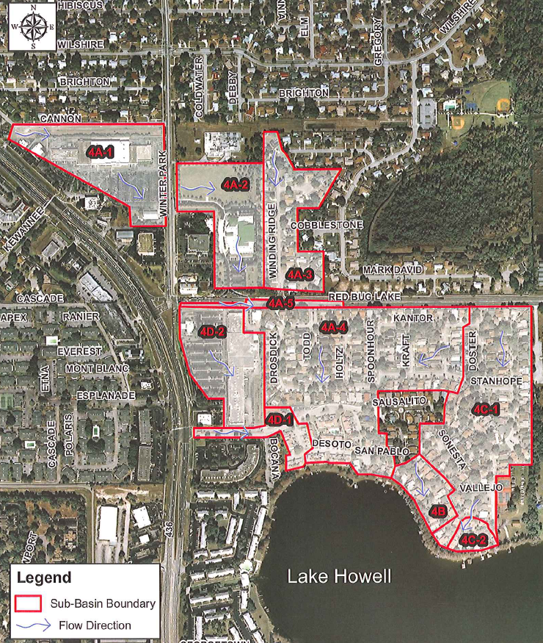
Stormwater Outfall Improvements
Treatment area approx 155 acres (largely untreated)
Residential, park, & commercial uses

Slide 11
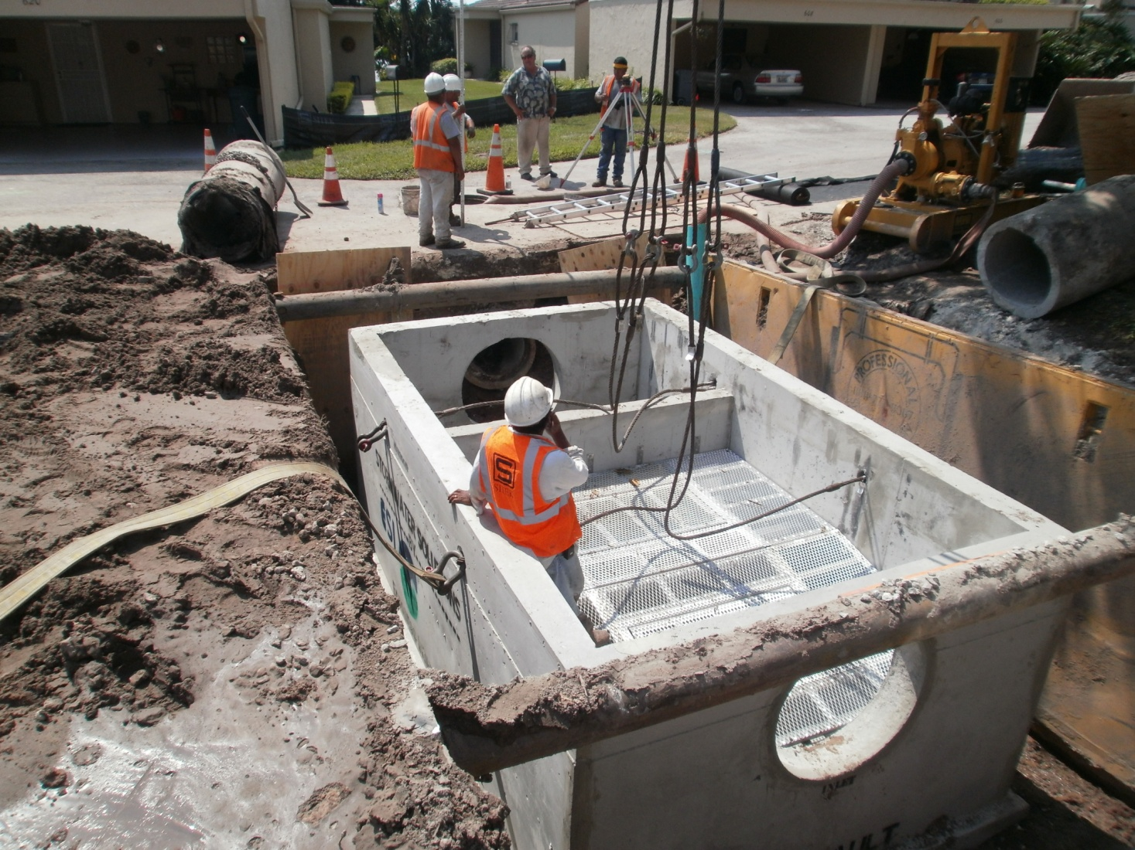
Installation

Slide 12
Installation
(videos)

Slide 13
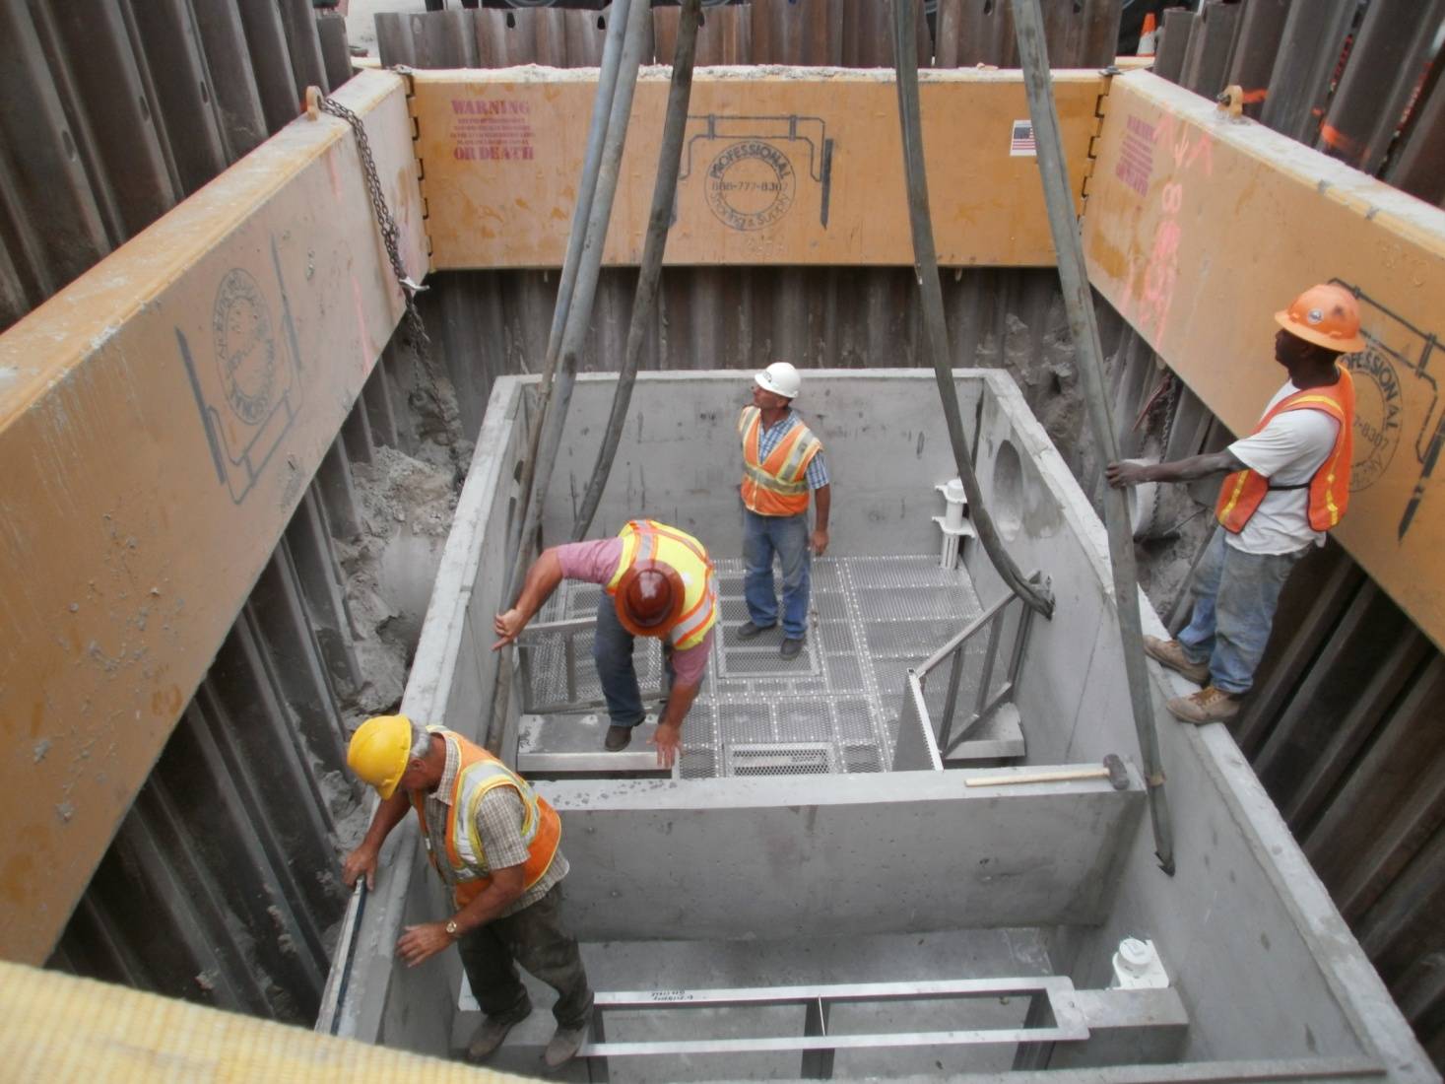
Installation
Notes:
Approx 13+ ft excavation (including 1 ft bedding gravel)

Slide 14
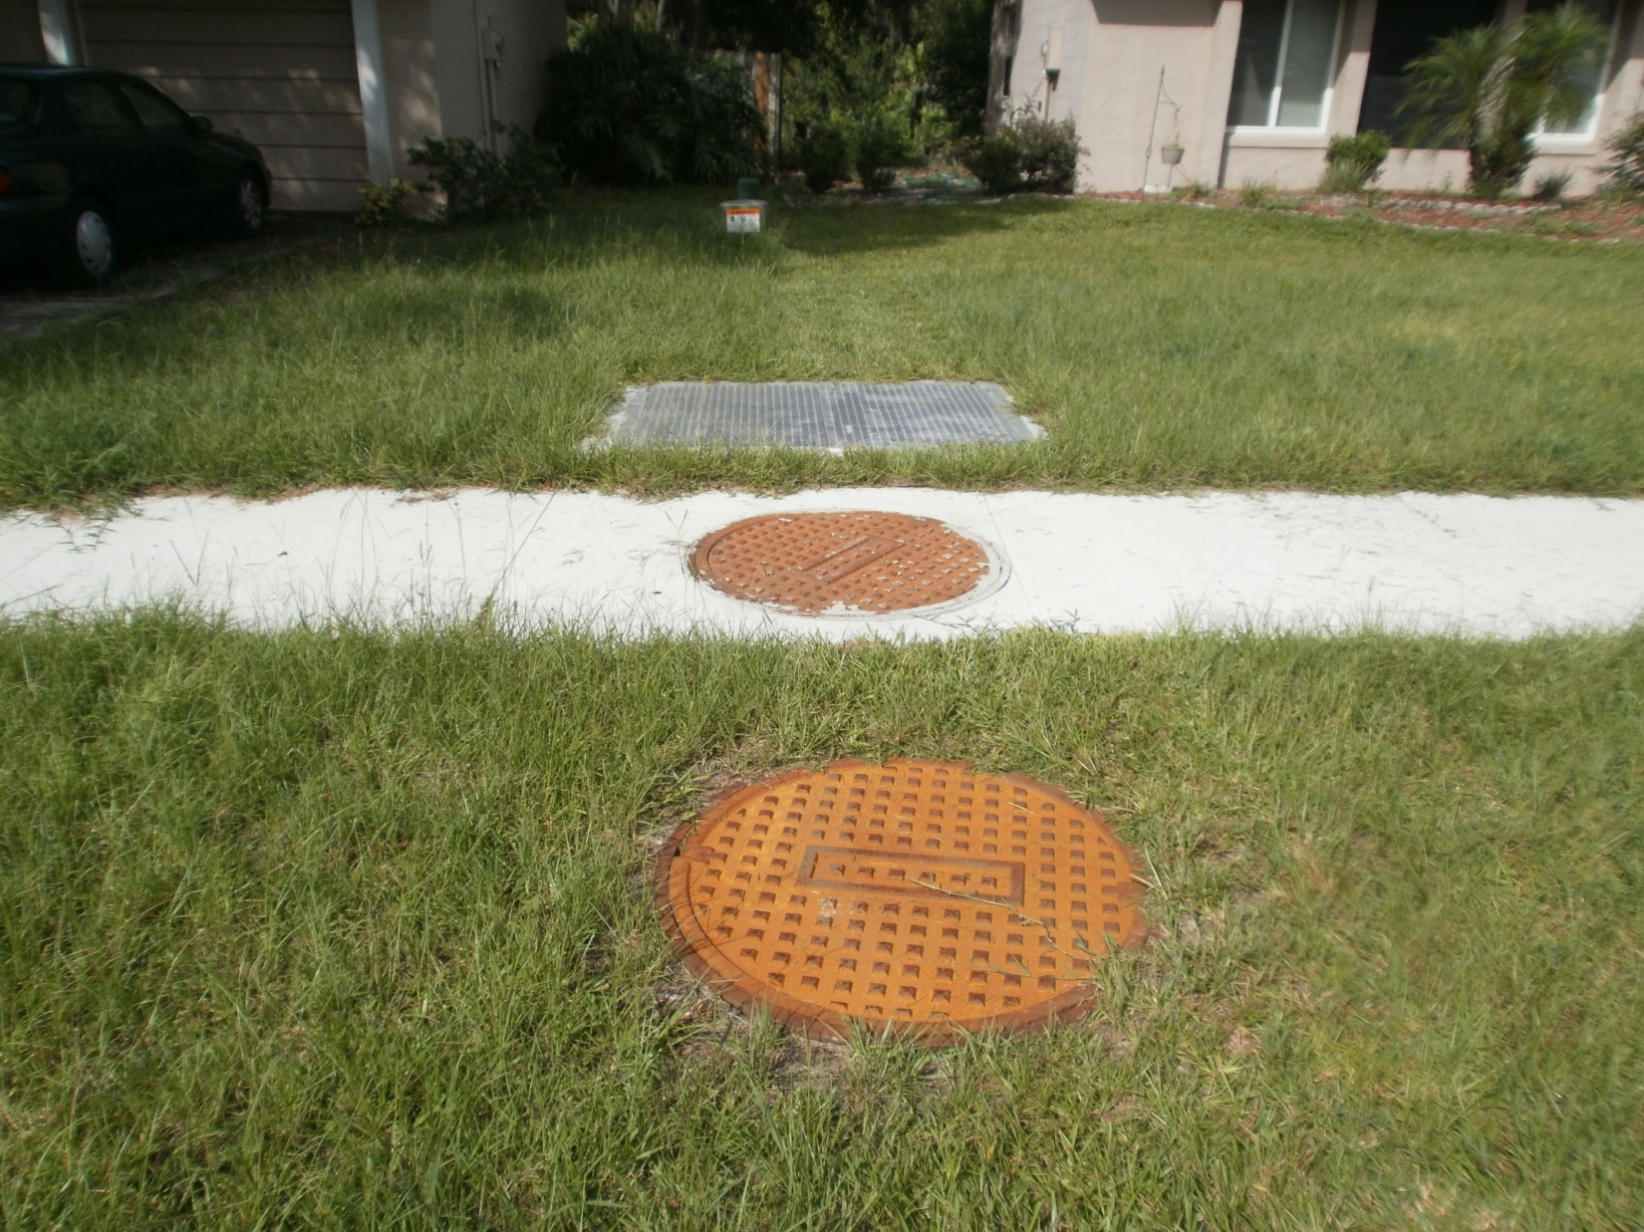
Restoration
Notes:
Approx 13+ ft excavation (including 1 ft bedding gravel)

Slide 15
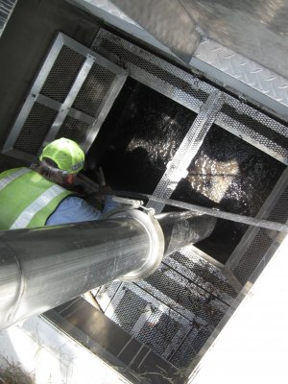
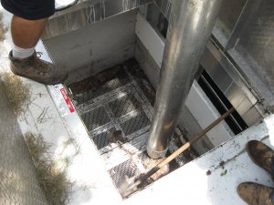
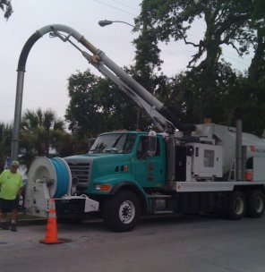
Maintenance
Leaf/litter removal from screens
“Vac-con” sediment chambers
Replace filters and other chemical media
Frequency varies by location/season

Slide 16
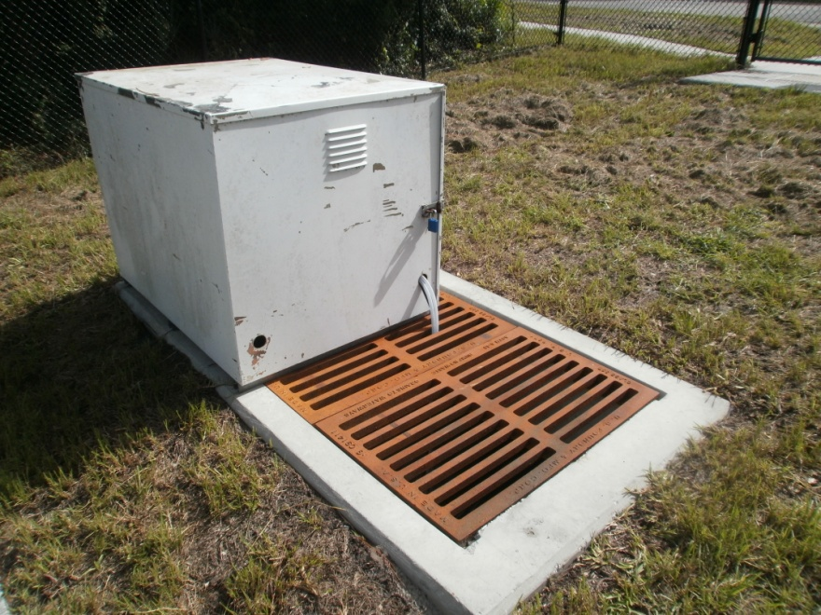
Efficiency Evaluation
Evaluation covers:
  4 baffle boxes with varying features
  1 CDS (continuous deflective separation) unit
  2 inlet baskets
  Multiple parameters (not just TP)
Monitoring Plan currently under review by FDEP
Sampling Equipment Installed
Study complete by mid-2013

Slide 17
Stormwater Outfall Improvements
Funded by Stormwater Utility & FDEP Grant
  Approx total cost $755K
    $168K Design/Permitting/Post Design
    $435K Construction
    $52K Construction Engineering Inspection
    $100K Effectiveness Evaluation

Slide 18
Estimated Predicted Performance
BMAP Credit: 8.6 lbs TP/yr
STEPL model estimate: 51.7 lbs TP/yr
Upfront total cost* / lb TP/yr = $13K-$76K
Does not account for media filter TP removal or all gross pollutants removed
Suspended solids and sediment removals much, much higher
Unofficial “moratorium” on further baffle box installations pending efficiency evaluation results
*neglecting efficiency evaluation

Slide 19
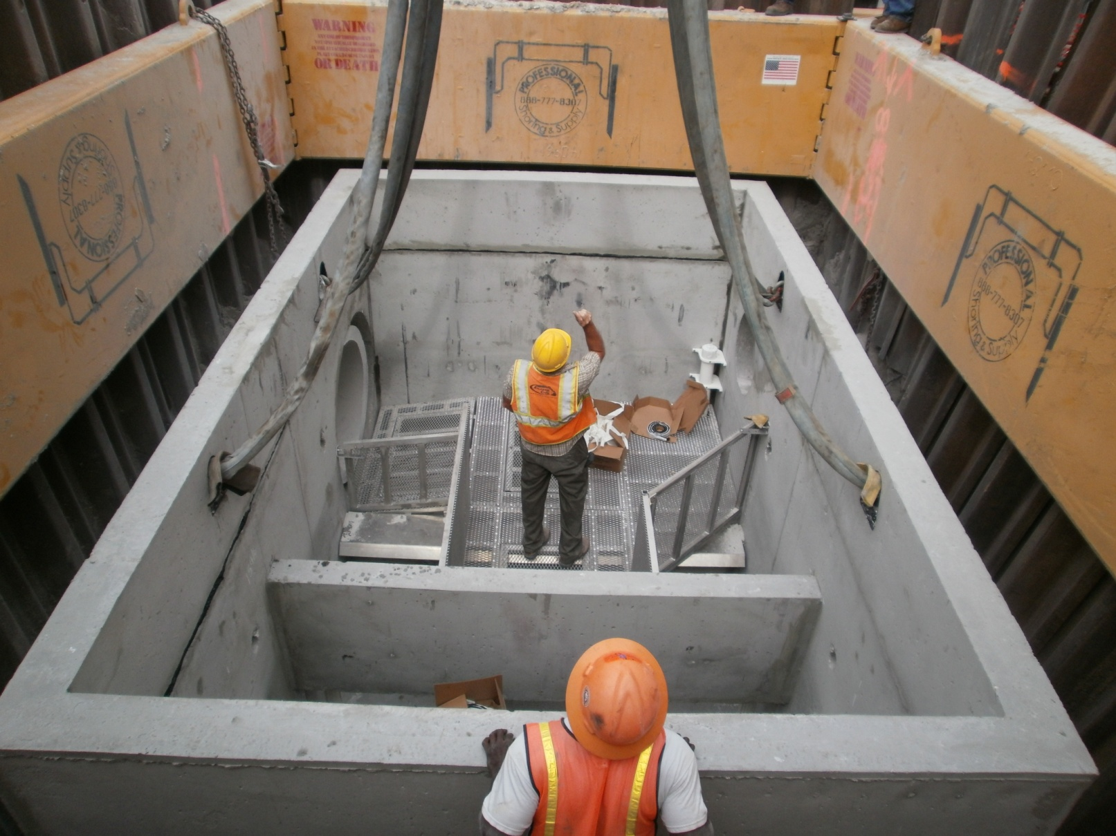
Questions?
Notes:
Sizes ranged from 15” (with two inflows) to 48” (pictured is 15” and 42”)

Slide 20
Find Out More
& Contact Information
www.casselberry.org/lakes
Kelly Brock, Ph.D., P.E., Assistant Public Works Director/City Engineer
  kbrock@casselberry.org
  (407) 262 7725 ext 1235

