Slide 1

City of Winter Park
Lake Jesup BMAP Update
July 19, 2012

Slide 2
Summary of BMAP Activities 2011/12
Retrofits/Capital
  Cortland Avenue Improvements (Lake Mizell)
  Morse Boulevard Improvements (Lake Osceola)
  Alabama Drive Improvements (Lake Maitland)
O & M
  Added two maintenance positions
  Continued retrofit cleaning & street sweeping activities
Public Education
  Newsletters (2)
  Florida Yards and Neighborhoods
  Misc. – School events, inlet signing

Slide 3
Cortland Avenue Improvements
Problems
  Two outfalls treated with alum still discharging leaves and sediment to Lake Mizell
  Sub-basin includes residential areas with heavy oak canopy
Solution
  Installed two 2nd generation baffle boxes (Suntree)
  Constructed in part with 319 grant

Slide 4
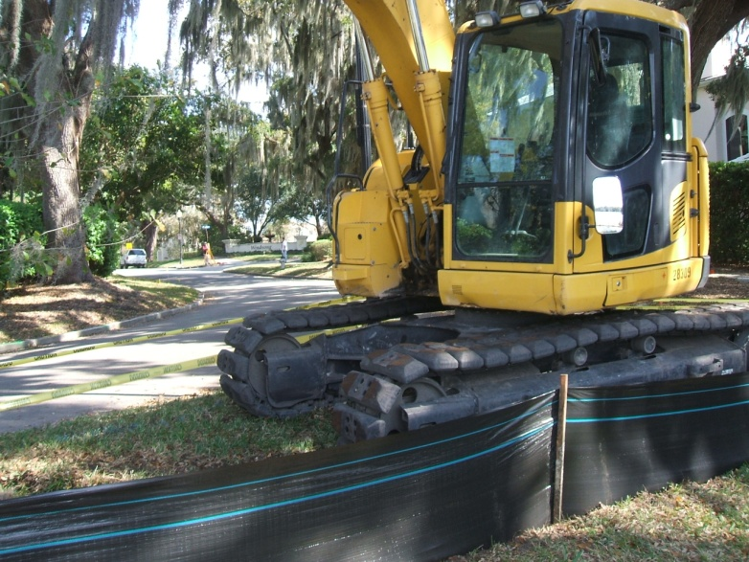
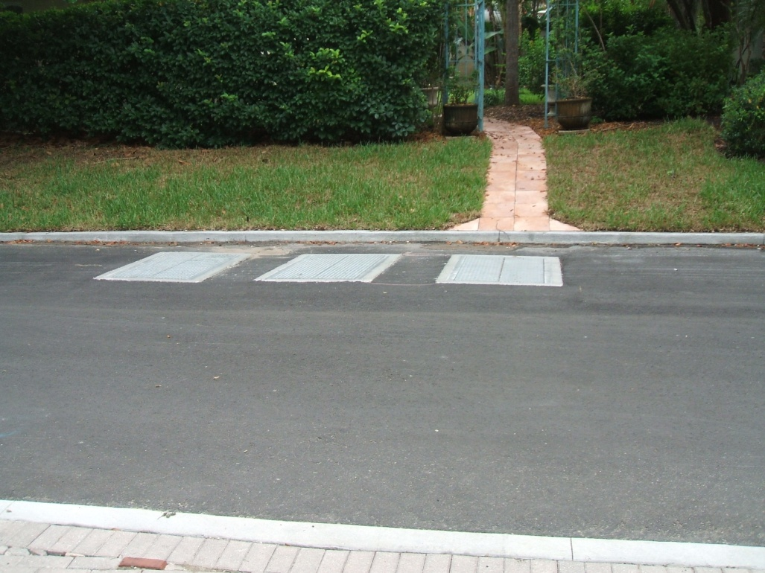
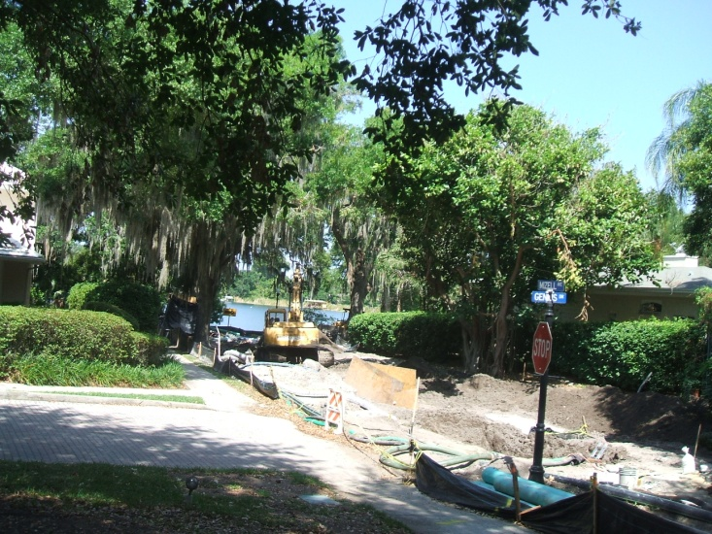
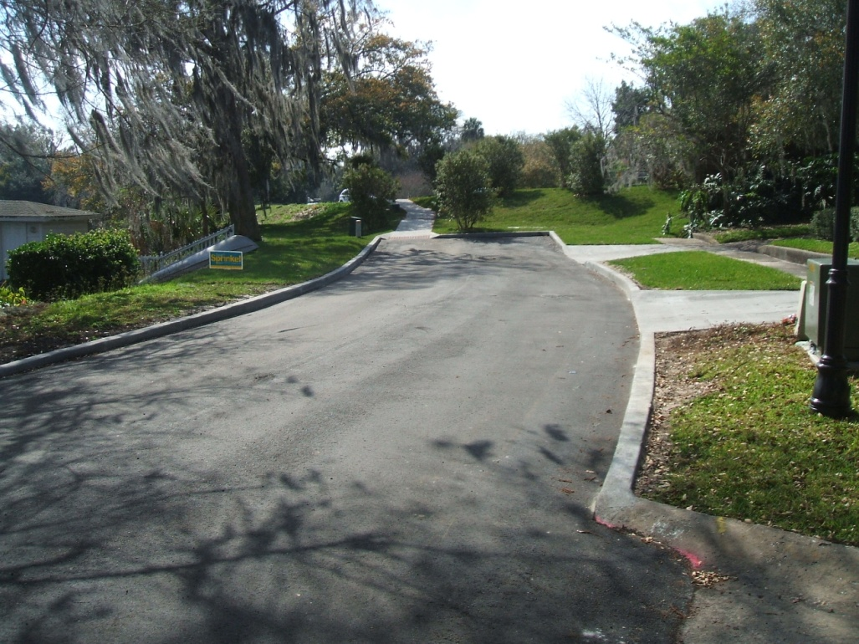
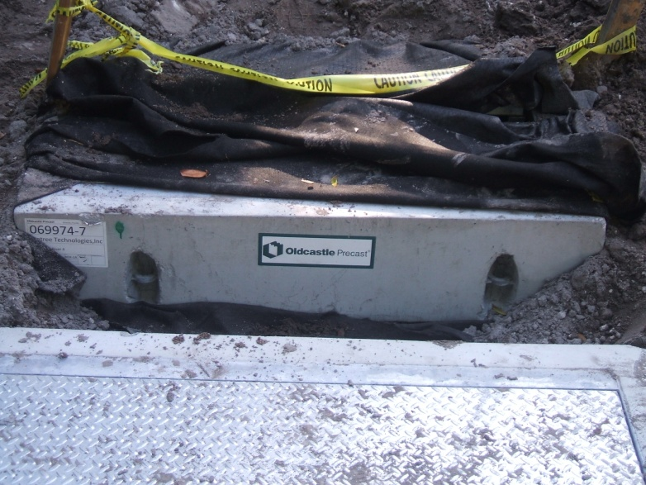

Slide 5
Morse Boulevard Improvements
Problems
  Two outfalls treated with alum still discharging leaves, sediment and litter to Lake Osceola
  Sub-basin includes downtown commercial district
Solution
  Installed two 2nd generation baffle boxes (Suntree)
  Constructed by in house crews -very deep installation vulnerable to rainfall during construction
  Constructed in part with 319 grant

Slide 6
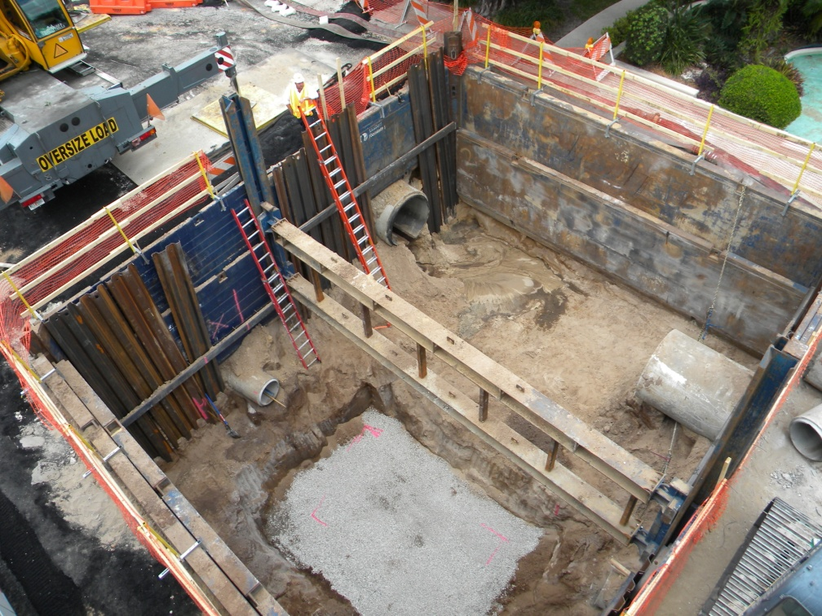
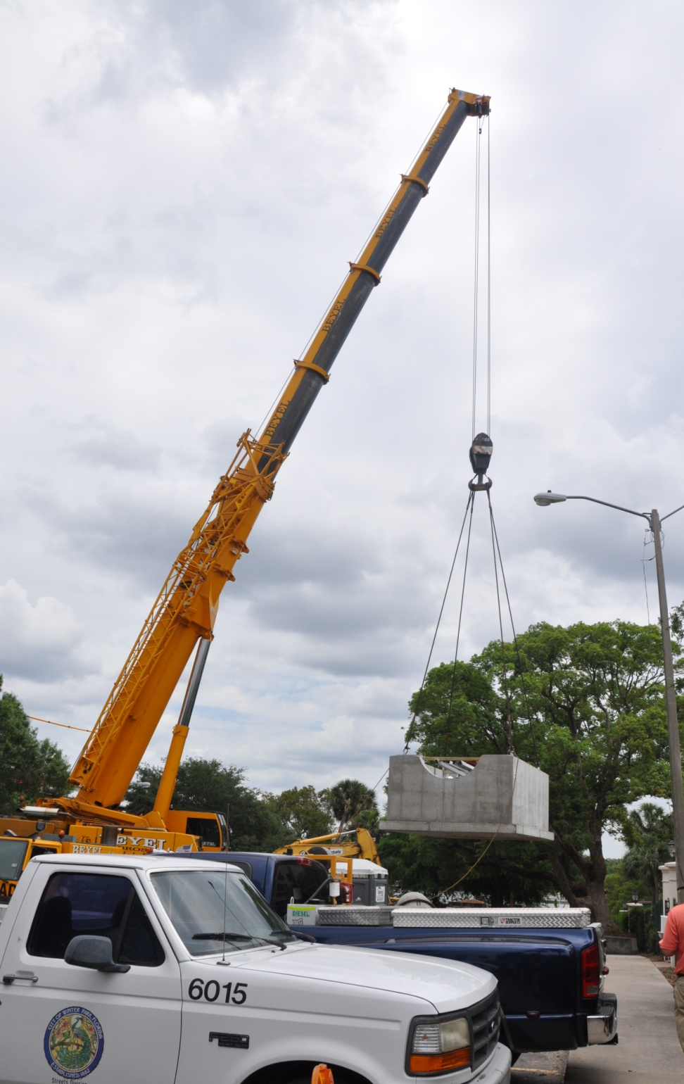
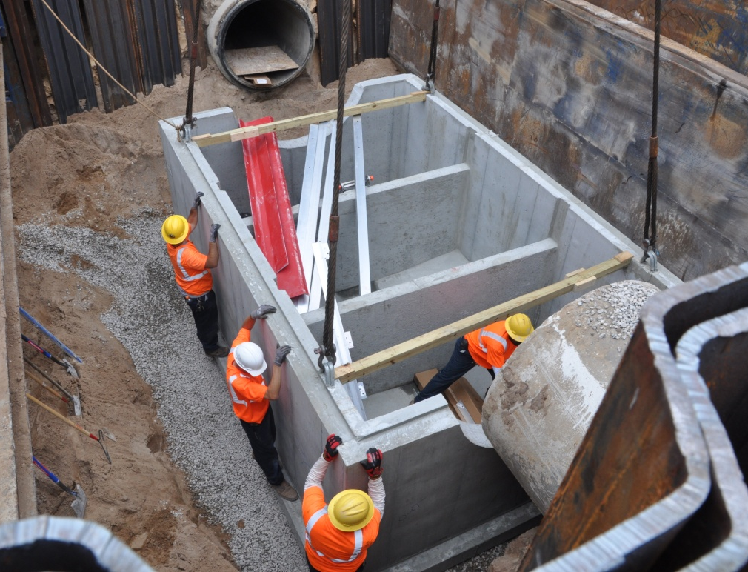

Slide 7
Alabama Drive Improvements
Problems
  2 uncontrolled overland discharges to Lake Maitland
  One untreated outfall
  No curbing – runoff pulling sediments from yards
Solutions
  Installed curbing to reduce sedimentation
  Constructed two small retention ponds
  Added one outfall with baffle box to control flow
  Added sediment removal inlet to existing outfall

Slide 8
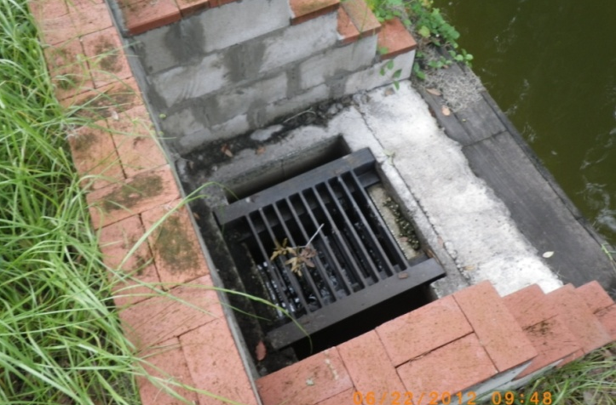
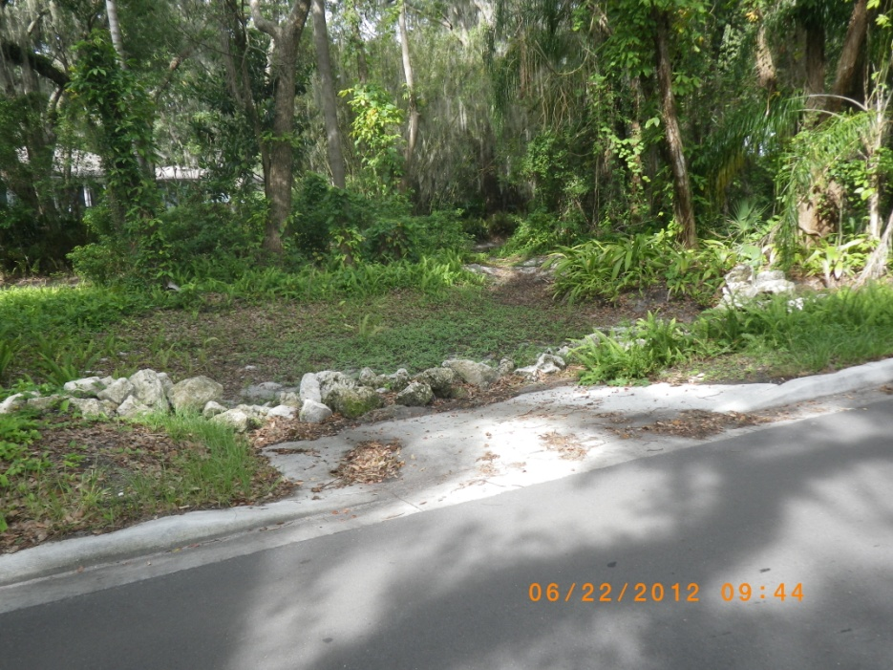
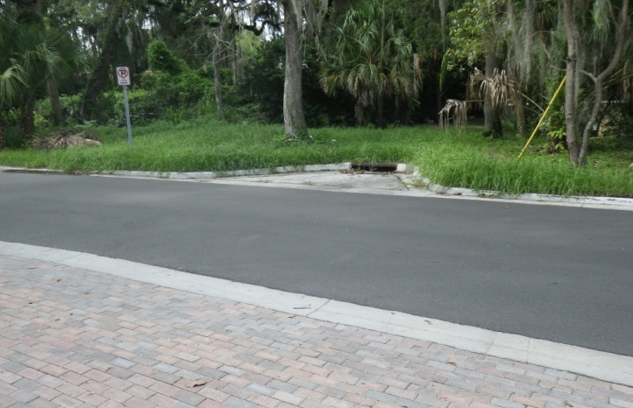
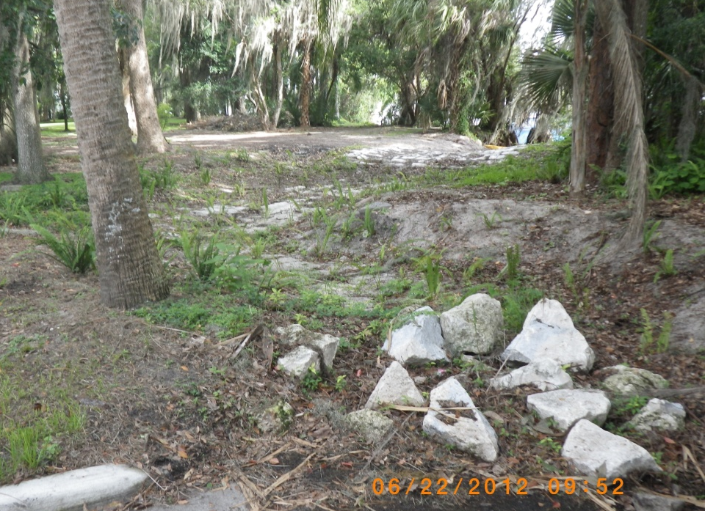
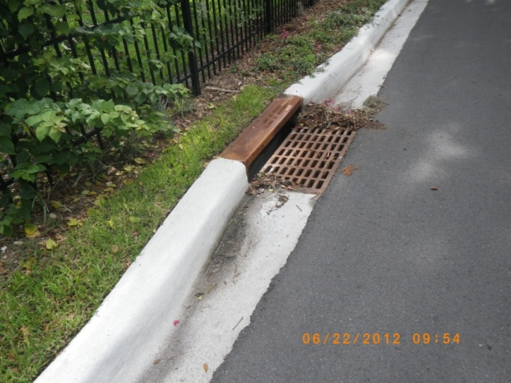
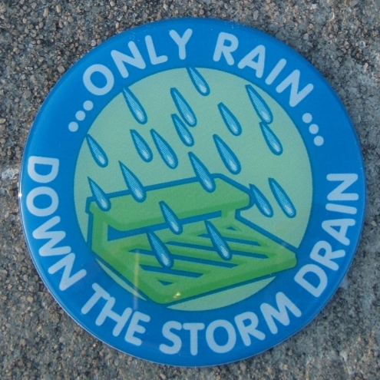

Slide 9
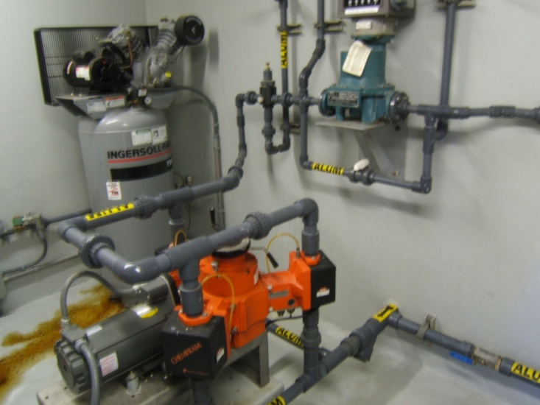
Projects Planned or Underway
Howell Branch Road Stormwater Pond Retrofit
  Existing pond provides only flow attenuation
  Modifications to provide treatment and reuse
Alum Station Upgrades
  Replace aging equipment
  Simplify operation
  Add telemetry
Lake Forest Retrofit
  Small lake controlled by drainwell
  Baffle box and pond planned for largest outfall

Slide 10
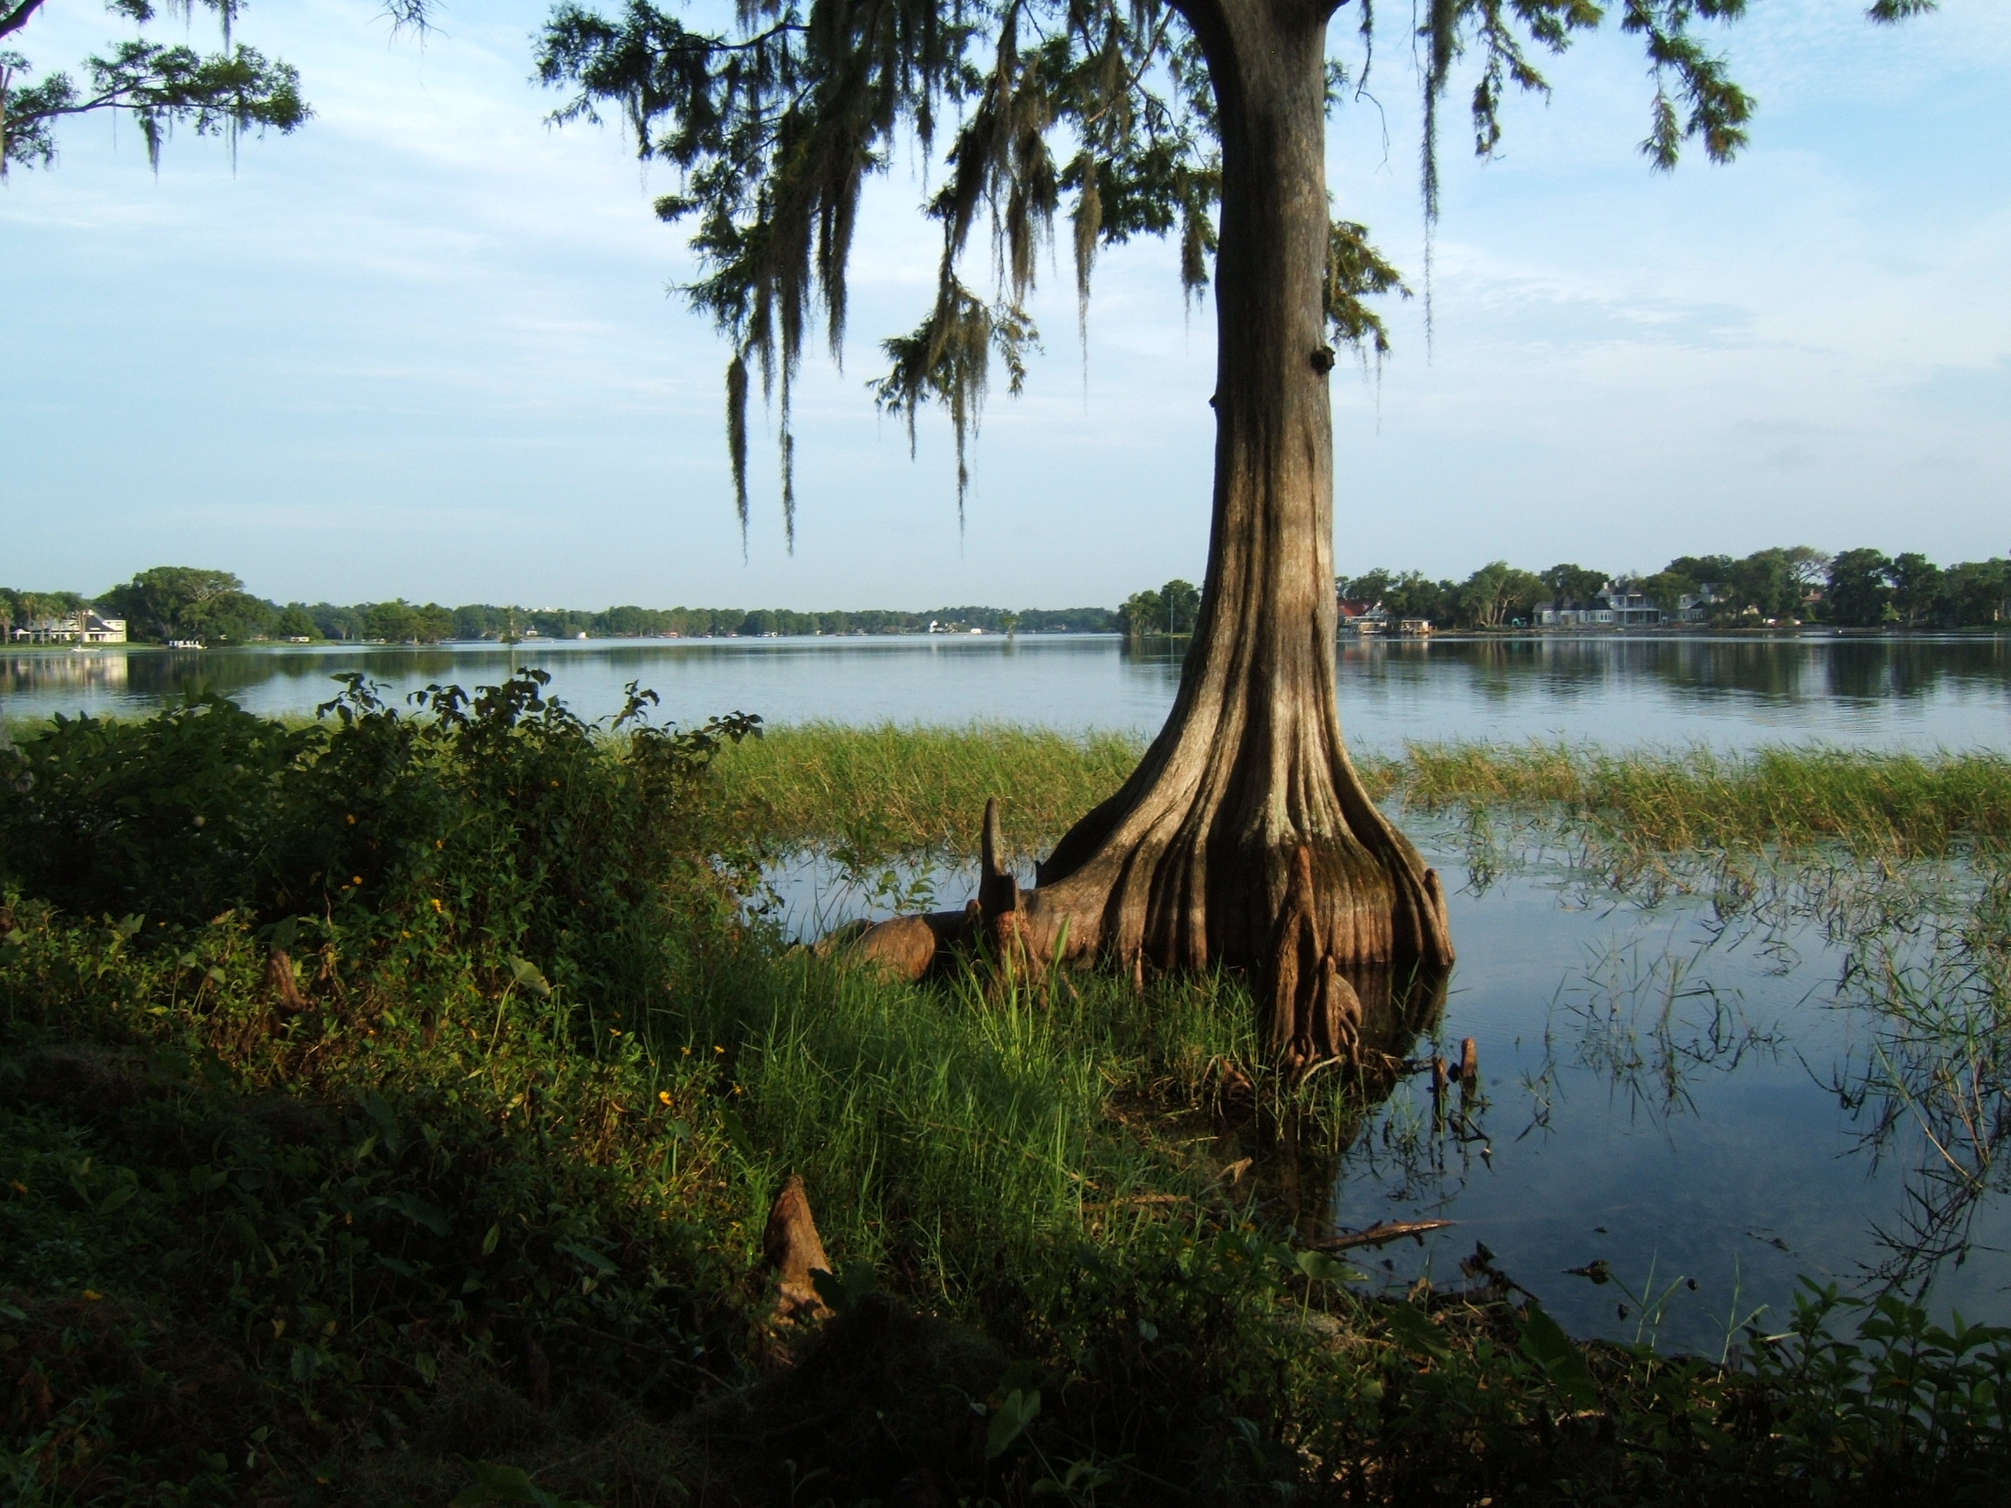
Questions?
www.cityofwinterpark.org/lakes

