Slide 1

2012 Update:
Projects Completed for the Lake Jesup BMAP
City of Orlando
By: Nabil Muhaisen
Stormwater Assistant Division Manager
Streets and Stormwater Division
Notes:
Introduction and Purpose of Presentation

Slide 2
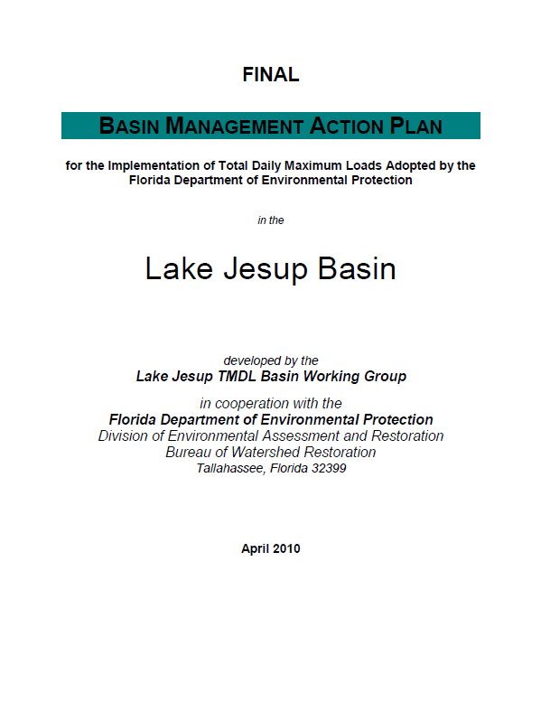

Lake Jesup
TMDL’s Adopted 2006
for TN and TP
BMAP Finalized April 2010
15 Year Reduction Timeframe

Slide 3
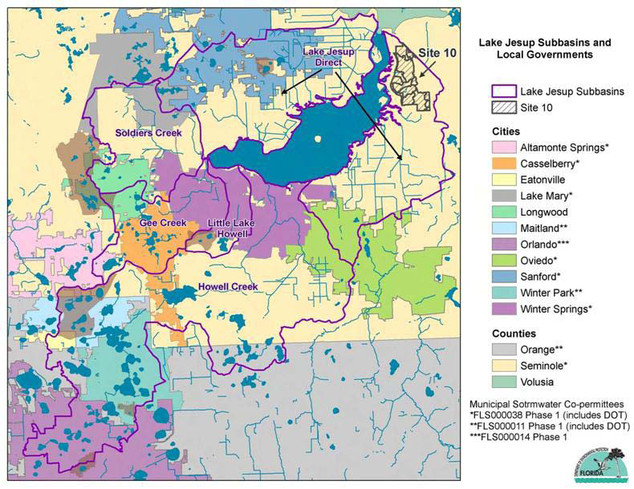

Lake Jesup BMAP Area
and Local Governments
Notes:
Outline of Area of BMAP; 11 cities and towns and 3 counties; FDOT

Slide 4
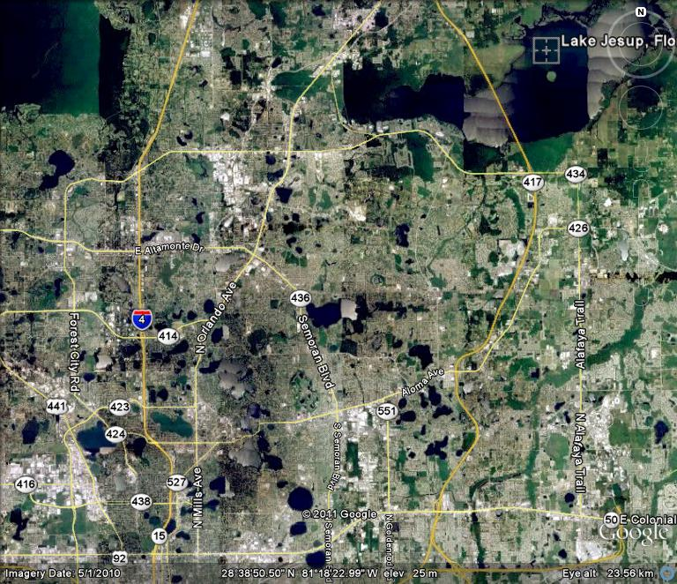
Lake Jesup
Orlando
Notes:
Proximity of City of Orlando to Lake Jesup / location perspective; approximately ____ miles as the crow flies; ____ miles of drainage ways

Slide 5
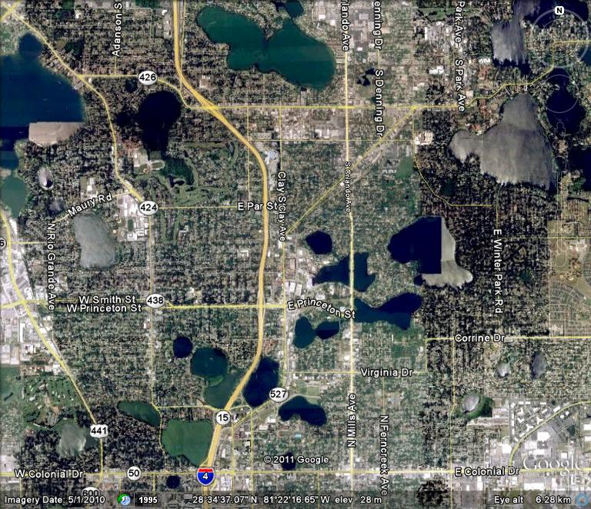
Howell Branch
Chain of Lakes
Notes:
City’s contribution to Lake Jesup comes from the Howell Branch Chain; City’s responsibility

Slide 6

City of Orlando
Projects prior to 2005: 154.6 lbs./yr TP reduction
2006 – 2011: 6 projects, $1M
TP reduction: 113.2 lbs./yr
Notes:
Previous projects allocated to reducing TP loading into / through the Howell Branch Chain; reviewed 6 specific projects last year (Spring Lake/Rio Grande Nutrient Separating Baffle Box, Spring Lake Pond FDOT, Overbrook Stormwater Improvements, Lake Adair/Reading Nutrient Separating Baffle Box, Lake Winyah/West Chester-Wilkinson Nutrient Separating Baffle Box, Mills Avenue Storm-Flo Litter Collection Screen)

Slide 7
City of Orlando
Completed Projects for 2012 Update:
  Guernsey Park Wet Detention Pond Expansion
  Lake Concord/Don Dudley Park 2nd Generation Baffle Boxes
Notes:
2 new projects completed since last update presentation: Guernsey Park Wet Detention Pond Expansion and the Lake Concord/Don Dudley Park 2nd Generation Baffle Box

Slide 8
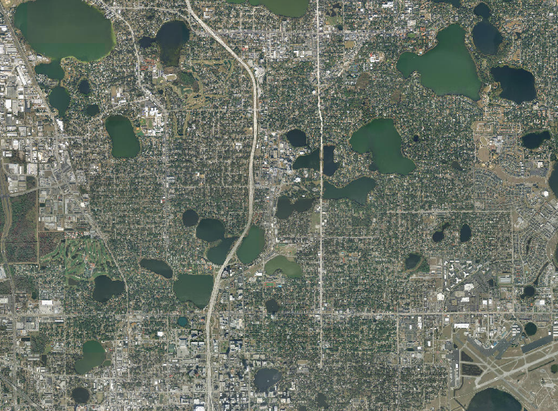
Guernsey Park Wet Detention Pond Expansion
Lake Virginia
Lake Sue
Guernsey Pond
Lake Ivanhoe
Lake Adair
Lake Concord
Downtown
Notes:
Guernsey Park is a small municipal park located southwest of the intersection of Guernsey Street and Northumberland Avenue, northwest of Lake Adair. Area residents use the park for passive recreation. The park contains a basketball court and a small wet detention pond. The pond is shallow, has very steep slopes. The pond discharges to Lake Adair through an existing pipe conveyance system.

Slide 9
Guernsey Park Wet Detention Pond Expansion
Enlarging Guernsey Pond - Removal of 8,500 cubic ft of soil and liner installation for expansion of treatment area
Plugging existing drainage outfall and installing new drainage system – more efficient flow and drainage of system
Notes:
The project proposes the expansion of an existing wet detention pond at Guernsey Park by increasing the size and depth of pond to increase treatment volume, and reduce the grade of the side slopes to allow for the construction of a functional and aesthetic littoral area around the edge of the pond. This project provides additional attenuation to improve the quality of stormwater runoff to Lake Adair, an impaired water body in the City of Orlando.
The construction consists of enlarging the existing Guernsey Park Pond, removing and replanting existing cypress trees in the pond, installing a new drainage outfall system, plugging the existing drainage outfall, constructing an overlook in the expanded pond, re-grading areas of the park and installing sod, and installing landscape material.

Slide 10
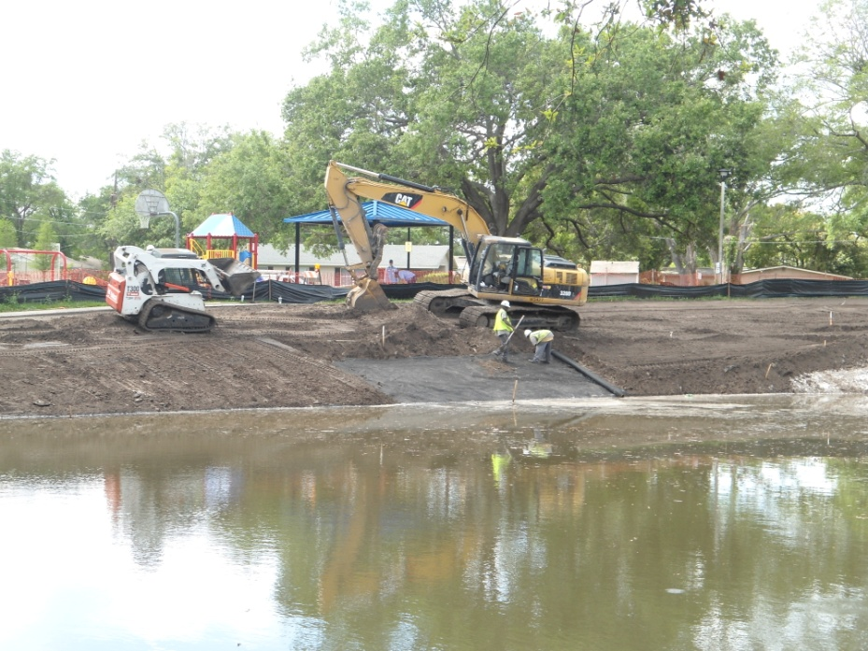
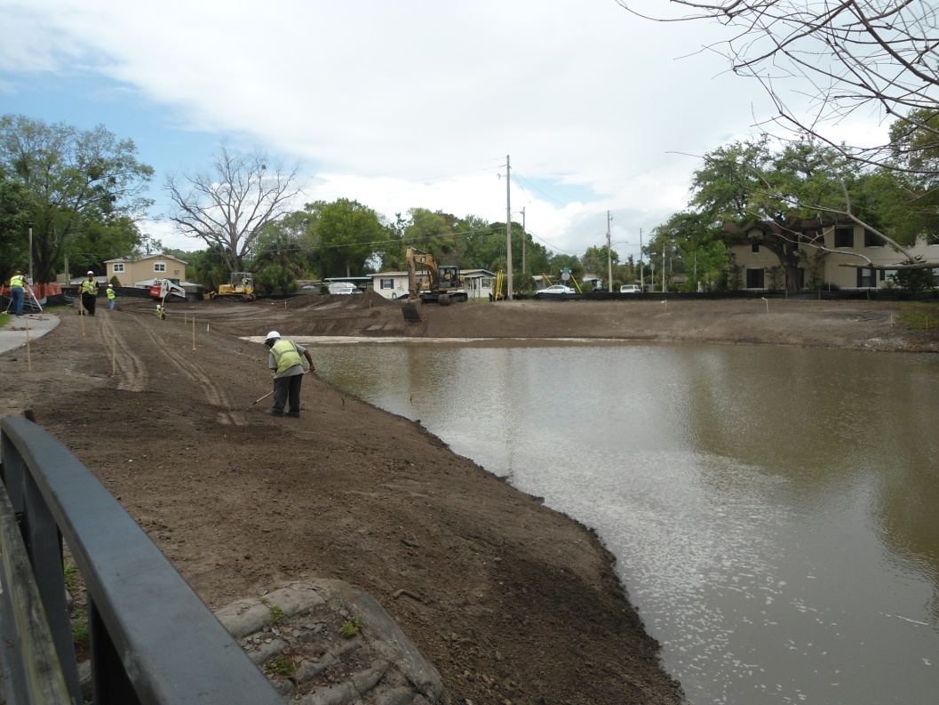
Guernsey Park Wet Detention Pond Expansion
Excavation and
re-grading
Approximately 80 drainage acres of treatment
Notes:
Pictures of construction – grading and excavation

Slide 11
Guernsey Park Wet Detention Pond Expansion (Continued)
Slip-lining existing 42-inch inlet pipe;
New manholes and weirs in outfall drainage system – increase treatment time
Re-grading and stabilization – reduce erosion/sedimentary pollution, and runoff loading

Slide 12
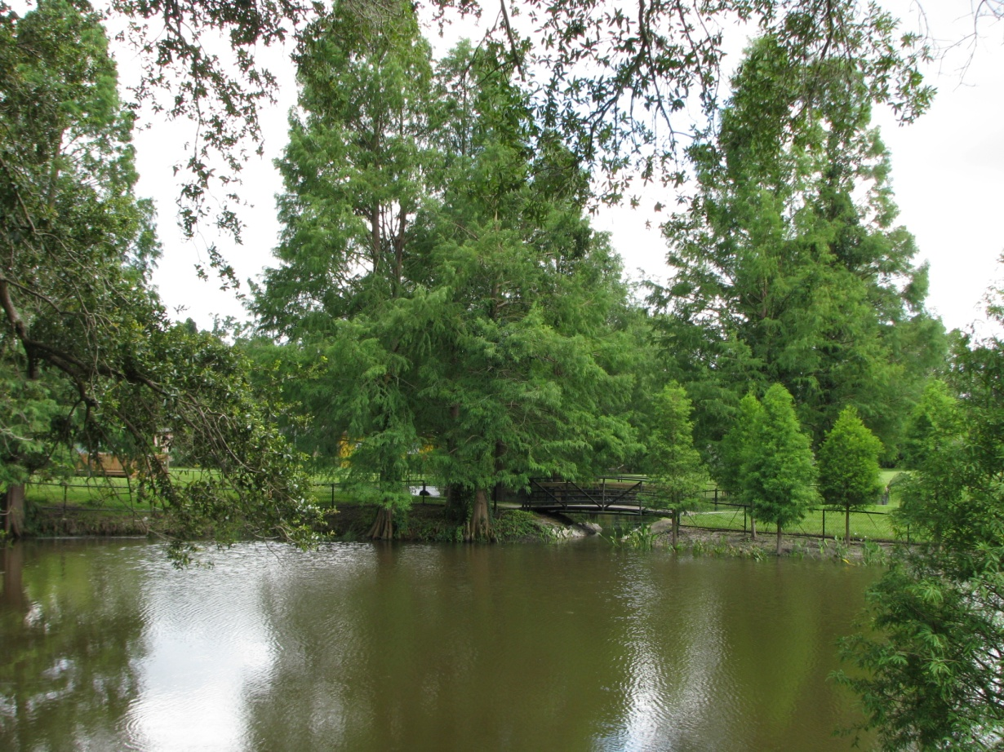
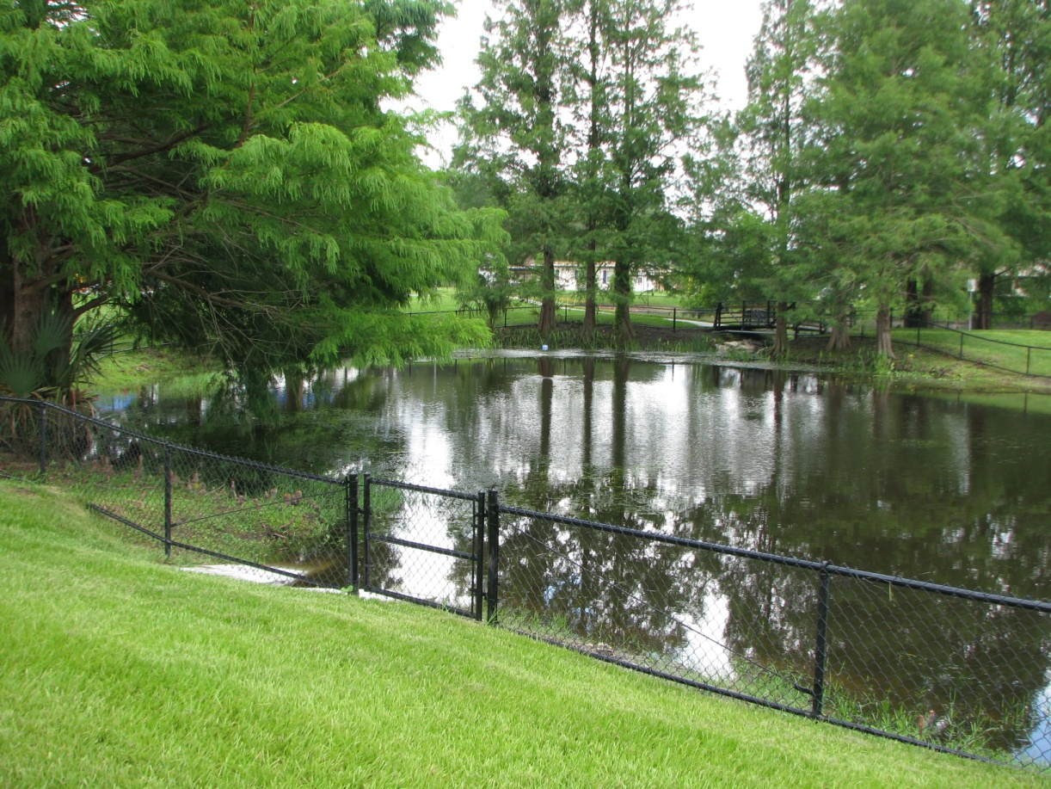
Guernsey Park Wet Detention Pond Expansion
Notes:
Some finished pictures

Slide 13
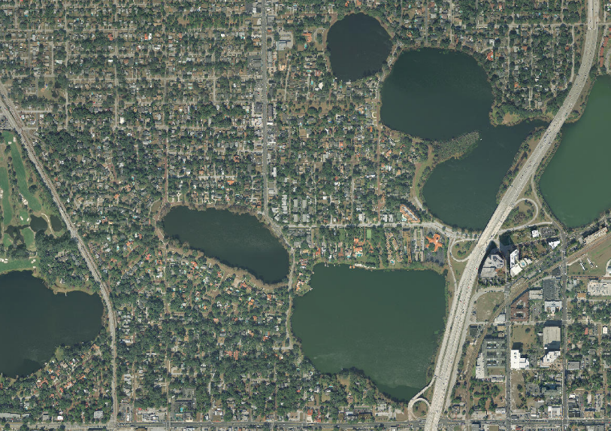
Lake Concord (Don Dudley Park)
2nd Generation Baffle Box Installation
Guernsey Pond
Lake Ivanhoe
Lake Adair
Lake Concord
Notes:
Lake Concord project summary: Much of the stormwater flow that goes into Lake Concord comes from
Edgewater Drive and gets into the lake through two storm-sewer pipes. The City has installed two baffle boxes on the land next to the Don Dudley Park. The land is bought from the private owner. The first baffle box provides treatment for stormwater runoff from State Road 50 through a conveyance system along Edgewater Drive. The second baffle box provides treatment for stormwater runoff from the residential area along Edgewater Drive.

Slide 14
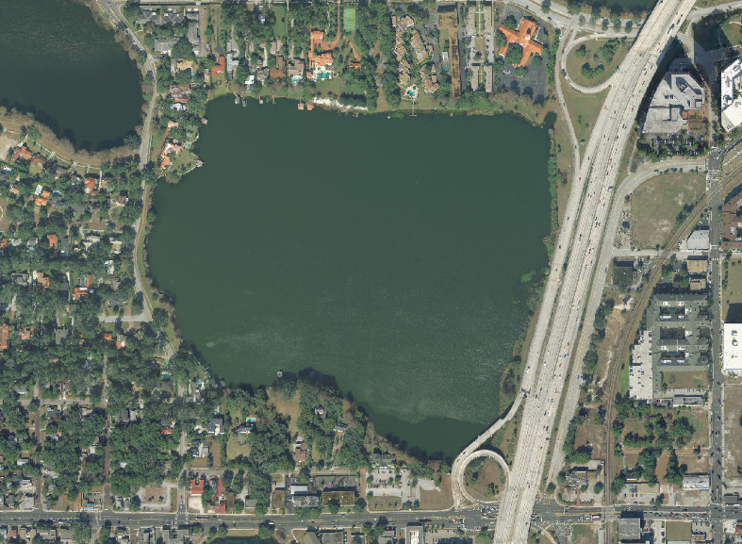
Lake Concord (Don Dudley Park)
2nd Generation Baffle Box Installation
Lake Concord

Slide 15
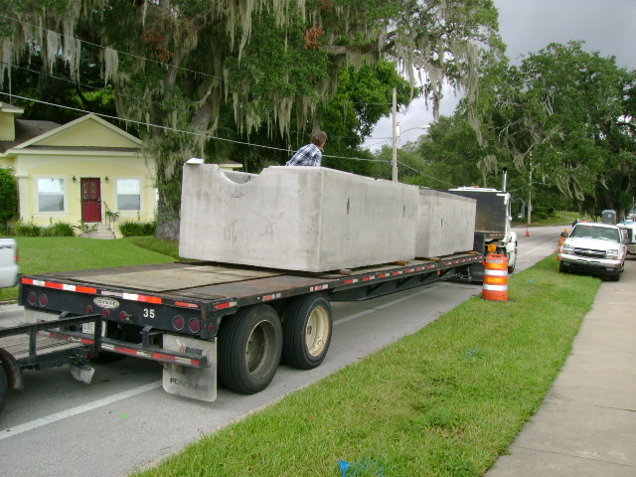
Lake Concord (Don Dudley Park)
2nd Generation Baffle Box Installation

Slide 16
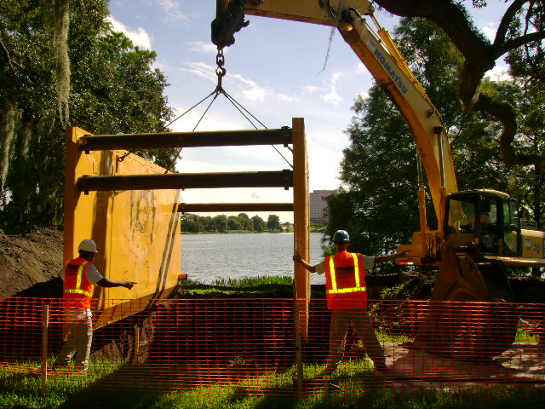
Baffle Box Transport & Installation

Slide 17
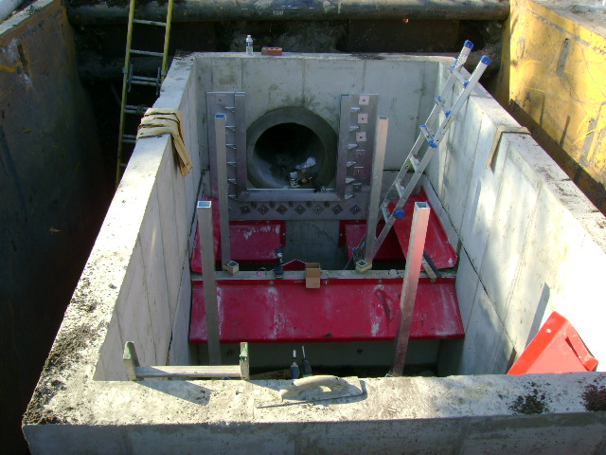
Designed In-House Double Boxes

Slide 18
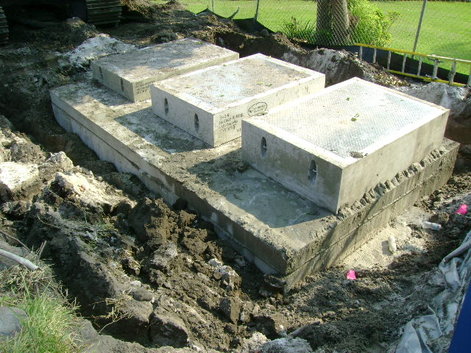
Lake Concord (Don Dudley Park)
2nd Generation Baffle Box Installation

Slide 19
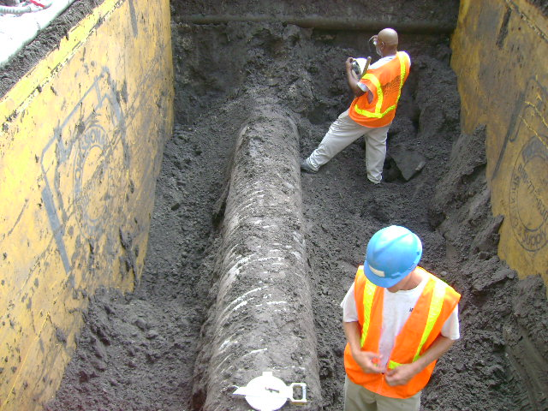
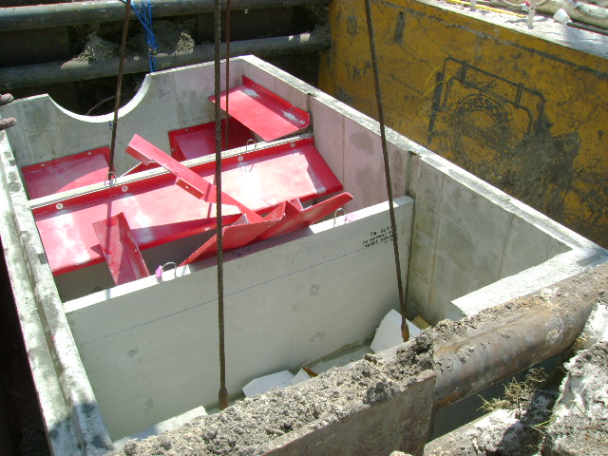
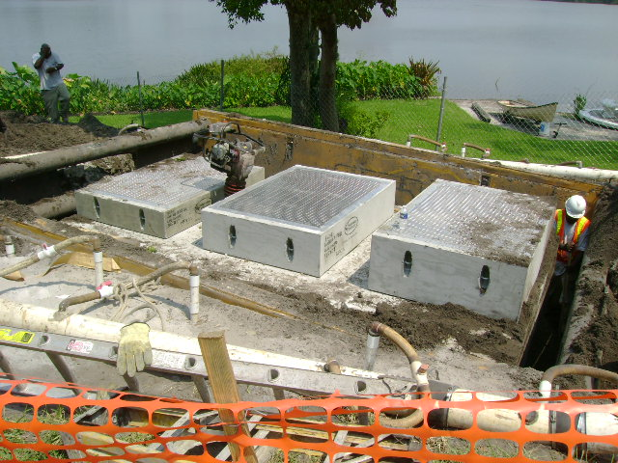
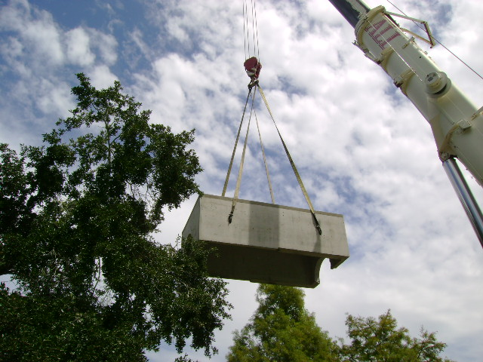

Slide 20
Completed Projects for 2012 Update:
Guernsey Park Wet Detention Pond Expansion
Lake Concord (Don Dudley Park) 2nd Generation Baffle Boxes
Notes:
Summarize that 2 projects are completed so far this year.

Slide 21
Guernsey Park Wet Detention Pond Expansion
80 acres of drainage treated
$232,641 total construction cost
Notes:
Grant monies were used for some aspects of the project; total City costs are $232,641

Slide 22
City of Orlando
Lake Concord (Don Dudley Park) 2nd Generation Baffle Box Installation
Treatment from SR 50 and Edgewater Dr. (2 inflows)
$202,606 total construction cost
Notes:
2 Baffle boxes treating stormwater from the neighborhoods around Edgewater Dr. (landscaping pollution and residential source loading prevention) and flow stormwater flow from SR 50/Colonial Dr.

Slide 23
City of Orlando
Total Annual Cost: $435,247
TP Reductions Needed before 2024: 25.9lbs./yr
Notes:
Moving closer to the goal of 979 lbs./year TP removed from the Lake Jesup Basin, the City only has 19.9 lbs./yr left to meet our goal.
Under budget for this time period?
On schedule for load reduction goals?
Annual reduction goals met?

Slide 24
Project Update:
Lake Concord Alum Treatment and [Nutrient Separating]Baffle Box---(Completed)
Guernsey Park Wet Detention Pond Expansion. (Completed)
Lake Ivanhoe Plaza Park Exfiltration
(Underway)

Slide 25
City of Orlando Project Summary | TP Reduction (lbs/yr)
BMAP Allocations | + 979
TMDL BMP’s | - 684.4
Projects Prior to 2005 | - 154.6
Completed Projects thru 2012 | - 113.2
Planned & Funded Projects thru 2013 | - 6.0

Slide 26
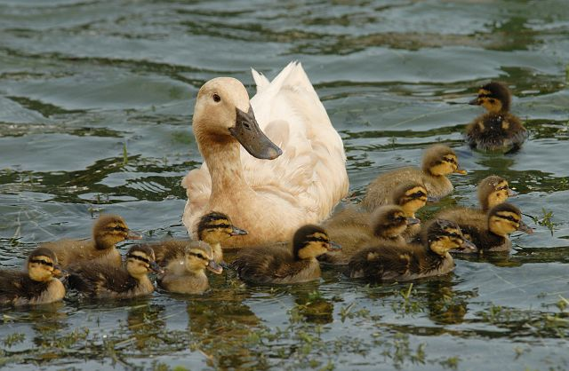
Thank You!

Slide 27
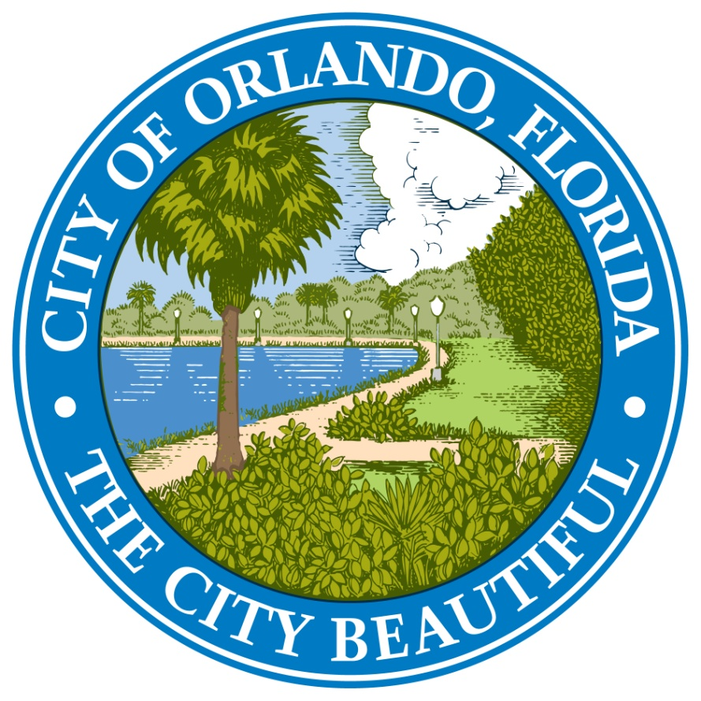
Questions ?

