Slide 1
Lake Jesup BMAP 2012 Annual Progress Report
Basin Working Group Meeting
July 19, 2012

Slide 2
Annual Report Overview
This is the second annual progress report on the basin management action plan (BMAP) activities.
Information was provided by the stakeholders on activities from June 1, 2011 through May 31, 2012.
The report includes:
  Major accomplishments;
  Major issues; and
  Upcoming year activities.

Slide 3
Background on the BMAP
The total maximum daily loads (TMDLs) for Lake Jesup were adopted in April 2006 for total phosphorus (TP) and total nitrogen (TN).
The BMAP focused on achieving the TP reductions over a 15-year period.
Detailed allocations were made to the responsible stakeholders to achieve the first one-third of the reductions over a 5-year period.
The BMAP was adopted by the Florida Department of Environmental Protection (FDEP) Secretary in May 2010.

Slide 4
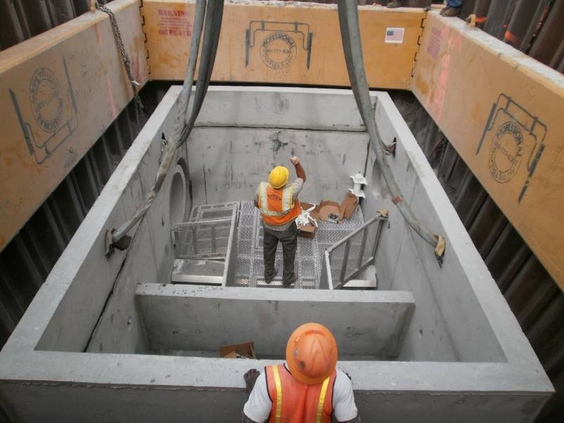
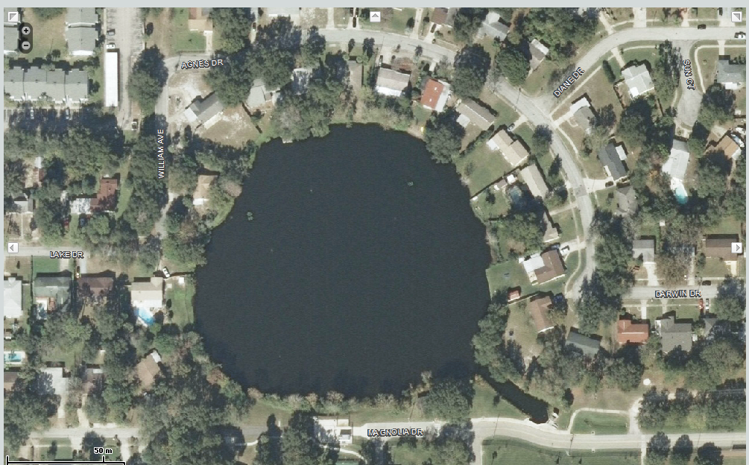
Accomplishments
  City of Altamonte Springs completed a native vegetation planting along Lake Maltbie.
  City of Casselberry installed 5 baffle boxes in the Howell Creek and Gee Creek subbasins as treatment for older subdivisions.
City of Altamonte Springs Lake Maltbie
City of Casselberry Baffle Box Installation

Slide 5
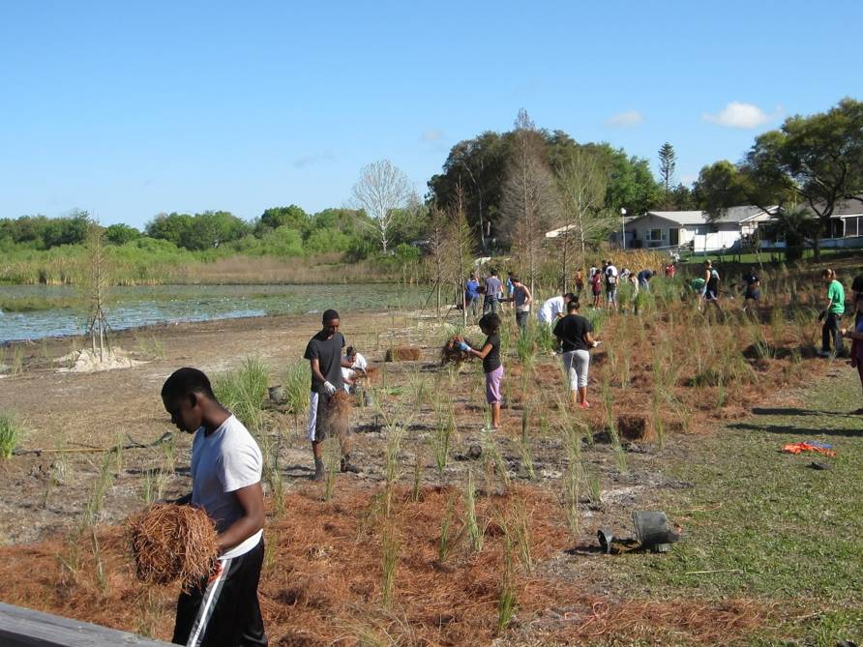
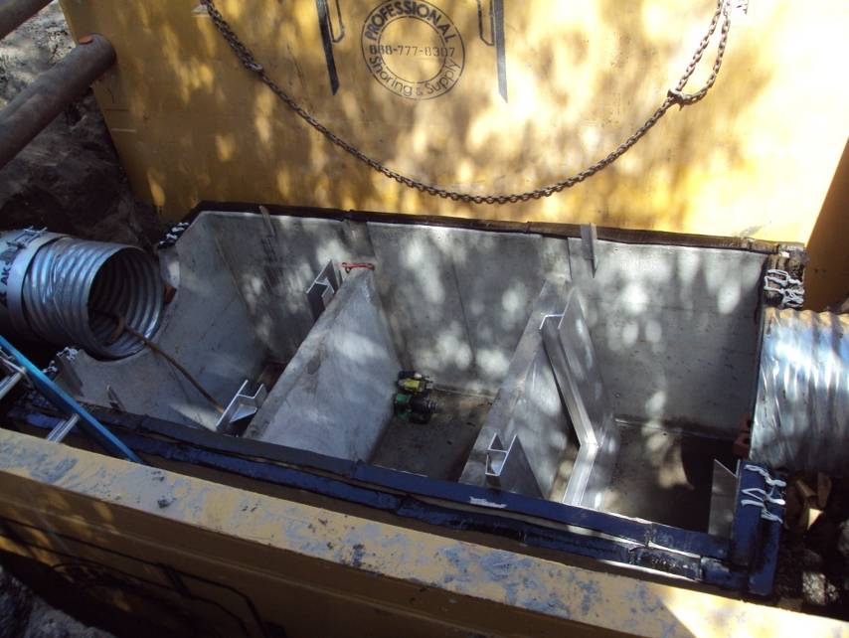
Accomplishments, continued
  City of Casselberry also completed a shoreline re-vegetation project on Lake Hodge.
  City of Maitland installed a baffle box on Packwood Avenue.
  City of Orlando completed the expansion of the Guernsey Park wet pond and installed baffle boxes near Lake Concord.
City of Casselberry Lake Hodge
City of Maitland Baffle Box Installation

Slide 6
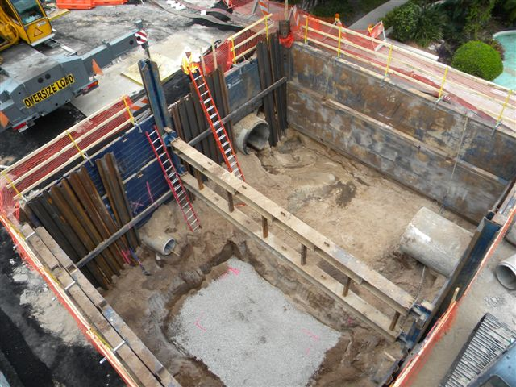
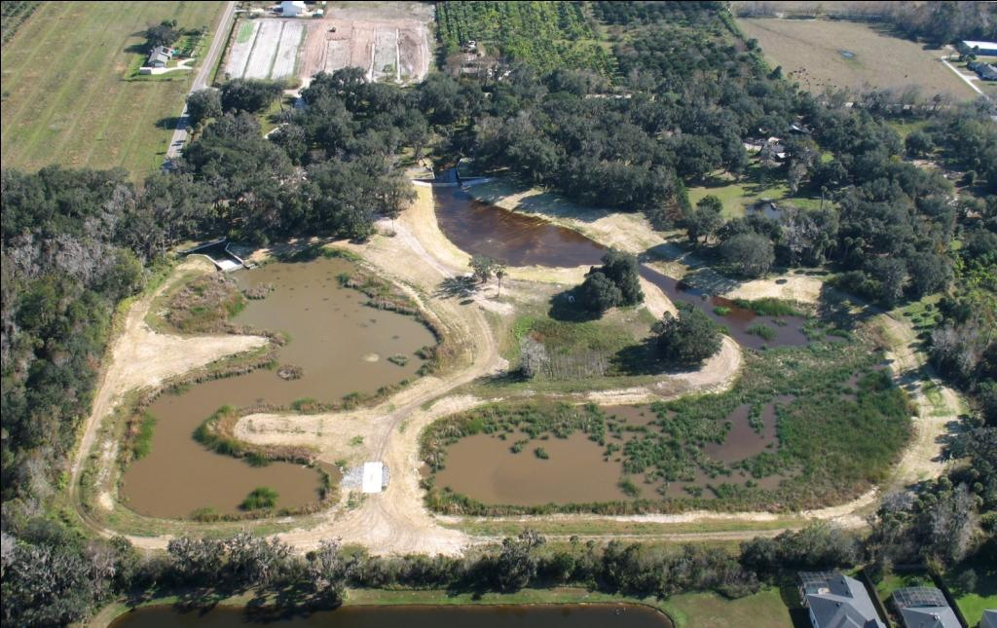
Accomplishments, continued
City of Winter Park completed the Courtland Avenue alum system retrofit, Alabama Drive improvements, and Morse Boulevard Outfalls.
City of Oviedo, City of Winter Springs, Seminole County, and SJRWMD completed the Solary Canal project.
City of Winter Park Morse Boulevard
Aerial Image of the Solary Canal Project

Slide 7
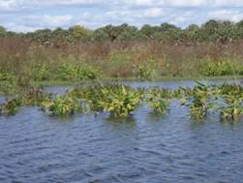
Accomplishments, continued
Seminole County completed the Lake Jesup Shoreline Restoration and Overlook Park Restoration projects and held the first Lake Jesup restoration event
Florida Department of Agriculture and Consumer Services (FDACS) enrolled growers in the container nursery, citrus, and cow/calf best management practice (BMP) manuals.
Total reductions from new urban projects are 946.5 lbs/yr TP.
Agricultural BMPs estimated reductions are 37.1 lbs/yr TP.
Seminole County Lake Jesup Shoreline Restoration

Slide 8
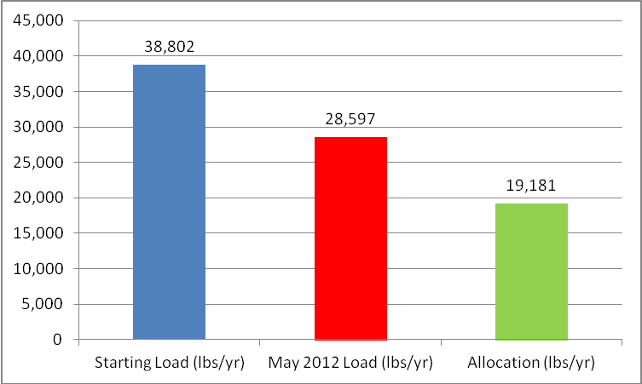
Progress to the TMDL
The total project reductions, including those projects shown as completed in the BMAP, are 9,171 lbs/yr TP.
  This is greater than the required reduction for the first BMAP iteration of 6,249.5 lbs/yr TP.

Slide 9

Monitoring and Research Accomplishments
All responsible stakeholders participated in the monitoring plan in the second year of BMAP implementation.
Casselberry completed a study on Queen’s Mirror and South Lake Triplet lakes to understand loading sources. The study found that nutrient cycling contributes 21%-32% of the TP load, and groundwater seepage contributes 1%-8% of the TP load. The city is planning on using whole lake alum treatment to reduce TP.

Slide 10


Research Accomplishments, con’t
Oviedo completed a study to determine the loading from the North Corporate Oviedo basin to Lake Jesup.
Seminole County began the second phase of the seepage study to quantify loading from sediments and groundwater in Lake Jesup.
The county is also starting efficiency monitoring of its Red Bug Lake Regional Stormwater Facility.

Slide 11
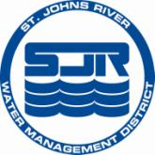
Research Accomplishments, con’t
St. Johns River Water Management District (SJRWMD) completed its sediment nutrient flux research study, which found high rates of sediment resuspension and deposition in Lake Jesup. The TP flux between the sediments and water column was estimated at 23 metric tons per year.
SJRWMD estimated reuse contributions in the watershed using a model. The model estimated the TP load to be 5 metric tons per year. SJRWMD, FDEP, and University of Florida – Institute of Food and Agricultural Sciences are developing fertilizer BMPs for reuse irrigation.

Slide 12
Lake Jesup Interagency Restoration Strategy
The Strategy was jointly developed by FDEP, SJRWMD, and the Florida Fish and Wildlife Conservation Commission (FWC).
Includes two phases:
  Phase 1 - Development of BMAP, reduce external loading to the lake, and reduce nutrients in the water column.
  Phase 2 – Implemented as needed based on results of Phase 1.
Strategy was endorsed by the agencies in January 2008.

Slide 13
Interagency Restoration Strategy, con’t
An addendum to the Strategy was finalized in January 2011 to address several changes in the basin:
  BMAP spread the reductions over 15 years.
  Improved reuse management and elimination of sludge disposal at Site 10.
  U.S. Army Corps of Engineers 1135 project determination.
  Construction of new State Road 46 high-span bridge.
  Updated list of regional projects.
  New timeline with parallel efforts to replace previous sequential timeline.

Slide 14
Interagency Restoration Strategy, con’t
The Strategy addendum was not signed by the Executive Directors at each agency.
Agency staff determined that the modifications in the addendum were not significant and were consistent with the goals in the original Strategy, which the Executive Directors have signed.
The activities in the Strategy are being implemented and an update is included in the BMAP annual progress report.

Slide 15
Interagency Restoration Strategy, con’t
As part of the Strategy, SJRWMD has completed feasibility studies for several regional projects:
  In-lake TP reduction pay-for-performance project completed its 3rd year of the 5-year project timeframe.
  First phase of the floating TP treatment feasibility study is complete. Initial results show 40%-97% TP removal. SJRWMD will provide technical support and the scope of work to any entity interested in this option.
  Completed the feasibility study for using alum to reduce TP concentrations in the tributaries. Conceptual systems can remove 4-6 metric tons/yr of TP. Deciding factors on where to place the systems will be land availability and proximity to Lake Jesup.

Slide 16
Issues
Several entities have encountered delays with their project implementation. However, these delays are not causing an issue with BMAP compliance because the stakeholders have either already achieved their BMAP required reductions or have still planned the projects during the first BMAP iteration.
The stakeholders noted that obtaining funding for the projects and research studies has been an issue.
Data were not collected from a few of the monitoring stations due to low flow conditions from lack of rainfall. The locations of these stations may need to be modified in the future if low flow continues to be an issue.

Slide 17
Questions and Discussion on the Annual Progress Report

