Slide 1
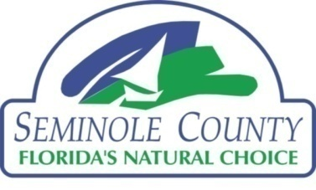
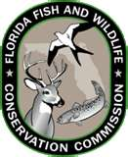
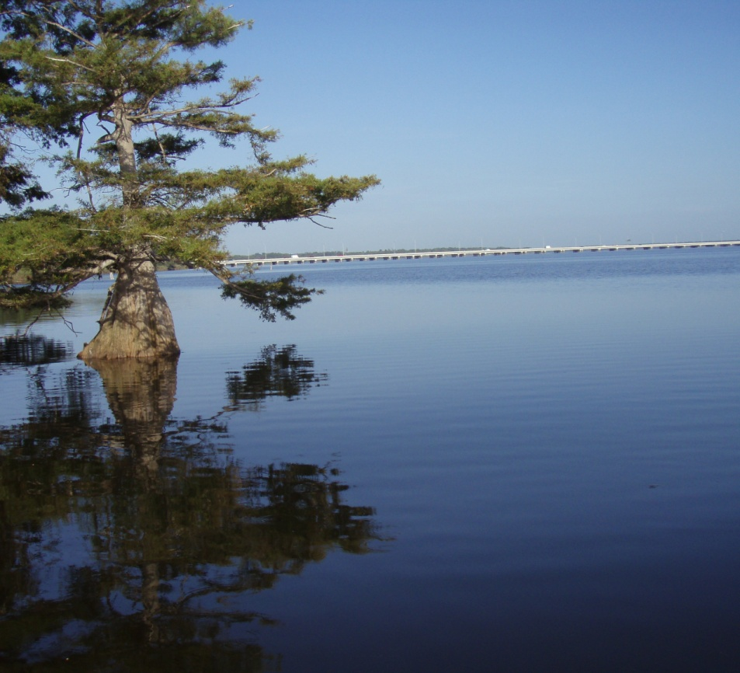
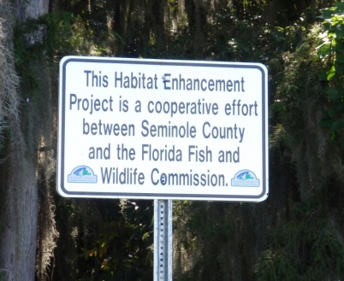
Lake Jesup Vegetative Restoration Update 2012
Presented by
Kim Ornberg, PE
Seminole County Public Works

Slide 2
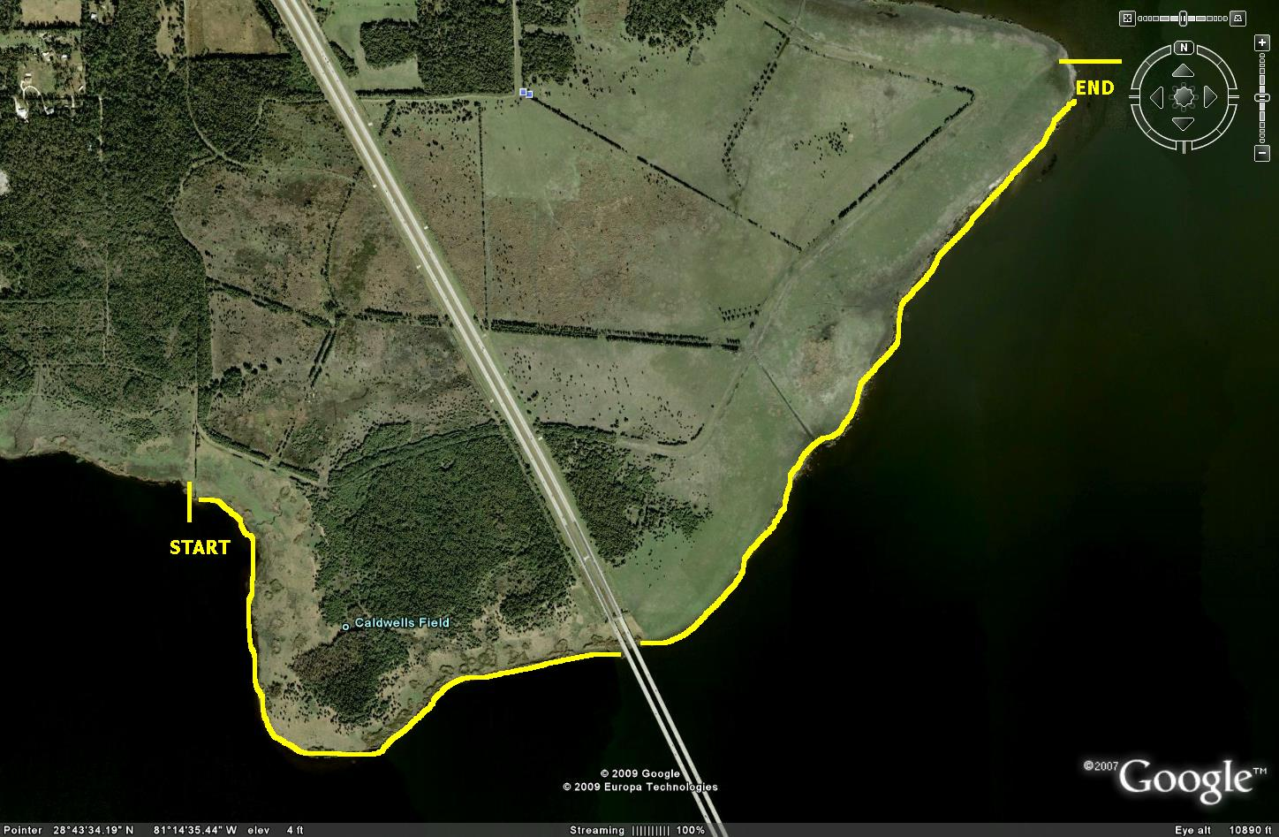
FWC/Seminole Co Projects
Shoreline restoration
Initiated 2009
14,500 LF
Phragmites removal
Native replanting
>115,000 plants
21 different native species

Slide 3
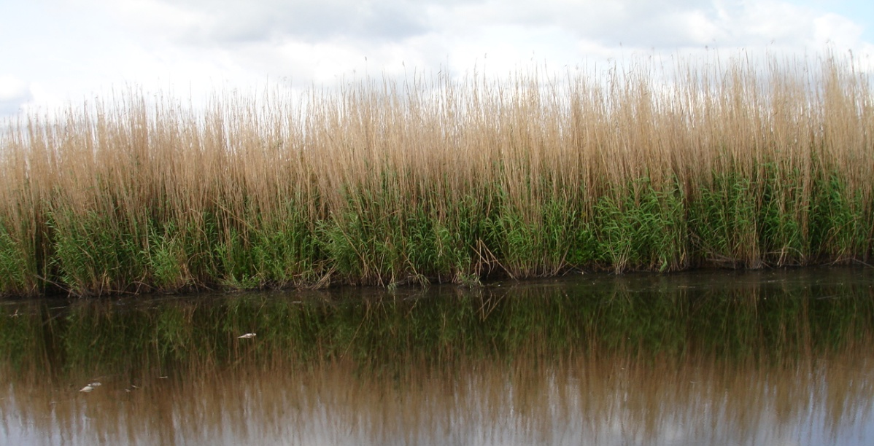
FWC/Seminole Co Projects
Before: Shoreline Dominated by Phragmites

Slide 4
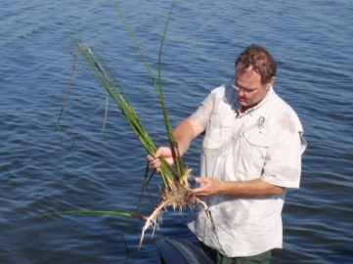
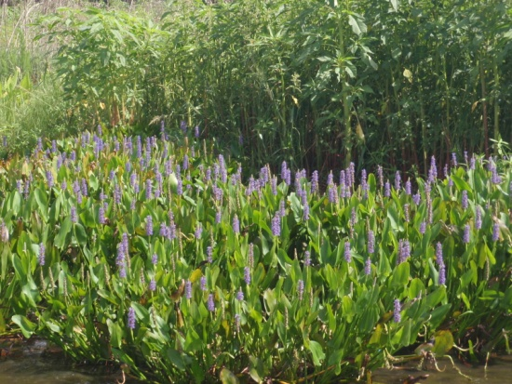
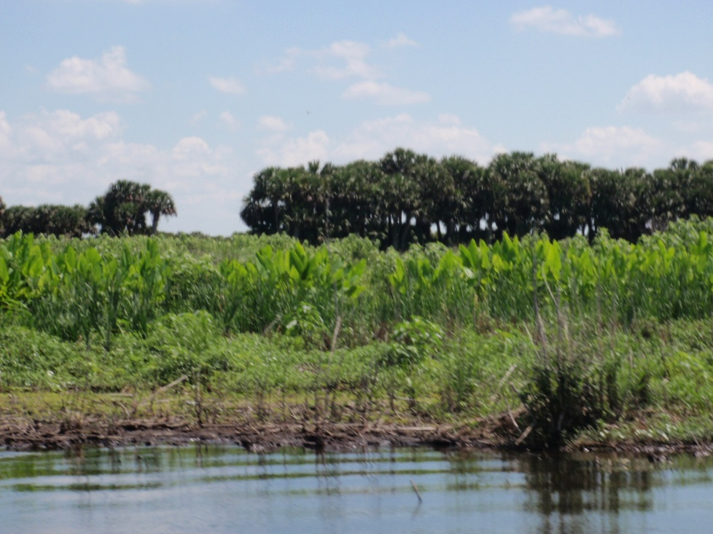
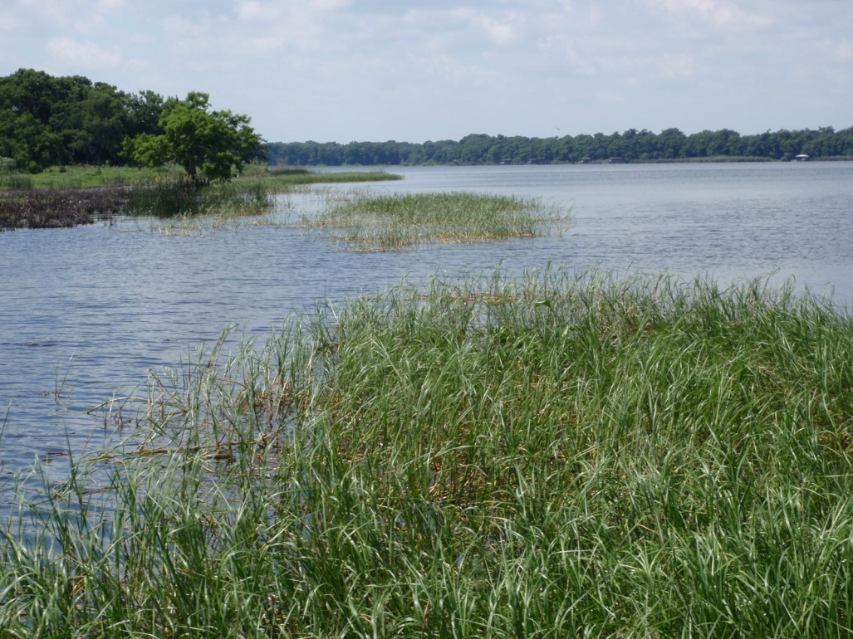
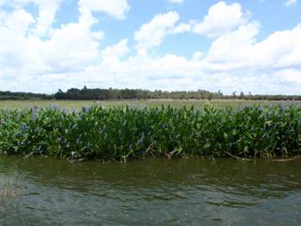
FWC/Seminole Co Projects
After: Spring 2012 Shoreline

Slide 5
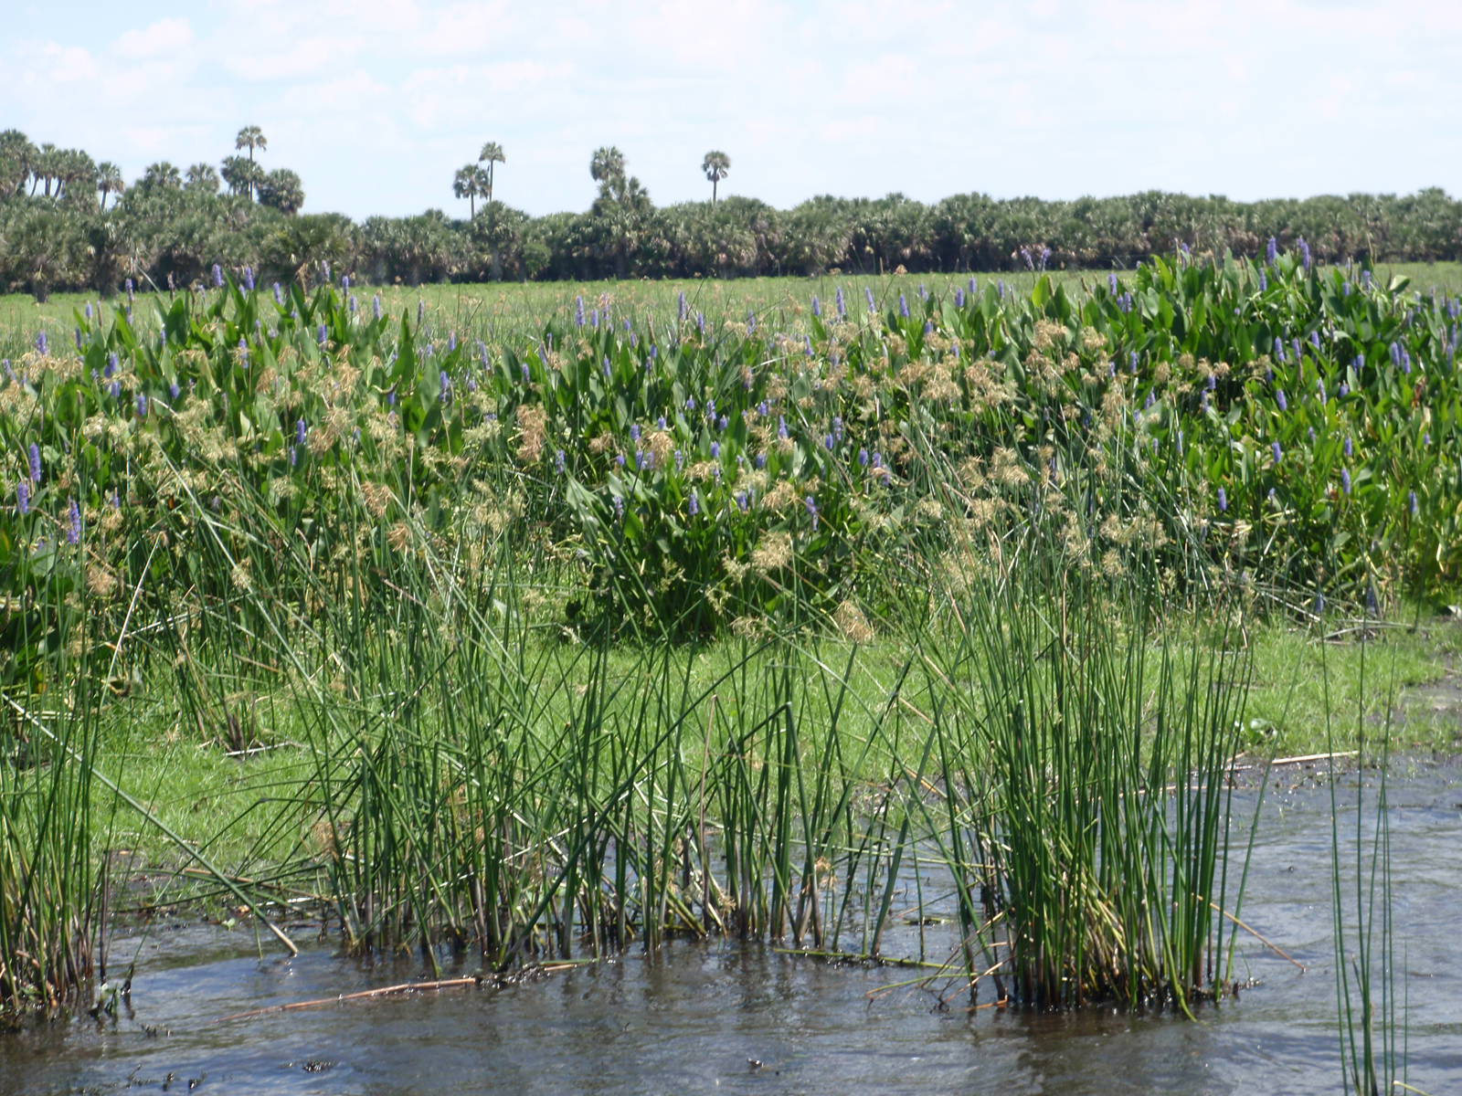
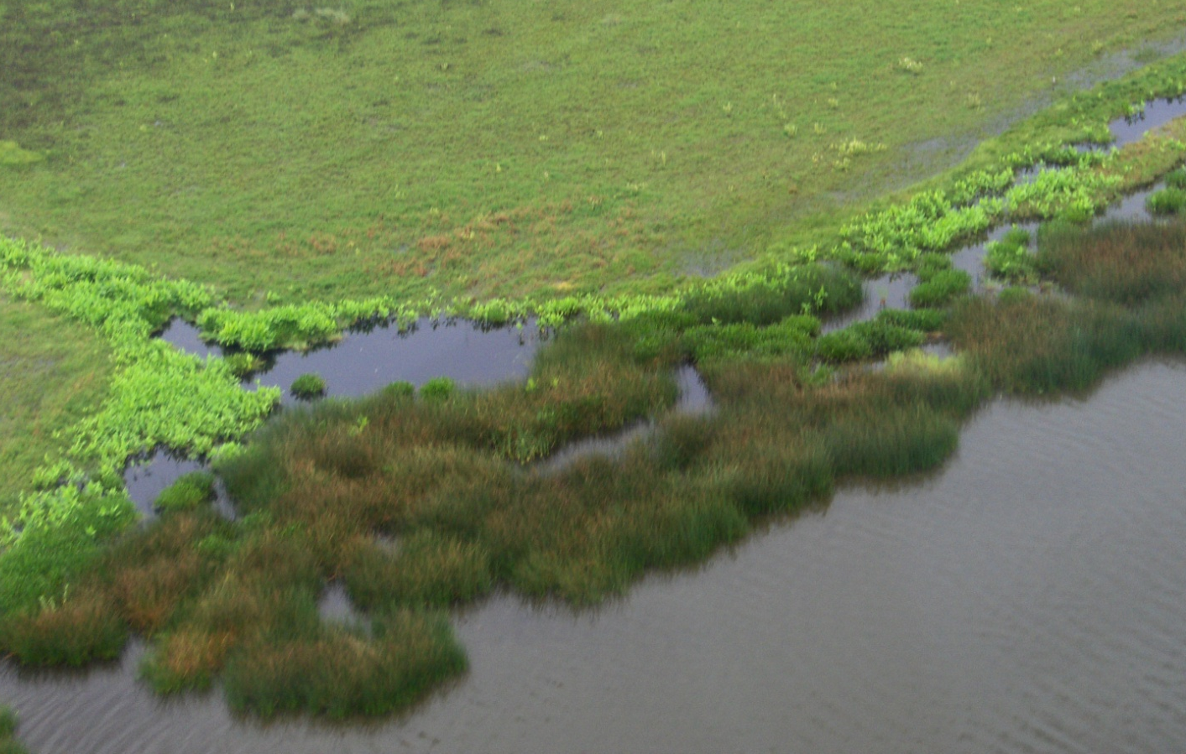
FWC/Seminole Co Projects
After: Spring 2012 Shoreline

Slide 6
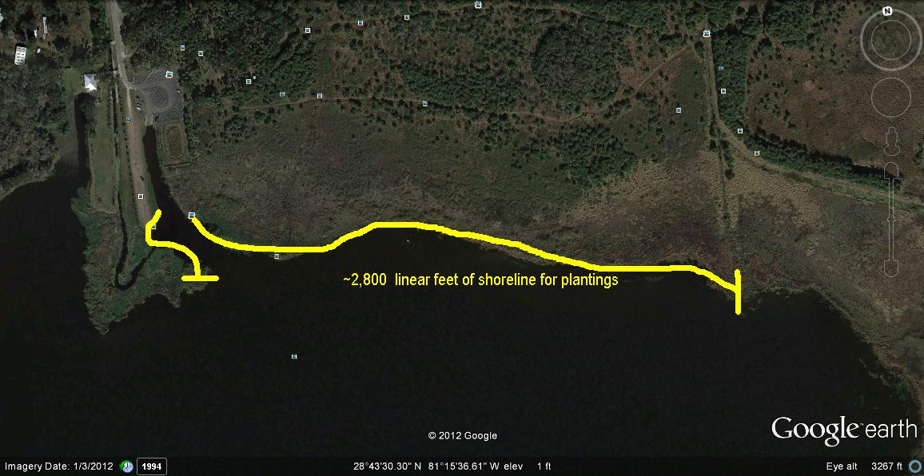
Phase 2 Shoreline Restoration
Initiated: June 2012
Completion date: September 2012

Slide 7
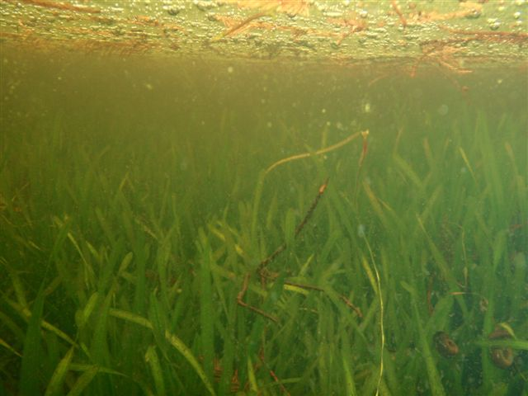
Lake Jesup SAV Restoration:
Eelgrass Project
Additional Cooperative Efforts, Research & Partners

Slide 8
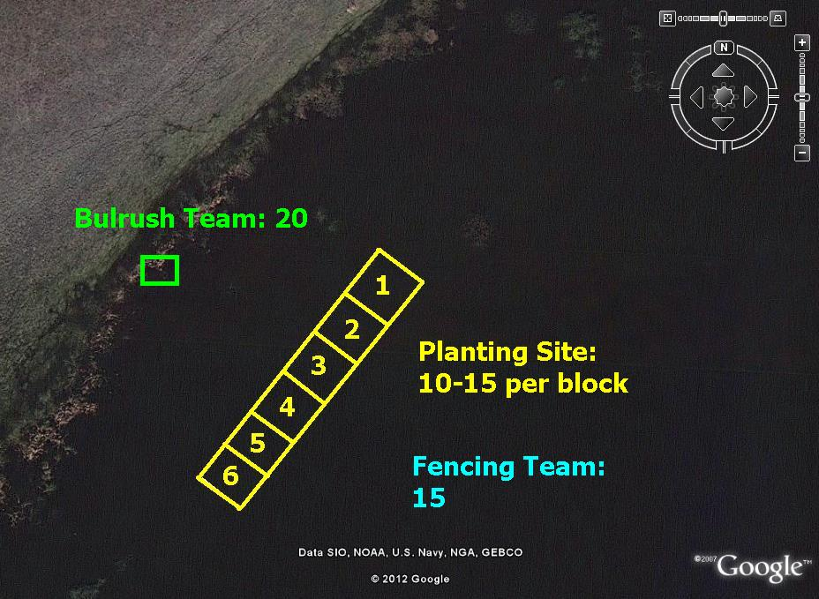
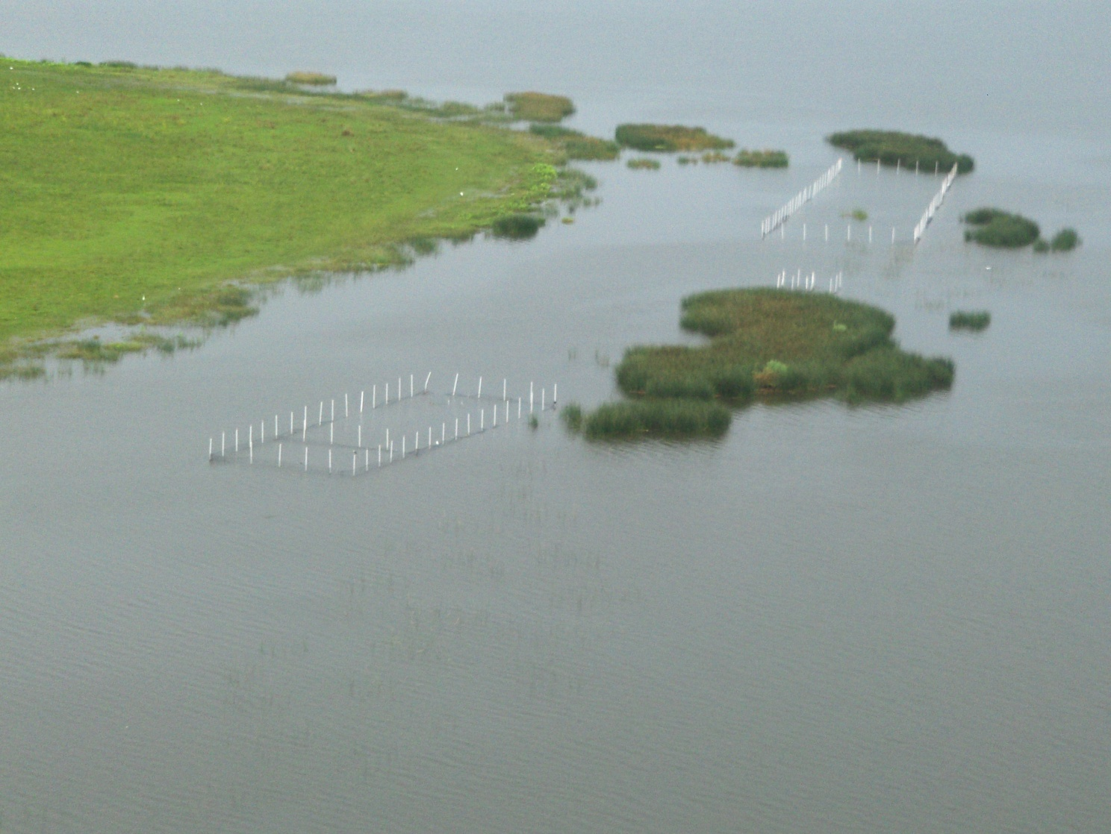
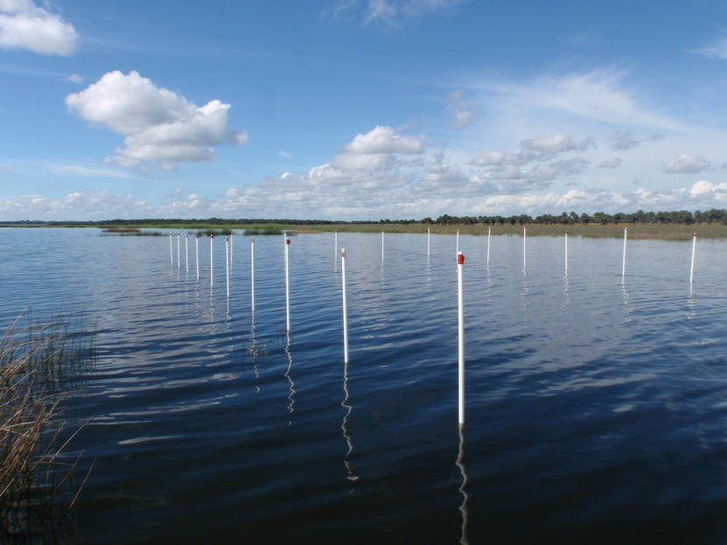
Eelgrass Restoration Project
Experimental Phase: 2011
Restoration Phase: 2012

Slide 9
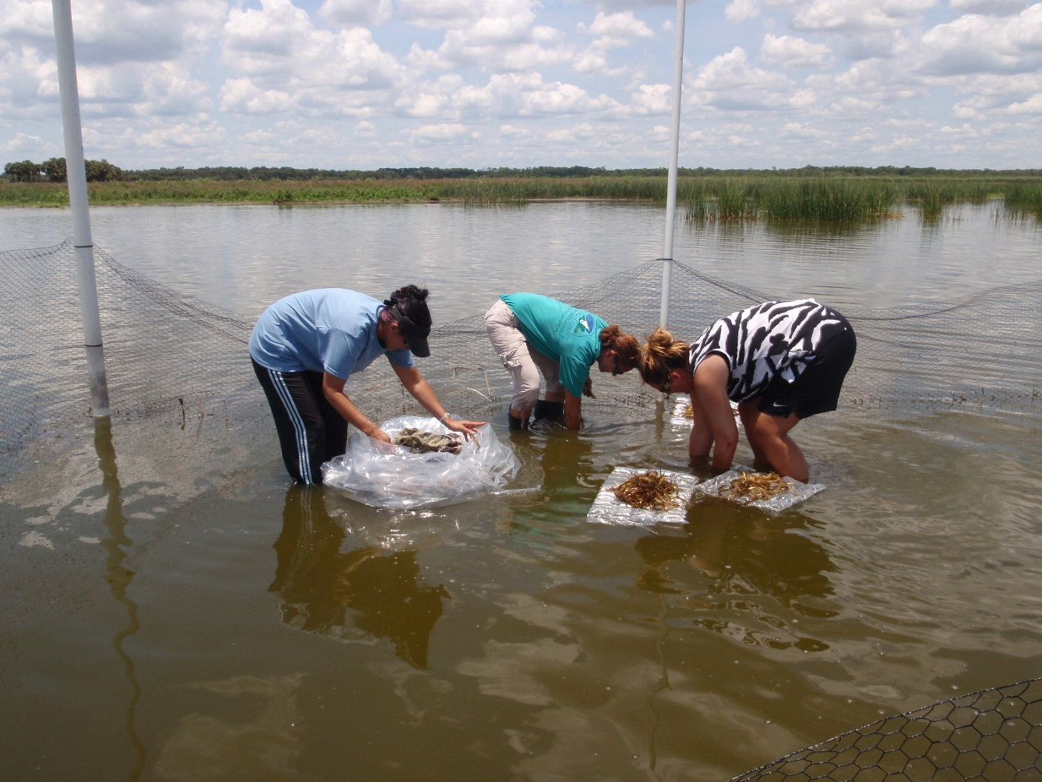
Experimental Phase:
Initial Plantings-
Purchased Eelgrass
June 2011
0% Survival

Slide 10
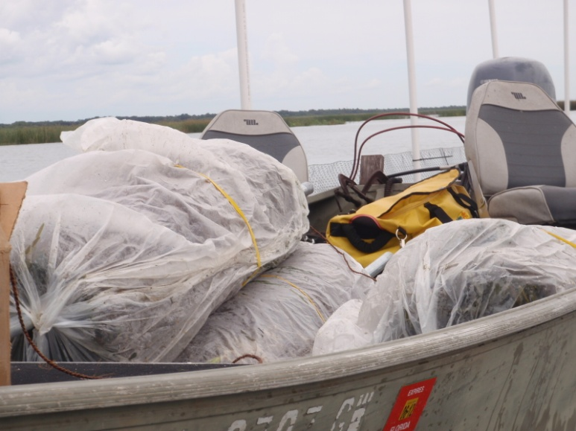
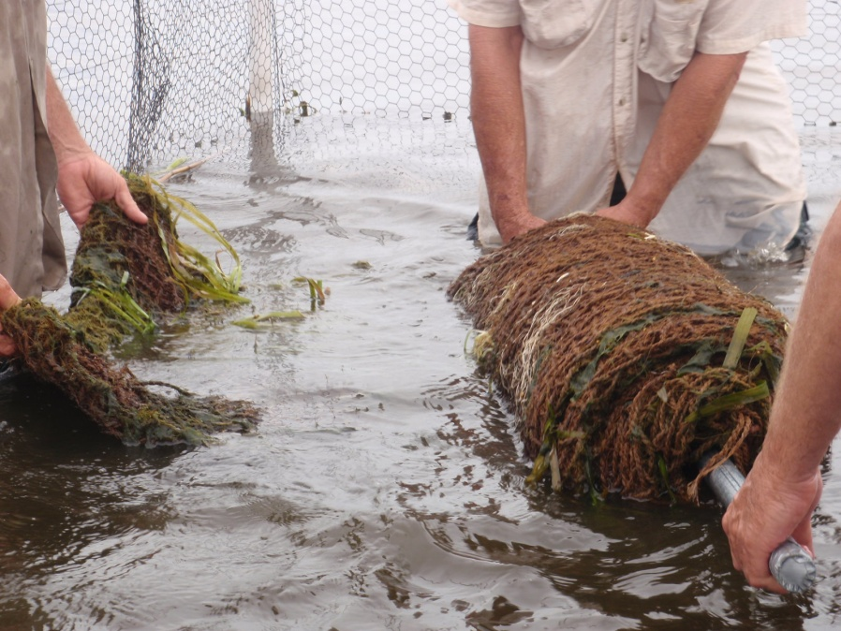
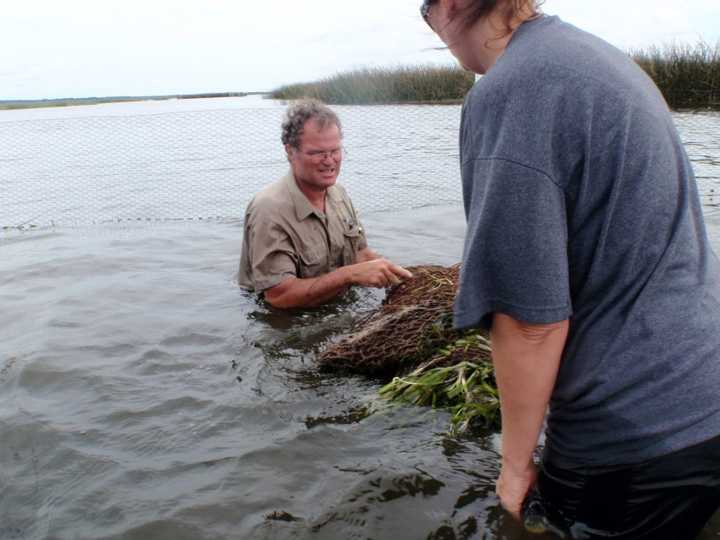
Experimental Phase:
Coco-mat Plantings
80% Survival
August 2011

Slide 11
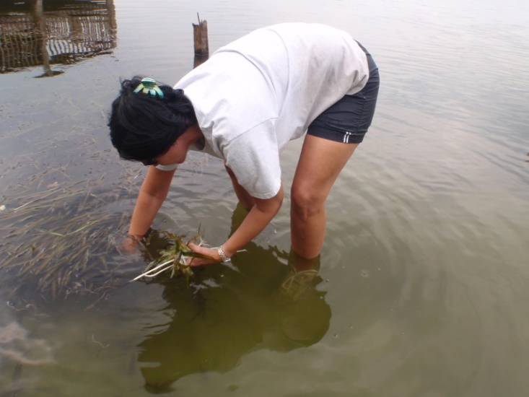
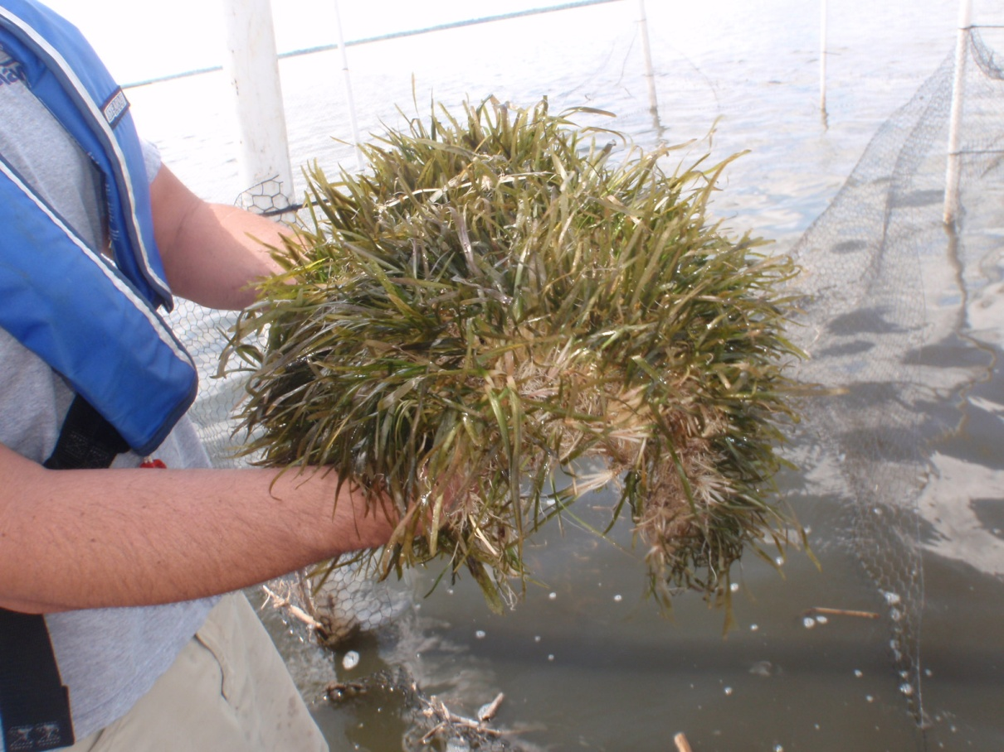
Experimental Phase:
Lake Howell Plantings
June 2011
<5% Survival

Slide 12
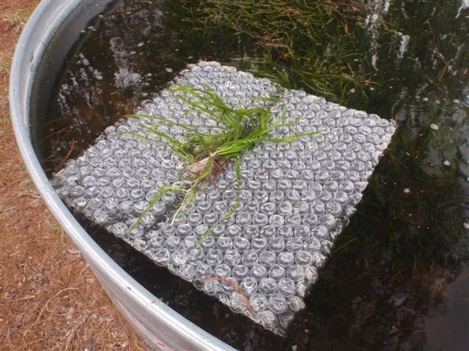
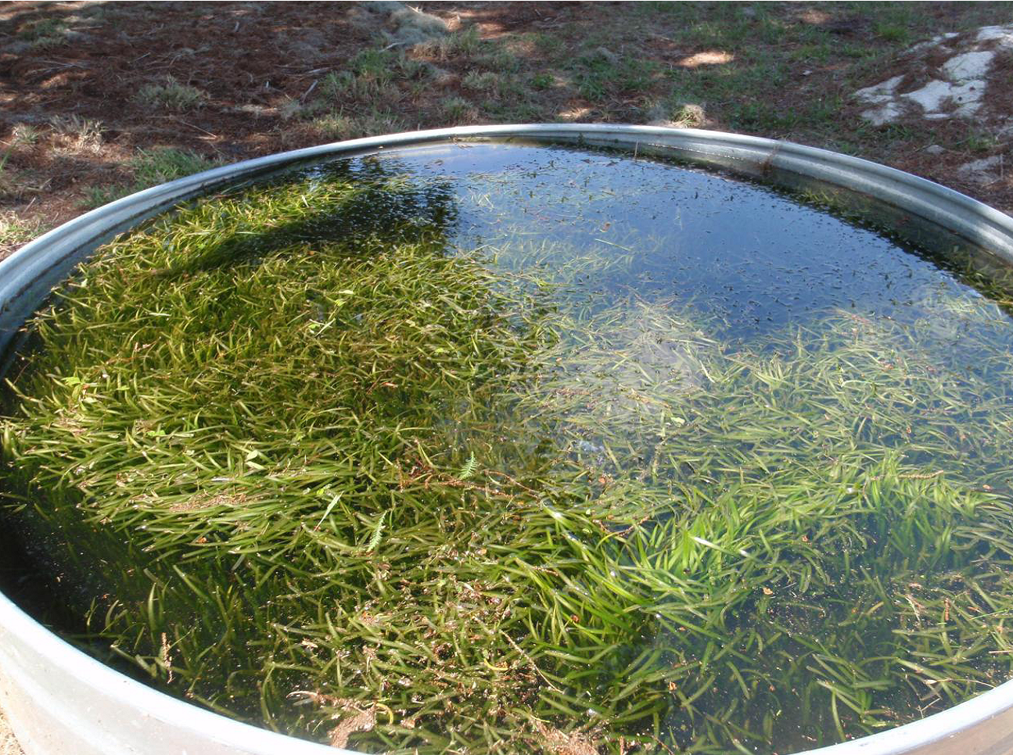
Restoration Phase:
Nursery tubs
April 12th, 2012

Slide 13
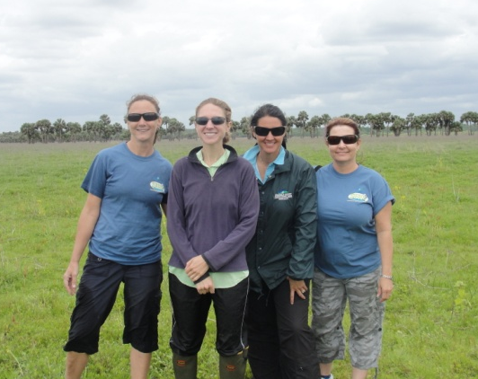
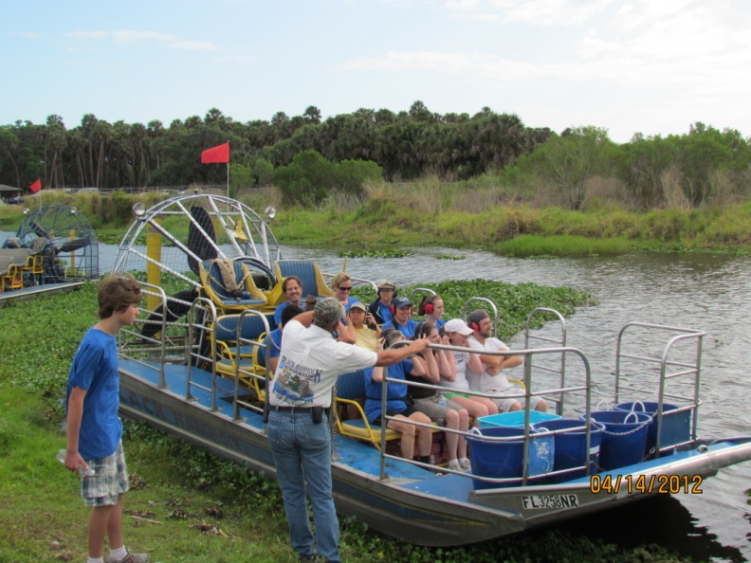
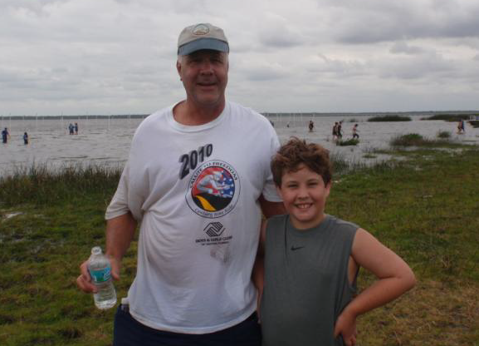
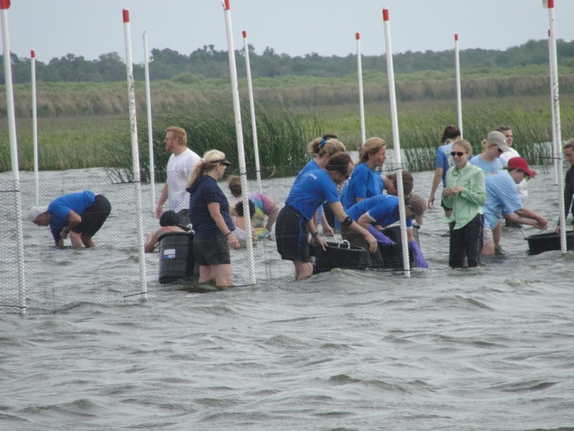
Restoration Event
November 2011 Event cancelled due to high water
Rescheduled April 14th 2012
110 Volunteers
30,000 plants
1 acre plot planted
Partners: FWC, SCSO, SERV, SJRWMD, FOLJ, FDEP, & Black Hammock Adventures

Slide 14
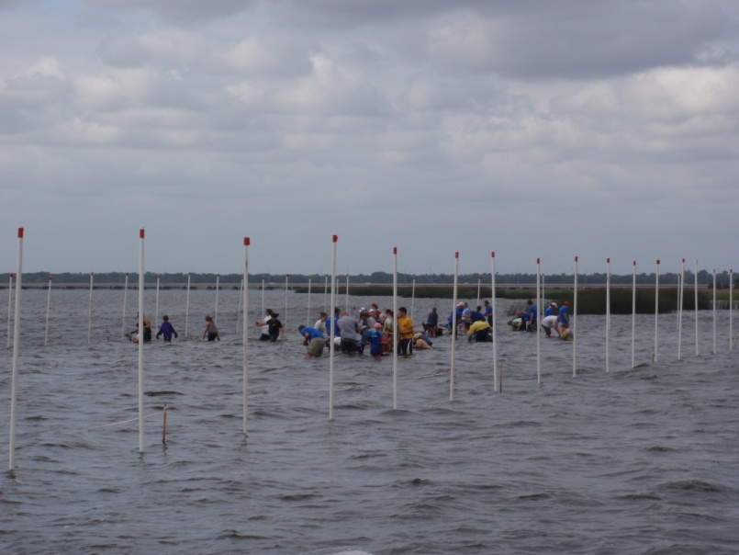
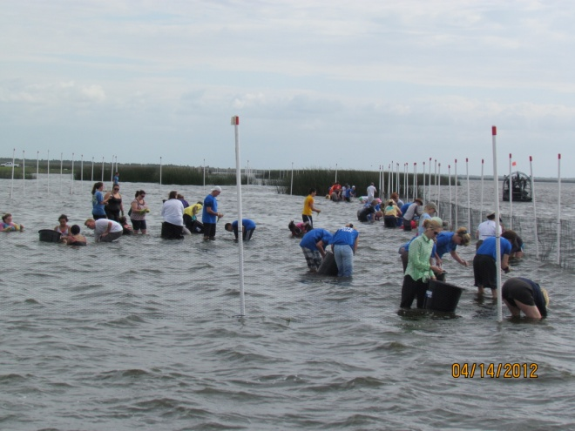
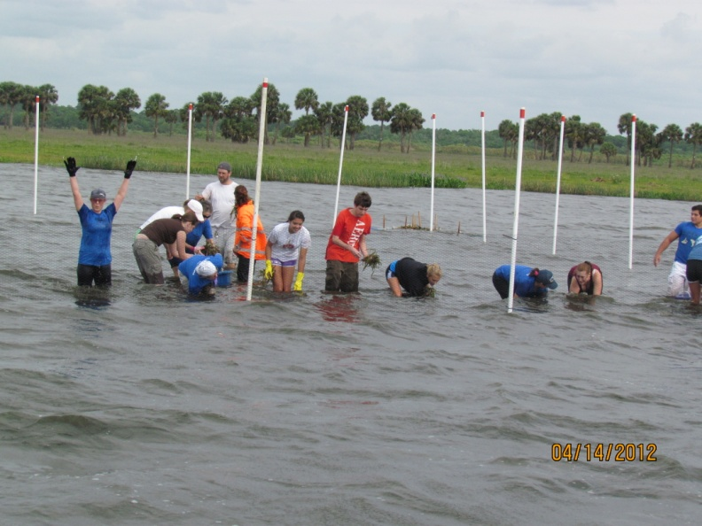
Restoration Event

Slide 15
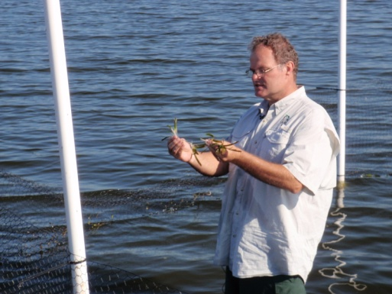
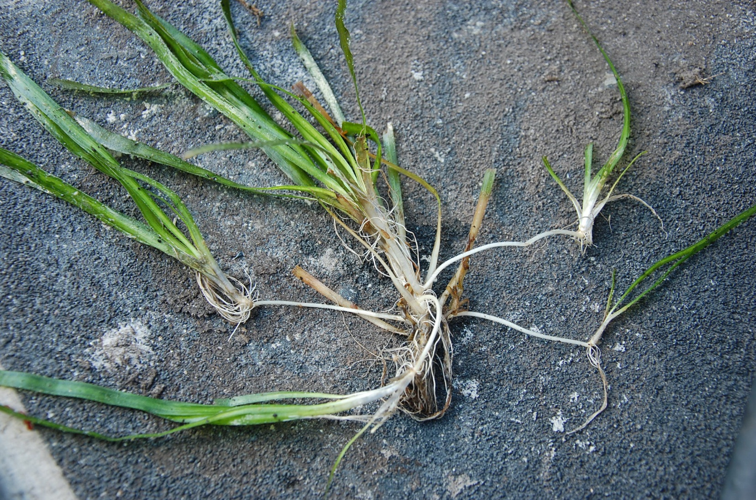
Post-Event Growth
Mother plant with 4 new daughter plants
80% Survival as of July 2012

Slide 16
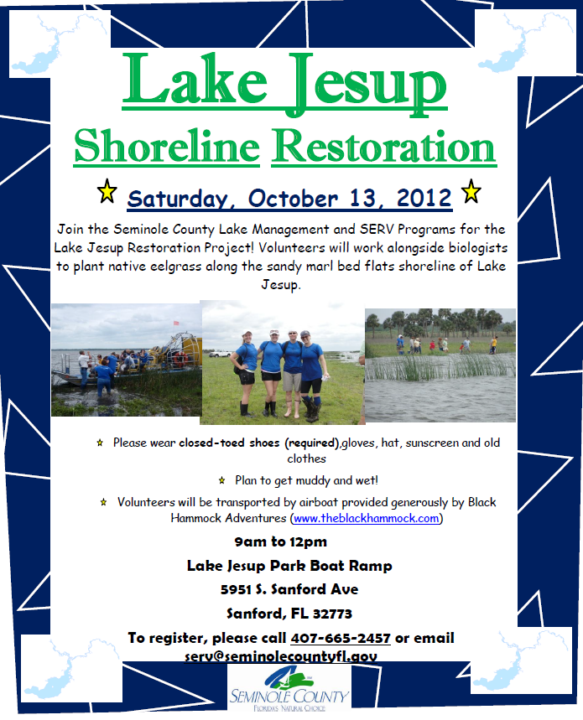
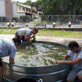
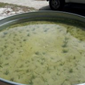
Next Event:
October 13, 2012
New tubs planted April 30, 2012

Slide 17
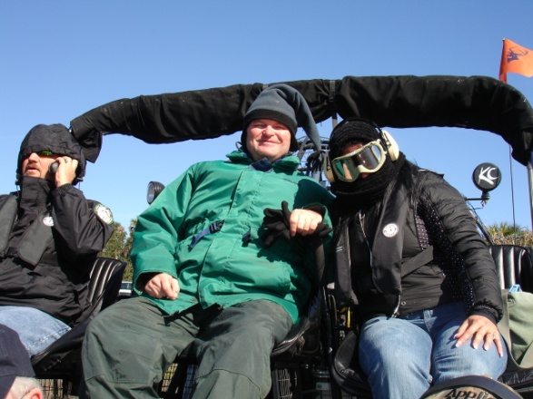
On-Going Efforts
Continue Quarterly Monitoring of Macrophytes
Continue/Expand Restoration Efforts with FWC
Continue SAV Mapping
Continue Bioassessments (LVI/Marcoinvertebrates)

Slide 18
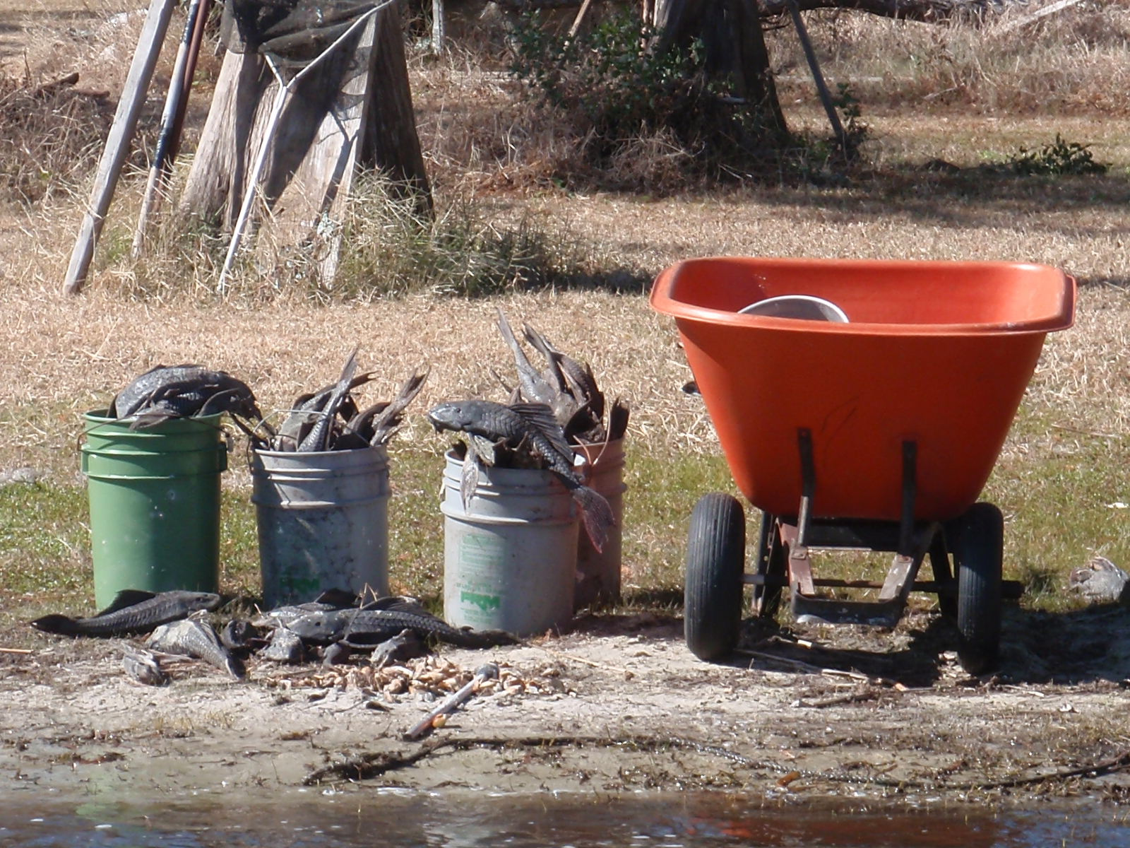
QUESTIONS???
Post-Freeze effects on Jesup

