Slide 1
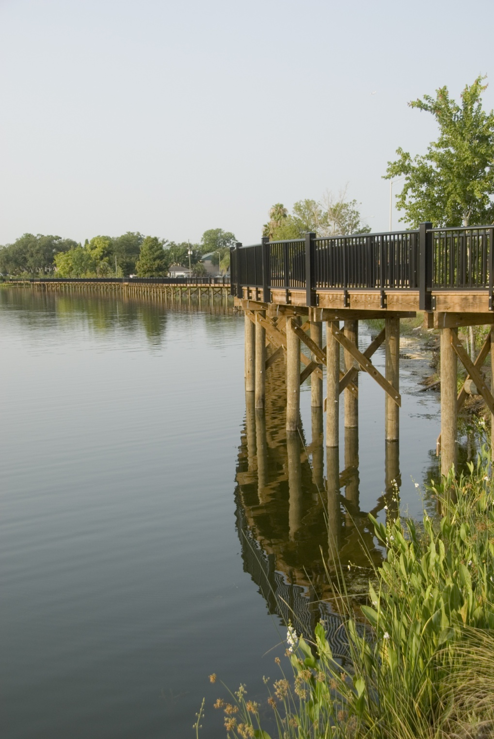

Lake Concord Park
A Water Quality BMP Showcase
Kelly H. Brock, Ph.D., P.E., LEED AP
Assistant Public Works Director/
City Engineer – City of Casselberry
Lake Jesup BMAP Meeting
July 21, 2011

Slide 2
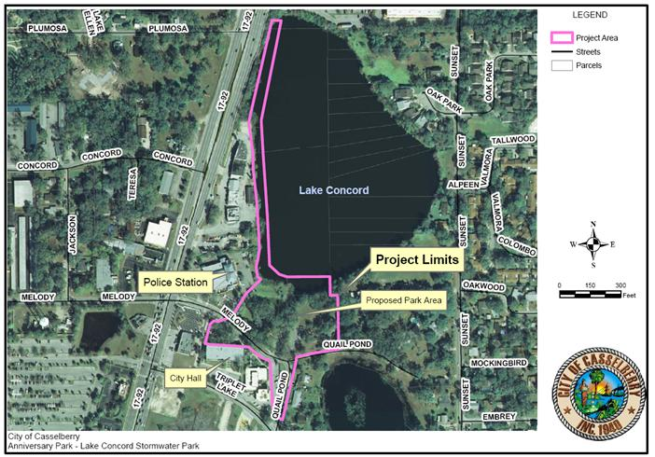
Project Location

Slide 3
Project Purpose
Redevelopment of Anniversary Park
-Part of City Center Concept
Park Facilities
-Venue for special events
and recreation
Stormwater/Water Quality Retrofits
-Part of Stormwater Master Plan & Lake Jesup BMAP
-Serves portion of City Municipal Complex and other areas
Public Education
Opportunities

Slide 4
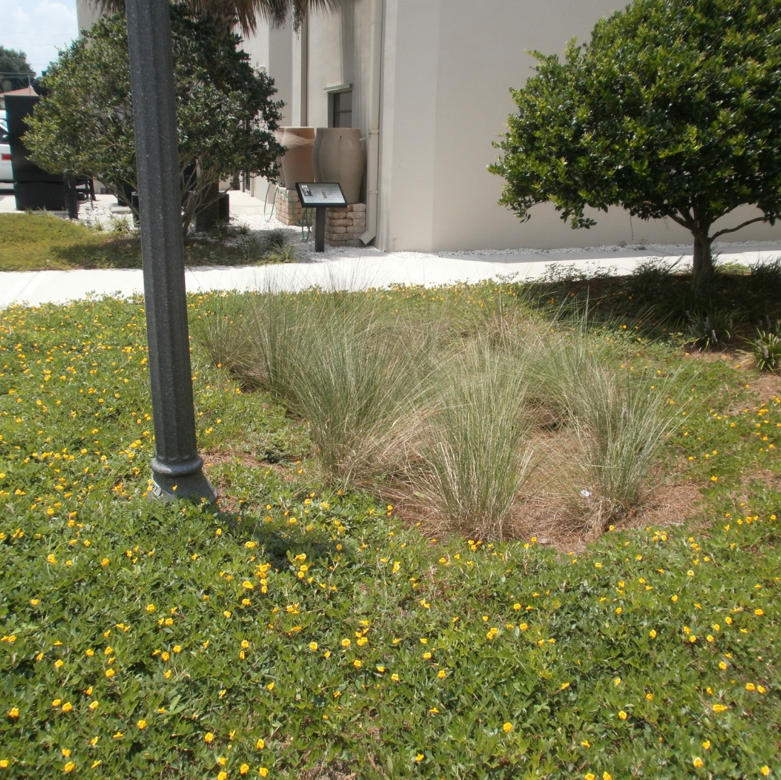
Design Elements
Stormwater BMP retrofits
  Exfiltration
  Dry detention
  Two baffle boxes
  Bioretention (“rain gardens”)
  Stormwater harvesting/reuse
  Pervious pavement systems
  Environmental swale/berm
  Lakeshore revegetation
  Rain Barrels
Low Impact Development (LID)
Florida-friendly landscaping
LED lighting
Recycled Materials

Slide 5
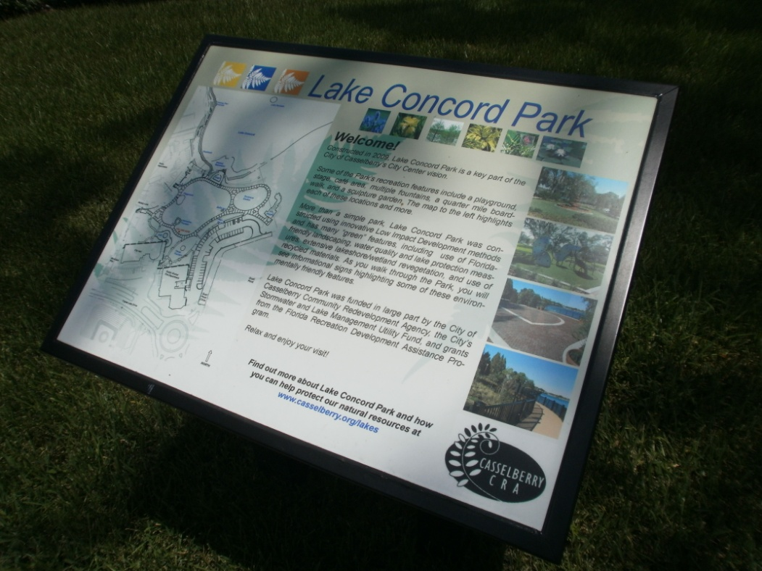
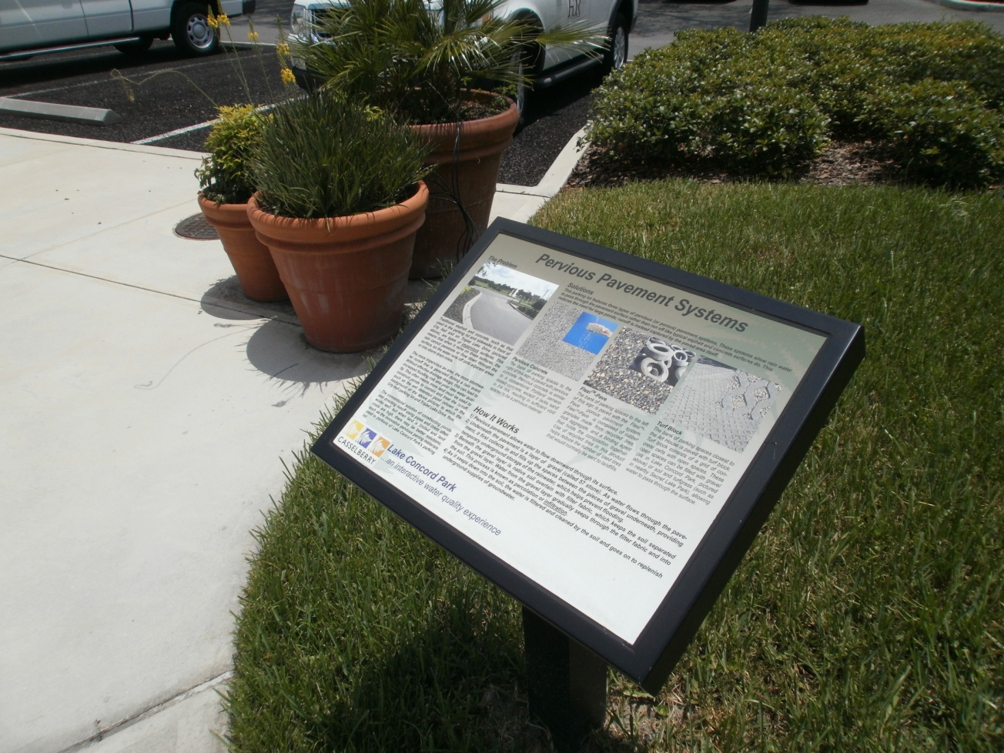
Educational Components
Stormwater BMP educational signage installed throughout the park

Slide 6
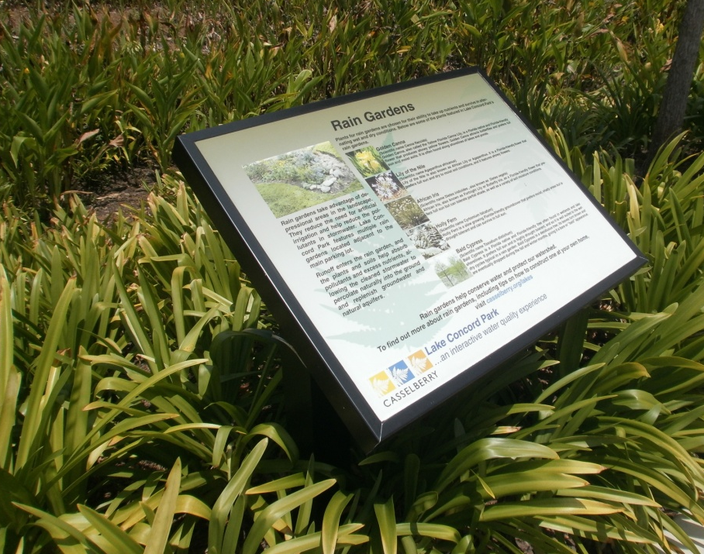
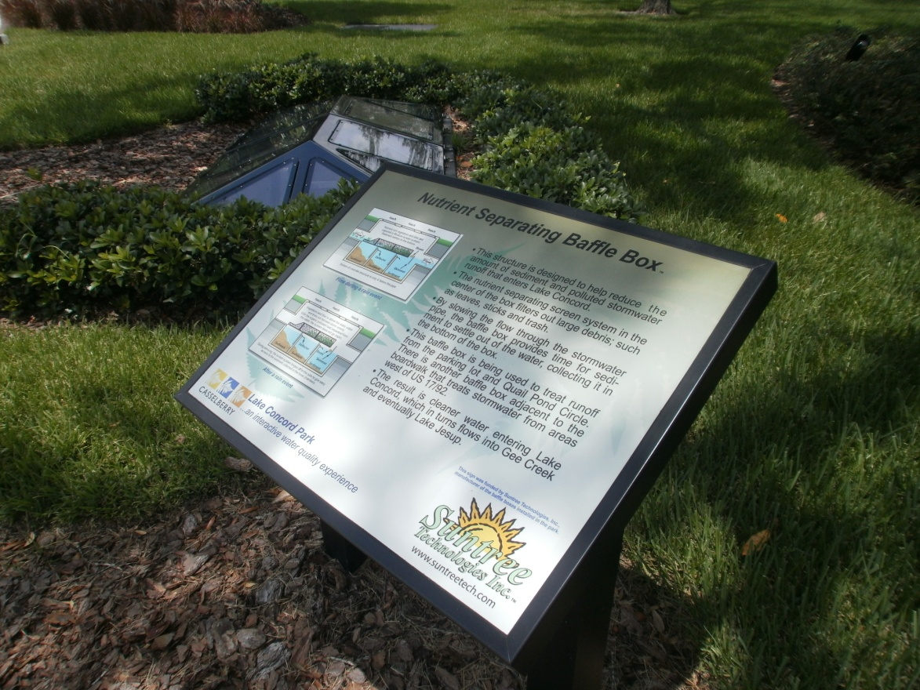
Educational Components

Slide 7
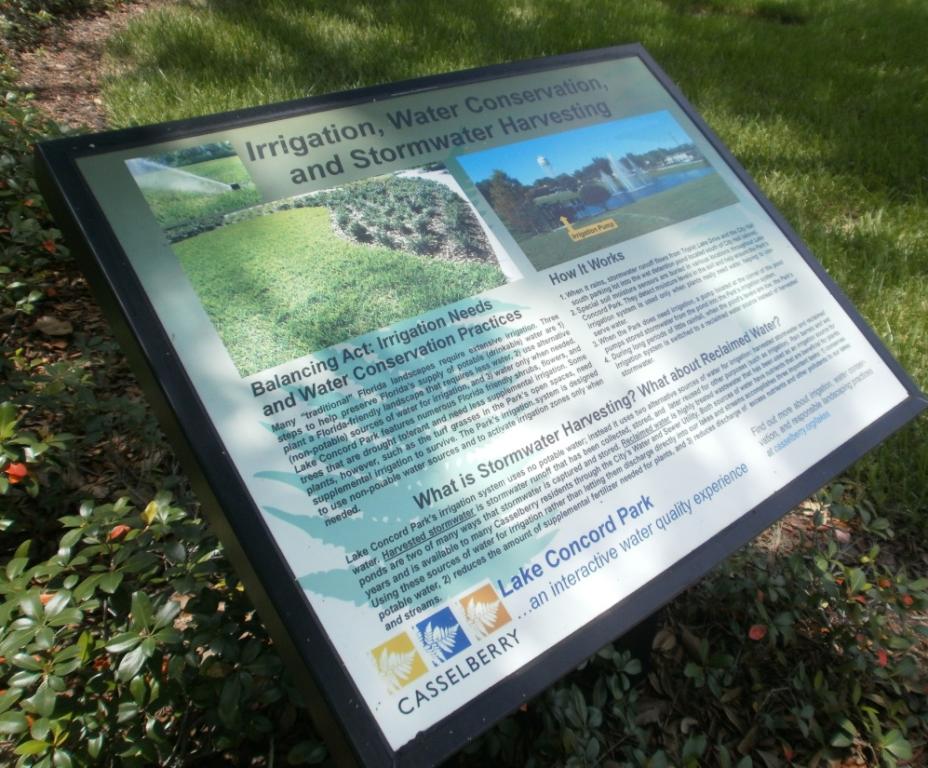
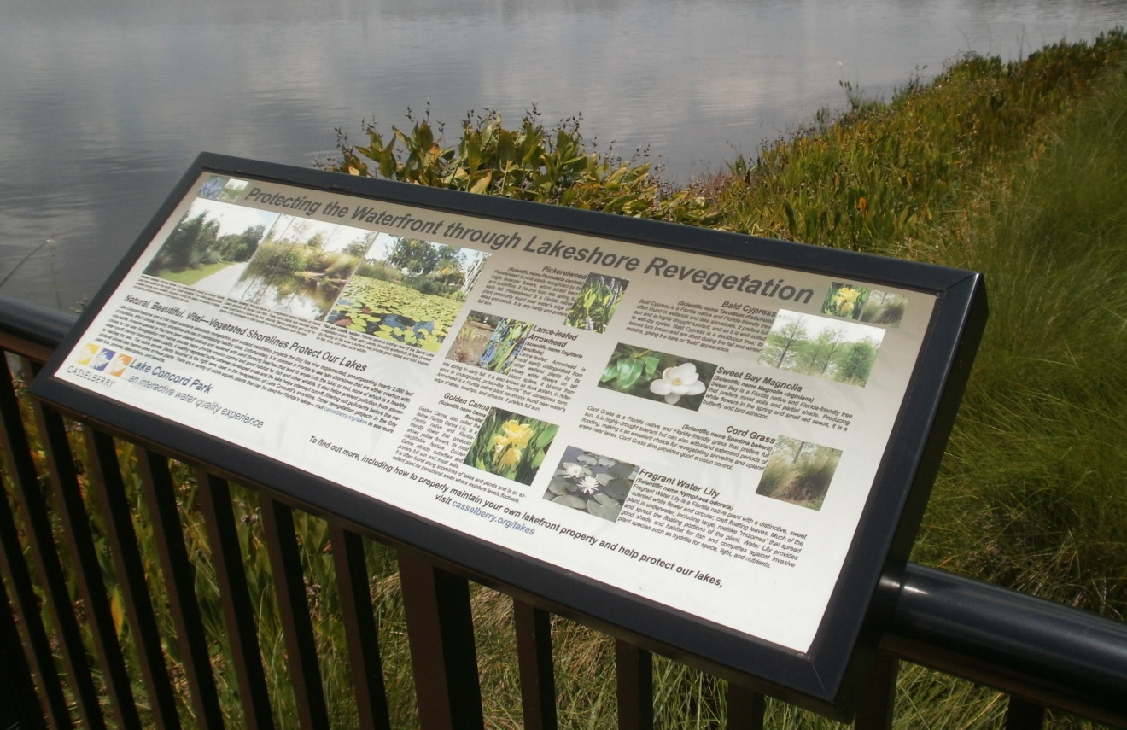
Educational Components

Slide 8
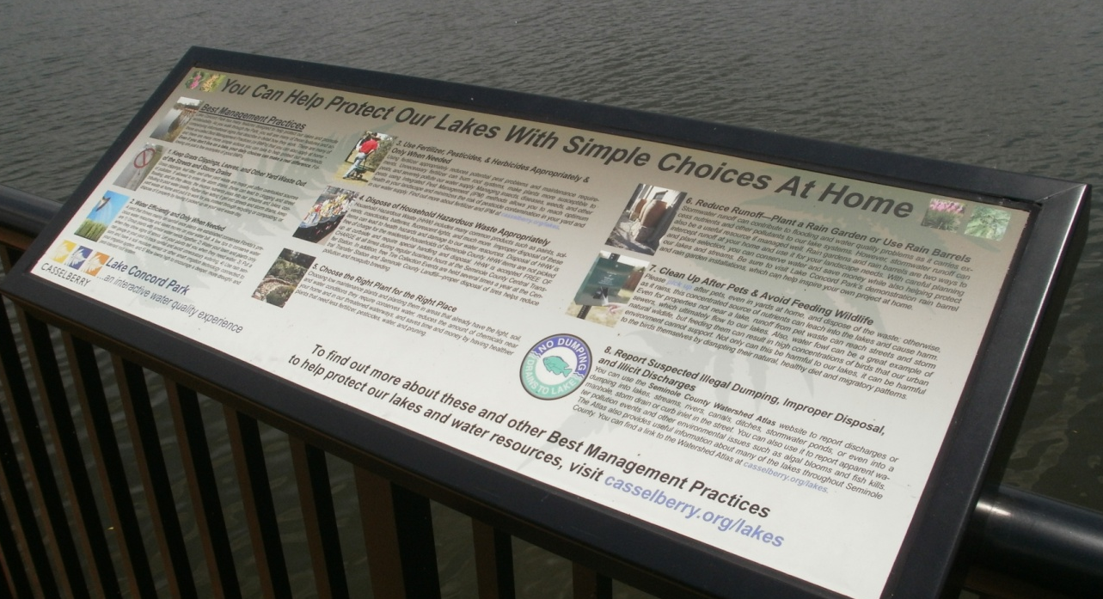
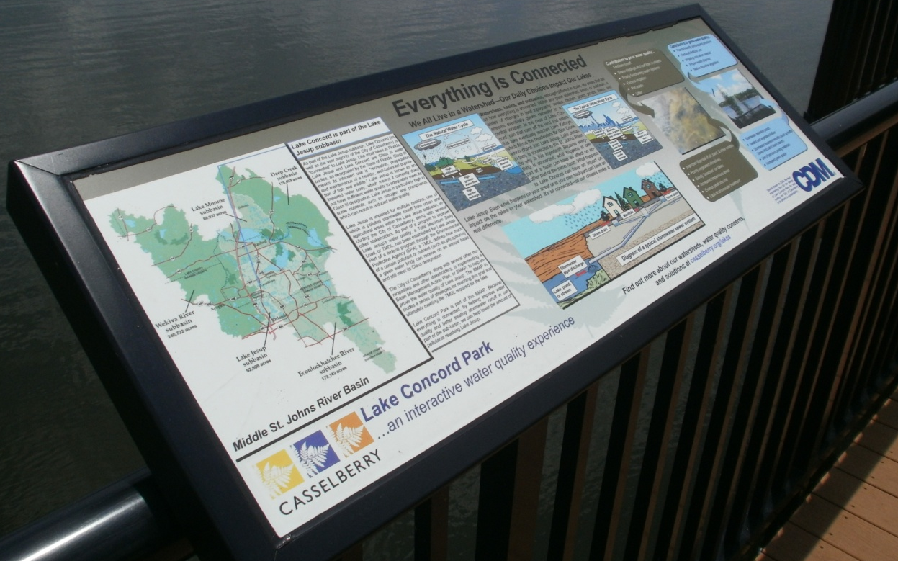
Educational Components

Slide 9
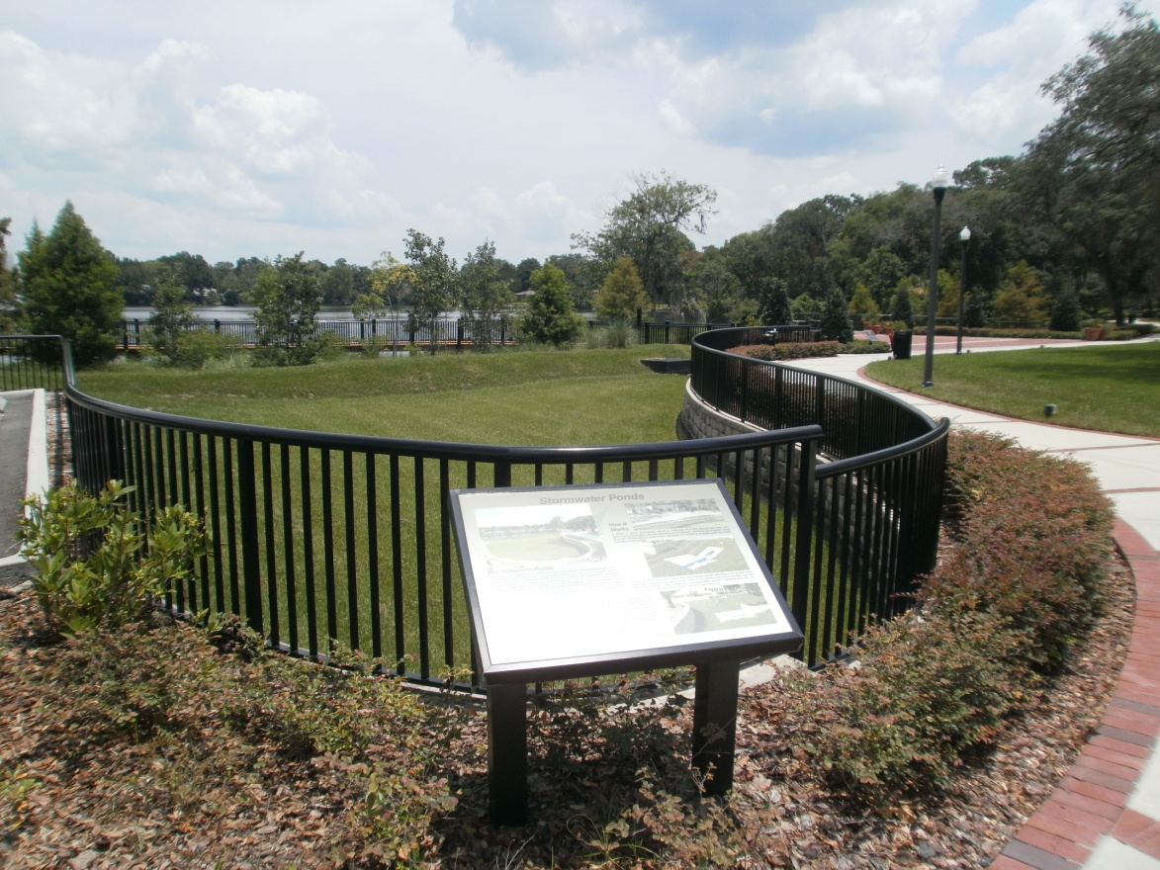
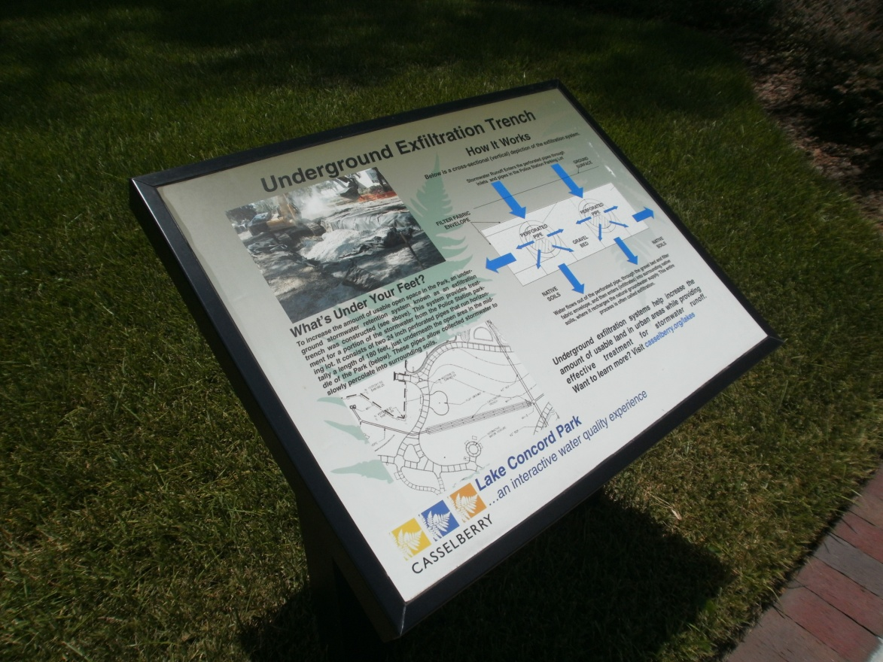
Educational Components

Slide 10
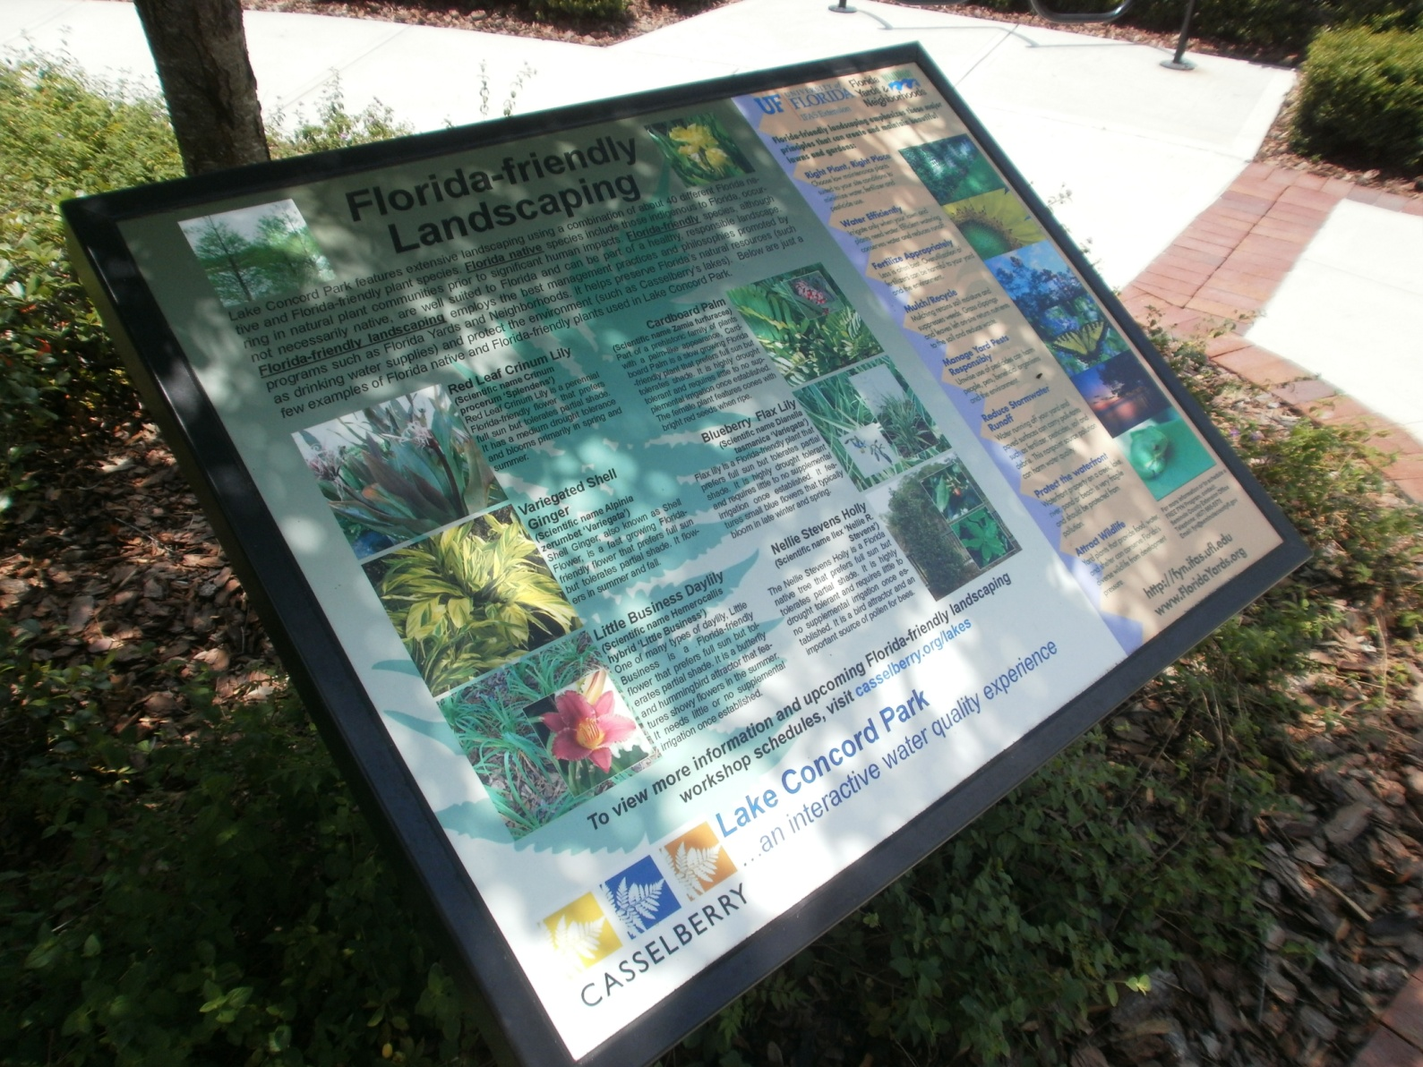
Educational Components

Slide 11
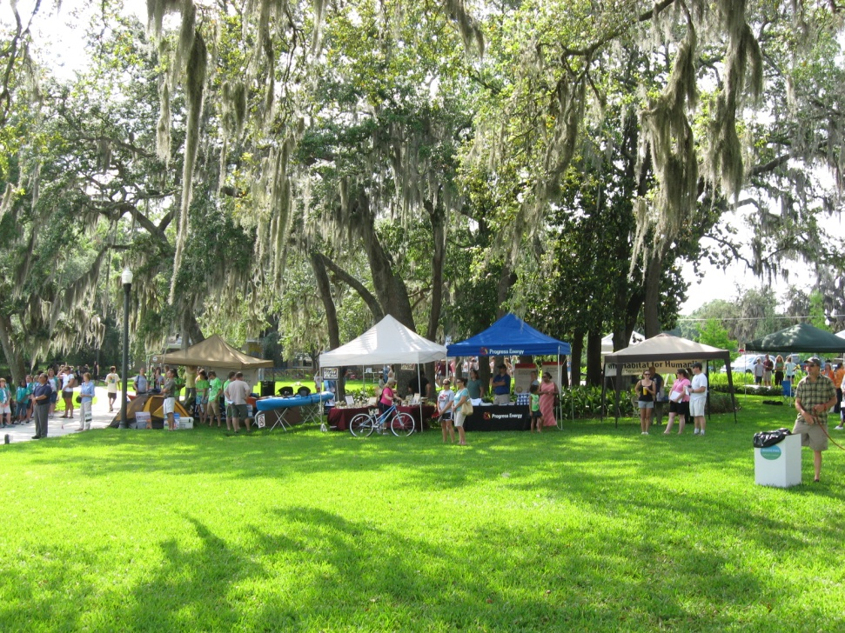
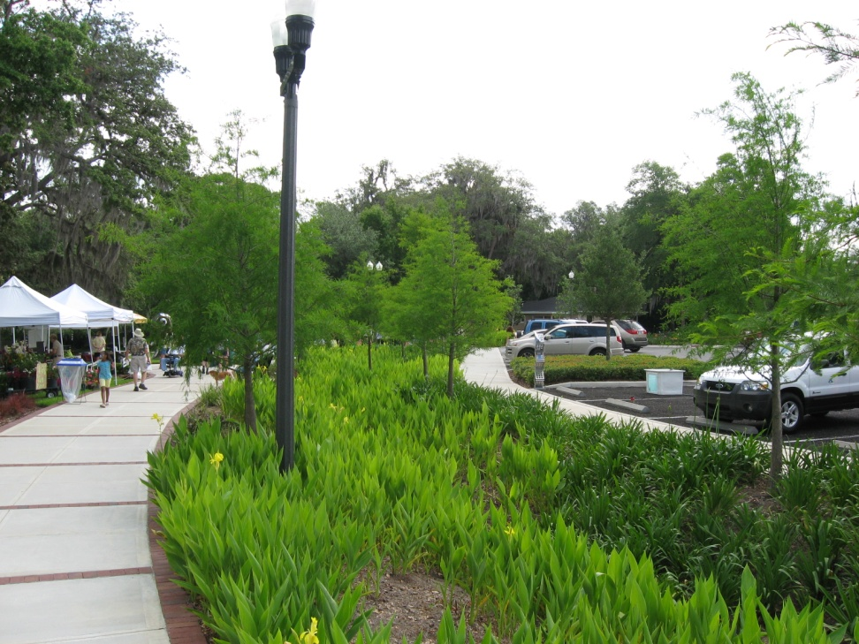
Educational Events
Joint ASCE and CFLMS meeting (with tour)
University of Florida Agricultural & Biological Engineering Tour
Florida Stormwater Association Training
SJRWMD staff
Rotary Club – Denmark
Earth Day

Slide 12
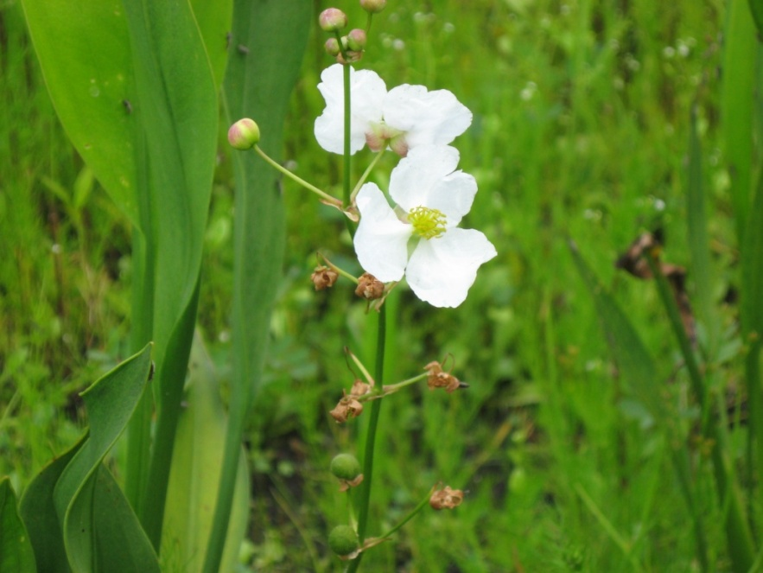
Awards
2010 Excellence Award (Florida Stormwater Association)
2010 Community Project (Landscape Contractor Magazine)
2010 Friends of Our Urban Forest Outstanding Project (Florida Urban Forestry Council)
2011 Program Excellence Award (Florida City and County Management Association)

Slide 13
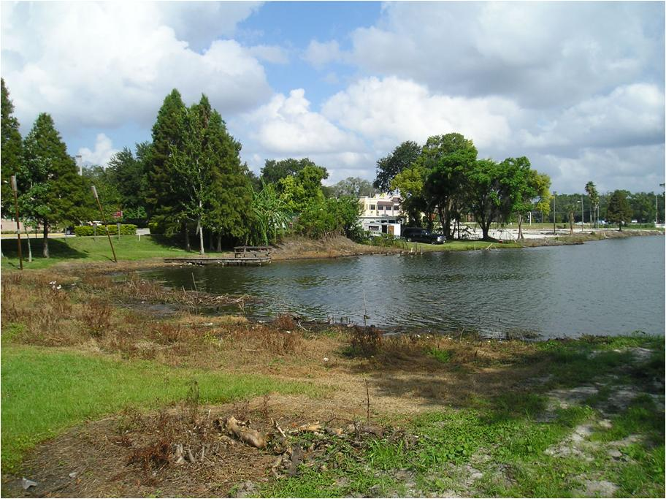
“Befores and Afters”

Slide 14
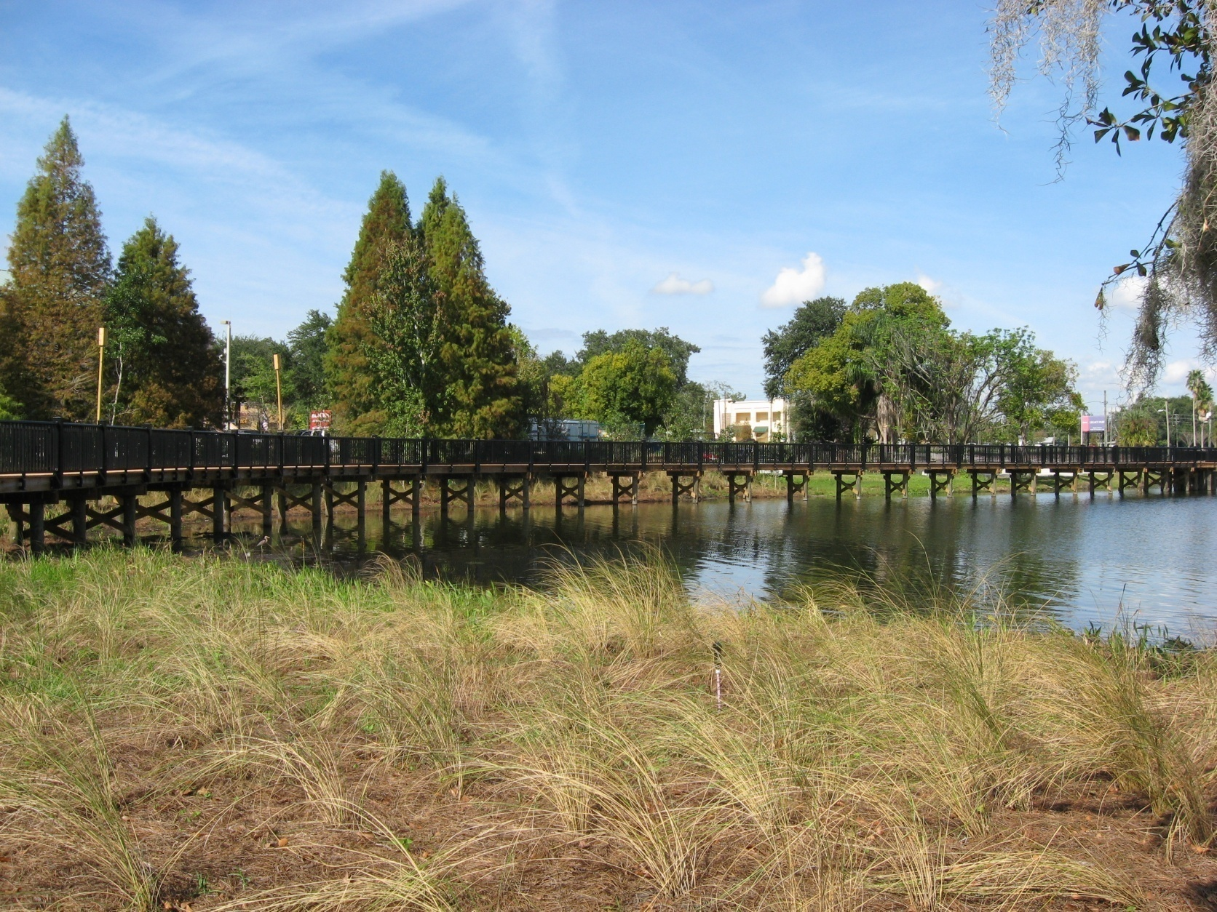
“Befores and Afters”

Slide 15
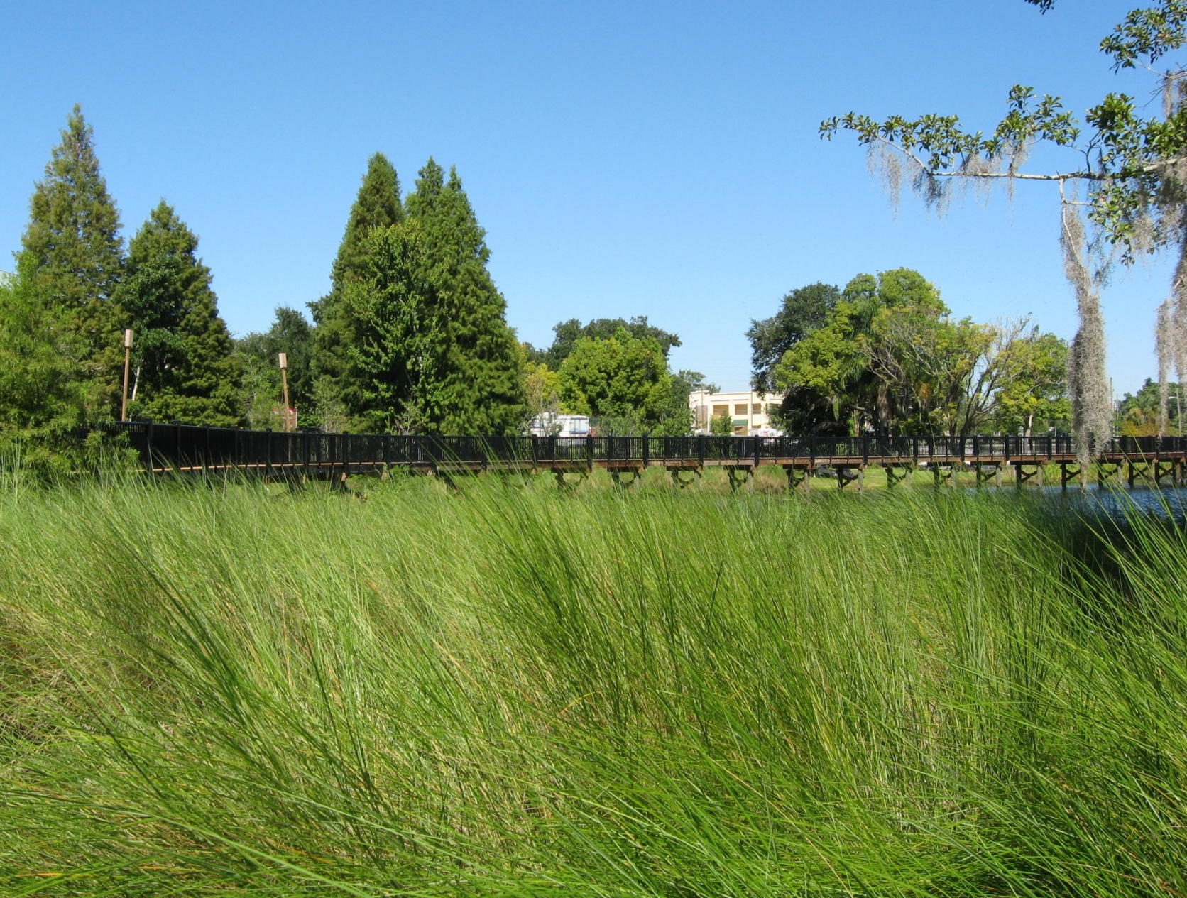
“Befores and Afters”

Slide 16
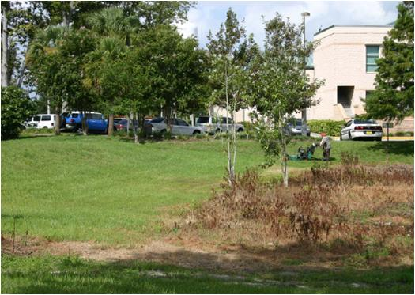
“Befores and Afters” (cont.)

Slide 17
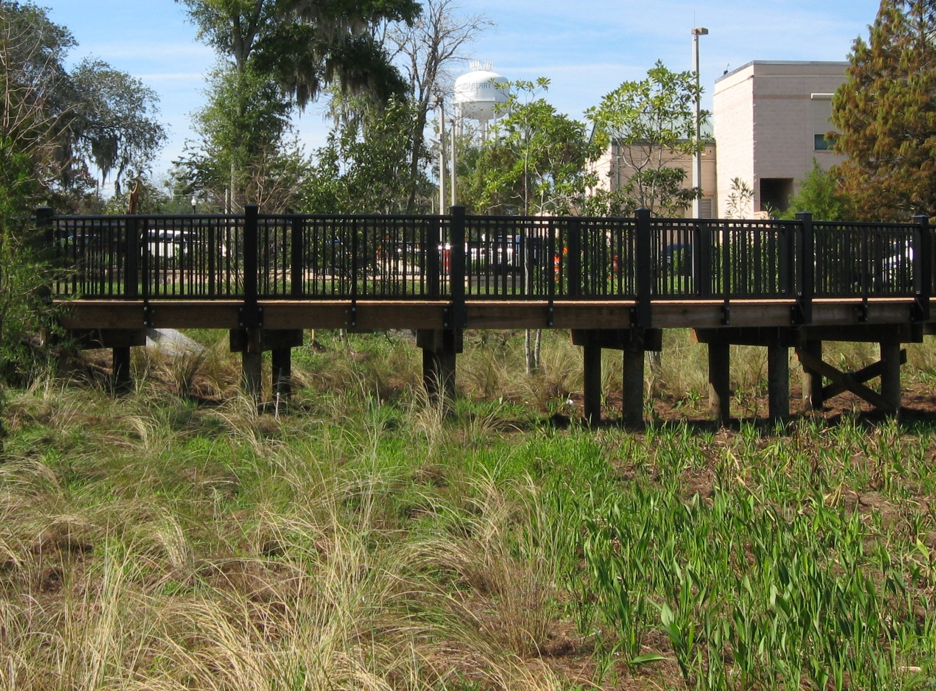
“Befores and Afters” (cont.)

Slide 18
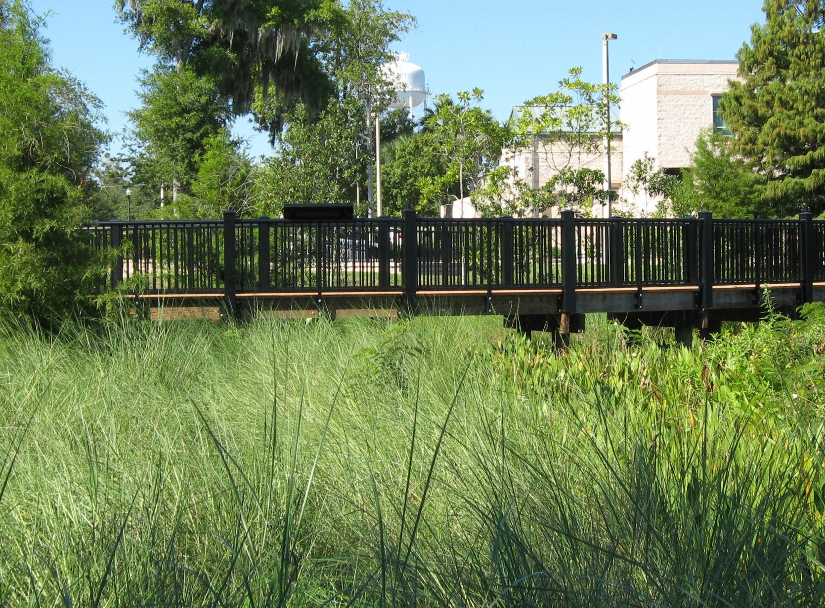
“Befores and Afters” (cont.)

Slide 19
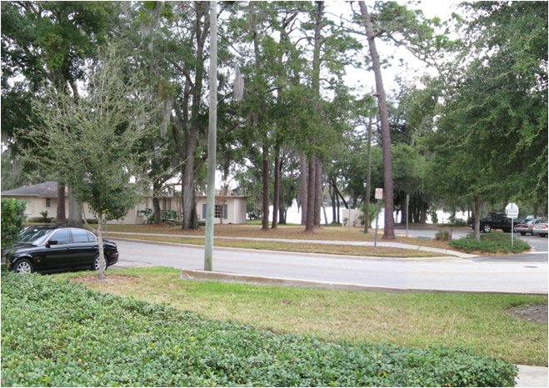
“Befores and Afters” (cont.)

Slide 20
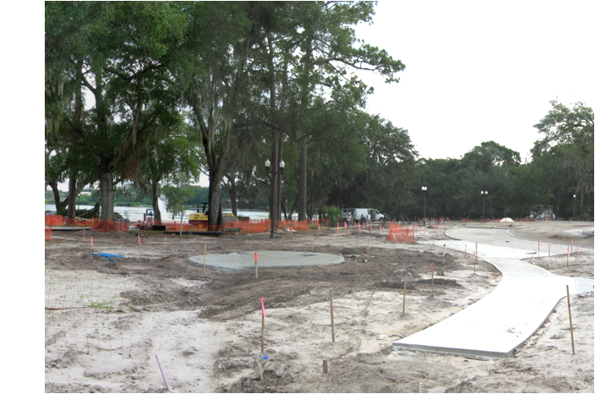
“Befores and Afters” (cont.)

Slide 21
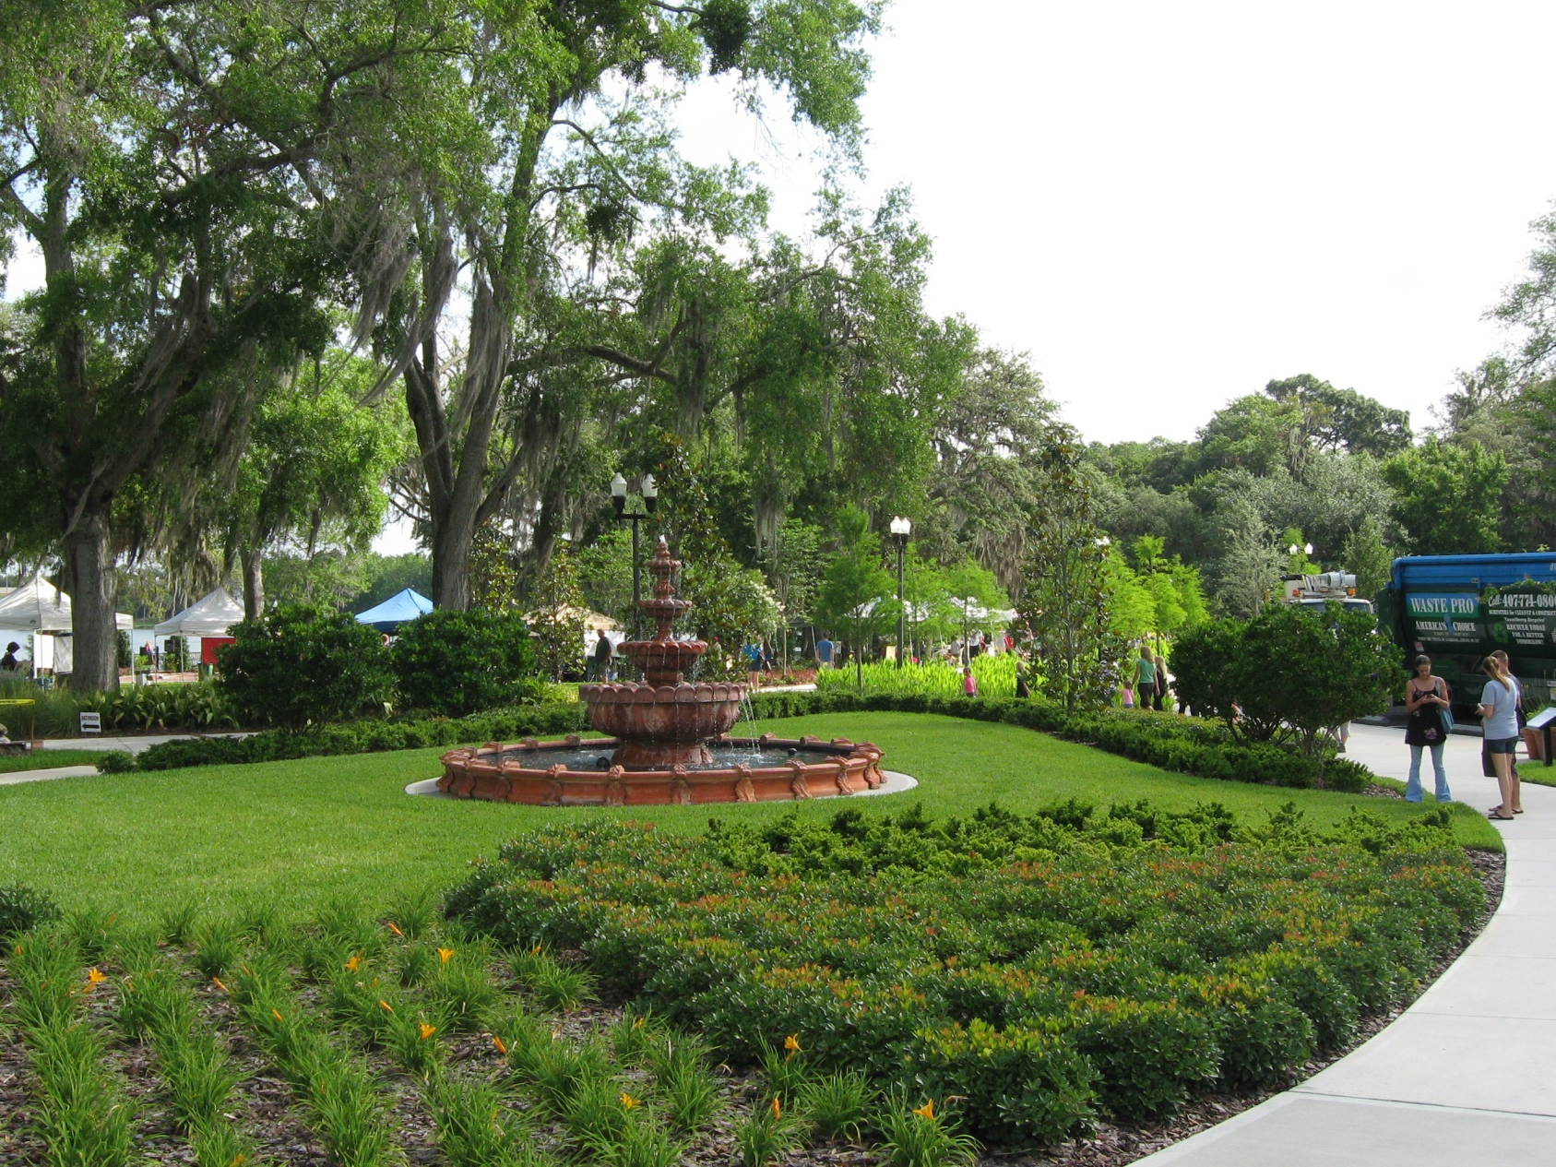
“Befores and Afters” (cont.)

Slide 22
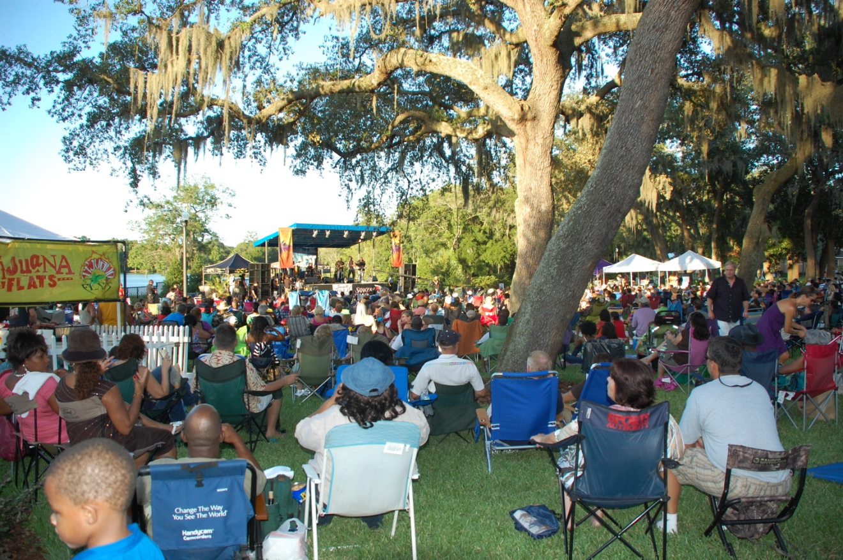
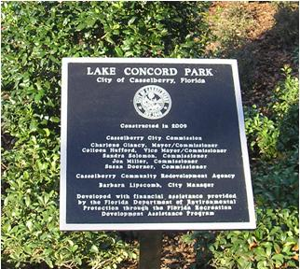
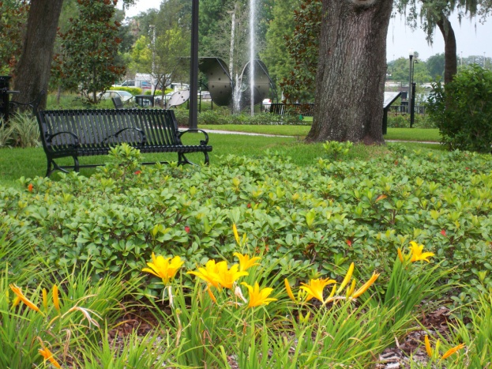
What Lake Concord Park Now Means to the City
New focal point of downtown community
  Helps regenerate the US 17-92 corridor in alignment with the City’s vision
  Cultural center
Improved pedestrian connectivity
Unique environmental teaching and promotional tool
  Unsurpassed public exposure
  Exemplifies contemporary stormwater BMPs

Slide 23
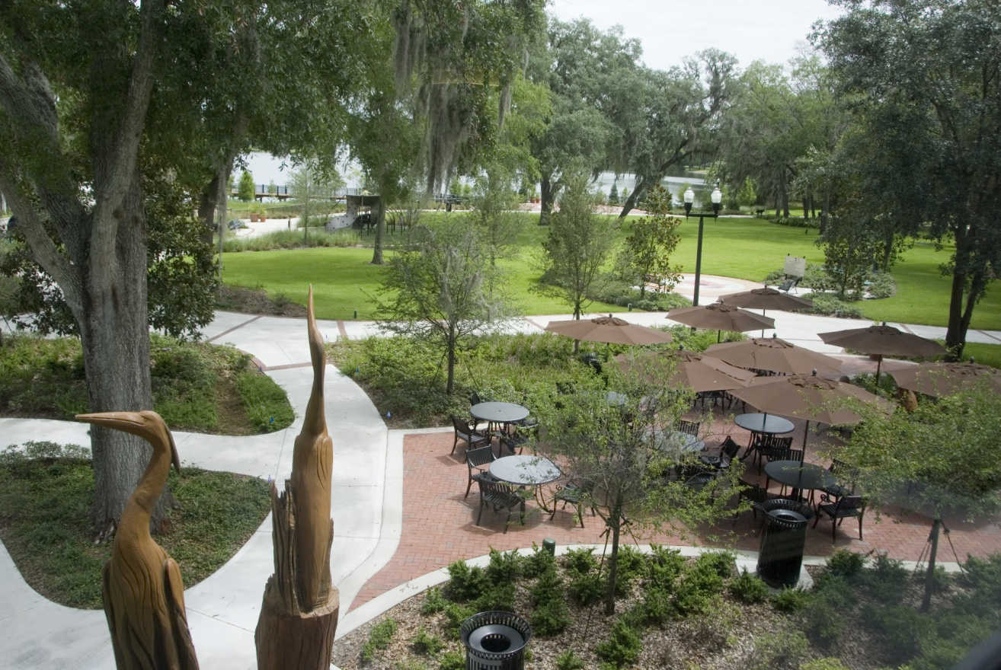

Comments/Questions?
For more information:
www.casselberry.org/lakes

