Slide 1
Lake Jesup BMAP Project Completion Update
Marissa Williams
City of Maitland
Stormwater and Lakes Management Division
July 21, 2011

Slide 2


Lake Maitland Basin Drainage Improvements
Historic “shovel ready” Quality Neighborhood Program (QNP) plans for the Ridgewood area;
Multiple banks of exfiltration chambers placed beneath existing local roadways
Filter untreated stormwater discharging into Lake Maitland on the Winter Park/Maitland Chain of Lakes

Slide 3
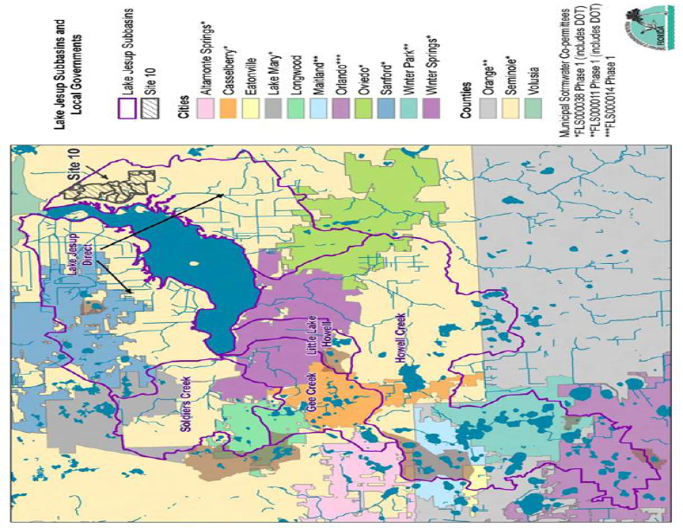
Location

Slide 4
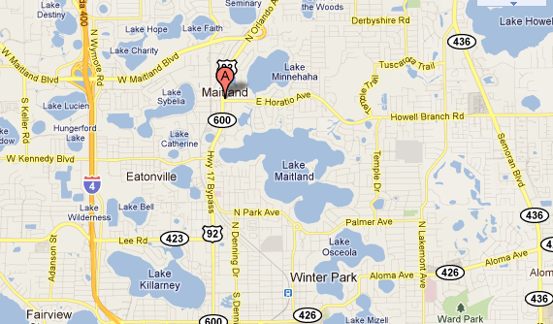
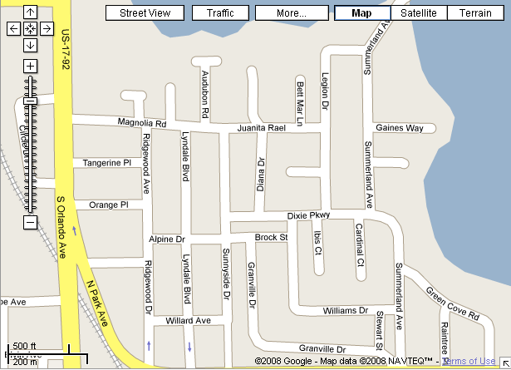
Location
42.9 acre drainage basin

Slide 5
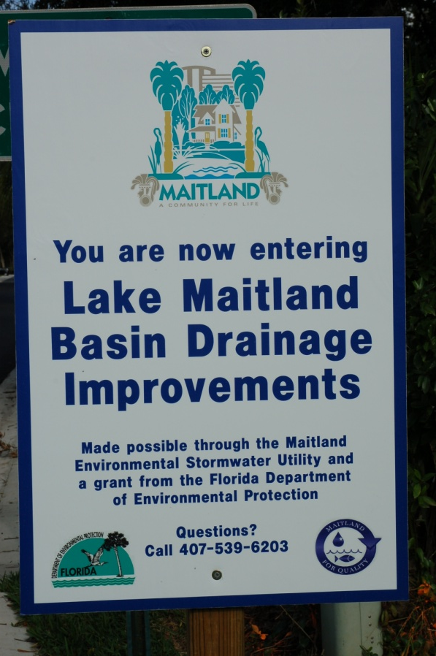
Funding
Section 319 grant awarded in the amount of almost $550,000 at a 50% cost share
Maitland adopted an Environmental Stormwater Utility in October 2009
Lowest bid obtained was close to half the original construction estimate

Slide 6
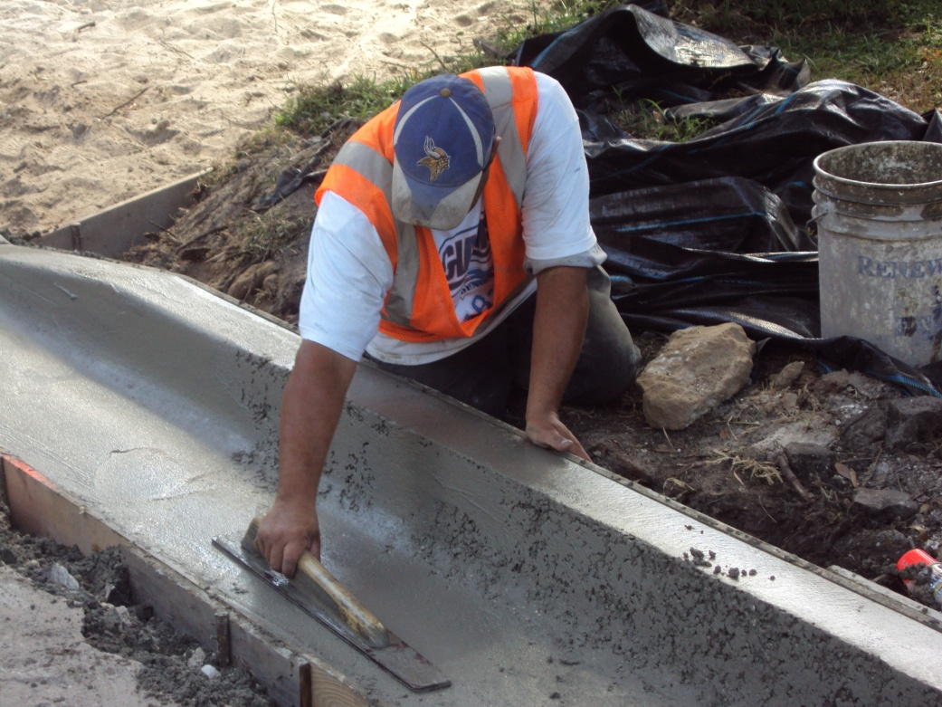
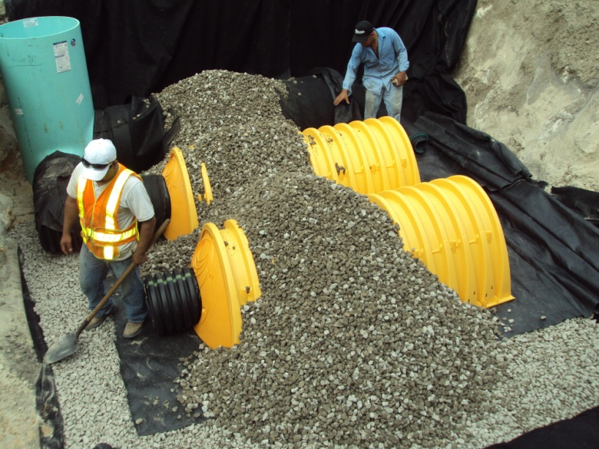
Construction
Completed through 2009-2010
Four banks of exfiltration chambers coupled with multiple roadway improvements

Slide 7
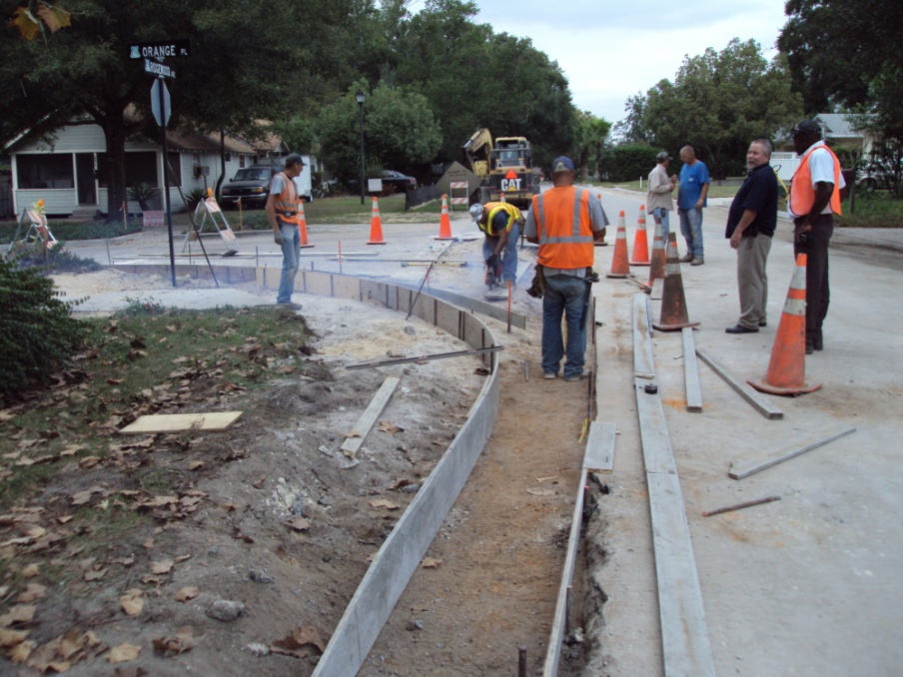
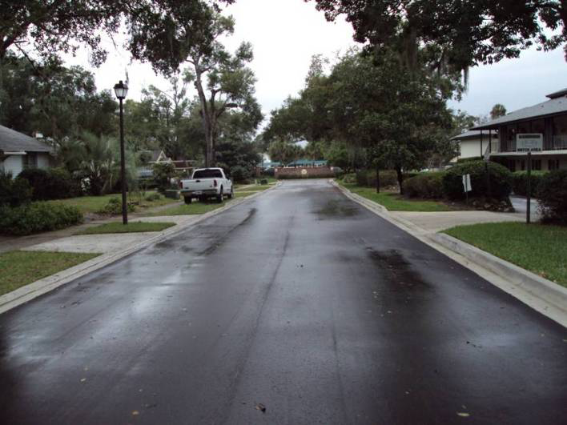
Questions

