Slide 1
Lake Jesup Interagency Restoration Strategy Addendum
Response to Changes Since 2008

Slide 2
Lake Jesup Interagency Restoration Strategy
Written as a broad lake restoration strategy
Supplemental to BMAP that focuses on current anthropogenic loads and TMDL targets
Represents cooperative agreement between FDEP, FWC and SJRWMD
Uses Adaptive Management model to ensure efficient, effective actions

Slide 3
Current Progress
BMAP approved
SJRWMD budgeted $2.5M for Jesup Pay-For-Performance nutrient removal project
  Cautious optimism about process
  Focus on lake removal because tributary treatment not feasible at time of proposal
Research studies in progress or complete to address data gaps
Several regional treatment feasibility studies complete

Slide 4
Addendum Changes
1st and 2nd Phases now parallel
BMAP focus on external reductions still holds until TMDL revisit 2014
Commitment to incorporate new data into 2014 TMDL revisit
Additional regional treatment projects included
Updates on feasibility studies provided

Slide 5
Contents
UPDATES
-Monitoring results for Site 10
-Summary of Regional P Removal Feasibility Studies
  Alum Tributary Treatment
  Floating Phosphorus Treatment
  Phragmites Harvest for Phosphorus Removal & Floodplain Management
  Pay-for-Performance Project
  Potential Regional Projects Updated
PLANNING FOR NEW POLLUTANT LOAD REDUCTION GOALS/TOTAL MAXIMUM DAILY LOADS
-Gaps in Information
  Nitrogen Fixation Results
  Sediment Nutrient Releases
  Groundwater Inputs
  Load Sources and Attenuation (County and Municipality Allocations)
-SJRWMD PLRG Schedule
-FDEP TMDL Schedule
-Update on Other Activities Completed or In Progress
  Native Vegetation Restoration
  Update Lake Jesup QUAL2K Water Quality Model
  Changes in Targeted Dredging Process

Slide 6
Future Update Changes
Once a year instead of twice
Simpler format

Slide 7
Next Steps
Send to Executive Offices of three agencies for approval
Distribute final document
Next meeting in June, 2012

Slide 8
Project Updates

Slide 9
Sediment Nutrient Cycle Study
FIU studying sediment cycling in Jesup
Using isotope dating to assess potential source – legacy versus new external
Preliminary findings – August 4, 2:30PM at SJRWMD HQ
Final report September 30, 2011

Slide 10
Floating TP Treatment
Adsorptive media effective at the TP range exhibited in Lake Jesup
Very, very small footprint for adsorptive media alone
Minimal by-product
Some biological or alternative filtering required
Ready and willing to work with stakeholders to customize

Slide 11
Phragmites Harvest
Lake Jesup Phragmites nets 10-20 lbs per acre removal
Ideal harvest period coincides with ideal harvest conditions
Cost estimates $50 - $300/lb P
Leaving sprayed Phragmites in situ pumps over 8lbs/acre P back into lake

Slide 12
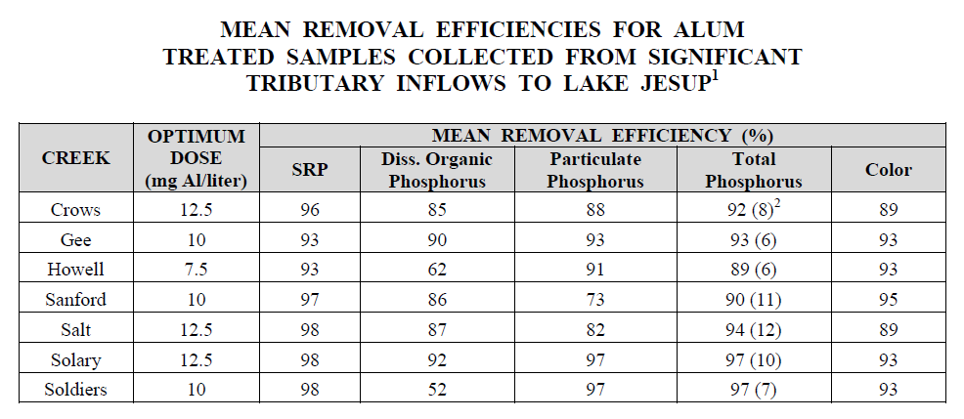
Alum Network
All treatment sites close to lake where concentrations and flows highest
All tributaries responded to reasonable alum dosage with no need for buffering
Floc generation ranged from 0.175 to 0.560 % of treatment volume

Slide 13
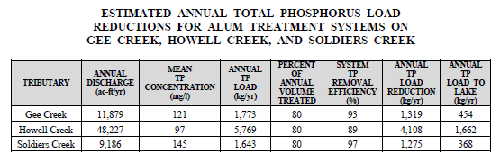
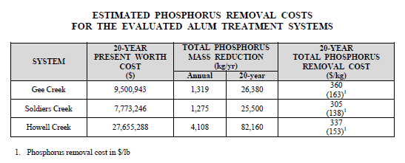
Alum Treatment

Slide 14
Pay for Performance Project

Slide 15
http://publicfiles.dep.state.fl.us/
DEAR/BMAP/MiddleStJohns/Lake_Jesup/
Lake_Jesup_Interagency_Restoration_Strategy/

Slide 16
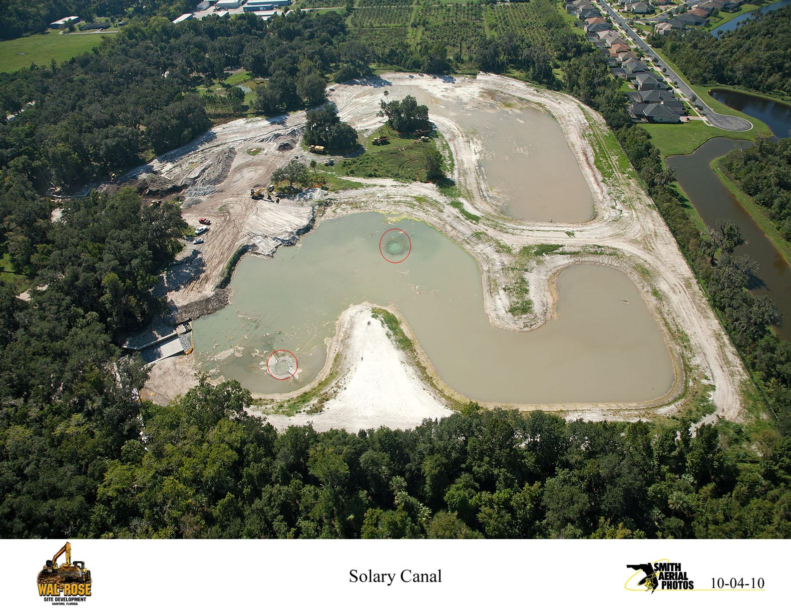
Solary Canal

