Slide 1
Lake Jesup BMAP 2011 Annual Progress Report
Basin Working Group Meeting
July 21, 2011

Slide 2
Annual Report Overview
This is the first annual progress report on the basin management action plan (BMAP) activities.
Information was provided by the stakeholders on activities from BMAP adoption (May 2010) through May 31, 2011.
The report includes:
  Major accomplishments;
  Major issues; and
  Upcoming year activities.

Slide 3
Background on the BMAP
The total maximum daily loads (TMDLs) for Lake Jesup were adopted in April 2006 for total phosphorus (TP) and total nitrogen (TN).
The BMAP focused on achieving the TP reductions over a 15-year period.
Detailed allocations were made to the responsible stakeholders to achieve the first one-third of the reductions over a five-year period.
The BMAP was adopted by the Florida Department of Environmental Protection (FDEP) Secretary in May 2010.

Slide 4
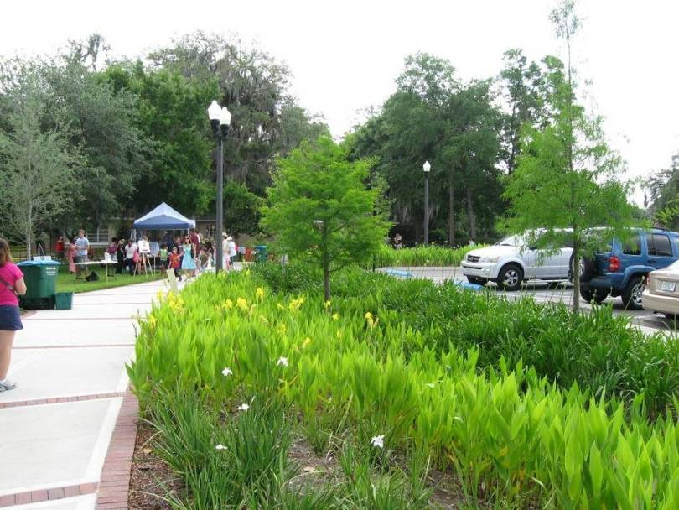
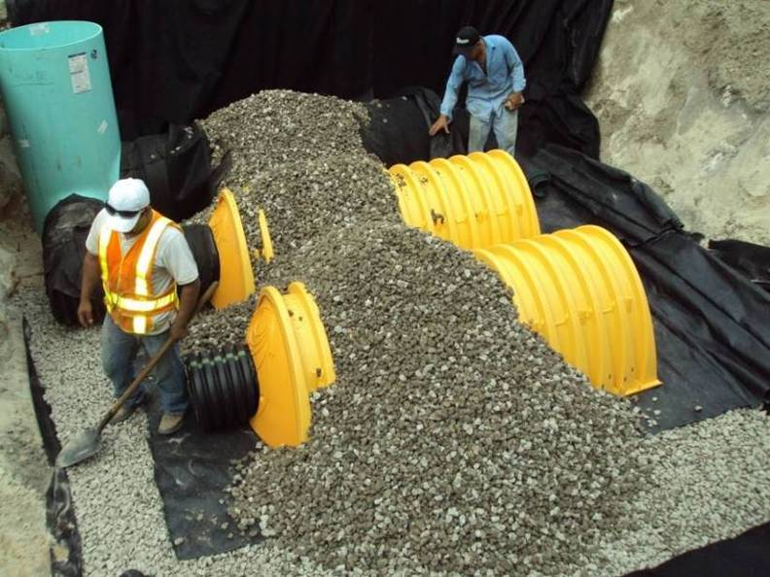
Accomplishments
  City of Casselberry Lake Concord Stormwater Park/Anniversary Park and Anchor Road Reconstruction.
  City of Maitland Lake Maitland Basin and North Lake Maitland Leaf Trap.
City of Casselberry Lake Concord Park
City of Maitland Lake Maitland Basin

Slide 5
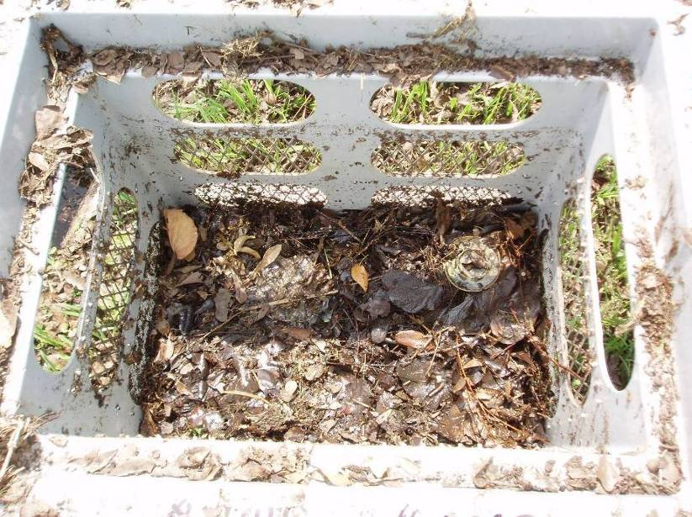
Accomplishments, continued
  City of Orlando Mills Avenue Retrofit, Overbrook Stormwater Improvements, Winyah 2nd Generation Baffle Box, Reading Drive 2nd Generation Baffle Box at Lake Adair, Spring Lake 2nd Generation Baffle Box at Rio Grande, and Florida Department of Transportation (FDOT) Pond Maintenance.
  FDOT State 46 Bridge Replacement Wet Detention Pond.
Orange County Hall Road Improvements and Lake Wauntta Improvements.
Orange County Inlet Basket

Slide 6
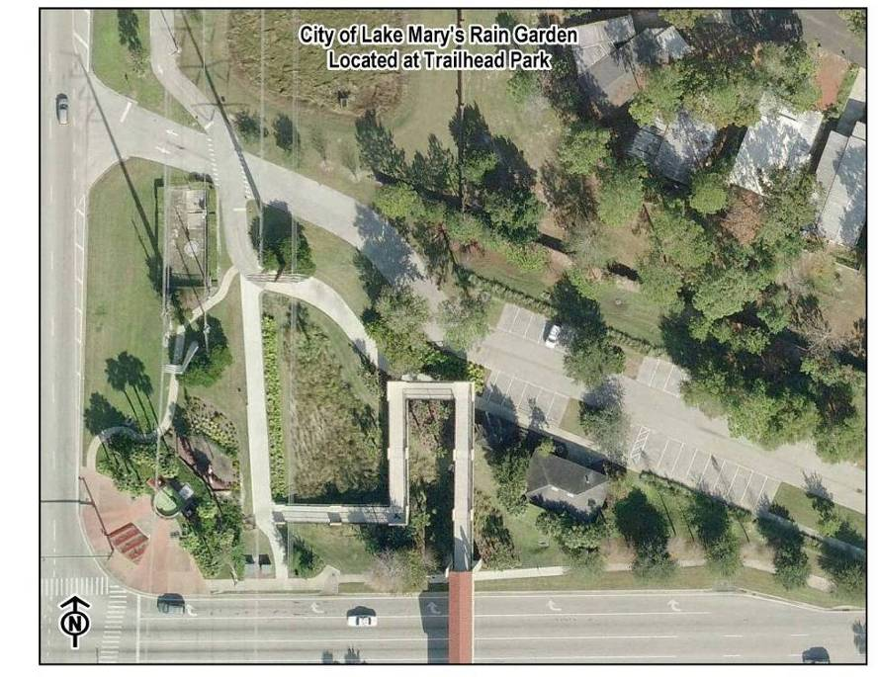
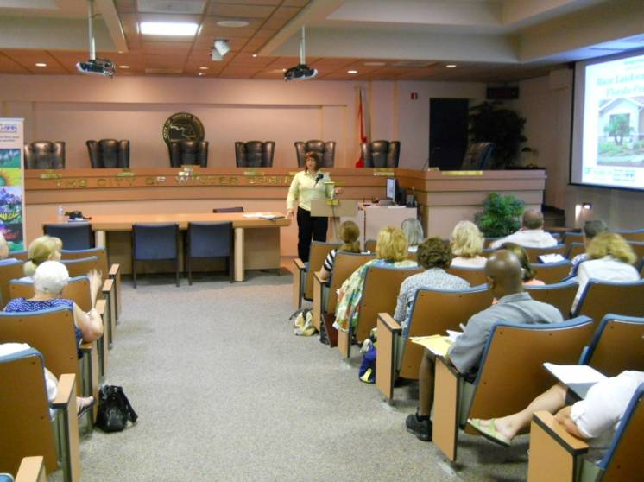
Accomplishments, continued
Seminole County Red Bug Lake Regional Stormwater Facility (RSF) and Anchor Road Reconstruction.
Florida Department of Agriculture and Consumer Services (FDACS) enrolled growers in the container nursery, citrus, and cow/calf best management practice (BMP) manuals.
Total reductions from all new projects (excluding agricultural BMPs) are 133.9 lbs/yr of TP.
City of Lake Mary Rain Garden
City of Winter Springs FYN Workshop

Slide 7
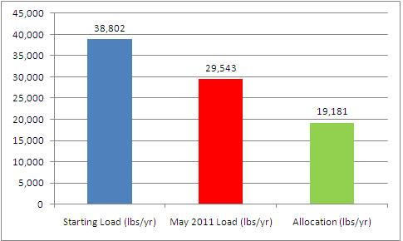
Progress to the TMDL
The total project reductions, including those projects shown as completed in the BMAP, are 8,224 lbs/yr TP.
  This is greater than the required reduction for the first BMAP iteration of 6,249.5 lbs/yr TP.
Notes:
First bar: TMDL starting loads for stormwater runoff and septic tanks from the TMDL.
Second bar: Current estimated loading, including project reductions and noncontributing areas.
Third bar: Total allocation for stormwater runoff and septic tanks to meet the TMDL.

Slide 8
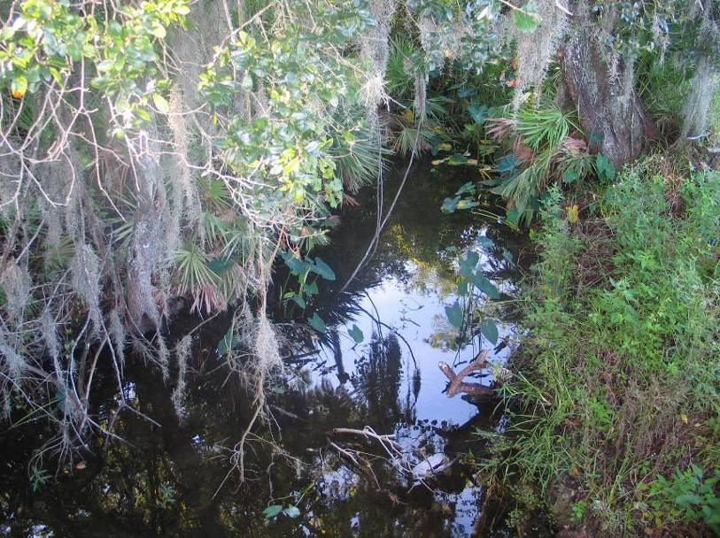
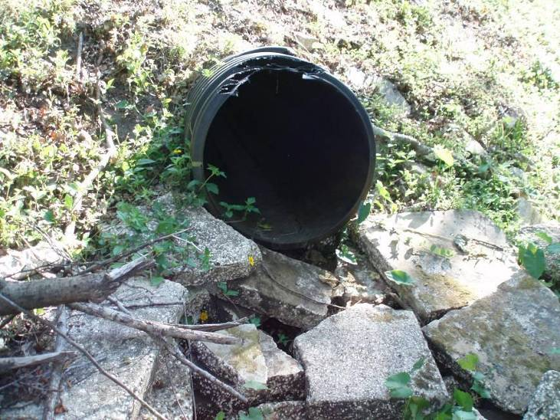

Monitoring and Research Accomplishments
All responsible stakeholders participated in the monitoring plan in the first year of BMAP implementation.
Oviedo is working on a research study to determine the loading from the North Corporate Oviedo drainage area. Draft report was under review until July 11th.
Lake Mary Soldiers Creek Downstream Site
Orange County Lake Burkett Site

Slide 9

Research Accomplishments, con’t
Orange County has been collecting monitoring data to determine the pollutant load being discharged from the county through Lake Burkett.
The county is also gathering data to determine if Lake Georgia and Lake Killarney discharge to the Lake Jesup Basin.

Slide 10

Research Accomplishments, con’t
Seminole County is conducting a seepage study to determine the surficial groundwater quality and quantity into and out of Lake Jesup. Phase 2 completion: June 2012.
The county is also working on an update of the QUAL2K model for the lake. Scheduled completion: December 2011.
Seminole County is including BMP efficiency monitoring as part of the Navy Canal and Cameron Ditch RSFs. Scheduled completion: July 2011.

Slide 11
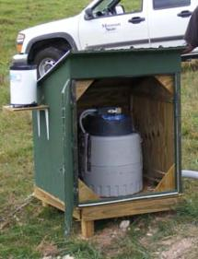


Research Accomplishments, con’t
Seminole County and SJRWMD added three storm event samplers to the Howell Creek subbasin to determine storm event loading.
Example of an autosampler.

Slide 12

Research Accomplishments, con’t
SJRWMD added additional elements to the sediment nutrient flux study. The deadline for the final report is September 30, 2011.
SJRWMD also estimated reuse nutrient contributions for the Lake Jesup watershed and the entire Middle St. Johns River Basin. Less than 50% of reuse sources monitor TP data and destination volume data are insufficient for accurate modeling of potential loads.

Slide 13

Research Accomplishments, con’t
As part of the Lake Jesup Interagency Restoration Strategy SJRWMD completed several feasibility studies:
  TP reductions from the Pay-for-Performance project are 60% - 80%.
  The first phase of the floating TP treatment feasibility study is complete with initial estimates of 40% - 97% TP removal.
    SJRWMD does not have funding for the second phase to optimize the removal but will provide technical support to interested entities.
  Alum treatment was found to be feasible on Gee Creek, Soldiers Creek, and Howell Creek. Twenty-year phosphorus removal costs range from $138-$163/lb of TP removed.

Slide 14
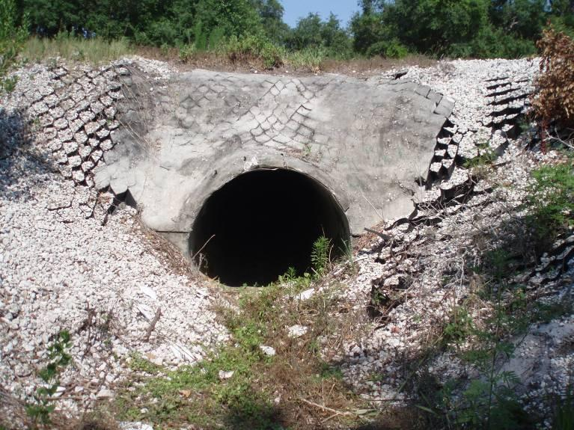
Issues
Several entities have encountered delays with their project implementation. However, these delays are not causing an issue with BMAP compliance.
The stakeholders noted that obtaining funding for the projects and research studies has been an issue.
Data were not collected from a few of the monitoring stations due to low flow conditions from lack of rainfall. The locations of these stations may need to be modified in the future if low flow continues to be an issue.
City of Lake Mary
Outlet of Big Lake Mary site

Slide 15
Questions and Discussion on the Annual Progress Report

