Slide 1
Seminole County
Jesup BMAP Monitoring Update
July 21, 2011

Slide 2
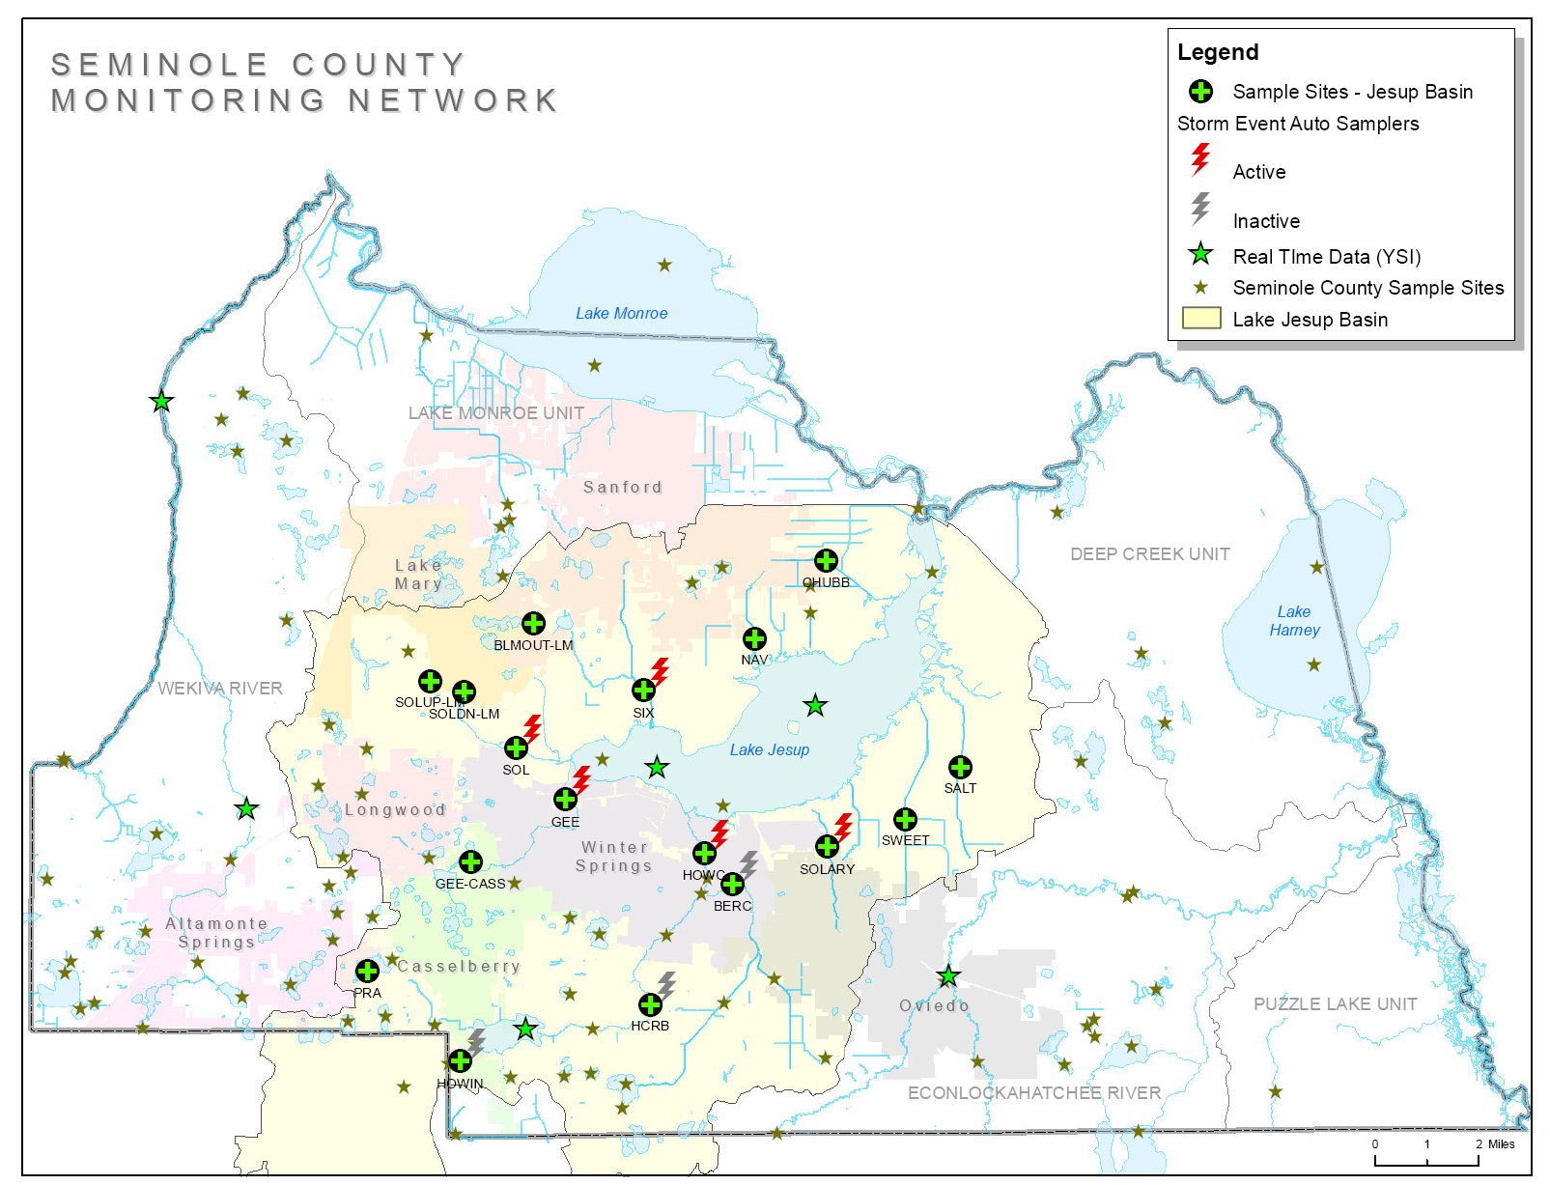

Slide 4

Logistics
Interlocal Agreement for TMDL Activities, executed July 6, 2007
- Interlocal created to streamline inter-governmental cooperation
and funding opportunities.
Letter of Understanding currently executed with each
City of Casselberry
City of Sanford
City of Lake Mary
City of Oviedo
*FDOT
City of Longwood (pending)
Set up purchase order with quarterly invoicing

Slide 5


Where Does All The Data Go?
STORET

Slide 6
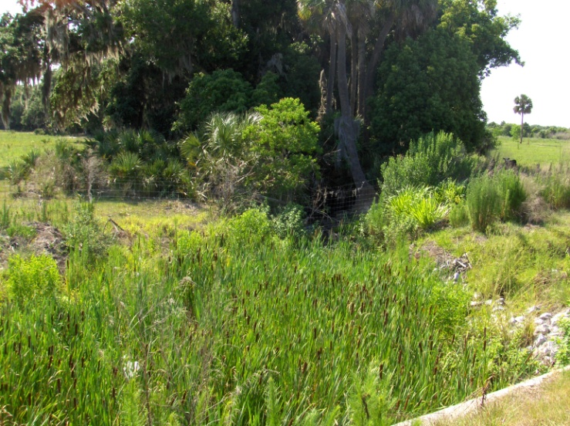
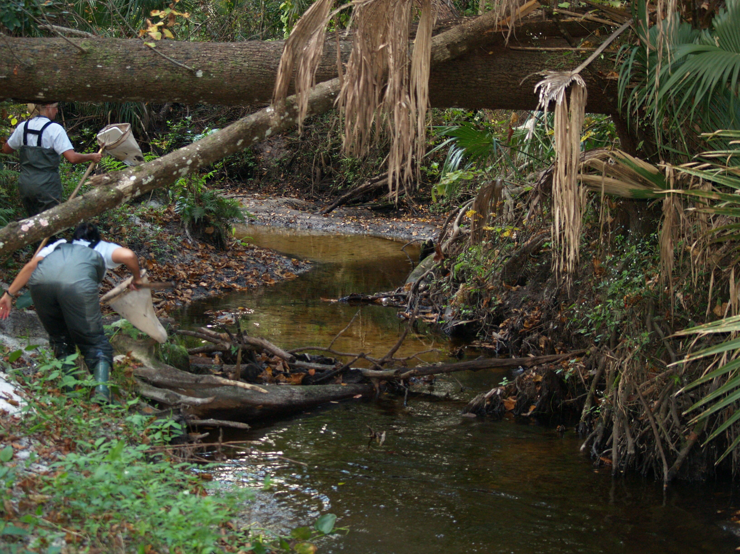
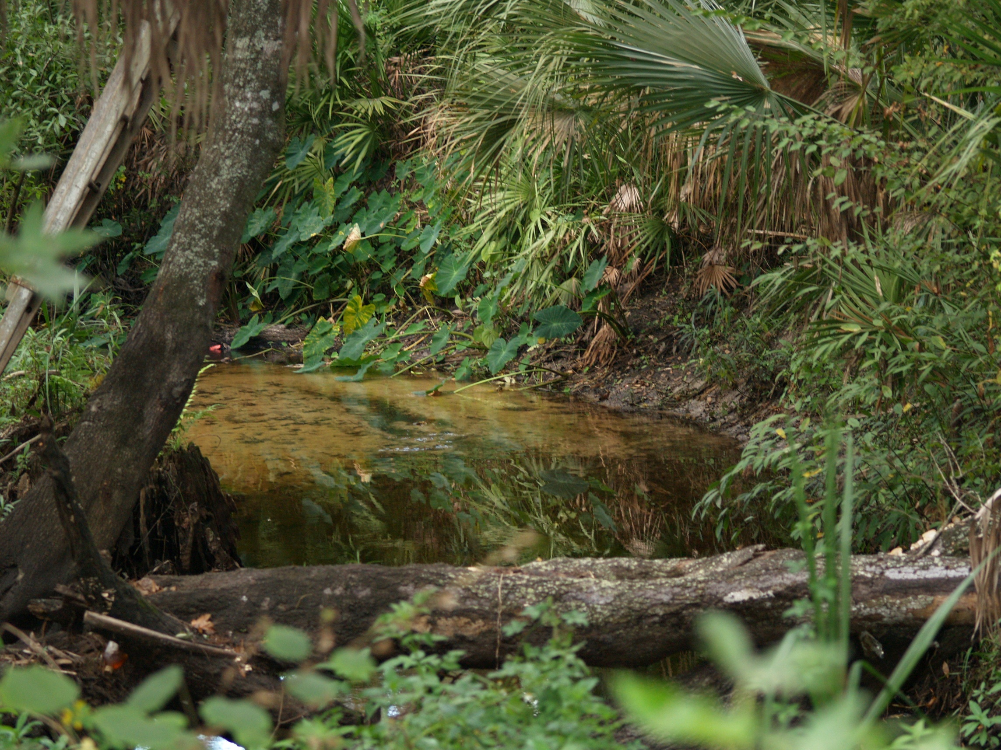
Some Preliminary Results…..

Slide 7
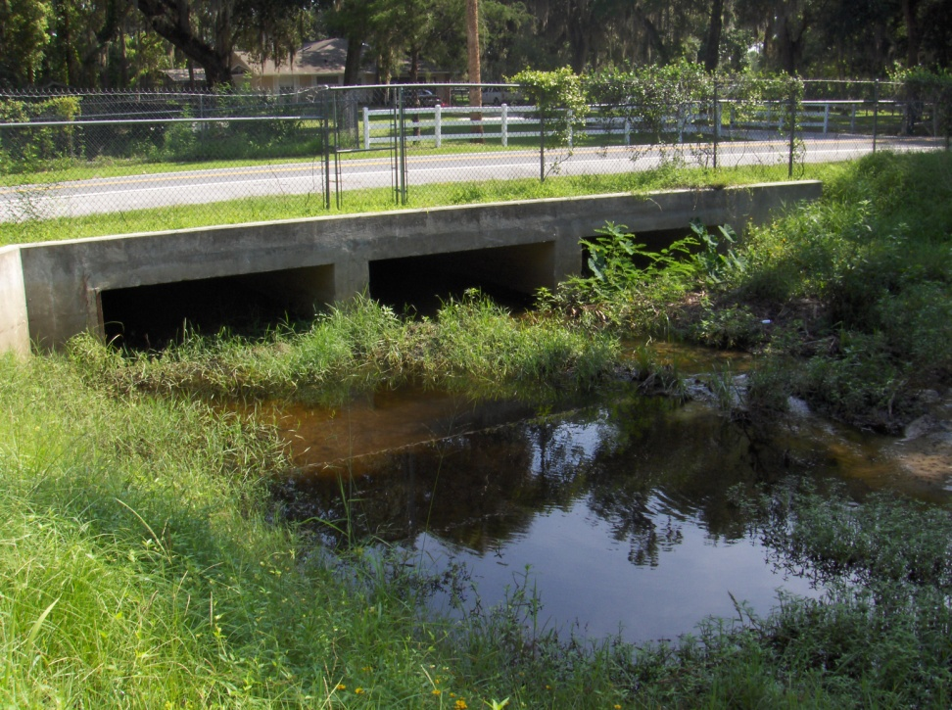
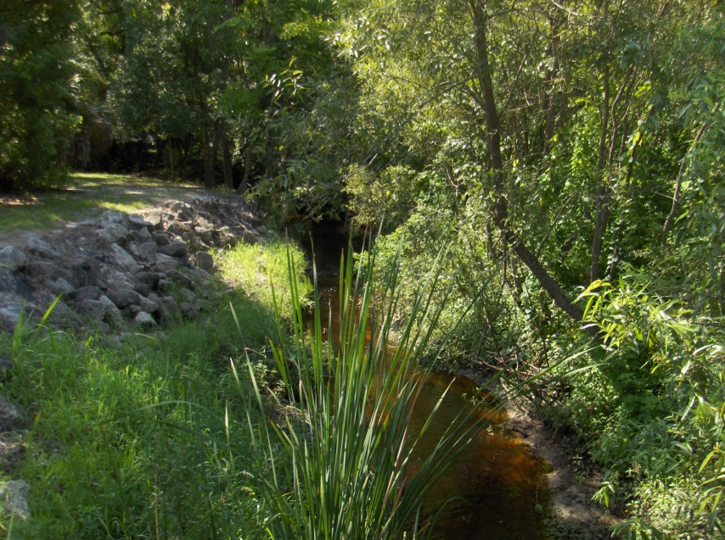
Navy Canal
0.085 mg/L TP
0.75 mg/L TN
Chub Creek
Six Mile Creek
0.482 mg/L TP
1.87 mg/L TN
0.158 mg/L TP
1.46 mg/L TN

Slide 8
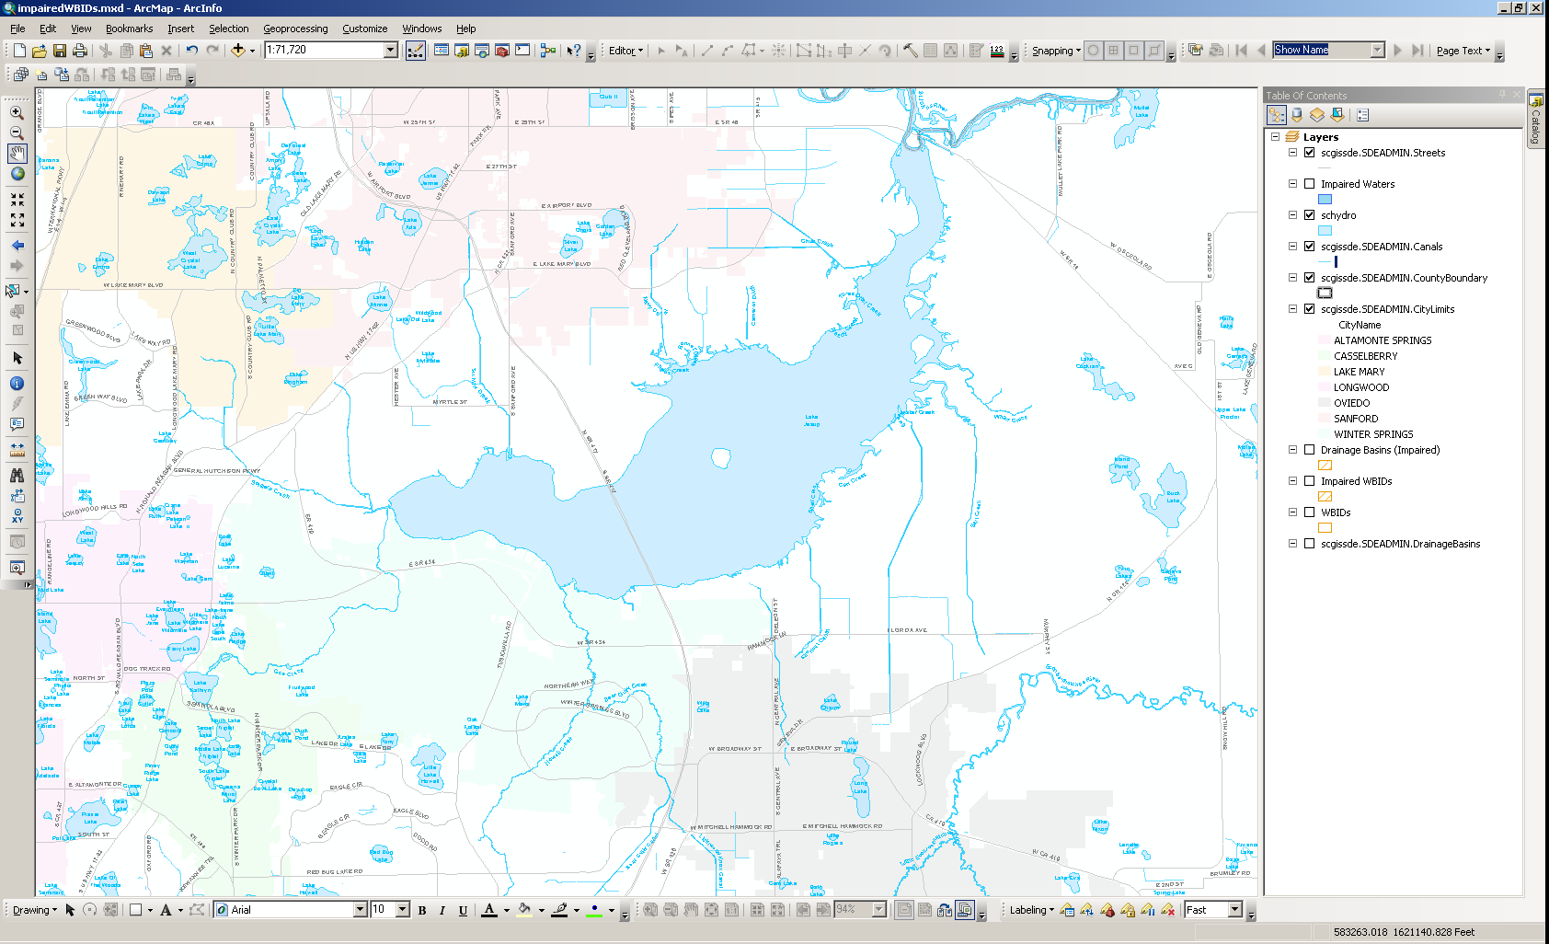
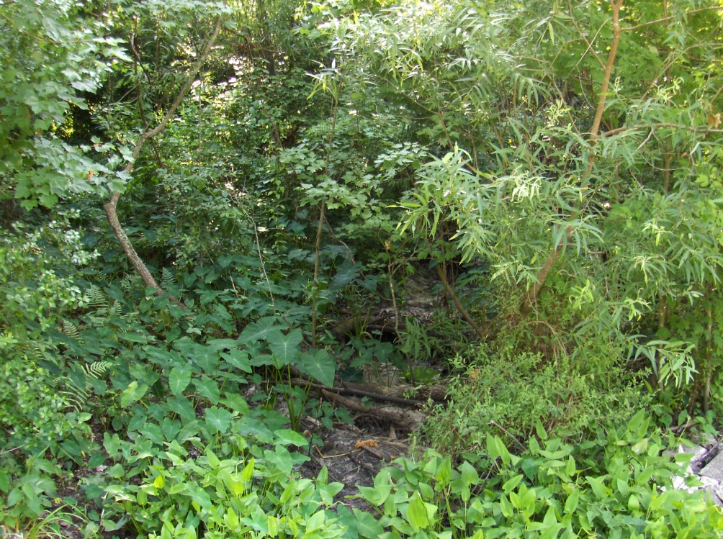
Soldier’s Creek - Upstream
0.482 mg/L TP
1.87 mg/L TN
Chub Creek
0.069 mg/L TP
1.32 mg/L TN
Soldier’s Creek @ CR 419
Soldier’s Creek-Downstream
0.083 mg/L TP
1.79 mg/L TN
0.145 mg/L TP
1.10 mg/L TN

Slide 9
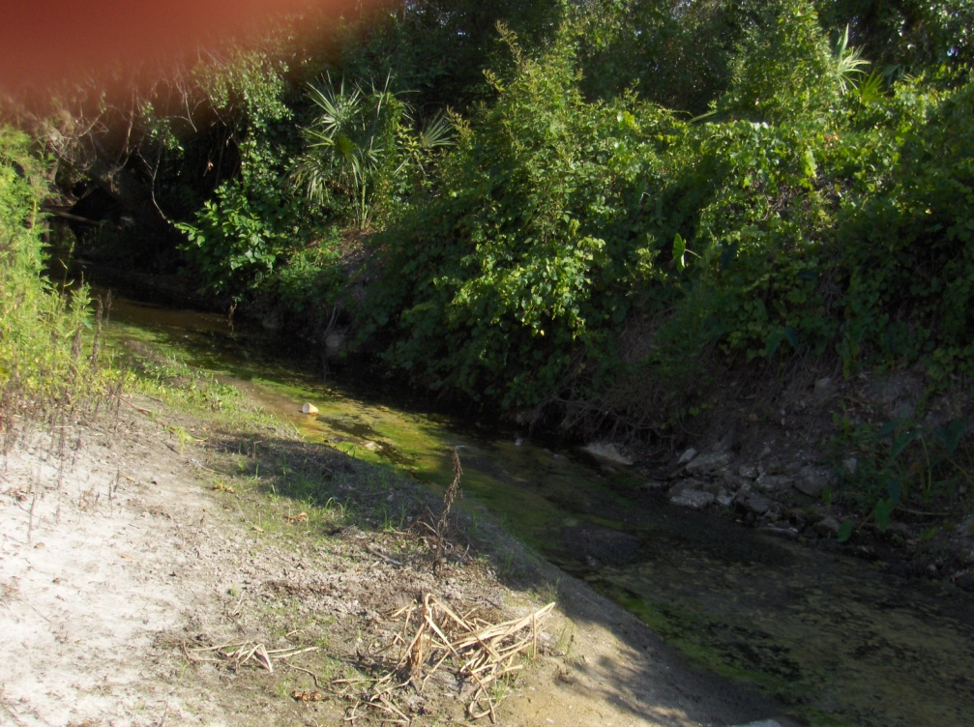
Gee Creek - Downstream
0.482 mg/L TP
1.87 mg/L TN
Chub Creek
0.136mg/L TP
1.12 mg/L TN
Gee Creek - Upstream
0.043 mg/L TP
0.88 mg/L TN

Slide 10
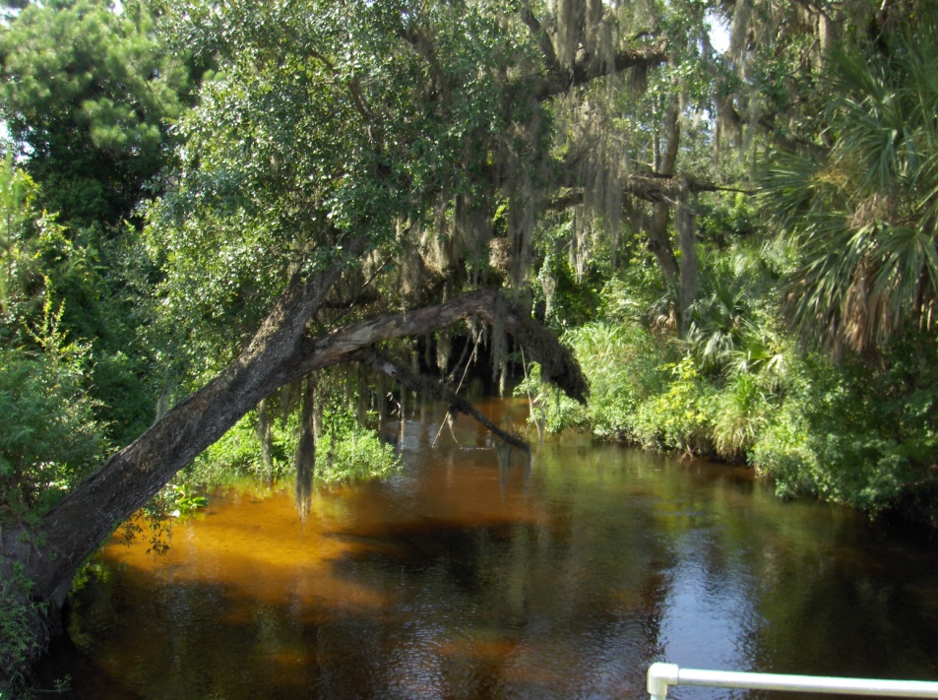
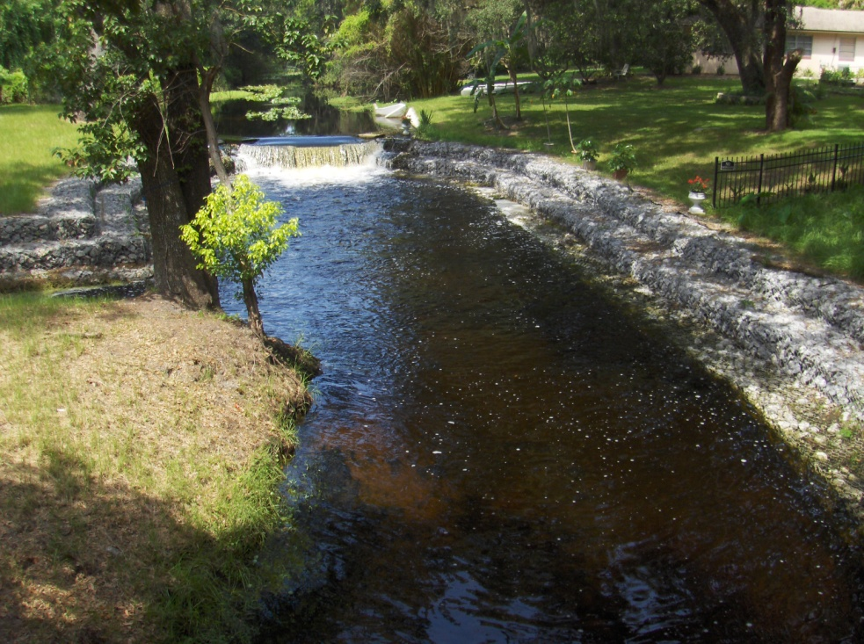
Howell Creek @ SR 434
0.113 mg/L TP
0.96 mg/L TN
Bear Creek
0.122 mg/L TP
0.90 mg/L TN
Howell Creek @ County
Border
Howell Creek @ Red Bug
0.056 mg/L TP
0.88 mg/L TN
0.037 mg/L TP
0.82 mg/L TN

Slide 11
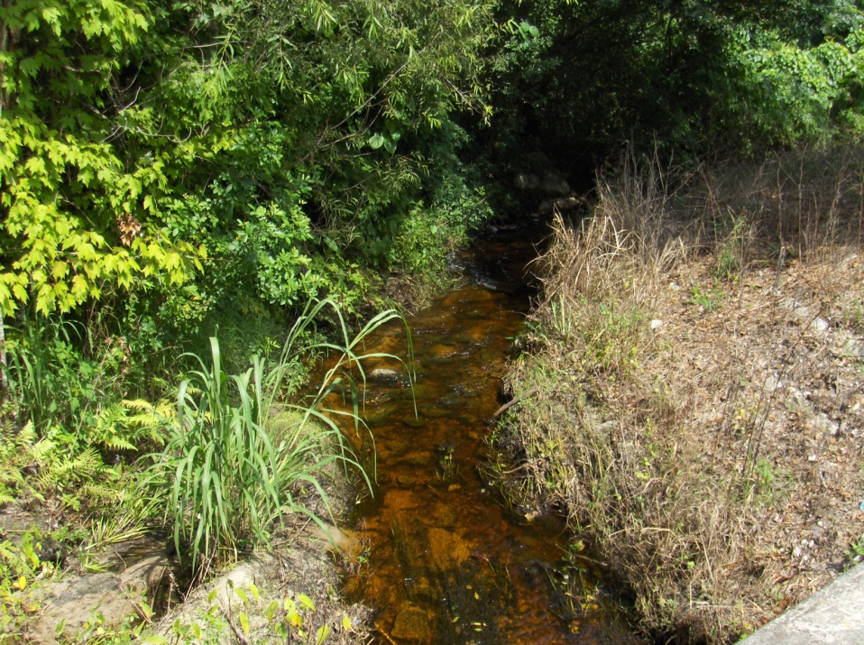
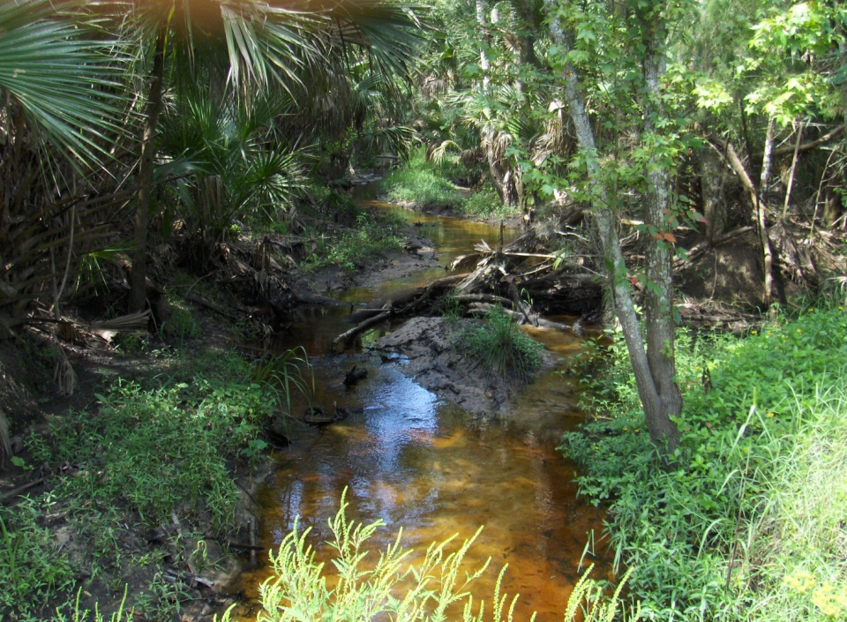
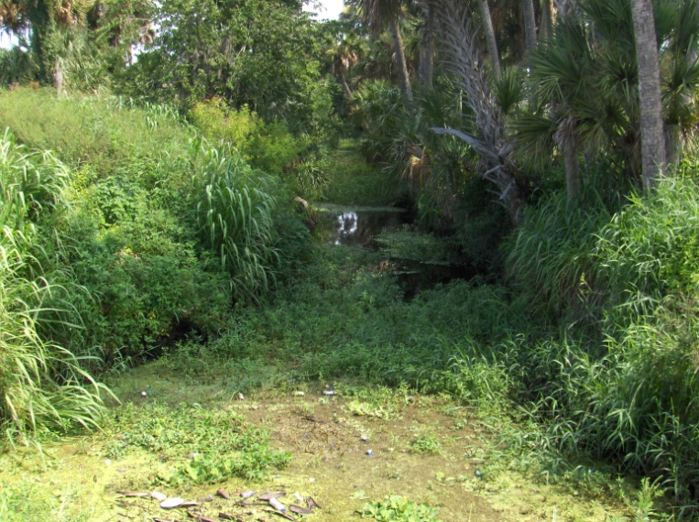
Solary Canal
Salt Creek
0.231 mg/L TP
1.61 mg/L TN
0.299 mg/L TP
1.79 mg/L TN
Sweetwater Creek
0.437 mg/L TP
1.42 mg/L TN

Slide 12
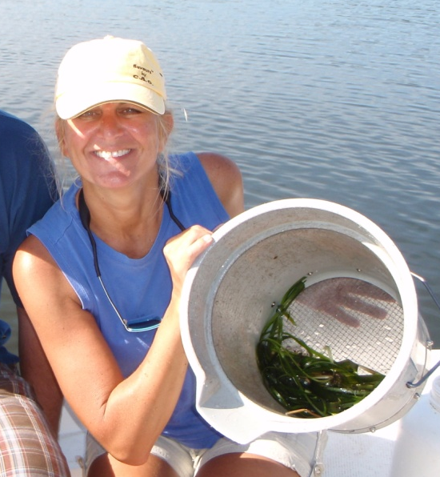
Biological Monitoring
Detects Acute and Chronic Pollutant Impacts
Long Term Water Quality Monitoring
Data Comparable to Known Reference Station

Slide 13
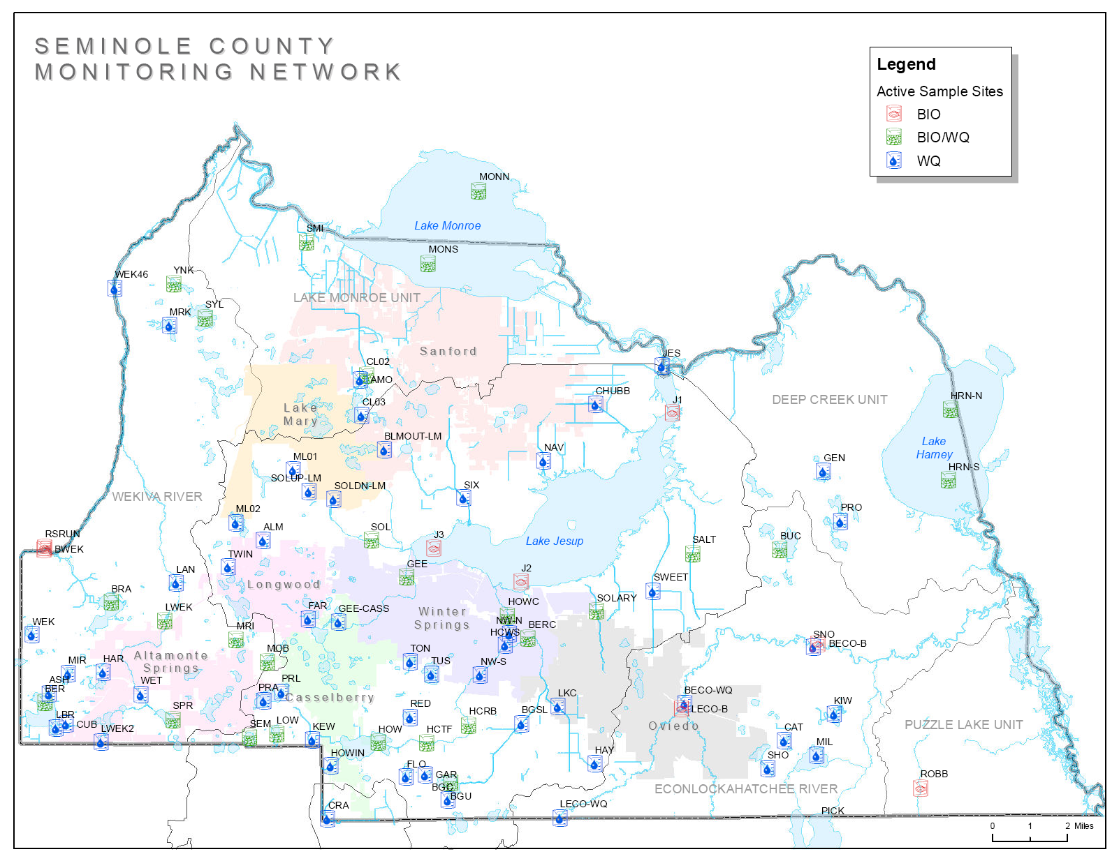

Slide 14

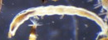
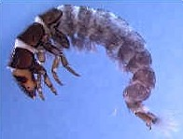
Very Poor
Very Poor
Healthy
Healthy
Very Poor
Healthy
Exceptional
Healthy
Fair
Healthy
Poor

Slide 15



Slide 16

Questions?

