Slide 1
TP Status
Lake Jesup and Main Tributaries

Slide 2
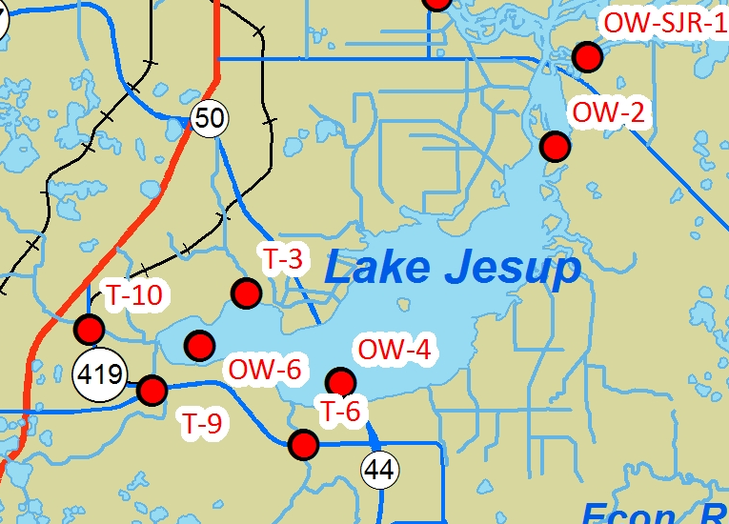
Water Quality Sampling Sites
Six-Mile Creek/Sanford Ave Canal T-3
3 In-Lake
Sites
OW-2
Soldiers Creek
T-10
OW-6
OW-4
Gee Creek T-9
Howell Creek T-6

Slide 3
TP Data
Comparing Two Time Periods
1996-2000 and
2008-2011

Slide 4
Howell Creek T-6 at CR434
Large Decrease (p = 0)
Average 96-00: 0.134 mg/L
Average 08-11: 0.088 mg/L

Slide 5
Soldiers Creek T-10 at CR419
Increase (p = 0)
Average 96-00: 0.138 mg/L
Average 08-11: 0.158 mg/L

Slide 6
Gee Creek T-9 at CR419
Small Increase (p = 0)
Average 96-00: 0.118 mg/L
Average 08-11: 0.120 mg/L

Slide 7
Six-Mile Creek at Sanford Ave Canal T-3
Decrease (p = 0)
Average 96-00: 0.177 mg/L
Average 08-11: 0.167 mg/L

Slide 8
Lake Jesup near Soldier/Gee Creek OW-6
Increase (p = 0)
Average 96-00: 0.146 mg/L
Average 08-11: 0.156 mg/L

Slide 9
Lake Jesup near Howell Creek OW-4
Increase (p = 0)
Average 96-00: 0.150 mg/L
Average 08-11: 0.167 mg/L

Slide 10
Water Quality Sampling Sites
Six-Mile Creek/Sanford Ave Canal T-3
3 In-Lake
Sites
OW-2
Soldiers Creek
T-10
OW-6
OW-4
Gee Creek T-9
Howell Creek T-6

Slide 11
Lake Jesup near Site 10 OW-2
Increase (p = 0)
Average 96-00: 0.150 mg/L
Average 08-11: 0.176 mg/L

Slide 12
Lake Jesup near Site 10
More Recent Results
Increase (p = 0)
Average 96-00: 0.150 mg/L
Average 08-11: 0.176 mg/L
Decrease (p = 0)
Average 96-00: 0.150 mg/L
Average 11/09-11: 0.145 mg/L

Slide 13
Summary
TP concentration increase at Soldiers and Gee Creeks and in the lake
Decrease at Howell Creek and Six Mile Creek at Sanford Avenue Canal
Decrease near Site 10 in last two years
TN trends not reviewed at this time because no meaningful decrease in TP concentrations
Not enough discharge data coincides with concentration data time periods to accurately assess load changes
Lake stage data indicates significantly lower levels between 2007 and 2011 than between 1996 and 2000

