Slide 1
Jesup Monitoring Maps
10/6/09

Slide 2
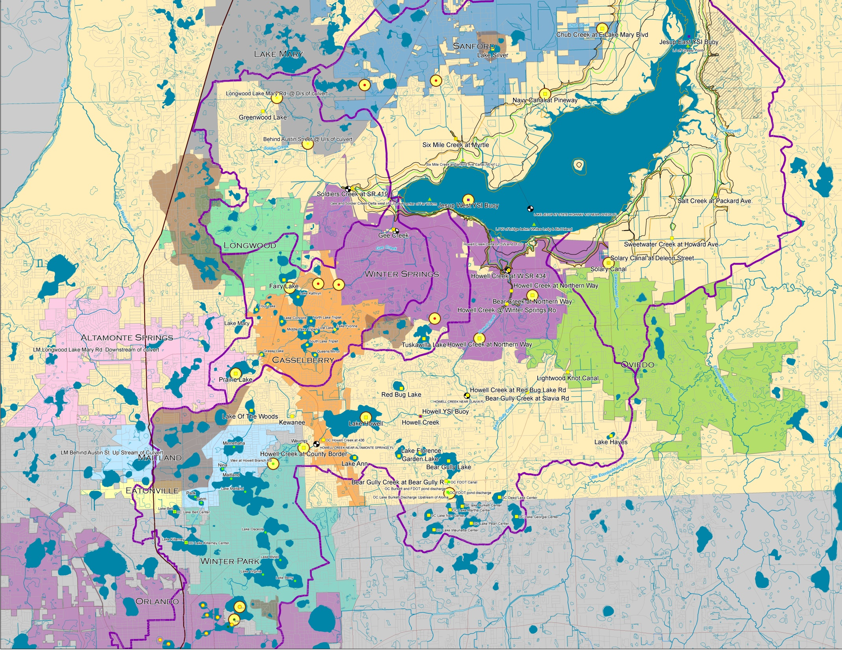
Basin Overview

Slide 3
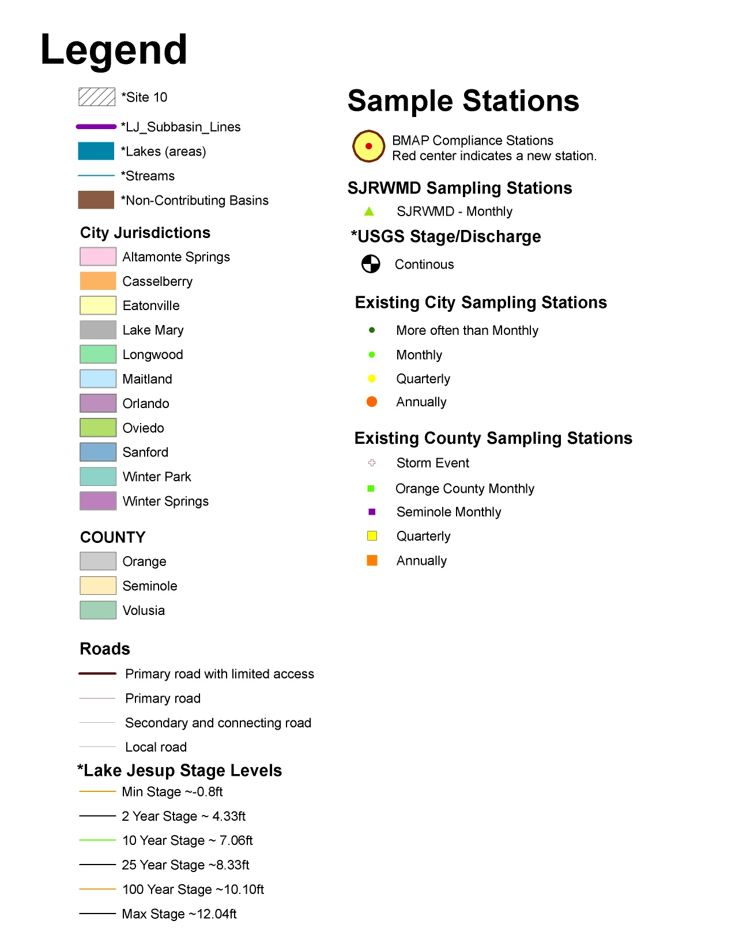

Slide 4
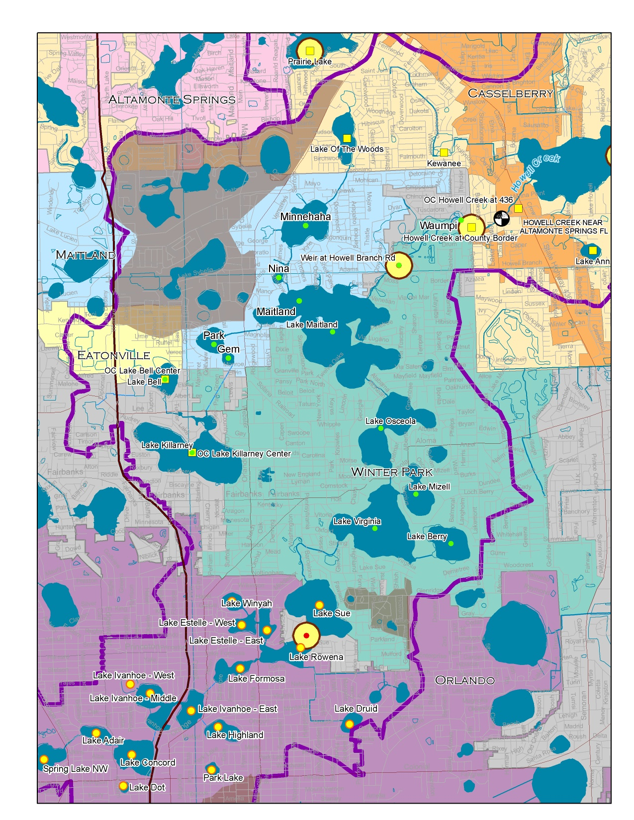
Orlando Winter Park
Maitland
Eatonville

Slide 5
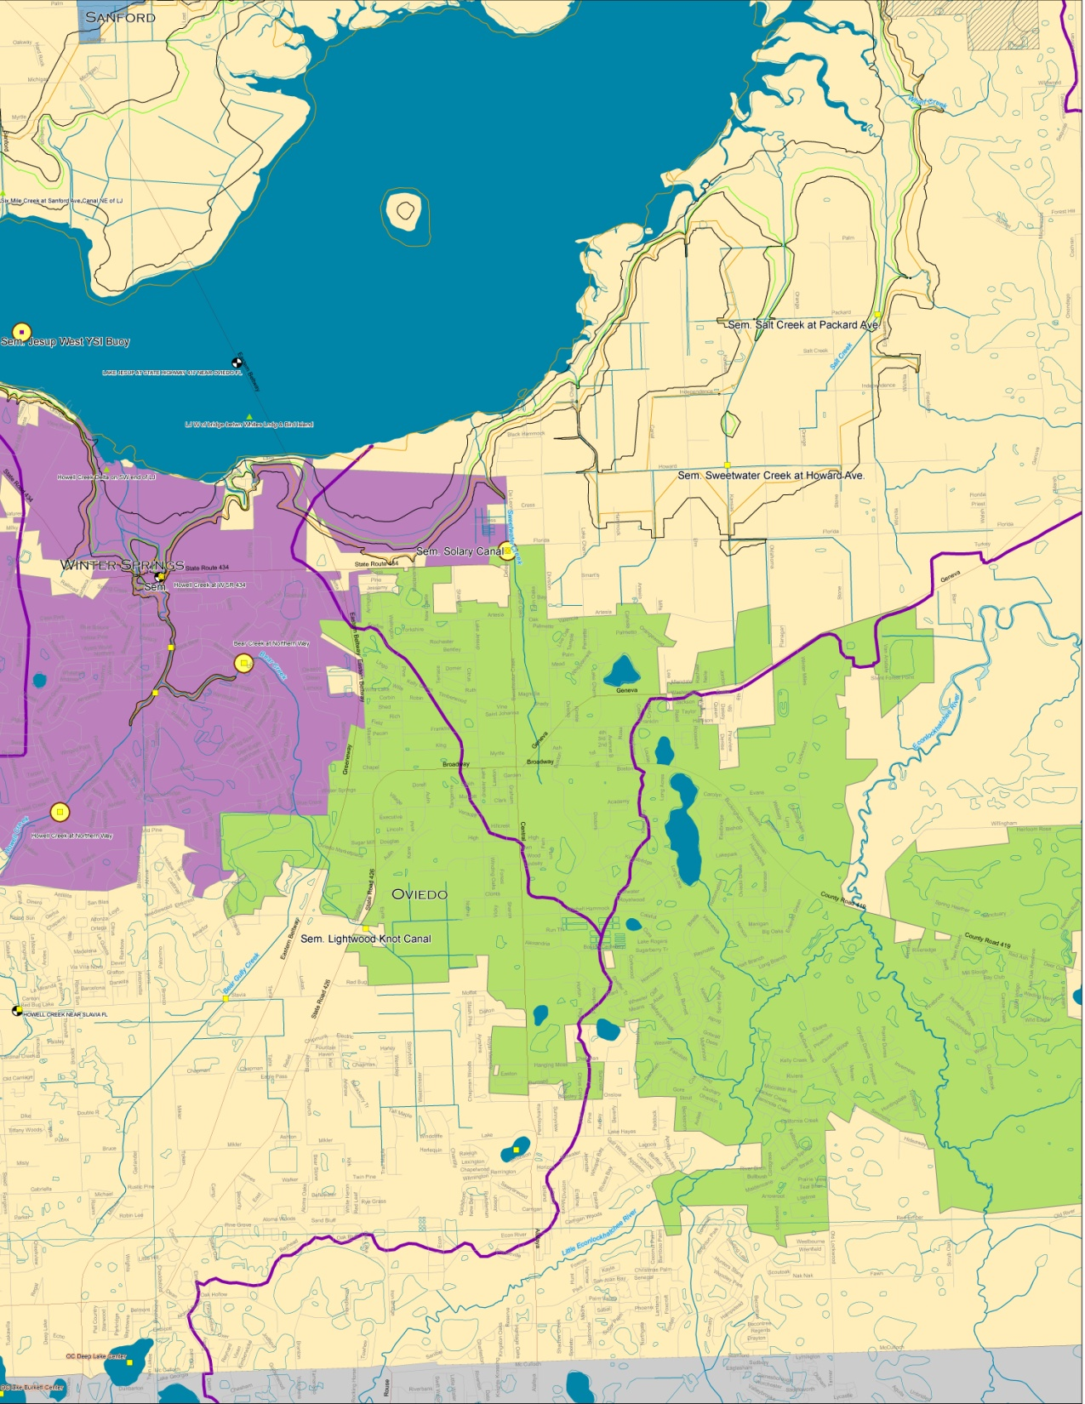
Oviedo

Slide 6
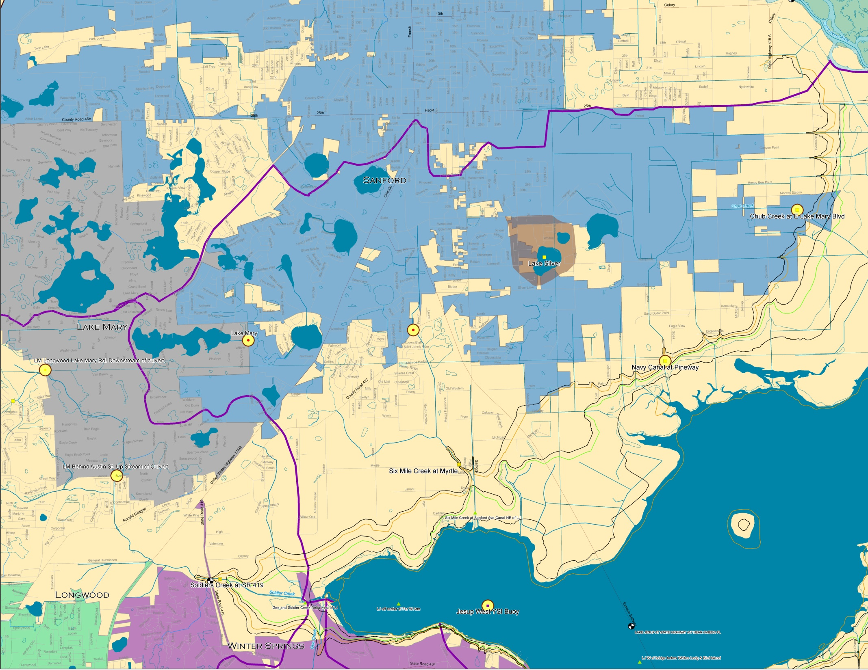
Sanford Lake Mary

Slide 7
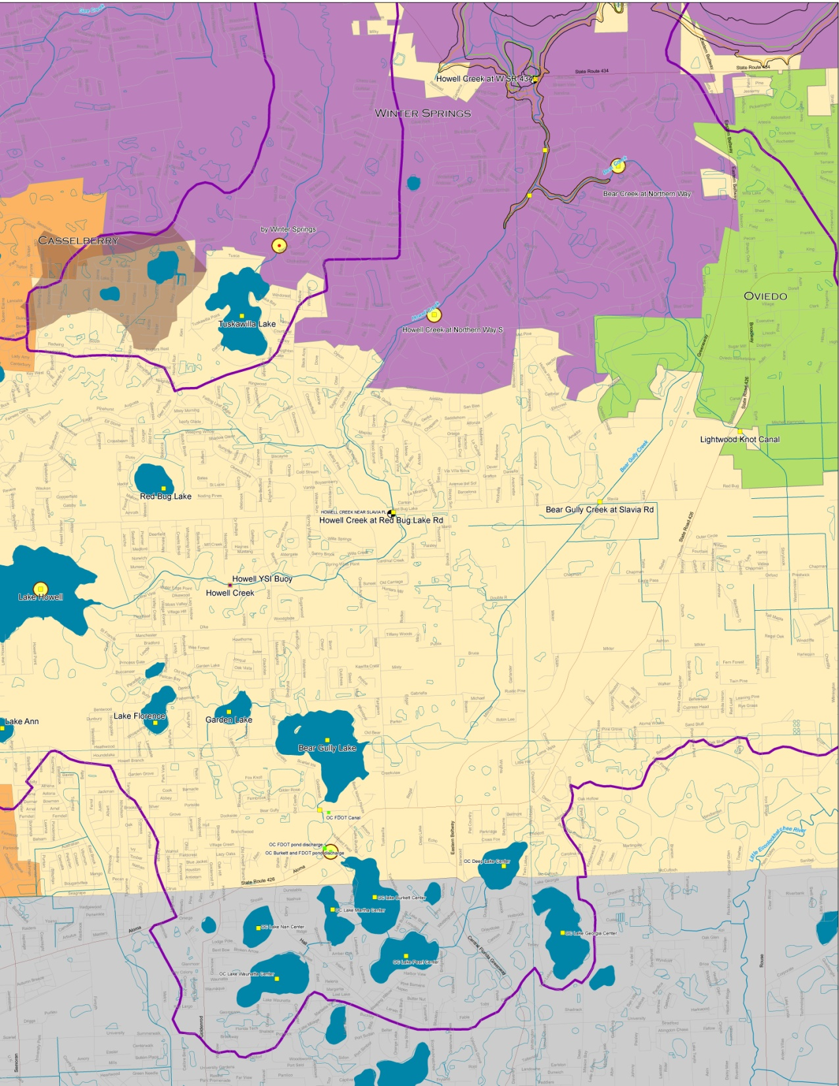
Seminole
Orange
County

Slide 8
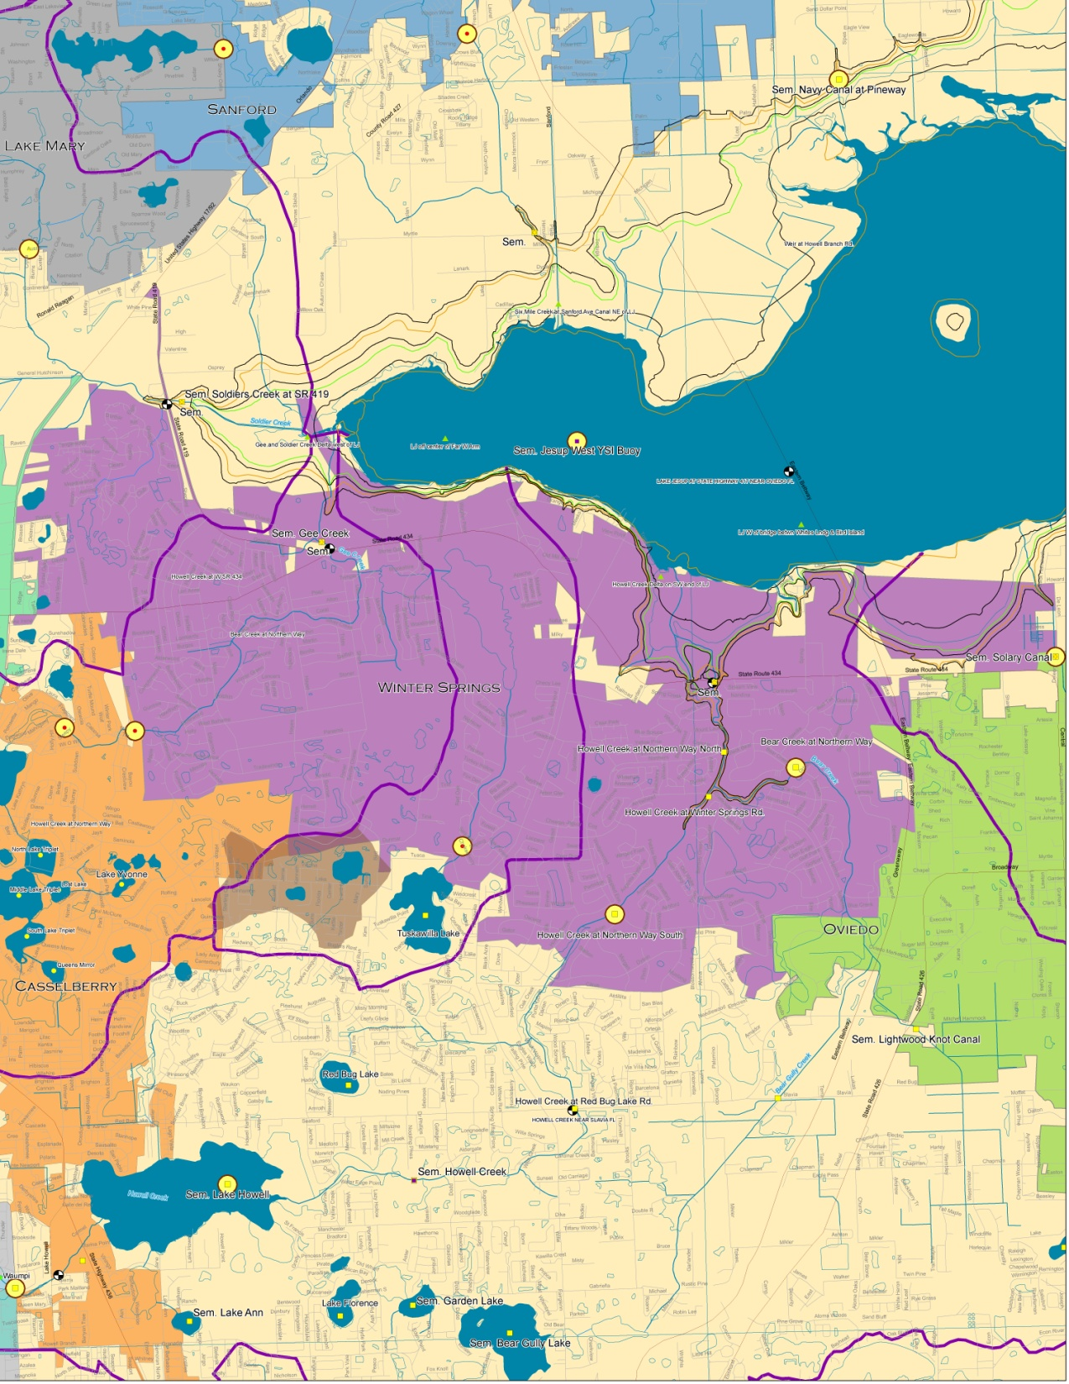
Winter Springs

Slide 9
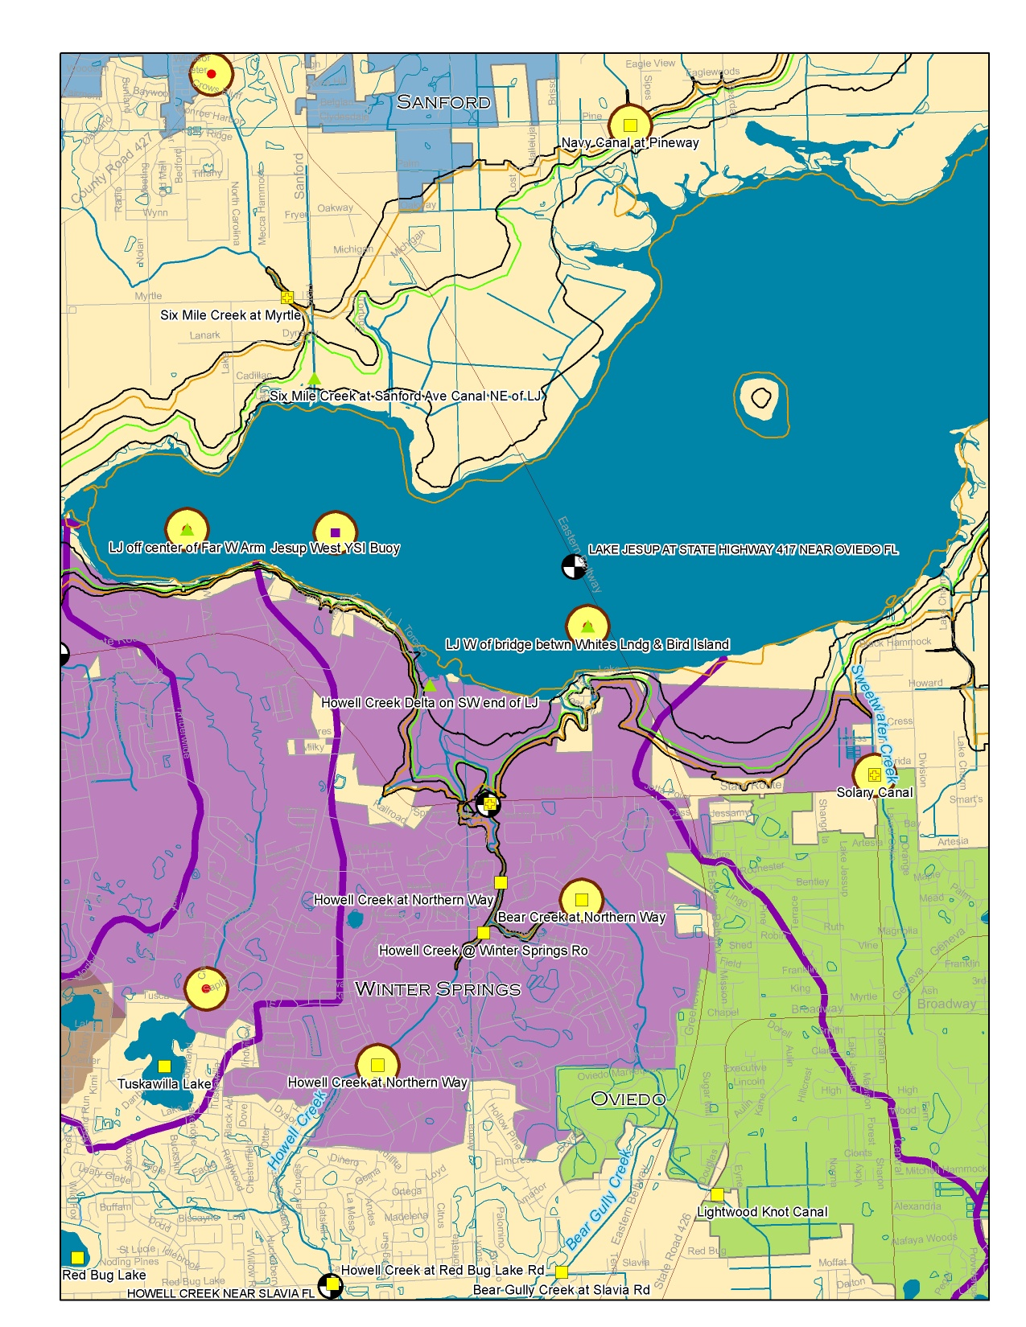
Winter Springs Lake Jesup

Slide 10
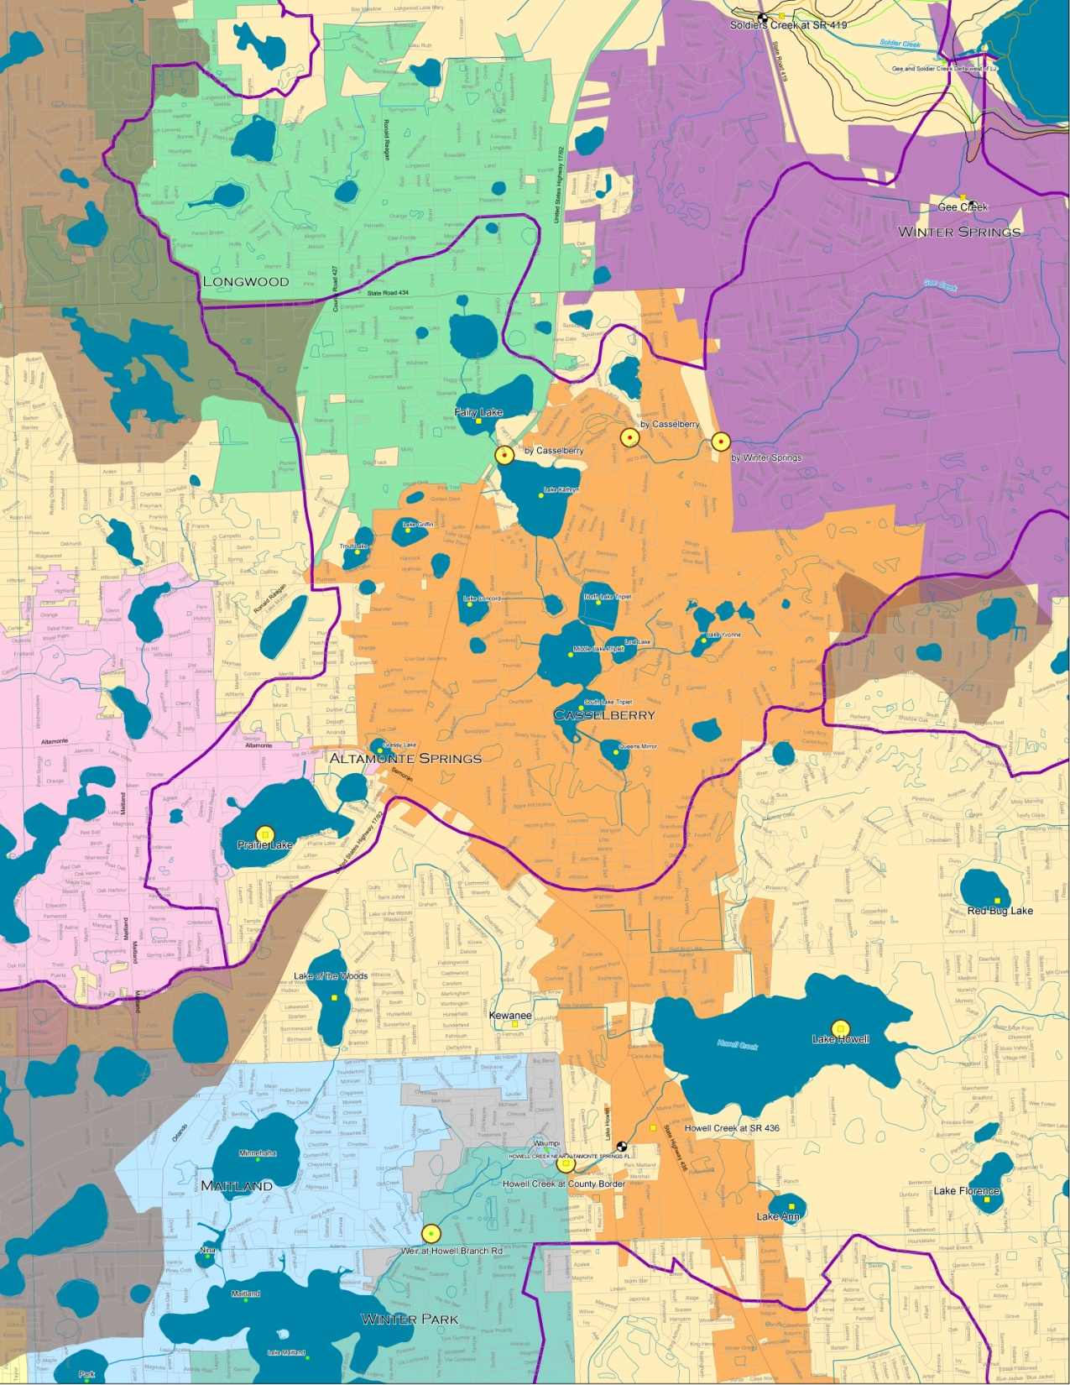
Casselberry
Longwood
Altamonte
Winter Springs

