Slide 1

And Now For Something
Completely Different
I want to take you back to Dr. Dave Tomasko’s presentation at the March 6, 2009 BMAP meeting and consider some recent data

Slide 2
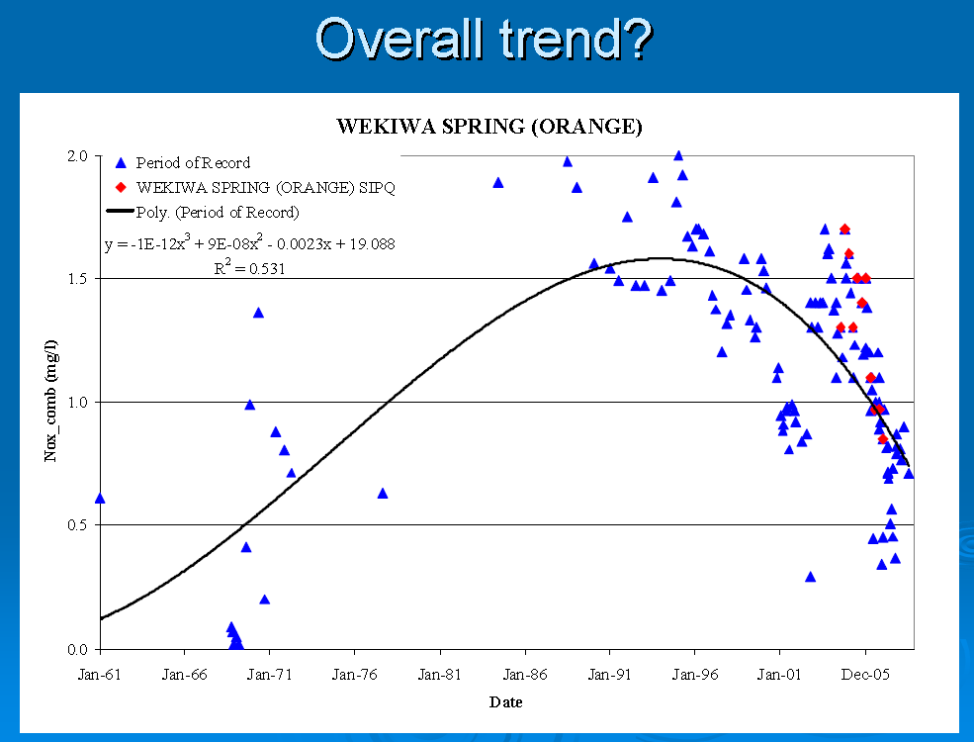
Dr. Dave Tomasko, PBSJ
Wekiva BMAP March 6, 2009

Slide 3
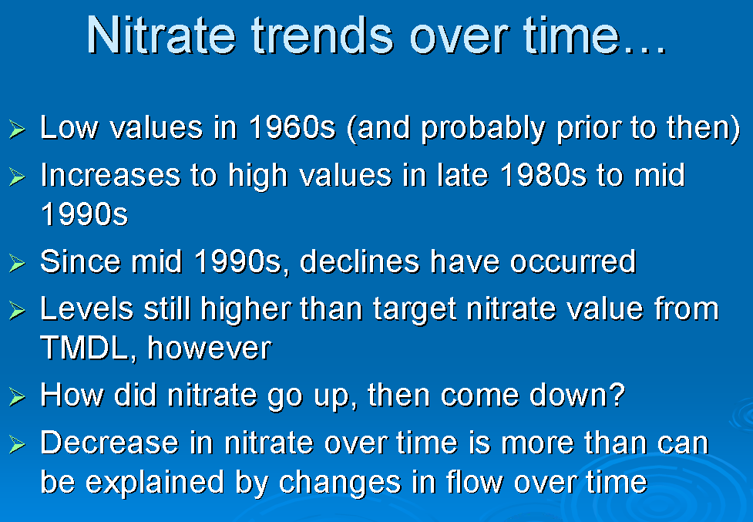
Dr. Dave Tomasko, PBSJ
Wekiva BMAP March 6, 2009

Slide 4
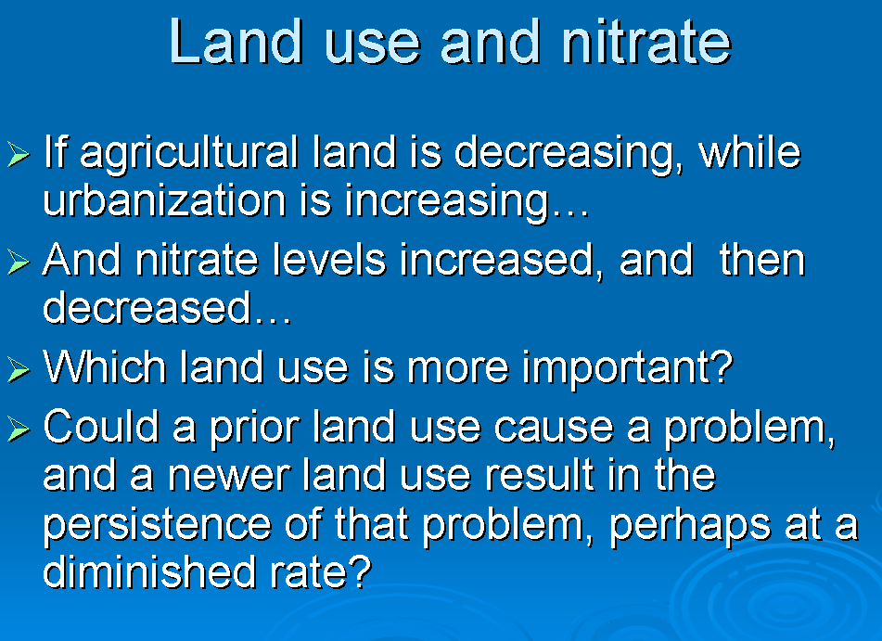
Dr. Dave Tomasko, PBSJ
Wekiva BMAP March 6, 2009

Slide 5
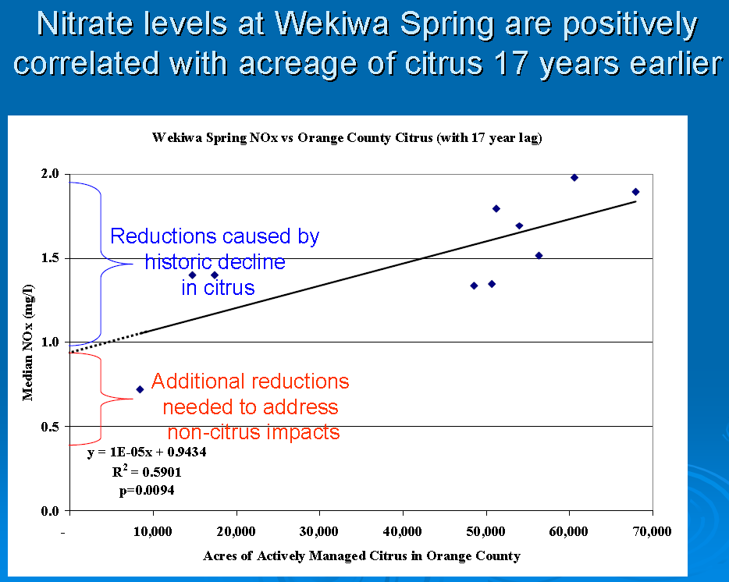
Dr. Dave Tomasko, PBS&J
Wekiva BMAP Meeting - March 6, 2009

Slide 6
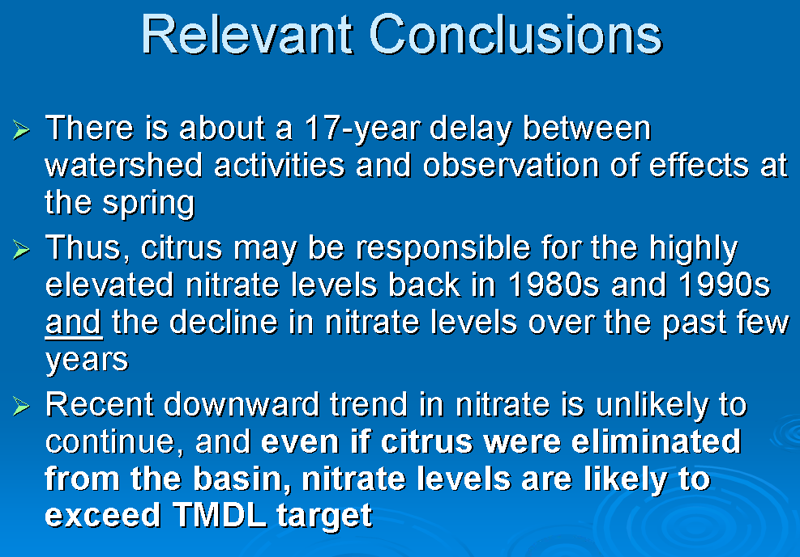
Dr. Dave Tomasko, PBSJ
Wekiva BMAP March 6, 2009

Slide 7
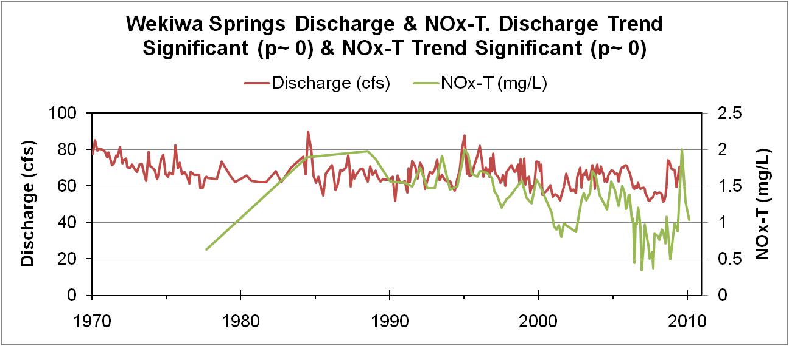
Relationship Between Discharge & Nitrate
Wekiwa Spring

Slide 8
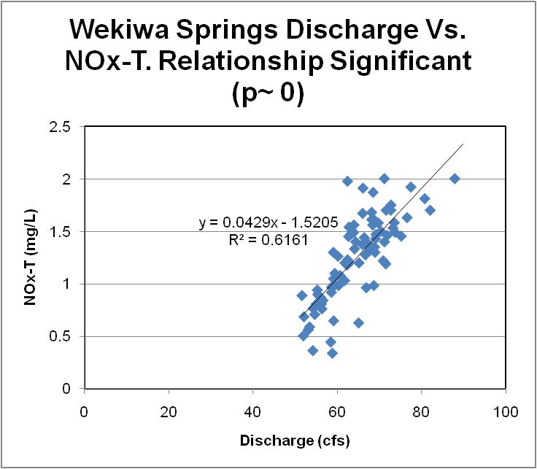
Relationship Between Discharge & Nitrate
Wekiwa Spring

Slide 9
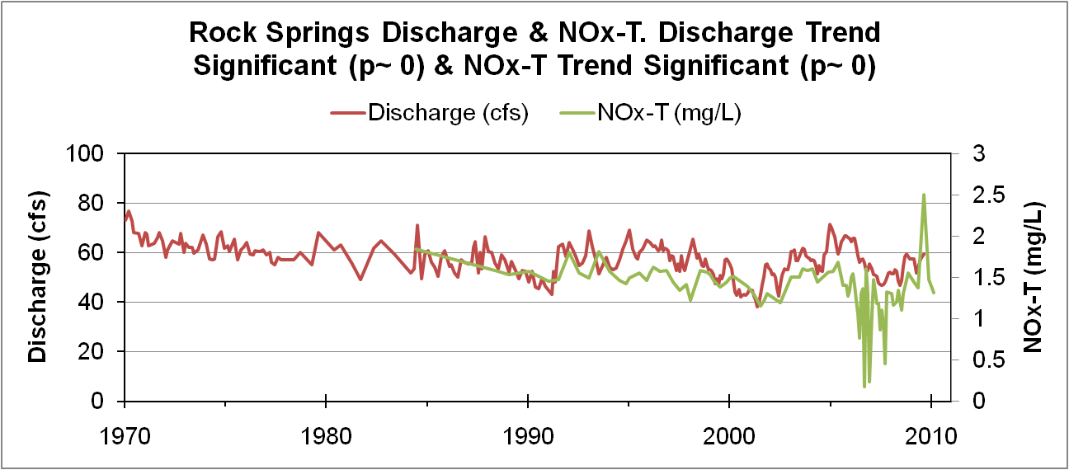
Relationship Between Discharge & Nitrate
Rock Spring

Slide 10
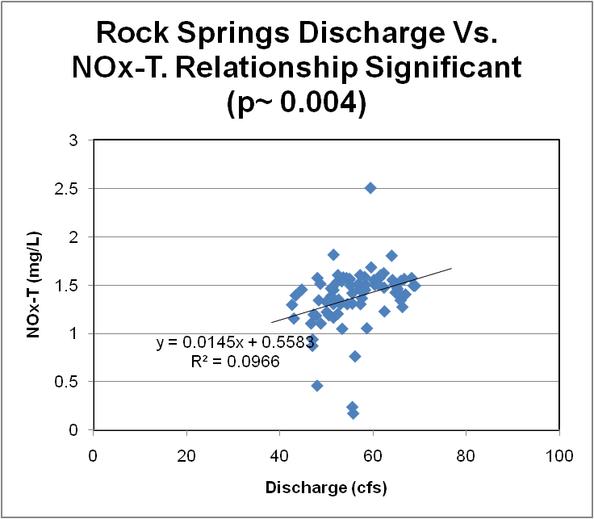
Relationship Between Discharge & Nitrate
Rock Spring

Slide 11
Relationship Between Discharge & Nitrate
One explanation for this relationship is that discharge is the result of a mix of older Floridan water, which tends to be less enriched with nutrients, and younger, shallower groundwater that due to its proximity to the surface is more nutrient enriched. During wetter periods when this shallower water contributes to the spring’s discharge, this younger water carries a higher nutrient content. This explanation is supported by Copeland et al. (2009).
Copeland, R., N. A. Doran, A. J. White and S. B. Upchurch. 2009. Regional and Statewide Trends in Florida's Spring and Well Groundwater Quality (1991-2003). Florida Geological Survey Bulletin No. 69. Tallahassee, FL: Florida Department of Environmental Protection.

Slide 12
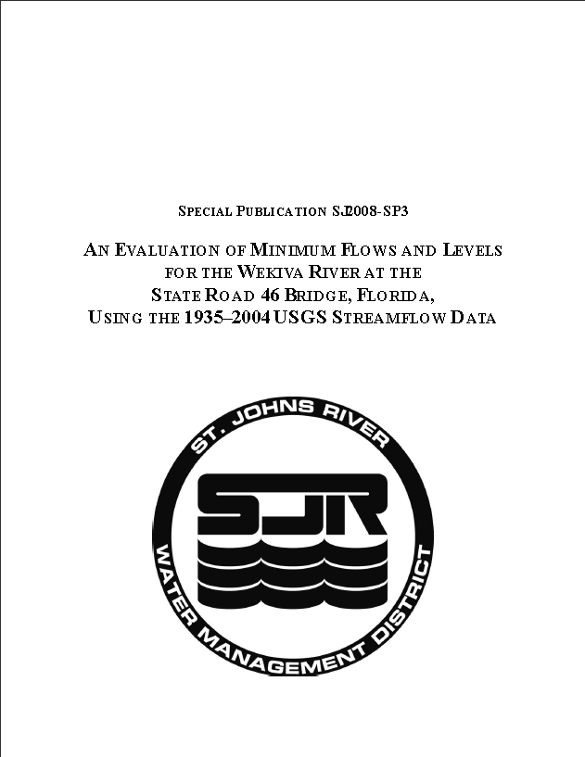
Wekiva River Minimum Flows & Levels
Five MFLs approved in 1992 for Wekiva River @ SR46
A 2008 analysis concluded that all discharge MFLs are being met (1936 – 2004 data).
“It appears, regulation of the Ocklawaha chain of lakes maintaining higher lake levels in about 1960 increased the groundwater contribution to the Wekiva River basin. This report estimates this increase as about 27.5 cfs for the Wekiva River at the S.R. 46 Bridge. However, how this increased groundwater contribution benefited MFLs is not specifically analyzed in this report.”
http://www.sjrwmd.com/technicalreports/pdfs/SP/SJ2008-SP3.pdf

Slide 13
Potential Consequences of Relationship Between Discharge & Nitrate
Springs protection involves both protecting against discharge reductions and nutrient enrichment, thus maintaining discharge will require reducing nutrient inputs to the shallower, younger groundwater.
There is a declining trend in nitrate, which is likely a result of several factors, including as Dr. Tomasko hypothesized, a reduction in nitrogen loading from citrus. The nitrate decline could also be the result of declining contributions of shallow groundwater.
To the extent that efforts to better manage springs consists of efforts to both maintain or increase their discharge and reduce nutrient concentrations, then special attention should be focused on limiting nutrient enrichment to portions of the springshed contributing younger water.
Rock Springs has similar trends and significant relationships, although the slope between discharge and nitrate is not as large, perhaps suggesting that a greater fraction of Wekiwa’s springshed is more developed relative to Rock Springs.

Slide 14
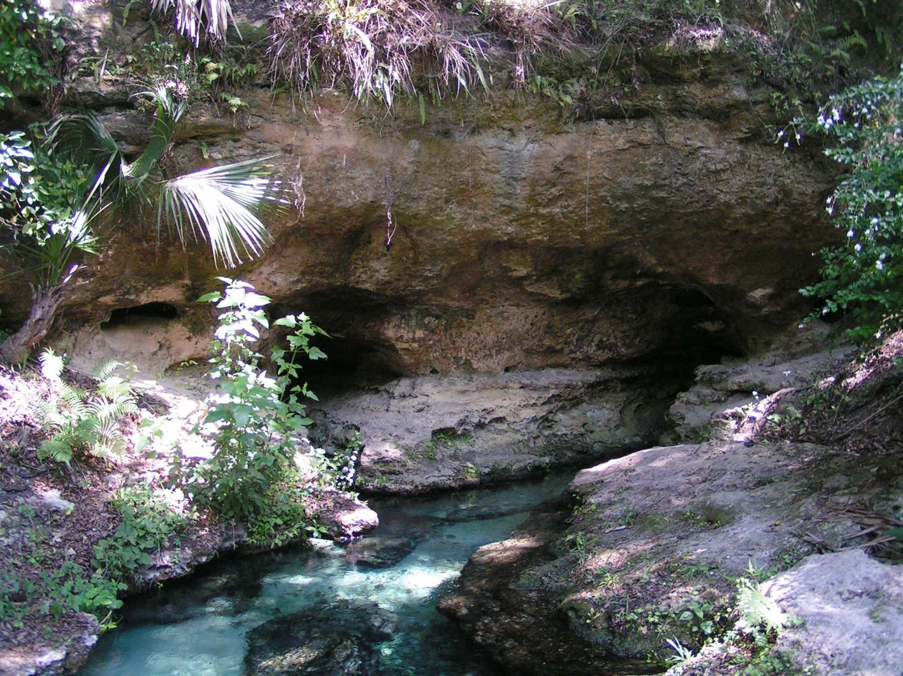
Questions? Comments? Discussion?

